Slide 1
Jenkins Build K8S
Presenter: Michael Pham

Slide 2
TABLE OF CONTENTS
1
2
Kubernetes Deployment
Jenkins overview
3
4
Full demo
Setup CI/CD on Kubernetes with Jenkins

Slide 3
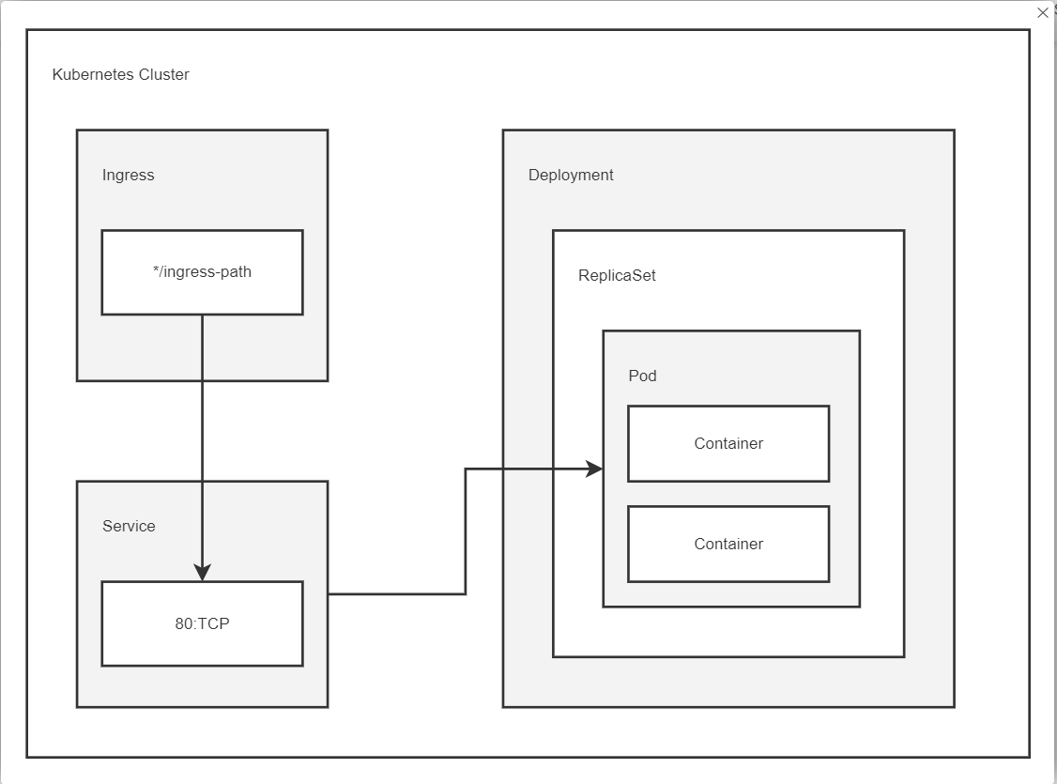
1. Kubernetes Deployment
Kubernetes deployments are essentially just a wrapper around Replicasets.
In Deployment manifest, spec.strategy.type has two possible values:
RollingUpdate: New pods are added
gradually, and old pods are terminated
gradually.
Recreate: All old pods are terminated
before any new pods are added.

Slide 4
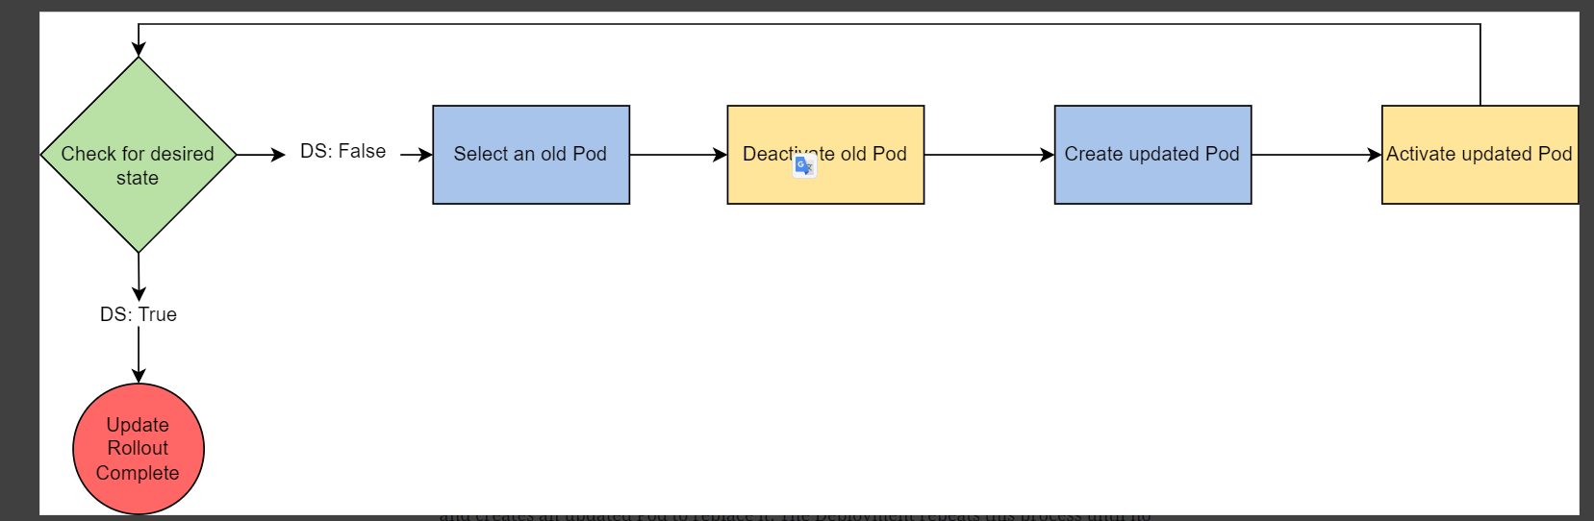
Rolling Update
Use case: Users expect applications to be available all the time and developers are expected to deploy new versions of them several times a day.
The rolling update strategy is a gradual process that allows you to update your Kubernetes system with only a minor effect on performance and no downtime

Slide 5
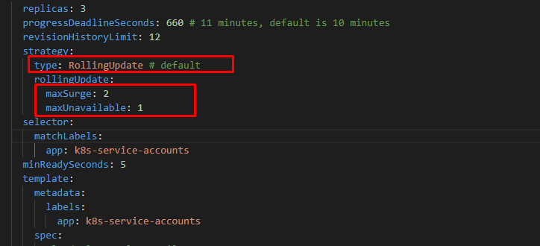
Rolling Update Detail
maxSurge: The number of pods that can be created above the desired amount of pods during an update
maxUnavailable: The number of pods that can be unavailable during the update process
minReadySeconds: A pod will be considered ready if its readiness probe is successful

Slide 6
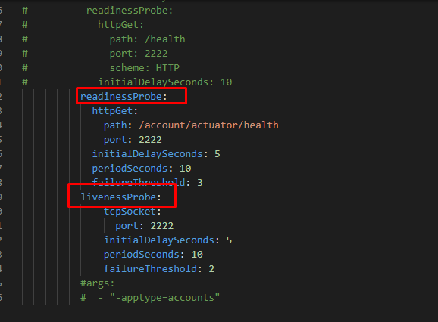
Rolling Update Detail
readinessProbe: indicates whether applications running in a container are ready to receive traffic
livenessProbe: detect and remedy applications broken states, and cannot recover except by being restarted

Slide 7
Rolling update visualization

Slide 8
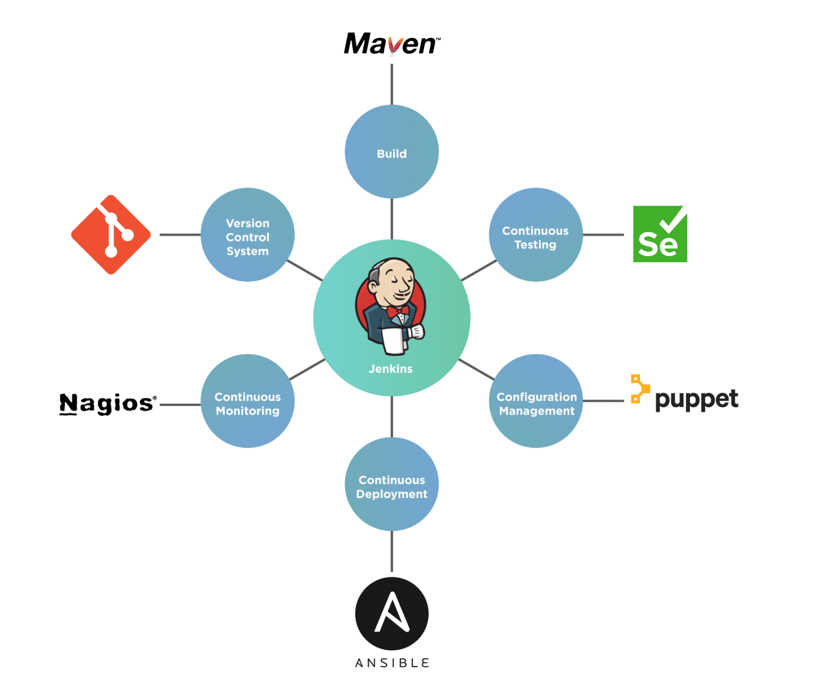
2. Jenkins overview

Slide 9
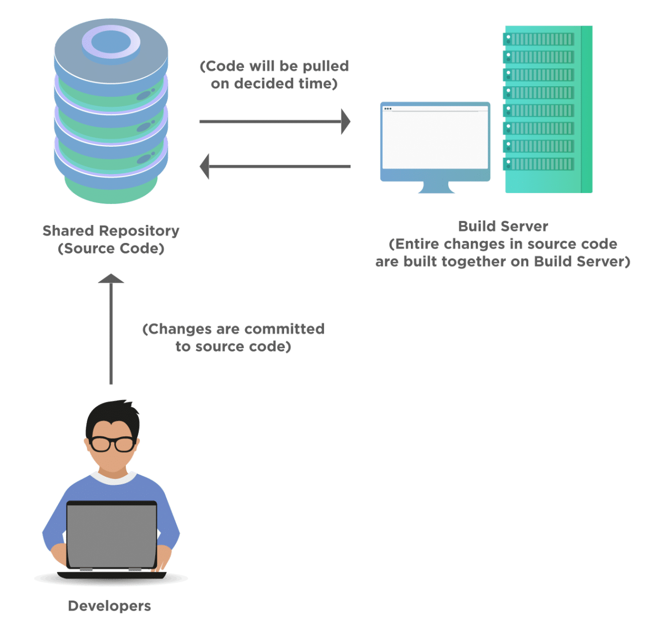
Traditional Process of Software Delivery

Slide 10
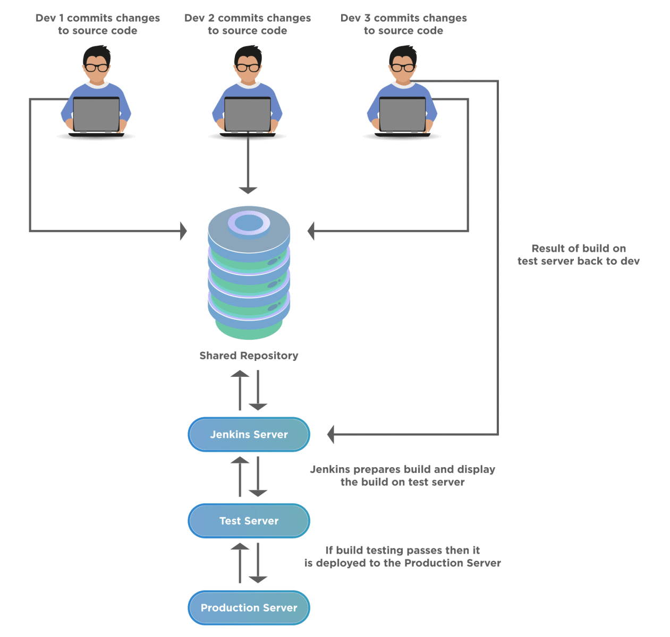
Continuous Integration and Delivery with Jenkins

Slide 11
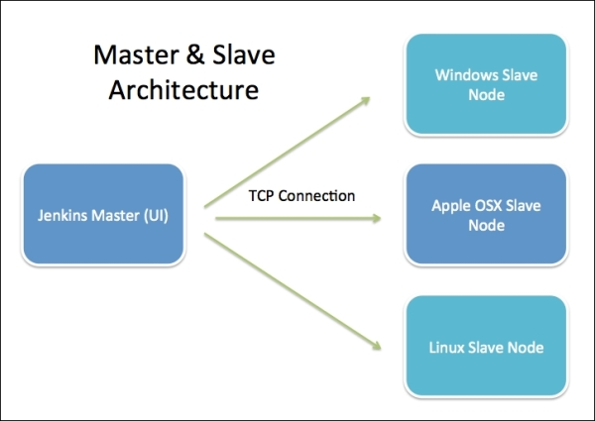
Jenkins Architecture

Slide 12
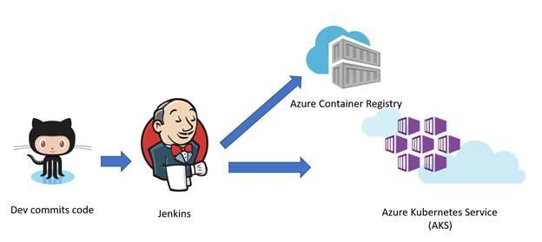
3. Setup CI/CD on Kubernetes with Jenkins

Slide 13
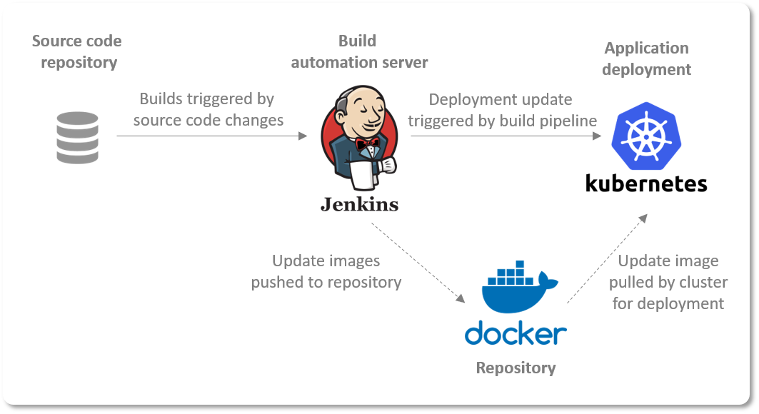
Basic use case
1. Developer create pull request to develop branch.
Jenkins auto trigger test this branch.
2. Jenkins auto close pull request when test pull request is marked as failure.
3. Admin approval and merge this pull request to develop branch.
=> Jenkins auto trigger build newest source code to K8S Server

Slide 14
Preparation
1. Source code: https://github.com/haunxhus/k8s-aws-microservices, branch main
2. Jenkins server:
Memory: Min 4Gi
Disk: Min 20Gi
OS: Ubuntu 18.04
3. Docker registry server (private registry):
Memory: Min 8Gi
Disk: Min 50gi
OS: Ubuntu 18.04
4. Kubernetes server using microk8s:
memory: Min 18Gi
Disk: Min 60Gi
OS: Ubuntu 18.04

Slide 15
Setup Jenkins Server
1. Dashboard > Manage Jenkins > Plugin Manager
Install GitHub Pull Request Builder Plugin.
Install Github plugin.
2. Dashboard > Manage Jenkins > Configure System -> GitHub Pull Request Builder
GitHub Auth/Credentials add personal Github token
Admin list /Advanced/ Crontab line set * * * * *
Application Setup/ Commit Status Build Result add build result messages for SUCCESS, ERROR, FAILURE status

Slide 16
Setup Jenkins Server
3. Dashboard/<Item name>/Configuration
GitHub project add Project url: https://github.com/phamvanlinh20111993/k8s-example/
Source Code Management/Git add Repository URL: https://<personal-token>@github.com/phamvanlinh20111993/k8s-example.git and Credentials
In Branches to build
*/develop => auto trigger when have new commit in develop branch
${ghprbActualCommit} => auto trigger when create pull request
In Build Triggers
Click check GitHub Pull Request Builder
Click check GitHub hook trigger for GITScm polling
In Build Steps add build step to define steps build
In Post-build Actions add E-mail Notification when build success or fail

Slide 17
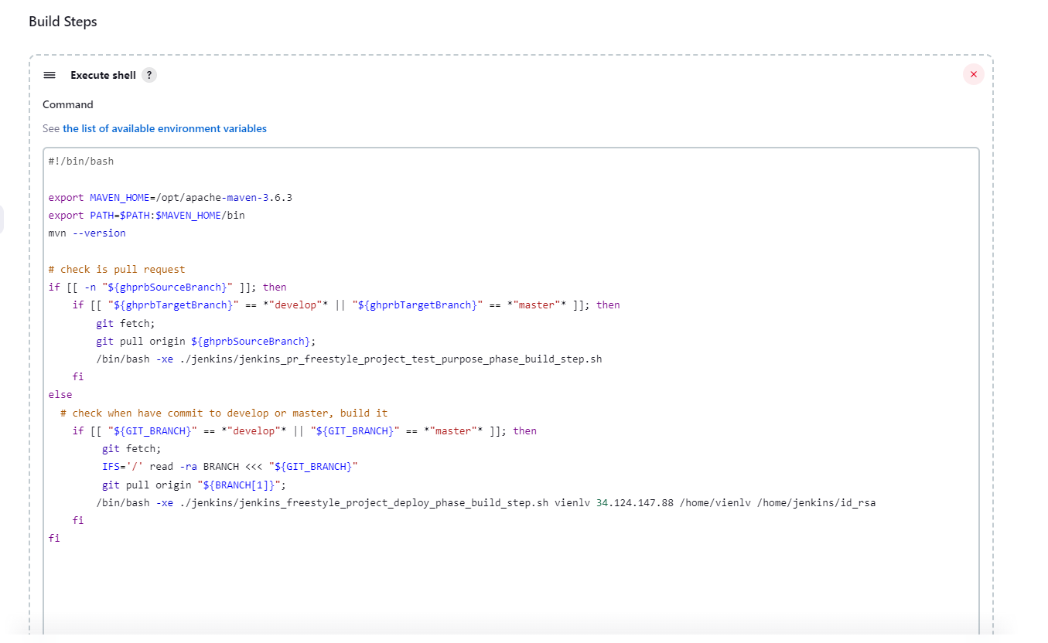
Setup Jenkins Server

Slide 18
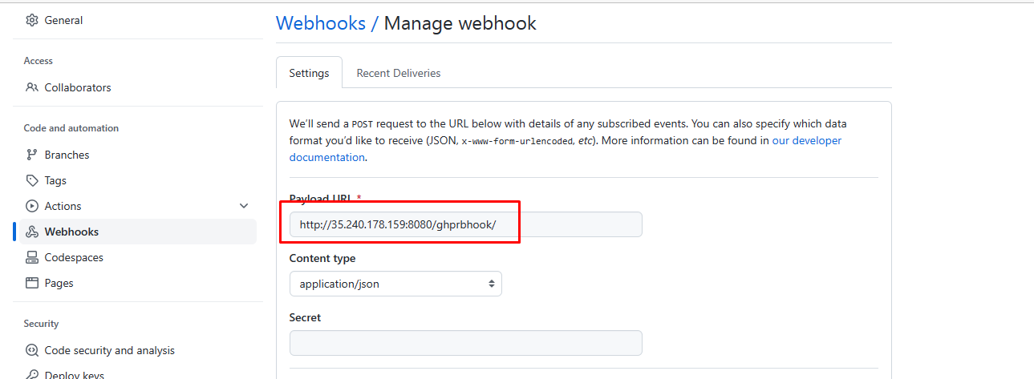
Create Github Webhooks

Slide 19
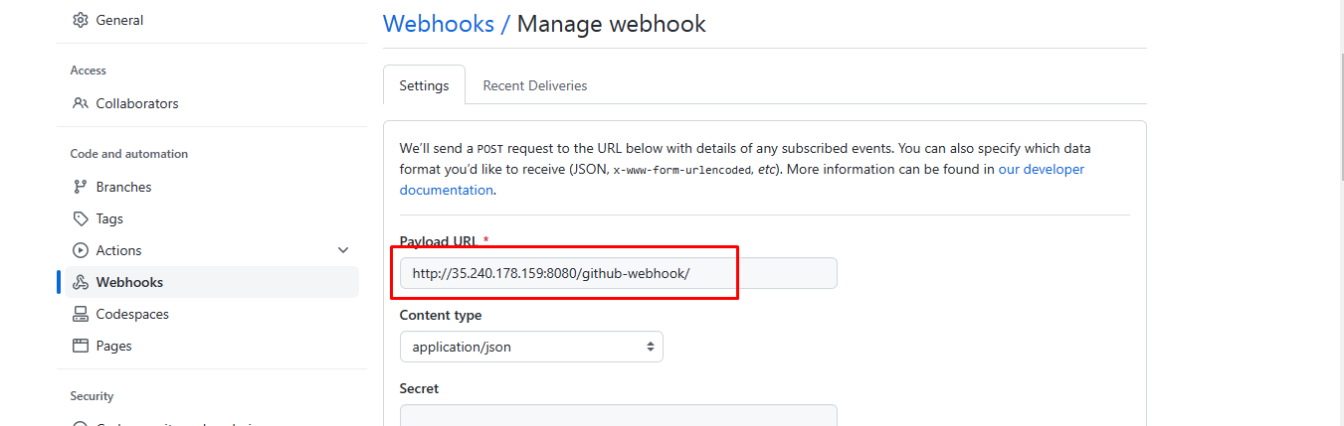
Create Github Webhooks

Slide 20

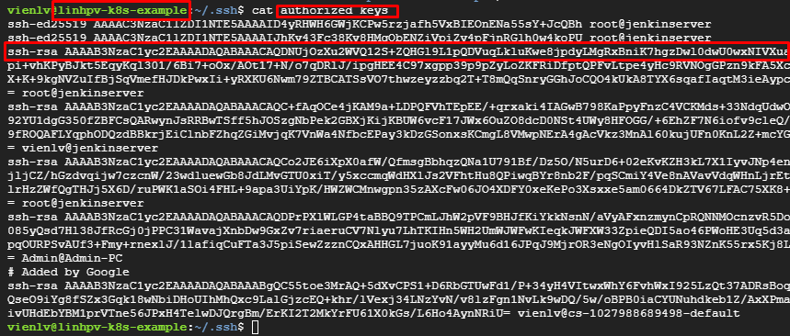
SSH from Jenkins Server to K8s Server
1. In Jenkins server. Install and setup SSH-Client using script : https://github.com/haunxhus/k8s-aws-microservices/blob/feature/setup_jenkins/jenkins/ssh_script_client_config_ubuntu18.04.sh
2. Generate public/private key and add public key to authorized_keys file in K8s Server

Slide 21
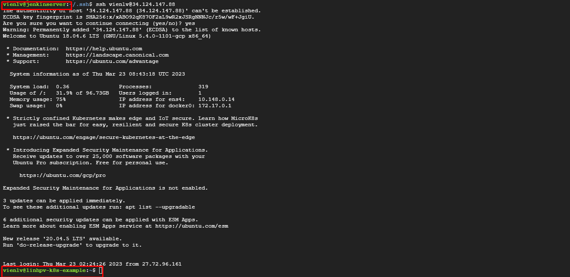
SSH from Jenkins Server to K8s Server
3. In K8s server. Install and setup SSH-Server using script : https://github.com/haunxhus/k8s-aws-microservices/blob/feature/setup_jenkins/jenkins/install_jenkins_server_ubuntu18.04.sh
4. Test SSH connection from Jenkins server to K8S Server: ssh –vvv user@remote_IP

Slide 22
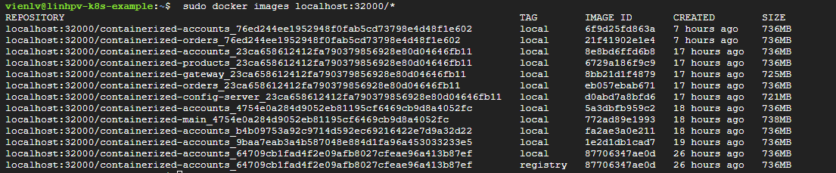
Push Image to Docker Registry
Using commands:
sudo docker load -i $HOME/microservice-k8s-tar/$COMMIT_HASH/image/$FILE
sudo docker tag "$CNAME:$IMAGE_VERSION" $REGISTRY_URL/"$CNAME:$IMAGE_VERSION“
sudo docker push $REGISTRY_URL/"$CNAME:$IMAGE_VERSION"

Slide 23
Pull Image from Docker Registry And Build In K8s Server
Change image version using commands:
sudo microk8s kubectl set image deployment/$DEPLOYNAME -n=$K8S_SERVICE_NAMSPACE $CONTAINERNAME=$REGISTRY_URL/"${SPLIT[0]}:$IMAGE_VERSION" --record
Change k8s config using commands:
sudo microk8s kubectl apply -f $file_config_name
Check rollout deployment history:
sudo microk8s kubectl rollout history deployment/$DEPLOYNAME -n=$K8S_SERVICE_NAMSPACE

Slide 24
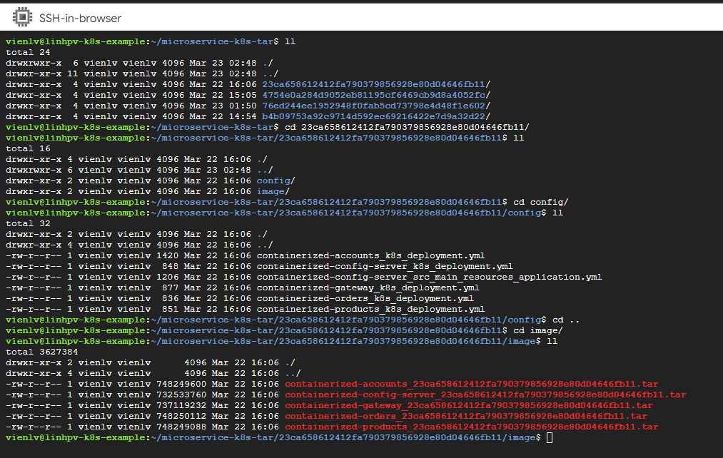
Pull Image from Docker Registry And Build In K8s Server

Slide 25
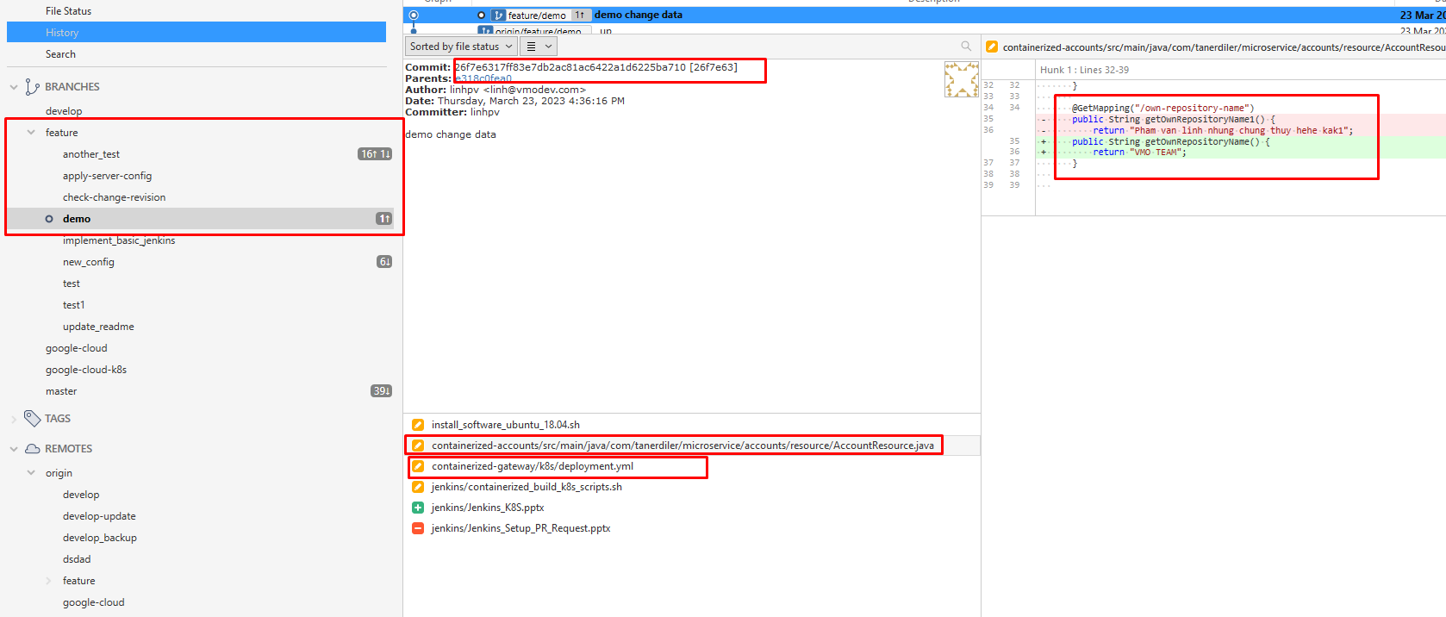
4. Full demo

Slide 26
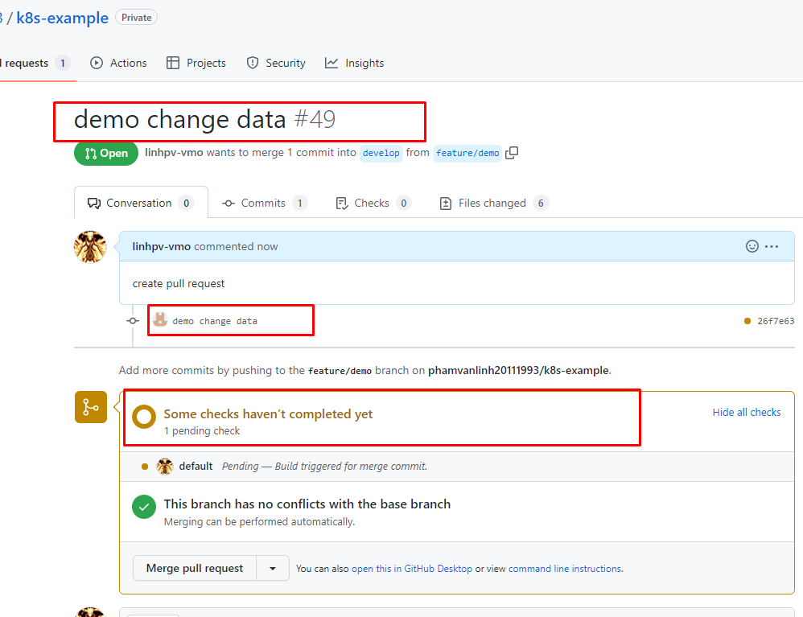
4. Full demo

Slide 27
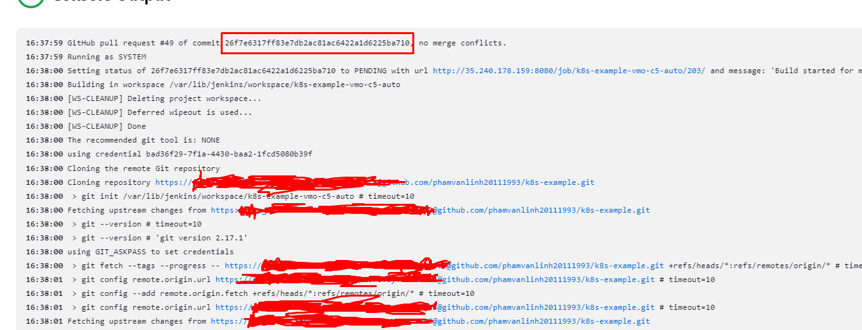
4. Full demo

Slide 28
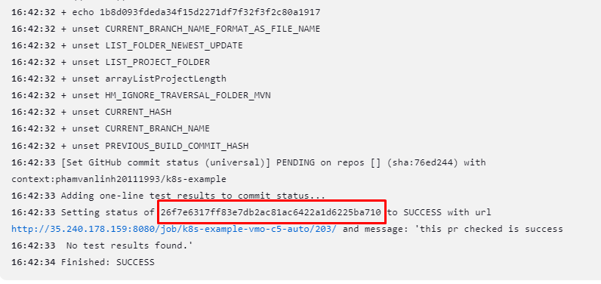
4. Full demo

Slide 29
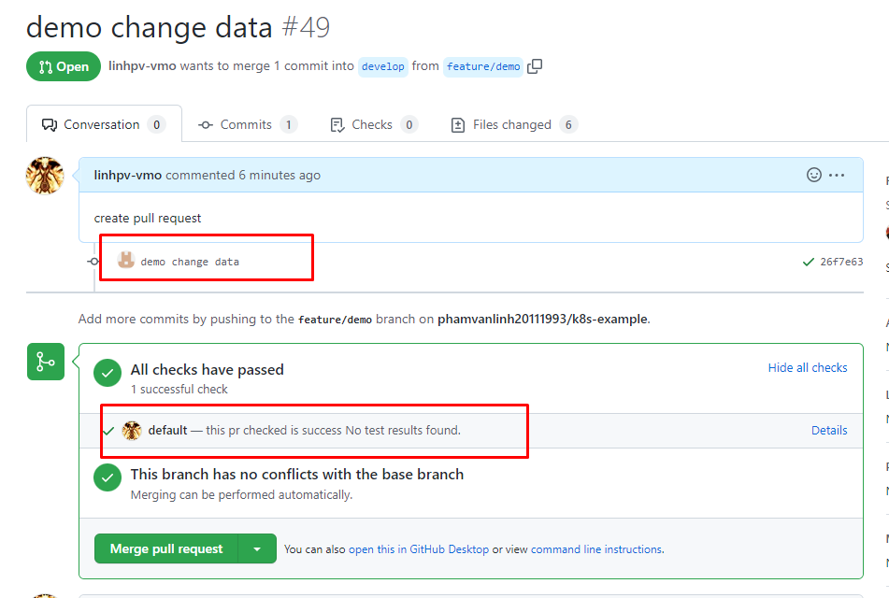
4. Full demo

Slide 30
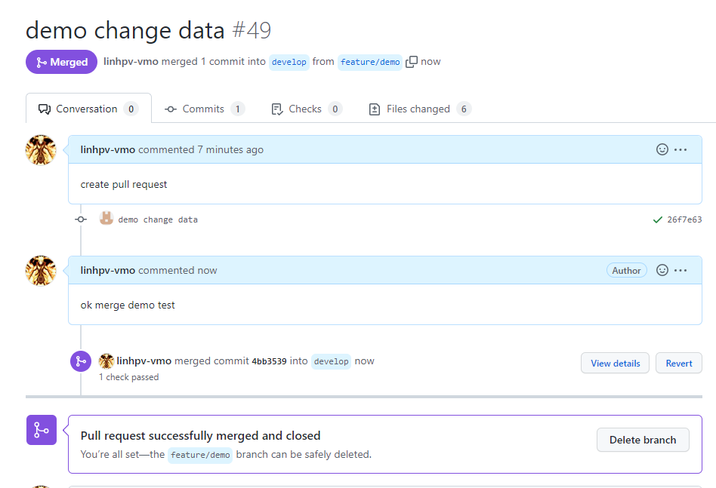
4. Full demo

Slide 31
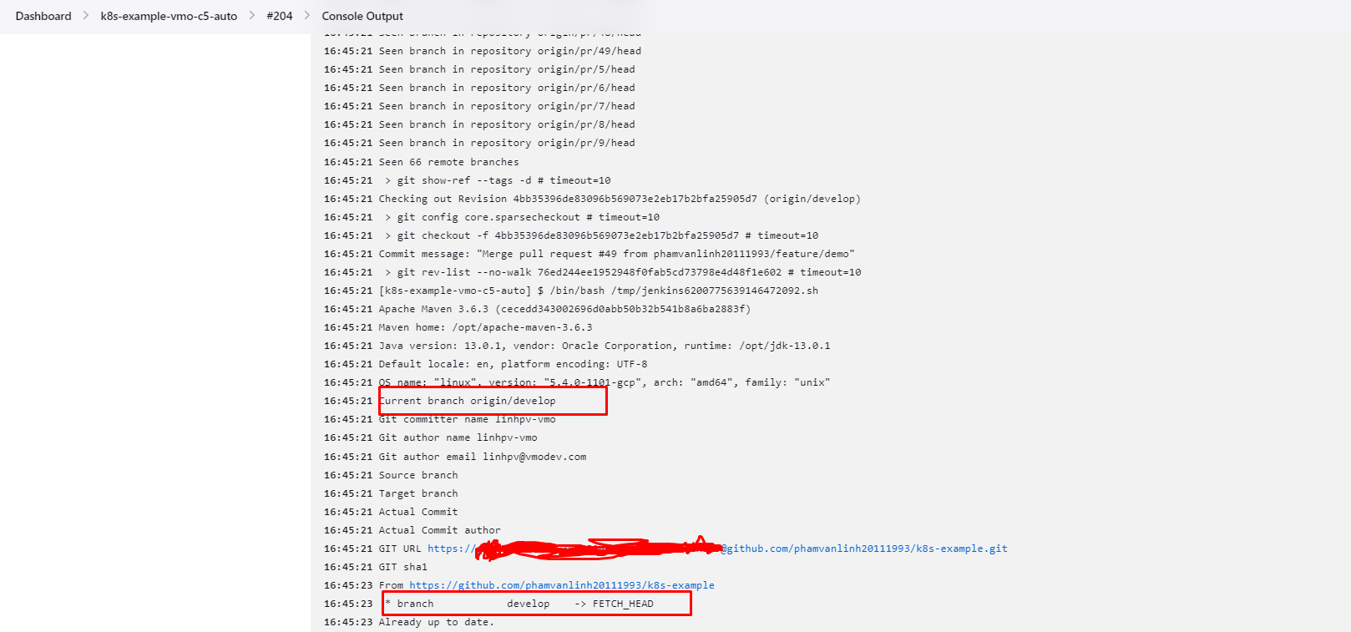
4. Full demo

Slide 32
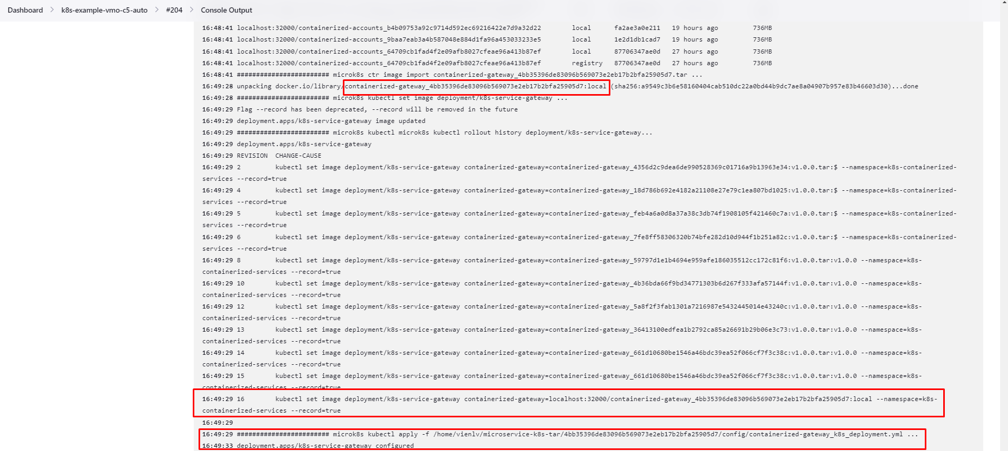
4. Full demo

Slide 33
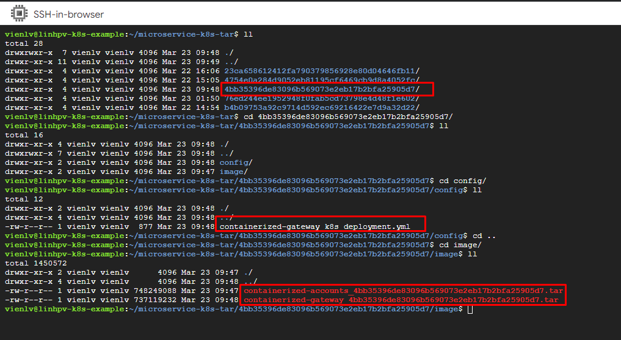
4. Full demo

Slide 34
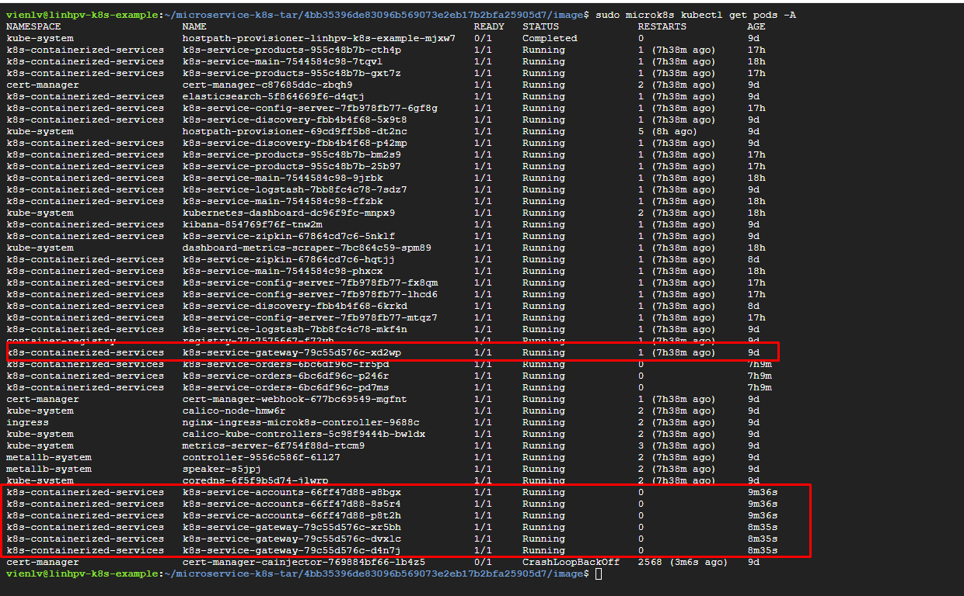
4. Full demo

Slide 35
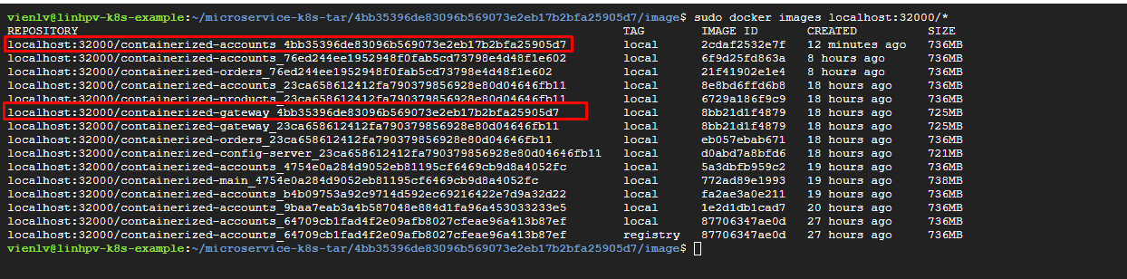
4. Full demo

Slide 36
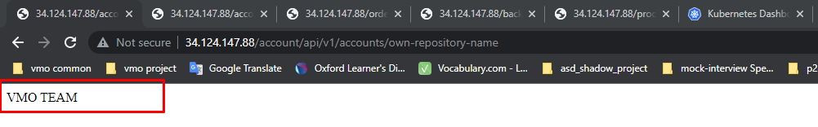
4. Full demo

Slide 37
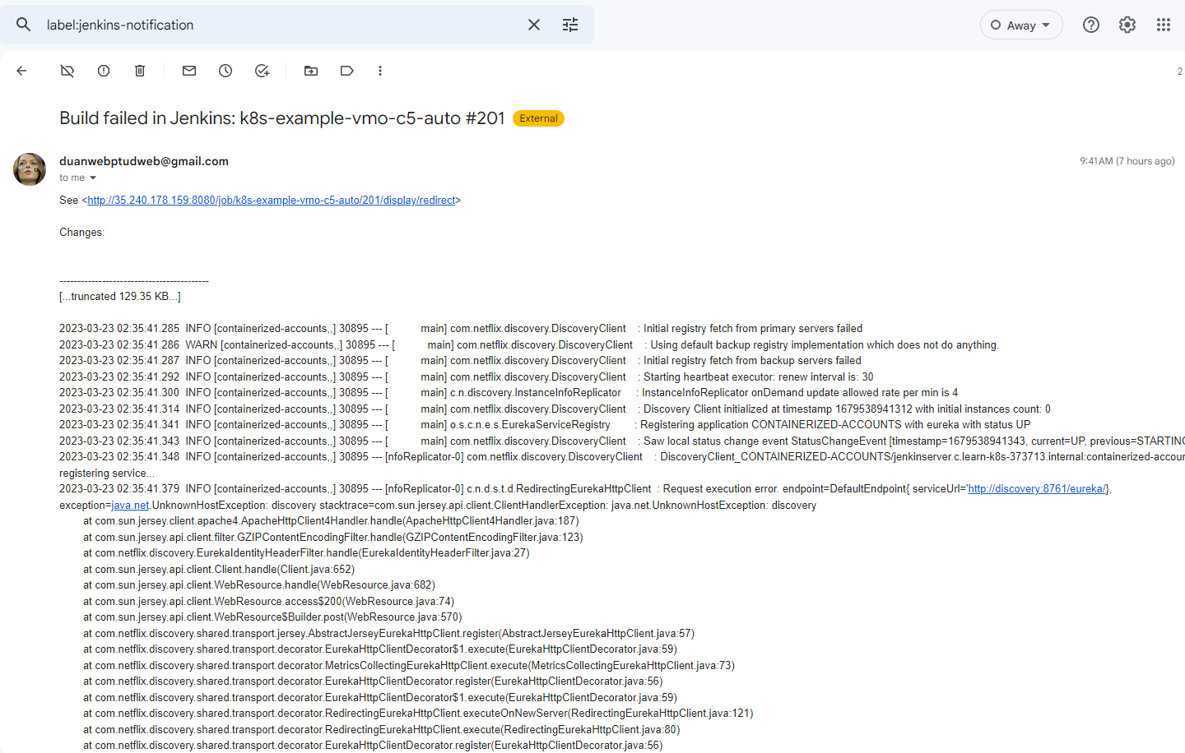
4. Full demo

Slide 38
- Rollout update status: https://kubernetes.io/docs/tutorials/kubernetes-basics/update/update-intro/ https://www.bluematador.com/blog/kubernetes-deployments-rolling-update-configuration https://www.educative.io/blog/kubernetes-deployments-strategies - Jenkins with kubernetes: https://www.linkedin.com/pulse/configuring-cicd-kubernetes-jenkins-anant-jakhmola https://www.linkedin.com/pulse/integrating-kubernetes-jenkins-github-docker-milind-verma - Jenkins overview: https://www.toolsqa.com/jenkins/what-is-jenkins/ https://www.devopsschool.com/blog/jenkins-architecture-explained/ - Other: https://microk8s.io/docs/registry-images https://microk8s.io/docs/registry-built-in https://docs.docker.com/registry/deploying/ Configure Liveness, Readiness and Startup Probes | Kubernetes
References link

Slide 39
To be the continue… Thank you for listening

