Slide 1
CDC 2023
Natural Science: Wildfires in the US (2000 - 2010)
Team Members:
Shivani Kale
David Kim
Andy Chan
Haosheng Shi

Slide 2
Problem Statement
We want to provide a visible index with which different states across the country can use to better channel their efforts in preventing and addressing wildfires

Slide 3
Agenda
Data Cleaning & Wrangling
Feature Engineering
Data Analysis (Descriptive)
Data Analysis (Diagnostic)
Impact Analysis
Future of this project
Conclusion

Slide 4
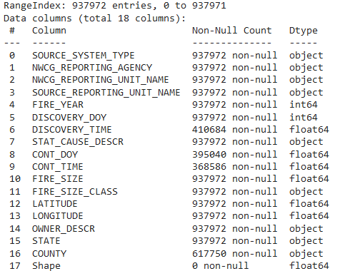
Data Cleaning & Wrangling
Selected features for descriptive and diagnostic analysis

Slide 5
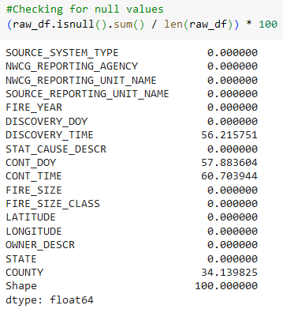
Data Cleaning & Wrangling
Dropped a feature with 100% Null values
Generated additional features from subsets for enhanced descriptive analysis

Slide 6
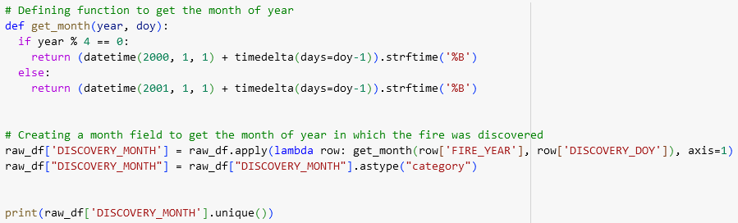
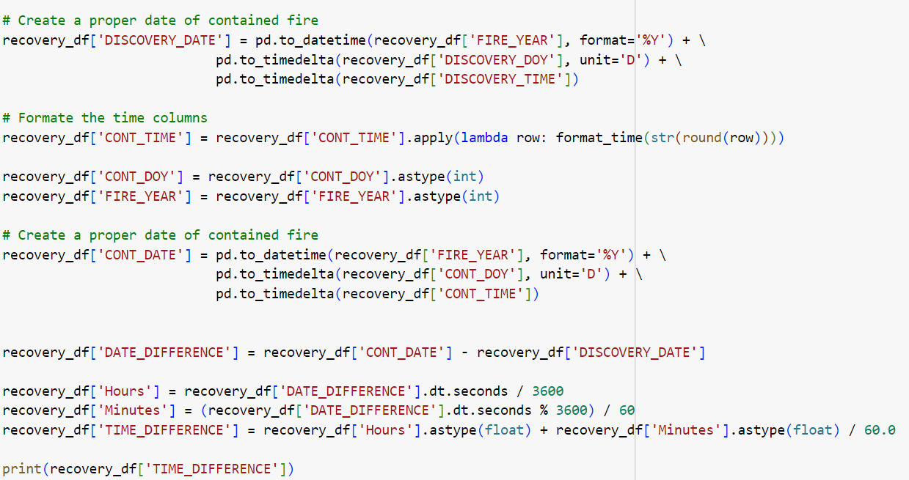
Feature Engineering
Created DISCOVERY_MONTH feature based on DISCOVERY_DOY
Created Time Difference feature to calculate the time required for containing the fire.

Slide 7
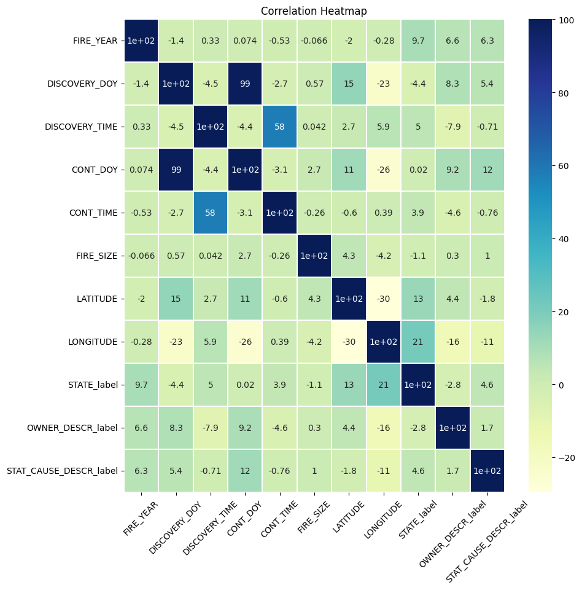
Checking Correlation between Features
Performed Label Encoding for categorical fields.
The Heatmap does not show high correlation between data fields.

Slide 8
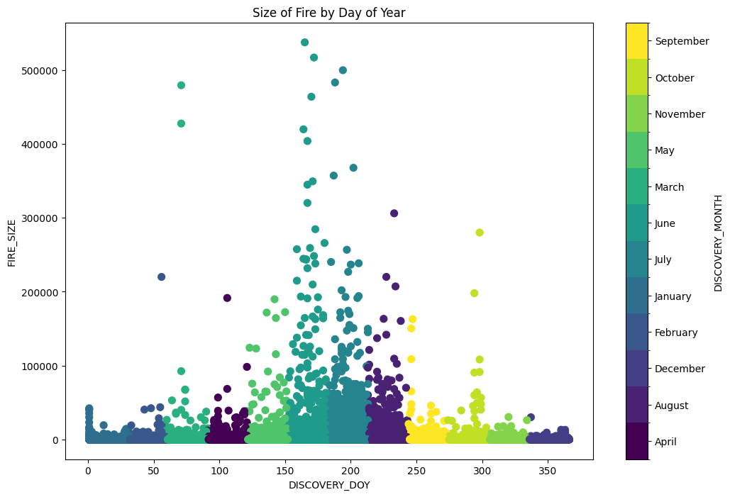
Charts from Descriptive Analysis

Slide 9
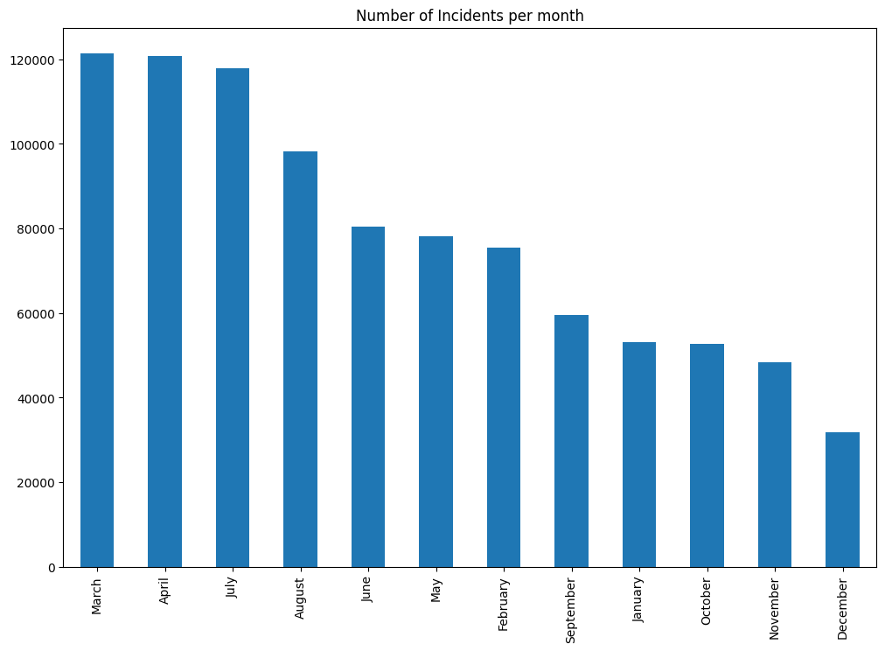
Charts from Descriptive Analysis

Slide 10
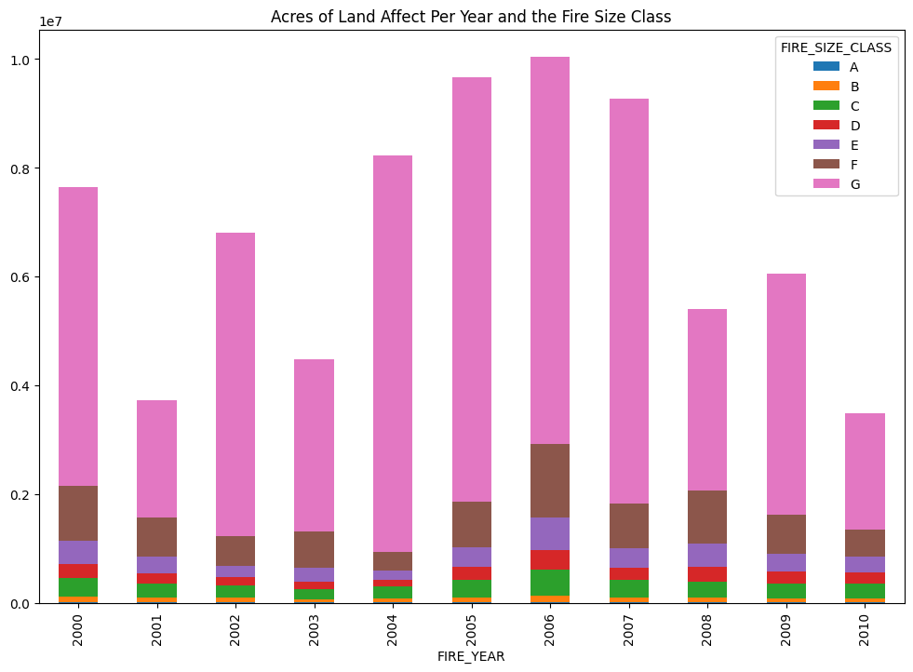
Charts from Descriptive Analysis

Slide 11
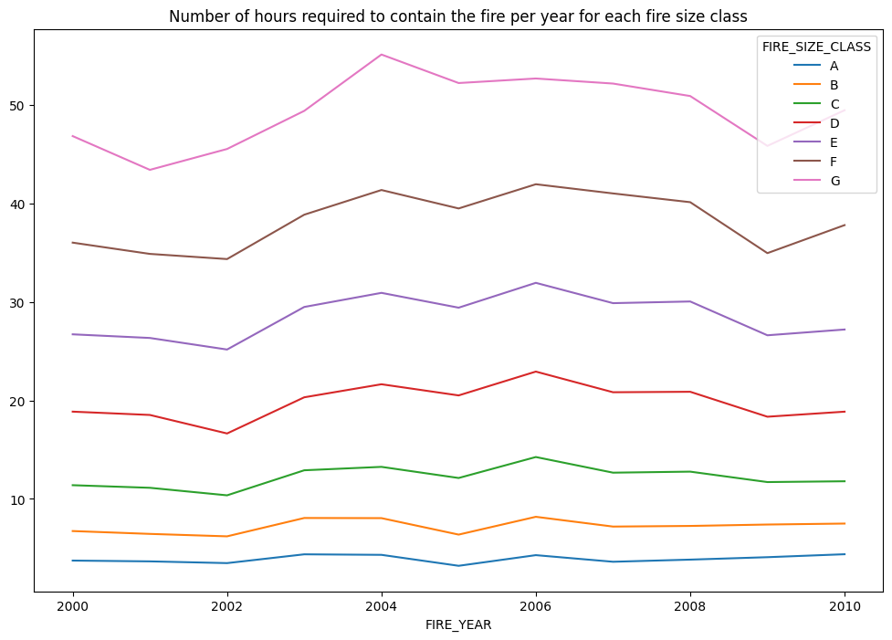
Charts from Descriptive Analysis

Slide 12

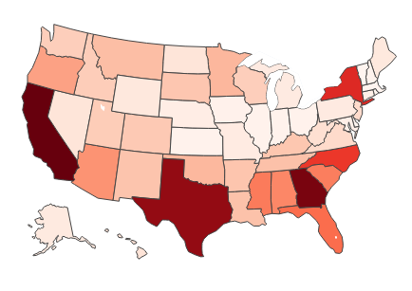
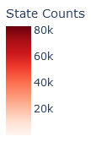
Geographical Visualization of Descriptive Analysis

Slide 13
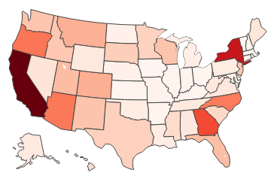
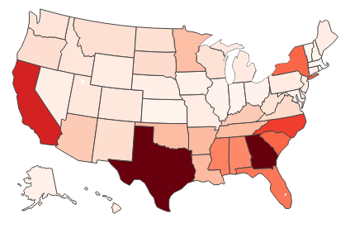
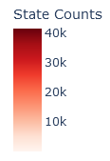
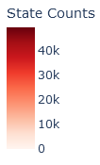
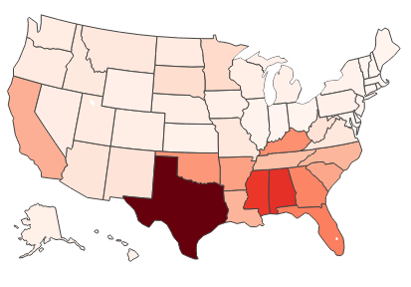
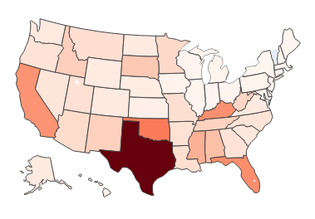
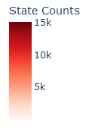
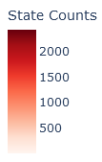
Geographical Visualization of Descriptive Analysis

Slide 14
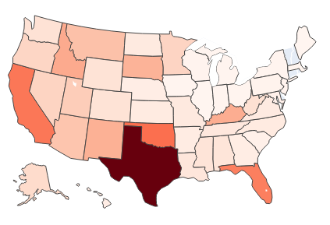
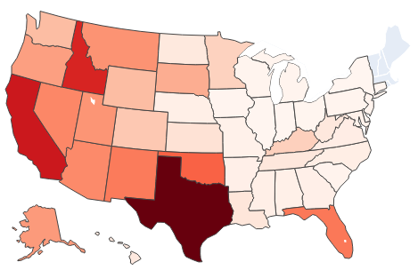
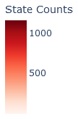
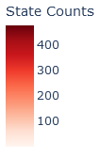
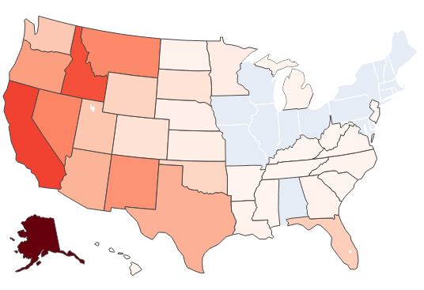
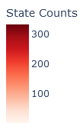
Geographical Visualization of Descriptive Analysis

Slide 15
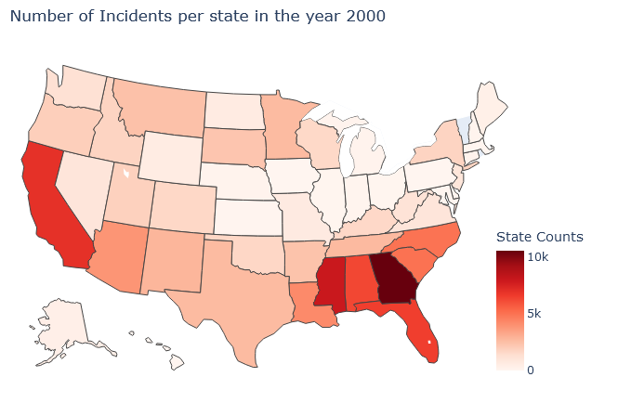
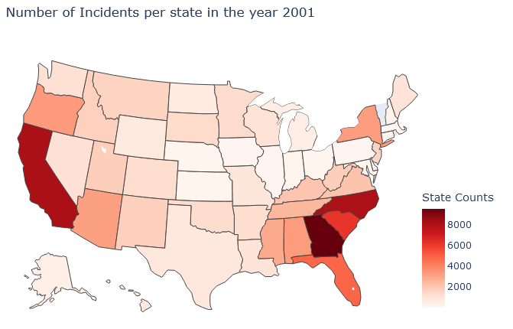
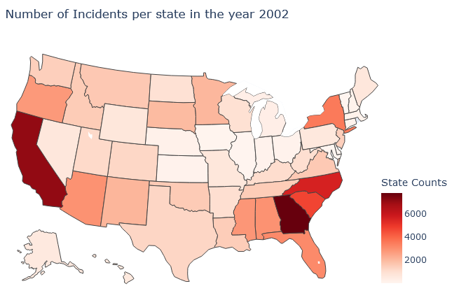
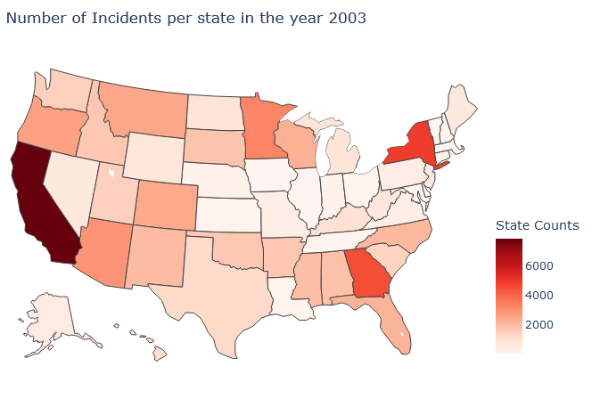
Geographical Visualization of Descriptive Analysis

Slide 16
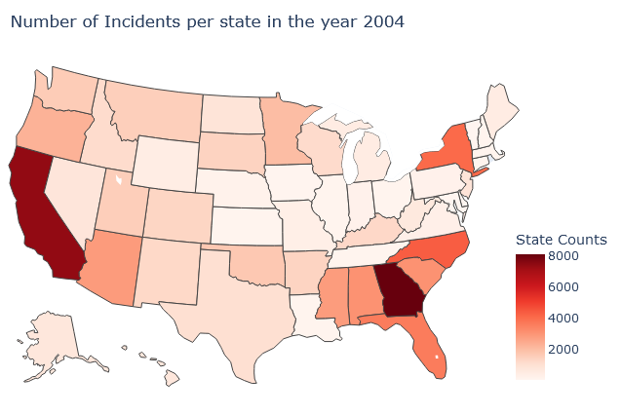
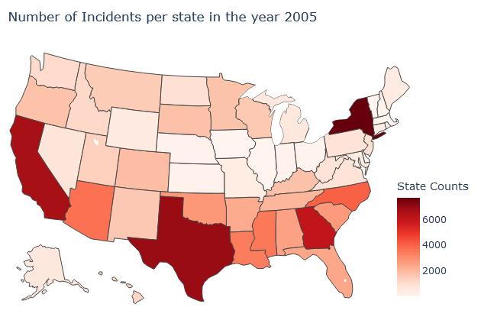
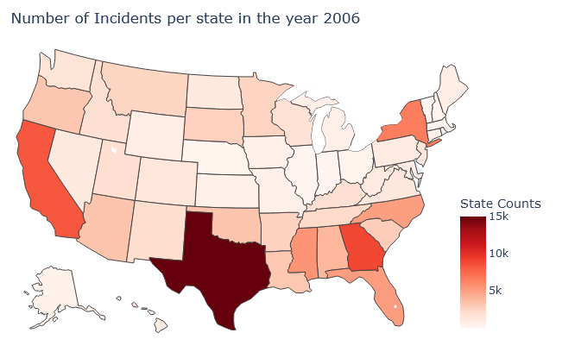
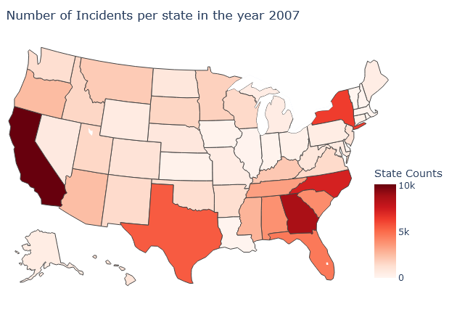
Geographical Visualization of Descriptive Analysis

Slide 17
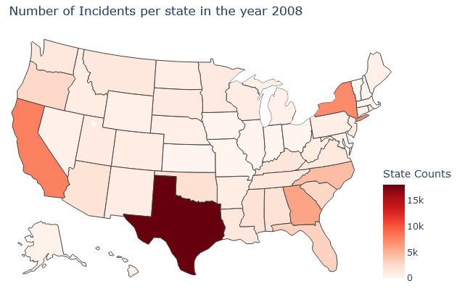
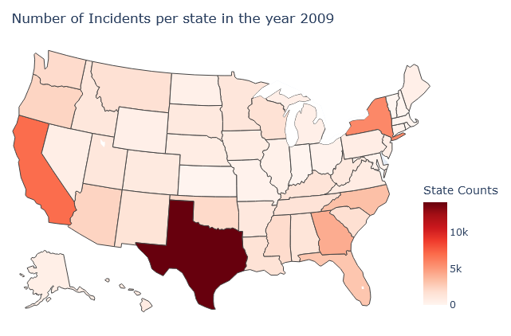
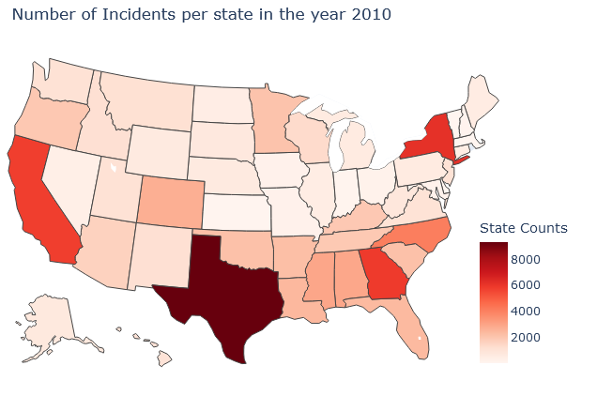
Geographical Visualization of Descriptive Analysis

Slide 18
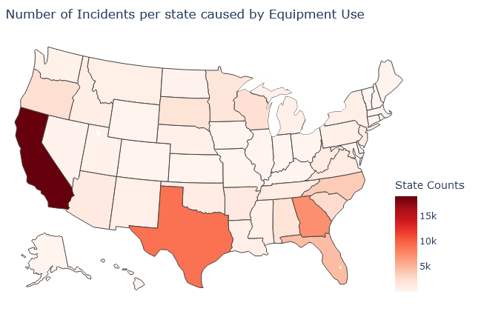
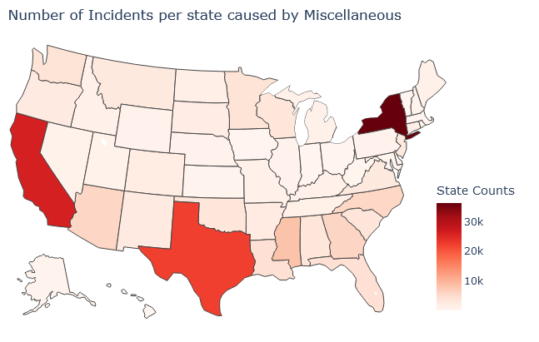
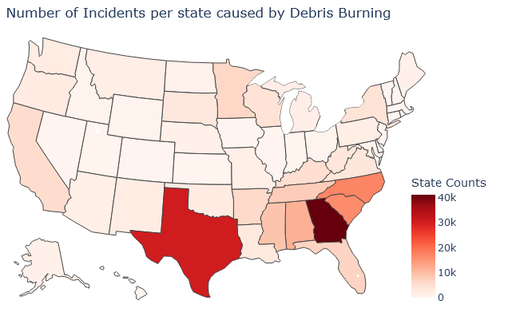
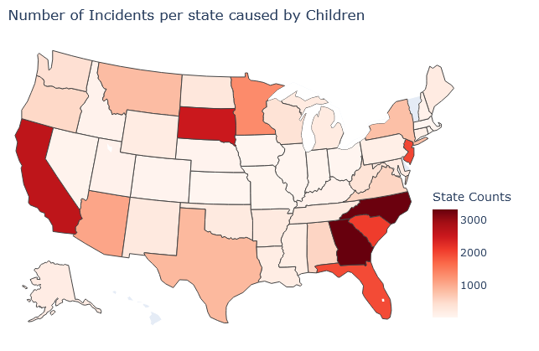
Geographical Visualization of Diagnostic Analysis

Slide 19
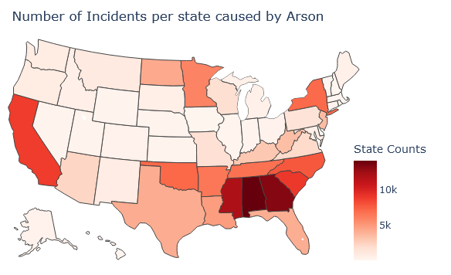
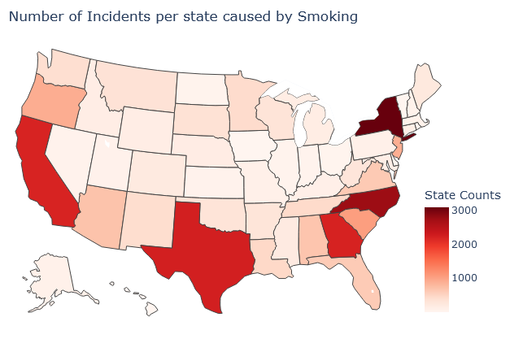
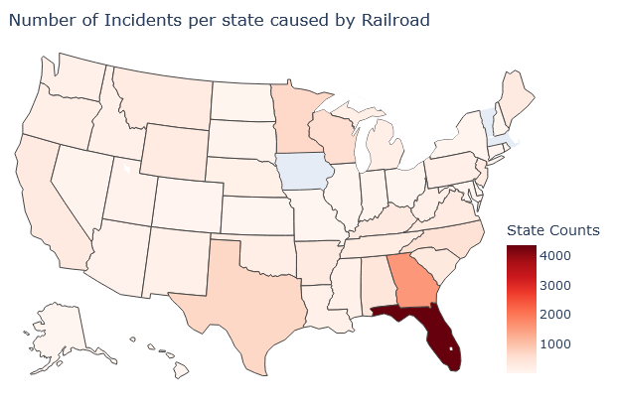
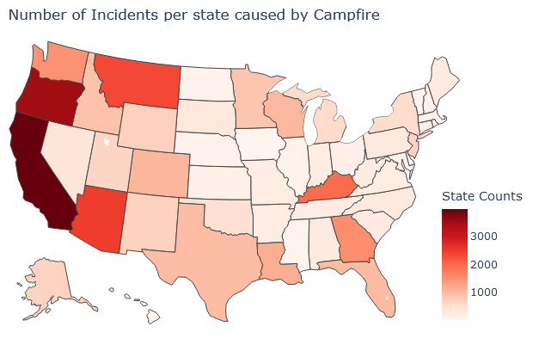
Geographical Visualization of Diagnostic Analysis

Slide 20
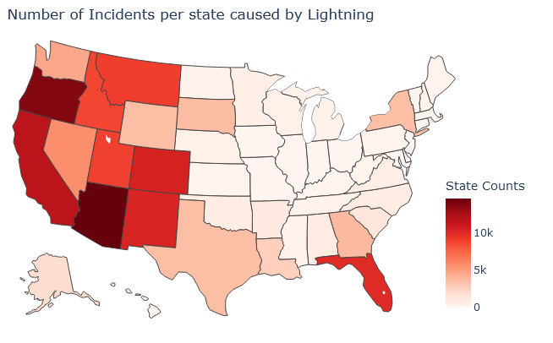
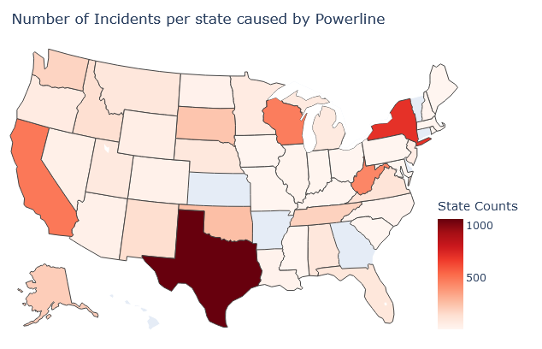
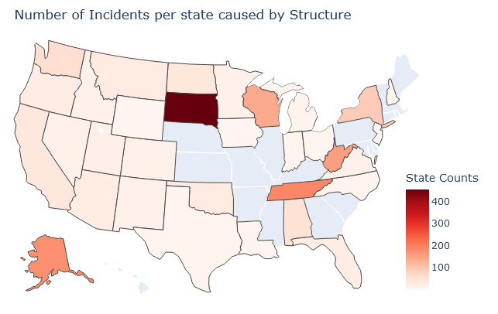
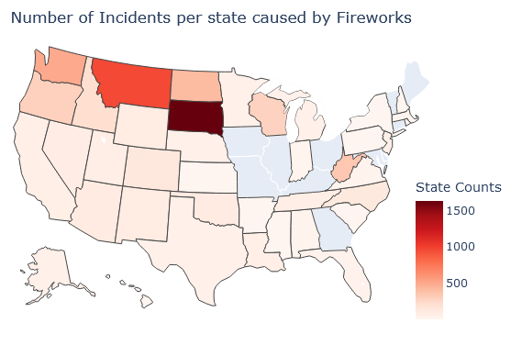
Geographical Visualization of Diagnostic Analysis

Slide 21
Impact Analysis
Descriptive and diagnostic analysis from previous wildfire episodes can serve as basis for identifying frequent patterns and generate substantiated measures for future incidents
Resource management may refine containment measures by looking at descriptive features such as number of acres harmed and time required to contain the fire
States may adjust where to focus their attention by looking at diagnostic features in causes and geographical analysis in which parts of the country were most affected by particular causes

Slide 22
Future of this Project
The data can be linked with financial data to understand financial implications and requirements.
Resources data can be added to understand the resources required to address this issue and the amount of resources required.
We can extend the project to analyze more dataset based on the most probable cause of the fire incident.

Slide 23
Conclusion
Almost all states have experienced wildfires in some form, which left “unforgettable” damage to our country as a whole.
By visibly framing numerous causes and consequence of wildfires through descriptive and diagnostic analysis, we hope to improve concentrating efforts in preventing and handling wildfires

Slide 24
Thank you!
We welcome Q&As and feedbacks.

