Slide 1

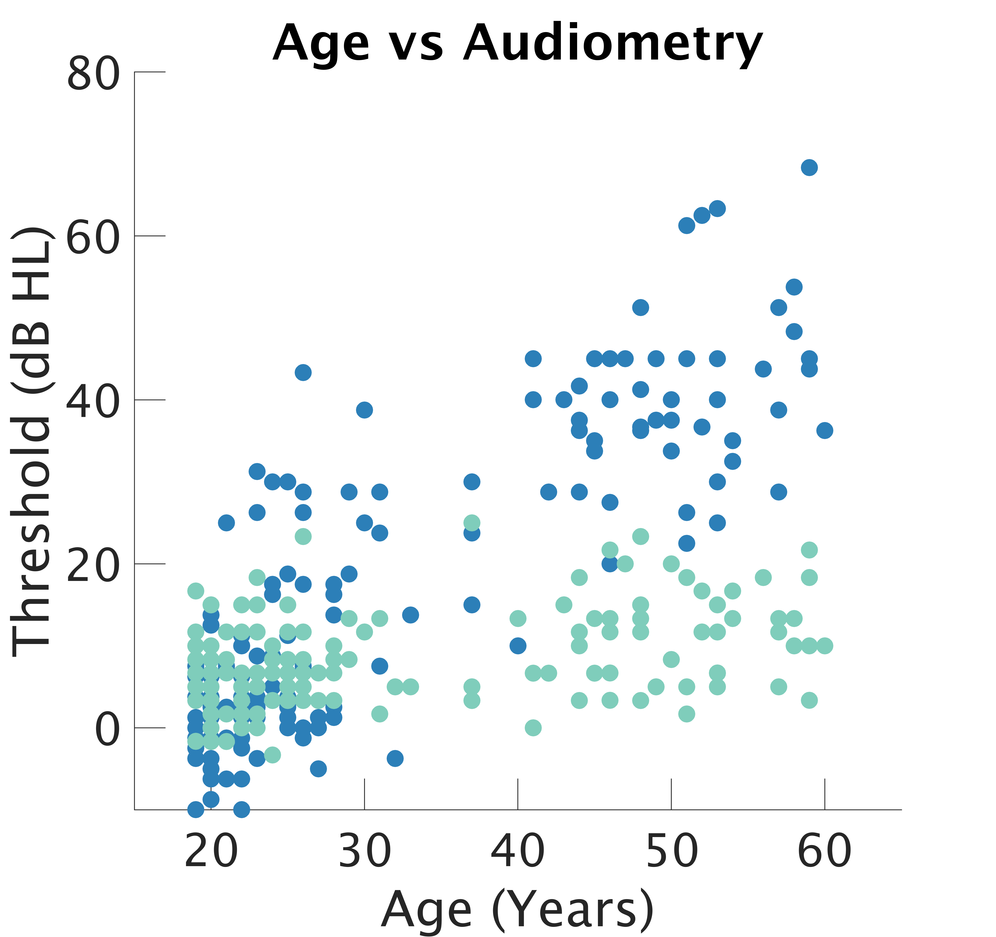
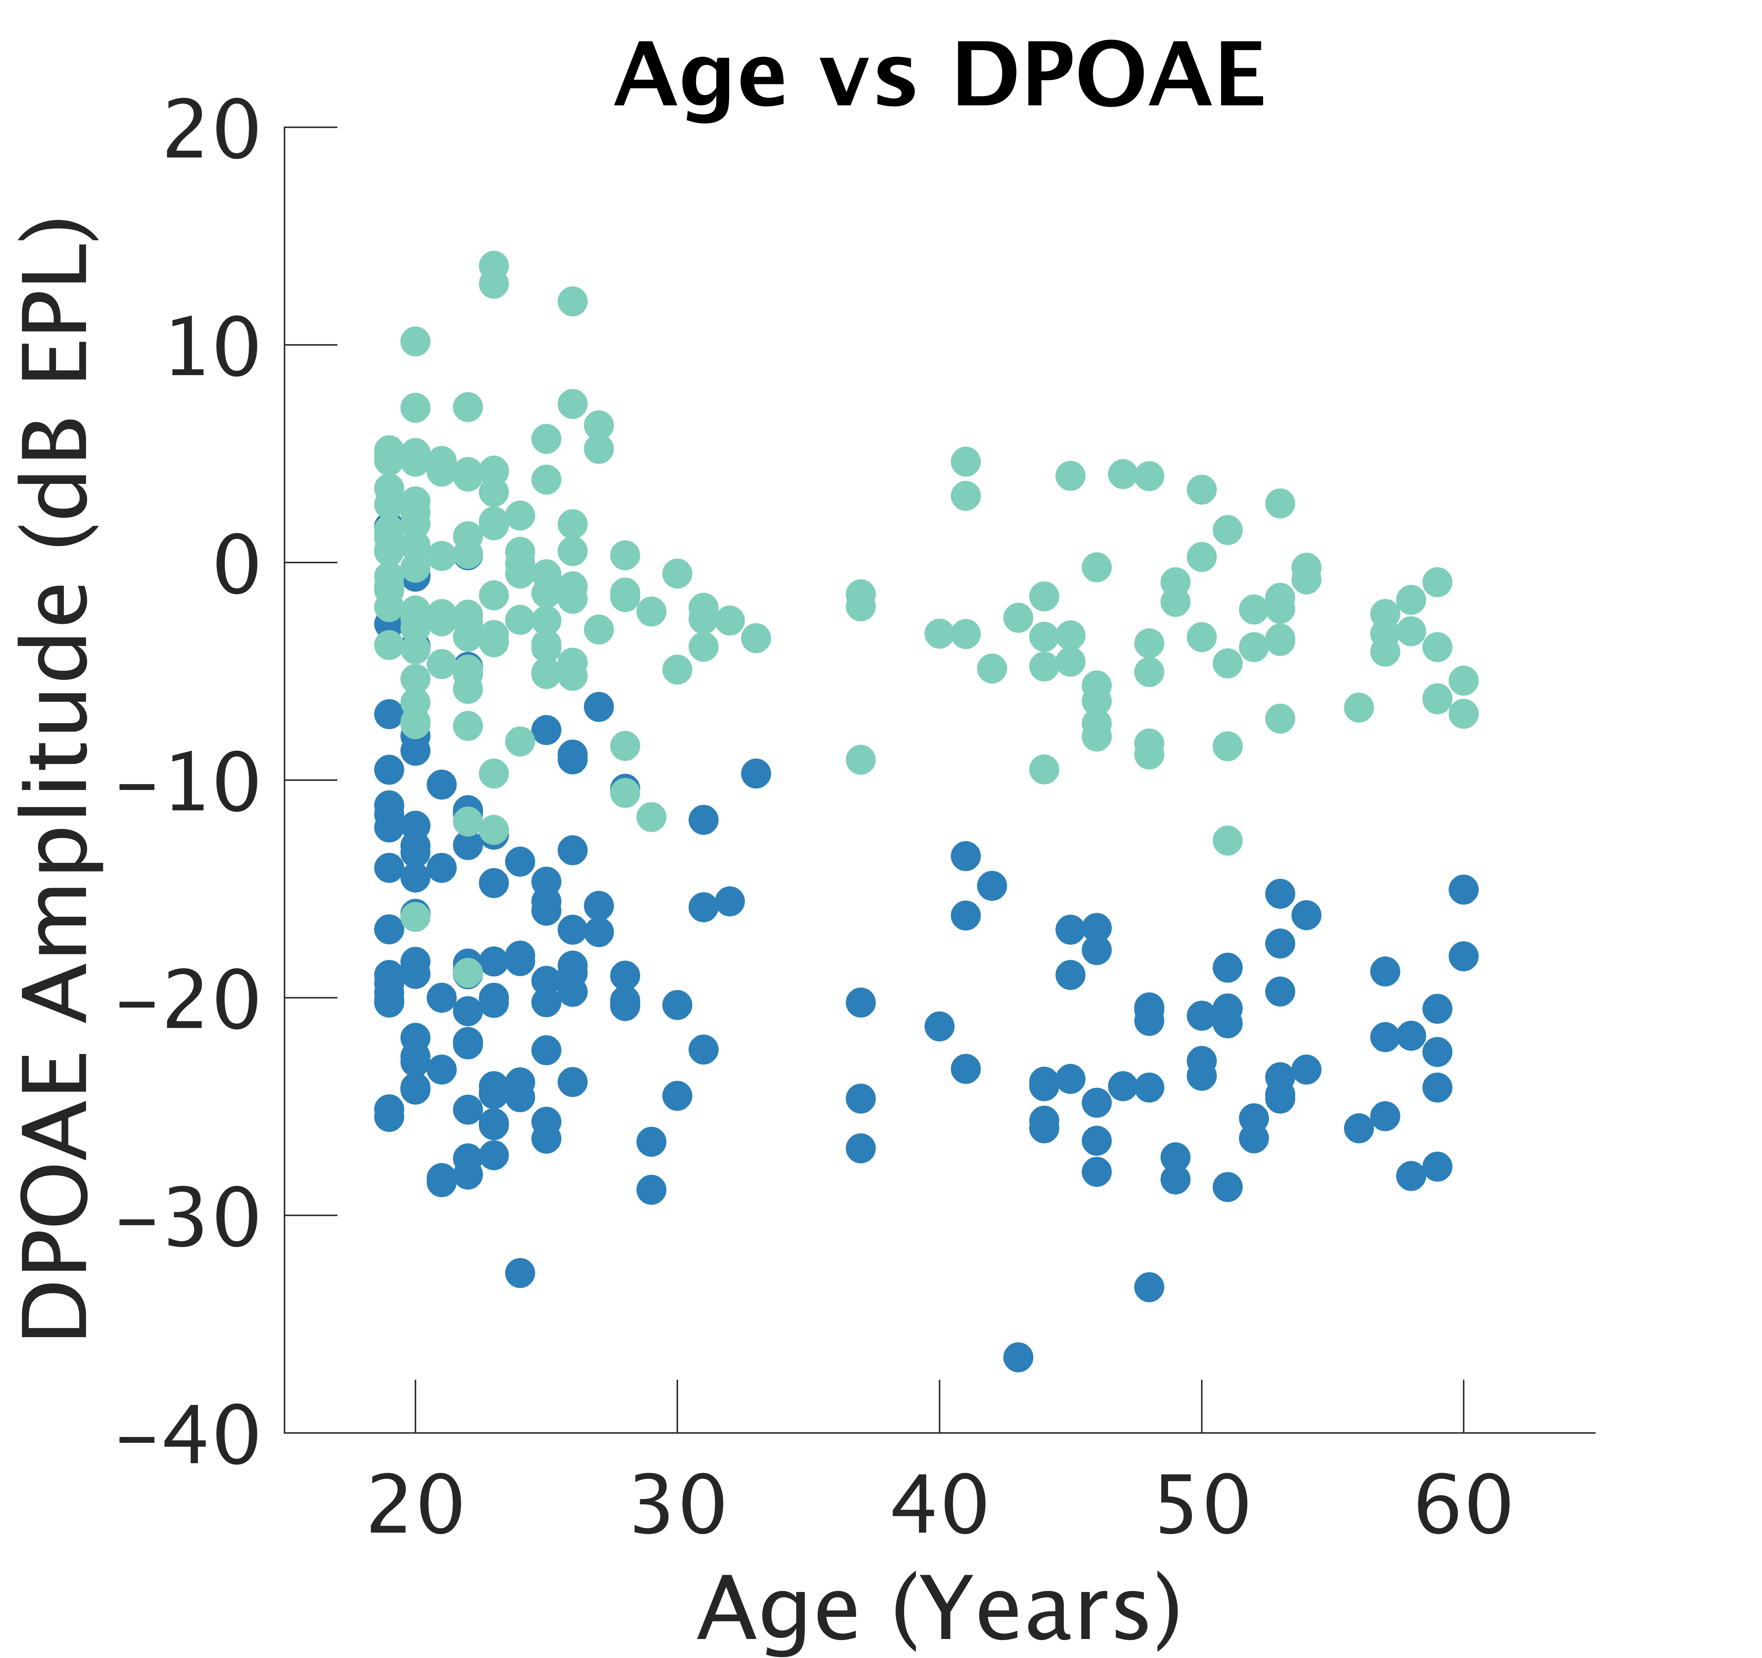
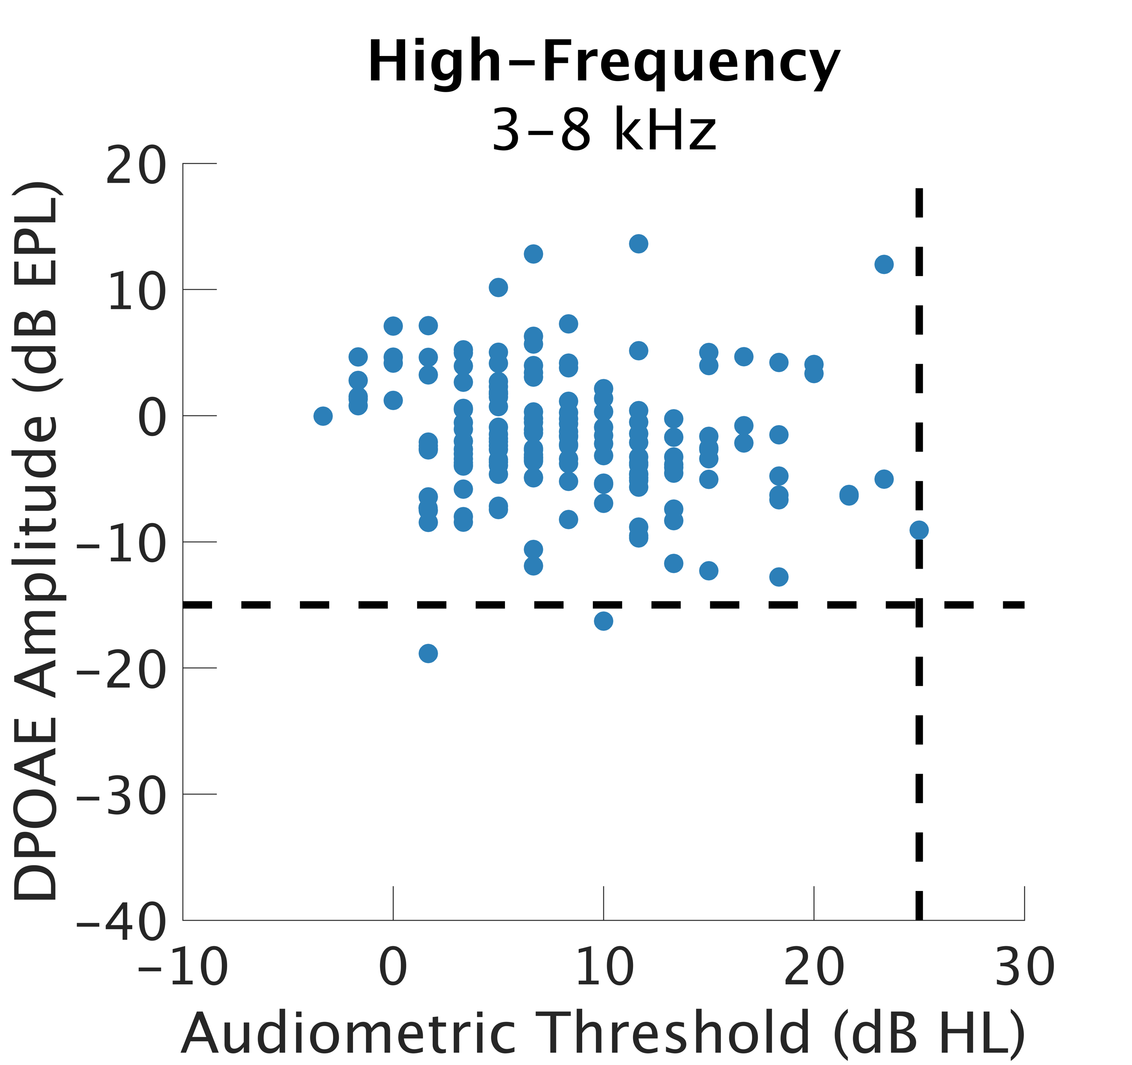
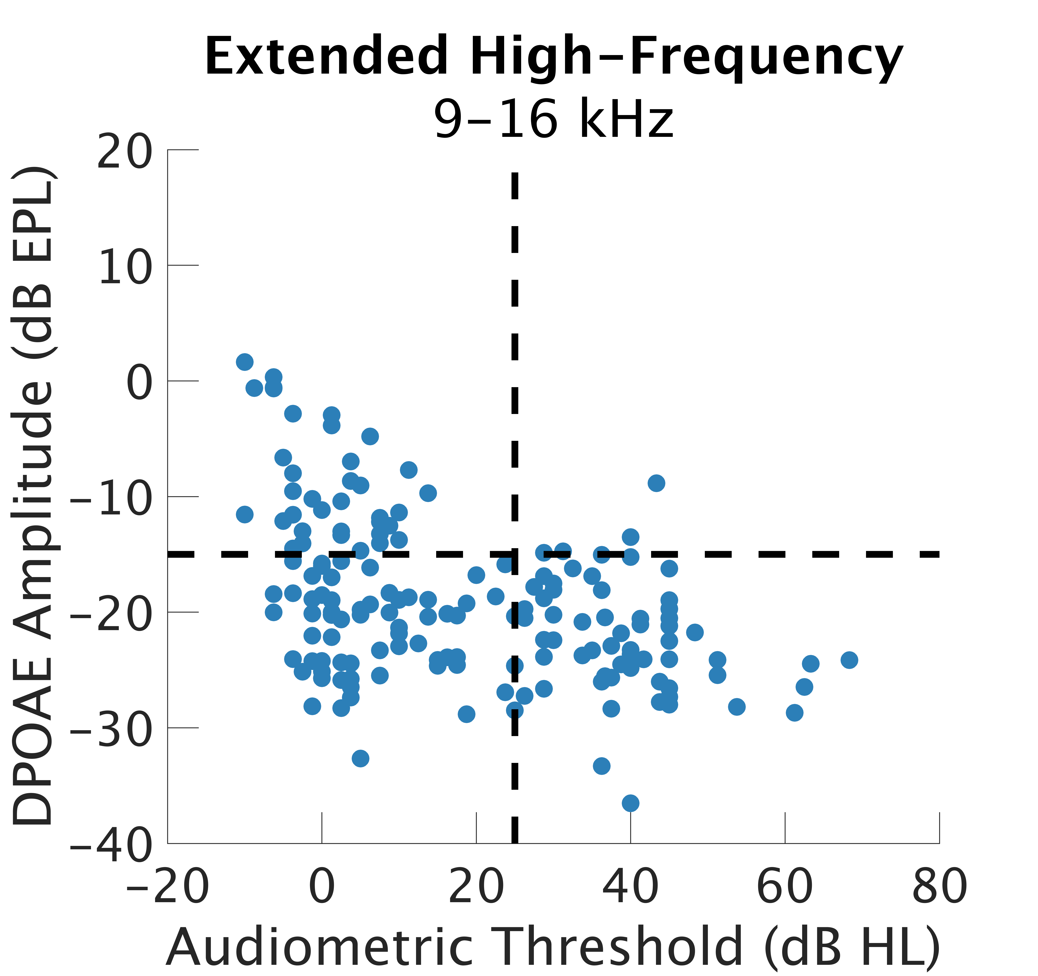
Relationship Between Distortion Product Otoacoustic Emissions and Audiometric Thresholds in the Extended High-Frequency Range
Samantha Hauser, AuD¹ , Anna Hagedorn BS¹ , Alexandra Mai, AuD¹, Hari Bharadwaj, PhD²
¹Speech, Language and Hearing Sciences, Purdue University, ²University of Pittsburgh
Introduction
Swept Distortion Product Otoacoustic Emissions
Effect of Age
Bullet points of background info with citations [3]
Individual Swept Distortion Product Otoacoustic Emissions after Calibration
Description of Age results
Here we examined the correlations between behavioral audiometry and DPOAEs in the high-frequency and extended high-frequency ranges when using precise calibration techniques.
EPL/FPL Calibration
Individualized In-Ear Calibrations Increases reliability of measures in the high frequencies
details
Analysis Windows Isolate the Distortion Component
Conclusions
DPOAEs Correlate with Audiometric Thresholds
EPL calibrations improve
Future Directions
Methods
We are measuring both distortion and reflection type emissions using swept DPOAE and swept SFOAE paradigms and expanding to include individuals with sensorineural hearing loss.
Participants
Individuals aged 18 – 60 years with normal audiometric thresholds from 250-8000 Hz (n=166).
Thresholds at frequencies above 8000 Hz were allowed to vary.
Participants completed other audiological measures as part of a larger study on cochlear synaptopathy [Bharadwaj 2022]
Swept DPOAEs
DPOAEs were measured from 2000-16000 Hz
Analyses
Thresholds were averaged
References
References: [1] Salvi, Wang & Ding, Hear Res 2000. [2] Resnick & Polley, eLife 2017. [3] Bhardwaj, Mai, Ginsberg, Dougherty, Muthiah, Hagedorn, Simpson, & Heinz bioRxiv 2021. [4] Kuajawa & Liberman 2015 [5] Eggermont, Hear Res 1993. [6] Maddox & Lee, eNeuro, 2018. [7] Verhey, Pressnitzer & Winter, Exp Brain Res 2003. [8] Caspary, Ling, Turner & Hughes, J Exp Biol 2008.
Acknowledgements: Funding was provided by NIH R01DC015989 (HB) and NIH T32XXXXX (SH)

