Slide 1

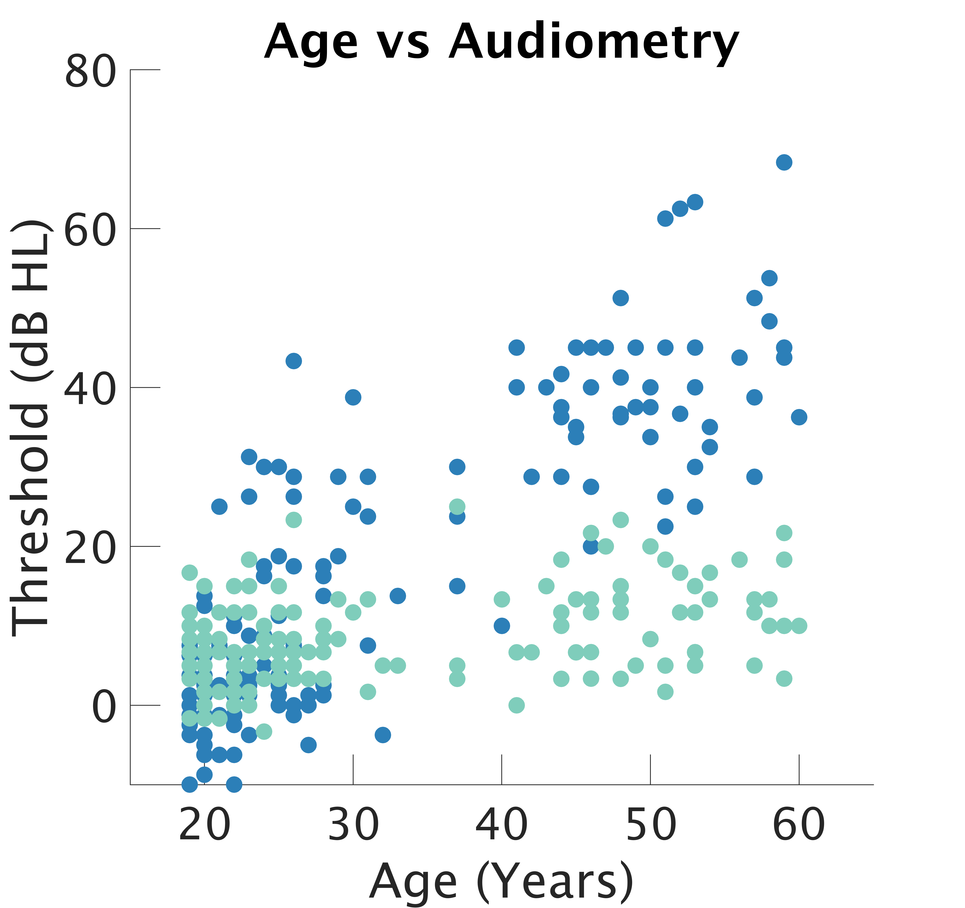
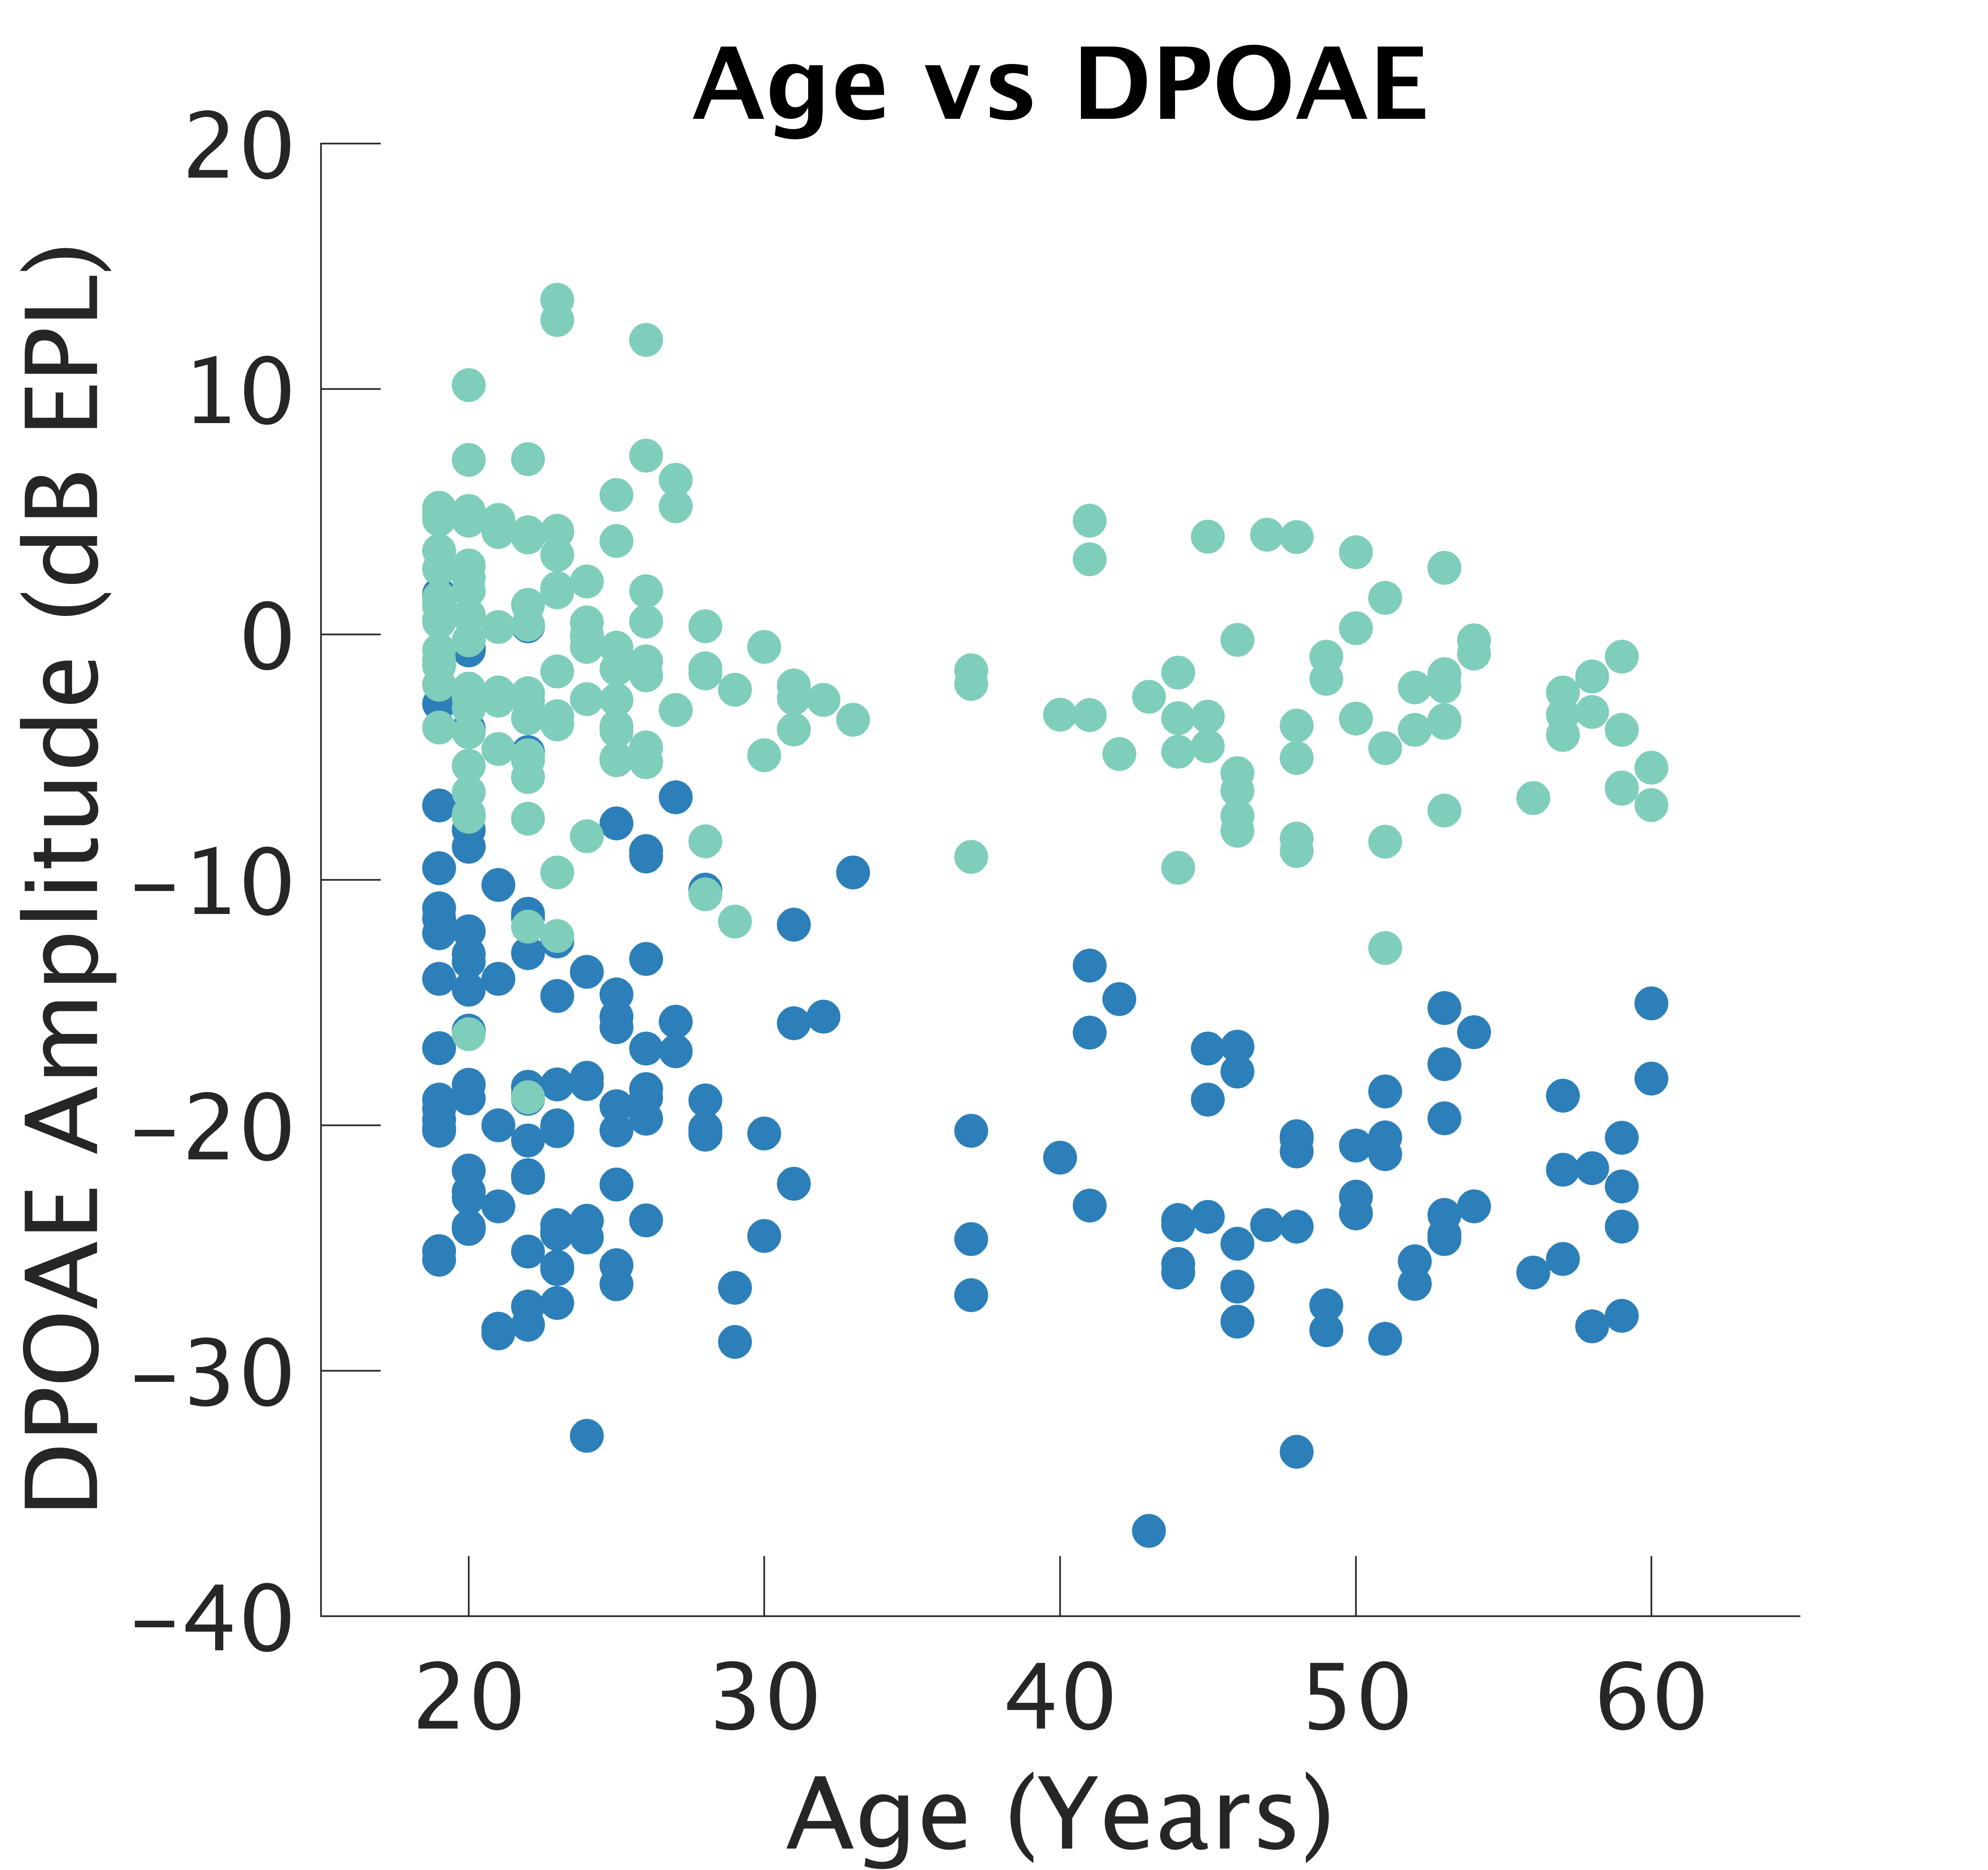
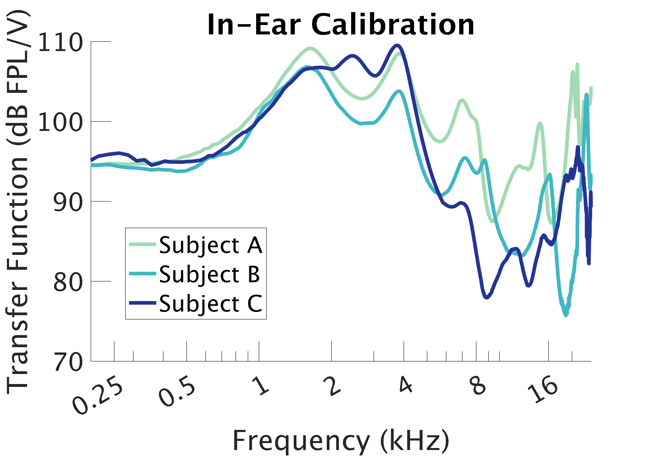
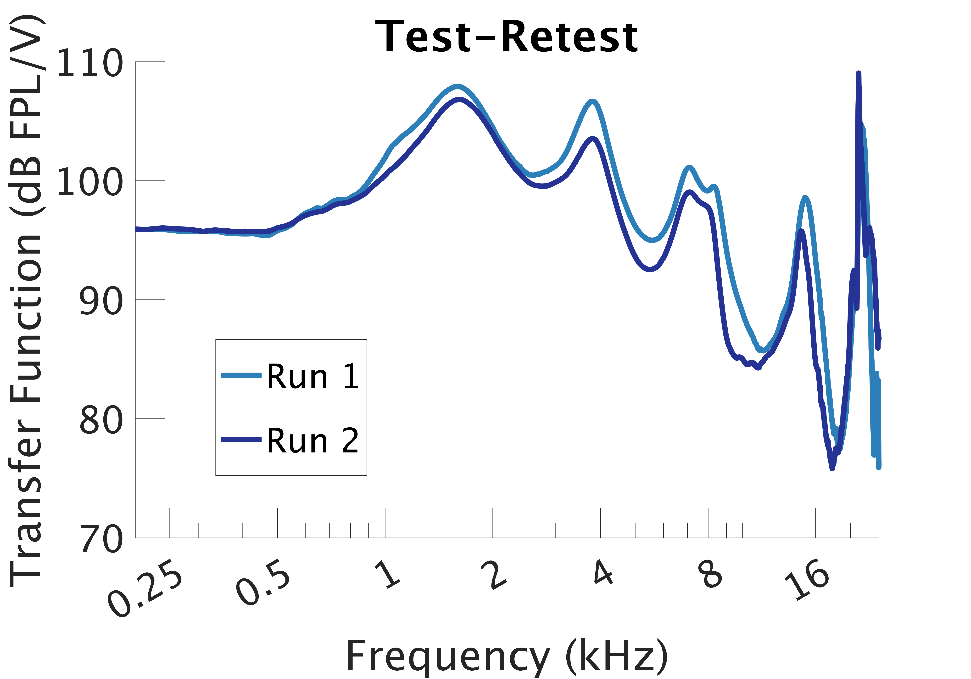
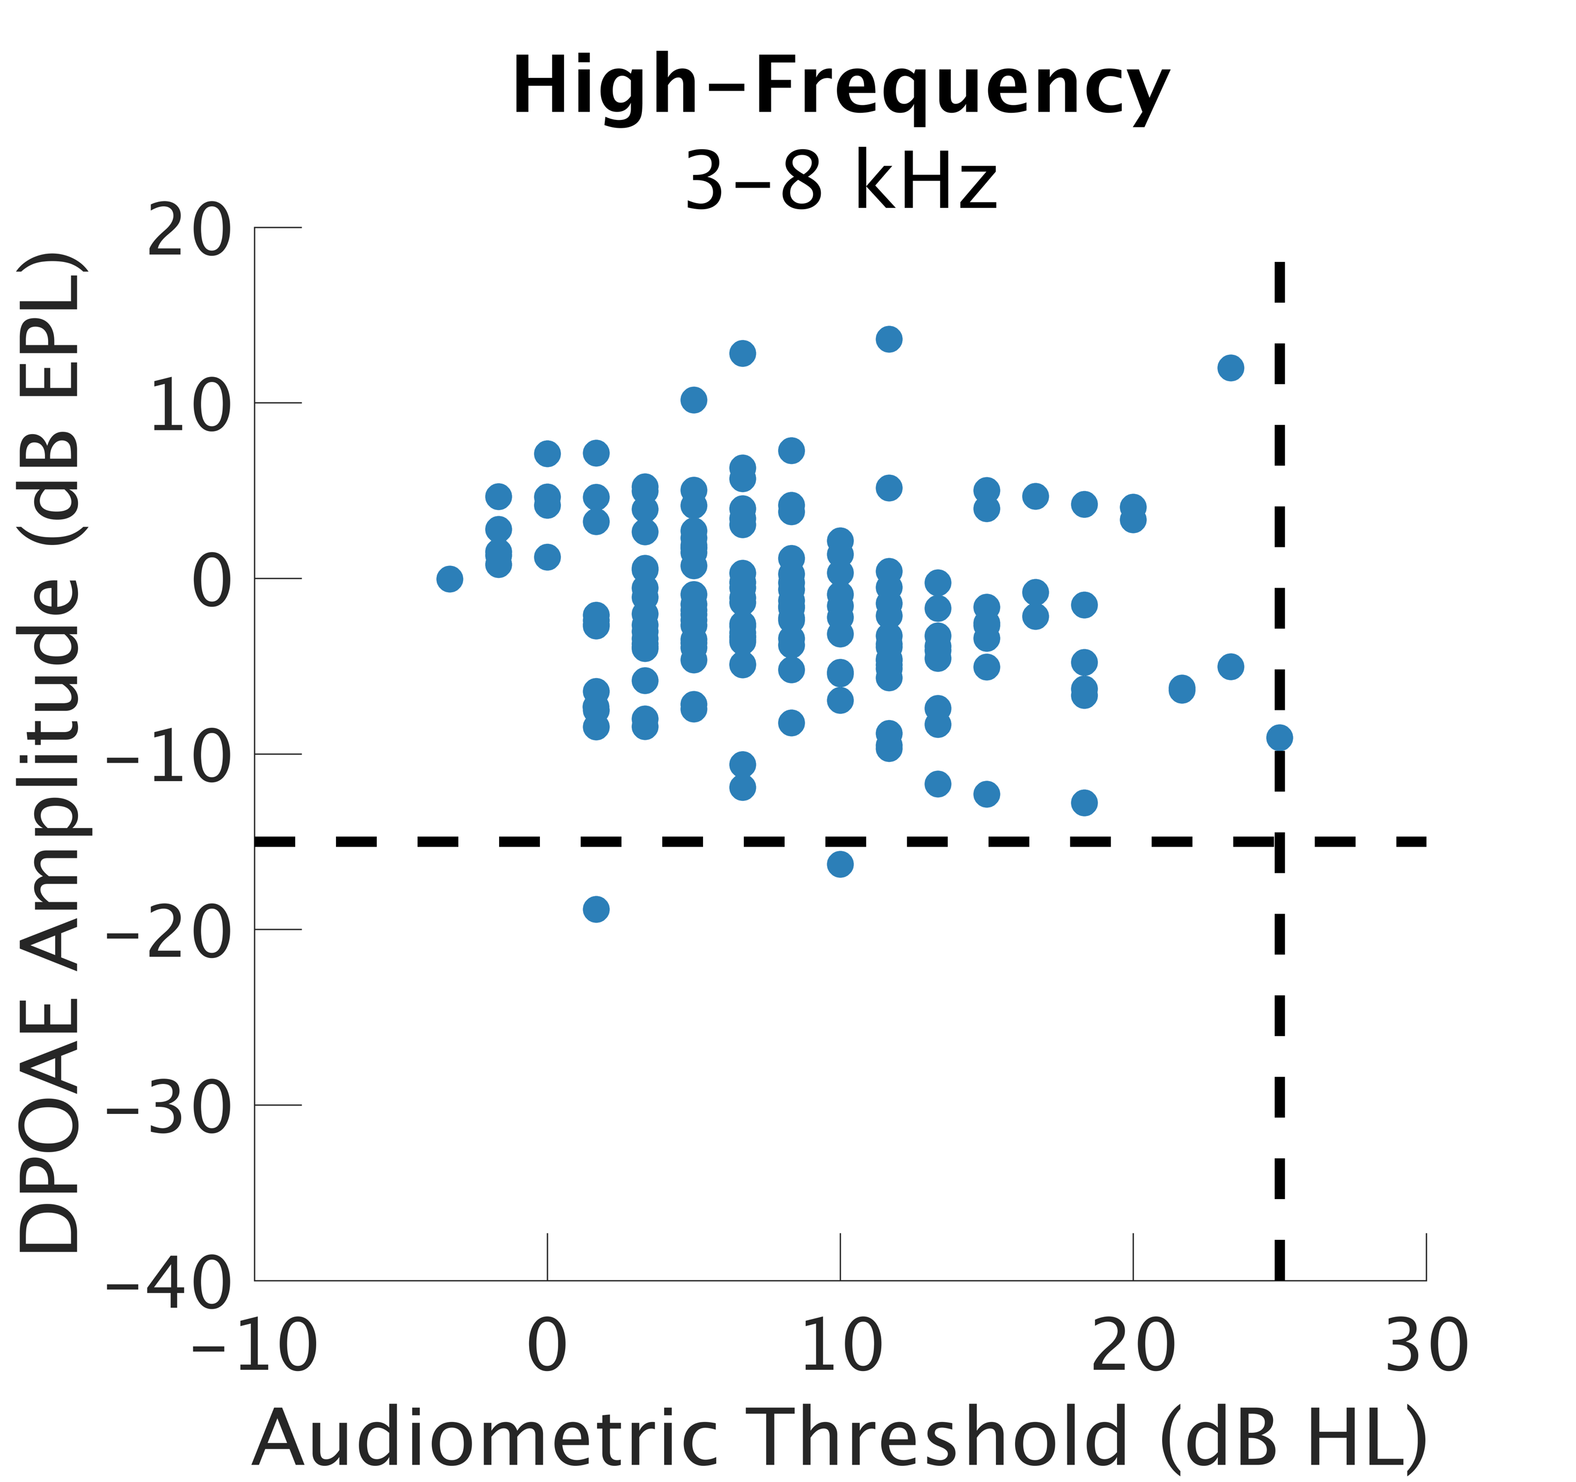
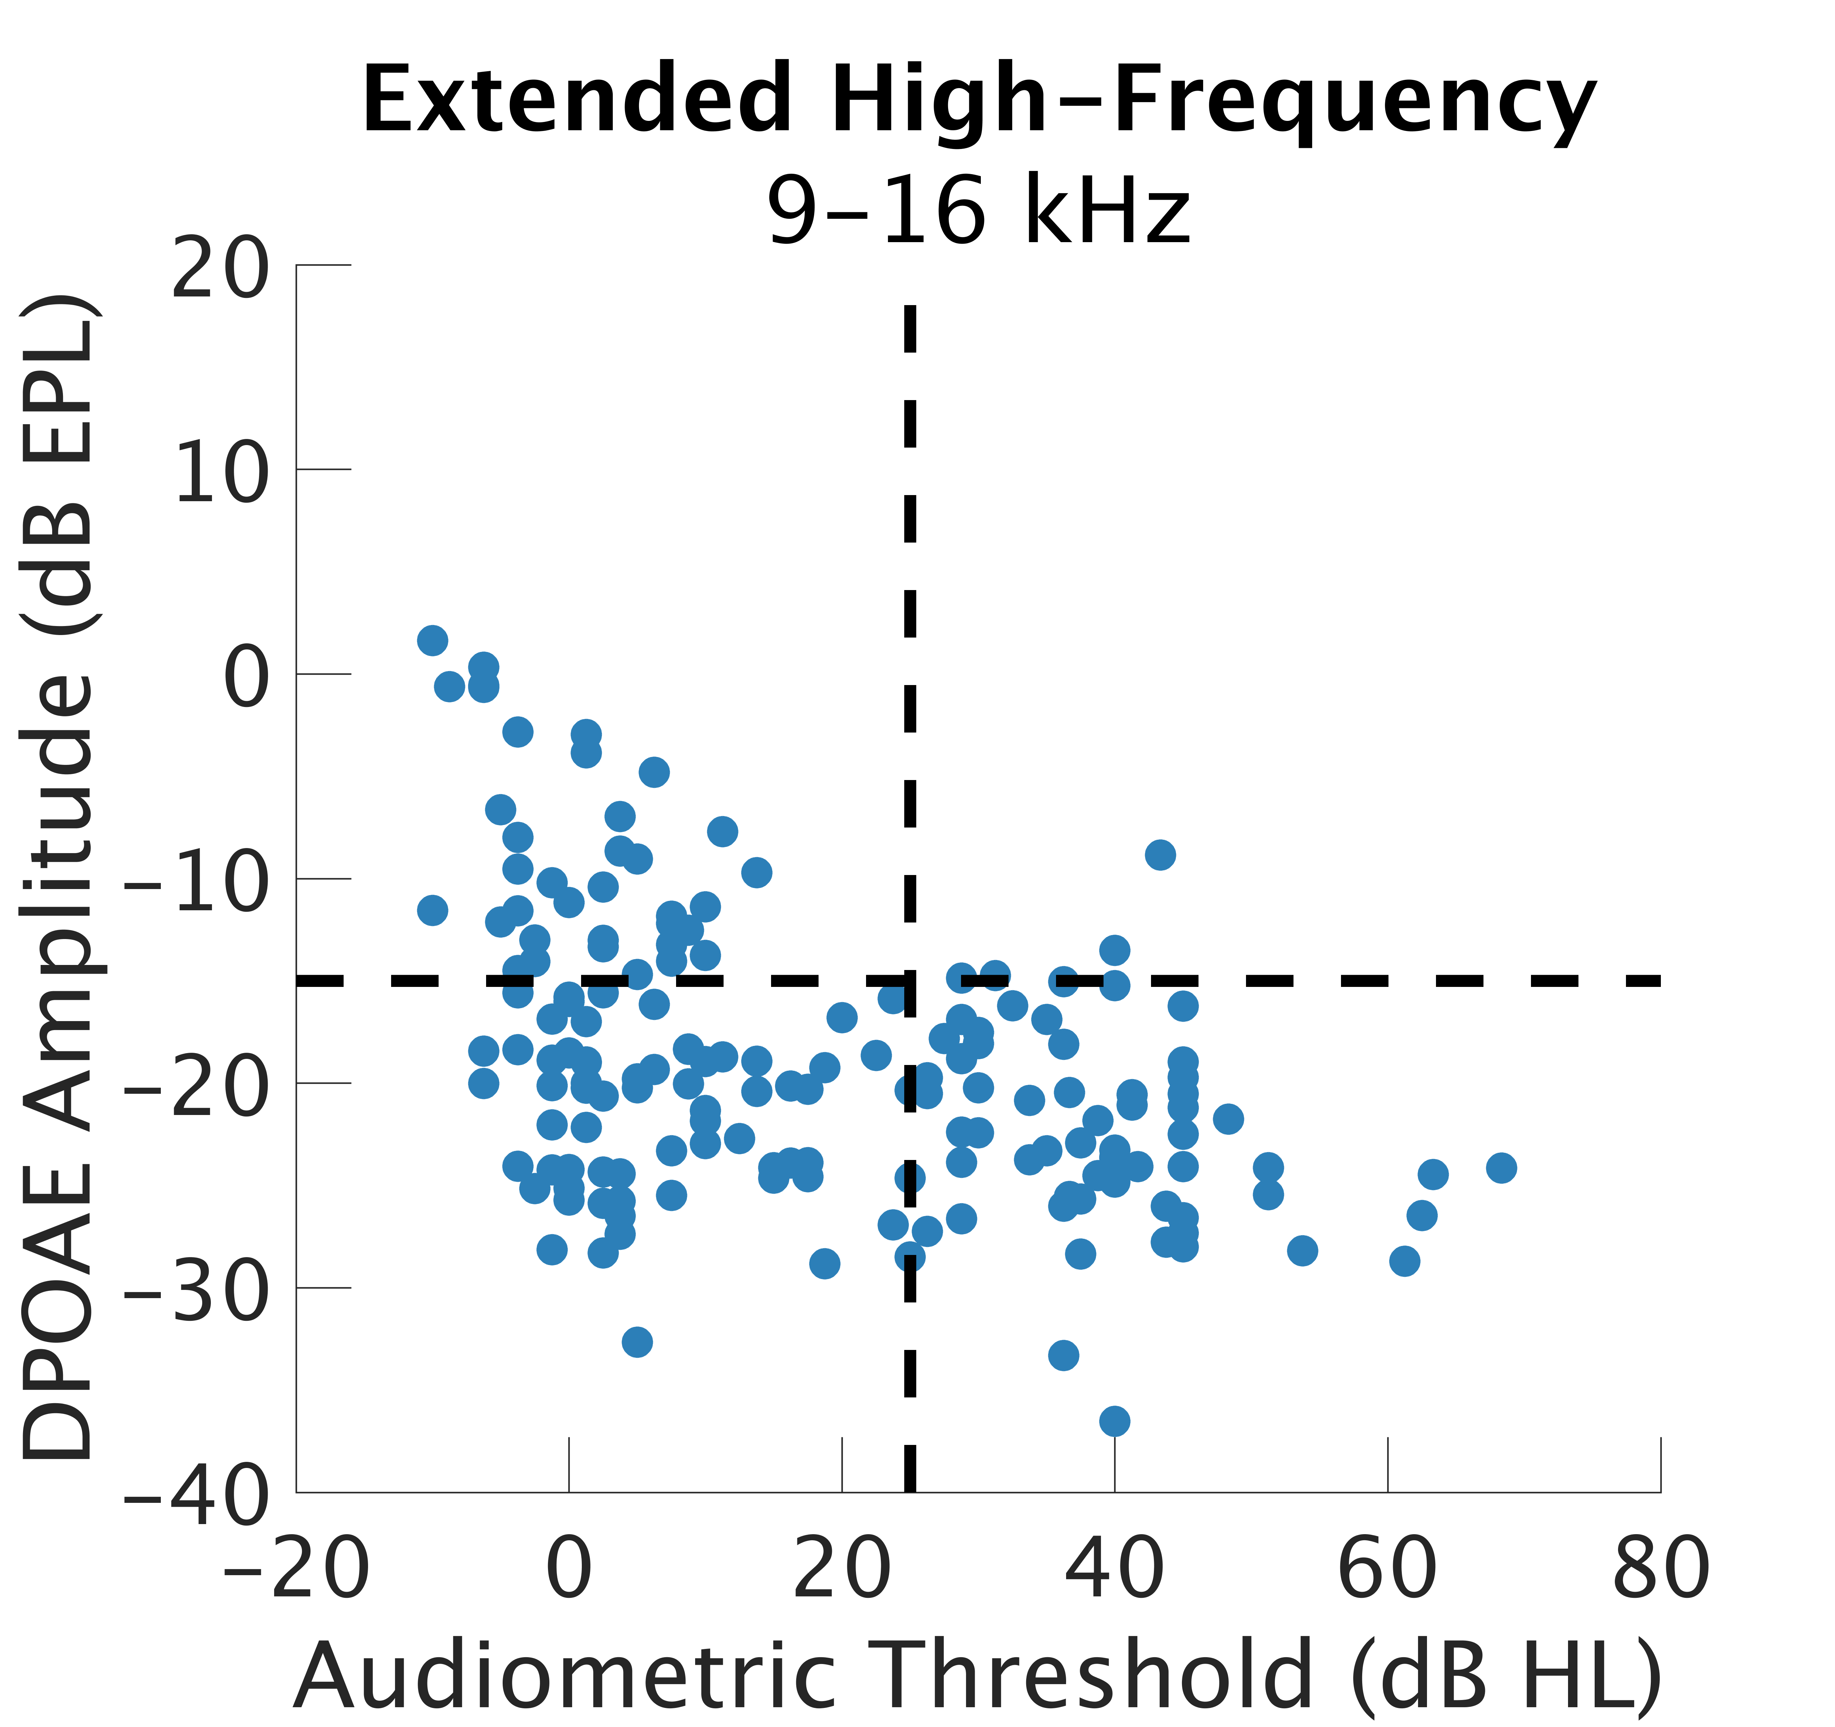
Relationship Between Distortion Product Otoacoustic Emissions and Audiometric Thresholds in the Extended High-Frequency Range
Samantha N. Hauser, AuD¹ , Anna Hagedorn, BS¹ , Alexandra R. Hustedt-Mai, AuD¹, Hari M. Bharadwaj, PhD²
¹Speech, Language and Hearing Sciences, Purdue University, ²University of Pittsburgh
Introduction
Swept Distortion Product Otoacoustic Emissions
Effect of Age
Distortion product otoacoustic emissions are commonly used in the audiology clinic and in research as a measure of cochlear health, specifically outer hair cell function [X].
While clinical hearing assessment via behavioral audiometry is limited to 250-8000 Hz, the extended high-frequency hearing range is most susceptible to ototoxic medications, aging, and possibly acoustic over exposure.
Interpretation of high-frequency DPOAEs is complicated due to variation in emission amplitudes across repeated measures.
One source of variation is individual ear calibration methods. Traditional SPL calibration methods do not consider standing waves generated in the ear canal.
Newer methods that calculate forward pressure level (FPL) of stimuli and emitted pressure level (EPL) of the emission have been shown to reduce test-retest variability compared to SPL measures for either the stimulus or the emission. [1]
Description of Age results
Here we examined the relationship between behavioral audiometry and DPOAEs in the high-frequency and extended high-frequency ranges when using FPL/EPL calibration techniques.
FPL/EPL Calibration
FPL increases reliability of measures in the high frequencies
Calibrations vary significantly between individuals and across test sessions for a given subject up to 20 dB, especially in the high frequencies (> 4 kHz).
Conclusions
Individual Swept Distortion Product Otoacoustic Emissions after Calibration
Swept DPOAEs were measured from XXX-16 kHz.
Responses were windowed to isolate the distortion component, rather than calculate the mixed (D and R) components of the response.
EPL calibrations improve
Probe Calibration
The ER-10X probe was calibrated by coupling the eartip to the ER-10X calibrator (brass cylinders of 8 mm diameter and 5 different lengths) and measuring the response to a click probe to estimate the Thevenin-equivalent source pressure and impedance.
In-ear Calibration
Once the eartip was placed in the subject’s ear, the click stimulus was used to estimate the immittance properties of the subject’s ear. Low-frequency (200-500 Hz average) ear absorbance was less than 29% to ensure an adequate seal was acquired.
DPOAEs Correlate with Audiometric Thresholds
Future Directions
We are measuring both distortion and reflection type emissions using swept DPOAE and swept SFOAE paradigms and expanding to include individuals with sensorineural hearing loss.
Methods
Participants
166 individuals (61 male) age 18 – 60 years with normal audiometric thresholds from 250-8000 Hz,
Participants completed other audiological measures as part of a larger study on cochlear synaptopathy [2]
Because we required hearing to be within normal limits through 8000 Hz, some subjects had to be excluded. In particular, males aged 35-60.
References
References: [1] Maxim, Shera, Charaziak & Abdala, Ear Hear 2019. [2] Bharadwaj, Hustedt-Mai, Ginsberg, Dougherty, Muthaiah, Hagedorn, Simpson & Heinz, Comm Bio 2022
Acknowledgements: Funding was provided by NIH R01DC015989 (HB) and NIH T32XXXXX (SH)

