Slide 1

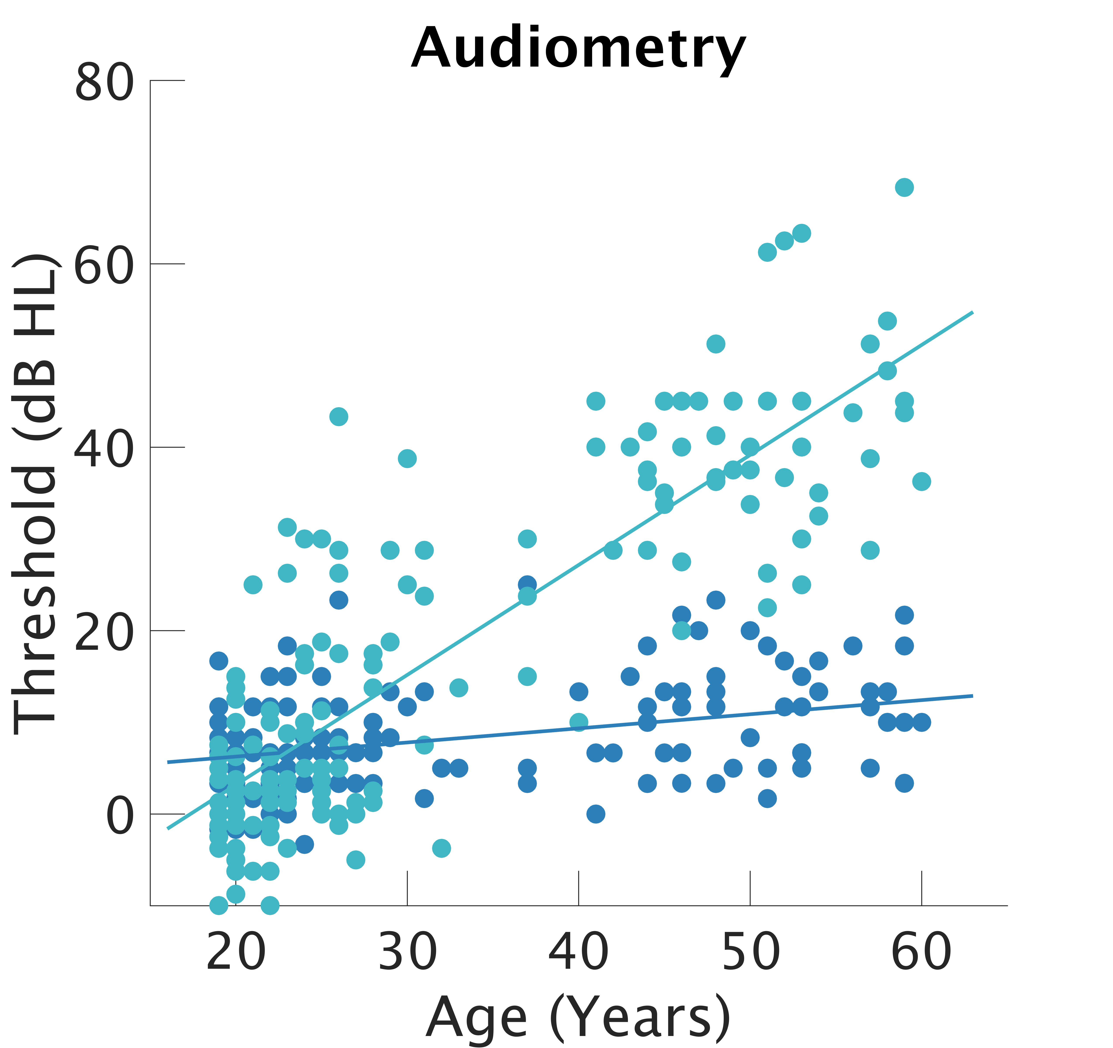
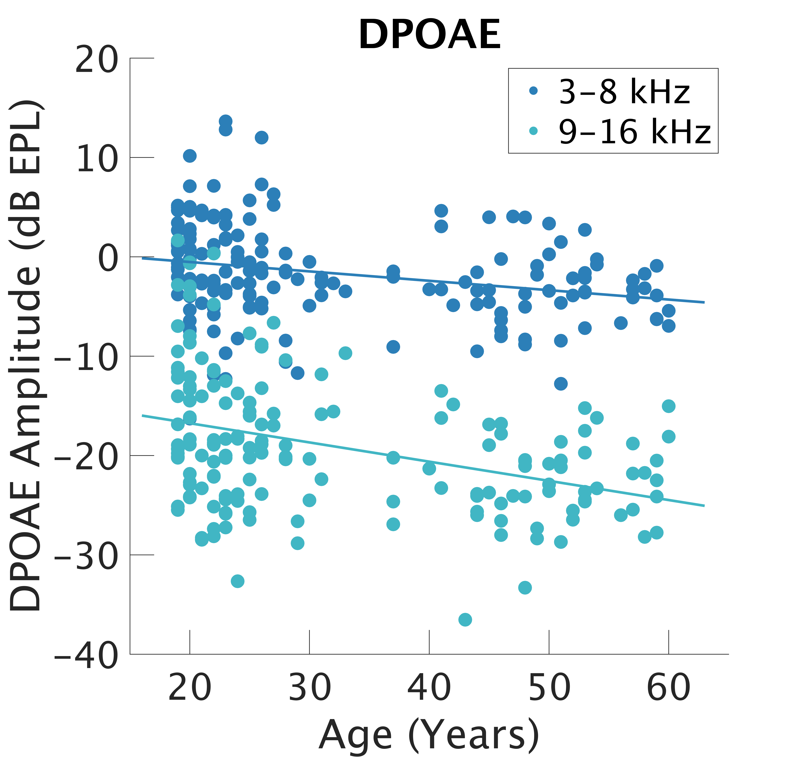
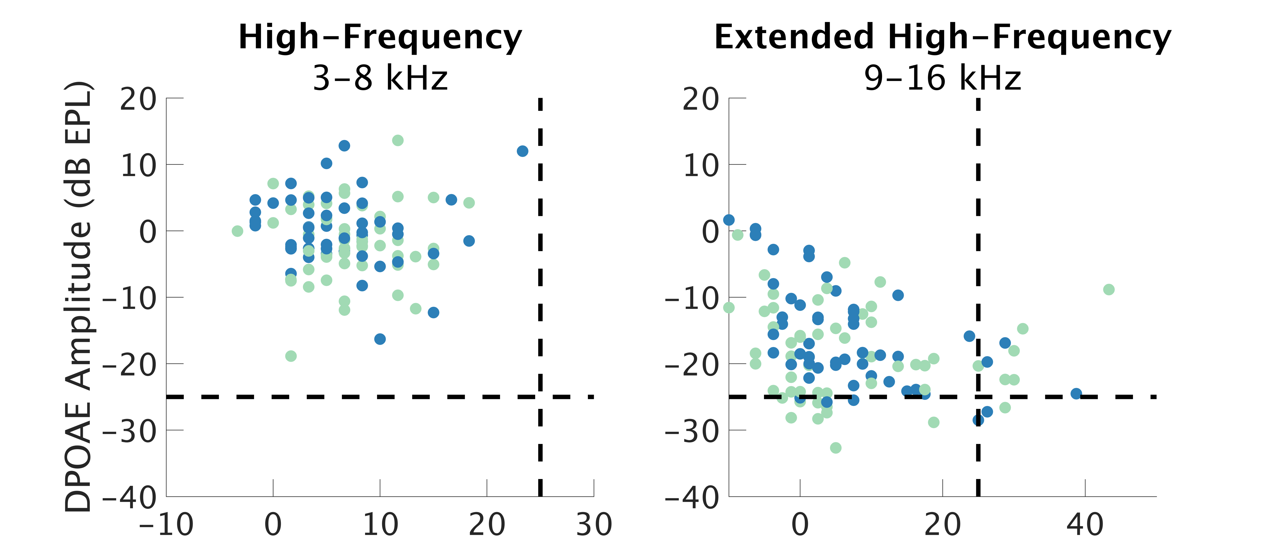
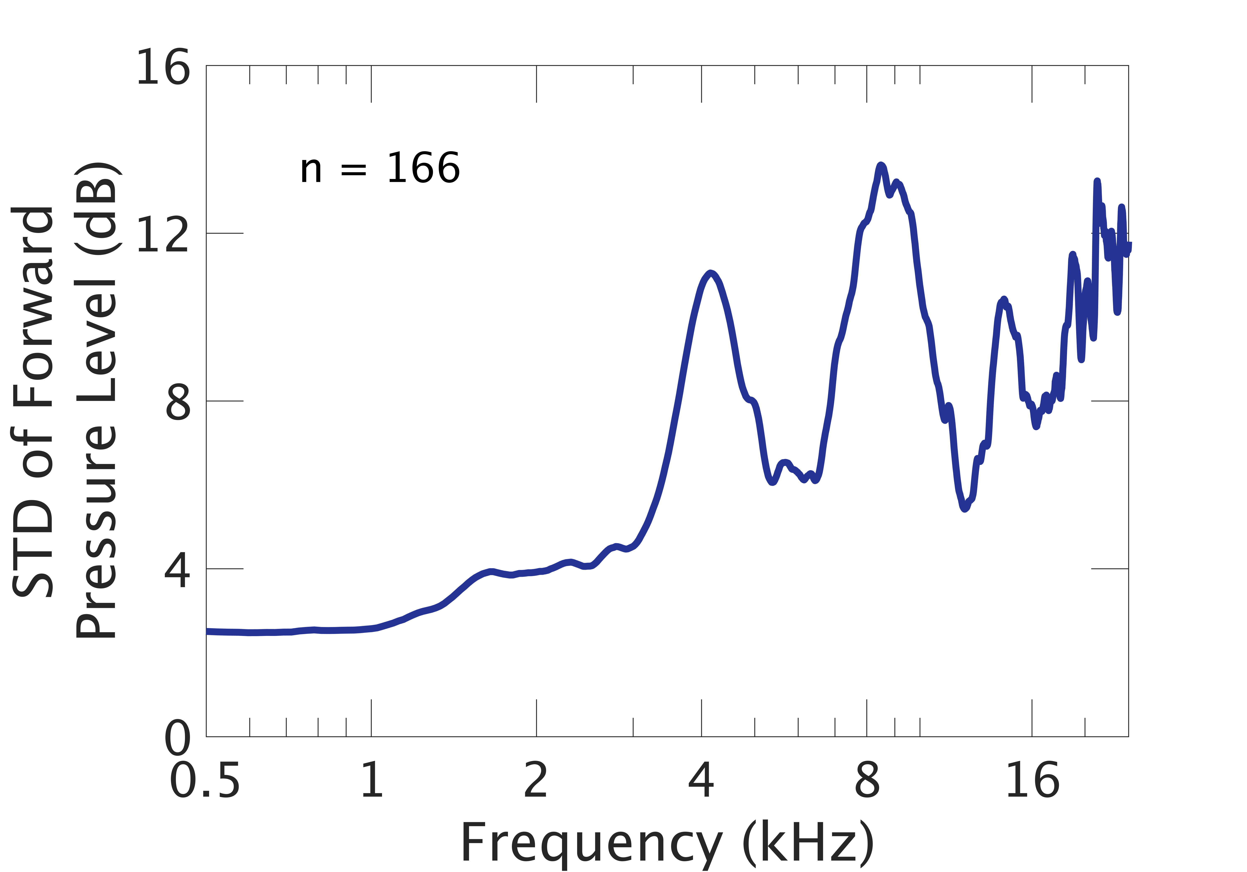
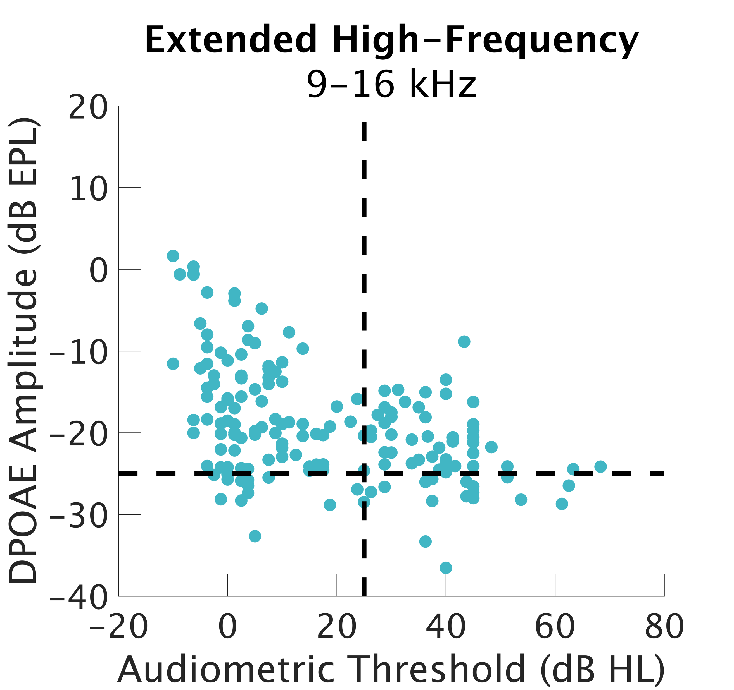
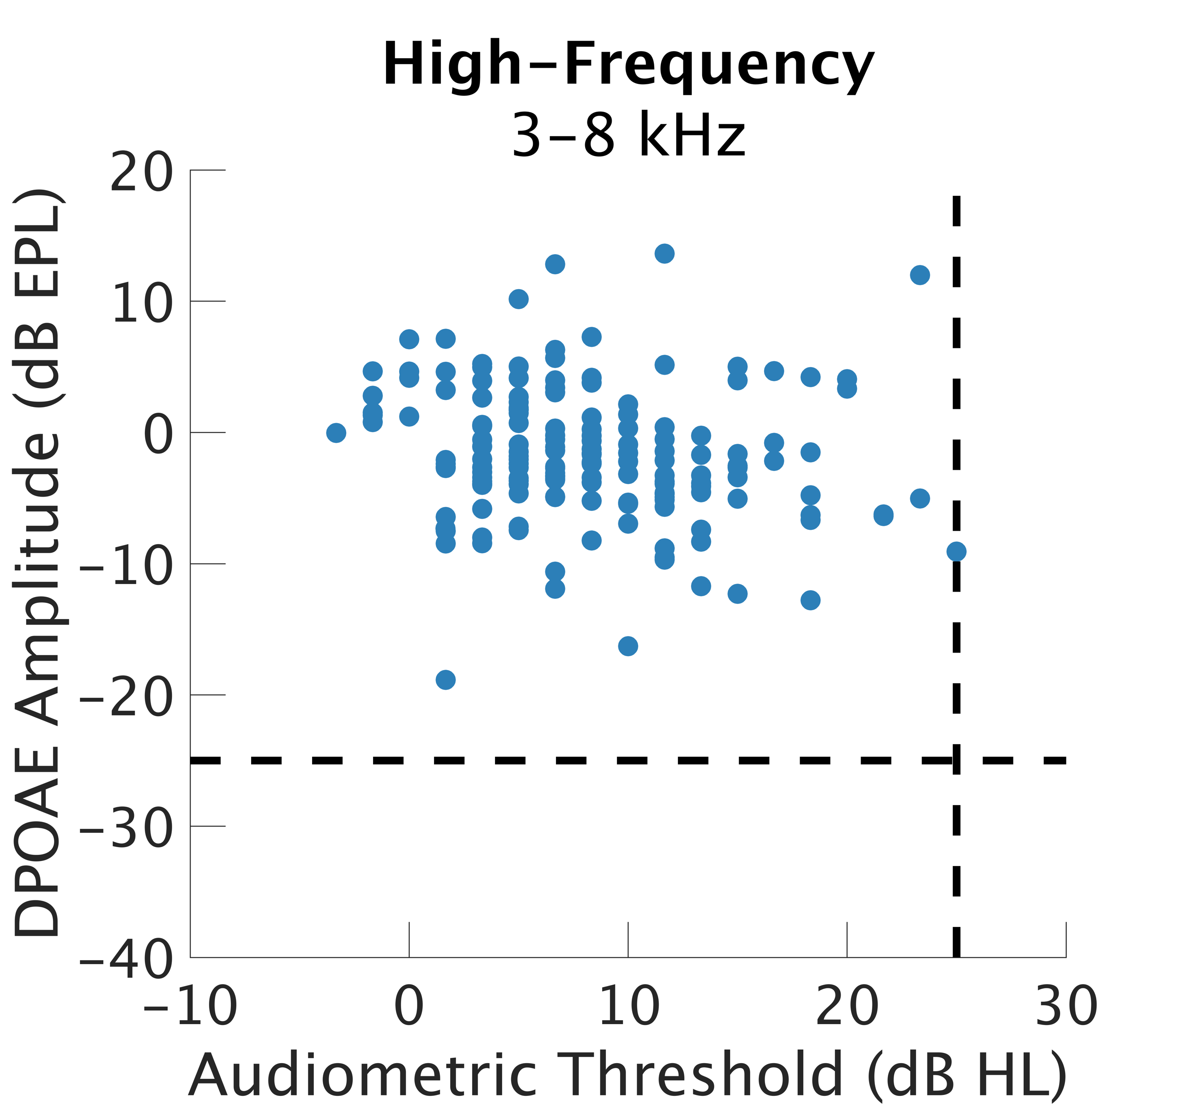
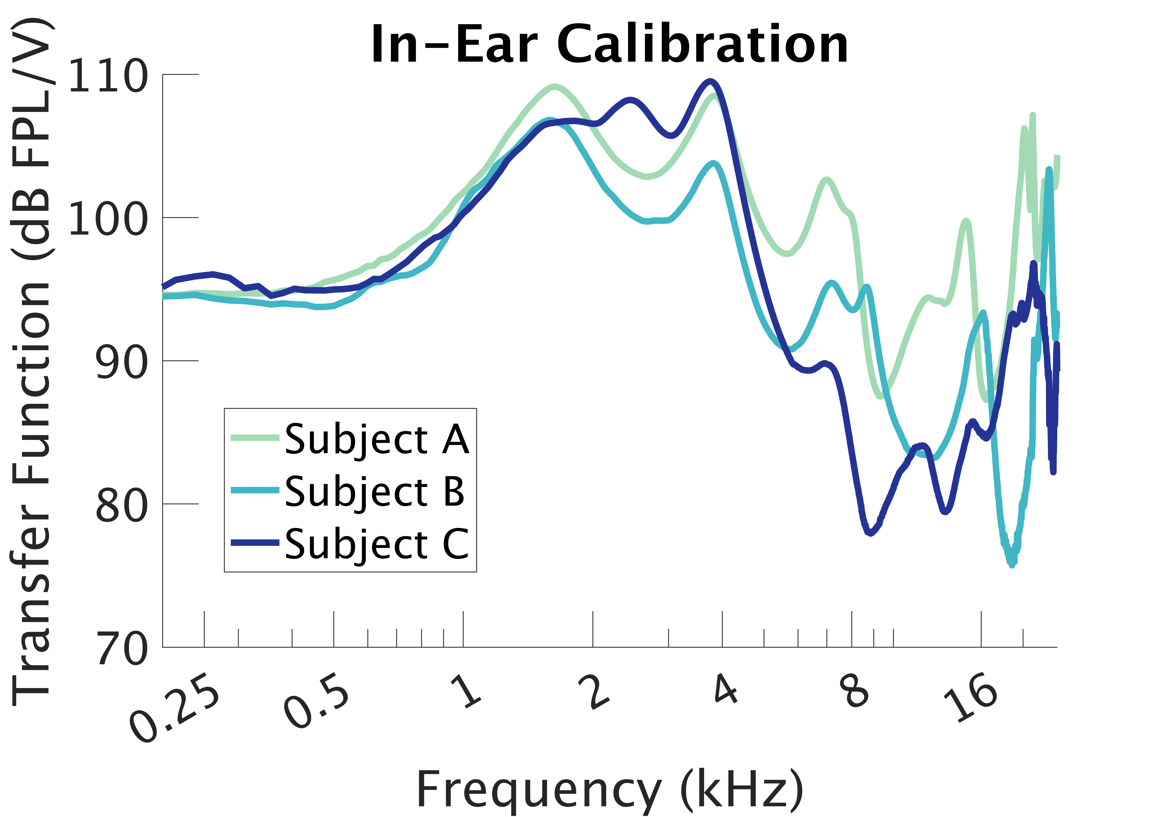
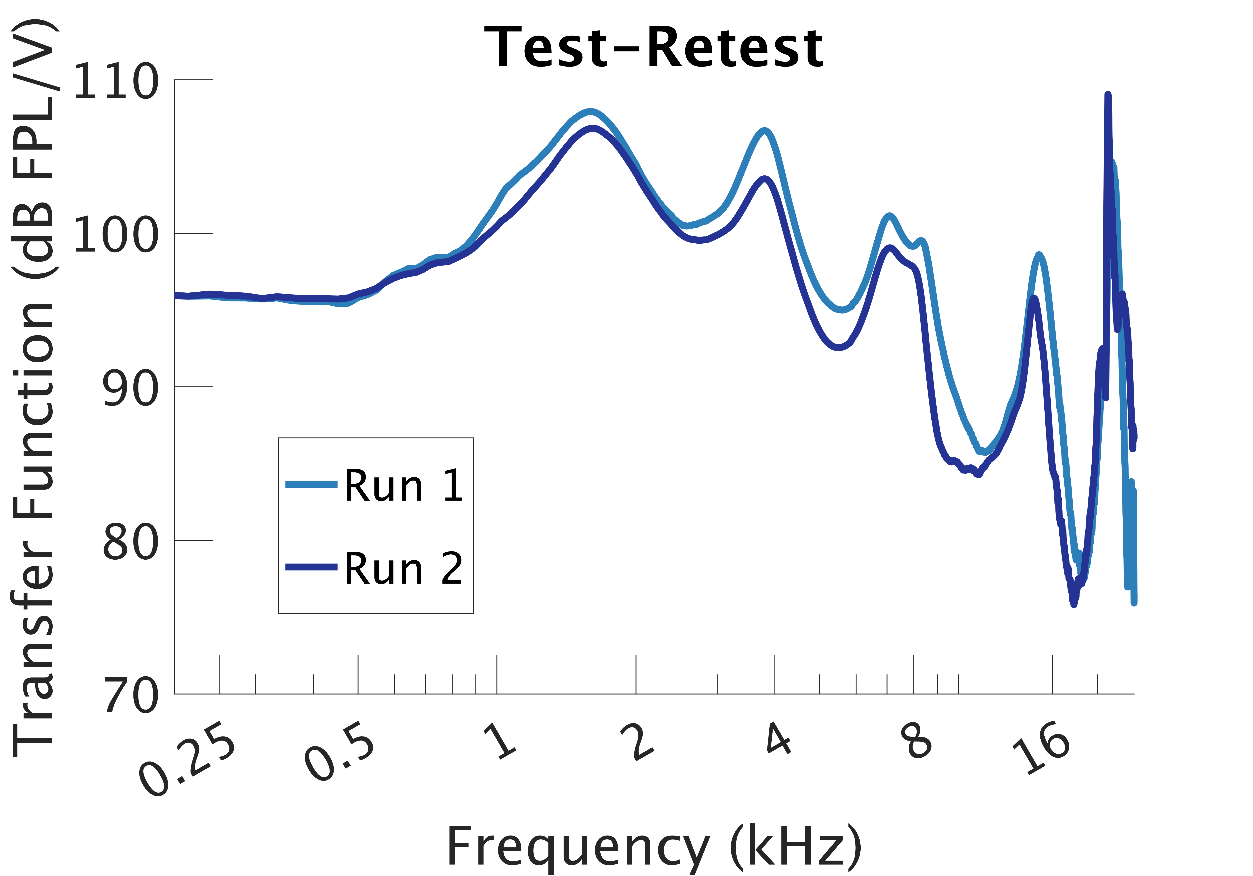
Relationship Between Distortion Product Otoacoustic Emissions and Audiometric Thresholds in the Extended High-Frequency Range
Samantha Hauser, AuD¹ , Anna Hagedorn, BS¹ , Alexandra Hustedt-Mai, AuD¹, Hari Bharadwaj, PhD²
¹Speech, Language and Hearing Sciences, Purdue University, ²Communication Science and Disorders, University of Pittsburgh
Introduction
Swept Distortion Product Otoacoustic Emissions
Effect of Age and Noise Exposure
Distortion product otoacoustic emissions (DPOAEs) are commonly used in the audiology clinic and in research as a measure of cochlear health, specifically outer hair cell function [X].
While clinical hearing assessment via behavioral audiometry is limited to 250-8000 Hz, the extended high-frequency hearing range is most susceptible to ototoxic medications, aging, and possibly acoustic over exposure.
Interpretation of high-frequency DPOAEs is complicated due to variation in emission amplitudes across repeated measures.
One source of variation is individual ear calibration methods. Traditional SPL calibration methods do not consider standing waves generated in the ear canal.
Newer methods that calculate forward pressure level (FPL) of stimuli and emitted pressure level (EPL) of the emission have been shown to reduce test-retest variability compared to SPL measures for either the stimulus or the emission. [1]
Audiometric thresholds increase with age
There was no differences between men and women.
Here we examined the relationship between behavioral audiometry and DPOAEs in the high-frequency and extended high-frequency ranges when using FPL/EPL calibration techniques.
Participants
166 individuals (61 male) age 18 – 60 years with normal audiometric thresholds from 250-8000 Hz.
Participants completed other audiological measures as part of a larger study on cochlear synaptopathy [2]. Because we required hearing to be within normal limits through 8000 Hz, some subjects had to be excluded. In particular, males and people aged 35-60.
Individual Swept Distortion Product Otoacoustic Emissions after Calibration
Swept DPOAEs were measured from 2-16 kHz.
Responses were windowed to isolate the distortion component, rather than calculate the mixed (D and R) components of the response.
FPL/EPL Calibration
The level at the OAE microphone underestimates the level at the eardrum due to standing waves in the ear canal.
Forward and backward traveling waves interact in the ear canal, preventing accurate measurement of sound levels in the ear.
This same problem occurs for the emission as it travels to the microphone.
Traditional SPL calibrations lead to significant variability in output, especially at high frequencies
Greatest variability is seen at frequencies near and above 4 kHz.
Ear canal acoustics differ significantly between ears and calibrations vary across test sessions.
Three subjects vary by as much as 20 dB depending on the location of peaks.
Probe placement within the ear canal also affects calibrations.
DPOAEs Correlate with Audiometric Thresholds
Conclusions
FPL/EPL calibrations reduce
Future Directions
We are measuring both distortion and reflection type emissions using swept DPOAE and swept SFOAE paradigms and expanding to include individuals with sensorineural hearing loss.
High Frequencies (3-8 kHz)
All participants had normal hearing sensitivity through 8 kHz. DPOAEs were present for all participants in the same frequency range.
DPOAE amplitude was negatively correlated with audiometric thresholds.
Extended High Frequencies (9-16 kHz)
54.2% of participants who presented with normal hearing in the extended high frequency range had present DPOAEs.
27.1% of participants with thresholds > 25 dB had DP amplitudes above the noise floor. 10.2% correct rejections. 8.4% had normal thresholds, but low DP amp.
References
Calibration Methods
Estimate Thevenin characteristics of probe using standard rigid tubes (ER-10X calibrator).
Estimate impedance, Z_{L}, of the ear at the entrance to the canal
Iteratively estimate characteristic impedance Z₀ of the ear canal by constraining time-domain reflectance to be causal (Rasetshwane & Neely, 2011)
Use Z₀ and Z_{L} to derive and control Forward Pressure Level (FPL).
References: [1] Maxim, Shera, Charaziak & Abdala, Ear Hear 2019. [2] Bharadwaj, Hustedt-Mai, Ginsberg, Dougherty, Muthaiah, Hagedorn, Simpson & Heinz, Comm Bio 2022 [3] Rasetshwane & Neely, J Acoust Soc Am. 2011
Acknowledgements: Funding was provided by NIH R01DC015989 (HB) and NIH T32- DC016853 (SH)

