Slide 1
Detecting and Disambiguating “Hidden” Cochlear Pathologies
Samantha Hauser
December 6, 2024
Data Science for Biologists 695
Final Project

Slide 2
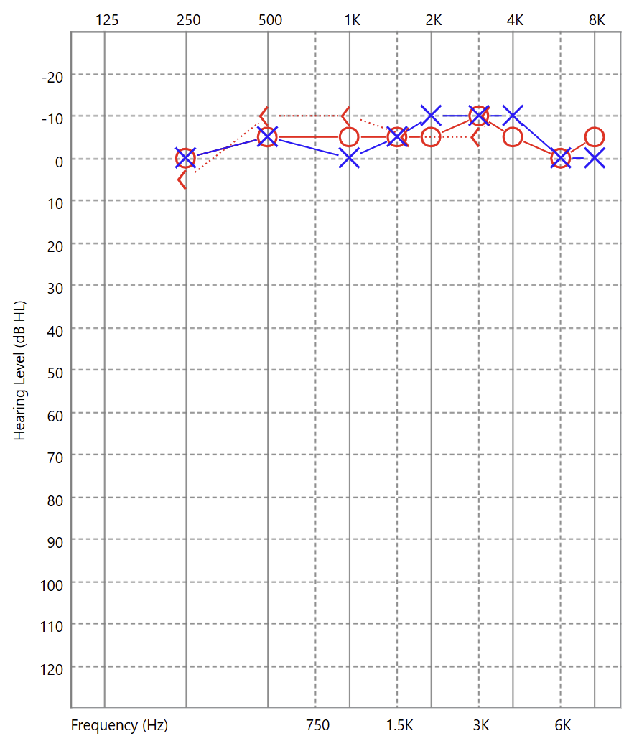
Introduction
Frequency (Hz)
Normal Hearing
Hearing is assessed by recording the level of the softest sound a person can hear in a sound booth across a range of frequencies that are important for speech (the audiogram).
The audiogram does not predict how well you hear in all situations.
It’s estimated ~12% of people with normal hearing still have some hearing difficulty (Tremblay, 2015).
Hearing Level (dB HL)
Hearing Loss

Slide 3
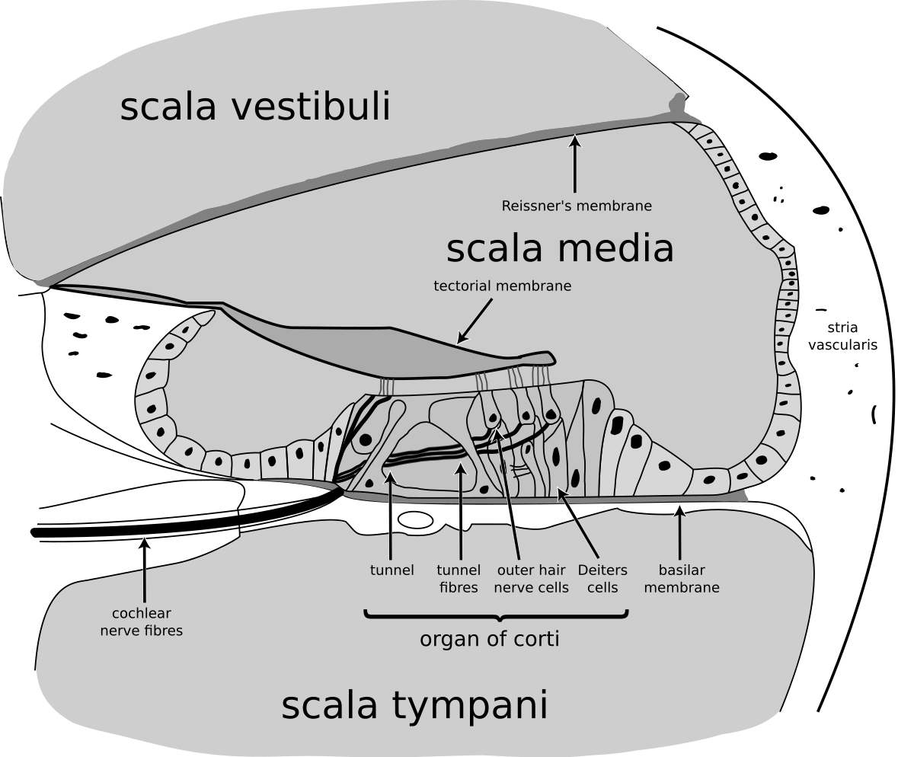
Introduction
The hearing test is not sensitive to all types of inner ear (cochlea) damage.
Some cochlear problems result in “Hidden Hearing Loss”
Two potential sites of hidden hearing loss are:
Inner Hair Cell Dysfunction
Cochlear Synaptopathy

Slide 4
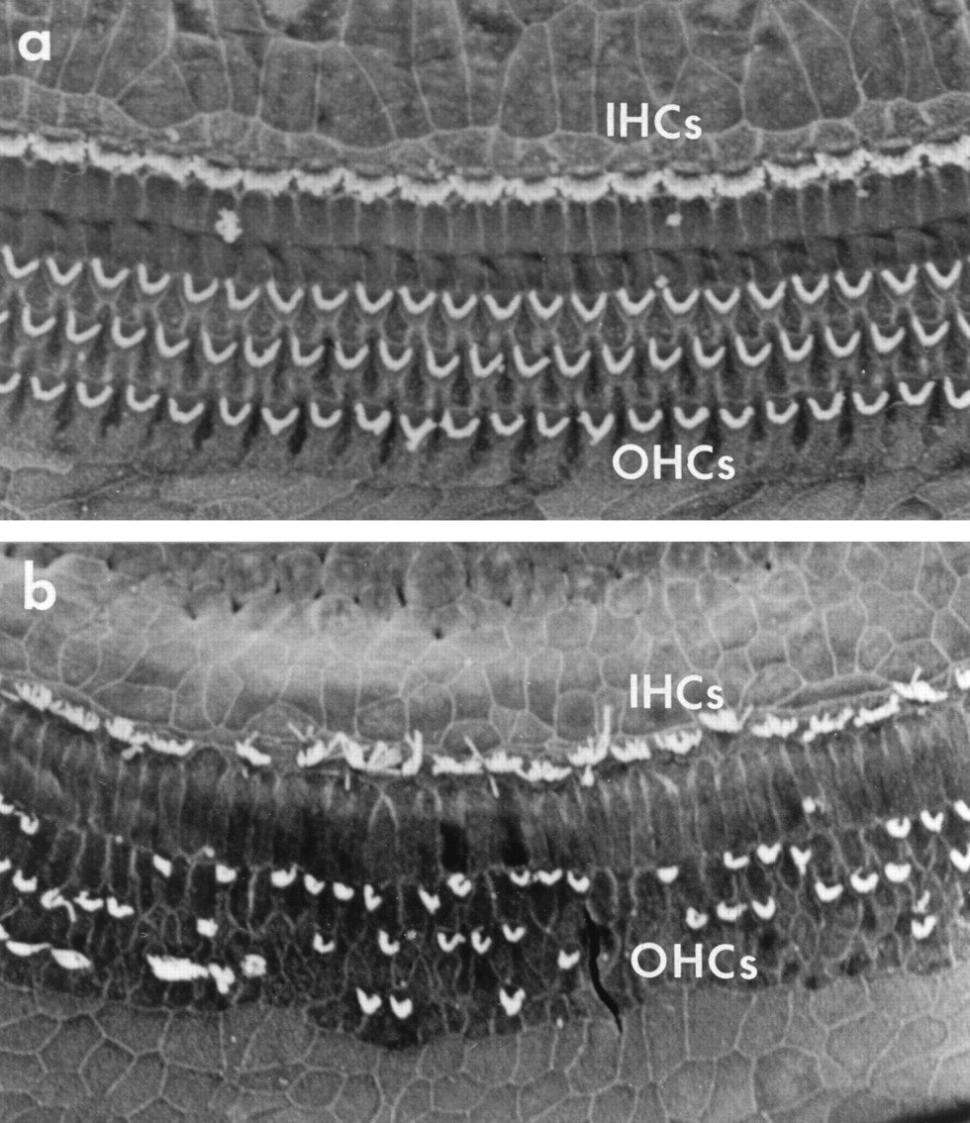
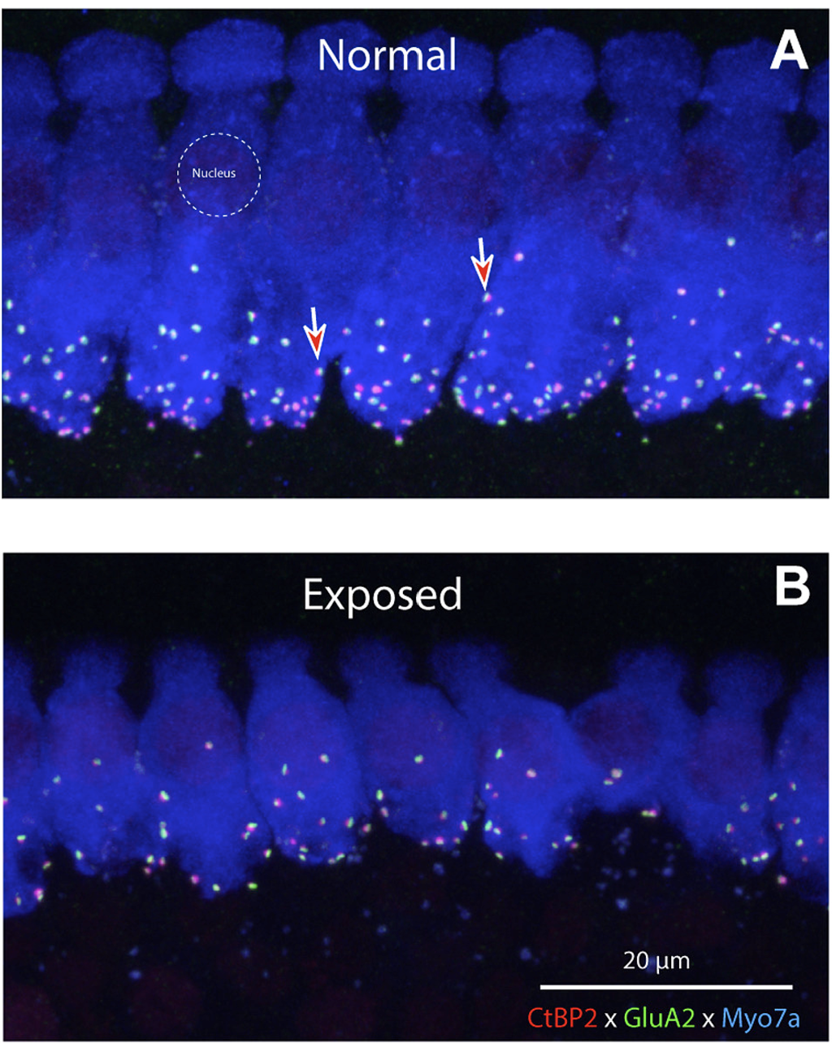
Introduction
Inner Hair Cell Dysfunction
Cochlear Synaptopathy
Ryan, 2000
Liberman & Kujawa, 2017

Slide 5
Introduction – Data Description
Chinchillas (n=16)
2 exposure groups
Inner hair cell (IHC) damage – CA
Cochear synaptopathy – TTS
4 biomarkers
Auditory Brainstem Response (ABR) – hearing test (shouldn’t be affected)
DPOAE – outer hair cells (shouldn’t be affected)
Middle Ear Muscle Reflex (MEMR) – TTS (and CA?)
Envelope Following Response to RAM – TTS (and CA?)

Slide 6
Methods – Data Processing
Data Collection
Pre-exposure
Data Processing
Calculate thresholds
Selection of Relevant Variables
Multiple frequencies?
Post-exposure
Convert from mic response
Sum or individual points?
Notes:
Pre-processing for organizing, filtering, datatypes transformed

Slide 7
Subject | Sex | Group
Q412 | M | TTS
Q441 | F | CA
Q430 | M | CA
… | … | …
Subject | Status | MEMR_threshold
Q412 | 0 | 65.4
Q412 | 2 | 68.2
… | … | …
Subject | Status | ABR_500 | ABR_1000 | ABR_...
Q412 | 0 | 24.23 | 8.51 | …
Q412 | 2 | 34.70 | 21.87 | …
… | … | … | … | …
Subject | Status | EFR
Q412 | 0 | 24.23
Q412 | 2 | 34.70
… | … | …
Subject | Status | DP_500 | DP_1000 | DP_...
Q412 | 0 | 15.87 | 21.22 | …
Q412 | 2 | 16.23 | 19.05 | …
… | … | … | … | …

Slide 8
Aims and Hypotheses
1. Are any of the biomarkers (ABR, EFR, MEMR, DPOAE) sensitive to inner hair cell damage or cochlear synaptopathy? i.e., are pre-exposure responses different from post-exposure responses?
ABR and DPOAEs will not be different before and after exposure since they are primarily driven by outer hair cell function rather than inner hair cell function. EFR amplitudes and MEMR thresholds will both be significantly worse in the post-exposure condition compared to the pre-exposure condition.
2. Does IHC damage affect the biomarkers differently than CS? i.e., are post-exposure responses for the two groups different across any of the individual biomarkers?
While both CS and IHC dysfunction will both reduce EFR amplitudes, MEMR thresholds will be reduced more in the TTS group than the CA group.
3. Can integration of results across biomarkers better differentiate the groups than a single biomarker alone?
Integration across all biomarkers will differentiate between the CA and TTS exposure groups better than any individual metric.

Slide 9
Methods – Data Processing
Data Collection
Pre-exposure
Data Processing
Calculate thresholds
Selection of Relevant Variables
Multiple frequencies?
Post-exposure
Convert from mic response
Sum or individual points?
Compiling Data
Pre and Post
Selection/Filtering
Group
Status
Measure
Difference
All measures
Reorganize by Frequency (as needed)
Pivot_longer
Combine metrics
Notes:
Pre-processing for organizing, filtering, datatypes transformed

Slide 10
Methods – Data Processing
Subject | Sex | Group | Status
Q412 | M | TTS | Pre
Q412 | M | TTS | Post
Q430 | M | CA | Pre
… | … | … | …
MEMR_threshold
65.4
68.2
71.34
…
EFR
24.23
34.70
43.1
…
DP_...
…
…
…
…
ABR_...
…
…
…

Slide 11
Methods – Data Processing
Subject | Status | DP_500 | DP_1000 | DP_...
Q412 | Pre | 15.87 | 21.22 | …
Q412 | Post | 16.23 | 19.05 | …
… | … | … | … | …
Subject | Sex | Group | Status | Freq | Amp.
Q412 | M | TTS | Pre | 500 | 15.6
Q412 | M | TTS | Pre | 1000 | 17.3
Q412 | M | TTS | Pre | 2000 | 16.9
Q412 | M | TTS | Pre | 4000 | 17.3
Q412 | M | TTS | Post | 500 | 14.6
Q412 | M | TTS | Post | 1000 | 13.2
… | … | … | … | --- | …

Slide 12
Methods - Analysis
Aim 1
Effect of Exposure
Aim 2
Difference in Groups
Aim 3
Biomarker Profiles
Calculate Pre-Post Difference
Plot change in each biomarker
Linear Models w/ Effect of Group
Filter to only Post-exposure Data
Visualize two groups
Linear models to test for differences between groups
Collapse Metrics
Select Model
Split data (train/test)
Check fit
Notes:
Methods to test hypotheses, flowcharts, bullet points

Slide 13
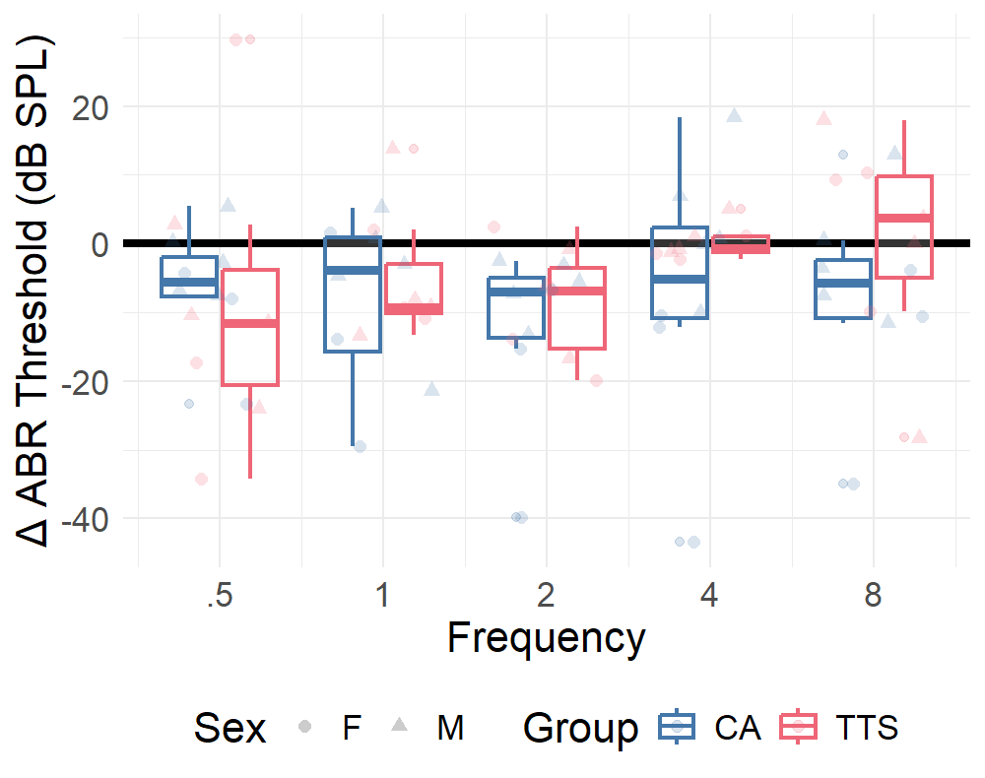
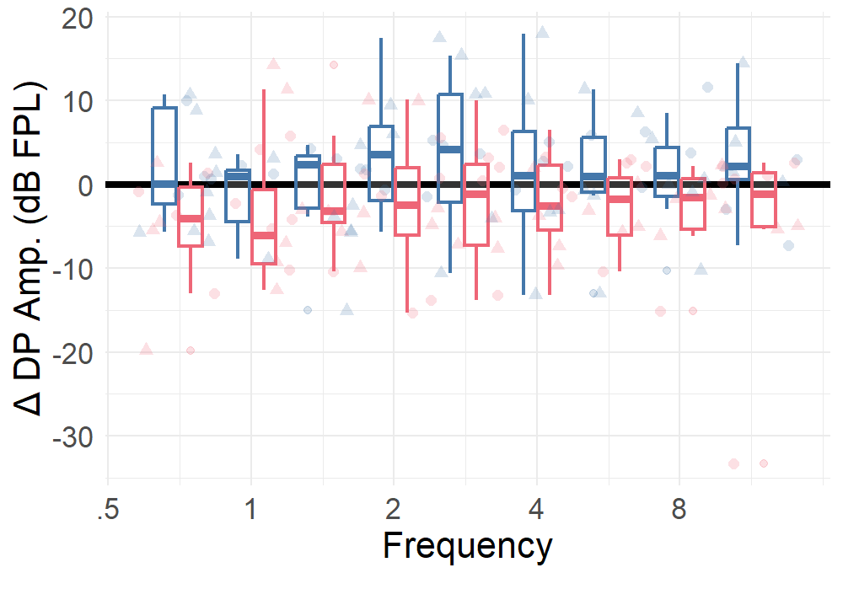
Aim 1 – Effect of Exposure
^{ABR}
^{DPOAE}
No effect of frequency
Significant effect of Group
GroupCA (t = -3.743, p = 0.0004)
GroupTTS (t=-2.362, p = 0.0208)
Significant effect of Group
GroupTTS (t=-2.803, p = 0.0058)
No effect of frequency

Slide 14
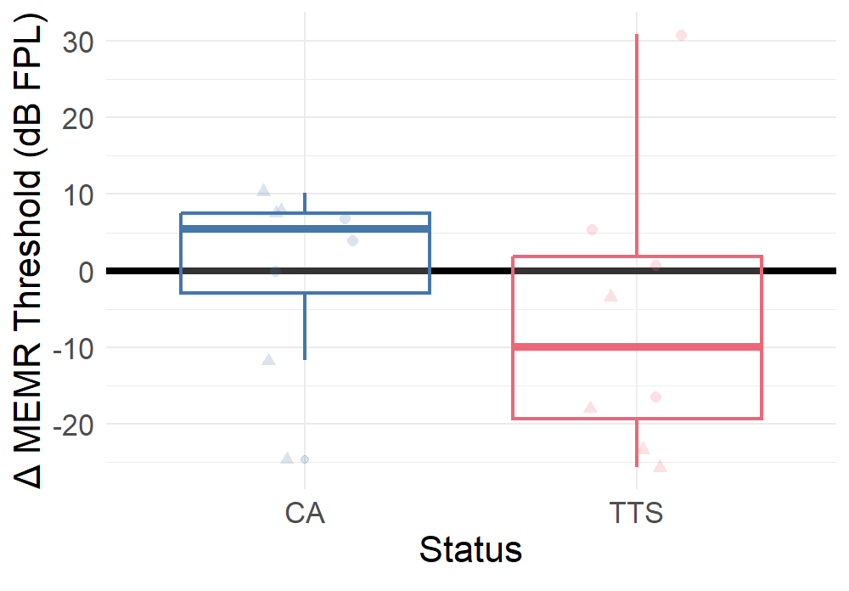
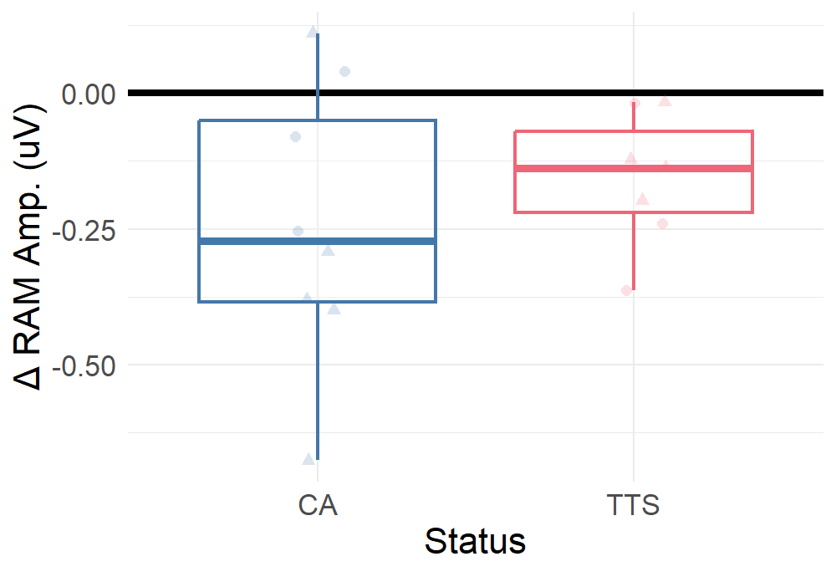
Aim 1 – Effect of Exposure
^{MEMR}
^{EFR}
Significant effect of Group
GroupCA (t = -3.302, p = 0.0057)
Almost…GroupTTS (t=-2.008, p = 0.0658)
No effect of Group

Slide 15
Aim 1 – Effect of Exposure
CA: Affects ABR and EFR
TTS: Affects DPOAEs

Slide 16
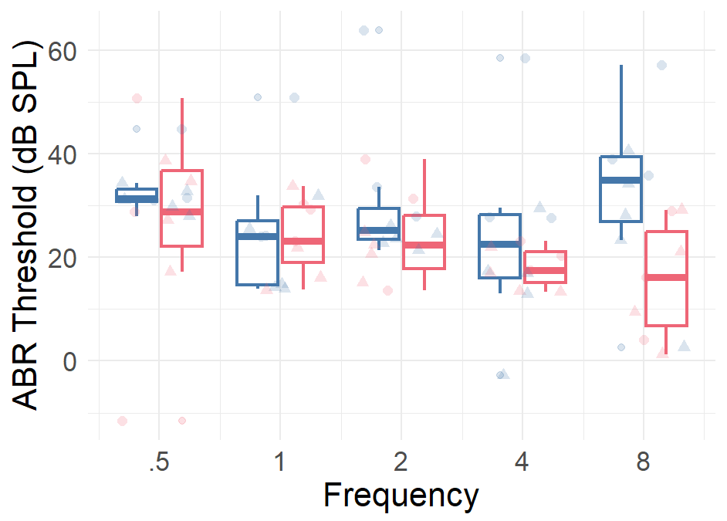
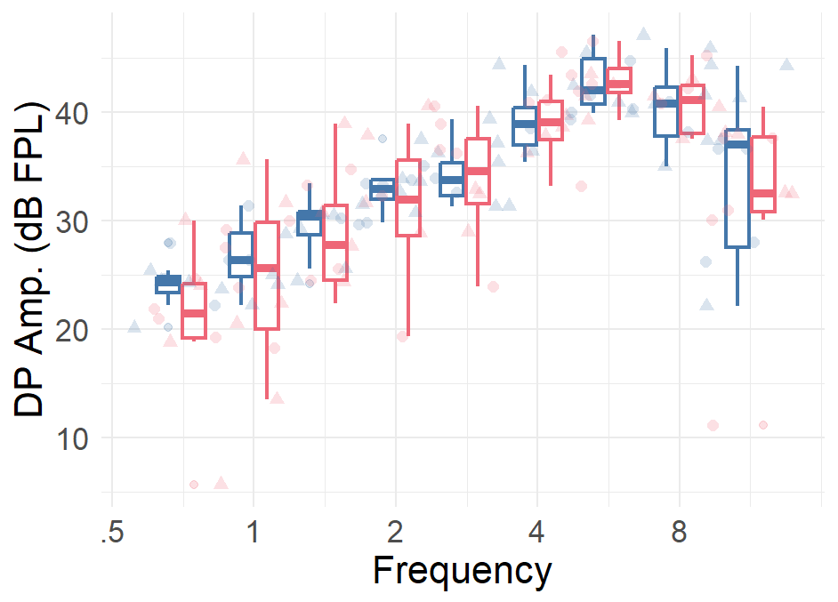
Aim 2 – Post-Exposure Comparison
^{ABR}
^{DPOAE}
No effect of frequency
Significant difference in Group
GroupTTS (t=-1.984, p = 0.0491)
No significant effect of Group
Significant effect of frequency

Slide 17
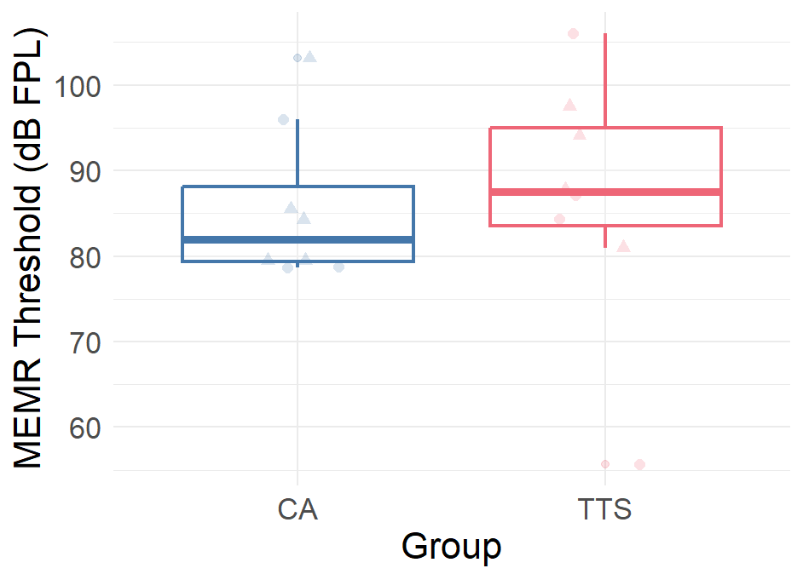
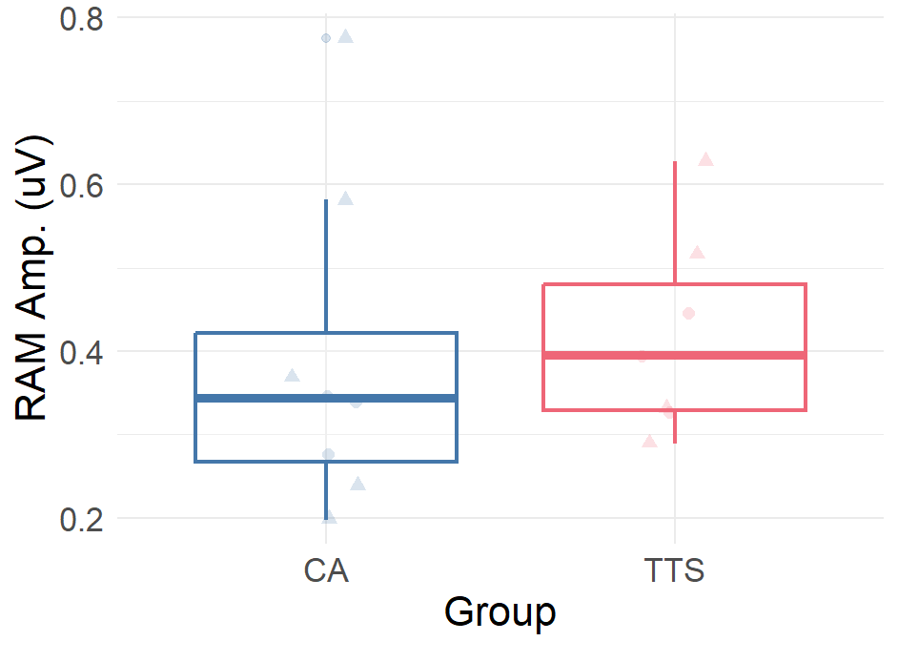
Aim 2 – Post-Exposure Comparison
^{MEMR}
^{EFR}
No significant effect of Group
No significant effect of Group

Slide 18
Aim 2 – Post-Exposure Comparison
ABRs differentiate CA and TTS groups

Slide 19
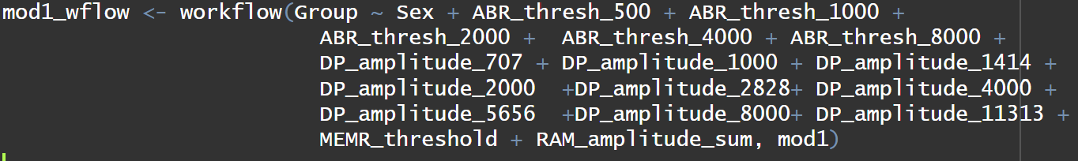
Results Aim 3 – Biomarker Profiles of HHL
6 | 5
0 | 0
Decision tree
Logistic regression
SVM
Random forest
Tuning parameters
Adding 3rd group (baseline)
PCA (& recipe steps)
TTS CA
Prediction
CA TTS
Truth

Slide 20
Conclusions
Aim 1:
These exposures may not be completely hidden
ABR shows changes from baseline in both groups
DPOAEs are worse with TTS
EFR worse with CA
Aim 2:
ABR is differentiates CA and TTS post-exposure
Aim 3:
Including more variables does not clearly differentiate between the post-exposure groups
Limited with small dataset
Perhaps other metrics would improve the fit

Slide 21
References
Tremblay KL, Pinto A, Fischer ME, Klein BE, Klein R, Levy S, Tweed TS, Cruickshanks KJ. Self-reported hearing difficulties among adults with normal audiograms: The Beaver Dam Offspring Study. Ear Hear. 2015;36(6): e290-299.
A.F. Ryan, Protection of auditory receptors and neurons: Evidence for interactive damage, Proc. Natl. Acad. Sci. U.S.A. 97 (13) 6939-6940, https://doi.org/10.1073/pnas.97.13.6939 (2000).
M. Charles Liberman, Sharon G. Kujawa, Cochlear synaptopathy in acquired sensorineural hearing loss: Manifestations and mechanisms, Hearing Research, Volume 349, (2017) 138-147, https://doi.org/10.1016/j.heares.2017.01.003.

