Slide 1

Lets learn… Multiple regression
Taylor Winter
Notes:
This is a very basic overview of regression

Slide 2
What is multiple regression ?
Multiple regression is a Generalised Linear Model
Uses a number of variables to predict an outcome
What does multiple regression tell us ?
Whether a variable predicts a given outcome
Strength of relationship between a predictor and predicted variable
Notes:
A lot of models we may have used, t-tests and ANOVA, are in fact types of linear regression.
Although we are using the word ‘predict’, do note that this doesn’t imply either a causal or temporal connection between variables.
In Psychology, we often see ‘dependent variable’ being used in lieu of outcome or predicted variable. Similarly we see ‘independent variable’ being used in lieu of predictor.

Slide 3

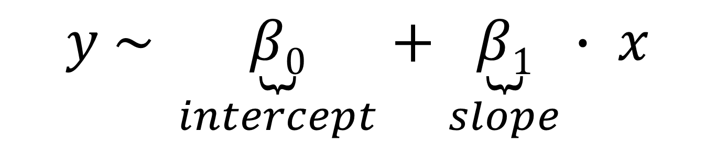
What does a regression equation look like ?
$$y \sim x$$
We need two extra parameters to understand the relationship…
$$y \sim \underset{intercept}{\underbrace{β0}}+\underset{slope}{\underbrace{β1}}∙ x$$
Notes:
Above is the most basic type of regression model, we are trying to predict y, the outcome, using x, the predictor.
You might wonder why we have a squiggle, tilde, instead of equals.
In this case, we assume the outcome is always going to be some continuous variable, such as age, stress, or height.
This model is exactly as it would be entered into a statistical package such as R.
To determine the relationship between x and y, we would add two parameters: An intercept and a slope, denoted by Beta. The example will make it more clear as to how we utilise these two estimates.

Slide 4
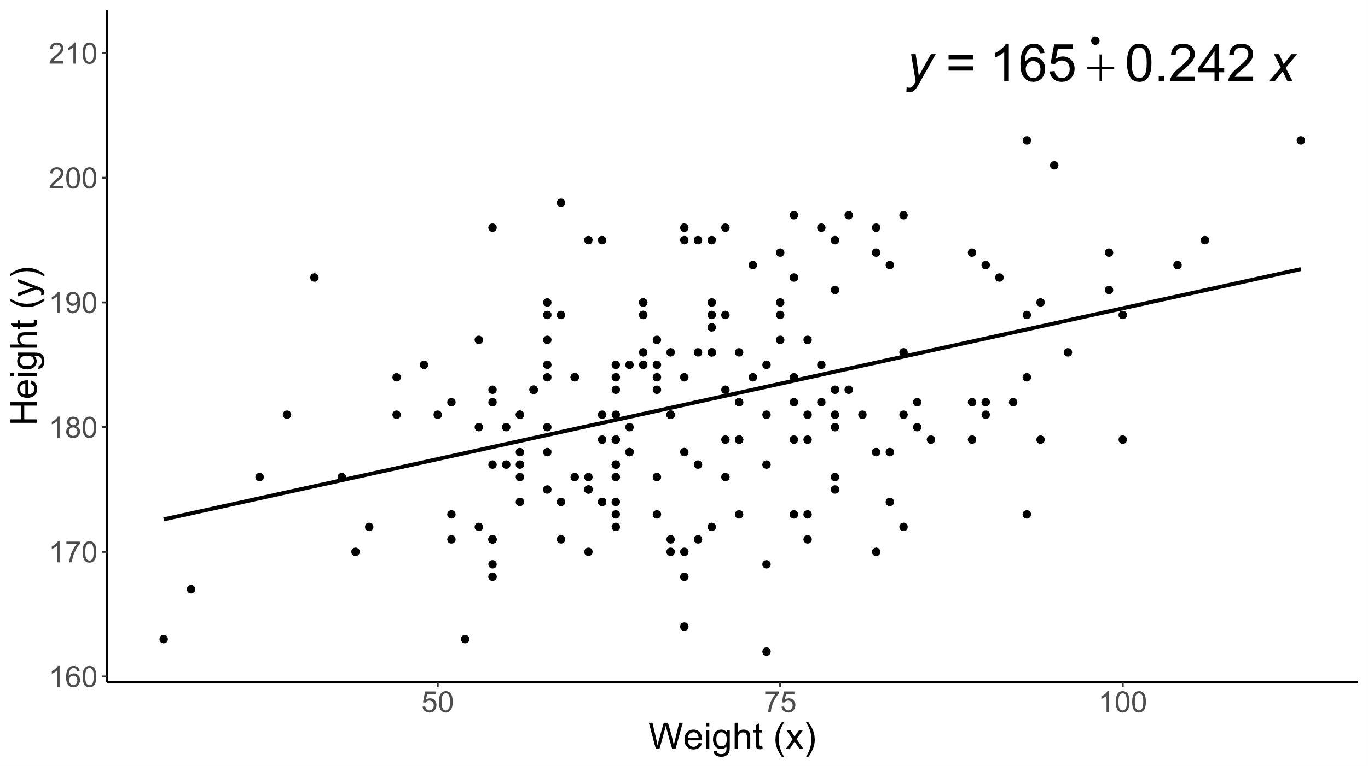
Example: Single continuous predictor
Notes:
How do we interpret the above numbers ?
In this example, we are predicting height based on peoples weight (think which is the dependent and independent variable).
If we look at the line going through our data, known as the line of best fit, and drew it out to a weight of zero kg, it would intersect at a height of 165cm. You may wonder why it doesn’t look like it here, its simply because our axis are broken.
The number 0.242 is the amount of increase in height we observe after a one unit, or one kg, increase in weight.
You can see how you might fit in this model by taking your own weight, multiplying by 0.242, and then adding 165.
How this is simple regression, but we very quickly want to consider what it looks like if we had multiple predictors.

Slide 5
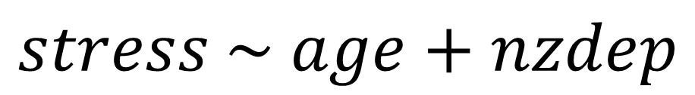
Example: Two continuous predictors
$$stress \sim age+nzdep$$
$$stress \sim β0+β1age+β2nzdep$$
Regression coefficients predicting levels of stress
 | Estimate | Std. Error | t value | Pr(>|t|)
(Intercept) | 3.756 | 0.167 | 22.545 | p < 0.001
age | -0.027 | 0.002 | -11.414 | p < 0.001
nzdep | 0.212 | 0.016 | 12.898 | p < 0.001
Notes:
Here we have stress being predicted by age and the level of deprivation someone lives in (explain variables and dataset).
Instead of having a single beta coefficient, we now have two, one slope for each variable.
Also, I have now included an example output from R (show how each estimate matches up to a beta coefficient).
We ignore t-values and p-values for now, we want to focus on understanding how the coefficients work together to predict an outcome
As we did above, we can take the intercept, add a slope effect for age, then for nzdep. Effects are additive because they are independent of one another.
One thing you may note, is that both variables are continuous. In reality, there are a bunch of different variable types we need to consider though.

Slide 6
What other variable types can we use ?
Continuous (e.g. Age, IQ)
Are two datapoints are different
Is one datapoint higher than another
How far apart two are datapoints
Ordinal (e.g. Qualification, Likert)
Are two datapoints are different
Is one datapoint higher than another
Categorical (e.g. Sex, Ethnicity)
Are two datapoints are different
Notes:
So what does it look like if we use a categorical variable to predict an outcome ?

Slide 7
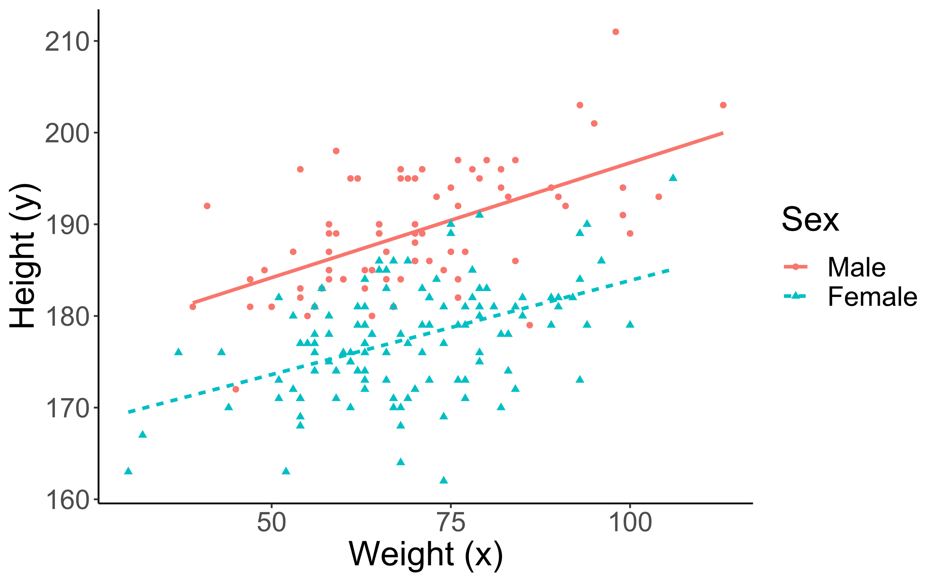
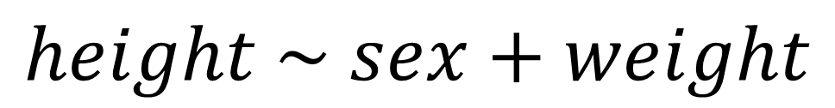
Example: Continuous and categorical predictors
$$height \sim sex+weight$$
Summary of regression coefficients predicting height
 | Estimate | Std. Error | t value | Pr(>|t|)
(Intercept) | 173.428 | 1.973 | 87.882 | p < 0.001
sexFemale | -11.450 | 0.785 | -14.596 | p < 0.001
weight | 0.225 | 0.027 | 8.391 | p < 0.001
Notes:
Here we go back to our original example of height and weight, but we suspect sex may also tell us a lot about a samples heights.
Instead of modelling a slope, we are now modelling a change in the intercept for sex.
You may wonder why our results say ‘sexFemale’. This is because with categorical variables, your linear model will pick one category to include in the intercept, and then simple model the other categories as a difference or deviation from the intercept.
If we step through it again, in this case, we would take our weight multiplied by 0.225, if we are female, we would subtract 11cm, then add the intercept of 173cm to, hopefully, get a height much closer to your own (which on average should be true).
A quick note, if we were modelling say ethnicity, one ethnicity would be included in the intercept, and then we would have one intercept estimate for each other ethnicity in our results section.

Slide 8
Pitstop: Where are we at now ?
We determine the association between an outcome or dependent variable using one or more predictors or independent variables.
We can use a number of variable types: Continuous, Ordinal, Categorical
All regression models give us an intercept, then a slope for continuous variables or intercept for categorical variables
Effects are independent and therefore additive, one variable does not depend on the other.

Slide 9
What if effects are not additive ?
We might expect variables to react with each other
If one variable increases, it results in an even bigger increase in another variable
If we assume exercise reduces stress, perhaps younger people see a bigger reduction in stress than older people.
Perhaps a variable influences an outcome for one group but not another
Perhaps the relationship between height and weight is smaller for females relative to males

Slide 10
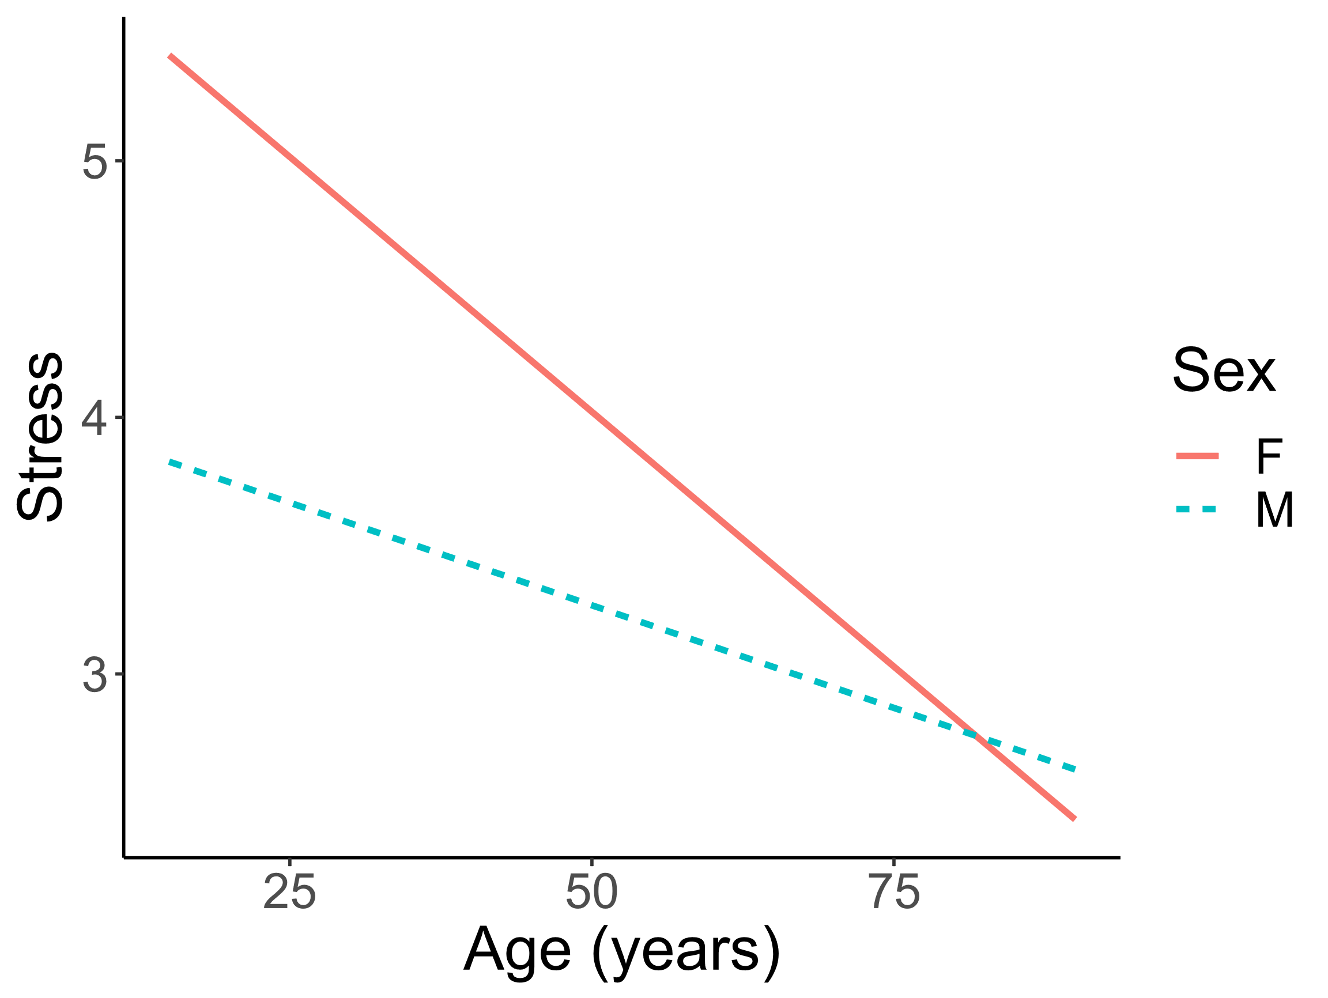
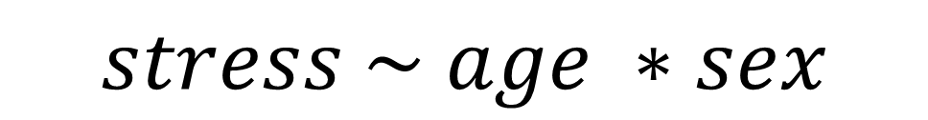
Example: Continuous and categorical interaction
$$stress \sim age ∗sex$$
$$stress \sim β0+β1age+β2sex+β3age:sex$$
Summary of regression coefficients predicting levels of stress
 | Estimate | Std. Error | t value | Pr(>|t|)
(Intercept) | 6.0079 | 0.1657 | 36.2523 | p < 0.001
age | -0.040 | 0.003 | -12.610 | p < 0.001
sexM | -1.941 | 0.253 | -7.681 | p < 0.001
age:sexM | 0.024 | 0.005 | 4.941 | p < 0.001
Notes:
This model above is how you would enter the model in R, and we use the asterisk, *, to denote an interaction between two variables.
When we enter this model, it gets broken down into two main effects, and then a third effect which is the product of the two variables.
The extra effect gets given its own parameter/coefficient.
In our example we determined that as age increases, stress decreases, but we want to know if a decrease in stress associated with age is larger for one sex relative to the other.
We can see that as age increases, females undergo a large decrease in their level of stress relative to males. However, because of the main effect of sex, females have a higher intercept (walk through how you add the effects).

Slide 11
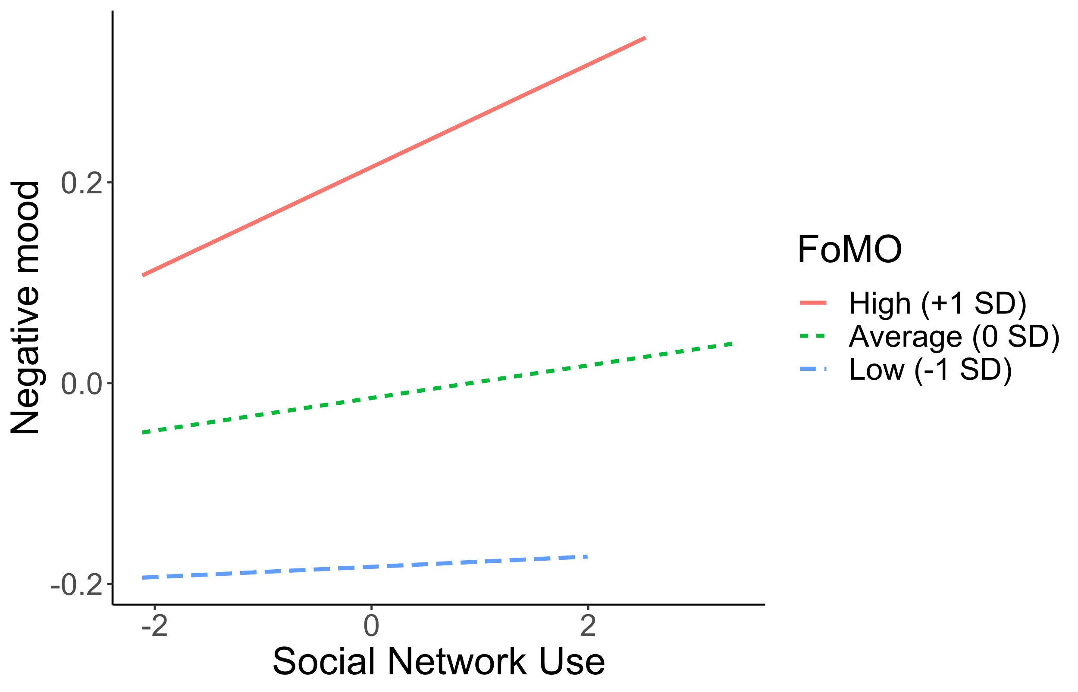
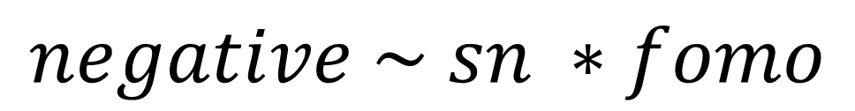
Example: Interaction between continuous variables
$$negative \sim sn ∗fomo$$
Summary of regression coefficients predicting negative affect
 | Estimate | Std. Error | t value | Pr(>|t|)
(Intercept) | -0.0087 | 0.0074 | -1.1694 | 0.2423
sn | 0.014 | 0.008 | 1.760 | 0.0785
fomo | 0.133 | 0.008 | 17.803 | 0
sn:fomo | 0.039 | 0.008 | 5.139 | 0
Notes:
Describe dataset and the model
In this case we have two continuous variables interaction with each other.
The interaction term, in this case, is the product of the two variables.
As both predictors are continuous, it gets a little more complicated to understand, typically we split one variable into upper, average, and lower groups to ease interpretation (describe the interaction effect).

Slide 12
Wrapping up
We can predict an outcome using one or more variables of different types.
We can interpret one or more coefficients, which are either slopes or intercept differences.
We can cheat with interaction terms, allowing us to model dependence between variables.
Tutorial on what we learnt using R: https://github.com/haututu/regressionLectures

Slide 13

Questions and discussion

