Slide 1

Multiple Regression
Taylor Winter
Victoria University of Wellington

Slide 2
What is multiple regression ?
Uses two or more variables to understand the variance in an outcome.
  The variables used to understand variance are independent variables (IVs)
  The outcome is a dependent variable (DV).
Notes:
A lot of models we may have used, t-tests and ANOVA, are in fact types of linear regression.
Although we are using the word ‘predict’, do note that this doesn’t imply either a causal or temporal connection between variables.
In Psychology, we often see ‘dependent variable’ being used in lieu of outcome or predicted variable. Similarly we see ‘independent variable’ being used in lieu of predictor.

Slide 3


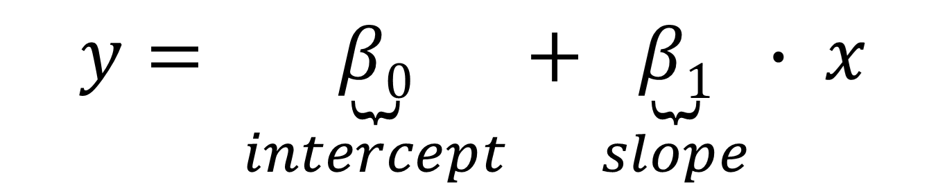
What does a regression equation look like ?
We introduce a new symbol to connect IV and DV
Notes:
Above is the most basic type of regression model, we are trying to predict y, the outcome, using x, the predictor.
You might wonder why we have a squiggle, tilde, instead of equals.
In this case, we assume the outcome is always going to be some continuous variable, such as age, stress, or height.
This model is exactly as it would be entered into a statistical package such as R.
To determine the relationship between x and y, we would add two parameters: An intercept and a slope, denoted by Beta. The example will make it more clear as to how we utilise these two estimates.

Slide 4
What does multiple regression tell us ?
Whether an independent variable is associated with the dependent variable
Strength of relationship between dependent and independent variables
How much variance can be explained by the independent variables

Slide 5
Does weight predict height ?
Data
  Synthetic sample of 200 adolescents at Otago
Variables
  Height in centimetres
  Weight in kilograms
  Sex – male/female
Questions
  Does height increase as weight increases ?

Slide 6
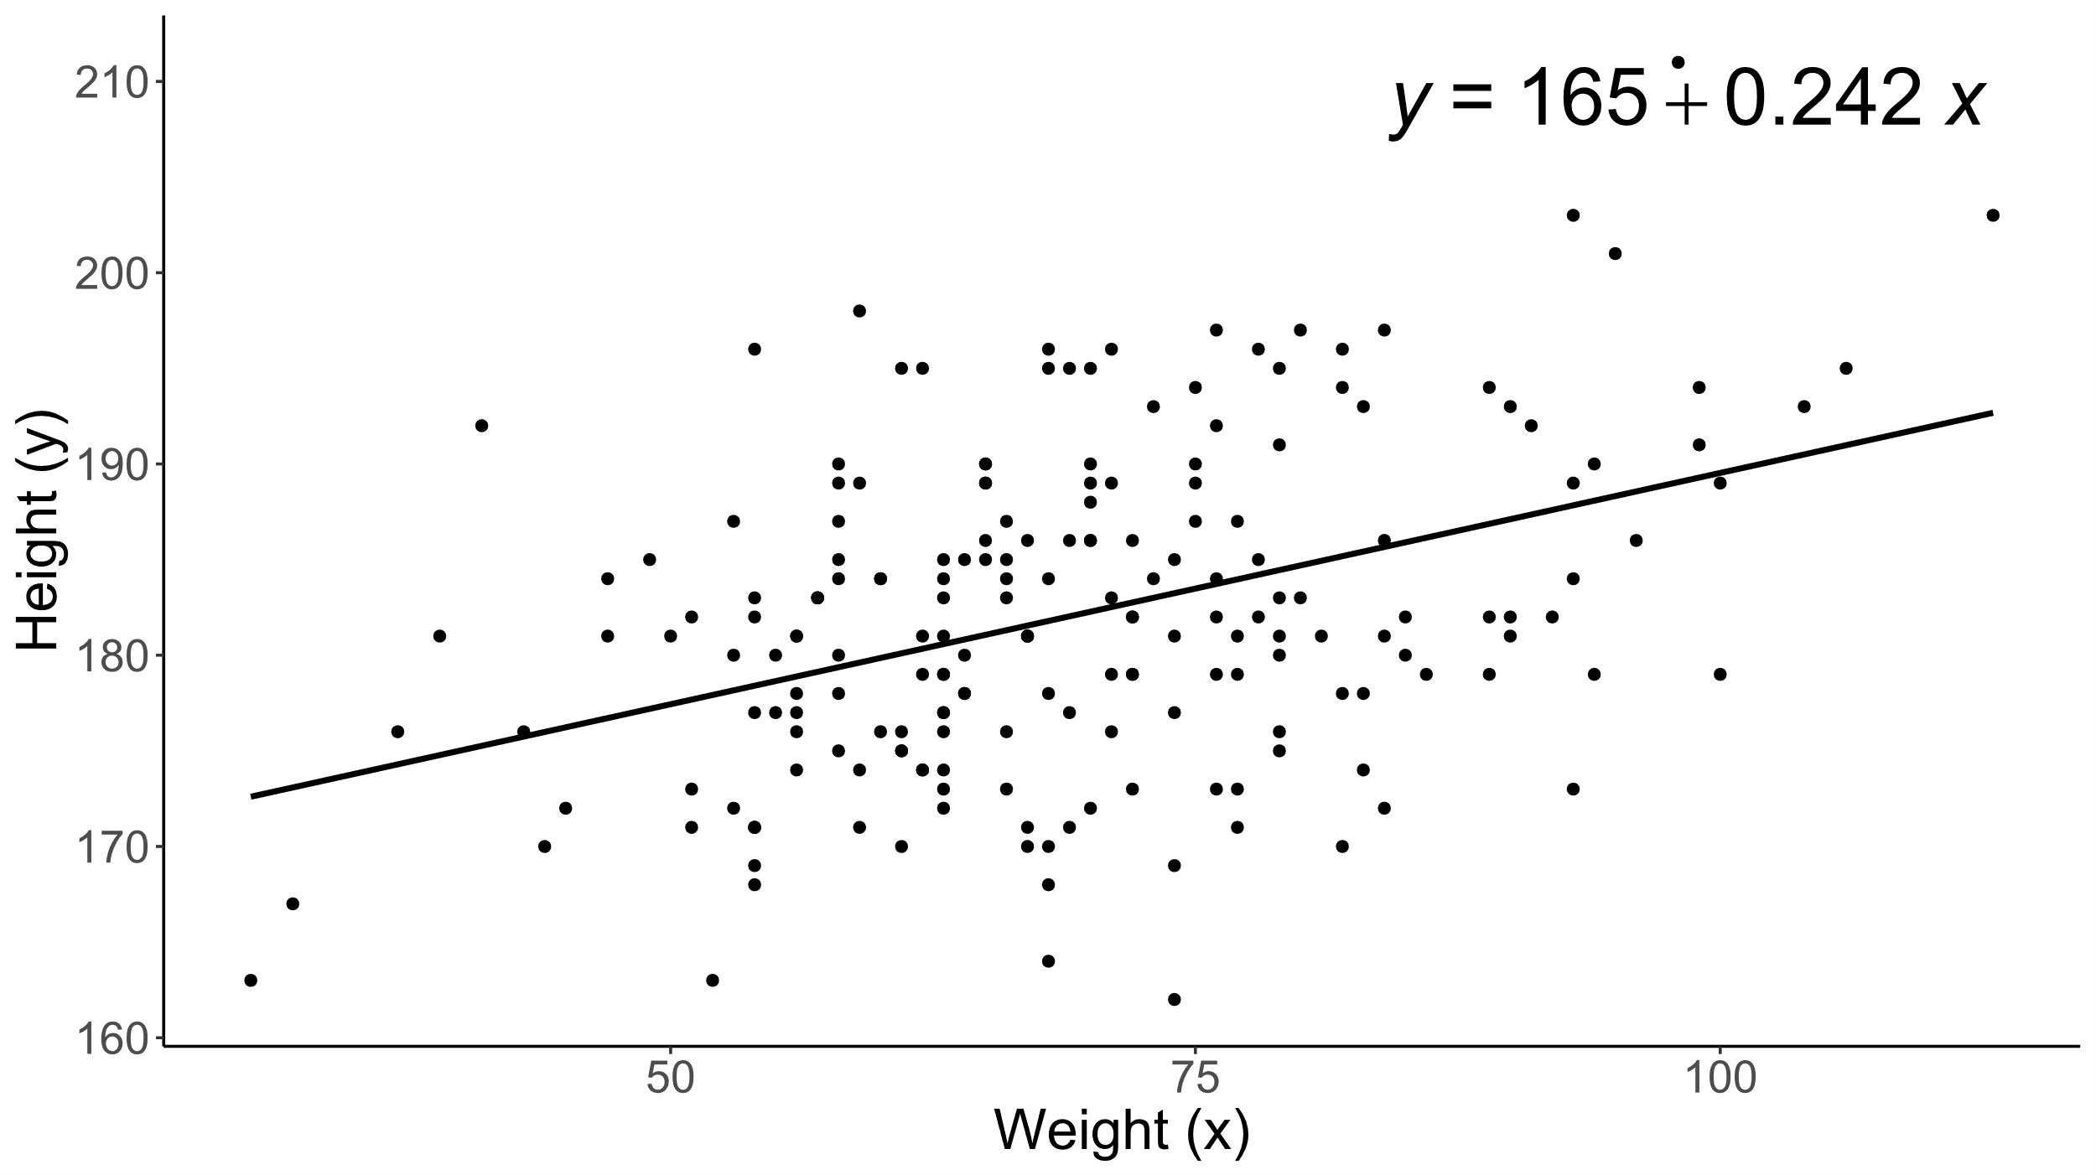
Example: Single continuous predictor
Notes:
How do we interpret the above numbers ?
In this example, we are predicting height based on peoples weight (think which is the dependent and independent variable).
If we look at the line going through our data, known as the line of best fit, and drew it out to a weight of zero kg, it would intersect at a height of 165cm. You may wonder why it doesn’t look like it here, its simply because our axis are broken.
The number 0.242 is the amount of increase in height we observe after a one unit, or one kg, increase in weight.
You can see how you might fit in this model by taking your own weight, multiplying by 0.242, and then adding 165.
How this is simple regression, but we very quickly want to consider what it looks like if we had multiple predictors.

Slide 7
How do we know if the model is useful ?
We select coefficients that explain the most variance in the outcome
We can find the overall variance using R²
  If R² = 0 then it’s the worst possible model
  If R² = 1 then it’s the best possible model… but probably bad (overfitting)
  Typically between an R² between 0.2 and 0.6 is what we see in Psychology
Proportion R² explained by each variable is used to estimate p-values
The size of effect, p-values, and confidence intervals indicate whether we reject the null-hypothesis

Slide 8
Is age and deprivation associated with stress?
Data
  New Zealand Health Survey
  10,000 nationally representative participants
Variables
  Stress (20-50); lower is better
  Deprivation (1-10); higher is worse
  Age in years
Questions
  Does your level of stress change as you age ?
  Is the level of socio-economic deprivation associated with stress ?

Slide 9
Example: Two continuous predictors
r² = 0.02
Regression coefficients predicting levels of stress
 | Estimate | Std. Error | t value | Pr(>|t|)
(Intercept) | 3.756 | 0.167 | 22.545 | p < 0.001
age | -0.027 | 0.002 | -11.414 | p < 0.001
nzdep | 0.212 | 0.016 | 12.898 | p < 0.001
Notes:
Also, I have now included an example output from R (show how each estimate matches up to a beta coefficient).
We ignore t-values and p-values for now, we want to focus on understanding how the coefficients work together to predict an outcome
As we did above, we can take the intercept, add a slope effect for age, then for nzdep. Effects are additive because they are independent of one another.
One thing you may note, is that both variables are continuous. In reality, there are a bunch of different variable types we need to consider though.

Slide 10
Different types of variable
Continuous (e.g. Age, IQ)
  Are two datapoints different?
  Is one datapoint higher than another?
  How far apart two are datapoints?
Ordinal (e.g. Qualification, Likert)
  Are two datapoints different?
  Is one datapoint higher than another?
Categorical (e.g. Sex, Ethnicity)
  Are two datapoints different?
Notes:
So what does it look like if we use a categorical variable to predict an outcome ?

Slide 11
Is sex and weight associated with height ?
Data
  Synthetic sample of 200 adolescents at Otago
Variables
  Height in centimetres
  Weight in kilograms
  Sex – male/female
Questions
  Does height increase as weight increases ?
  Do males have different average heights to females ?

Slide 12
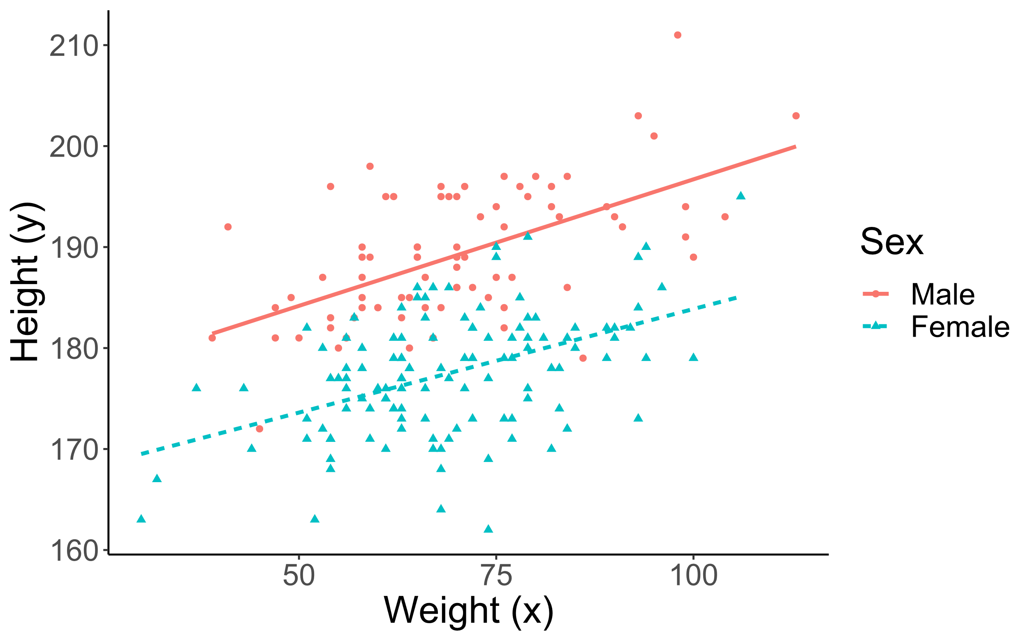
Example: Continuous and categorical predictors
r² = 0.6
Summary of regression coefficients predicting height
 | Estimate | Std. Error | t value | Pr(>|t|)
(Intercept) | 173.428 | 1.973 | 87.882 | p < 0.001
Sex: female - male | -11.450 | 0.785 | -14.596 | p < 0.001
weight | 0.225 | 0.027 | 8.391 | p < 0.001
Notes:
Here we go back to our original example of height and weight, but we suspect sex may also tell us a lot about a samples heights.
Instead of modelling a slope, we are now modelling a change in the intercept for sex.
You may wonder why our results say ‘sexFemale’. This is because with categorical variables, your linear model will pick one category to include in the intercept, and then simple model the other categories as a difference or deviation from the intercept.
If we step through it again, in this case, we would take our weight multiplied by 0.225, if we are female, we would subtract 11cm, then add the intercept of 173cm to, hopefully, get a height much closer to your own (which on average should be true).
A quick note, if we were modelling say ethnicity, one ethnicity would be included in the intercept, and then we would have one intercept estimate for each other ethnicity in our results section.

Slide 13
What if effects are not additive ?
We might expect variables to interact with each other
If one variable increases, it results in an even bigger increase in another variable
  E.g., younger people see a bigger reduction in stress after exercise.
  This is an example of continuous moderation
A variable can influence an outcome for one group but not another
  E.g., the relationship between height and weight is smaller for females relative to males
  This is an example of categorical moderation

Slide 14
Does sex moderate the effect of age on stress
Data
  New Zealand Health Survey
  10,000 nationally representative participants
Variables
  Stress – Ten questions giving score between 10 and 50
  Age in years
  Sex – male/female
Questions
  Does your level of stress change as you age ?
  Doe males have different levels of stress to females ?
  Do males have a smaller reduction in stress due to age, relative to females?

Slide 15
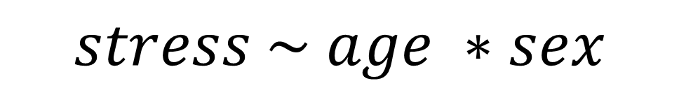
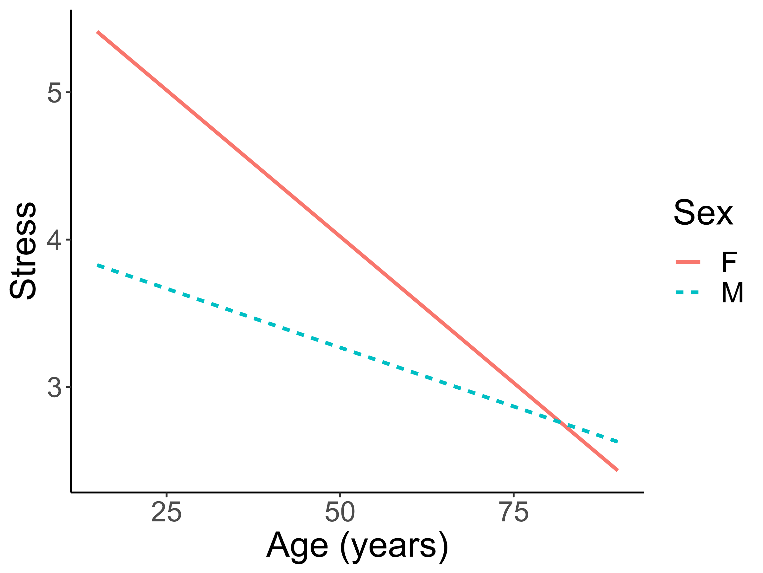
Example: Continuous and categorical interaction
Summary of regression coefficients predicting levels of stress
 | Estimate | Std. Error | t value | Pr(>|t|)
(Intercept) | 6.0079 | 0.1657 | 36.2523 | p < 0.001
age | -0.040 | 0.003 | -12.610 | p < 0.001
sexM | -1.941 | 0.253 | -7.681 | p < 0.001
age:sexM | 0.024 | 0.005 | 4.941 | p < 0.001
Notes:
This model above is how you would enter the model in R, and we use the asterisk, *, to denote an interaction between two variables.
When we enter this model, it gets broken down into two main effects, and then a third effect which is the product of the two variables.
The extra effect gets given its own parameter/coefficient.
In our example we determined that as age increases, stress decreases, but we want to know if a decrease in stress associated with age is larger for one sex relative to the other.
We can see that as age increases, females undergo a large decrease in their level of stress relative to males. However, because of the main effect of sex, females have a higher intercept (walk through how you add the effects).

Slide 16
Wrapping up
We can predict an outcome using one or more variables of different types.
We can interpret one or more coefficients, which are either slopes or intercept differences.
We can model multiplicative differences between variables, allowing us to investigate categorical moderators.
We can determine whether an effect is likely to be meaningful

Slide 17
Example study: Background
There has been growing concern that movies associating mental illness with violence can contribute to increased levels of prejudice.
We also suspect that empathetic people are less likely to show prejudice and could also be less susceptible to prejudice induced by a movie.
We tested hypotheses by getting 100 people to watch Terminator:Dark Fate and 100 people to watch Joker
Collected demographics before the movie
Measured prejudice and empathy directly after the movie

Slide 18
Example study: Design
Joker increases prejudice
  Prejudice is the outcome
  Movie is a main effect
Empathetic people have lower prejudice
  Empathy is a main effect
Empathetic people are less likely to show prejudice after Joker
  Empathy moderates the effect of Joker, i.e., a movie-empathy interaction
We didn’t counterbalance age and sex, so must control for it
  Age and sex are main effects

Slide 19
Example study: Model
Does empathy moderate the effect of Joker
Is Joker associated with higher prejudice?
Do empathetic people have lower prejudice?

Slide 20
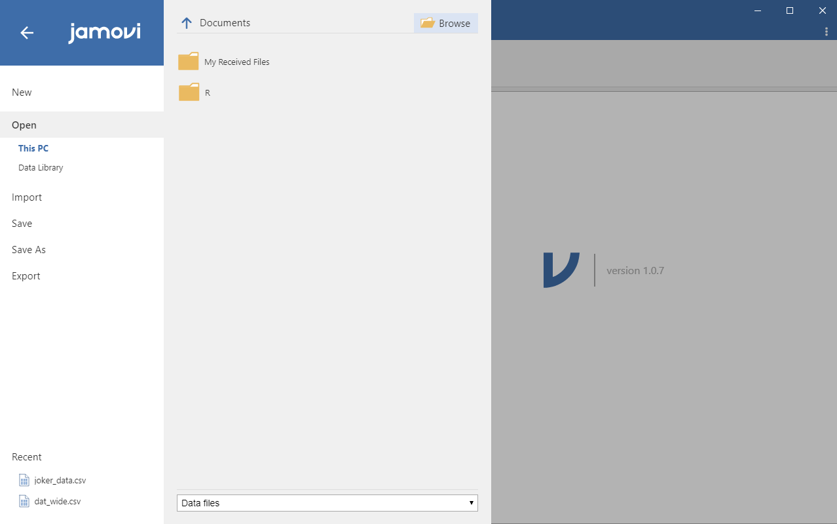
Example: Load Data

Slide 21
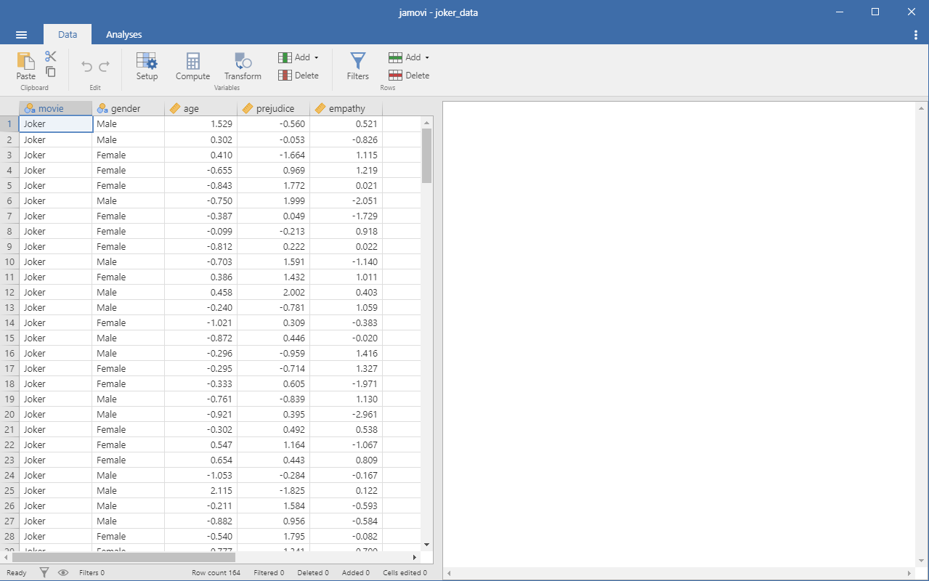
Example: Data Panel

Slide 22
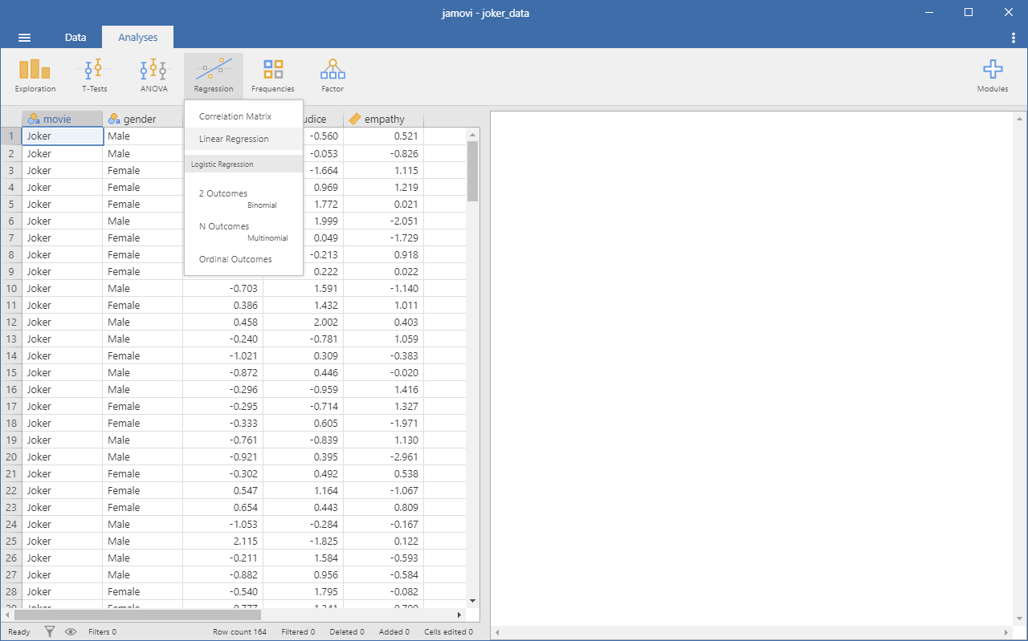
Example: Analysis Panel

Slide 23
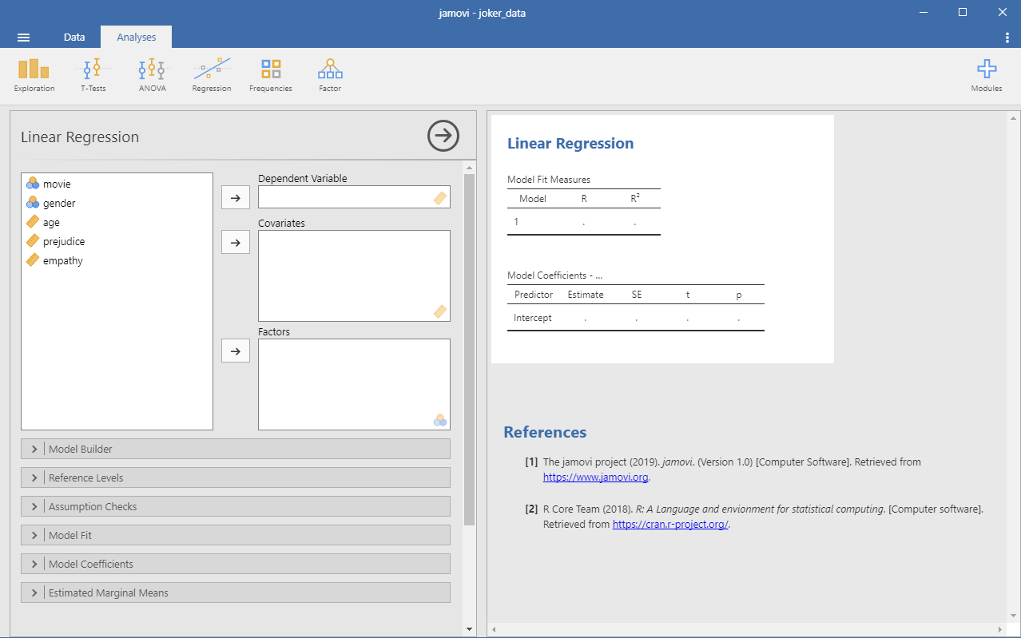


Example: Input variables
{Outcome}
{Continuous}
Output
{Categorical}
Options

Slide 24
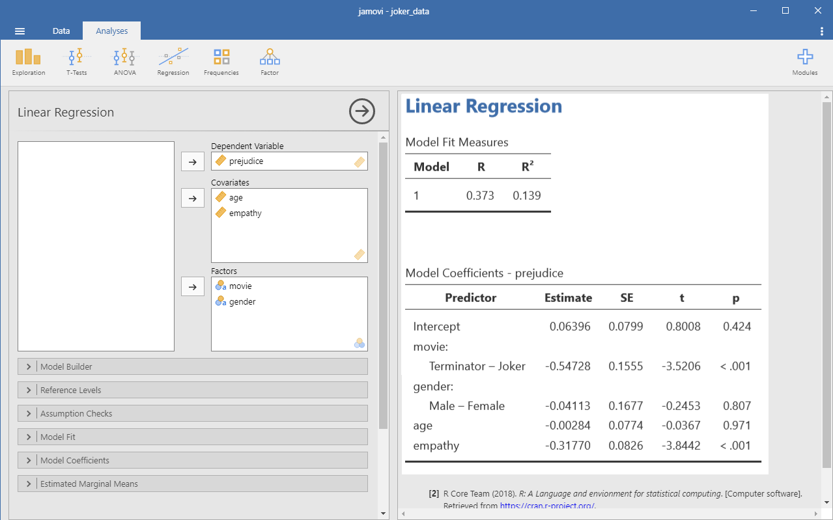
Example: Input variables
1. Flip reference for easier reading
2. Add moderator (empathy * movie)

Slide 25
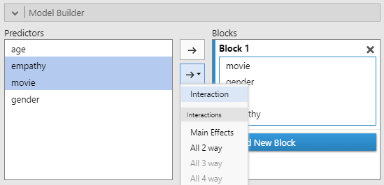
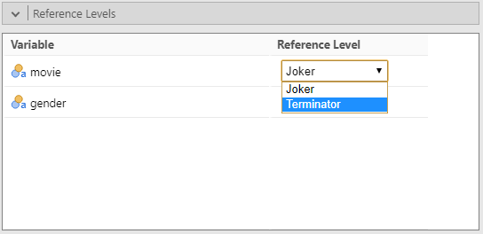
Example: Tweaking model
Ctrl-Click variables you want in interaction
Click arrow with dropdown and select interaction
Change reference level for movie to Terminator

Slide 26
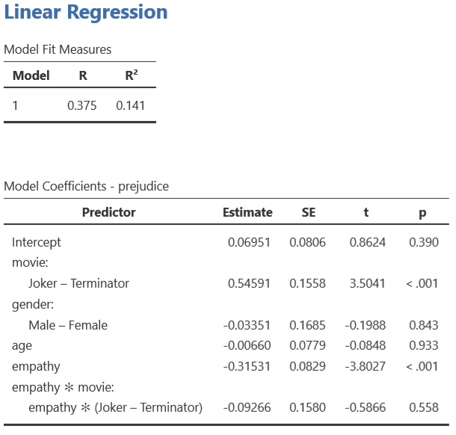
Example: Interpreting results
Is movie associated with prejudice ?
Is empathy associated with prejudice ?
Do empathetic people show less prejudice after watching a movie relative to less empathetic people ?

Slide 27
Example: Conclusions
Prejudice of participants who watched Joker was 0.55 SD higher than participants who watched Terminator: Dark Fate, p < 0.001.
A 1 SD increase in a participants level of empathy was associated with a 0.32 SD decrease in their level of prejudice, p < 0.001.
Empathy did not moderate the increase in prejudice associated with Joker, p = 0.558.

Slide 28

Questions and discussion

