Slide 1


Modern statistics knowledge and skills: what you need and how to get it
Day 5 Experimental Design and Analysis (EDA: full stats module)
Ed Harris
University of Mpumalanga, ZA
2023-03-23 to 2023-03-30

Slide 2

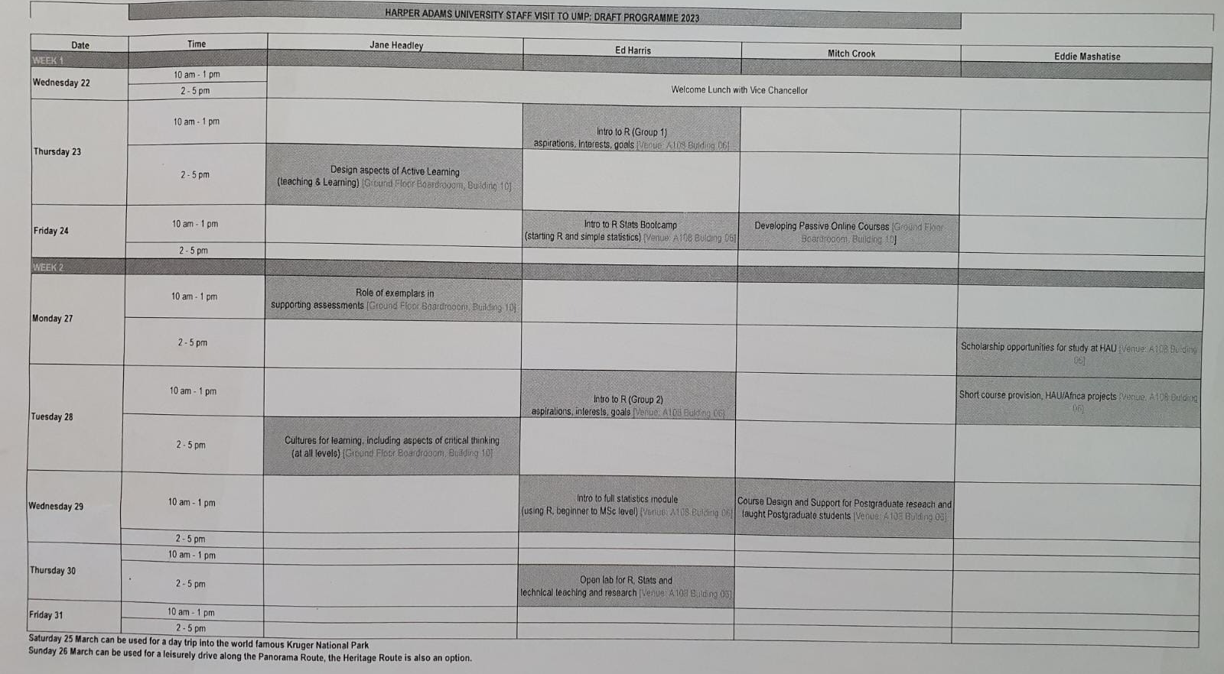


Slide 3
Last session
Review data activity from previous day
R Stats Bootcamp page 11
T-test, graphing practice

Slide 4
Today
Overview of EDA Experimental Design and Analysis module
Talks: overview and graphics 1
Lab: Graphs 1

Slide 5










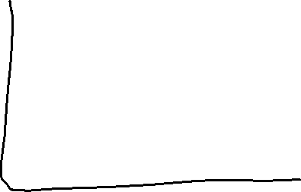


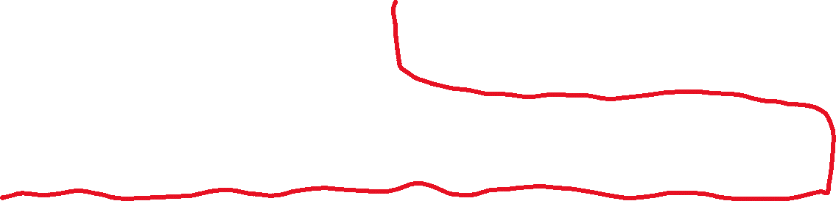







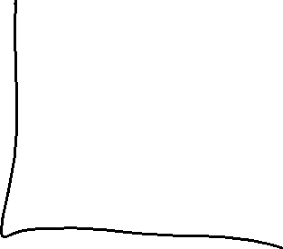








Slide 6

https://hauum-2023.github.io/website/
HAUUM = Harper Adams University – University of Mpumalanga

Slide 7



























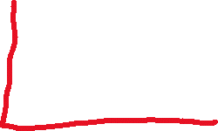

Slide 8







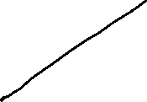














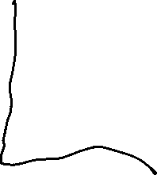


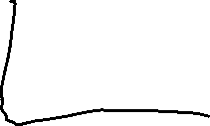
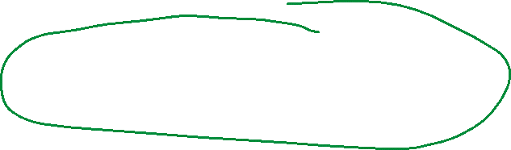



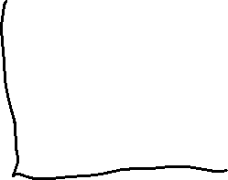
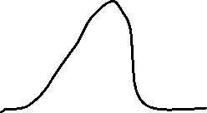




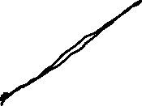




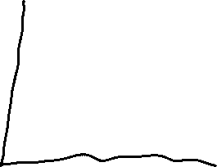

Slide 9




























Slide 10














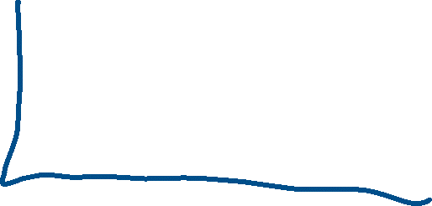





Slide 11
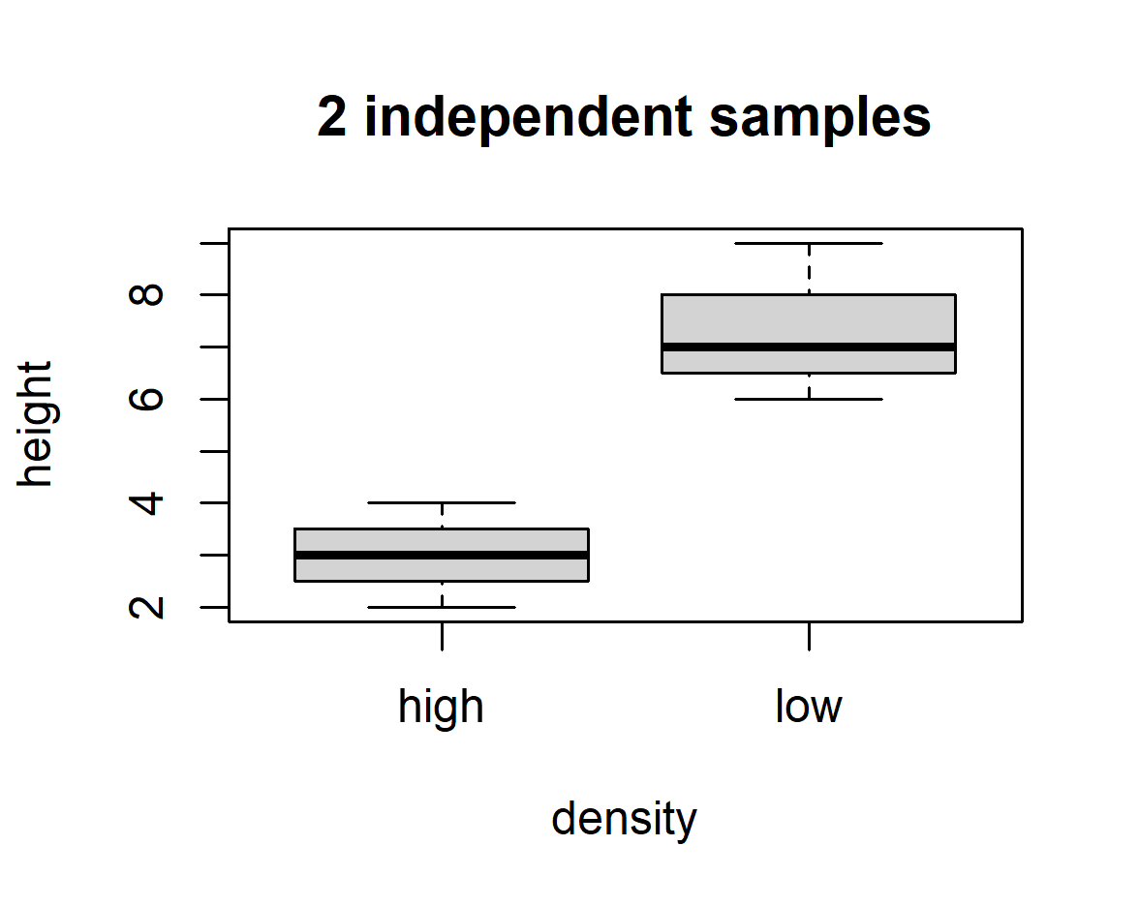







Slide 12
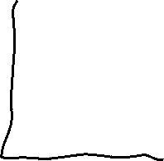

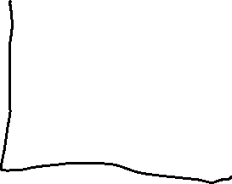






















Slide 13





HA: My data are DIFFERENT TO GAUSSIAN
Every test we report 3 things:
Test statistic (S = 0.92)
P-value (P = 0.0007)
Degrees of freedom or sample size (n = 60)
We found our data were different to Gaussian
(Shapiro test: S = 0.92, P = 0.0007, n = 60)

Slide 14
Welch Two Sample t-test
data: height by density
t = -8.6257, df = 11.868, p-value = 1.865e-06
alternative hypothesis: true difference in means between group high and group low is not equal to 0
95 percent confidence interval:
-5.190611 -3.095103
sample estimates:
mean in group high mean in group low
3.428571 7.571429
We found a significant different in tree height between high
density and low density plots
(t-test: t=-8.6, df = 11.9, P < 0.0001)

