Slide 1


Modern statistics knowledge and skills: what you need and how to get it
Day 5 Experimental Design and Analysis (EDA: full stats module)
Ed Harris
University of Mpumalanga, ZA
2023-03-23 to 2023-03-30

Slide 2

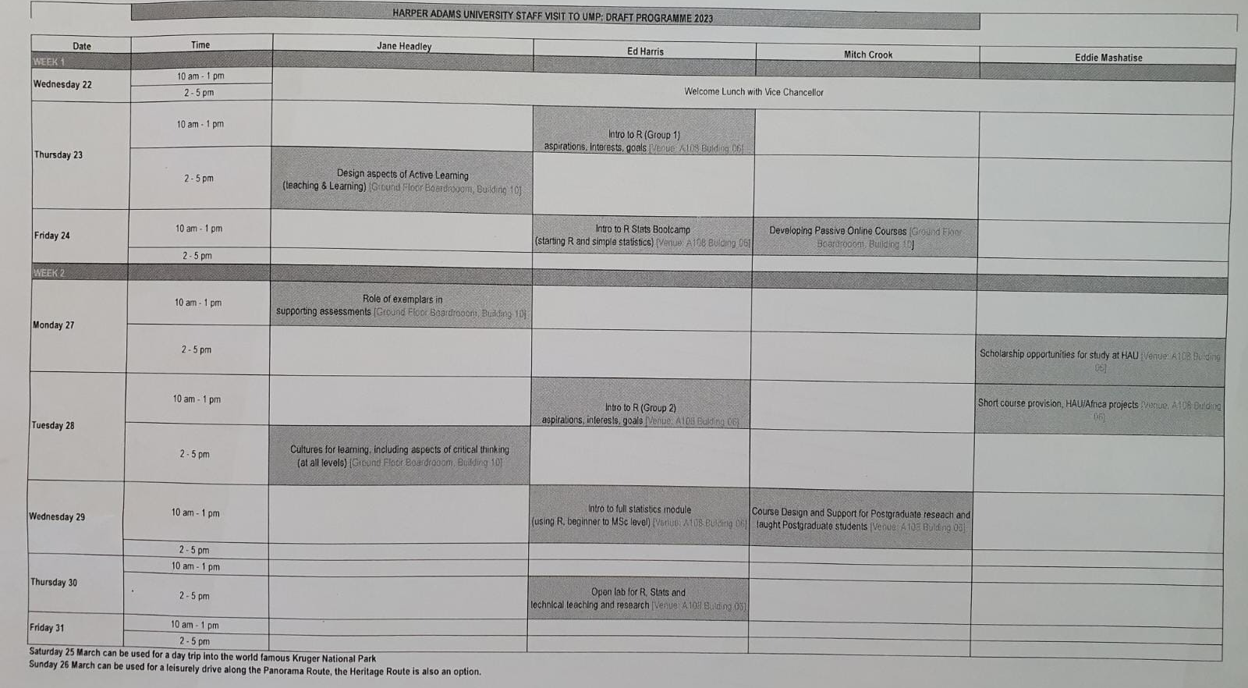


Slide 3
Last session
Review data activity from previous day
R Stats Bootcamp page 11
T-test, graphing practice

Slide 4
Today
Invitation to HARUG!
Overview of EDA Experimental Design and Analysis module
Talks: overview and graphics 1
Lab: Graphs 1

Slide 5

https://hauum-2023.github.io/website/
HAUUM = Harper Adams University – University of Mpumalanga

