Slide 1
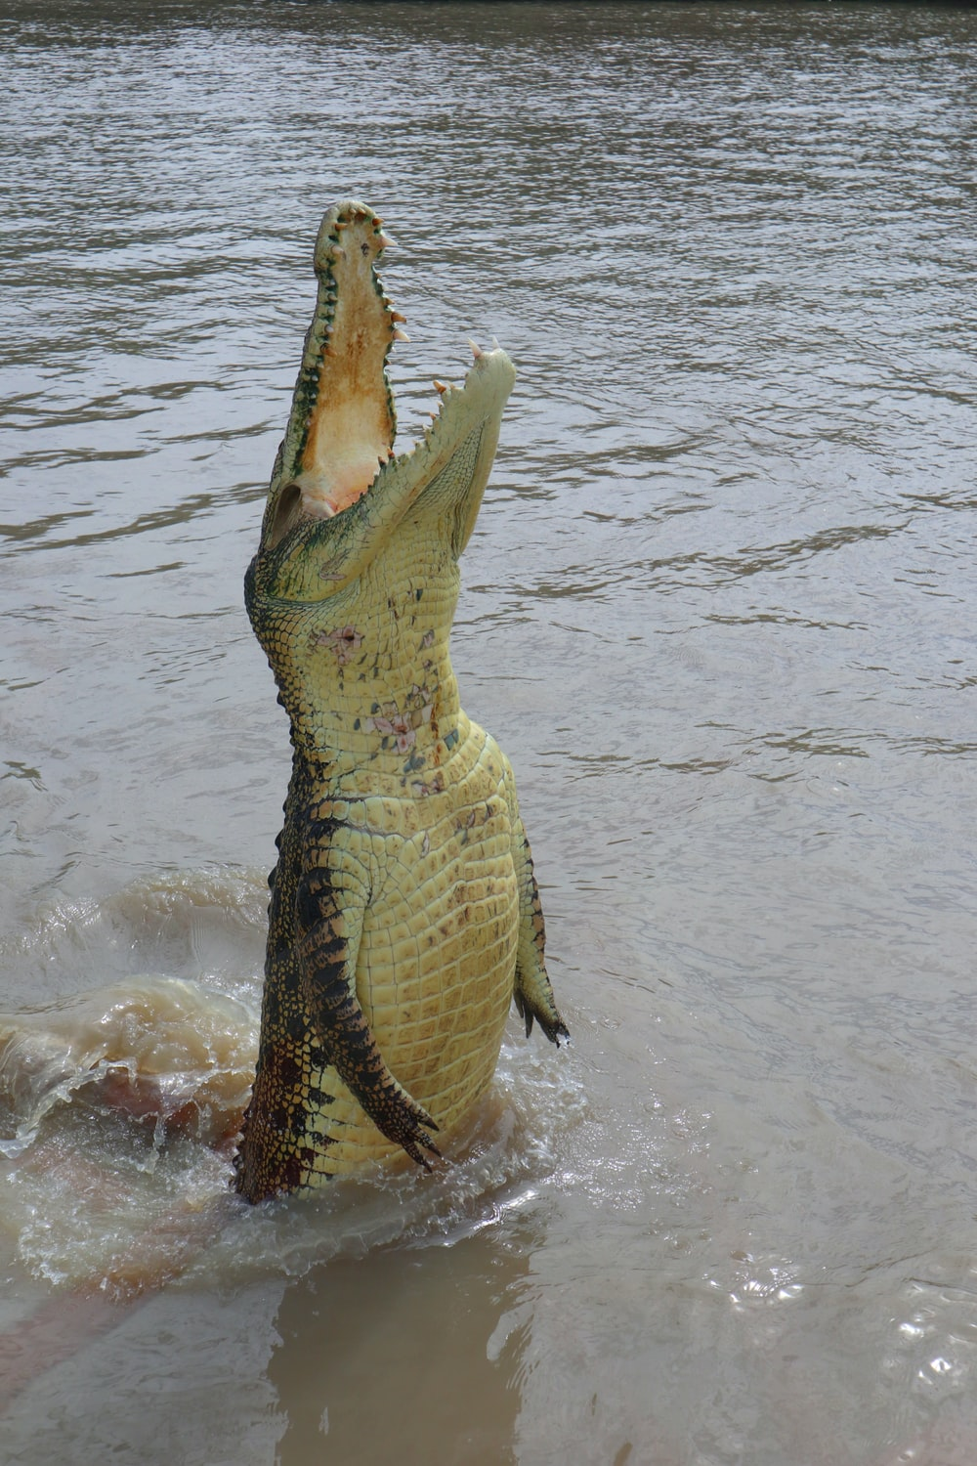

Modern statistics knowledge and skills: what you need and how to get it
Day 2 R Stats Bootcamp
Ed Harris
University of Mpumalanga, ZA
2023-03-23 to -

Slide 2

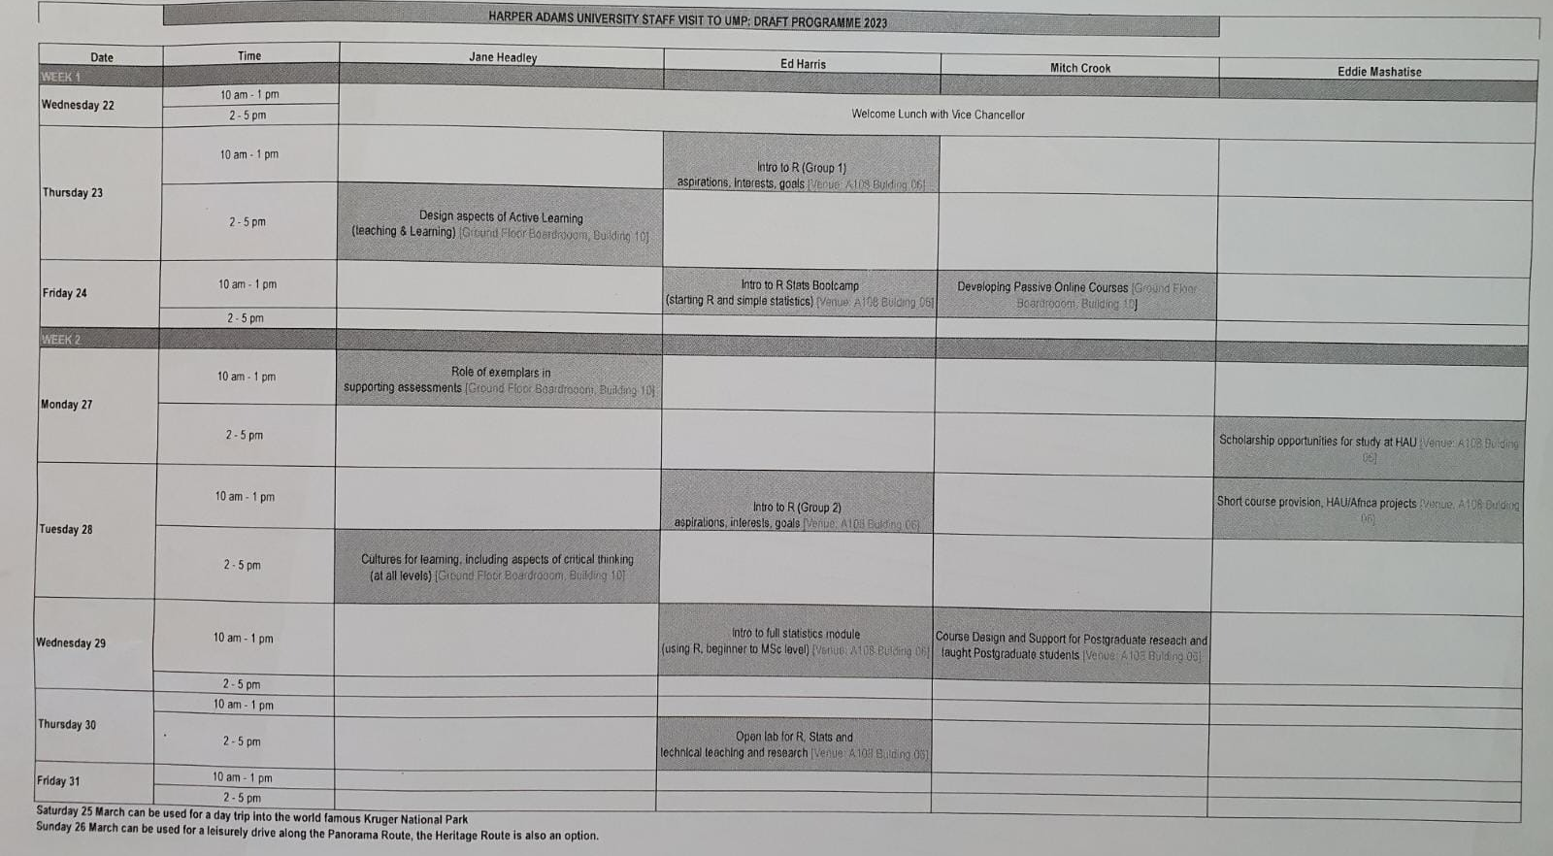


Slide 3
Last session
General statistics capacity and best practice
Tidy Data, reproducible practice and R
R stats Bootcamp what is it?
Install R and Rstudio…

Slide 4
Today
Finish R Stats Bootcamp page 1
We will go fast and get to reading in Data (page 5)
Pause to do practice questions and code-along
Afternoon: some data evaluation

Slide 5











Slide 6
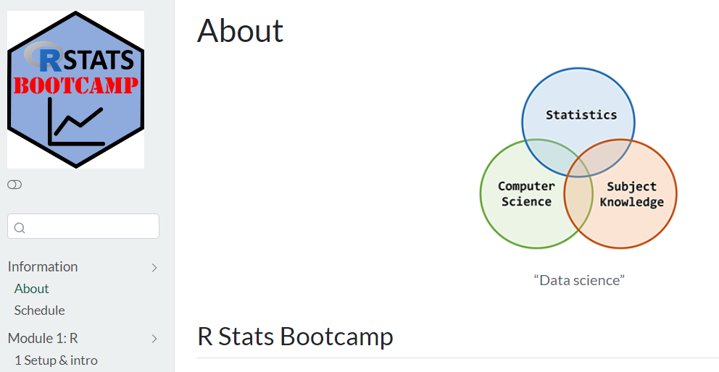
https://rstats-bootcamp.github.io/website/

