Slide 1
Oral report
QR decomposition for 4x4 real matrix with systolic array architecture
Student : 111521035 林豪澤
111521040 吳瑋恩
December 7, 2023
1

Slide 2
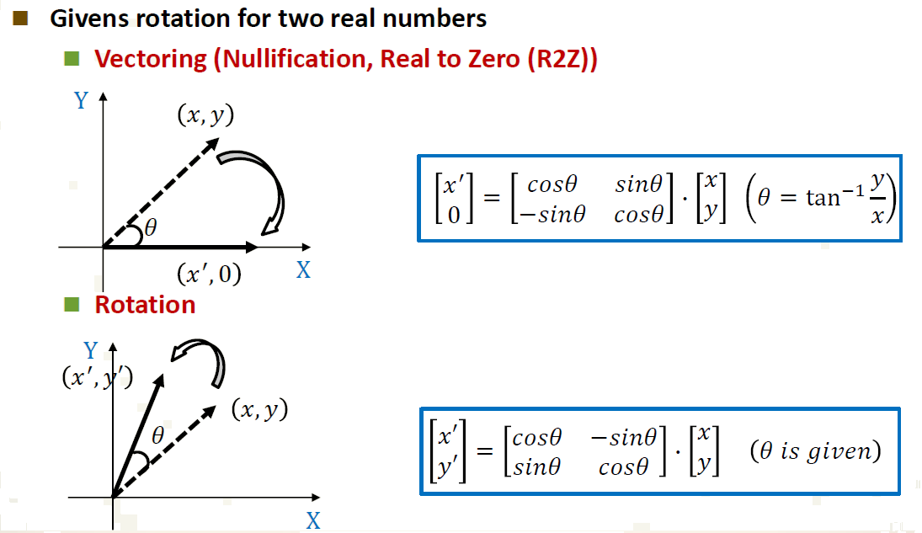
CORDIC

Slide 3
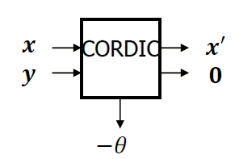
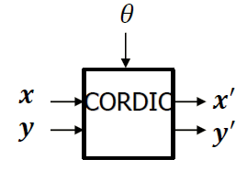
Process element
Mode 0: Vectoring mode
Mode 1: Rotation mode

Slide 4
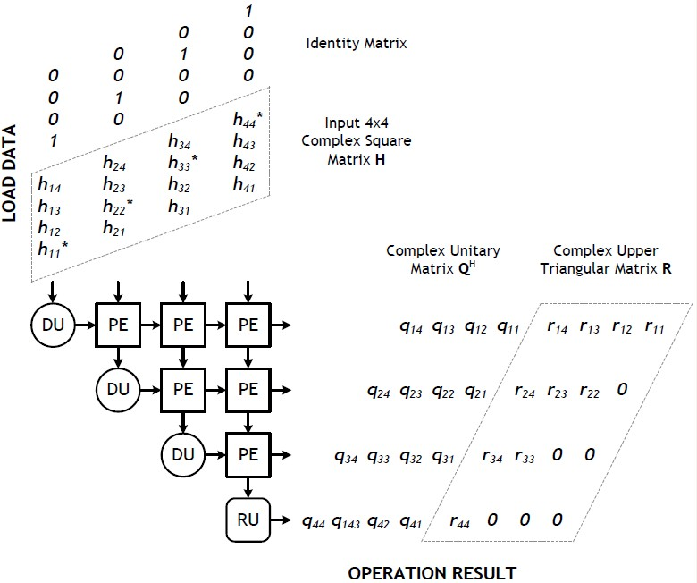
Systolic array architecture

Slide 5
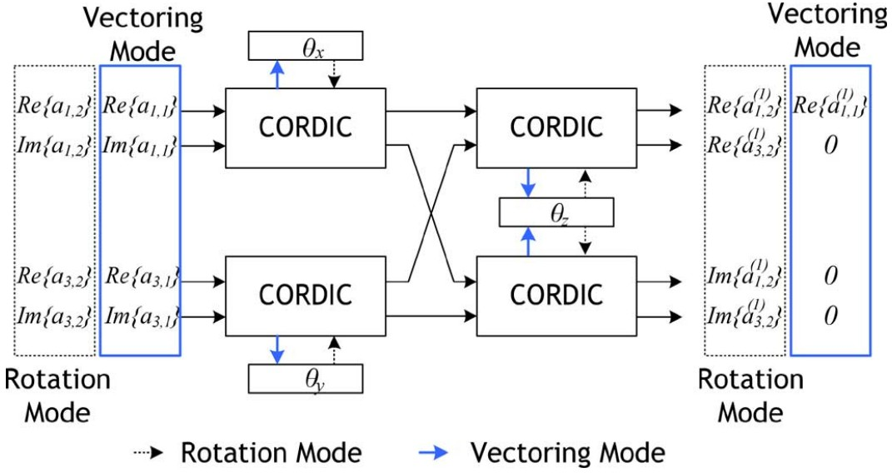
Process element
Complex value PE

Slide 6
Reference
[1] Zheng-Yu Huang and Pei-Yun Tsai, “Efficient Implementation of QR Decomposition for Gigabit MIMO-OFDM Systems,” IEEE Transactions on Circuits and Systems I: Regular paper, vol. 58, pp. 2531-2542, Oct. 2011.
DCCDL course

Slide 7
Thanks you for your listening!

