Slide 1
Final Project QR decomposition for 4x4 real matrix with systolic array architecture
Student: 林豪澤 111521035
吳瑋恩 111521040

Slide 2
Outline
Algorithm
System Simulation
Architecture
Environment Setting
Hardware Implementation
Compare Results
Reference

Slide 3
分工表
分工表 |  | 吳瑋恩 | 林豪澤
matlab simulation |  | % | %
 | function implementation | 50 | 50
 | truncation | 70 | 30
 | NRMSE calculate | 70 | 30
 | verilog input and output generate | 50 | 50
verilog
 | Without pipeline | 100 | 0
 | With 4 stages pipeline | 25 | 75
 | With 13 stages pipeline | 25 | 75
PPT&Word
 | Word | 20 | 80
 | PPT | 70 | 30

Slide 4
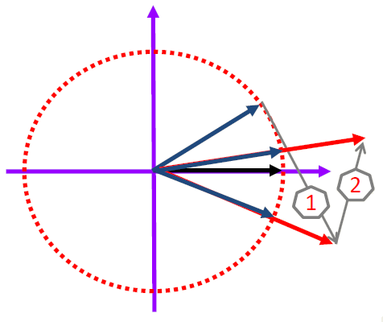

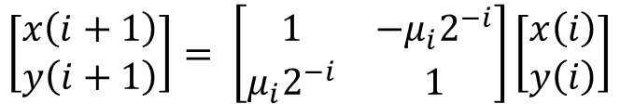

Algorithm
CORDIC (Vectoring mode)
Initialization
Direction
Micro rotation
Angle accumulation
$$x\left(0\right)=x, y\left(0\right)=y, θ^{′}\left(0\right)=0$$
$$μ_{i}=−sign(y\left(i\right))$$
$$\left[\begin{matrix}x\left(i+1\right) \\ y\left(i+1\right)\end{matrix}\right]= \left[\begin{matrix}1 & −μ_{i}2^{−i} \\ μ_{i}2^{−i} & 1\end{matrix}\right]\left[\begin{matrix}x\left(i\right) \\ y\left(i\right)\end{matrix}\right]$$
$$θ^{′}\left(i+1\right)=θ^{′}\left(i\right)−μ_{i}θ_{i}$$

Slide 5
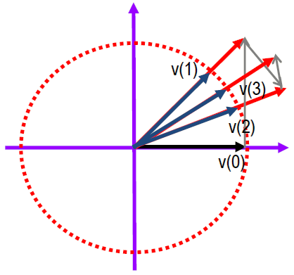

Algorithm
CORDIC (Rotation mode)
Initialization
Direction
Micro rotation
Angle accumulation
$$x\left(0\right)=x, y\left(0\right)=y, θ^{′}\left(0\right)=θ$$
$$μ_{i}=sign(θ^{′}\left(i\right))$$
$$\left[\begin{matrix}x\left(i+1\right) \\ y\left(i+1\right)\end{matrix}\right]= \left[\begin{matrix}1 & −μ_{i}2^{−i} \\ μ_{i}2^{−i} & 1\end{matrix}\right]\left[\begin{matrix}x\left(i\right) \\ y\left(i\right)\end{matrix}\right]$$
$$θ^{′}\left(i+1\right)=θ^{′}\left(i\right)−μ_{i}θ_{i}$$

Slide 6
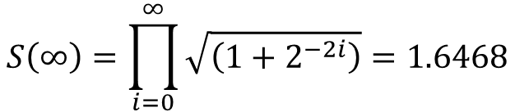
Algorithm
CORDIC
Scaling Factor
Converge range
$$S\left(∞\right)=\prod_{i=0}^{∞}{\sqrt{\left(1+2^{−2i}\right)}=1.6468}$$
$$θ_{max}=\tan^{−1}\left(2^{−i}\right)=1.7433…≈{99}^{o}$$

Slide 7
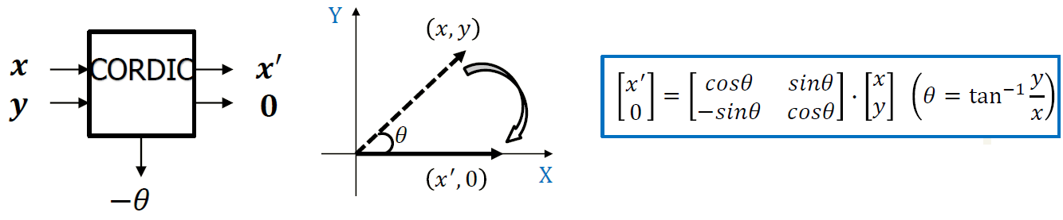
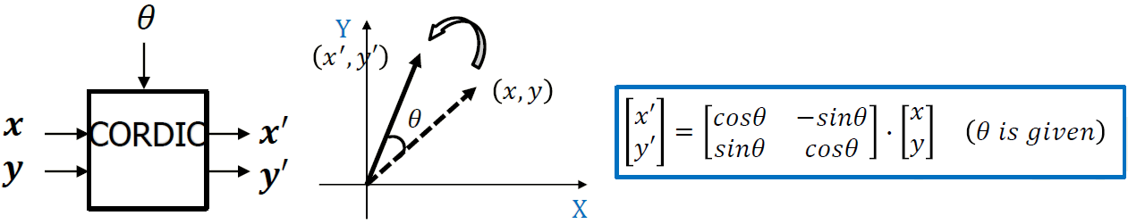
Algorithm
Givens rotation for two real numbers
Vectoring (Real to Zero)
Rotation

Slide 8
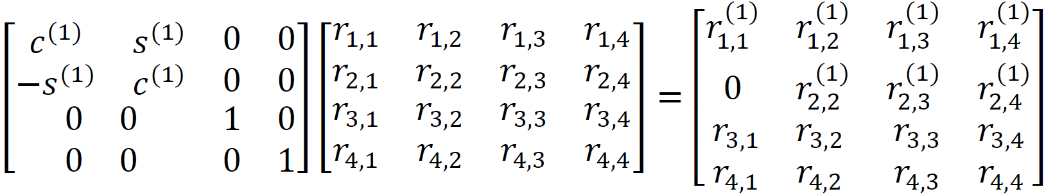
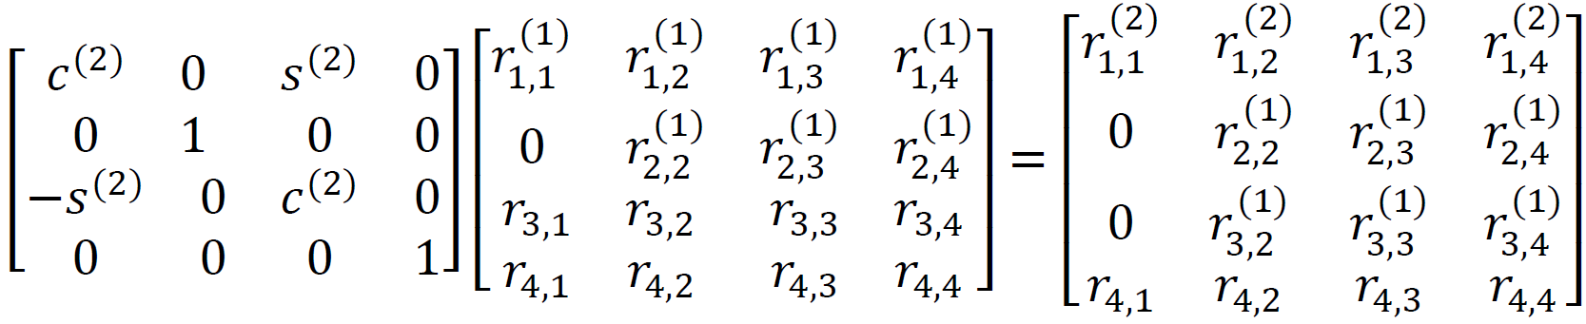

Algorithm
QR decomposition
$$r_{2}∗r_{1}∗H$$
: vectoring mode
: rotation mode

Slide 9
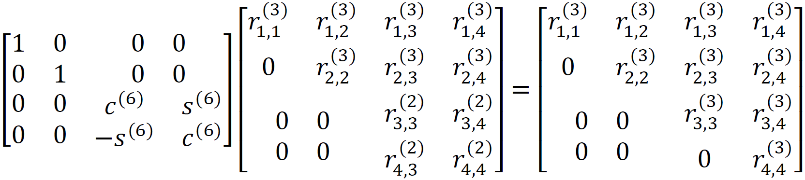

Algorithm
QR decomposition
.
.
.
$${{r_{6}∗r_{5}∗r}_{4}∗r_{3}∗r}_{2}∗r_{1}∗H=Q^{H}∗H=R$$
$$Q={I∗r}_{1}^{H}∗r_{2}^{H}∗r_{3}^{H}∗r_{4}^{H}∗r_{5}^{H}∗r_{6}^{H}$$
: vectoring mode
: rotation mode

Slide 10

System Simulation
System Specification
Processing 4x4 real matrix to generate Q and R matrixes of consecutive 1000 matrixes
Normalized RMSE = 0.5*10⁻³
Notes:
正規化均方根誤差經常被被使用於量測兩個信號，如圖像、影片，及聲音訊號等之間的相似度。

Slide 11
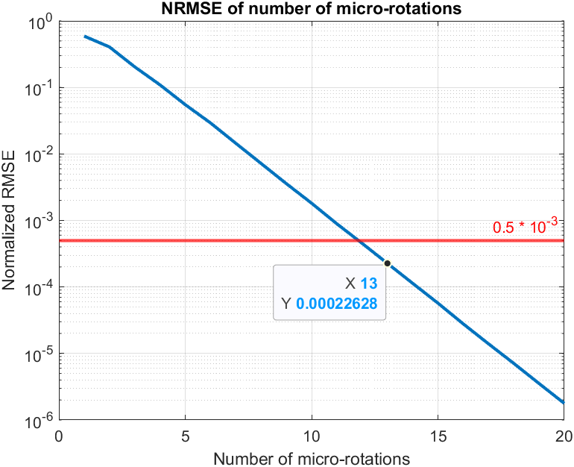
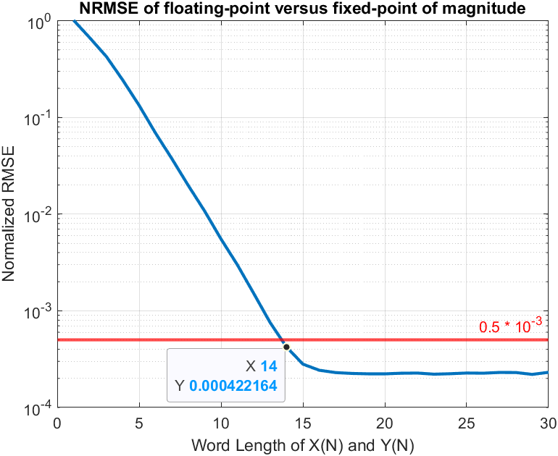
System Simulation
Quantization
Rotation number and magnitude

Slide 12
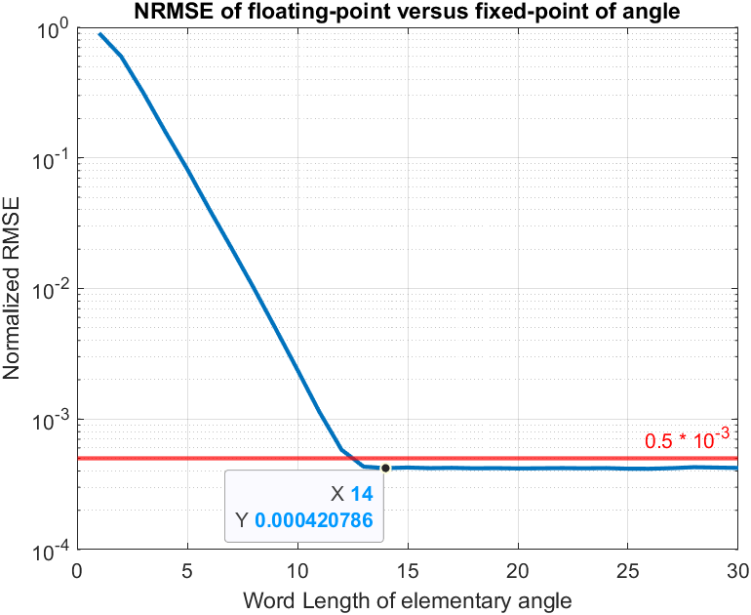
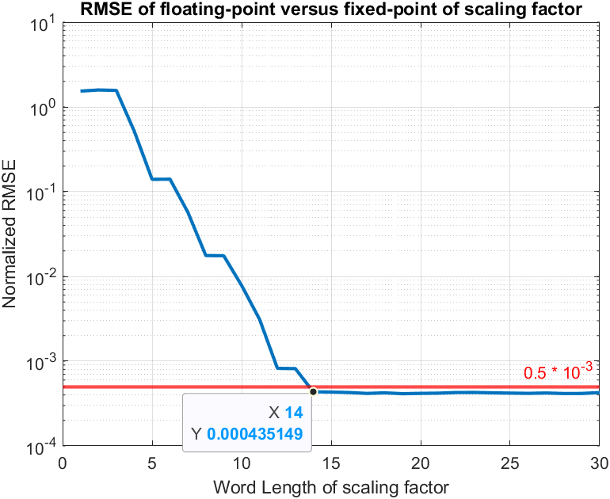
System Simulation
Quantization
Angle and scaling factor

Slide 13
System Simulation
Quantization
 | Data Format | Total word length(bits)
Magnitude | S2.14 | 17
Angle | S2.14 | 17
Scaling Factor | S1.14 | 16

Slide 14
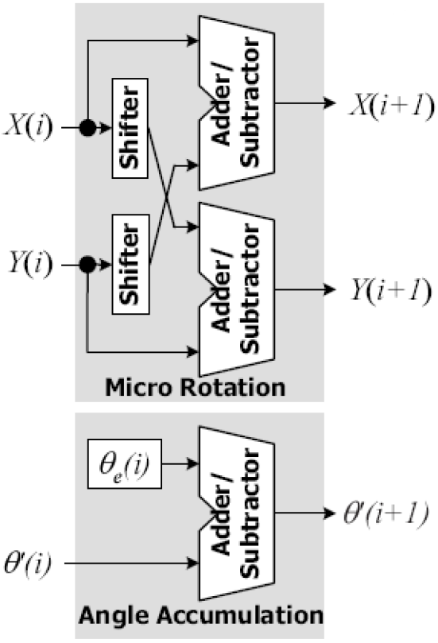
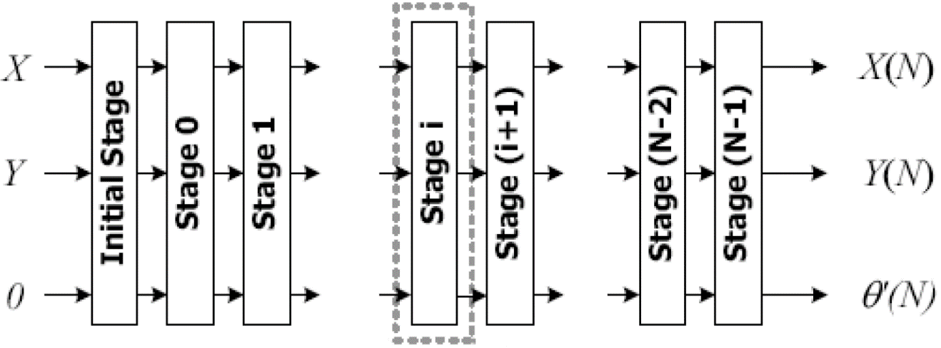
Architecture
CORDIC
Initial Stage
Micro rotation
Scaling factor

Slide 15
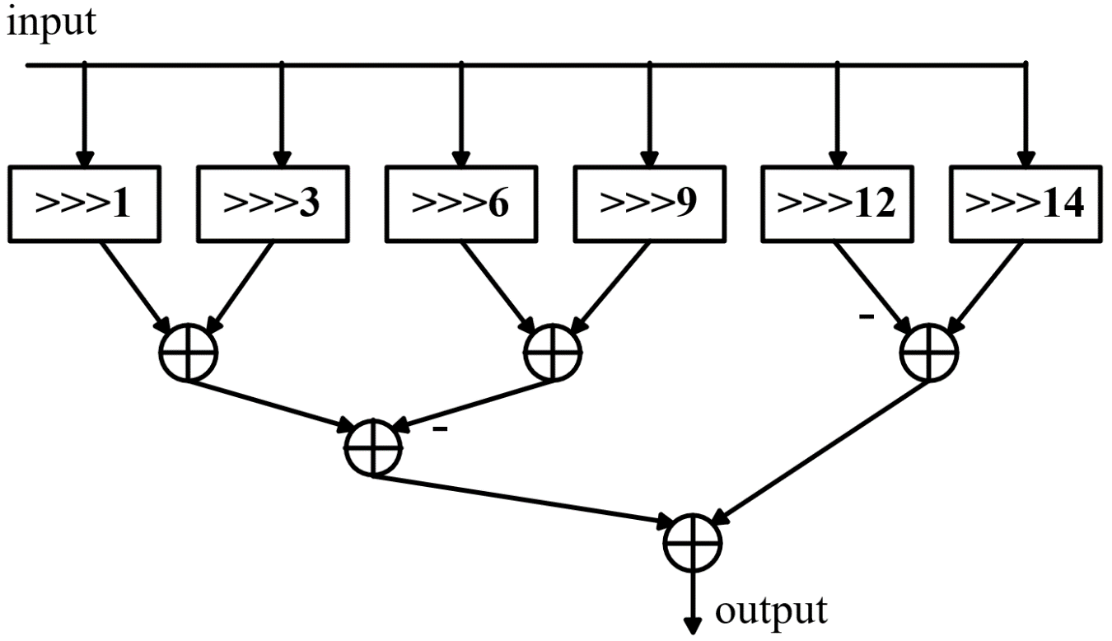

Architecture
CORDIC
Canonic Signed Digit (CSD)
$$Scaling factor=0.60725=2^{−1}+2^{−3}−2^{−6}−2^{−9}−2^{−12}+2^{−14}$$

Slide 16
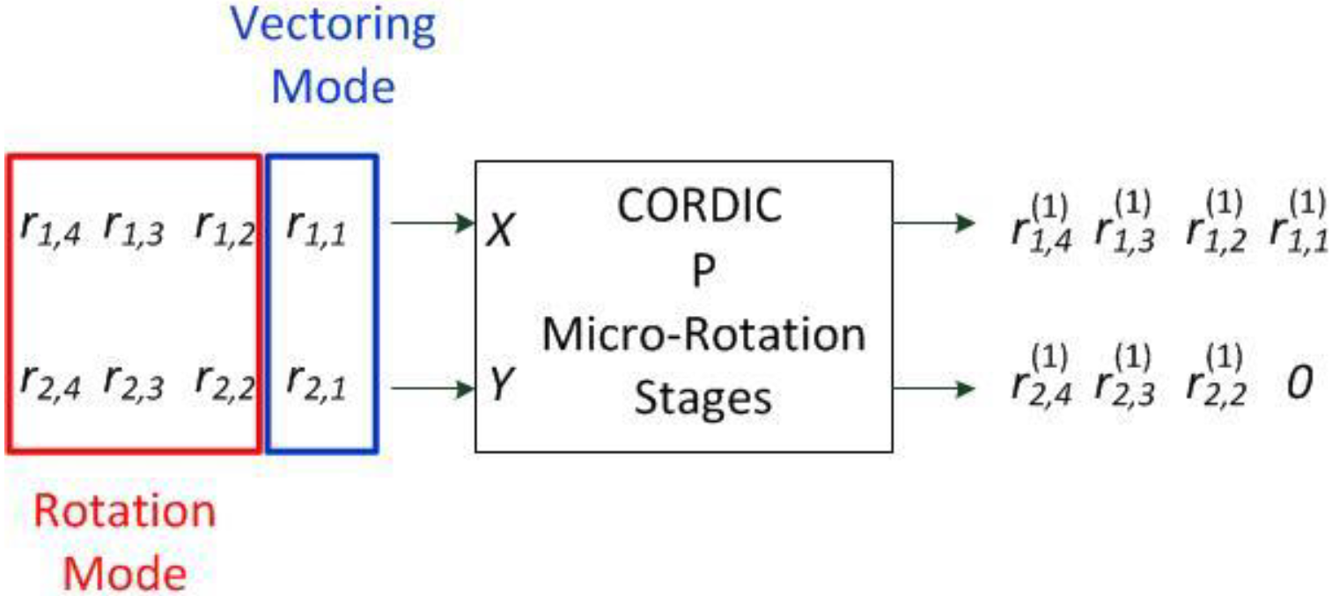
Architecture
Processing element
Rotation number : 13

Slide 17
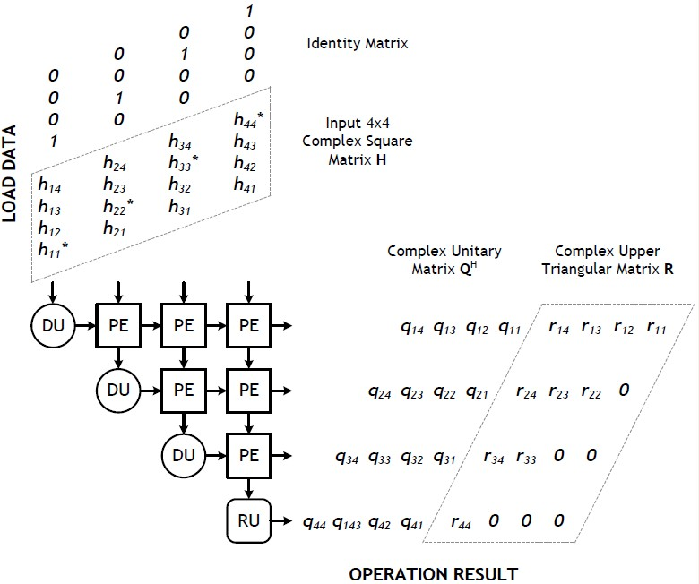
Architecture
Systolic array
H = QR
Q^{H} H = Q^{H} QR
= R
Q^{H} = Q⁻¹

Slide 18
Environment Setting
RTL simulation
Instruction : vcs TESTBED.v -R -full64 -debug_access+all +v2k -sverilog +define+RTL -cm line+cond+tgl+fsm+branch+assert
Synthesis : Design Compiler
Process : TSMC 0.13um
Input delay : 0.5*cycle time
Output delay : 0.5*cycle time
Output load : 0.05 Pf
Simulation model : tsmc13.v

Slide 19
Environment Setting
Gate-level simulation
Instruction : vcs TESTBED.v -v /cad/CBDK/CBDK_IC_Contest_v2.1/Verilog/tsmc13.v -R -full64 -debug_access+all +v2k -sverilog +define+GATE +lint=TFIPC-L +neg_tchk

Slide 20
Hardware Implementation
Non-pipeline version
Fourth stage pipeline version
Fully stage pipeline version

Slide 21
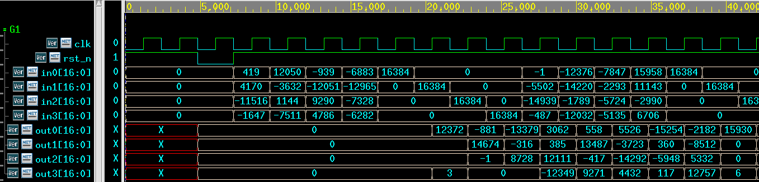
Hardware Implementation
Non-pipeline version
RTL simulation
Clock cycle time : 24 ns
Processing time : 5 cycles (120ns)
Throughput : 10.42 matrices/µs
: H
: R
: I
: Q^{H}

Slide 22
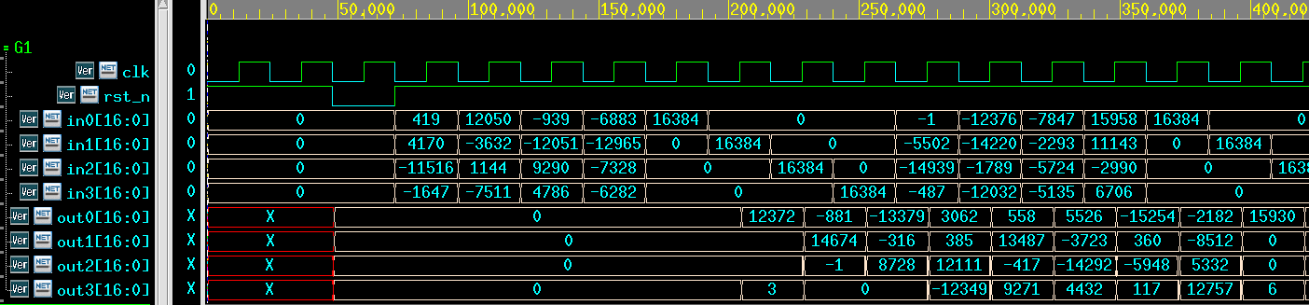
Hardware Implementation
Non-pipeline version
Gate-level simulation
: H
: R
: I
: Q^{H}

Slide 23
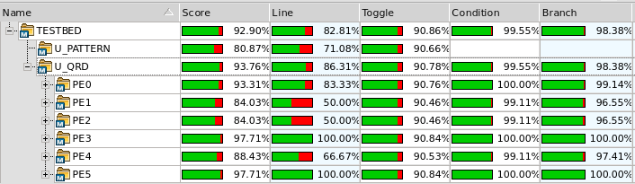
Hardware Implementation
Verification
Number of patterns : 1000

Slide 24
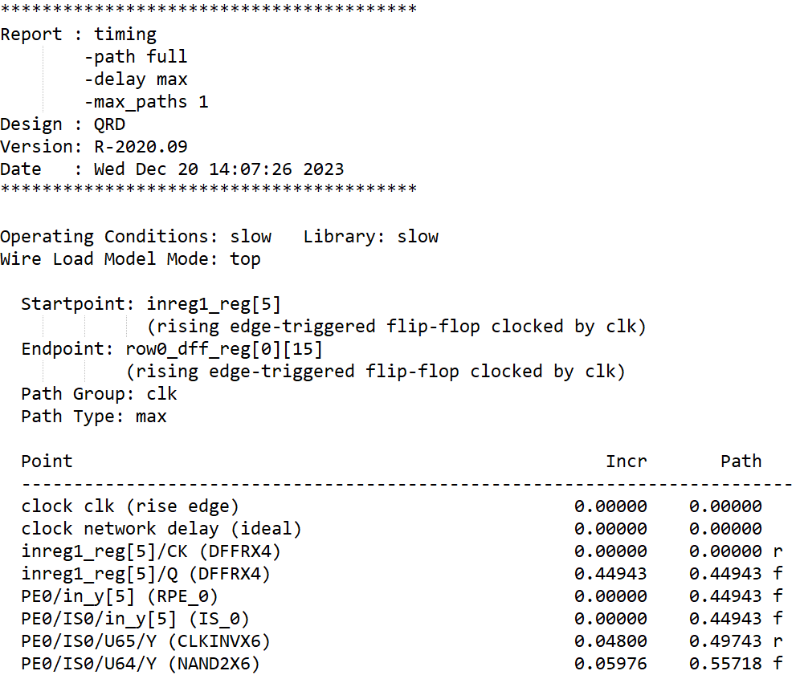
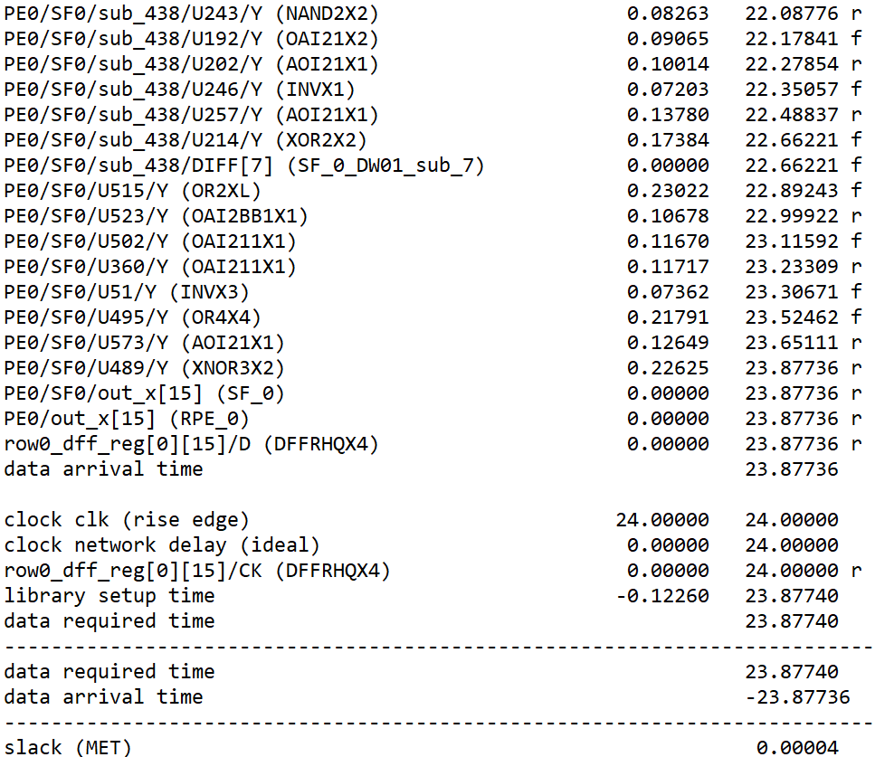
Hardware Implementation
Non-pipeline version
Clock cycle time : 24 ns

Slide 25
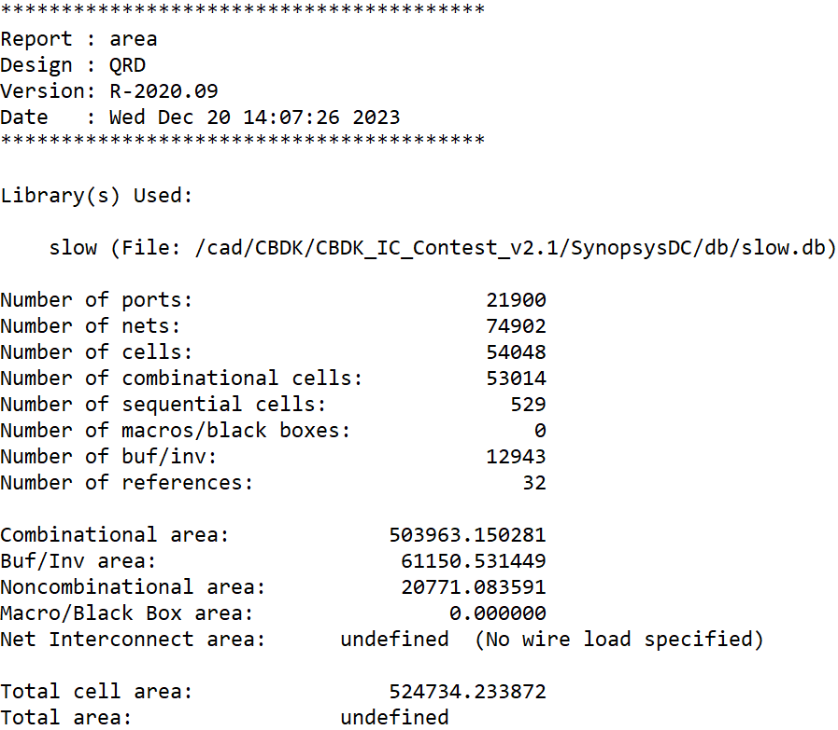
Hardware Implementation
Non-pipeline version
Total cell area : 524734.23µm²

Slide 26
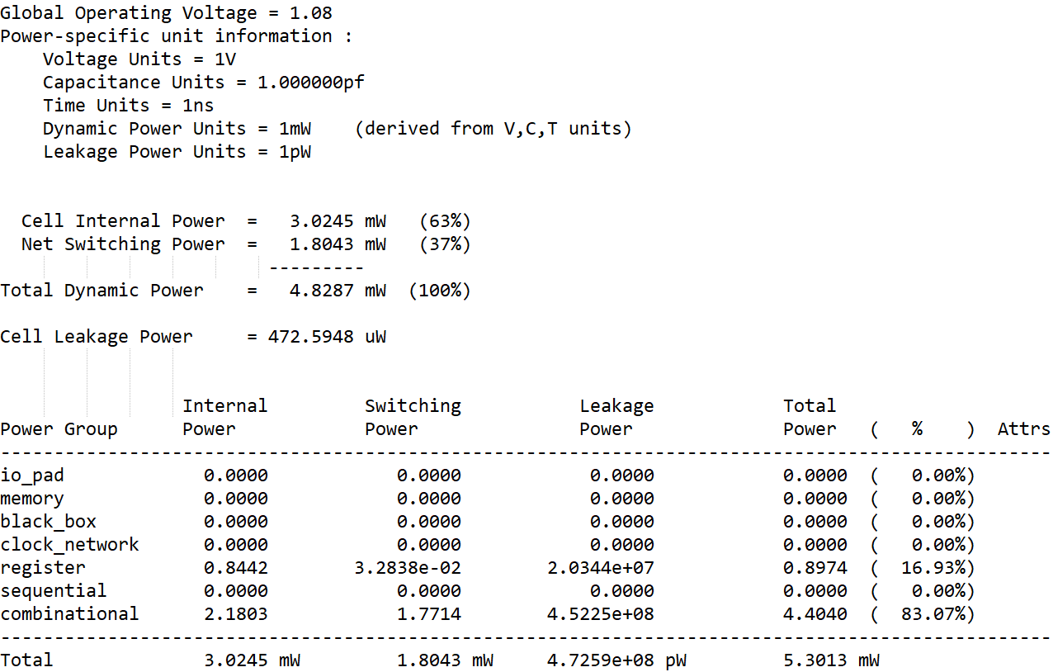
Hardware Implementation
Non-pipeline version
Total power : 5.3013mW

Slide 27
Compare Results
Summary
Speed optimized
Pipeline type | Area(µm²) | Timing(ns) | Power(mW) | Critical path
Non | 524734.23 | 24 | 5.3013 | 1IS + 13MR + 1SF
Fourth stage | 495576.29 | 11 | 10.5945 | 4MR
Fully stage | 647342.52 | 3 | 68.0877 | 1MR

Slide 28
Compare Results
Summary
Speed optimized
Pipeline type | Timing(ns) | Processing time | Throughput (matrices/µs)
Non | 24 | 5 cycles / 120ns | 10.42
Fourth stage | 11 | 20 cycles / 220 ns | 22.72
Fully stage | 3 | 75 cycles / 225ns | 83.33

Slide 29
Compare Results
Summary
Same throughput
Pipeline type | Area(µm²) | Timing(ns) | Power(mW) | Critical path
Non | 524734.23 | 24 | 5.3013 | 1IS + 13MR + 1SF
Fourth stage | 379514.87 | 24 | 3.6463 | 4MR
Fully stage | 475385.72 | 24 | 6.7697 | 1MR

Slide 30
Compare Results
Summary
Same throughput
Pipeline type | Timing(ns) | Processing time | Throughput (matrices/µs)
Non | 24 | 5 cycles / 120ns | 10.42
Fourth stage | 24 | 20 cycles / 480 ns | 10.42
Fully stage | 24 | 75 cycles / 1800ns | 10.42

Slide 31
Reference
[1] Zheng-Yu Huang and Pei-Yun Tsai, “Efficient Implementation of QR Decomposition for Gigabit MIMO-OFDM Systems,” IEEE Transactions on Circuits and Systems I: Regular paper, vol. 58, pp. 2531-2542, Oct. 2011.
DCCDL course

Slide 32
Thanks you for your listening!

