Slide 1
Project 1: edit distance for machine translation
Andrew Hearst

Slide 2
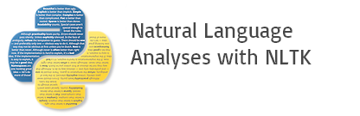

Open Source Code
Natural Language Toolkit (NLTK)
Plotly

Slide 3
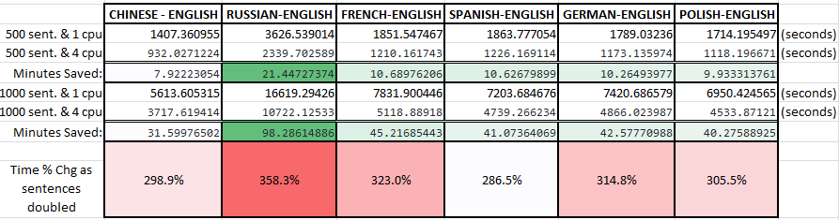
Technical Challenges
PROBLEM:
How do you efficiently calculate the edit distance between 1,000 sentence pairs?
SOLUTIONS:
Don’t repeat calculations
Break up work into batches using multi-core processor

Slide 4
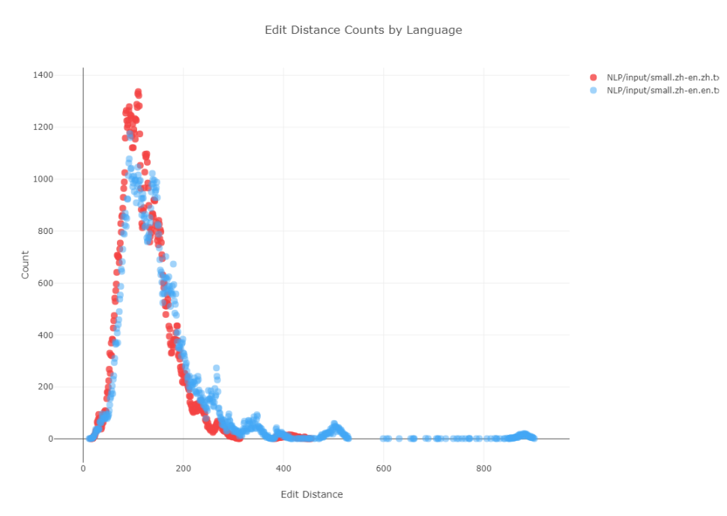
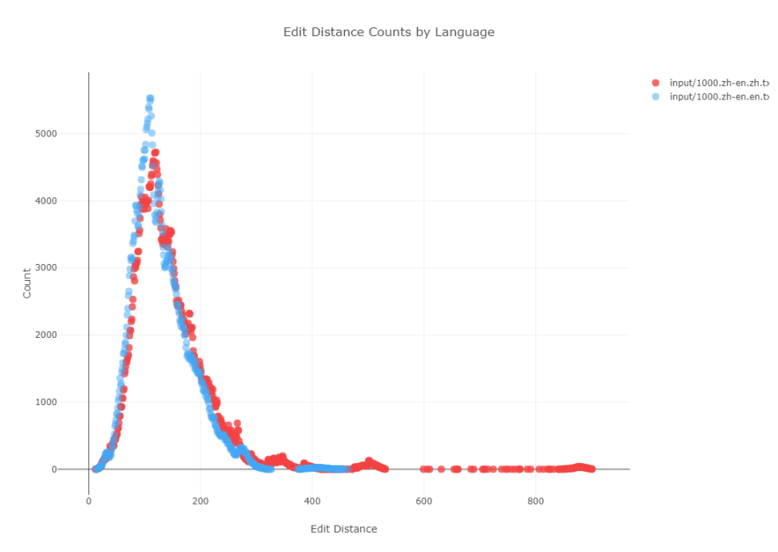
Edit Distances - Chinese

Slide 5
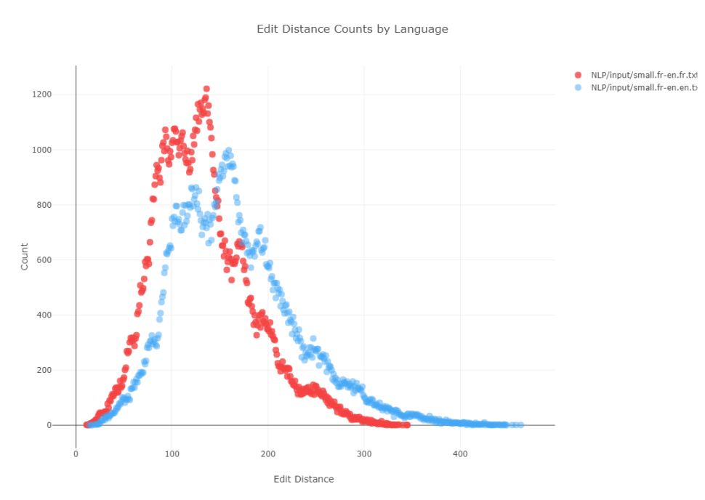
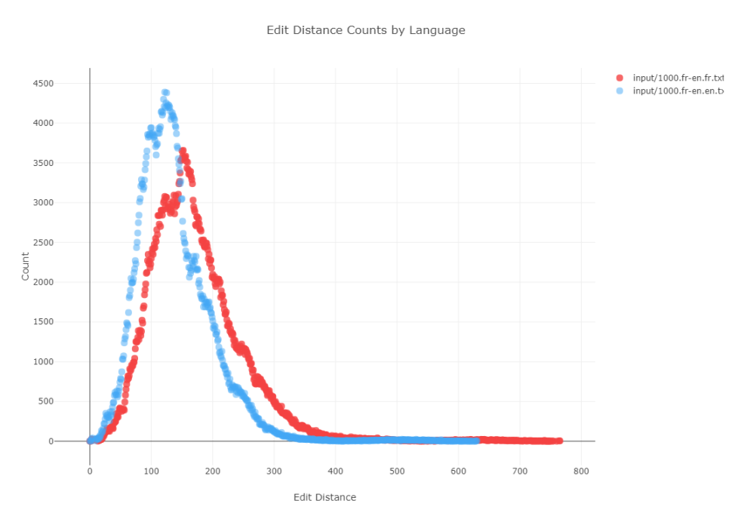
Edit Distances - French

Slide 6
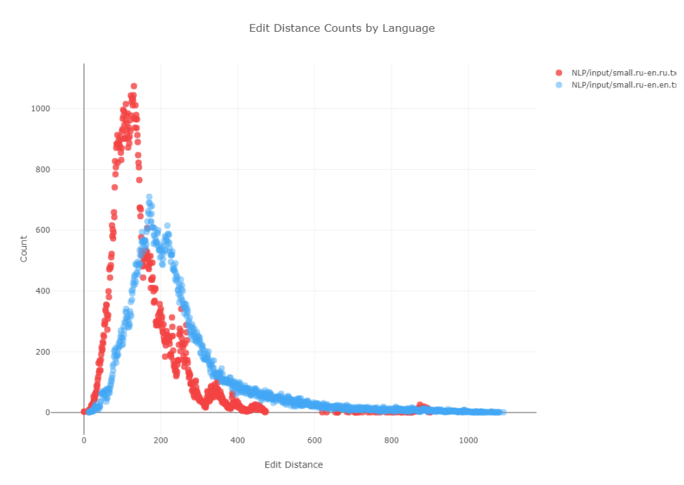
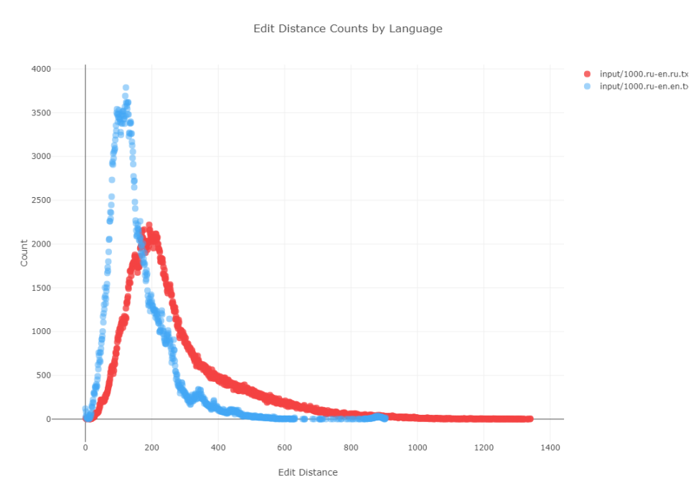
Edit Distances - Russian

Slide 7
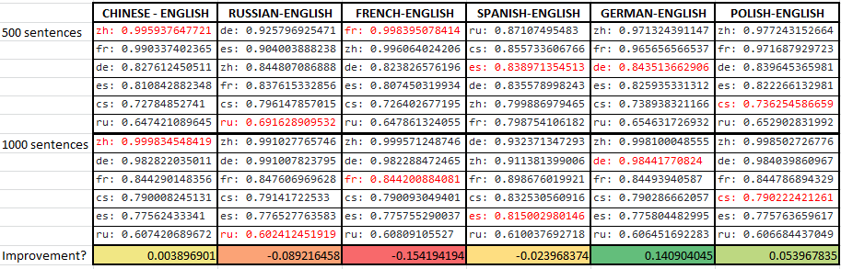
Prediction Accuracy

Slide 8
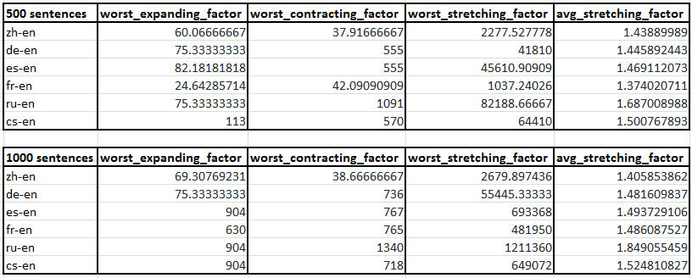
Language Parameters

