Slide 1
TripSharing

Slide 2
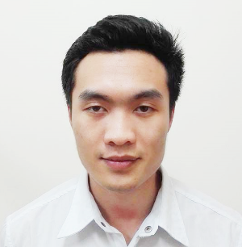

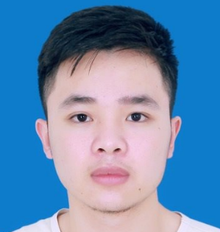



Hà Văn Thái
Nguyễn Văn Phong
Our Team
Lí Phúc Linh
Instructor.
Đào Trọng Duy
Trần Văn Phong
Lê Xuân Trường

Slide 3
01
Introduction
02
Project Management
03
Requirement Specifications
Agenda
04
Software Design
05
Testing
06
Demonstration

Slide 4
TRIP
SHARING
1. INTRODUCTION

Slide 5
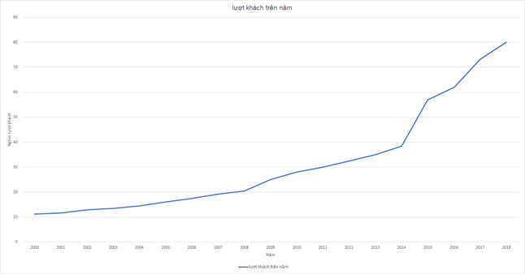




Background
Number of tourist in Vietnam increase rapidly
Young tourists tend to explore wild place
People love to talk about their experience
Some people feel difficult to find a travel companion
Number of local tourists reach 80 million in 2018
Notes:
Explain why people love to talk about their experience
Explain why it’s hard to find a travel companion nowadays

Slide 6



Exist system
Advantages
They already have a booking system
They have huge amount of data
Limitations
They only focus on famous travel destination
Their finding-travel-companion feature doesn’t have a group chat for discussion
Notes:
Explain why people love to talk about their experience
Explain why it’s hard to find a travel companion nowadays

Slide 7

Our proposal
Focus on both well-known and lesser-known travel places, even if it has not be discovered
Allows users to share their travel experience by articles and images
All users’ contribution on the system are recorded as point
Has finding-travel-companion feature
Notes:
Explain why people love to talk about their experience
Explain why it’s hard to find a travel companion nowadays

Slide 8
TRIP
SHARING
2. PROJECT MANAGEMENT

Slide 9
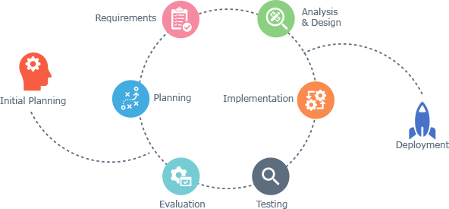
Software Development Process
Advantages:
Generates working software quickly and early during the software lifecycle
This model is more flexible – less costly to change scope and requirements
It is easier to test and debug during a smaller iteration
Easier to manage risk because risky pieces are identified and handled during it’d iteration
Iterative and Incremental Software Development Model
Notes:
<UPDATE PROS & WHY>

Slide 10
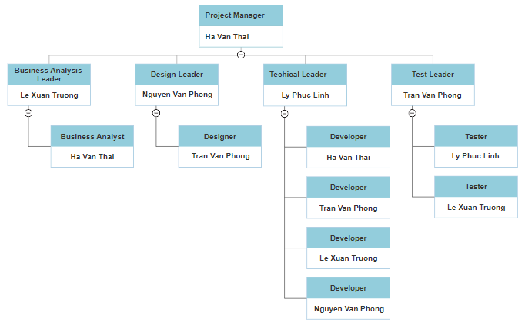
Organization Structure

Slide 11
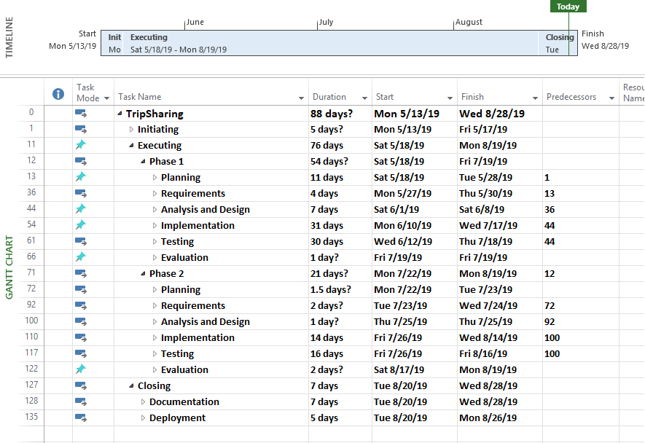
Work Breakdown Structure

Slide 12
TRIP
SHARING
3. SOFTWARE REQUIREMENT SPECIFICATION

Slide 13
Roles
Actor | Description
Guest | Anyone who visits the website and doesn’t have an account yet.
Member | Those who has registered an account on TripSharing.
Administrator | Who has the highest the permission level and has responsible for managing the entire website.

Slide 14
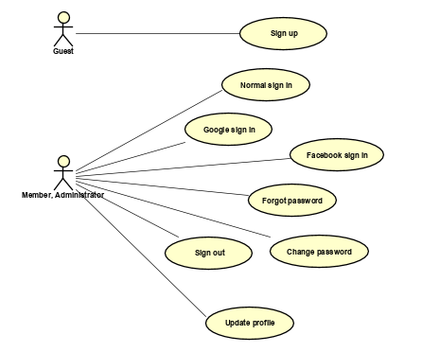
Use case Diagram

Slide 15
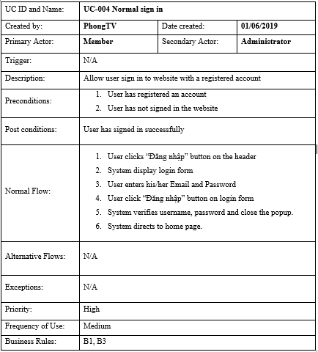
Use case detail example

Slide 16
Non-Functional Requirements
Maintainability And Extensibility | Microservices architecture for backend Object Oriented Programming paradigm is applied in order to ensure scalability & maintainability Using TSLint for a consistent coding convention
Availability and Scalability | Google Cloud service for automatic horizontal scalability Third-party services for convenient development: SendGrid, Google Storage.
Performance | Backend system uses background job for external requests, heavy processing requests such as sending email Load balancer is apply for both front-end instance and back-end instance
Usability | The interface should be elegant and simple Links, buttons and checkboxes are easily clickable Search is available on every page, not just the homepage

Slide 17
TRIP
SHARING
4. SOFTWARE DESIGN

Slide 18
Software Architecture

Slide 19










Software Architecture Explanation

Slide 20
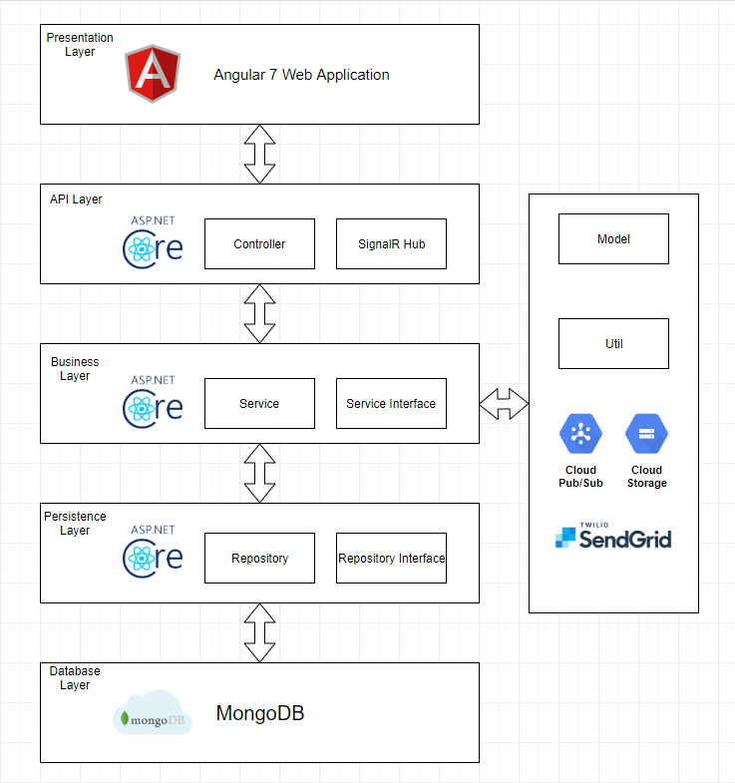
Architecture Layer Design

Slide 21
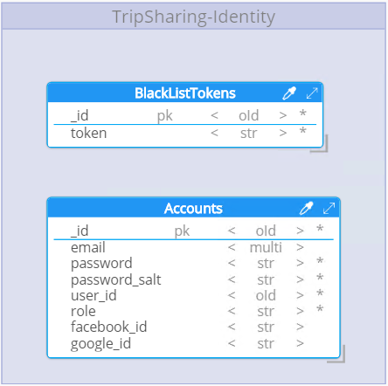
Identity Provider Database Design

Slide 22
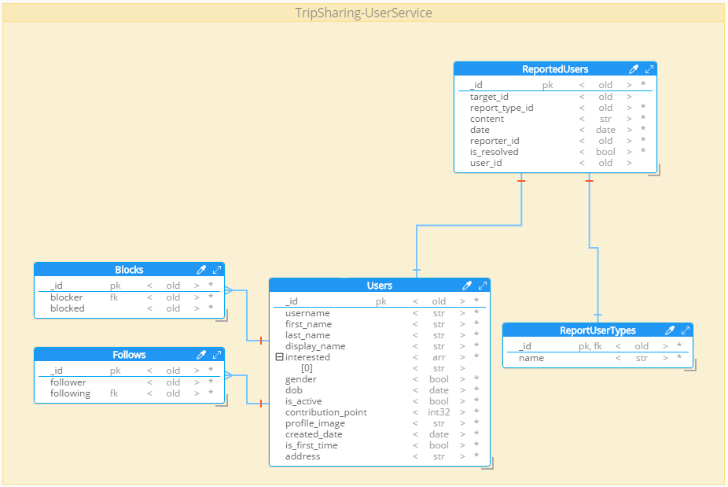
User
Database Design

Slide 23
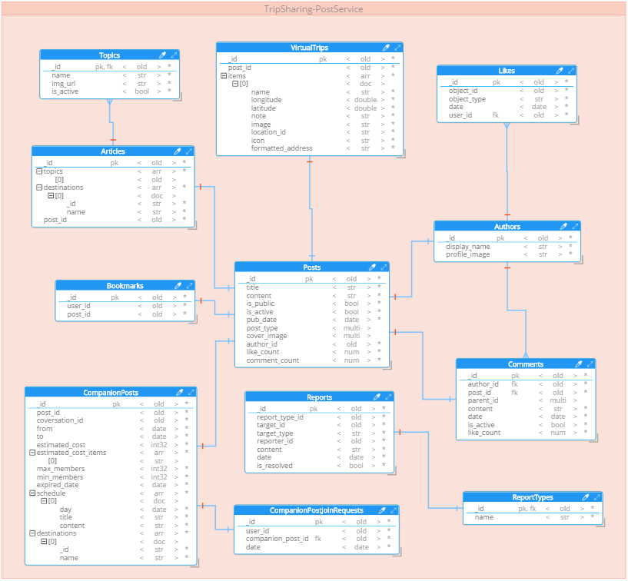
Post Database Design

Slide 24
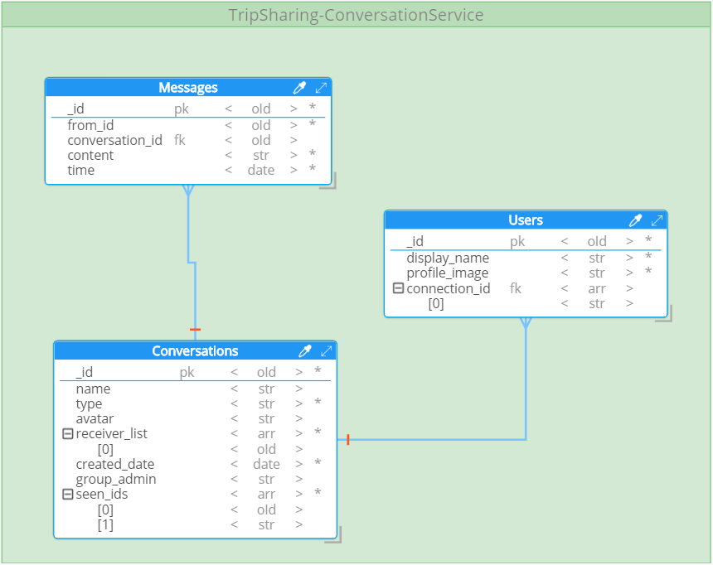
Conversation Database Design

Slide 25
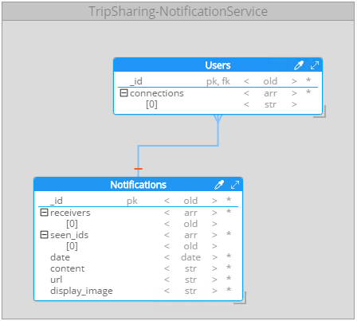
Notification Database Design

Slide 26
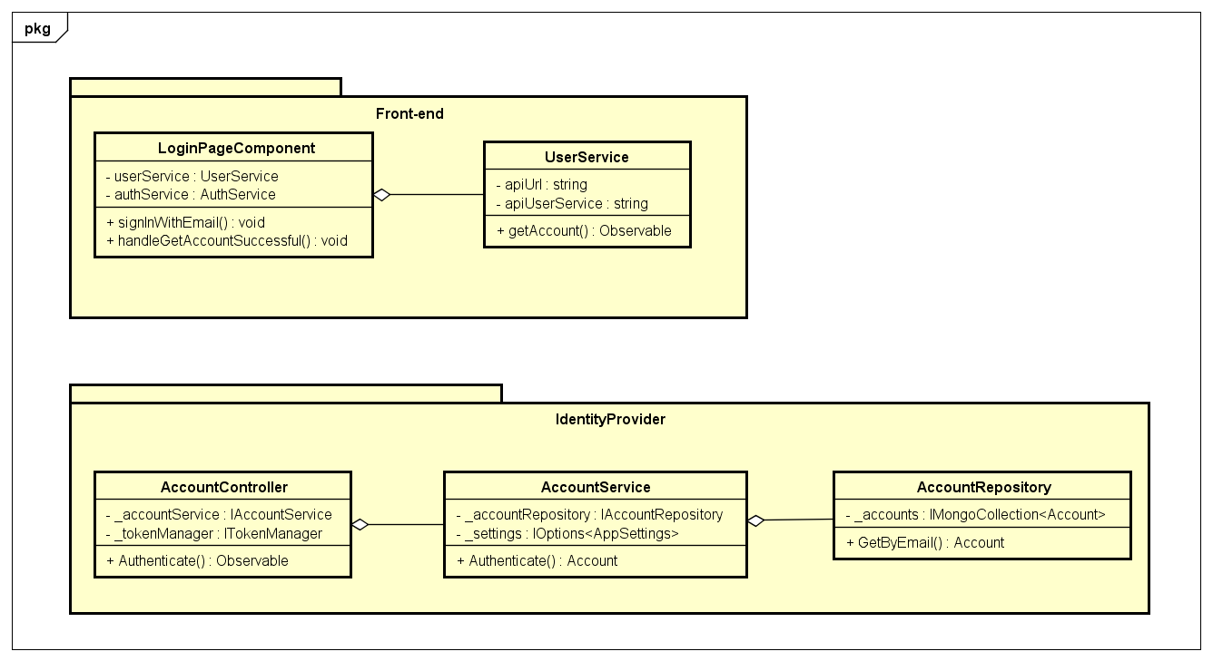
Detail design example
Normal sign in
Class diagram

Slide 27
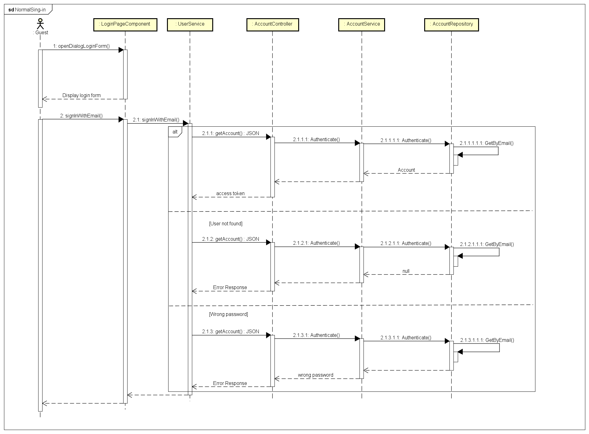
Detail design example
Normal sign in
Sequence diagram

Slide 28
TRIP
SHARING
5. TESTING

Slide 29






Testing Tools
Notes:
- Talk more about every tools

Slide 30
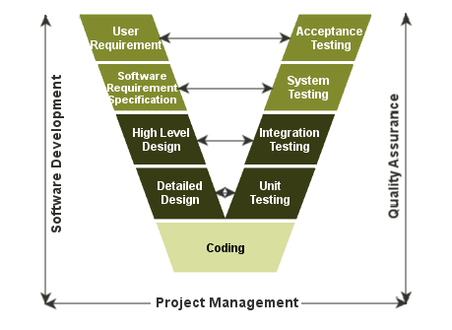
Test Model
Notes:
- Unit test: Test small units of codes
- Integration test: Test group of combined individual modules
- System test: Evaluate system’s compliance with its function requirement
- Acceptance test: Evaluate system’s compliance with business requirement and assess whether it is acceptable for delivery

Slide 31
Test Report
 | Number of test cases
Unit Test | 259
Integration Test | 406
System Test | Xx
Coverage | Xx

Slide 32
TRIP
SHARING
6. DEMONSTRATION

Slide 33
Thank You

