Slide 1
TripSharing

Slide 2


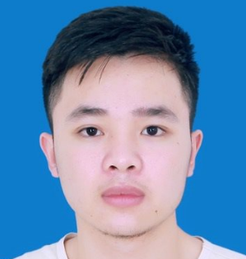



Hà Văn Thái
Nguyễn Văn Phong
Our Team
Lí Phúc Linh
Instructor.
Đào Trọng Duy
Trần Văn Phong
Lê Xuân Trường

Slide 3
01
Introduction
Agenda
02
Project Management
03
Requirement Specifications
04
Software Design
05
Testing
06
Demonstration

Slide 4
TRIP
SHARING
1. INTRODUCTION

Slide 5
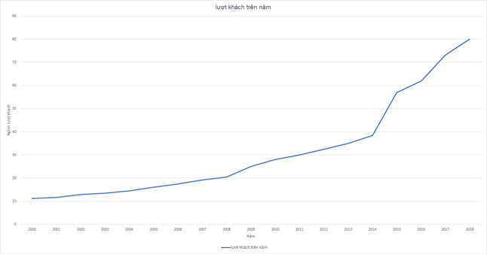




Background
Number of tourist in Vietnam increase rapidly
Young tourists tend to explore wild place
People love to talk about their experience
Some people feel difficult to find a travel companion
Number of local tourists reach 80 million in 2018
Notes:
Explain why people love to talk about their experience
Explain why it’s hard to find a travel companion nowadays

Slide 6



Exist system
Advantages
They already have a booking system
They have huge amount of data
Limitations
They only focus on famous travel destination
Their finding-travel-companion feature doesn’t have a group chat for discussion
Notes:
Explain why people love to talk about their experience
Explain why it’s hard to find a travel companion nowadays

Slide 7

Our proposal
Focus on both well-known and lesser-known travel places, even if it has not be discovered
Allows users to share their travel experience by articles and images
All users’ contribution on the system are recorded as point
Has finding-travel-companion feature
Notes:
Explain why people love to talk about their experience
Explain why it’s hard to find a travel companion nowadays

Slide 8
TRIP
SHARING
2. PROJECT MANAGEMENT

Slide 9
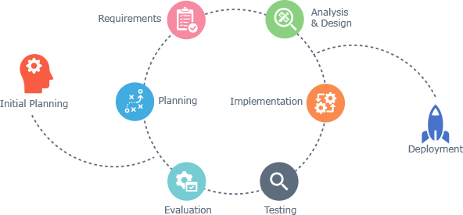
Software Development Process
Advantages:
Generates working software quickly and early during the software lifecycle
This model is more flexible – less costly to change scope and requirements
It is easier to test and debug during a smaller iteration
It is easier to test and debug during a smaller iteration
Easier to manage risk because risky pieces are identified and handled during it’d iteration
Iterative and Incremental Software Development Model
Notes:
<UPDATE PROS & WHY>

Slide 10
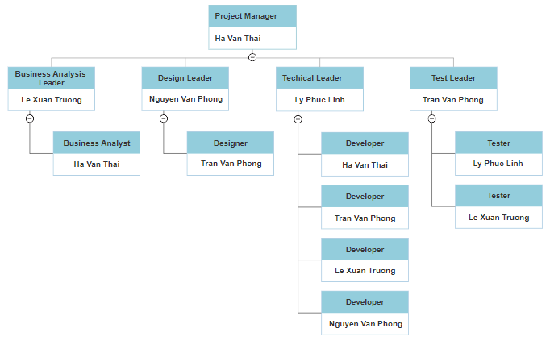
Organization Structure

Slide 11
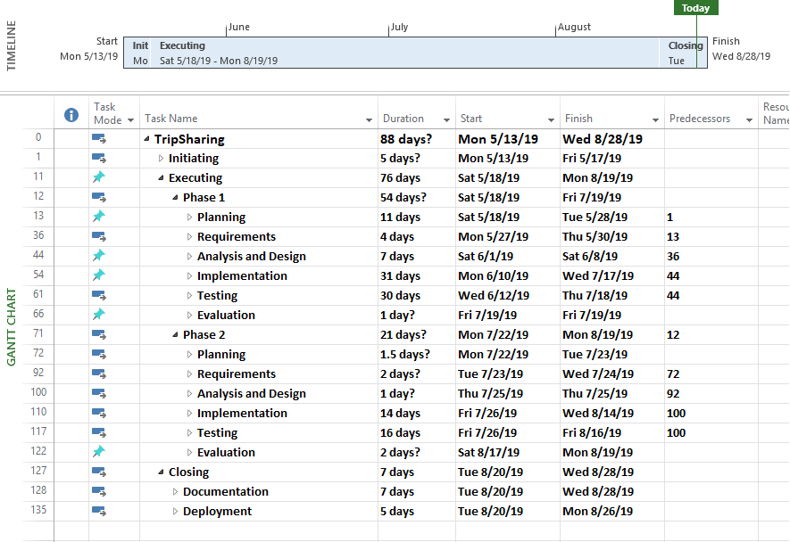
Work Breakdown Structure

Slide 12
TRIP
SHARING
3. SOFTWARE REQUIREMENT SPECIFICATION

Slide 13
Roles
Actor | Description
Guest | Anyone who visits the website and doesn’t have an account yet.
Member | Those who has registered an account on TripSharing.
Administrator | Who has the highest the permission level and has responsible for managing the entire website.
User | Any normal user of following types: Guest, Member, and Administrator

Slide 14
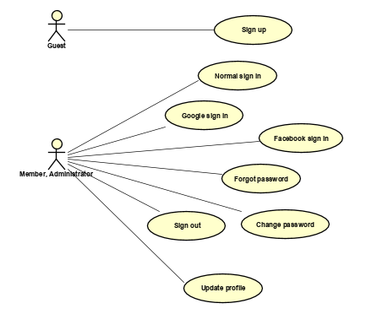
Use case Diagram

Slide 15
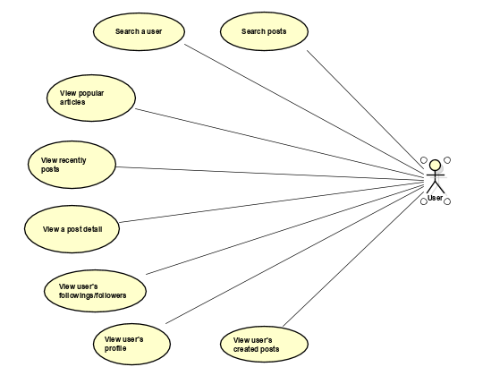
Use case Diagram

Slide 16
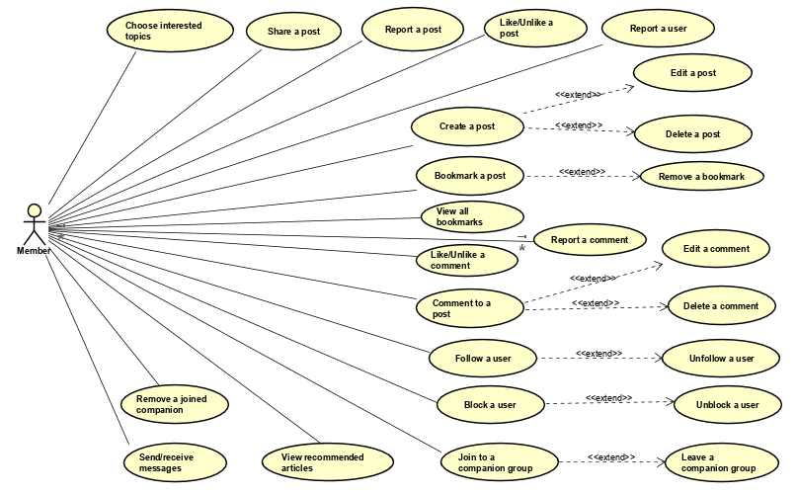
Use case Diagram

Slide 17
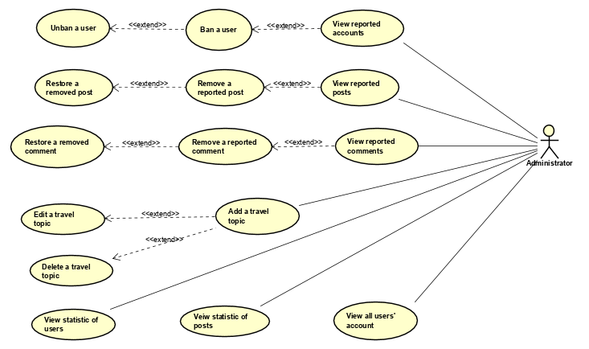
Use case Diagram

Slide 18
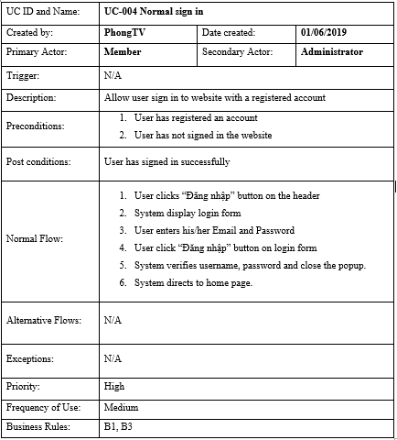
Use case detail example

Slide 19
Non-Functional Requirements
Maintainability And Extensibility | Microservices architecture for backend Object Oriented Programming paradigm is applied in order to ensure scalability & maintainability Using TSLint for a consistent coding convention
Availability and Scalability | Google Cloud service for automatic horizontal scalability Third-party services for convenient development: SendGrid, Google Storage.
Performance | Backend system uses background job for external requests, heavy processing requests such as sending email Load balancer is apply for both front-end instance and back-end instance
Usability | The interface should be elegant and simple Links, buttons and checkboxes are easily clickable Search is available on every page, not just the homepage

Slide 20
TRIP
SHARING
4. SOFTWARE DESIGN

Slide 21
Software Architecture

Slide 22


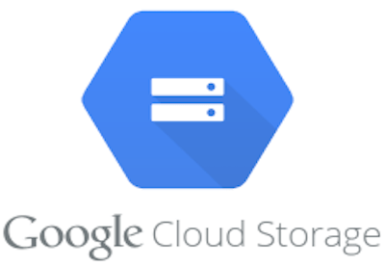


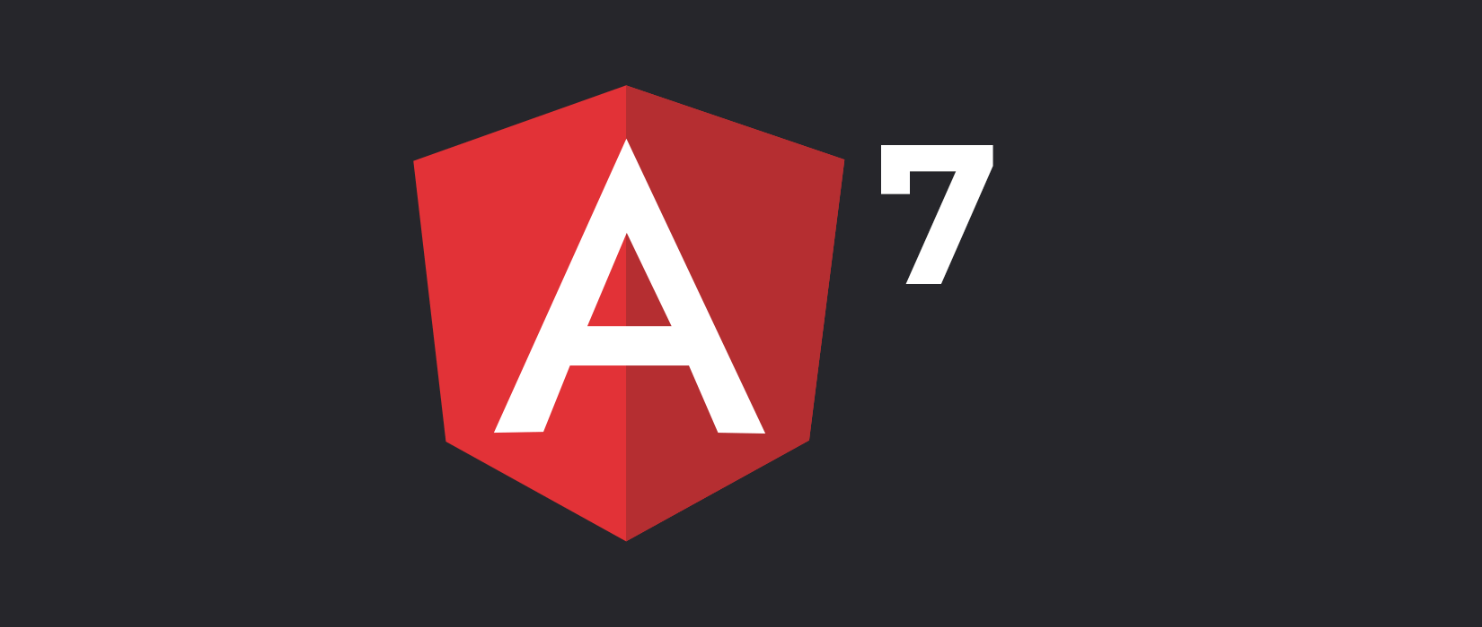
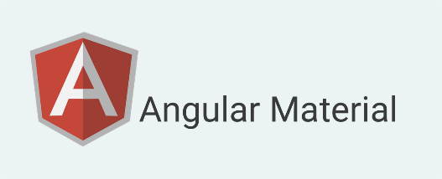



Software Architecture Explanation

Slide 23
Docker
Docker is a platform for developers and sysadmins to develop, deploy, and run applications with containers
Containerization is increasingly popular because containers are:
Flexible: Even the most complex applications can be containerized
Lightweight: Containers leverage and share the host kernel
Interchangeable: You can deploy updates and upgrades on-the-fly
Portable: You can build locally, deploy to the cloud, and run anywhere
Scalable: You can increase and automatically distribute container replicas

Slide 24


Google Cloud
Kubernetes Engine
Is a managed, production-ready environment for deploying containerized applications
Deploy a Wide Variety of Applications
Operate Seamlessly with High Availability
Google cloud load balancing
put your resources behind a single anycast IP and scale your resources up or down with intelligent autoscaling
scale as your users and traffic grow, including easily handling huge, unexpected, and instantaneous spikes

Slide 25
NginX
NginX is open source software for web serving, reverse proxying, caching, load balancing, media streaming.
Reverse Proxy Server:
hiding the existence and characteristics of the actual origin server
distributing the load
compressing and caching content
request / response manipulation

Slide 26
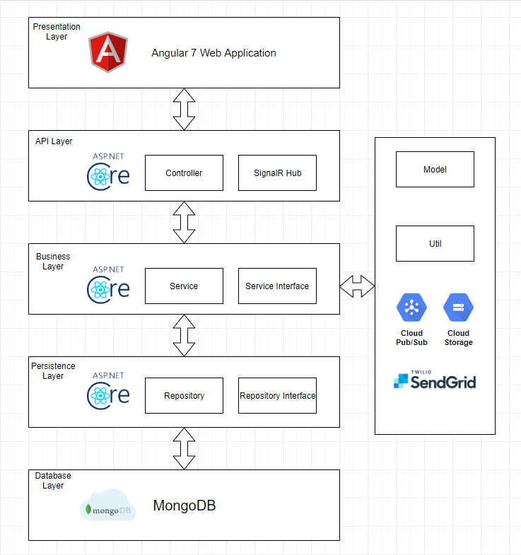
Architecture Layer Design

Slide 27



Database
Schema-less database. No schema migrations anymore
Store the data in a very rich way
{:}
Reliability, Performance & Ease of Use

Slide 28
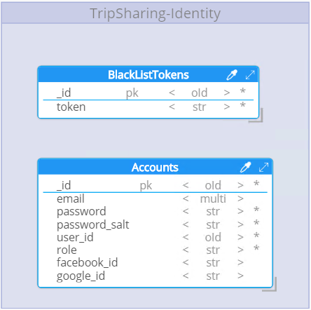
Identity Provider Database Design

Slide 29
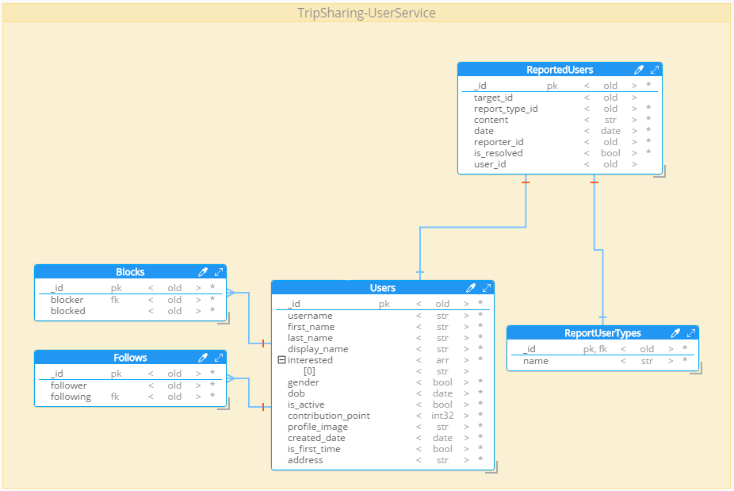
User
Database Design

Slide 30
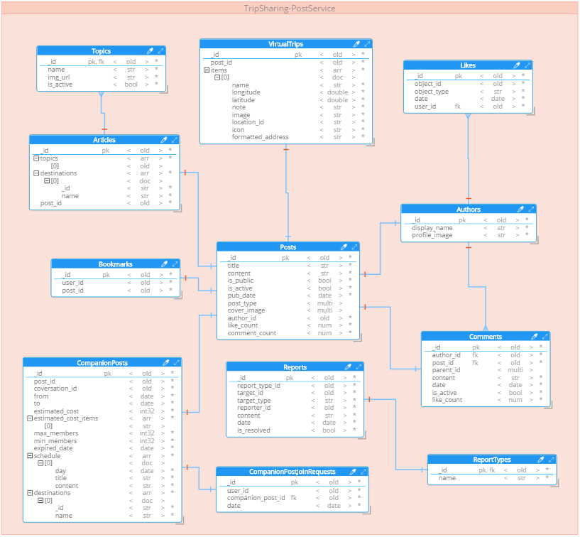
Post Database Design

Slide 31
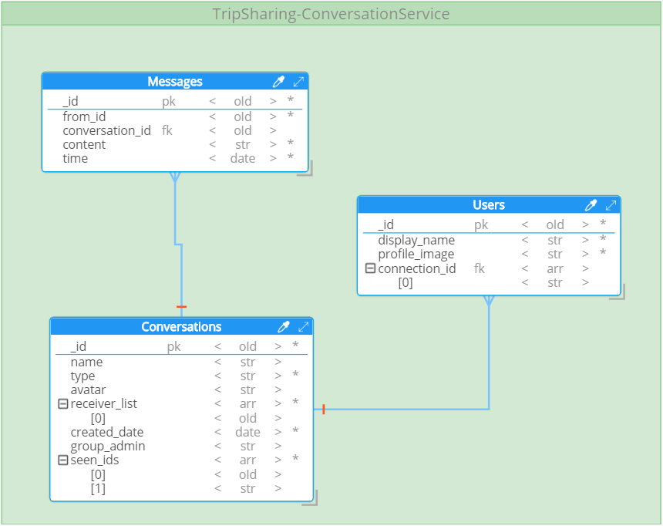
Conversation Database Design

Slide 32
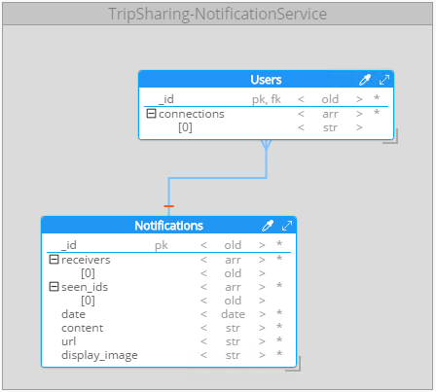
Notification Database Design

Slide 33
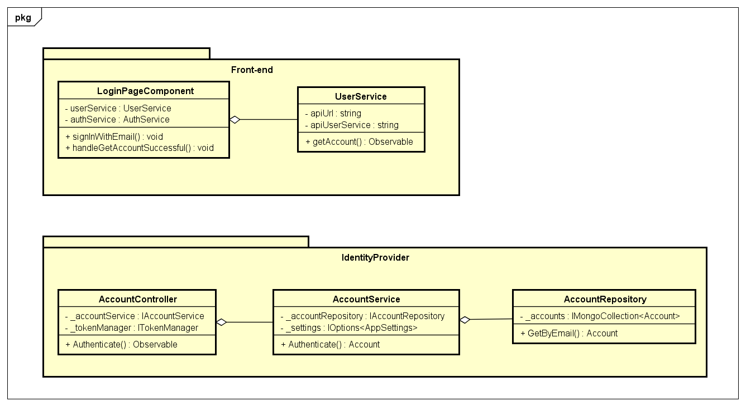
Detail design example
Normal sign in
Class diagram

Slide 34
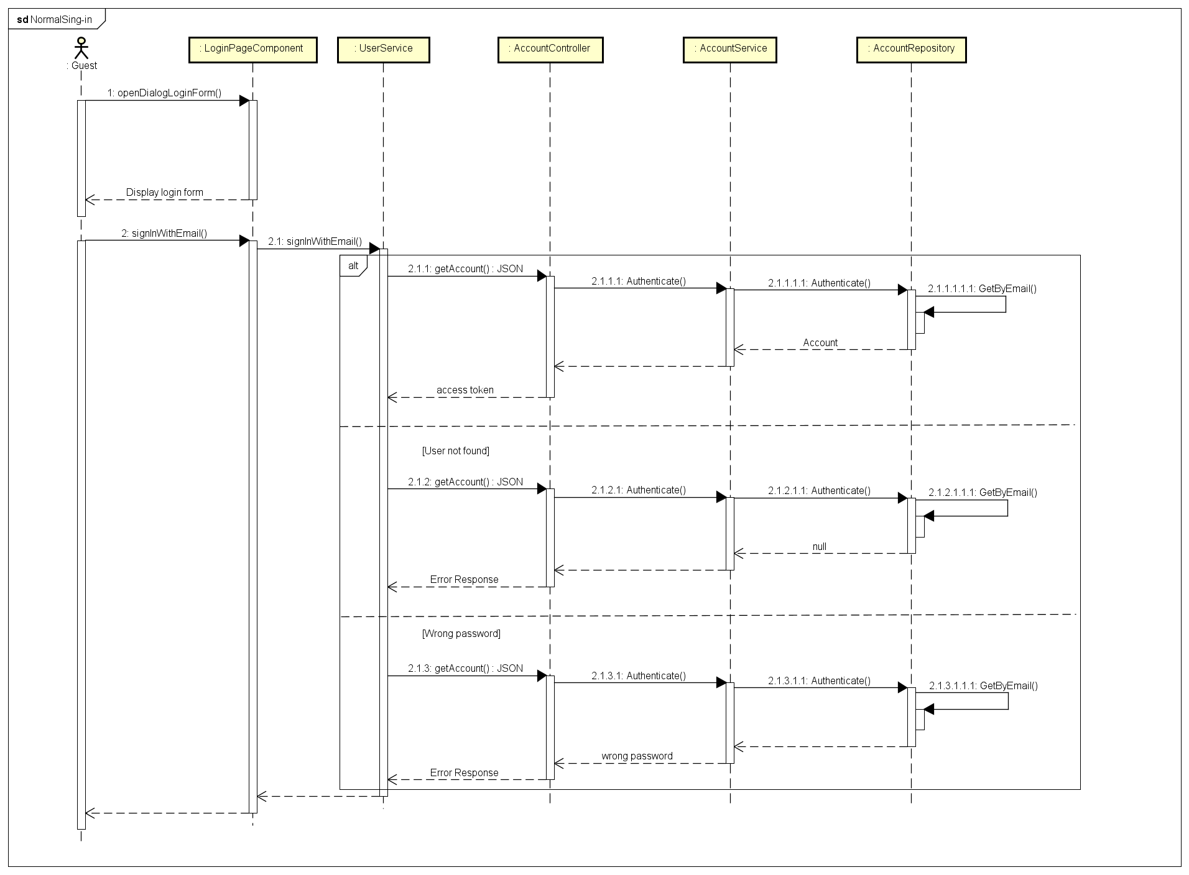
Detail design example
Normal sign in
Sequence diagram

Slide 35
TRIP
SHARING
5. TESTING

Slide 36






Testing Tools

Slide 37
Test Approach
Unit test
Integration test
Test small units of codes
Test group of combined individual modules
Trip
Sharing
Acceptance test
System test
Evaluate system’s compliance with its function requirement
Evaluate system’s compliance with business requirement and assess whether it is acceptable for delivery

Slide 38
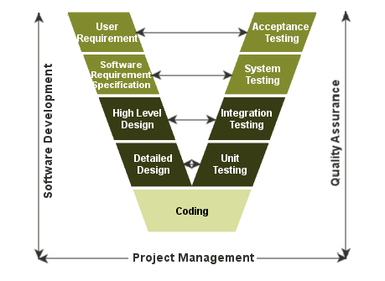
Test Model

Slide 39
Test Report
Unit Test | 259 test cases
Integration Test | 406 test cases
System Test | Xx test cases
Coverage | Xx %

Slide 40
TRIP
SHARING
6. DEMONSTRATION

Slide 41
Thank You

