Slide 1
TripSharing

Slide 2






Hà Văn Thái
Nguyễn Văn Phong
Our Team
Lí Phúc Linh
Instructor.
Đào Trọng Duy
Trần Văn Phong
Lê Xuân Trường

Slide 3
01
Introduction
02
Project Management
03
Requirement Specifications
Agenda
04
Software Design
05
Testing
06
Demonstration

Slide 4
TRIP
SHARING
1. INTRODUCTION

Slide 5
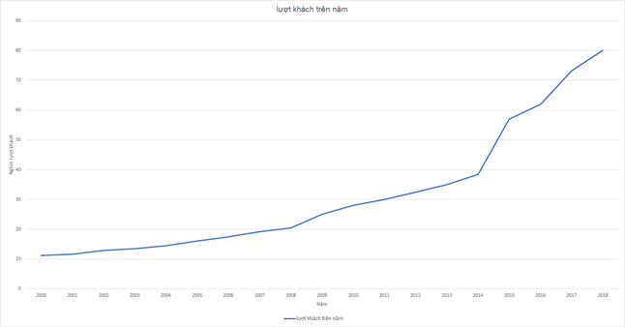




Background
Number of tourist in Vietnam increase rapidly
Young tourists tend to explore wild place
People love to talk about their experience
Some people feel difficult to find a travel companion
Number of local tourists reach 80 million in 2018
Notes:
Explain why people love to talk about their experience
Explain why it’s hard to find a travel companion nowadays

Slide 6


Slide 7



Exist system
Advantages
They already have a booking system
They have huge amount of data
Limitations
They only focus on famous travel destination
Their finding-travel-companion feature doesn’t have a group chat for discussion
Notes:
Explain why people love to talk about their experience
Explain why it’s hard to find a travel companion nowadays

Slide 8

Our proposal
Focus on both well-known and lesser-known travel places, even if it has not be discovered
Allows users to share their travel experience by articles and images
All users’ contribution on the system are recorded as point
Has finding-travel-companion feature
Notes:
Explain why people love to talk about their experience
Explain why it’s hard to find a travel companion nowadays

Slide 9
TRIP
SHARING
2. PROJECT MANAGEMENT

Slide 10
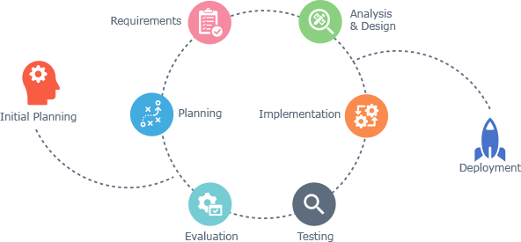
Software Development Process
Advantages:
Generates working software quickly and early during the software lifecycle
This model is more flexible – less costly to change scope and requirements
It is easier to test and debug during a smaller iteration
Easier to manage risk because risky pieces are identified and handled during its iteration
Iterative and Incremental Software Development Model
Notes:
<UPDATE PROS & WHY>

Slide 11
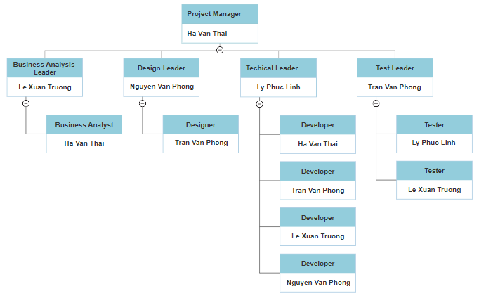
Organization Structure

Slide 12
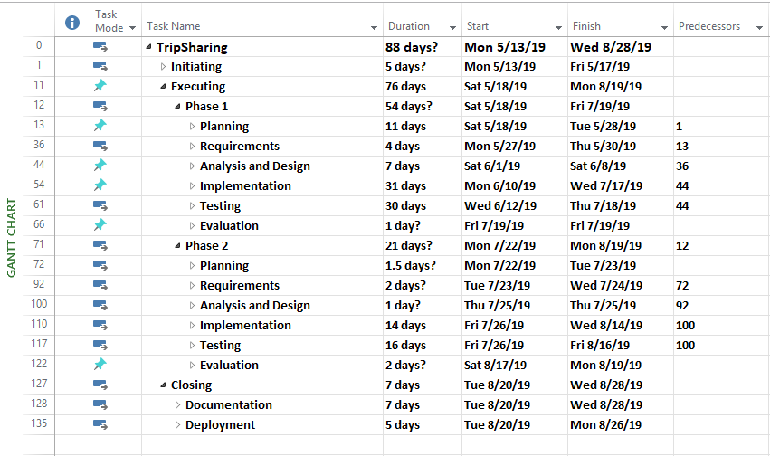
Work Breakdown Structure

Slide 13
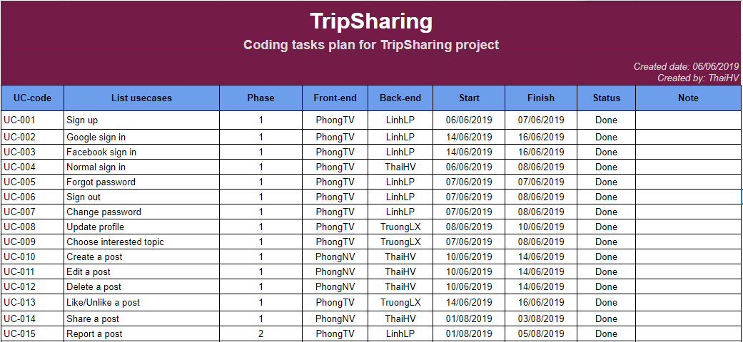
Coding Use case plan

Slide 14
TRIP
SHARING
3. SOFTWARE REQUIREMENT SPECIFICATION

Slide 15
Roles
Actor | Description
Guest | Anyone who visits the website and doesn’t have an account yet.
Member | Those who has registered an account on TripSharing.
Administrator | Who has the highest the permission level and has responsible for managing the entire website.

Slide 16
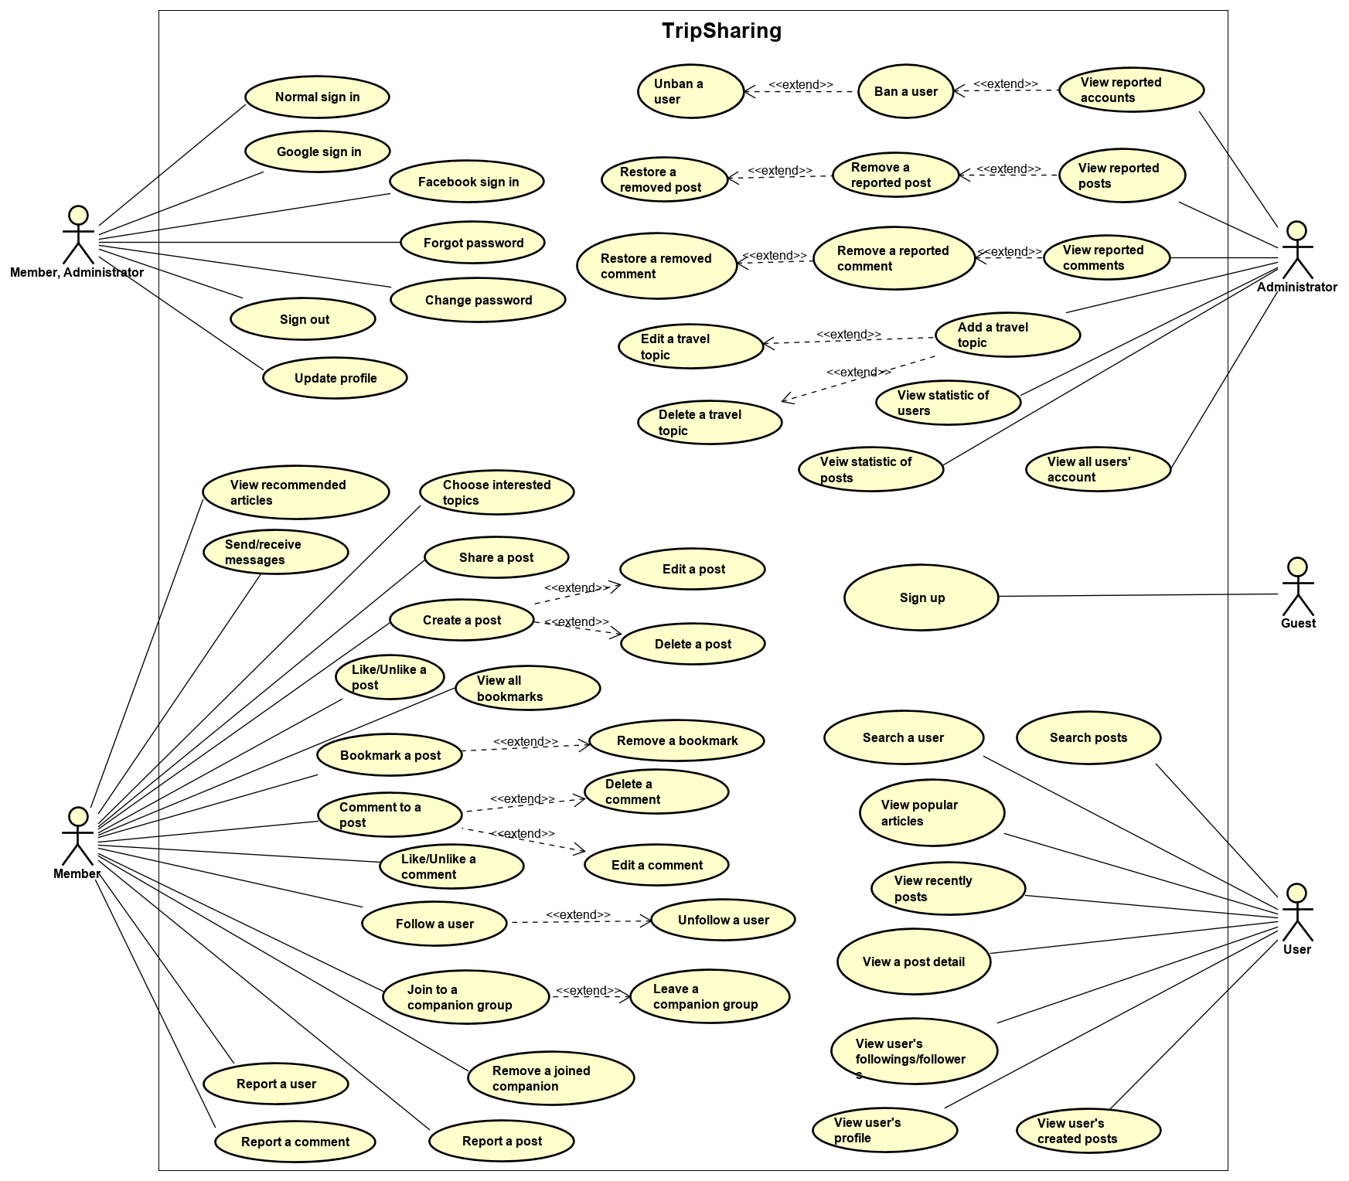
Use case Diagram

Slide 17
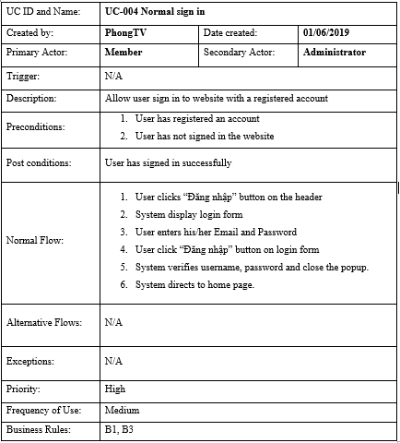
Use case detail example

Slide 18
Non-Functional Requirements
Security | Use token-based authentication to validate authorize request All query made to MongoDB must be escaped so no NoSQL Injection All passwords are encrypted with salt
Maintainability | Microservices architecture for backend Object Oriented Programming paradigm is applied Using TSLint for a consistent coding convention
Availability | Google Cloud service for automatic horizontal scalability Load balancing technique are applied for both frontend and backend instances.
Performance | Backend system uses background job for external requests, heavy processing requests such as sending email
Usability | Links, buttons and checkboxes are easily clickable All significant actions on website have confirm dialog Search is available on every page, not just the homepage

Slide 19
TRIP
SHARING
4. SOFTWARE DESIGN

Slide 20
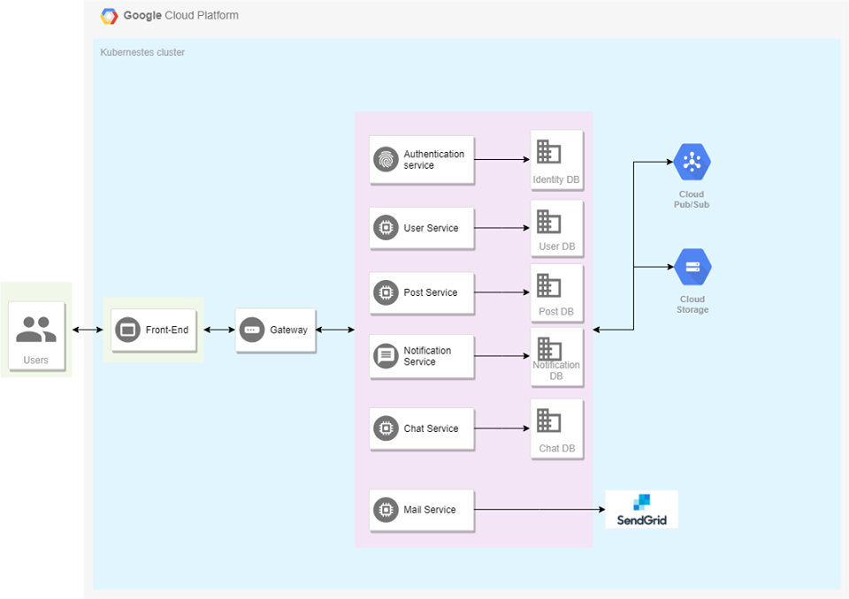
Software Architecture

Slide 21










Software Architecture Explanation

Slide 22
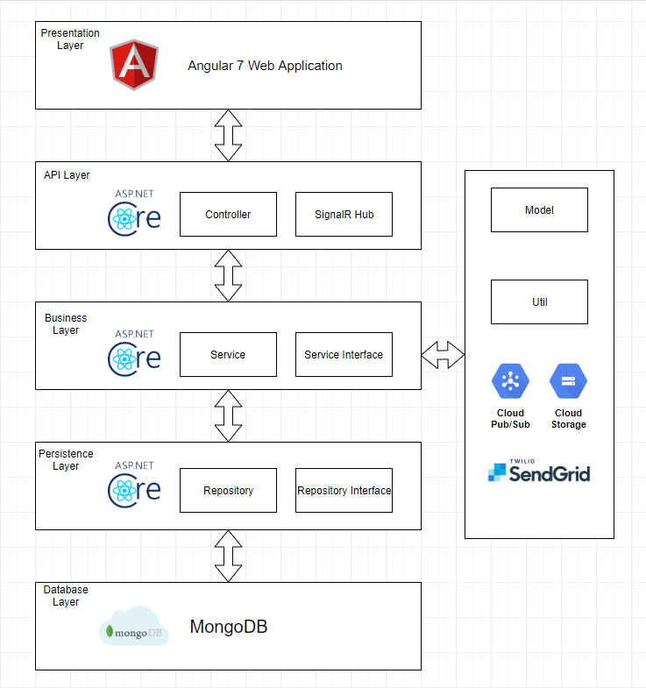
Architecture Layer Design

Slide 23
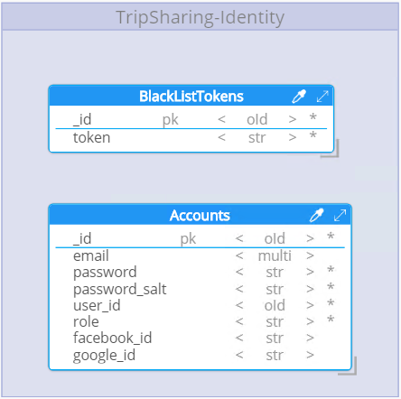
Identity Provider Database Design

Slide 24
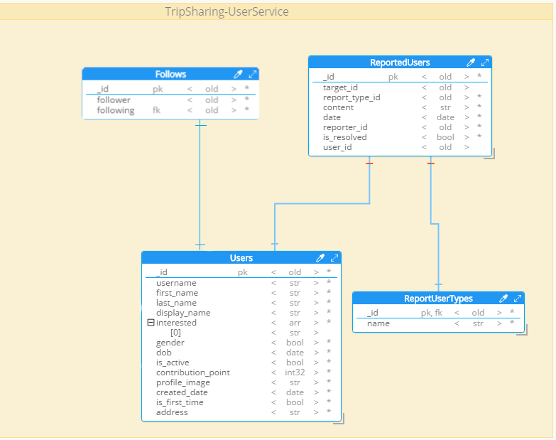
User
Database Design

Slide 25
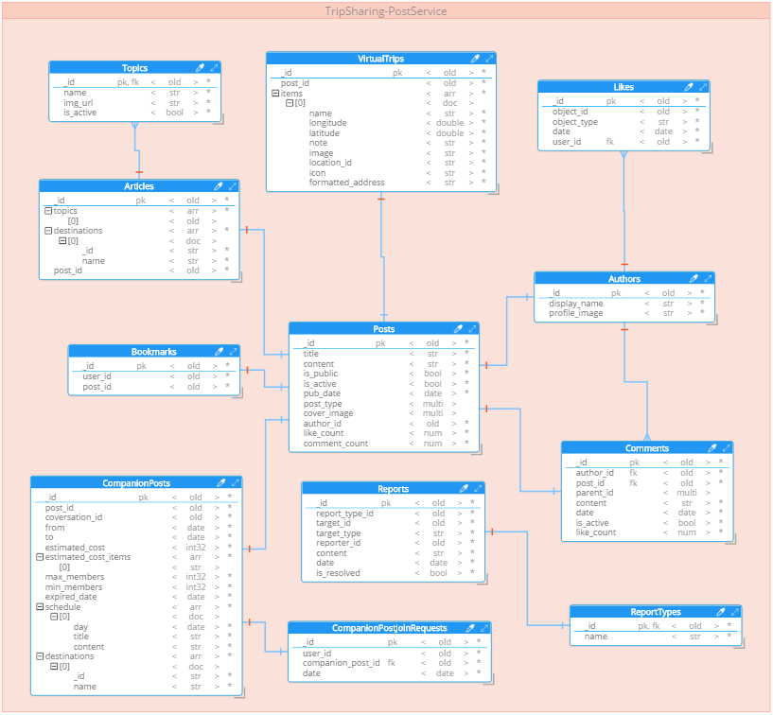
Post Database Design

Slide 26
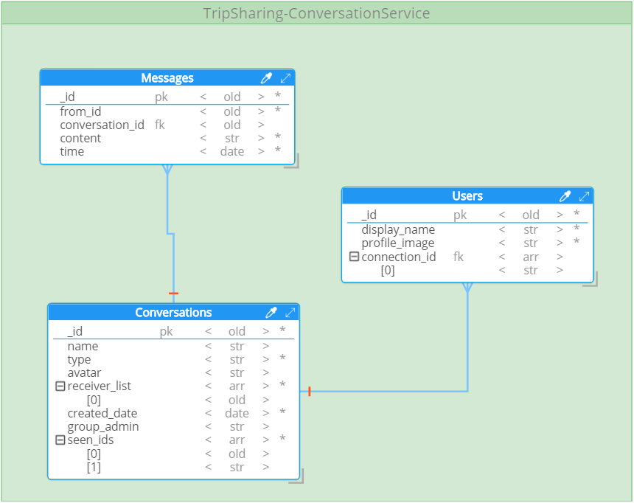
Conversation Database Design

Slide 27
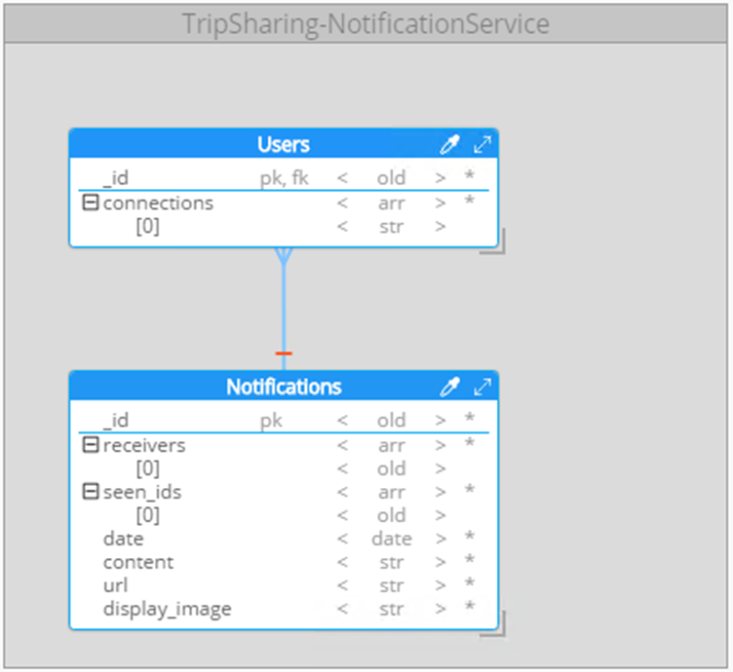
Notification Database Design

Slide 28
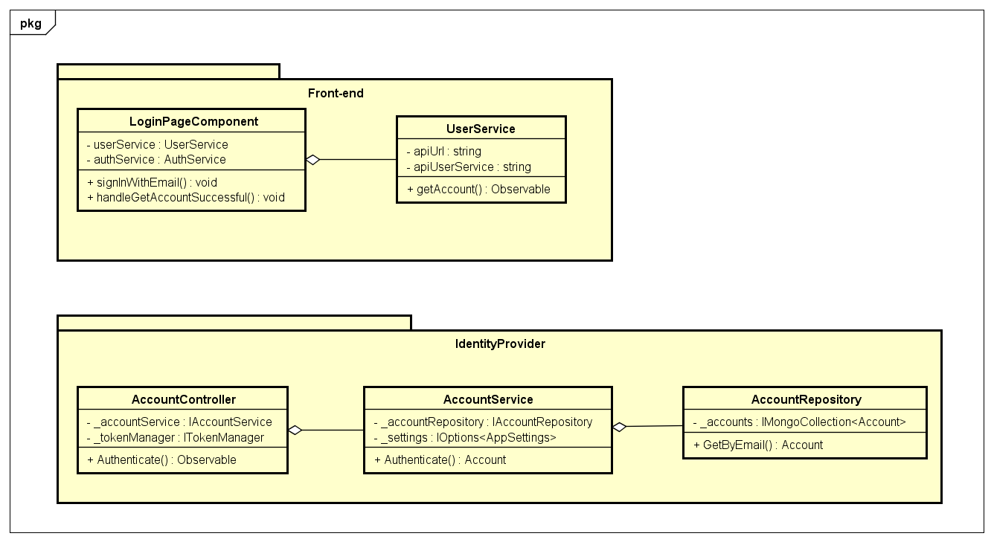
Detail design example
Normal sign in
Class diagram

Slide 29
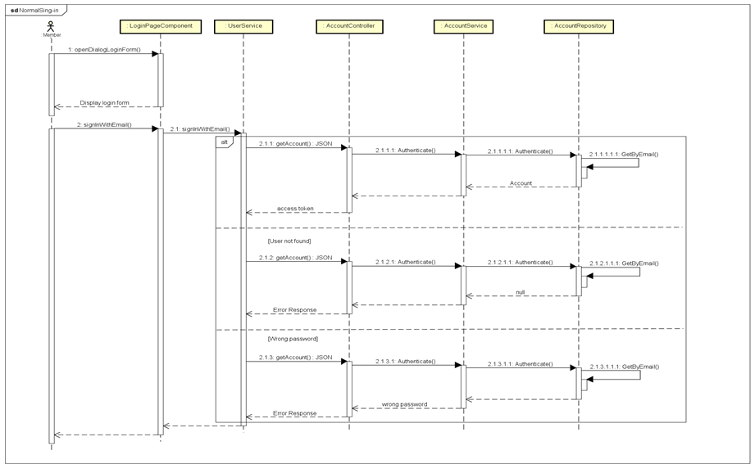
Detail design example
Normal sign in
Sequence diagram

Slide 30
TRIP
SHARING
5. TESTING

Slide 31






Testing Tools
Notes:
- Talk more about every tools

Slide 32
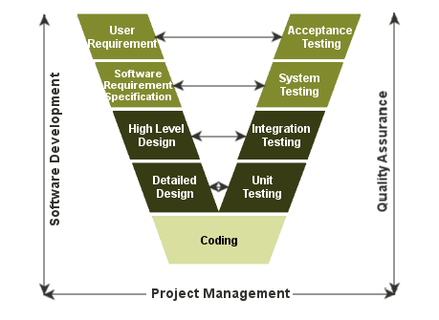
Test Model
Notes:
- Unit test: Test small units of codes
- Integration test: Test group of combined individual modules
- System test: Evaluate system’s compliance with its function requirement
- Acceptance test: Evaluate system’s compliance with business requirement and assess whether it is acceptable for delivery

Slide 33
Test Report
 | Number of test cases
Unit Test | 249
Integration Test | 398
System Test | 105
Coverage | 78%

Slide 34
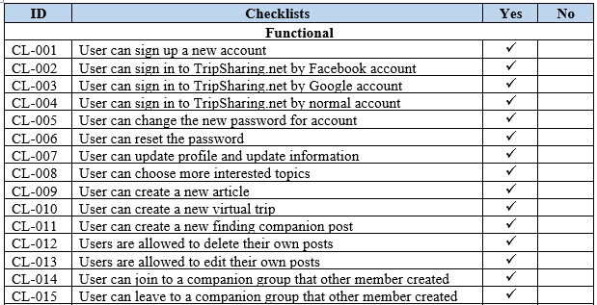
Acceptance Test

Slide 35
TRIP
SHARING
6. DEMONSTRATION

Slide 36
Thank You

