Slide 1
Assignment - 1
Group - 1

Slide 2
Q1 - Object Detection and Depth Estimation
Task A:
Record data and train Yolo model. Show model performance
Task B:
Display output from model
Task C:
Find depth and placement of box

Slide 3
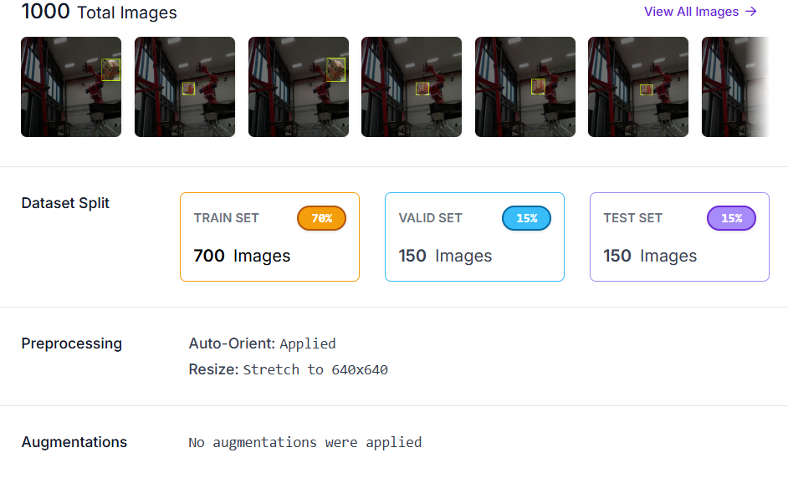
Task A
Data set
  1000 images
    700 train
    150 test
    150 val
Labeled using roboflow
Stretched to 640x640
No augmentation

Slide 4
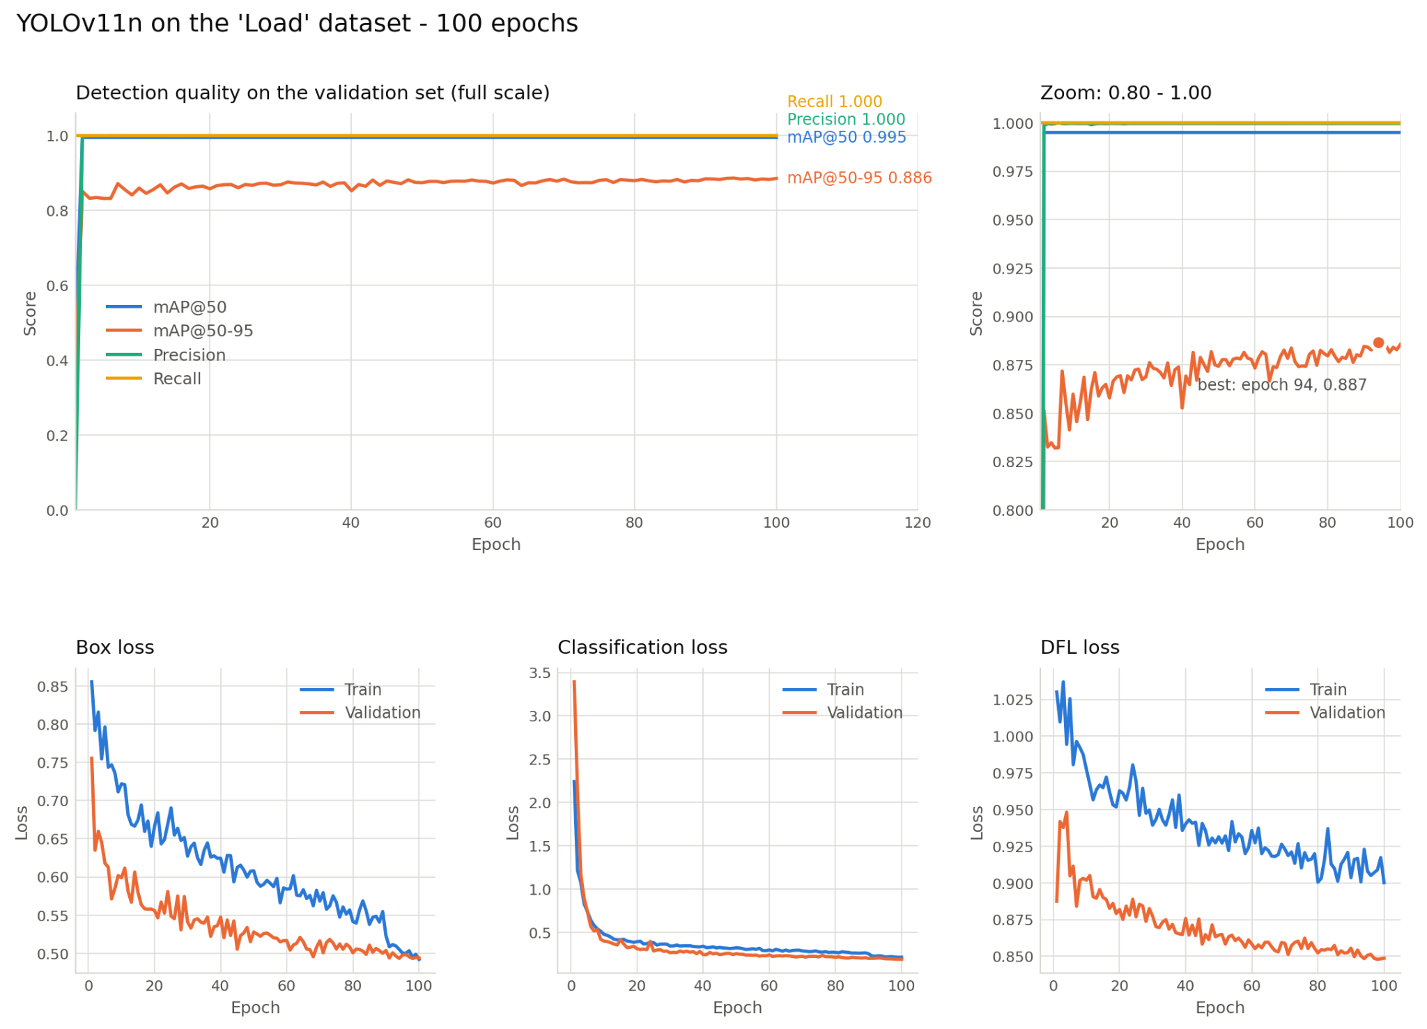
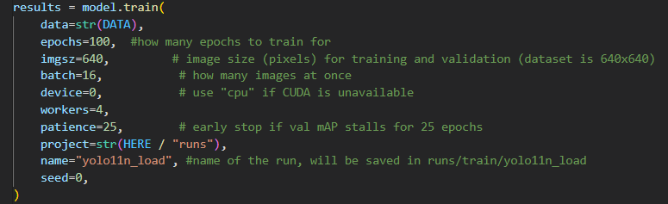
Task A
Goal:
  Train a model
Yolo v11 nano
  12 min to train
  Only 1 class
  2.9 million parameters
Notes:
Deteksjonsmetrikker (øverst):
Precision (1.000) – av alt modellen sa var et objekt, hvor stor andel som faktisk stemte. Høy precision = få falske alarmer.
Recall (1.000) – av alle objekter som faktisk fantes i bildene, hvor stor andel modellen klarte å finne. Høy recall = få objekter blir oversett.
mAP@50 (0.995) – "mean Average Precision" der en deteksjon regnes som riktig hvis boksen overlapper minst 50 % med fasit. En relativt snill terskel, derfor så høy score.
mAP@50-95 (0.886) – samme mål, men snittet over flere strenge overlapp-krav (50–95 %). Krever at boksen sitter presist, ikke bare "omtrent riktig". Dette regnes som den mest realistiske kvalitetsindikatoren, og 0.886 er fortsatt et solid resultat.
Loss-kurver (nederst) – jo lavere, jo bedre modellen lærer:
Box loss – hvor mye feil modellen gjør på plasseringen av bounding boxen (koordinater).
Classification loss – hvor mye feil modellen gjør på å gjette riktig klasse for objektet.
DFL loss – finjustering av selve boks-kantene, en teknikk moderne YOLO-versjoner bruker for skarpere lokalisering.

Slide 5
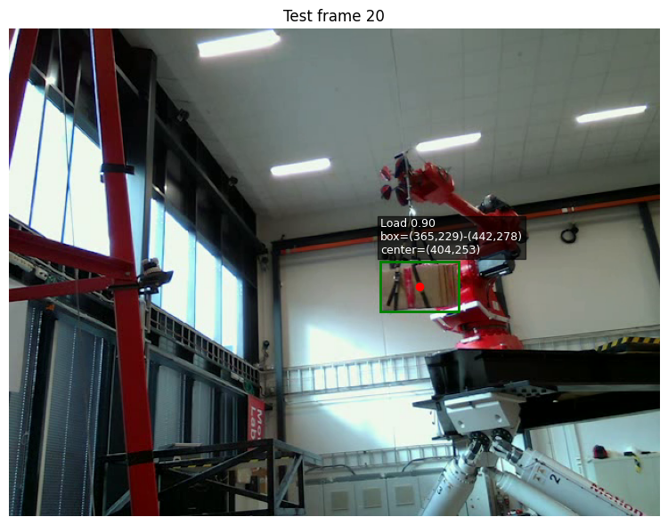
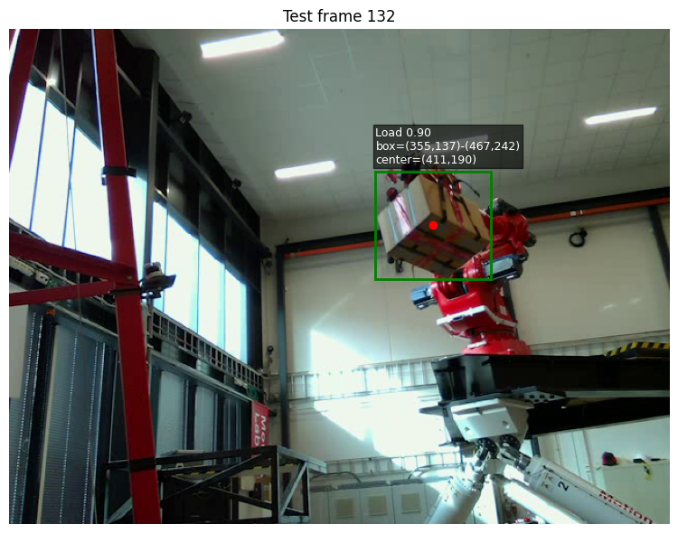
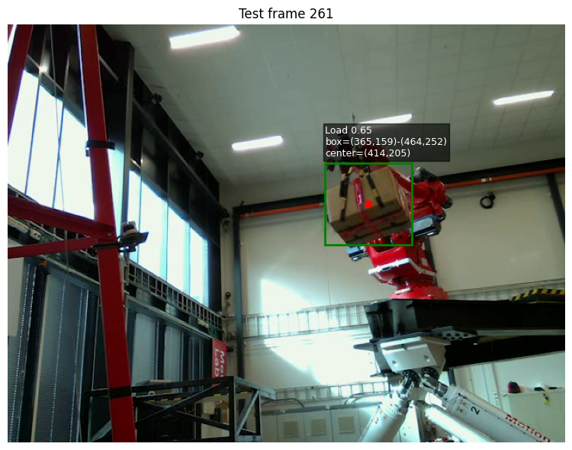
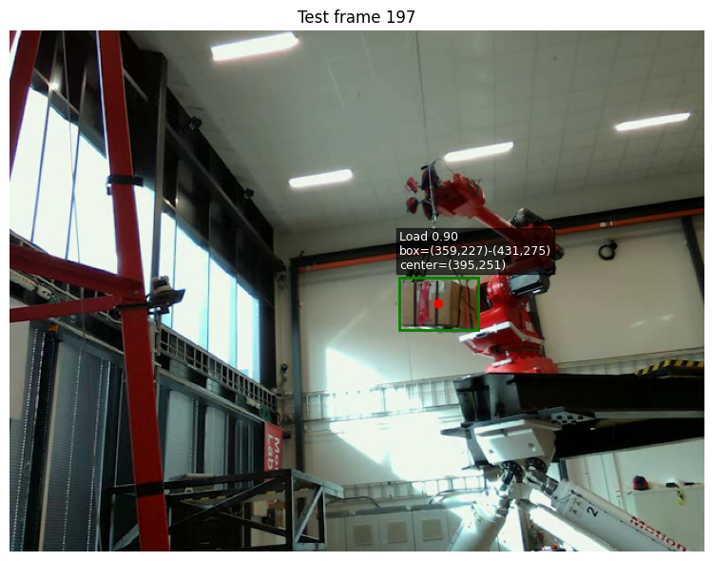
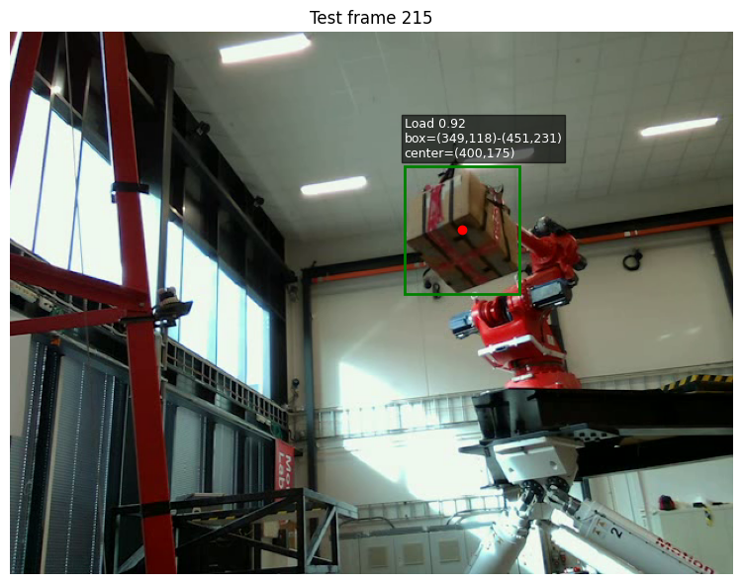
Task B
Goal :
  Sample 5 images and run model, and display output
Method:
  Used on data the model has not seen before
  Location shown by pixel count
  Box size shown
  Shows probability

Slide 6
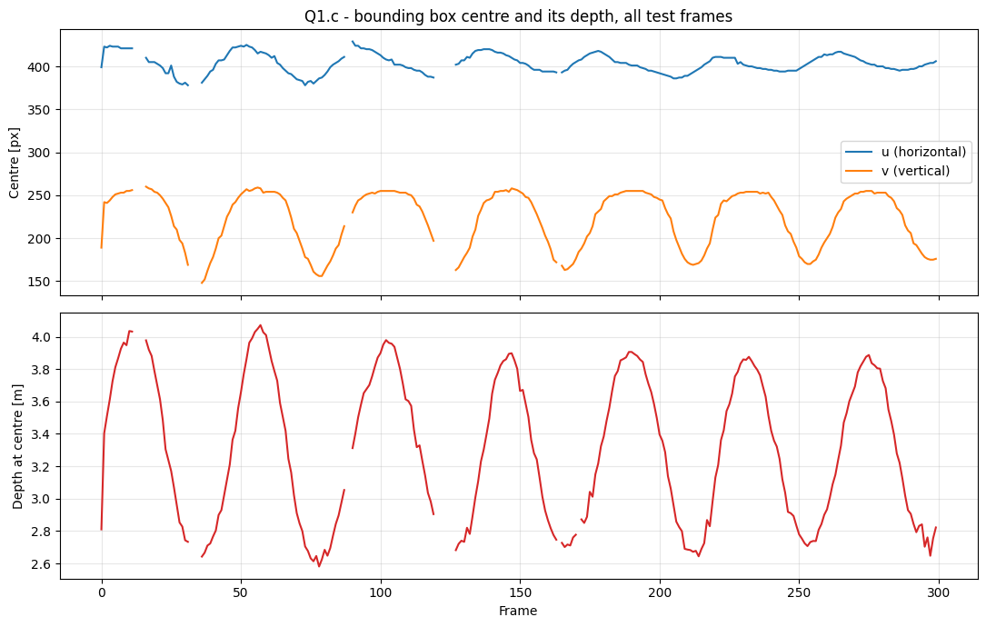
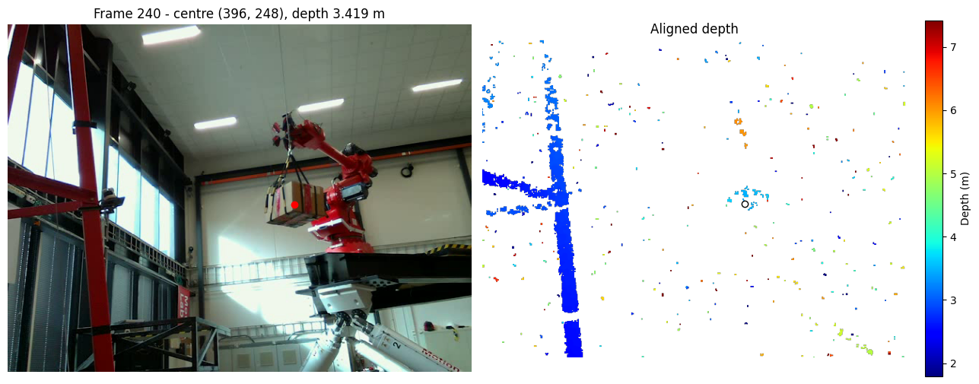
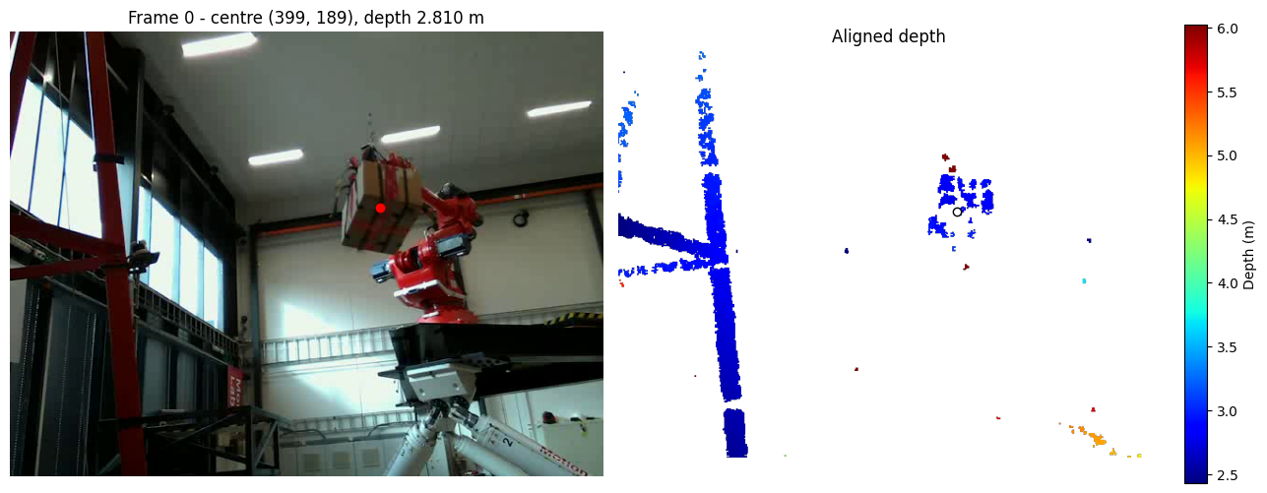
Task C
Goal:
  Find the depth of all images
Method/issues:
Model loss
Show depth at center
Depthmap

Slide 7
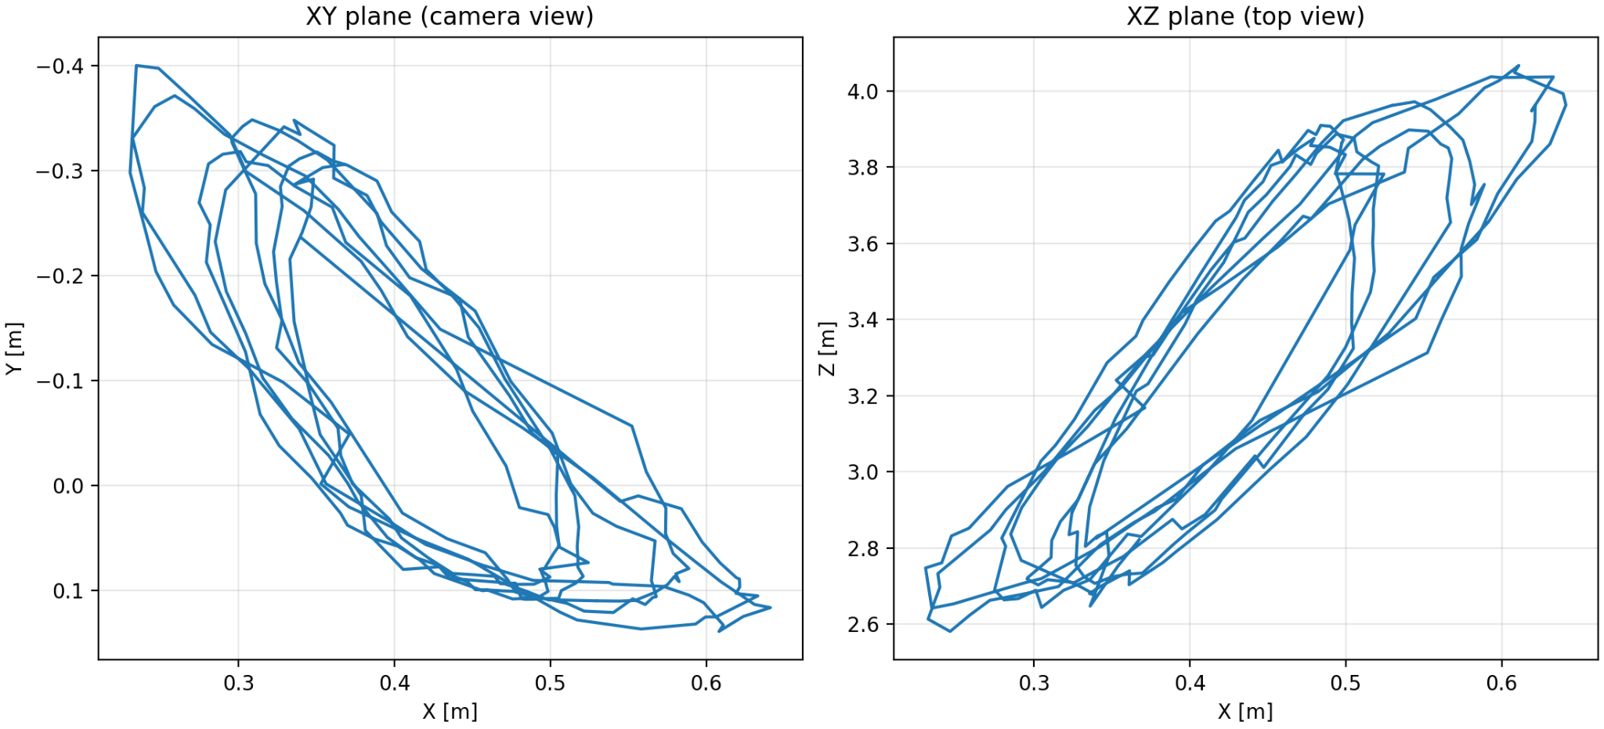
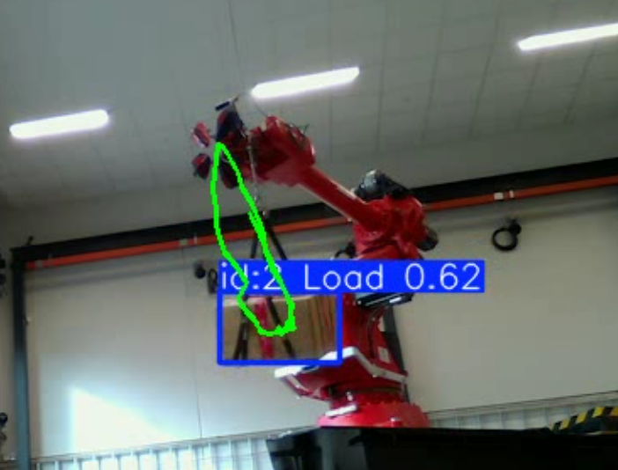
Q2 - Object Tracking
Objective
Track the swinging load and recover its 3D trajectory.
Method
Tracking with the YOLO model trained in Q1
Depth at the box centre from the L515, deprojected to (X, Y, Z)
Results
Repeated elliptical loops show a steady periodic swing
Largest motion is along depth (Z ≈ 2.6–4.1 m).

Slide 8
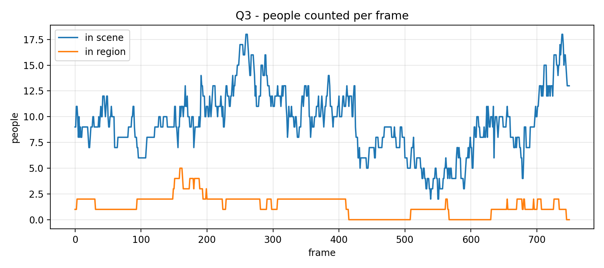
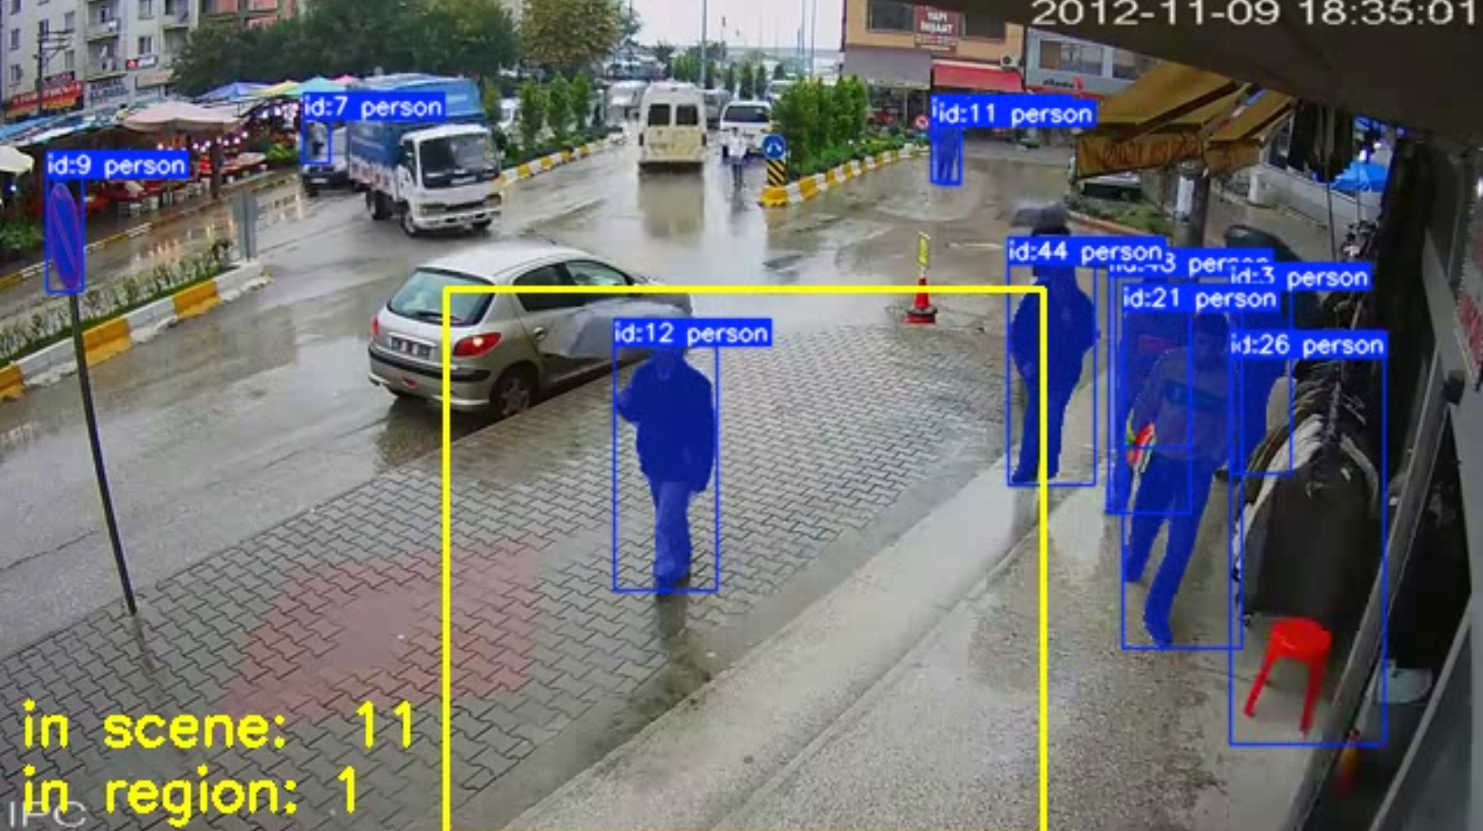
Q3 - Multi Object Segmentation, Tracking and Counting
Objective
Segment, track and count people in a video, both in the whole scene and inside a marked region.
Method
COCO-pretrained YOLO11 segmentation model with built-in tracking (class "person")
A person counts as "in region" when their box centre is inside the polygon
Results
Scene count varies between 2 and 18 people, typically 7–13
The region holds 0–5 people, usually 1–2

Slide 9
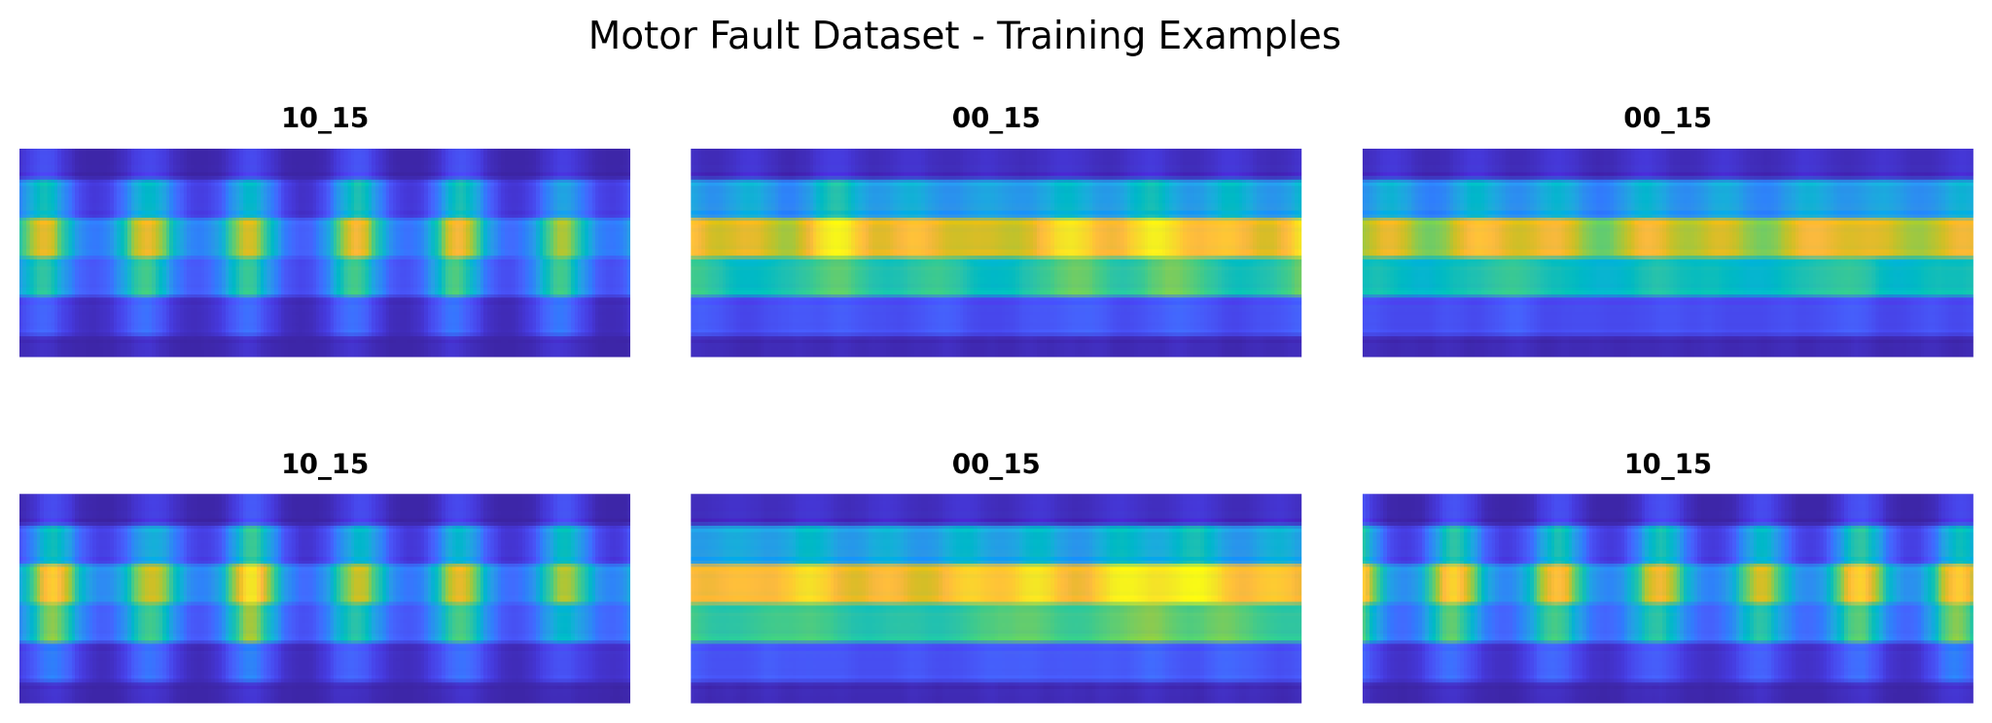
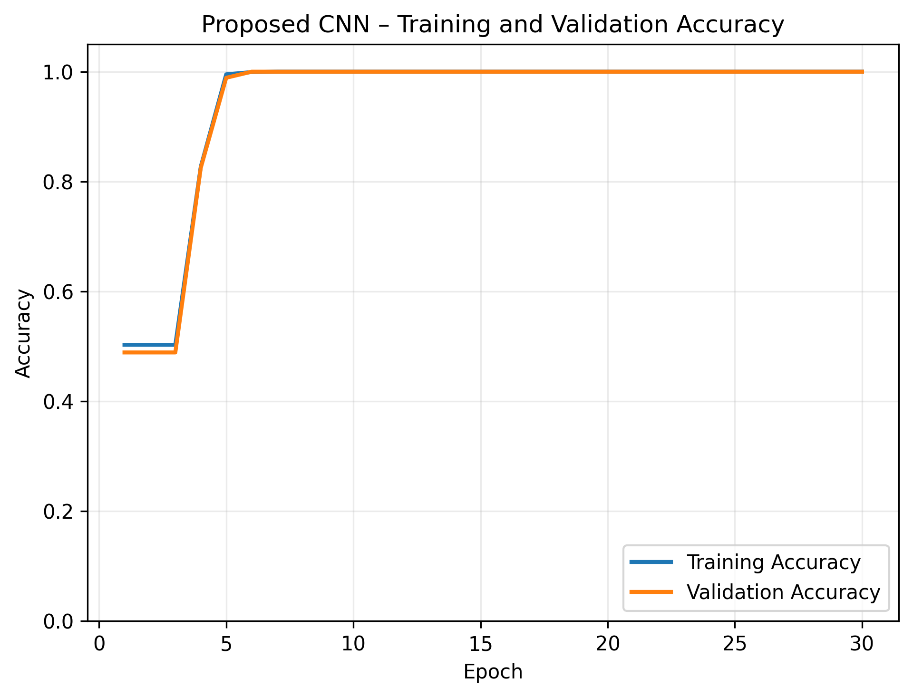
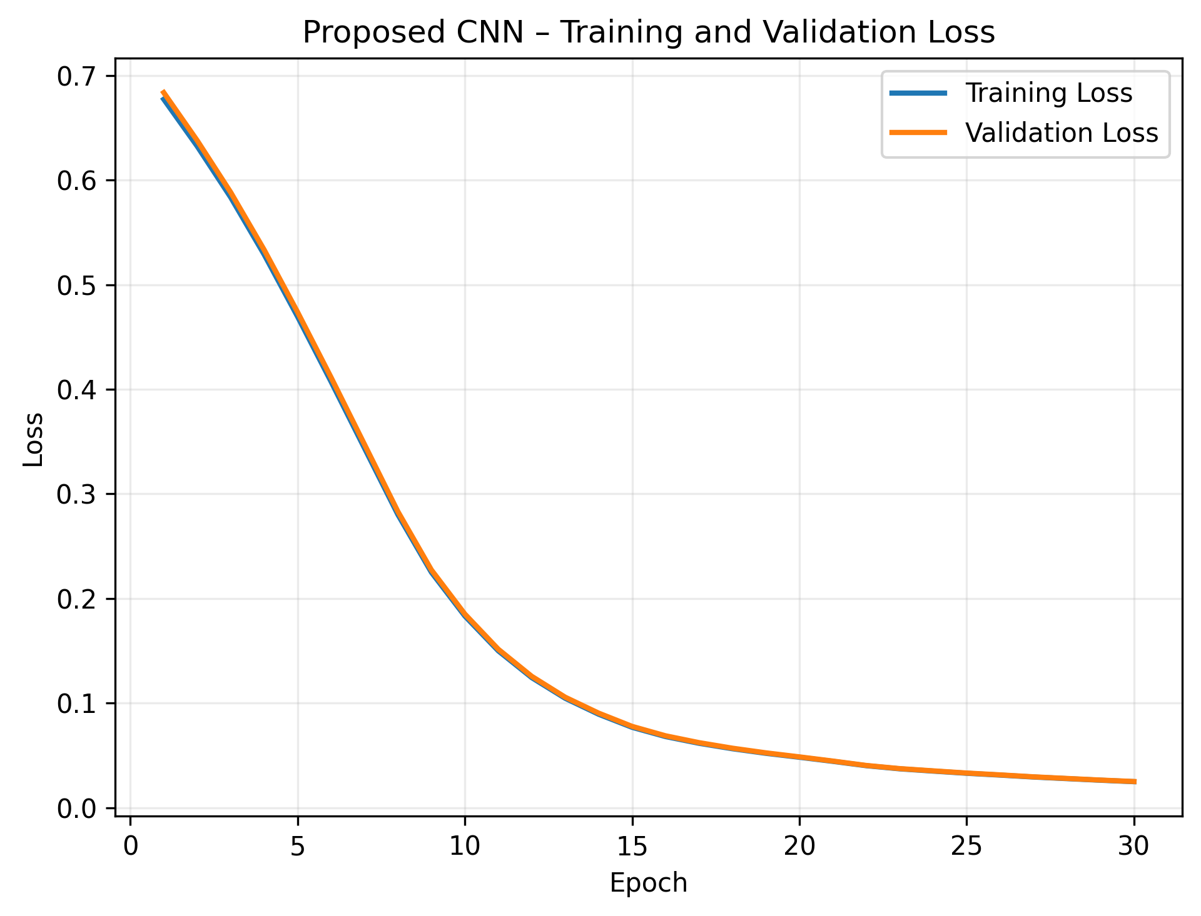
Q4 - Classification
Objective
Classify motor condition (00_15 vs 10_15) from signal images with a small CNN, and compare it to the class baseline.
Method
Fully convolutional CNN: 3 conv blocks + global average pooling
Same data and 30 epochs for both models
Results
Test accuracy 99.5% vs 98.0% for the baseline (1 of 200 wrong)
82% fewer parameters (1,681 vs 9,339) and converges by epoch 6
Slightly slower inference (1.03 vs 0.74 ms/image)

Slide 10
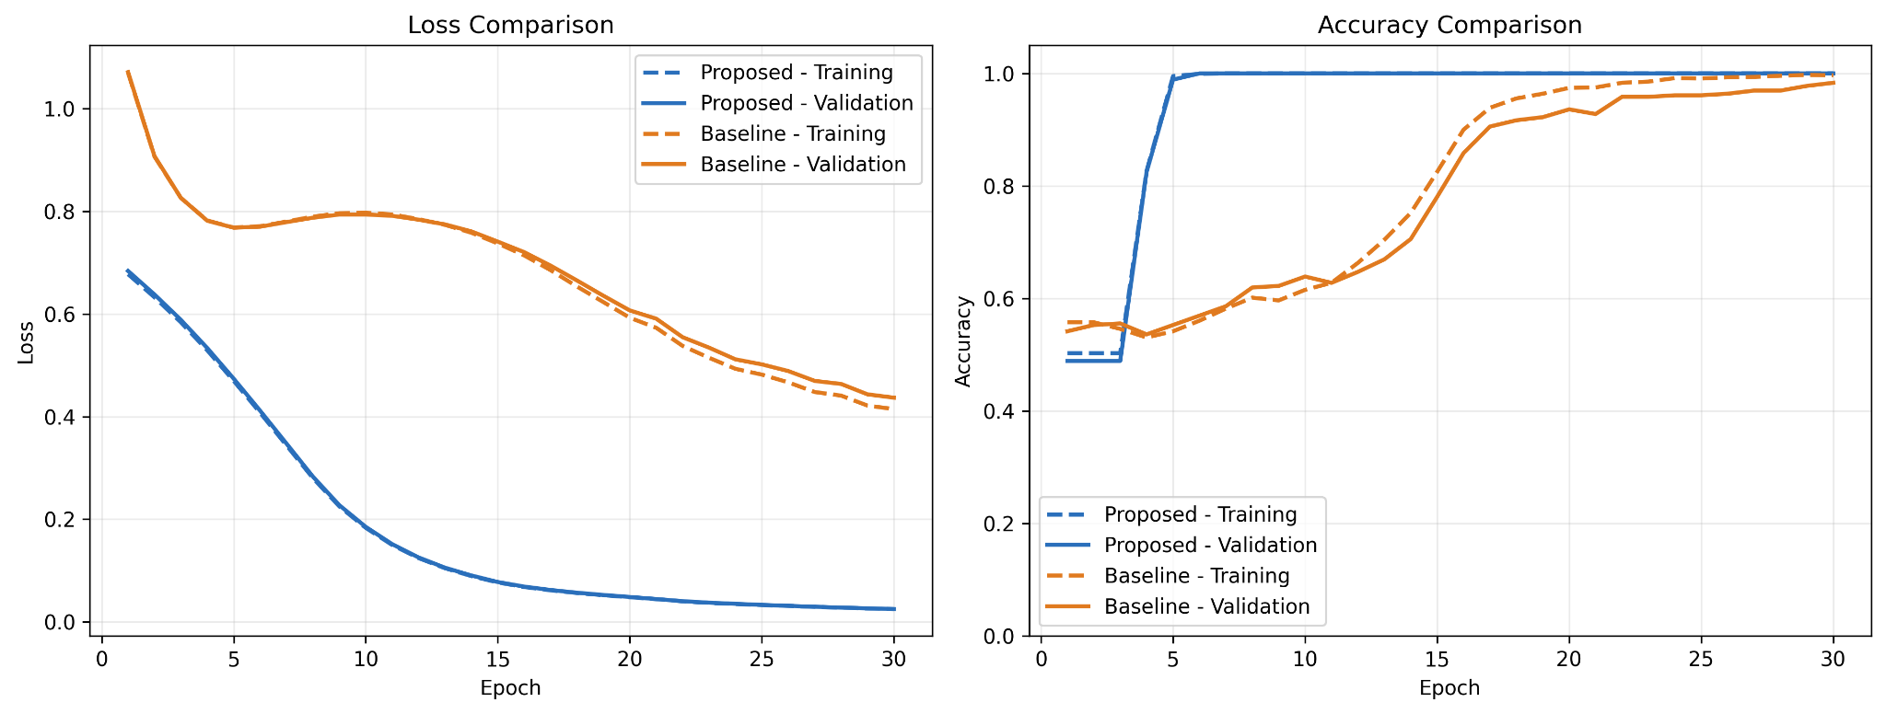
Q4 - Classification

Slide 11
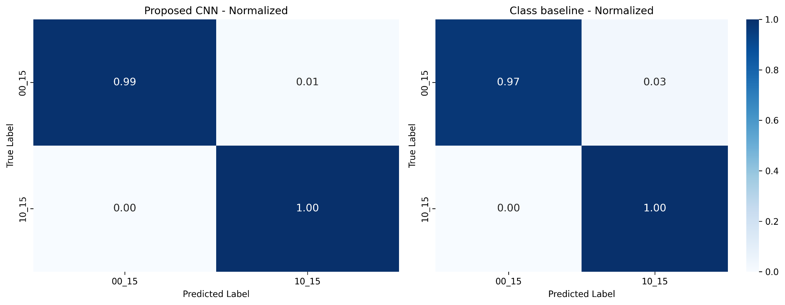
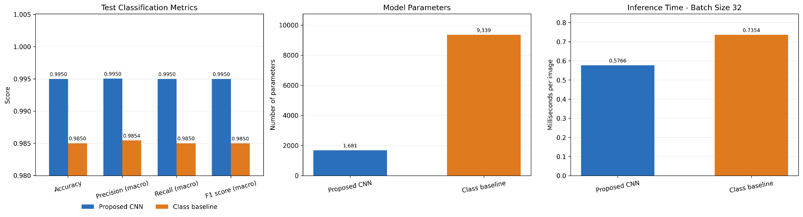
Q4 - Classification

Slide 12
Q5 - Classification - Transfer Learning
Objective
Compare model fusion, transfer learning and fine-tuning for CIFAR-10 classification.
Method
Fusion: frozen MobileNetV2 + EfficientNetB0 features, concatenated
Transfer learning: frozen MobileNetV2, same linear head
Fine-tuning: last 40 MobileNetV2 layers retrained with augmentation
Results
Fusion is most accurate (90.0%), ahead of fine-tuning (89.0%) and transfer learning (86.4%)
Fusion trains in 165 s, against about 2,350 s for fine-tuning
Transfer learning has the fastest inference (0.72 ms/image)
Cat vs. dog is the hardest pair for all three methods
Fusion trains fast because the backbones are frozen: features are extracted once and only a small linear head is trained. Fine-tuning must update 1.68M weights through the full network every epoch.

Slide 13
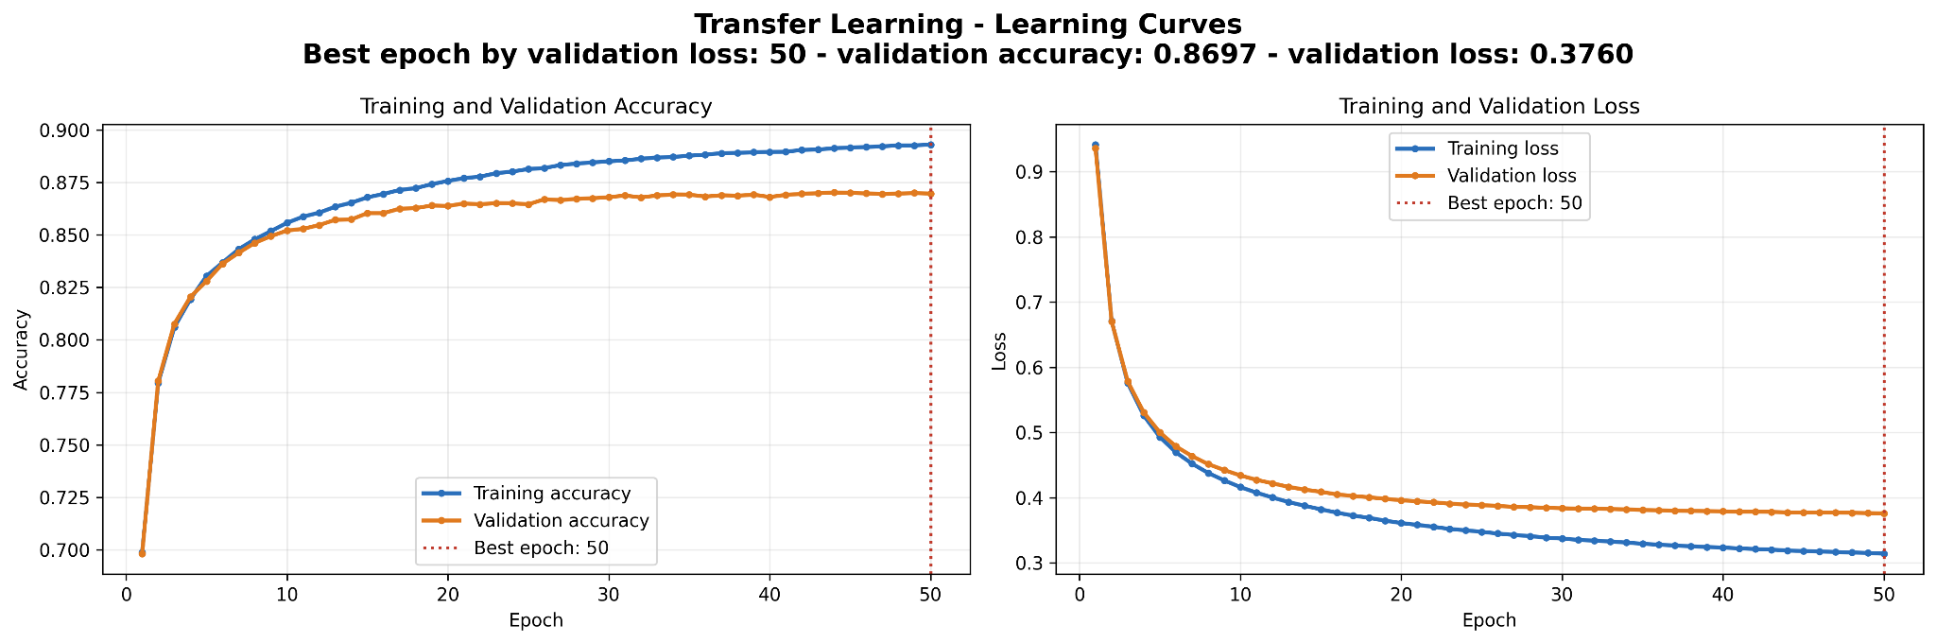
Q5 - Classification - Transfer Learning

Slide 14
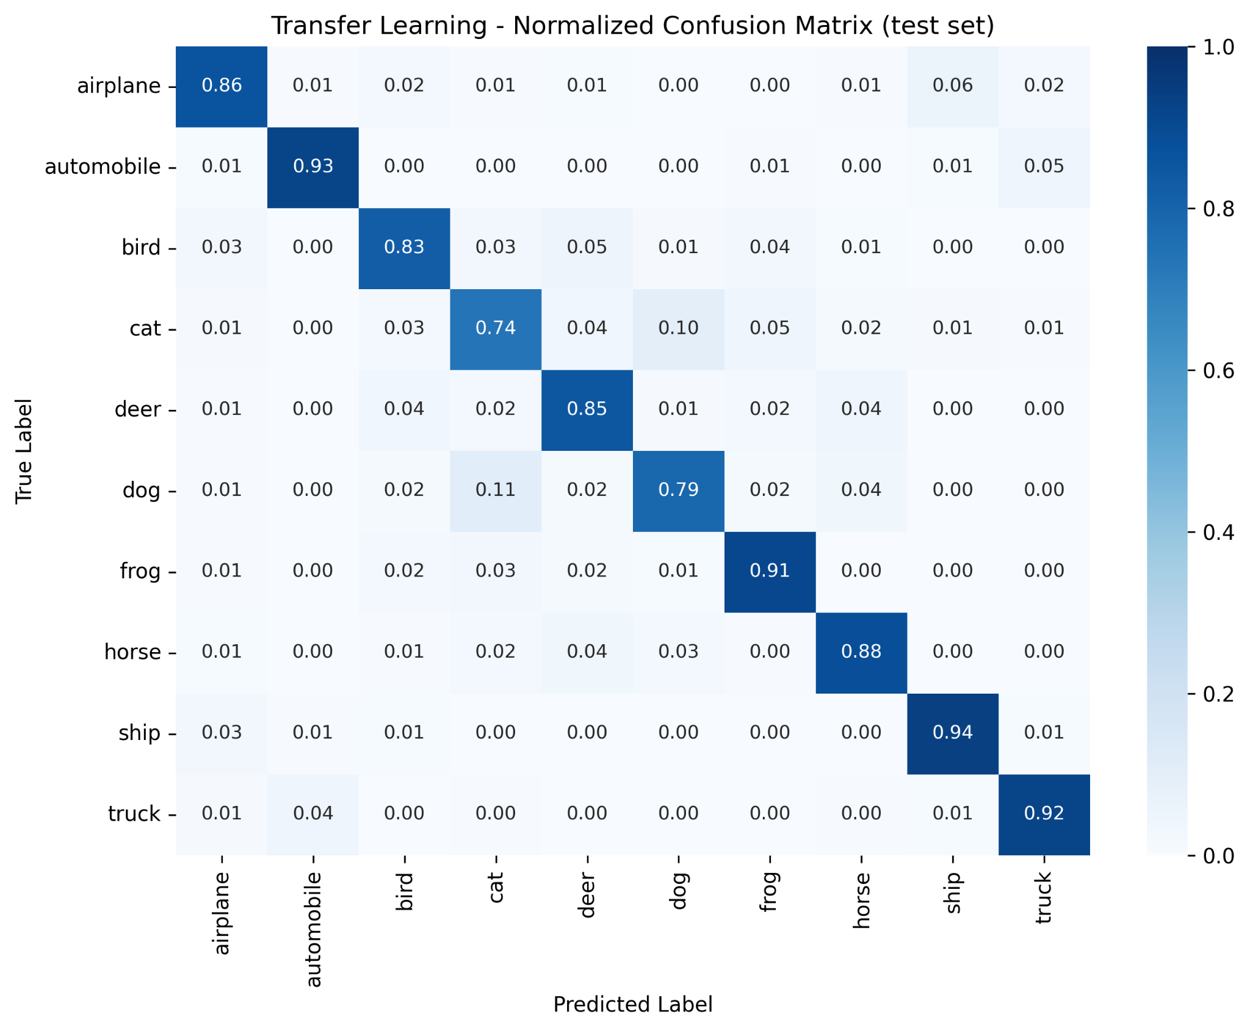
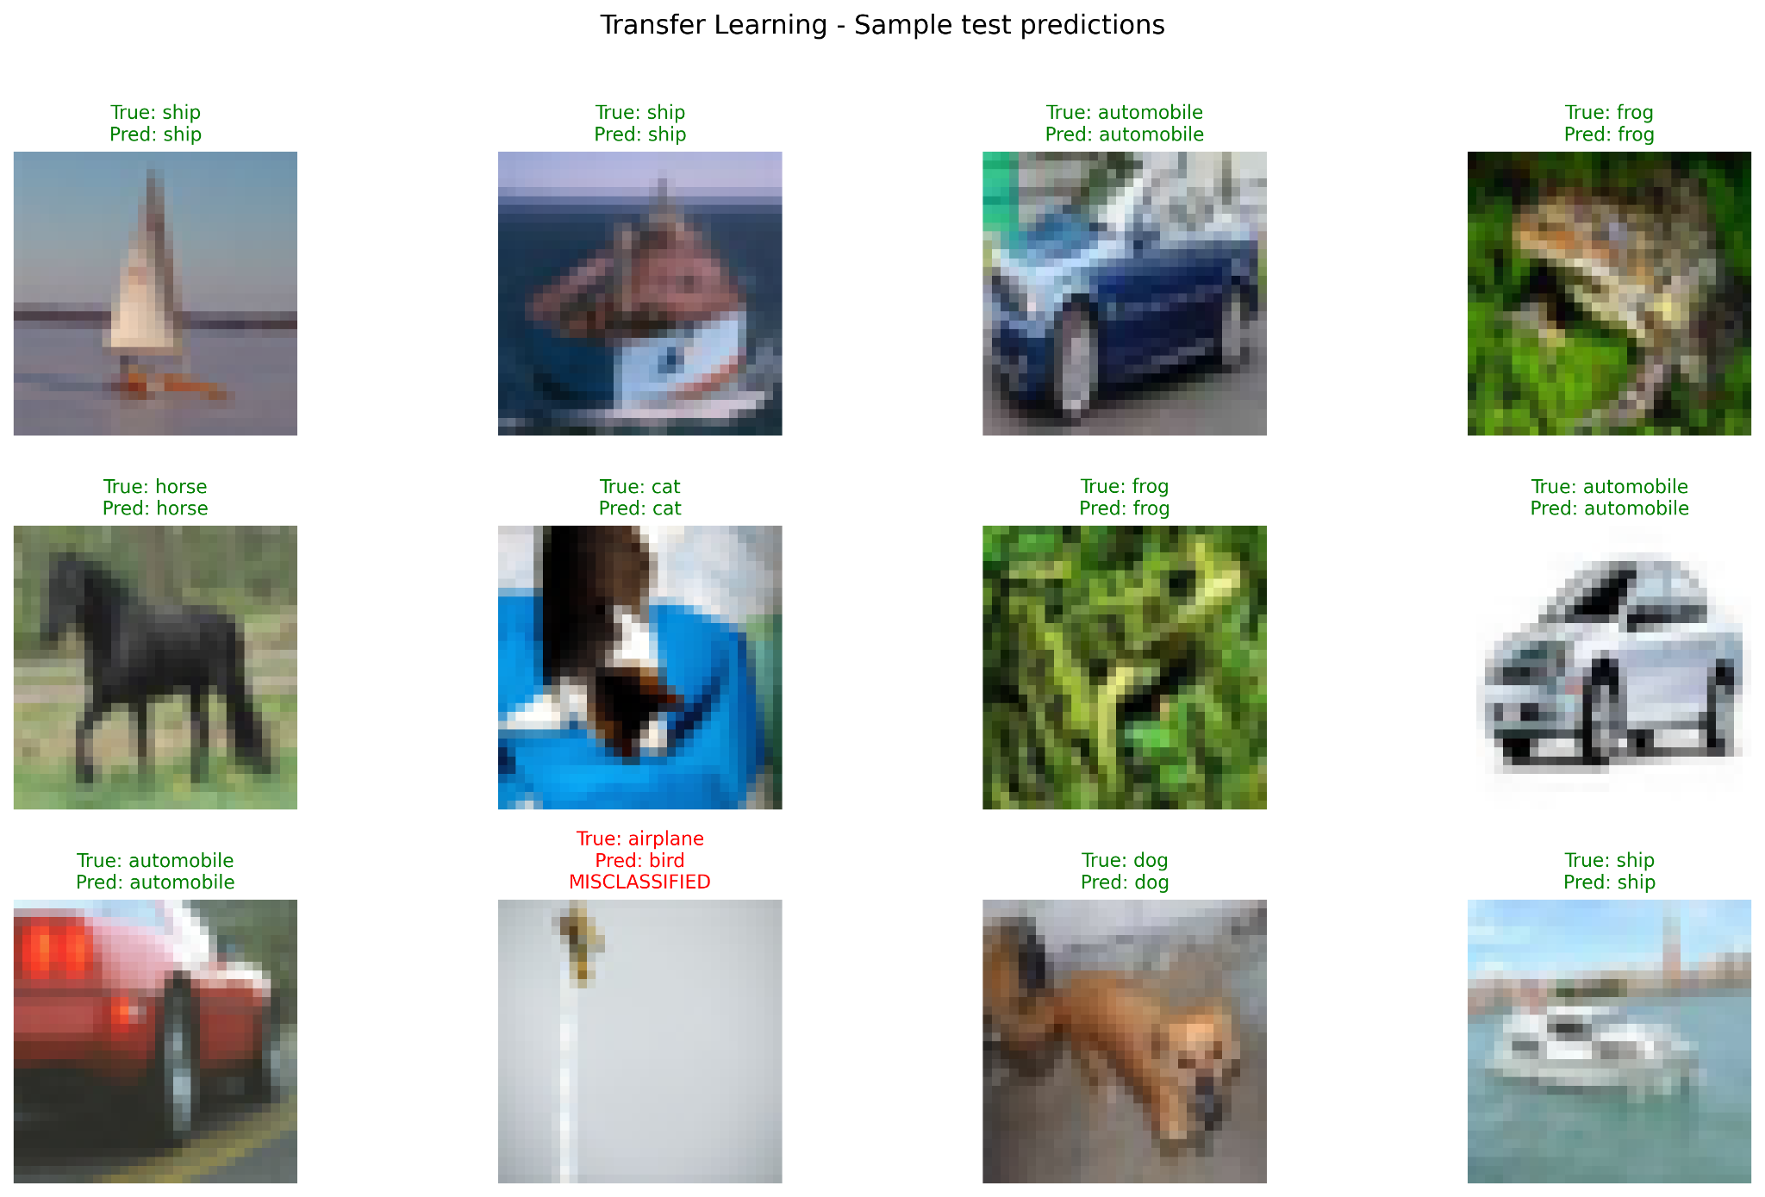
Q5 - Classification - Transfer Learning

Slide 15
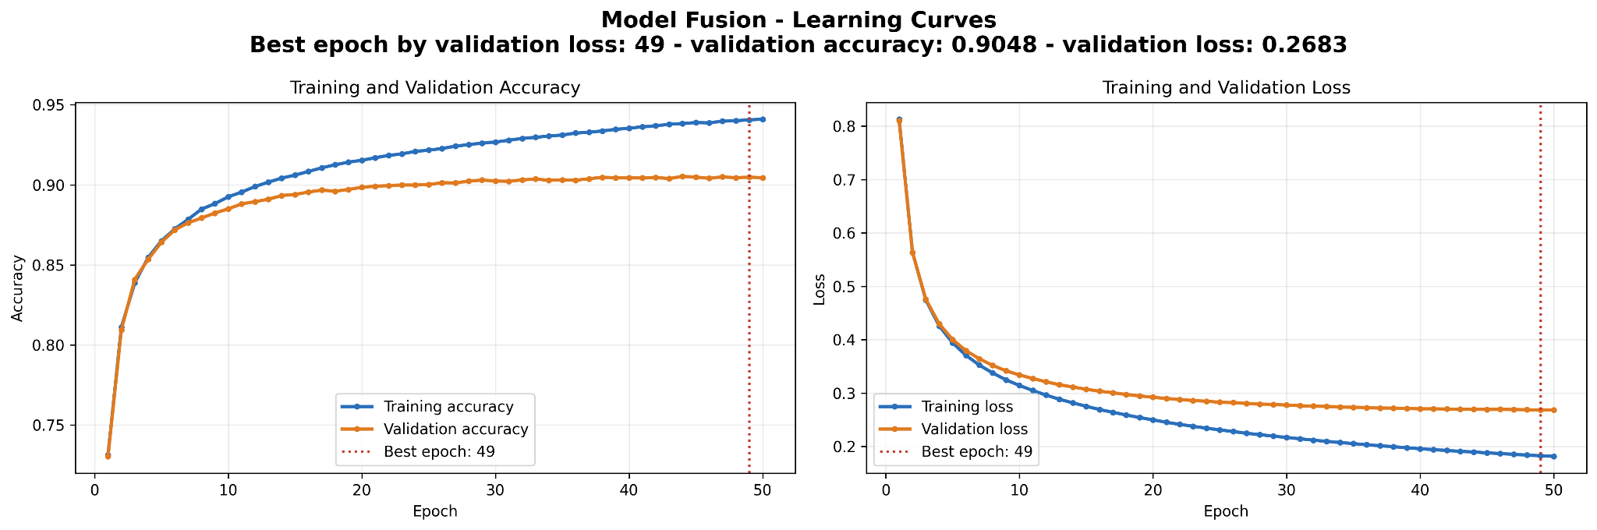
Q5 - Classification - Model Fusion

Slide 16
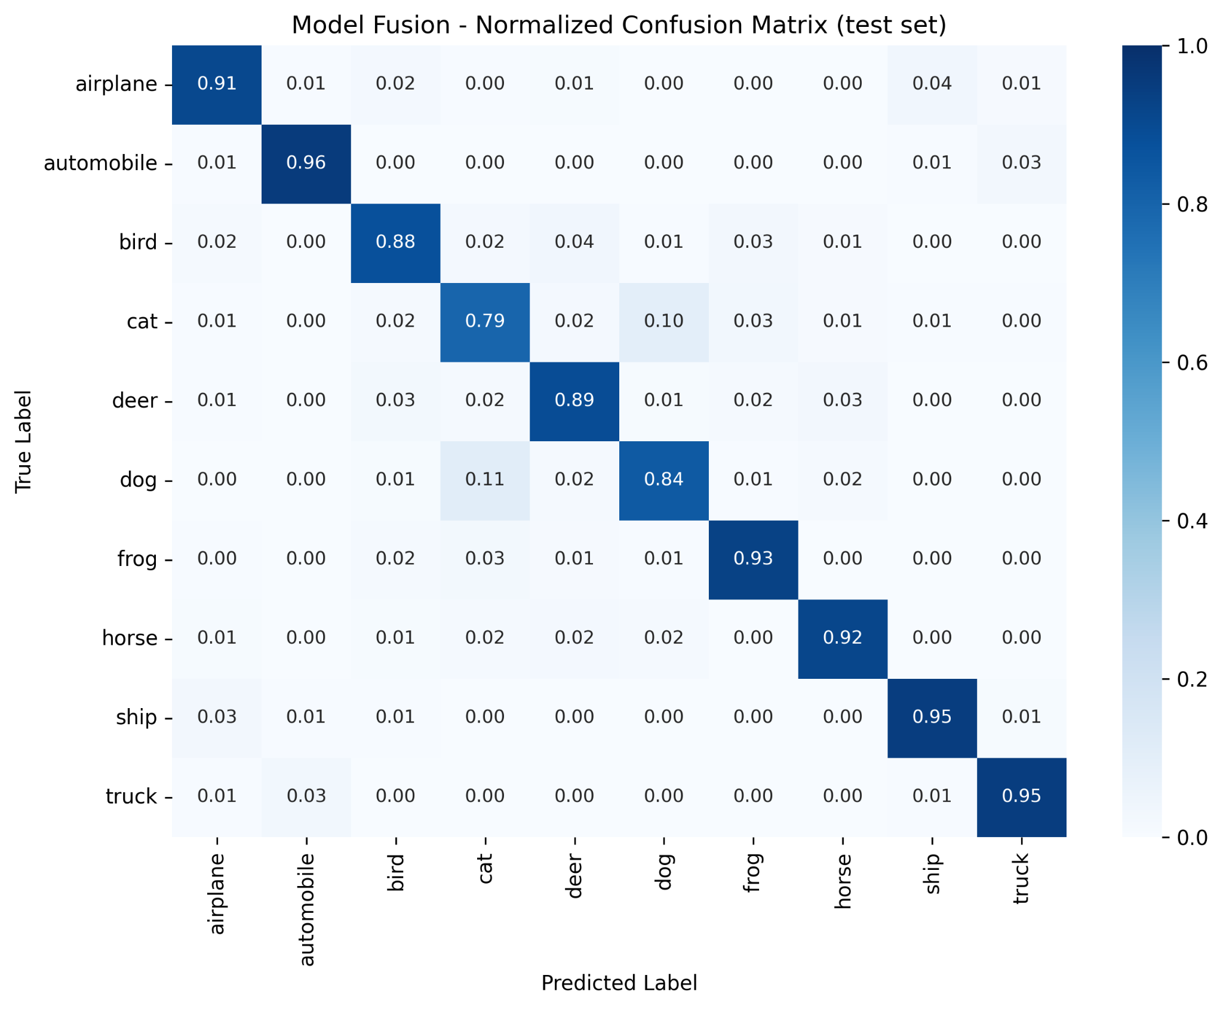

Q5 - Classification - Model Fusion

Slide 17
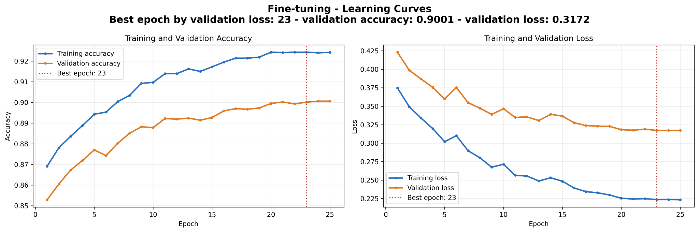
Q5 - Classification

Slide 18


Q5 - Classification

Slide 19
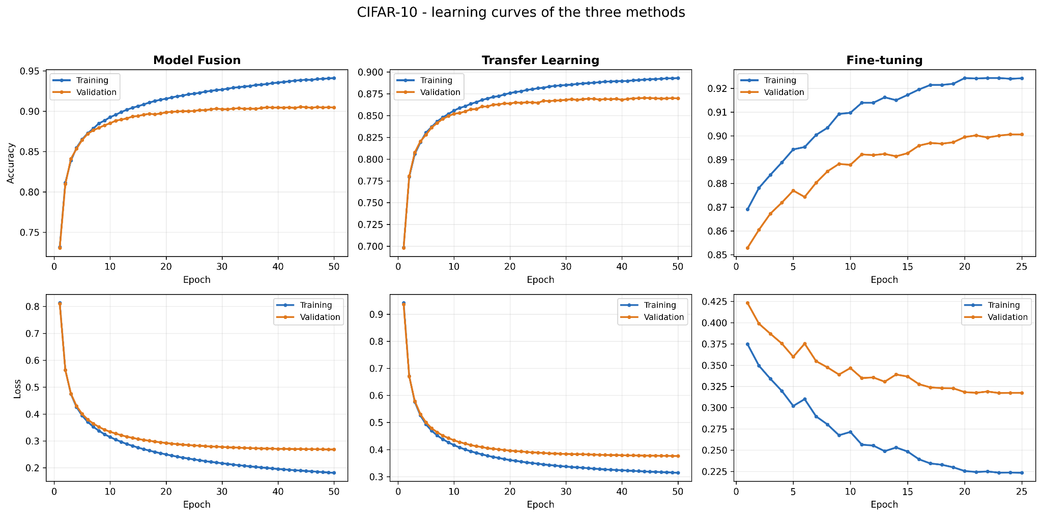
Q5 - Classification - Comparison

Slide 20
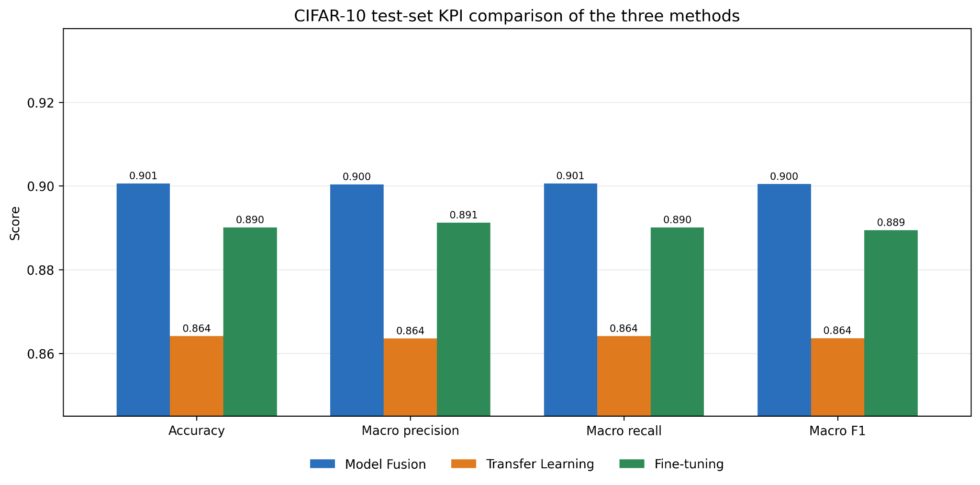
Q5 - Classification - Comparison

Slide 21
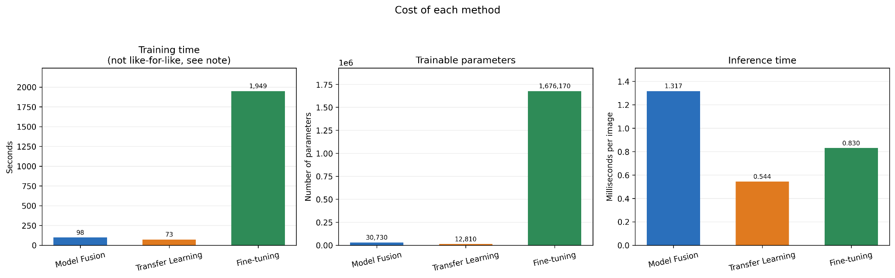
Q5 - Classification - Comparison

Slide 22
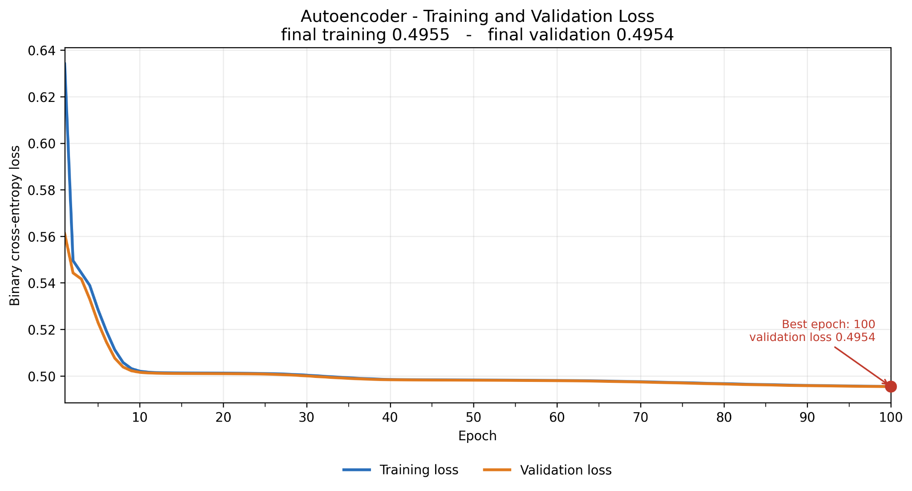
Q6 - Autoencoder
Objective
Compress the motor fault images into a 32-value latent vector and reconstruct them with an autoencoder.
Method
Dense autoencoder: 31,500 pixels → 32 latent values → 31,500 (about 984× compression)
Trained 100 epochs with binary cross-entropy, then evaluated on the test set by per-image MSE
Results
Training and validation loss converge to about 0.495, with no overfitting
Both classes are reconstructed well, and the periodic fault pattern is preserved
Faulty images have a higher mean error (≈0.0028 vs 0.0022), but the two distributions overlap

Slide 23
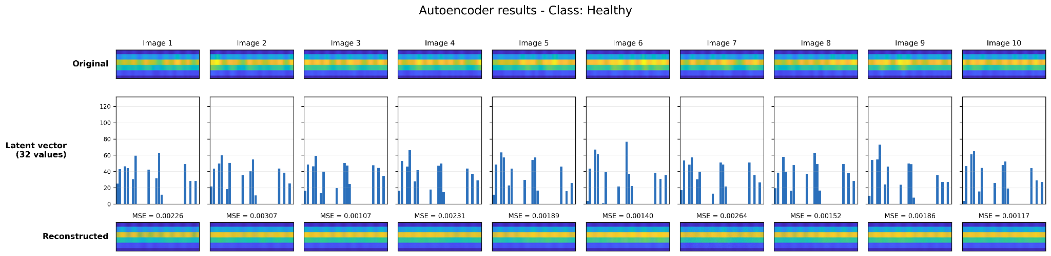
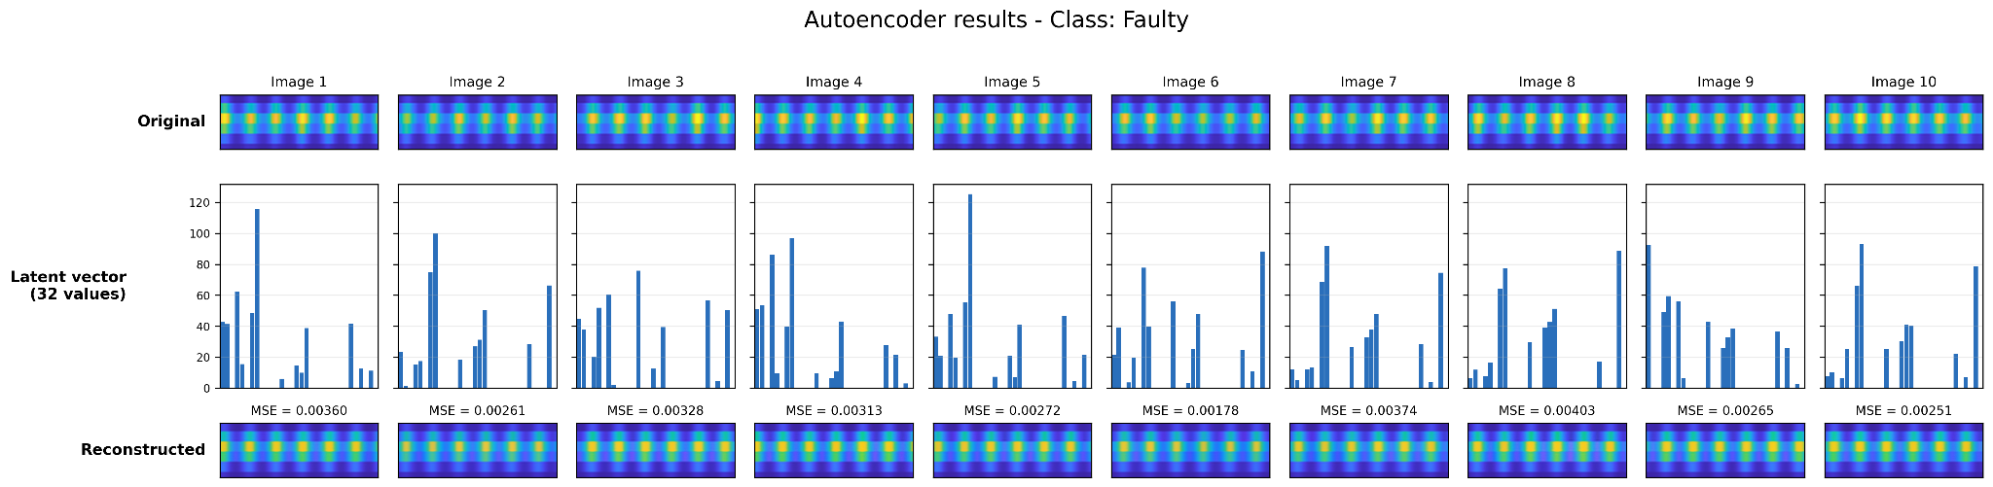
Q6 - Autoencoder

Slide 24
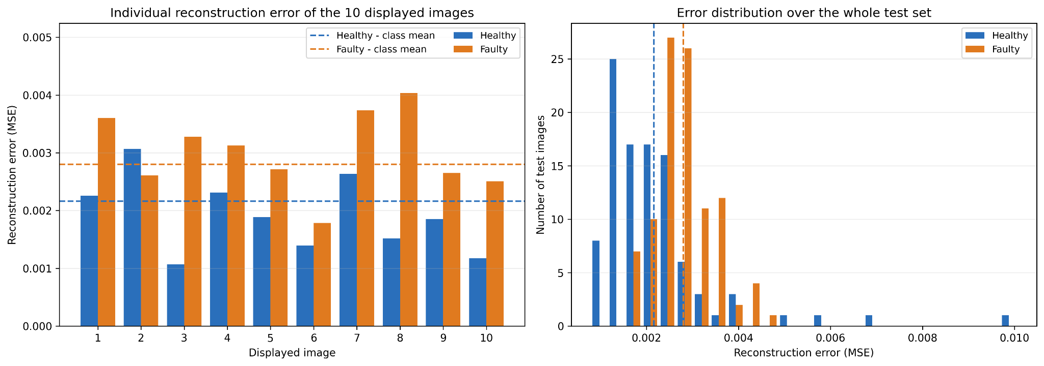
Q6 - Autoencoder

