Slide 1
STRATEGY PATTERN
A presentation of Group 4

Slide 2
TABLE OF CONTENTS
01
03
02
04
Introduction
Pros
& Cons
Strategy Pattern
Applications

Slide 3
01
Introduction

Slide 4

Problem
You have an express company. As it grows, you add more shipping methods for your customers.
You have been using a program to get the total cost of each shipment. With every type of shipping, you need to change the price.

Slide 5
NAIVE APPROACH
Add more conditional statements to your class’s method

Slide 6
Something look like this
int order::getCost(const string& type, const int& distance){ if (type == "bus") return distance*30; if (type == "car") return distance*25; if (type == "motorbike") return distance*10; if (type == "ship") return distance*40; if (type == "plane") return distance*70; }

Slide 7
Issues with this approach
Not friendly for future updates
Violate open-closed principle

Slide 8
02
Strategy Pattern

Slide 9
What is it?

Slide 10
Strategy is a behavioral design pattern that lets you define a family of algorithms, put each of them into a separate class, and make their objects interchangeable.

Slide 11

Take a look at the diagram

Slide 12
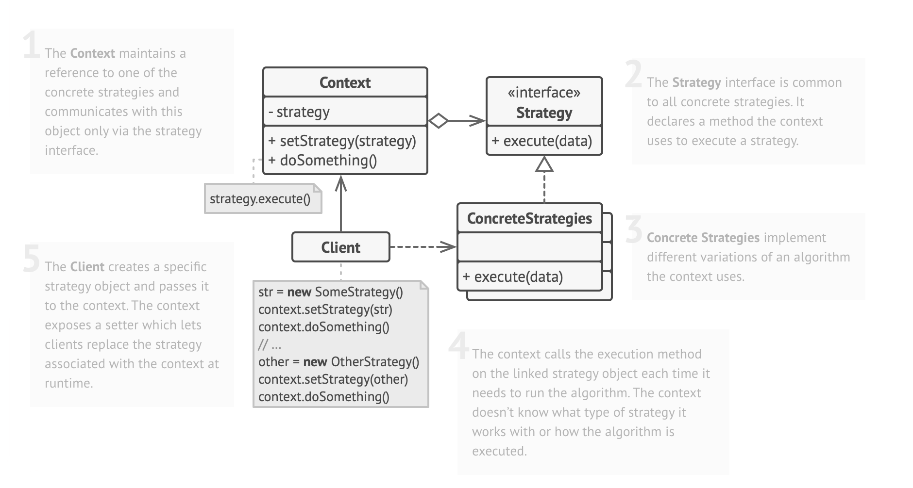

Slide 13
Come back to our problem: Applying Strategy Pattern

Slide 14
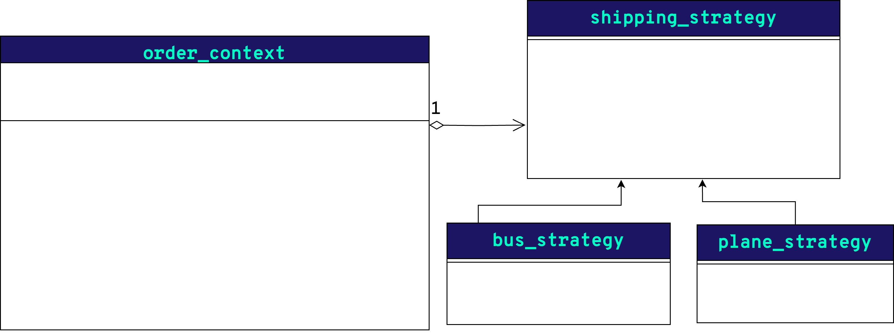
;
;

Slide 15
03
Pros and Cons

Slide 16
PROS
swap algorithms used inside an object at runtime
can isolate the implementation details of an algorithm
4
replace inheritance with composition
introduce new strategies without having to change the context

Slide 17
CONS
Clients must be aware of the differences between strategies to be able to select a proper one.
3
Shouldn’t use Strategy if you only have a couple of algorithms and they rarely change
A lot of modern programming languages have functional type support that lets you implement different versions of an algorithm inside a set of anonymous functions.

Slide 18
04
Applications

Slide 19
Use it when…
you want to use different variants of an algorithm within an object and be
able to switch from one algorithm to another during runtime.
you have a lot of similar classes that only differ in the way they execute some behavior./.
you want to isolate the business logic of a class from the implementation details of algorithms that may not be as important in the context of that logic.
your class has a massive conditional statement that switches between different variants of the same algorithm.

Slide 20
Some scenarios to use Strategy
1
2
3
4
5
Sorting Algorithms
Validation Rules
Database Access
Text Formatting
Payment Strategy

Slide 21

QUIZIZZ!
//Insert QR code here
___

Slide 22
THANK YOU FOR LISTENING!
Do you have any questions?

