Slide 1


Spotted Lanternfly Mapper
GIS 540 \ Spring 2024 \ NCSU
Javed Hossain 25 April 2024

Slide 2
Problem Statement
Collecting SLF spread and sighting data
Preprocessing Twitter posts
Classifying Twitter posts
Extracting locations from text
Generating maps of SLF spread/sighting

Slide 3
Required Components
Implement instructor feedback
Python geoprocessing
Python batch processing
Code reuse
Mapping

Slide 4
Required Components
Graphical User Interface
Reading and/or writing files
Reporting progress, using messages
Script tool portability

Slide 5
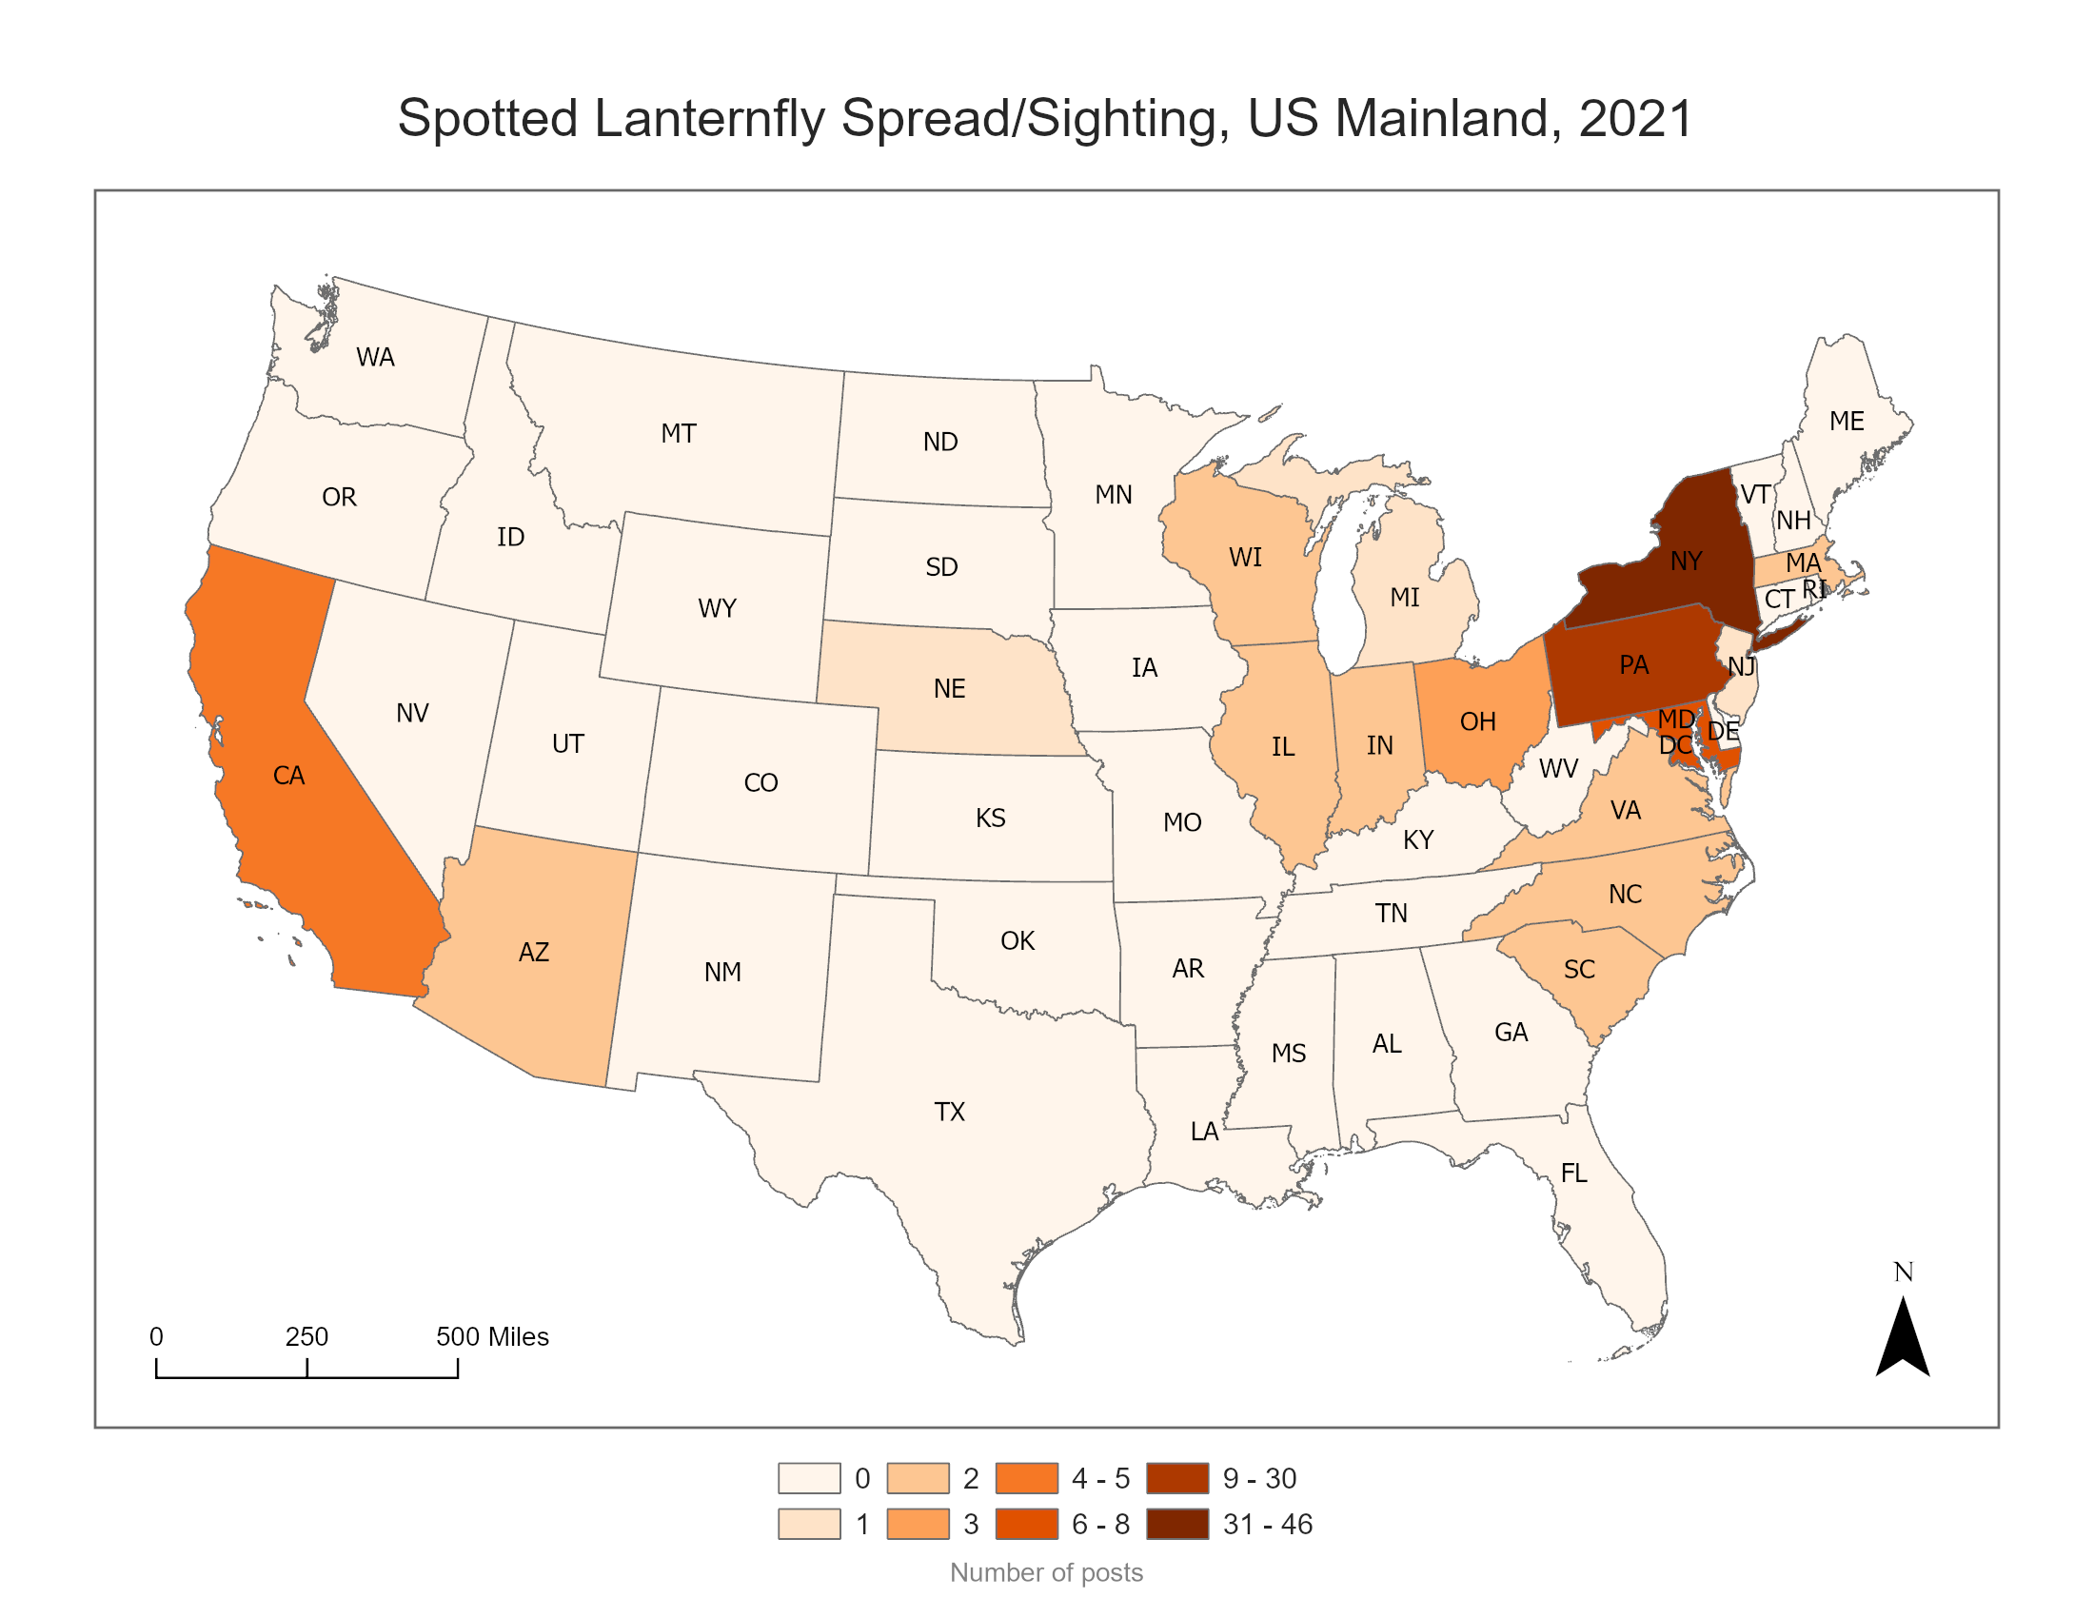
An example of a map created by Spotted Lanternfly Mapper.

