Slide 1
AI for Software Engineers Course
Core AI + Machine Learning Foundations (Engineer-Oriented)
Mehmet PEKMEZCİ
versiyon 3.2

Slide 2
Breakthrough
AlexNET - 2012
Alex Krizhevsky, Ilya Sutskever and Geoffrey Hinton
8 Layer CNN Architecture with 60M parameters,
Used GPU to calculate the results faster.
More than 10.8% above the runner-up in ImageNet Large Scale Visual Recognition Challenge (ILSVRC)

Slide 3
Core AI + Machine Learning Foundations (Engineer-Oriented)
AI landscape for engineers
How ML systems actually work
Core ML types (practical framing)
Neural networks intuition
Hands-on (important for engineers)

Slide 4
1 - AI Landscape for Engineers
AI vs ML vs Deep Learning vs Generative AI
Where classical software ends and ML systems begin
Why ML is “data + optimization + models”

Slide 5
1.1 - AI vs ML vs Deep Learning vs Generative AI
ARTIFICIAL INTELLIGENCE
MACHINE LEARNING
Prolog
REGRESSION
NEURAL NETWORKS
SVM
Comp. Vision
Fully Connected
RNN
LSTM
DECISION TREE
Automation
CNN
GAN
DBN
VAE
KAN
KNN
Robotics
RBM
GNN
PINN
Diffusion
PCA
NLP
TRANSFORMERS
RANDOM FOREST
...
BERT
ENC
BART
ENC-DEC
GPT
DEC
CLUSTERING
LLM
AGENTIC
Reinforcement Learn
…….

Slide 6
1.1 - AI vs ML vs Deep Learning vs Generative AI
AI
ML
MODEL
Code : Rule Based
No Training
Prolog/Lisp/CV/MFCC
Coded Human Experience
Directly Explainable
MODEL
Code : Parameter Based
Train Model Parameters
Python / SkLearn / ...
Human Experience + Data
Easy to Explain
Rule Based
No Training
Prolog/Lisp/CV/MFCC
Rule Based
No Training
Prolog/Lisp/CV/MFCC
Input
Output
Input
Output
DL
GEN
MODEL
Code : No Code
Train Model Parameters
Python / Torch / TensorFlow
Full Data
Hard to Explain
MODEL
Code : No Code
Train Model Parameters
Python / Torch / TensorFlow
Full Data
Very Hard to Explain
Rule Based
No Training
Prolog/Lisp/CV/MFCC
Rule Based
No Training
Prolog/Lisp/CV/MFCC
Input
Output
Input
Output
Random
Numbers

Slide 7


1.2 - Where classical software ends and ML systems begin
Example : Fibonacci Numbers : an=an-1+an-2 a100000=?
Math : Binet’s Formula (Generating Functions) (De Moivre 1730)
Algorithm :
Machine Learning : Generate 1000 data points , train model using these data, try to guess a100000 (test the model).
F_n=0 ; F_n_1=2; F_n_2=1
n=5
for in range(n):
F_n = F_n_1 + F_n_2
F_n_2=F_n_1
F_n_1=F_n
print(F_n)
O(n)

Slide 8
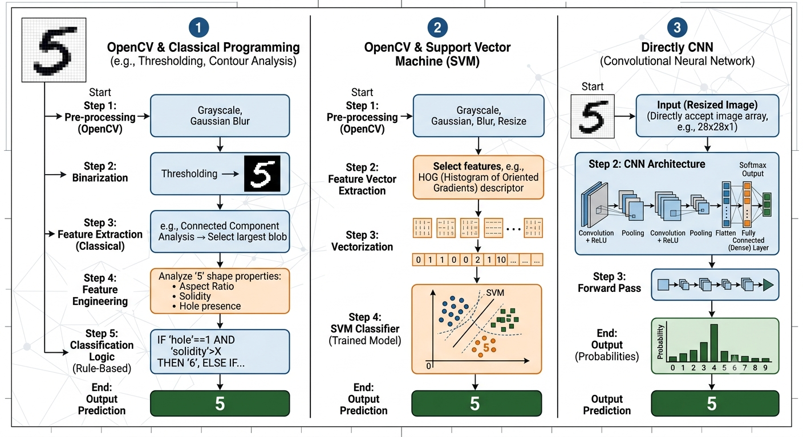
1.2 - Where classical software ends and ML systems begin

Slide 9
1.2 - Where classical software ends and ML systems begin
Solving problems with Classical Software :
Analyze the problem mathematically
Read previous works and try to generalize the previous solutions to cover your problem.
Test your solution on various input/output data of the problem.
Analytical proof exists BUT can not be easily generalized !
Solving problems with ML/DL :
Collect real data for the problem.
Choose the ML/DL Architecture to use. ( SVM, CNN, Transformer, …. )
Train, Validate and Test
Good generalization BUT no analytical proof and DEPENDS ON THE DATA QUALITY !

Slide 10
1.3 – Why ML is “data + optimization + models”
DATA
Provides examples for learning
Contains patterns and relationships
%90 of ML Project
Example: Images, text, audio, sensor readings
Input and
Corresponding
Outputs
MODEL
A mathematical function with adjustable parameters
Learns to represent patterns in the data
Example: Linear regression, neural networks
OPTIMIZATION
Adjusts the model parameters
Reduces prediction errors
Example: Gradient Descent
Loss Value
( Predicted
- Real)
Adjust
Parameters
(Weights)

Slide 11
1.3 – Why ML is “data + optimization + models”
DATA
MODEL
PREDICTS
COMPARE WITH TRUTH
COMPUTE THE LOSS
Data provides training examples.
The model makes predictions.
The loss measures prediction error.
Optimization updates the model parameters.
The process repeats until the error is minimized
OPTIMIZATION UPDATES THE MODEL PARAMETERS
BETTER MODEL

Slide 12
1.3 – Why ML is “data + optimization + models”
EXAMPLE
Without | What Happens
Data | No Information to learn from
Model | No function to represent the solution
Optimization | Model parameters never improve
Cat Images
Neural Network
Prediction
Error Loss
Data tells the algorithm what to learn.
Model defines how knowledge is represented.
Optimization determines how the model improves.
Gradient Descent
Improved
Neural Network

Slide 13
2 - How ML Systems Actually Work
Dataset → training → model → inference pipeline
Train/test split, overfitting (intuition, not math-heavy)
Loss function intuition
Feature vs representation learning
ML Model Evaluation : False Positive, Precision, Recall, Accuracy, Confusion Matrix

Slide 14
2.1 - Dataset → training → model → inference pipeline
PROBLEM DEFINITION
DATA COLLECTION
DATA VISUALIZATION
DATA CLEANING
FEATURE EXTRACTION
TRAINING
VALIDATION
VALIDATION
REPORT GENERATION
TESTING

Slide 15
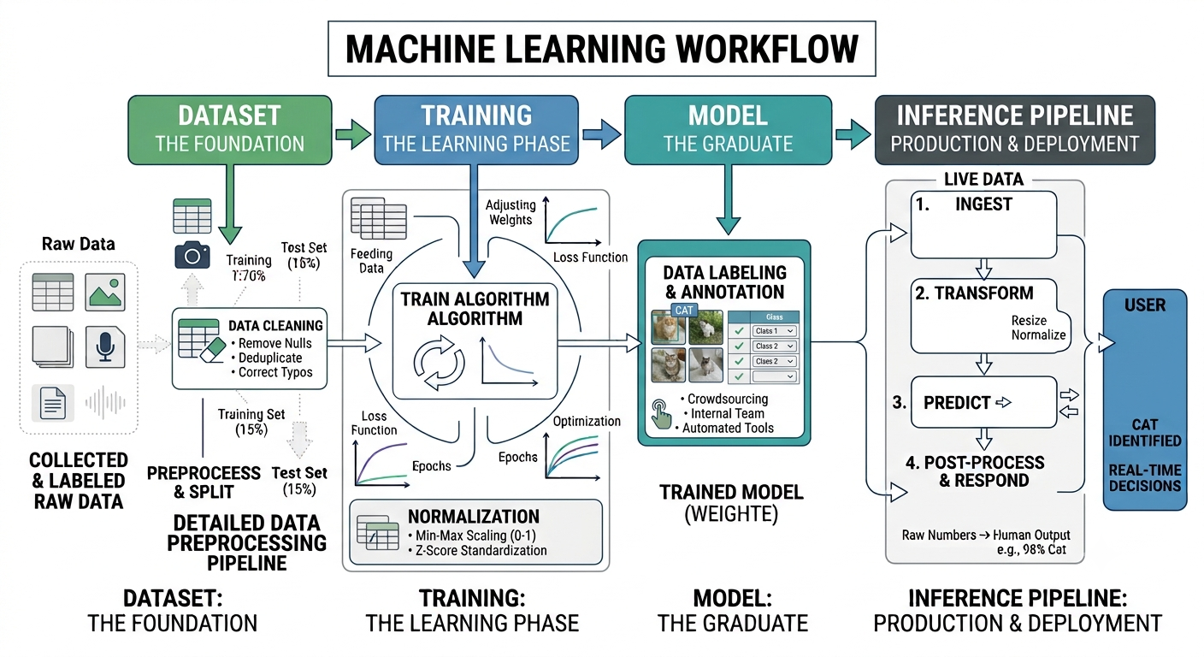
2.1 - Dataset → training → model → inference pipeline

Slide 16
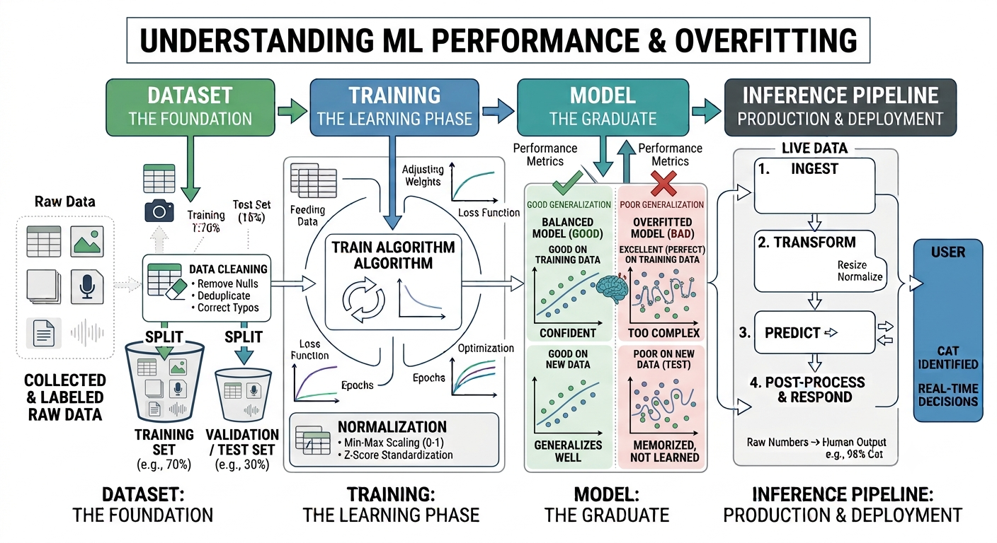
2.2 - Train/test split, overfitting (intuition, not math-heavy)

Slide 17
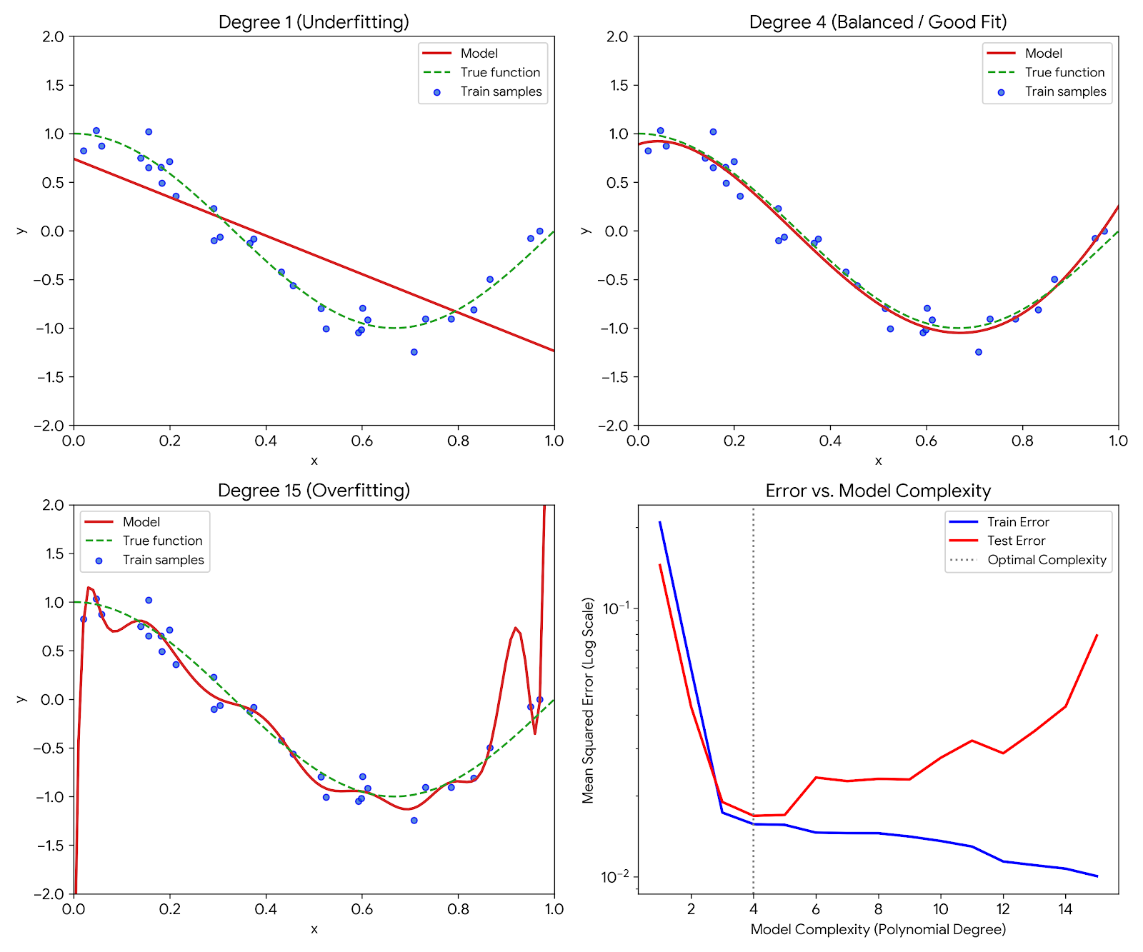
2.2 - Train/test split, overfitting (intuition, not math-heavy)

Slide 18
2.2 - Preventing overfitting
Regularization : Constraining the Model, L1, L2, Elastic, Dropout
Modifying the Data : Collect More Data, Augmentation, Feature Selection/Reduction
Adjusting Training Process : Early Stopping, Cross-Validation
Architectural Control and Ensembling : Reduce Model Capacity, Ensemble Methods (Multiple Small models instead of 1 big model)

Slide 19


2.3 – Loss Function Intuition
Loss Function = Distance Function = Metric
Loss = Error = Distance
X |  |  | Y
X1 | X2 | X3 | Y1 | Y2
1 | 2 | 3 | 4 | 5
11 | 12 | 13 | 14 | 15
21 | 22 | 23 | 24 | 25
31 | 32 | 33 | 34 | 35
41 | 42 | 43 | 44 | 45
X1
Ŷ1
L1= |Ŷ1 – 4| + |Ŷ2 – 5|
L2= sqrt( |Ŷ1 – 4|² + |Ŷ2 – 5|²)
L = -( 4 log(Ŷ1) + 5 log(Ŷ2) )
X2
Ŷ2
X3
Some of Loss Functions n = output vector length (in this case 2):
Minkowski Distance : , L1 = Manhattan Distance , L2 = Euclidean Distance
Cross Entropy : , Softmax , Log Loss , n=number of classes , output is one-hot encoded

Slide 20
2.3 – Loss Function Intuition
MAE : Mean Absolute Error
RMSE : Root Mean Squared Error ( A type of Euclidean Distance)
Cosine Distance : Used in LLMs, comparing two vectors X.Y / |X| . |Y| = cos between X and Y vectors.
KL Divergence : VAE, GAN ( Besides normal loss, the distance from distribution is added to loss)
Mahalonobis Distance : Distance to a group of data points ( 1-N)
Hinge Loss : Used in SVMs
SSIM ( Structural Similarity ) : Used to compare images, sound, …
PINN : Loss functions in physics informed neural network is physical formula like wave equation
Dice, Perceptual, Total Variations, …… ( Any Metric corresponding to problem nature)

Slide 21
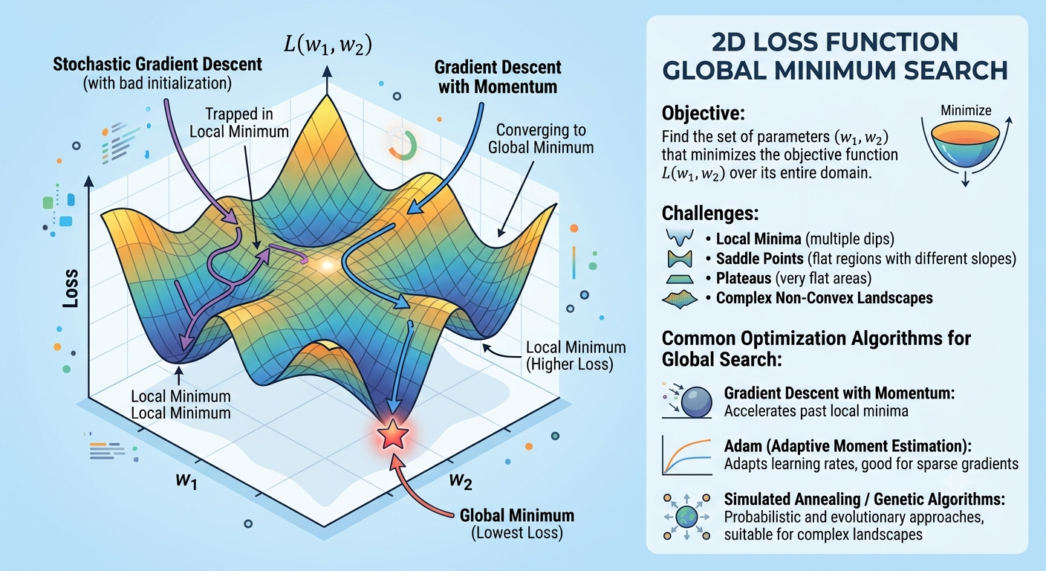
2.3 – Loss Function Intuition

Slide 22
2.4 - Feature vs representation learning
Feature Learning (Extraction) : Learn useful predictors.
Representation Learning : Learn a useful encoding of data.
Aspect | Feature Learning | Representation Learning
Goal | Learn useful features from raw data | Learn a meaningful representation of the data
Scope | Narrower | Broader
Output | Features for a specific task | Embeddings or latent representations that capture data structure
Typical Use | Classification, regression | Transfer learning, generation, clustering, downstream tasks
Relationship | A subset of representation learning | Includes feature learning and more

Slide 23
2.4 - Feature vs representation learning
Traditional approach: Human designs features such as edges, corners, texture descriptors (e.g., SIFT or HOG).
Feature learning: A neural network learns filters that detect edges, textures, object parts, etc., during training.
Representation learning: Aims to learn a transformation of the data into a representation that captures important underlying structure.
A good representation should ideally:
Preserve relevant information.
Discard irrelevant variation (noise).
Be useful for multiple downstream tasks.
Capture semantic relationships.
Examples include:
Latent vectors from autoencoders
Word embeddings (e.g., Word2Vec)
Contextual embeddings from BERT
Vision embeddings from contrastive learning models

Slide 24
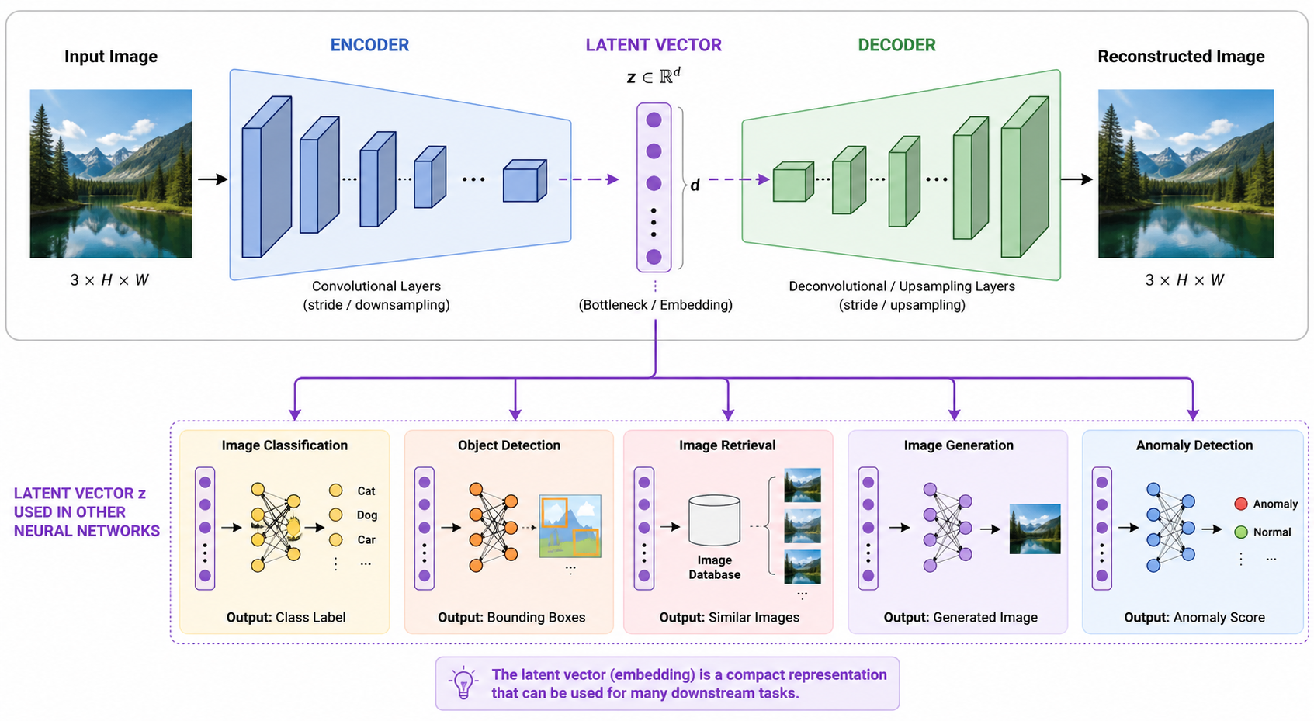
2.4 - Feature vs representation learning

Slide 25
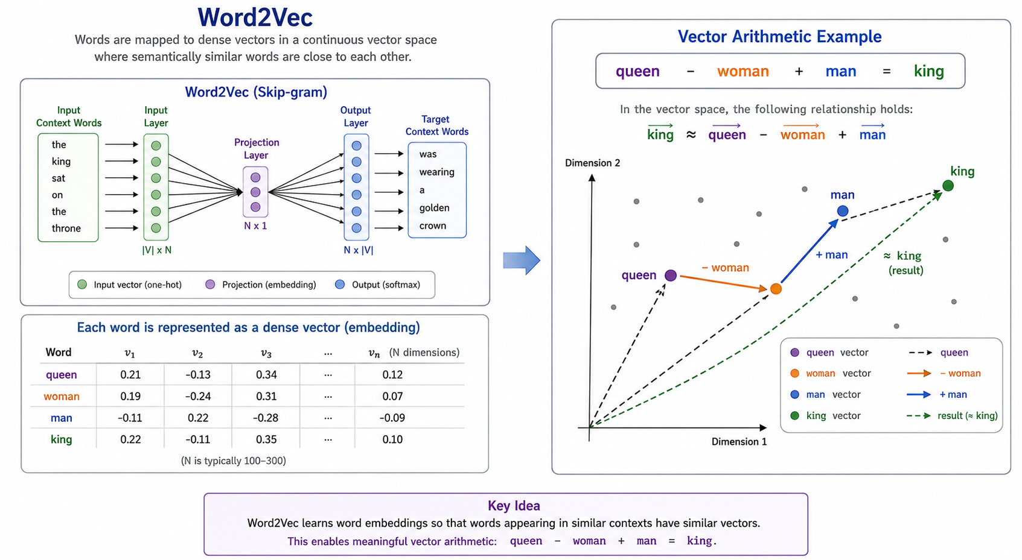
2.4 - Feature vs representation learning

Slide 26
2.5 - ML Model Evaluation : False Positive, Precision, Recall, Accuracy, Confusion Matrix
Suppose we have a “machine learning model” that predicts if a track is friend or foe (IFF):
FOE=POSITIVE, FRIEND=NEGATIVE
If the track is ACTUALLY FRIEND and the model PREDICTED as FRIEND : count as TRUE NEGATIVE
If the track is ACTUALLY FRIEND and the model PREDICTED as FOE : count as FALSE POSITIVE
If the track is ACTUALLY FOE and the model PREDICTED as FRIEND : count as FALSE NEGATIVE
If the track is ACTUALLY FOE and the model PREDICTED as FOE : count as TRUE POSITIVE
Confusion Matrix For Binary Classification
 | Predicted Positive | Predicted Negative
Actual Positive | Number of True Positives (TP) | Number of False Negatives (FN)
Actual Negative | Number of False Positives (FP) | Number of True Negatives (TN)

Slide 27
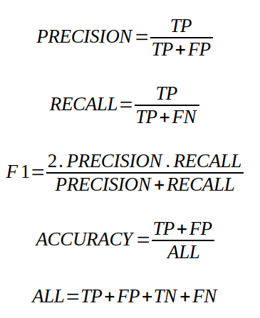
2.5 - ML Model Evaluation : False Positive, Precision, Recall, Accuracy, Confusion Matrix
 | Predicted Positive | Predicted Negative
Actual Positive | True Positives (TP) | False Negatives (FN)
Actual Negative | False Positives (FP) | True Negatives (TN)
HIGH PRECISION : Model should not miss any FOE, but some of the FOES may be FRIEND actually.
HIGH RECALL : Model may miss some FOEs, but should be sure that no actual FRIEND may be reported as FOE.
HIGH ACCURACY : Model should not miss any FOE, and also should be sure that no actual FRIEND may be reported as FOE.
F1 :
Completely ignores True Negatives (TN).
This metric is used in lieu of ACCURACY, when the data is heavily imbalanced.
Balance between catching positives and being right about them.

Slide 28
2.5 - ML Model Evaluation : False Positive, Precision, Recall, Accuracy, Confusion Matrix
Confusion Matrix : A confusion matrix is a table used to evaluate the performance of a classification model.
Each X-Y-Cell Filled By :
How many of detected Class X was actually Class Y ?
 | Naval Vessel Predicted | Cargo Vessel Predicted | Passenger Vessel Predicted
Naval Vessel Actual | 80 | 30 | 5
Cargo Vessel Actual | 16 | 650 | 5
Passenger Vessel Actual | 4 | 20 | 190
Suppose our model will classify the vessels on the sea :
We suppose that it is sufficient to classify the vessels into 3 classes :
Naval Vessel
Cargo Vessel
Passenger Vessel
Suppose we made 1000 experiments, 100 were said to be Naval Vessel but actually only 80 of them were Naval, 16 of them were cargo, 4 of them were Passenger ship. For the cargo and the passenger vessels, the numbers are shown above.

Slide 29
2.5 - ML Model Evaluation : False Positive, Precision, Recall, Accuracy, Confusion Matrix
CONFUSION MATRIX != CORRELATION MATRIX
A confusion matrix evaluates the performance of a classification model by comparing predicted classes to actual, ground-truth classes.
A correlation matrix measures and visualizes the statistical relationships (how they move together) between numerical variables in an ACTUAL dataset.
 | Naval Vessel | Cargo Vessel | Passenger Vessel
Naval Vessel | 80 | 30 | 5
Cargo Vessel | 16 | 650 | 5
Passenger Vessel | 4 | 20 | 190
 | Vessel has gun | Vessel has radar | Vessel has rooms | Vessel has portholes
Vessel has gun | 1.0 | 0.8 | 0.1 | 0.1
Vessel has radar | 0.8 | 1.0 | 0.1 | 0.1
Vessel has rooms | 0.1 | 0.1 | 1.0 | 0.9
Vessel has portholes | 0.1 | 0.1 | 0.9 | 1.0

Slide 30
2.5 - ML Model Evaluation : False Positive, Precision, Recall, Accuracy, Confusion Matrix
CONFUSION MATRIX IS USED IN THE MODEL EVALUATION PHASE
CORRELATION MATRIX IS USED IN THE DATA CLEANING/FEATURE EXTRACTION PHASES

Slide 31
3 - Core ML Types (practical framing)
Supervised learning (classification/regression)
Unsupervised learning (clustering, embeddings idea)
Reinforcement learning (high-level only)
Classical ML Techniques : Regression, KNN, SVM, Decision Tree, Random Forest, PCA, XGBoost, Ensemble Learning, K-Means clustering, DBScan clustering.

Slide 32
3.1 – Supervised Learning (Classification/Regression)
These two values are compared.
! LABELED REAL DATA !
X (input) |  |  | Y (labels)
X1 | X2 | X3 | Y1 | Y2
1 | 2 | 3 | 4 | 5
11 | 12 | 13 | 14 | 15
21 | 22 | 23 | 24 | 25
31 | 32 | 33 | 34 | 35
41 | 42 | 43 | 44 | 45
X1
PREDICTIONS
Ŷ1
X2
LOSS = |Ŷ1 – 4| + |Ŷ2 – 5|
Ŷ2
X3
LEARNING =
WEIGHT ADJUSTMENT
OPTIMIZER
(E.G. SGD)
SUPERVISED LEARNING = DATA IS LABELED AND THE MODEL IS LEARNING THOSE LABELS

Slide 33
3.1 – Supervised Learning (Classification/Regression)
Supervised Learning may be split into two types :
Regression : Curve fitting. When the target variable is a continuous, numeric value, the task is regression. The goal is to predict a specific quantity.
Classification : When the target variable is a category or a discrete value, the task is classification. The goal is to predict which class or bucket an input belongs to. (Binary/Multi)

Slide 34
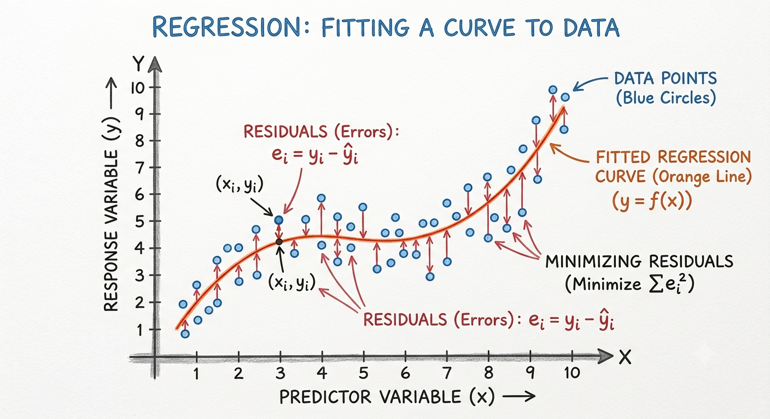
3.1 – Supervised Learning - Regression
REAL DATA
X1 | Y1
0.8 | 0.9
1 | 1.4
1.2 | 1.7
1.5 | 1.5
2 | 2.5
PREDICTIONS
X1
LOSS = |Ŷ1 – 4|
Ŷ1

Slide 35
3.1 – Supervised Learning - Classification
One-hot-Encoding
1
0
0
3 classes, vector length is 3, vector is composed of 1 and 0’s.
Class-1 is 100
Class-2 is 010
Class-3 is 001
REAL DATA
X1 | Y1
0.8 | 1
1 | 1
1.2 | 2
1.5 | 2
2 | 3
PREDICTIONS
X1
Ŷ1
One-hot-Encoded
Softmax
LOSS = Cross Entropy
=Σ Y1 log (Ŷ1)

Slide 36
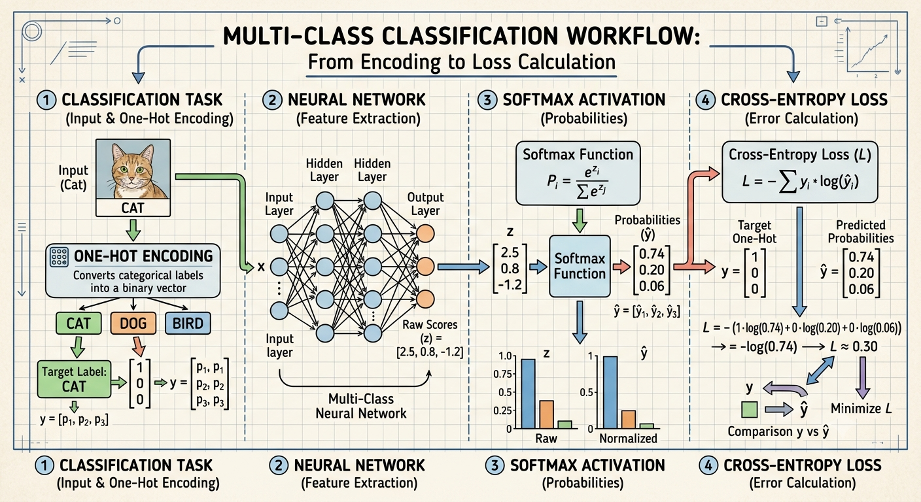
3.1 – Supervised Learning - Classification

Slide 37
3.2 – Unsupervised Learning (Embedding)
We use this latent vector to better represent data.
E.g. Word Embeddings
! NOT-LABELED REAL DATA !
X1 | X2 | X3
1 | 2 | 3
11 | 12 | 13
21 | 22 | 23
31 | 32 | 33
41 | 42 | 43
X1
Ẋ1
X2
Ẋ2
LOSS = |Ẋ1 – X1| + |Ẋ2 –X2|+|Ẋ3-X3|
X3
Ẋ3
LATENT VECTOR
LEARNING =
WEIGHT ADJUSTMENT
OPTIMIZER
(E.G. SGD)
UNSUPERVISED LEARNING = DATA IS NOT-LABELED AND THE MODEL IS LEARNING DATA FEATURES

Slide 38
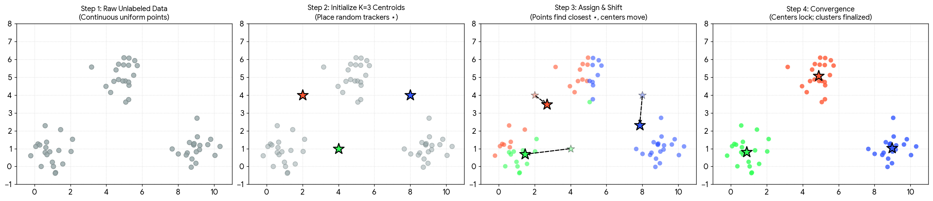
3.2 – Unsupervised Learning (Clustering)
Step 1: Raw Unlabeled Data: The dataset starts entirely gray. The computer only tracks the coordinates (X₁, X₂) without knowing what category anything belongs to.
Step 2: Initialize K=3 Centroids: You select the value of K. The algorithm seeds initial tracker points, known as centroids (shown as colored stars), across the data area.
Step 3: Assign & Shift:
Assignment: Each gray data point identifies which colored star is closest to it and temporarily adopts that color group.
Shift: Each star calculates the geometric center (the mean coordinate) of its newly claimed colored dots and shifts directly along a vector trajectory (indicated by the dashed arrows).
Step 4: Convergence: The assign-and-shift cycle loops automatically until the stars stop moving. The borders lock, yielding isolated, color-coded clusters.

Slide 39
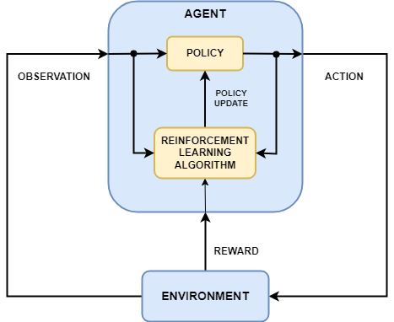
3.3 – Reinforcement Learning
Learns through interaction with an environment by trial and error.
Agent selects actions based on the current state to maximize cumulative reward.
Environment provides feedback in the form of rewards and next states.
Balances exploration and exploitation to discover optimal strategies.
Uses a policy or value function (e.g., Q-values) to improve decision-making over time.
Applications include robotics, game playing, autonomous driving, recommendation systems, and resource optimization.

Slide 40
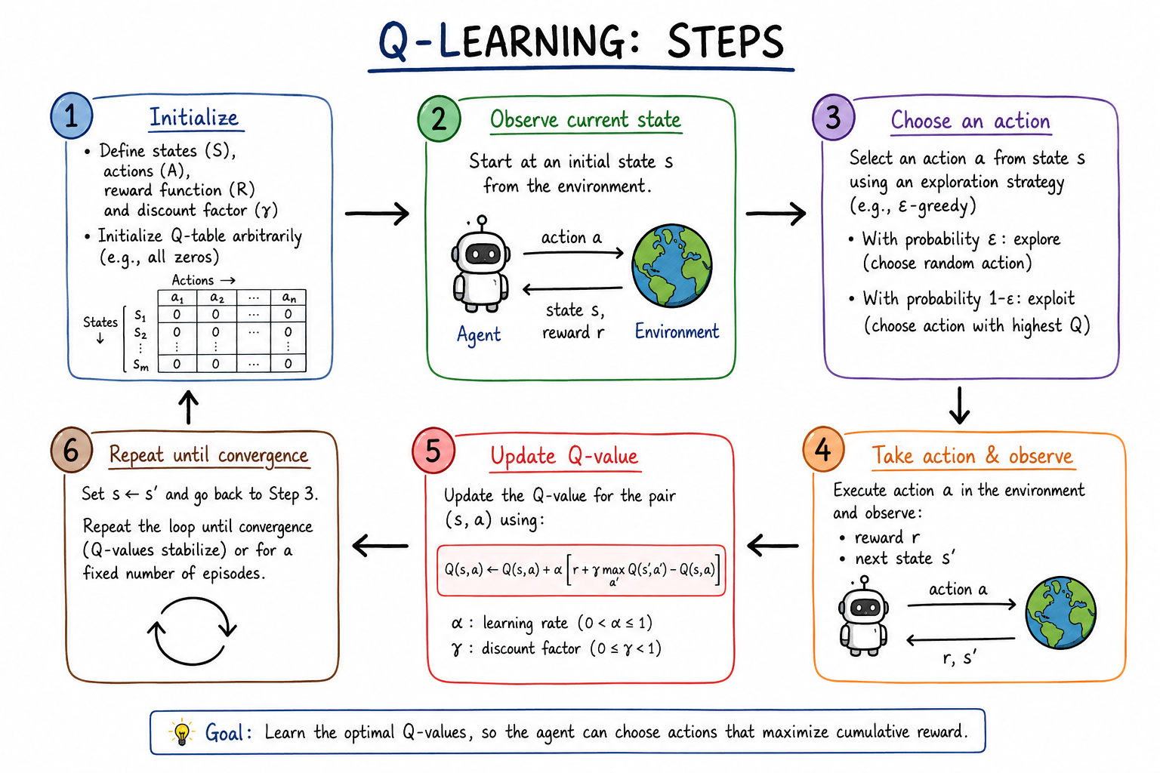
3.3 – Reinforcement Learning - Q-learning

Slide 41
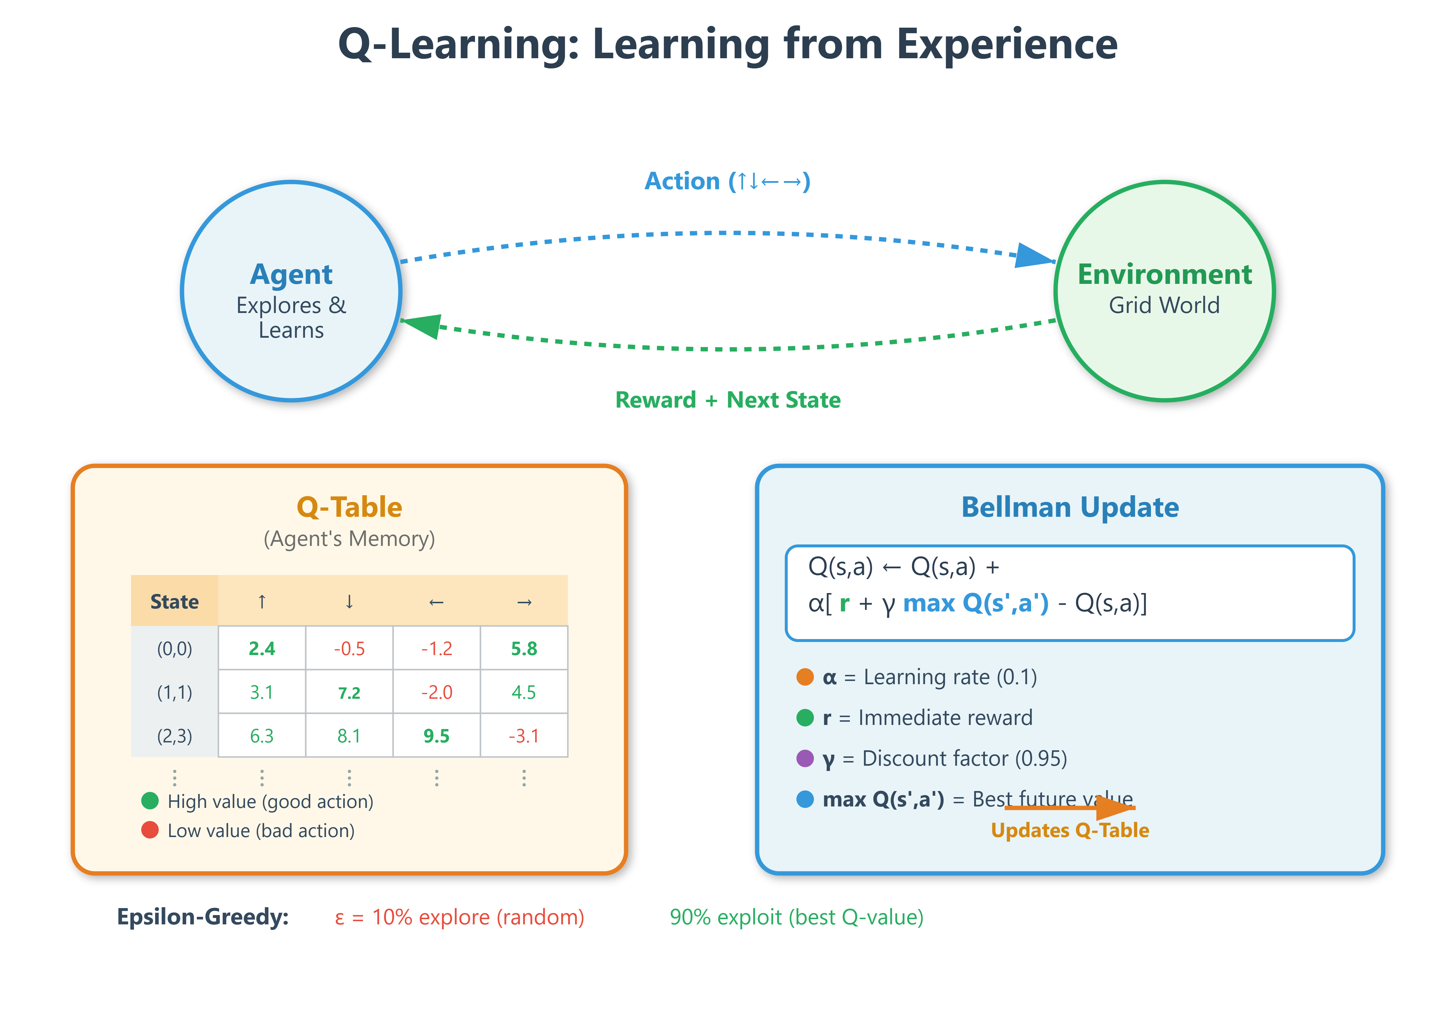
3.3 – Reinforcement Learning - Q-learning

Slide 42
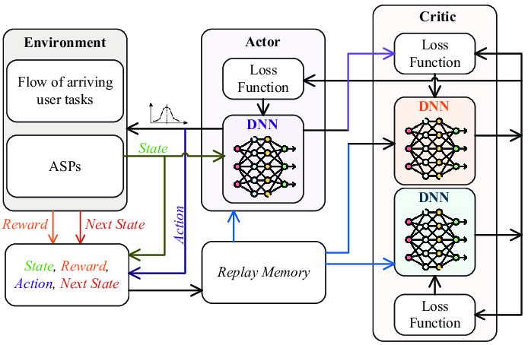
3.3 – Reinforcement Learning – Soft-Actor-Critic (SAC)

Slide 43
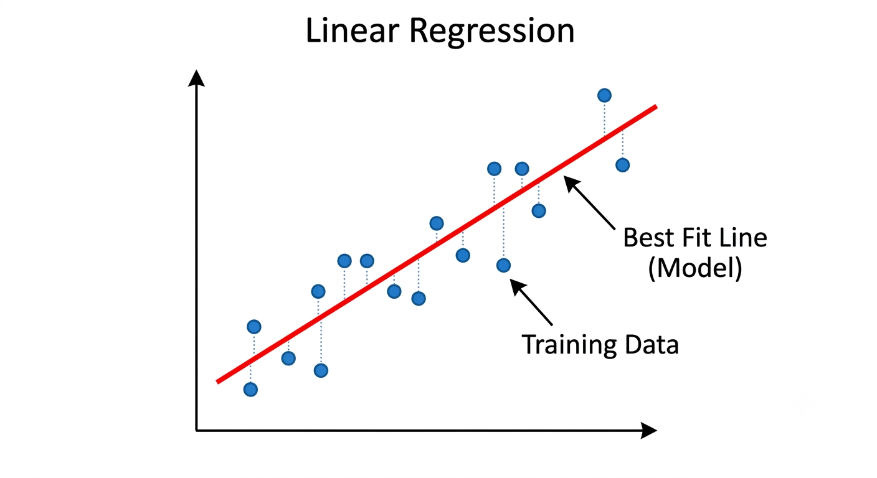
3.4 – Classical ML Techniques - Regression
Curve Fitting
Minimize the Errors (Residuals, dotted lines)

Slide 44
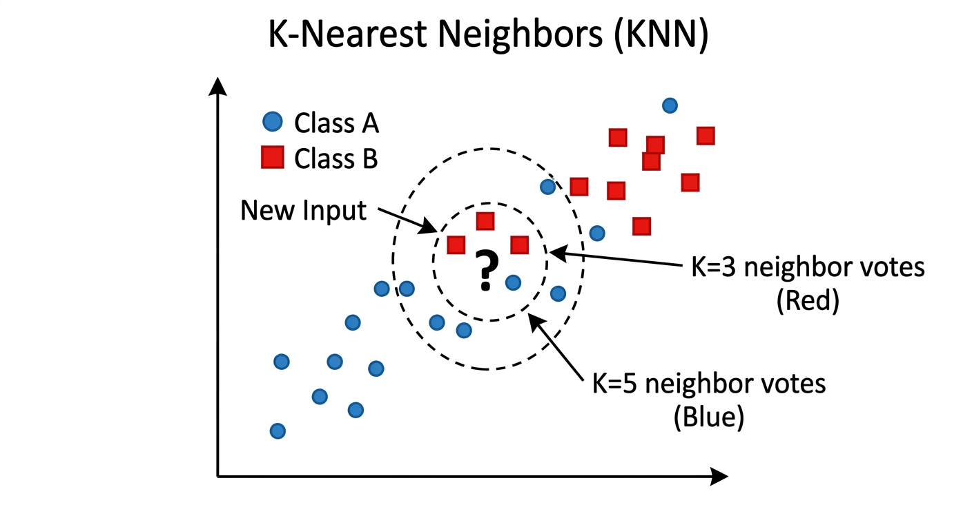
3.4 – Classical ML Techniques - KNN
The inner dashed circle shows classification for K=3 (the three nearest neighbors): It finds 2 red and 1 blue, classifying the point as Red
The outer dashed circle shows K=5: It finds 2 red and 3 blue, classifying the point as Blue. This highlights how sensitive KNN is to the choice of K

Slide 45
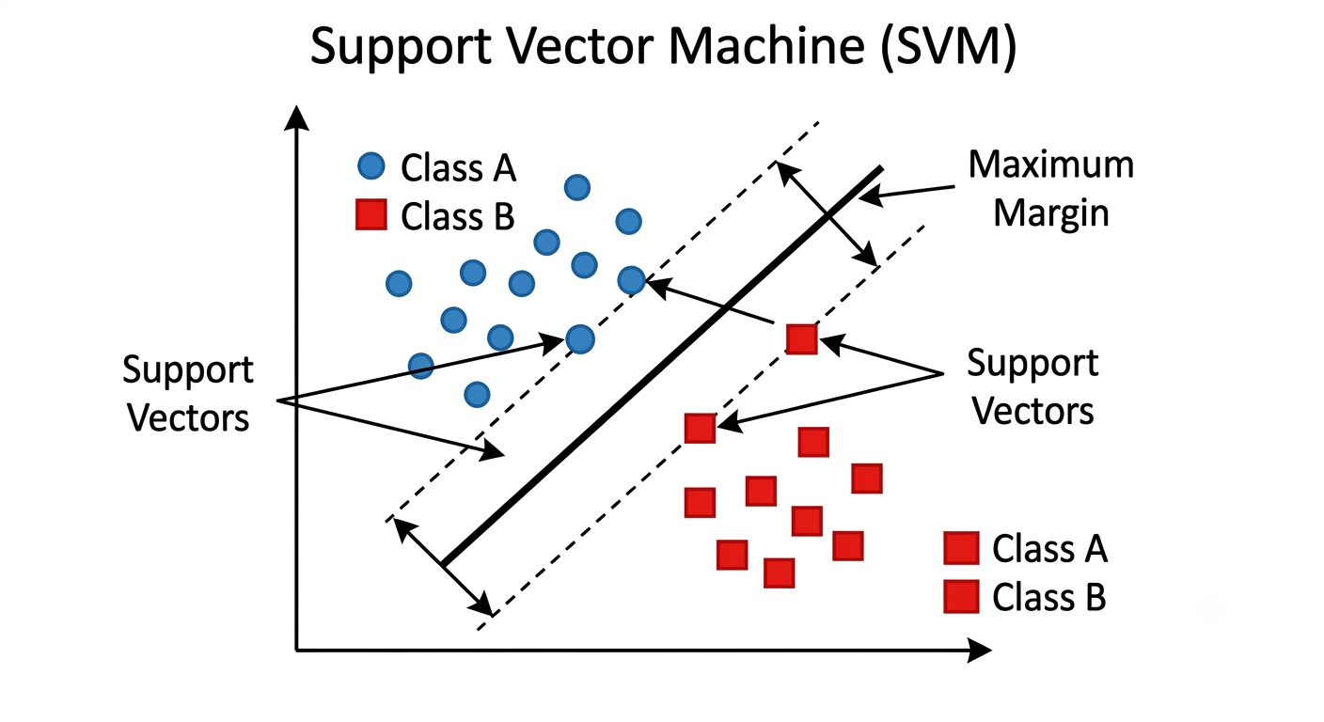
3.4 – Classical ML Techniques - SVM
Two groups of points (blue vs. red) are separated by a solid black line (the decision boundary, or hyperplane).
Two dashed parallel lines create a boundary 'margin.' The points that touch these dashed lines (labeled 'Support Vectors') are the critical data points that define the margin.
SVM works by maximizing the width of this margin, providing the most robust separation.

Slide 46
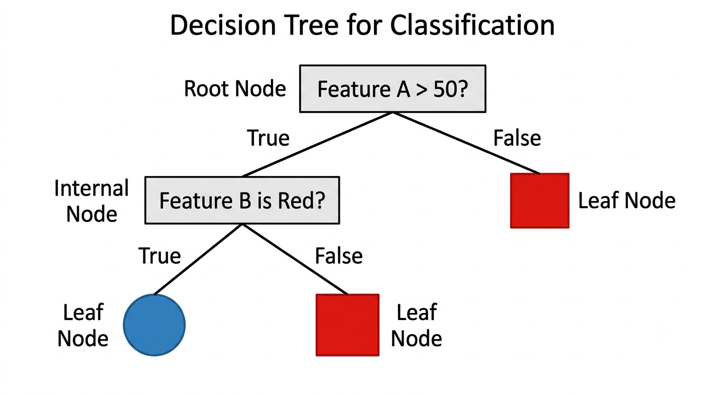
3.4 – Classical ML Techniques - Decision Trees
The tree starts at a 'Root Node' making the first logical split (e.g., 'Feature A > 50?').
If True, it follows the left branch; if False, the right.
The data flows through internal 'nodes' (decisions) until it reaches a 'Leaf Node,' which provides the final classification (Red/Blue)

Slide 47
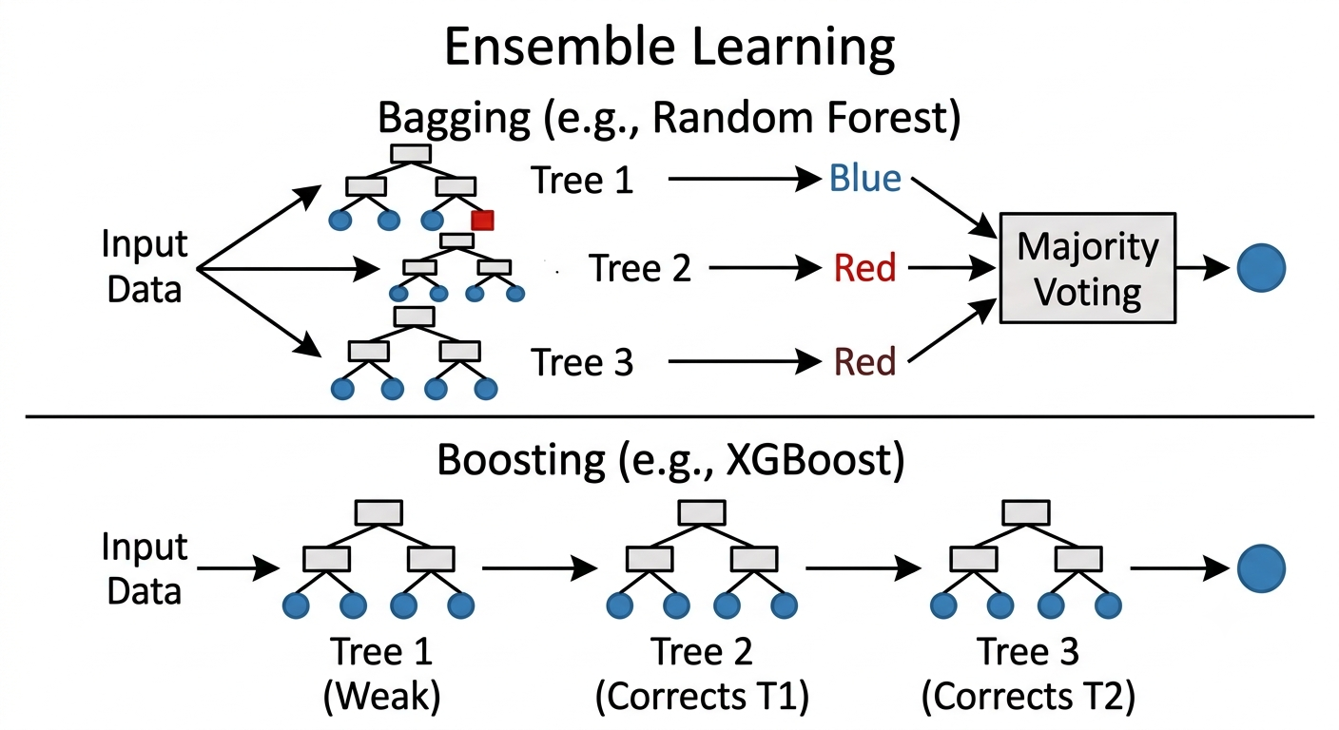
3.4 – Classical ML Techniques – Ensemble Learning
Bagging (Top): Multiple models (e.g., small trees) run in parallel (Tree 1, 2, 3). They are independent, and their final predictions are combined via 'Majority Voting'.
Boosting (Bottom): Models run sequentially (Tree 1 -> 2 -> 3). Tree 2 is trained to correct the errors of Tree 1, and Tree 3 corrects the combined errors of 1 and 2.

Slide 48
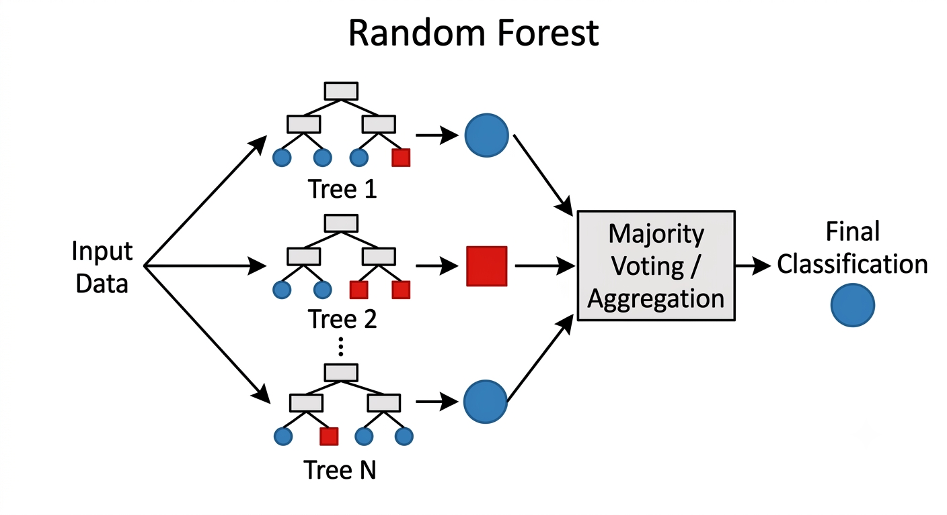
3.4 – Classical ML Techniques – Ensemble Learning - Random Forest
Multiple small decision trees ('Tree 1' through 'Tree N') are trained independently on random subsets of the data.
When new input data is received, each tree makes a prediction (e.g., Tree 1 predicts Blue, Tree 2 predicts Red, Tree N predicts Blue).
These predictions feed into a central 'Majority Voting' box. The final model prediction is the result of the vote (in this case, Blue).

Slide 49
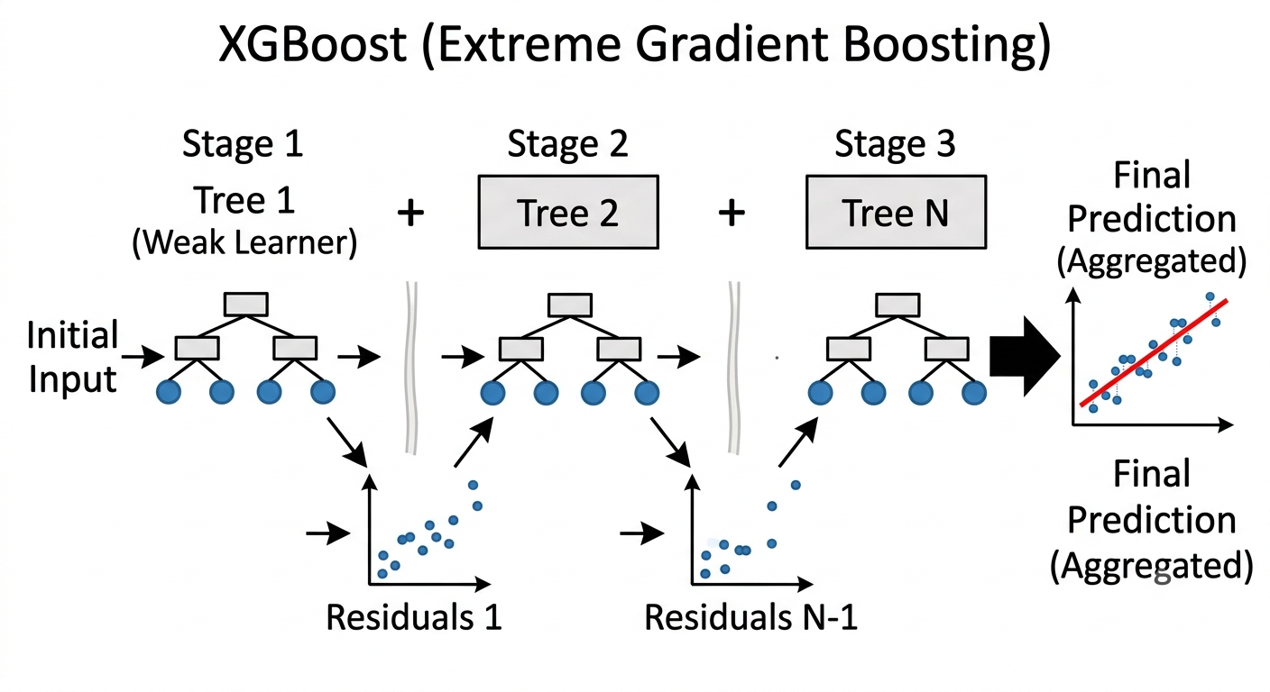
3.4 – Classical ML Techniques – Ensemble Learning - XGBoost
Tree 1 is trained on the data and makes predictions. The 'Residuals 1' scatter plot shows the initial errors.
Tree 2 is then trained specifically to predict those residuals. The additive nature is shown ('+') as the combination of Tree 1 and Tree 2 reduces the error (fewer residuals in 'Residuals 2').
his process repeats for N trees, sequentially minimizing the error until a highly accurate 'Final Prediction' is achieved.

Slide 50
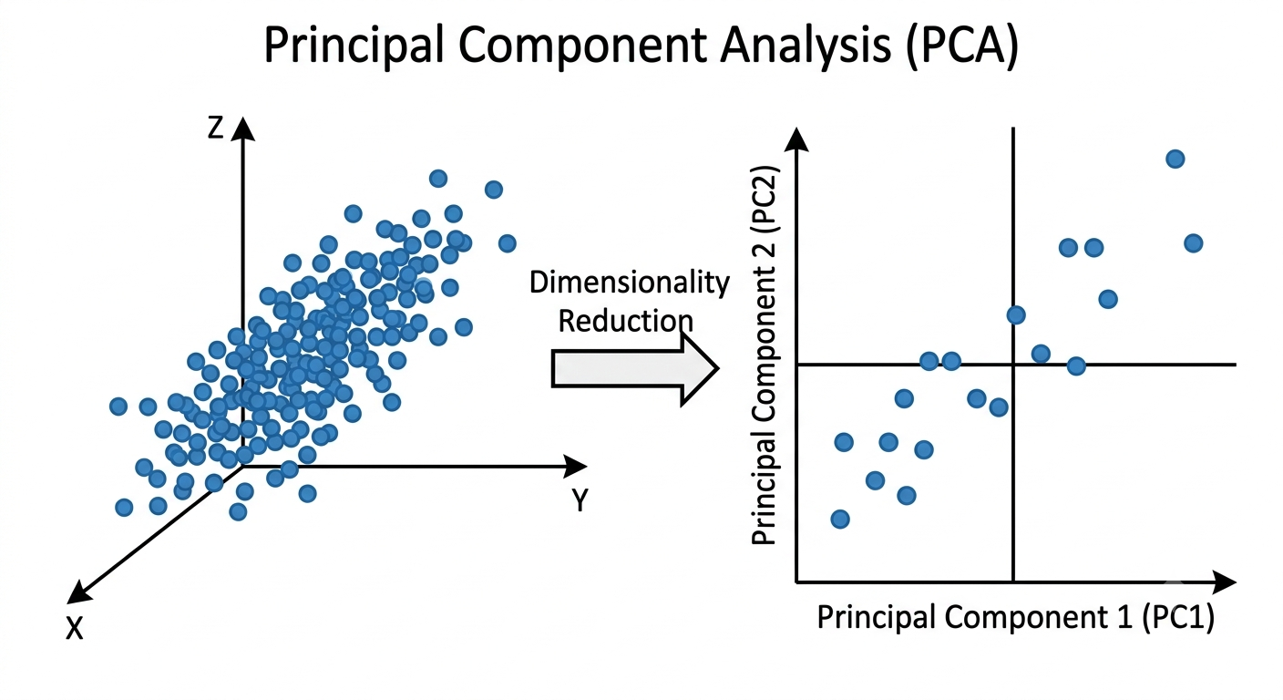
3.4 – Classical ML Techniques – Dimensionality Reduction - PCA
Suppose that we have multi-dimensional X (input).
We want to eliminate some of them(columns)
We use Singular Value Decomposition linear algebra technique to select which columns (features, X[i] ) represents best the data.
X (input) |  |  | Y (labels)
X1 | X2 | X3 | Y1 | Y2
1 | 2 | 3 | 4 | 5
11 | 12 | 13 | 14 | 15
21 | 22 | 23 | 24 | 25
31 | 32 | 33 | 34 | 35
41 | 42 | 43 | 44 | 45
Select one or more columns that represent best the data.

Slide 51
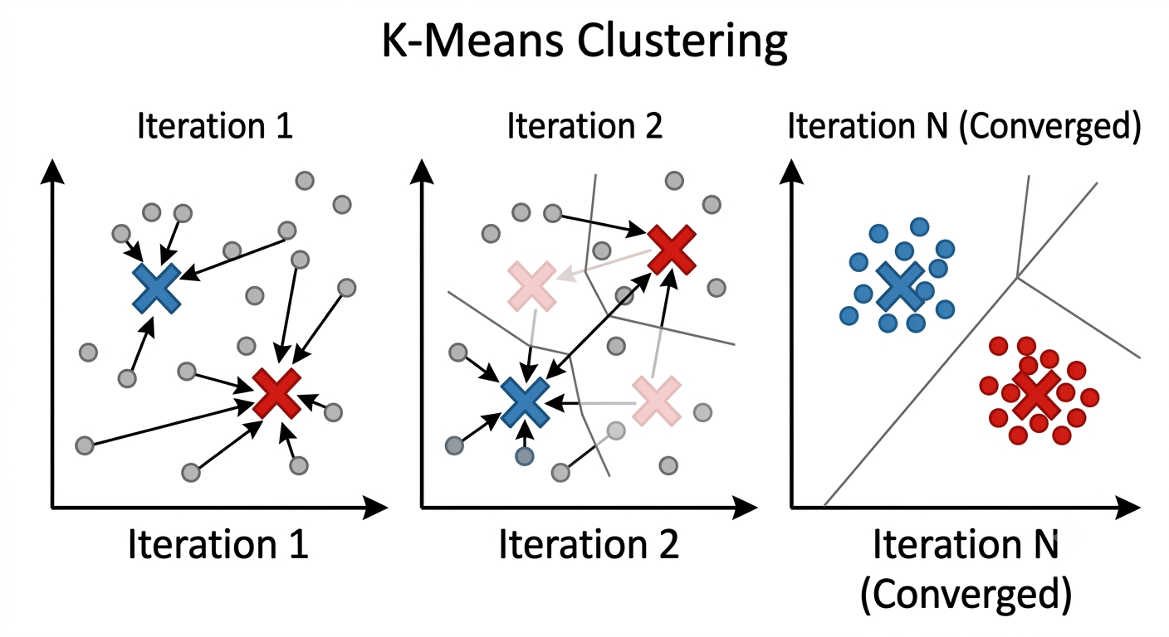
3.4 – Classical ML Techniques – Clustering - KMeans
Iteration 1: K=2, Two centroids (X) are randomly placed among unlabeled (grey) data. Points are assigned to the closest X, forming initial, messy clusters (faint red/blue boundaries).
Iteration 2: The centroids move to the center of their assigned points. The points are re-assigned, and the clusters start to define themselves.
Iteration N (Converged): The centroids have stopped moving. The points are clearly separated into stable Red and Blue clusters (re-using the established class colors from Image 1), with optimized Voronoi-like boundaries..

Slide 52
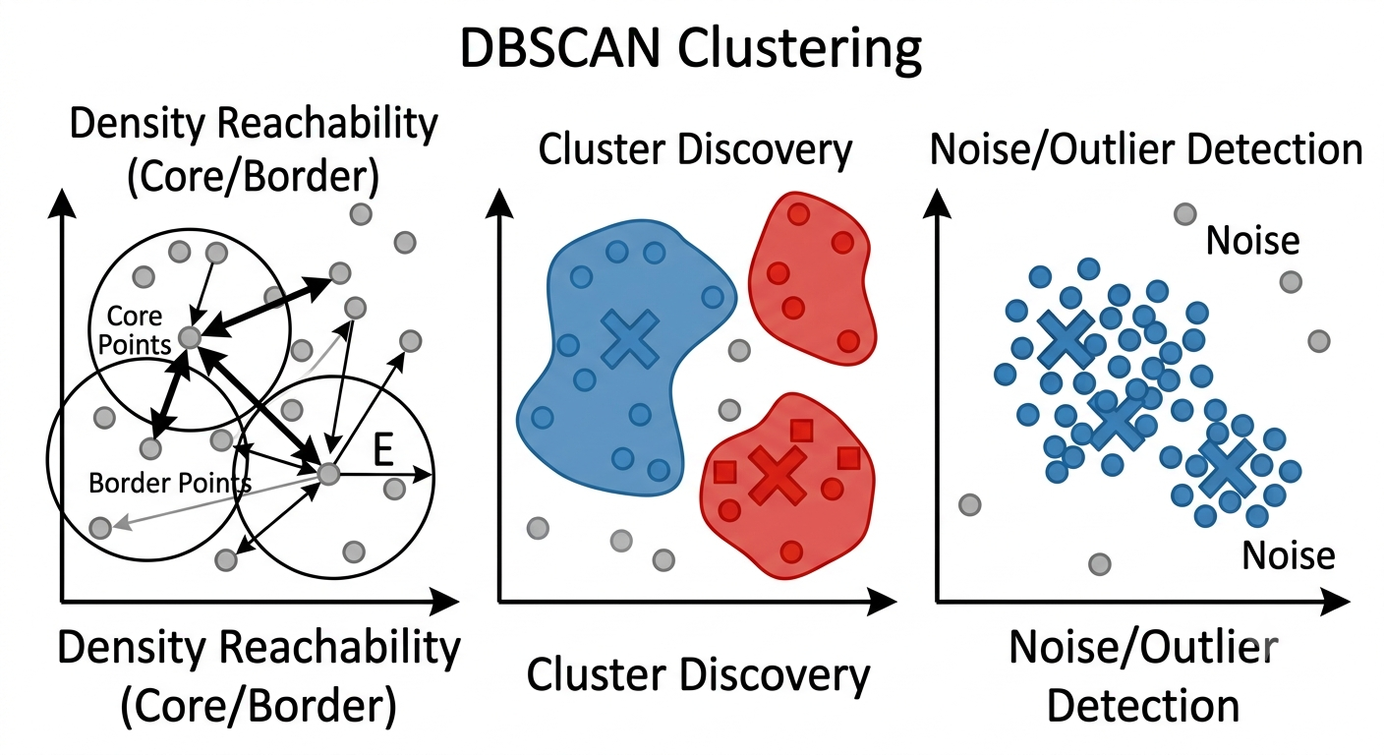
3.4 – Classical ML Techniques – Clustering - KMeans
DBSCAN (Density-Based Spatial Clustering of Applications with Noise) is an unsupervised clustering algorithm that finds clusters based on the density of data points. It is excellent at finding arbitrary shapes and identifying noise (outliers)..

Slide 53
4 - Neural Networks Intuition
Neurons, layers, activations (ReLU, softmax conceptually)
Why deep learning works better for perception/language
Classical DL Techniques : CNN, RNN, LSTM, GNN, RBM, VAE, GAN, KAN, Transformers, Diffusion
Preventing Overfitting (Memorization) : Early Stop, Dropout, Weight Regularization, Data Augmentation (**Very important), Simplify Model, Batch Normalization
Preventing Vanishing Gradient : Residuals (Skip Connections), Use RELU/LaekyRELU Activation Fn., Batch Normalization
Bias/Vairance problem, Regularization and smooth learning
Cross Entropy, Learning Rate Momentum

Slide 54
Hands-on
kk

