Slide 1
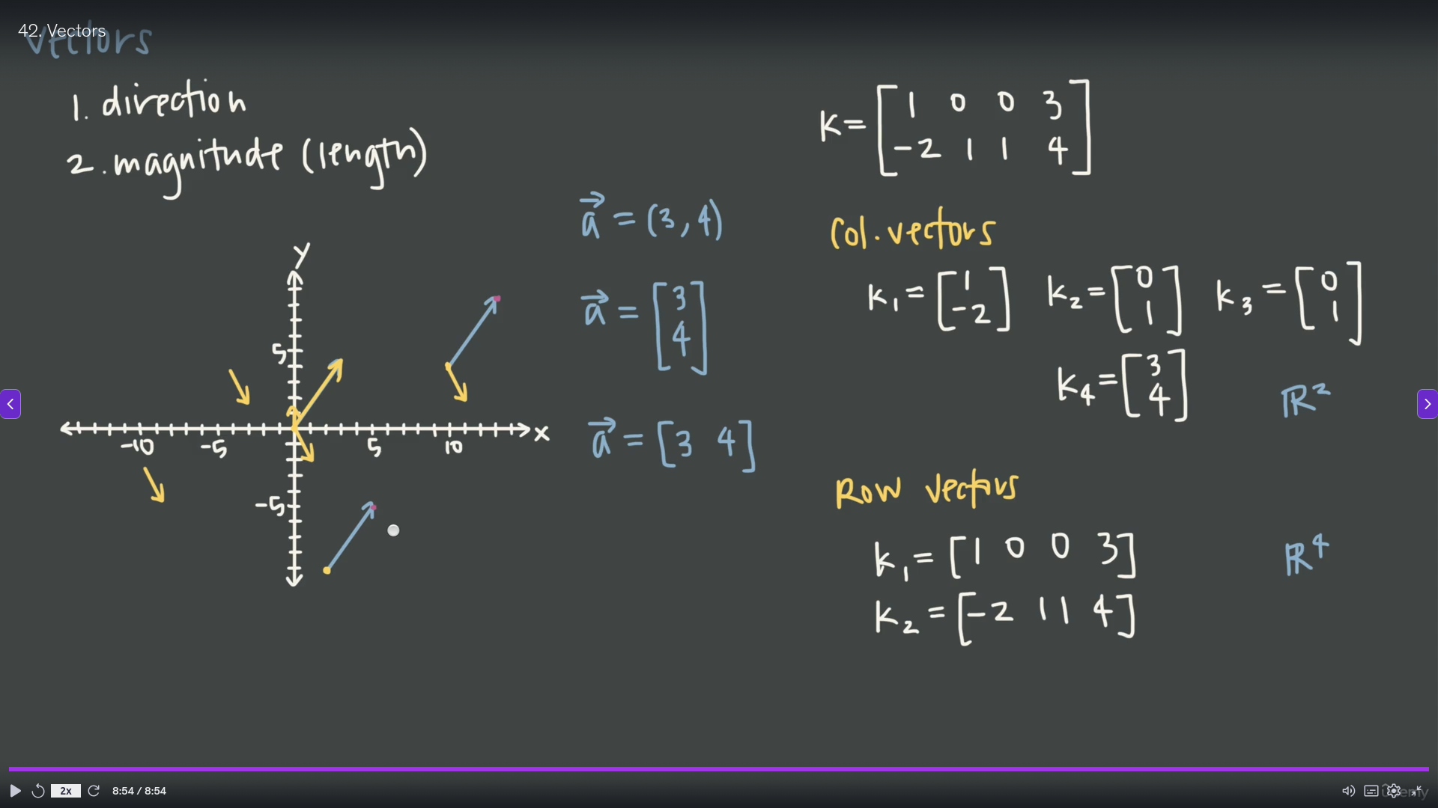

Slide 2
Tensors (Multilinear Map)
1
3
Vectors = 1st order Tensor (1D arrays)
Matrices = 2nd order Tensor (2D arrays)
3rd order Tensor , is a stack of matrices ( 3D arrays )
Tensor may have n order.
1 2 3
4 5 6
7 8 9
3x3 matrix
Represented as 2D array data structure.
1 2
3 4
1 2
3 4
1 2
3 4
1 2
3 4
2 x 2 x 3 Tensor (I ,j, k indices)

Slide 3
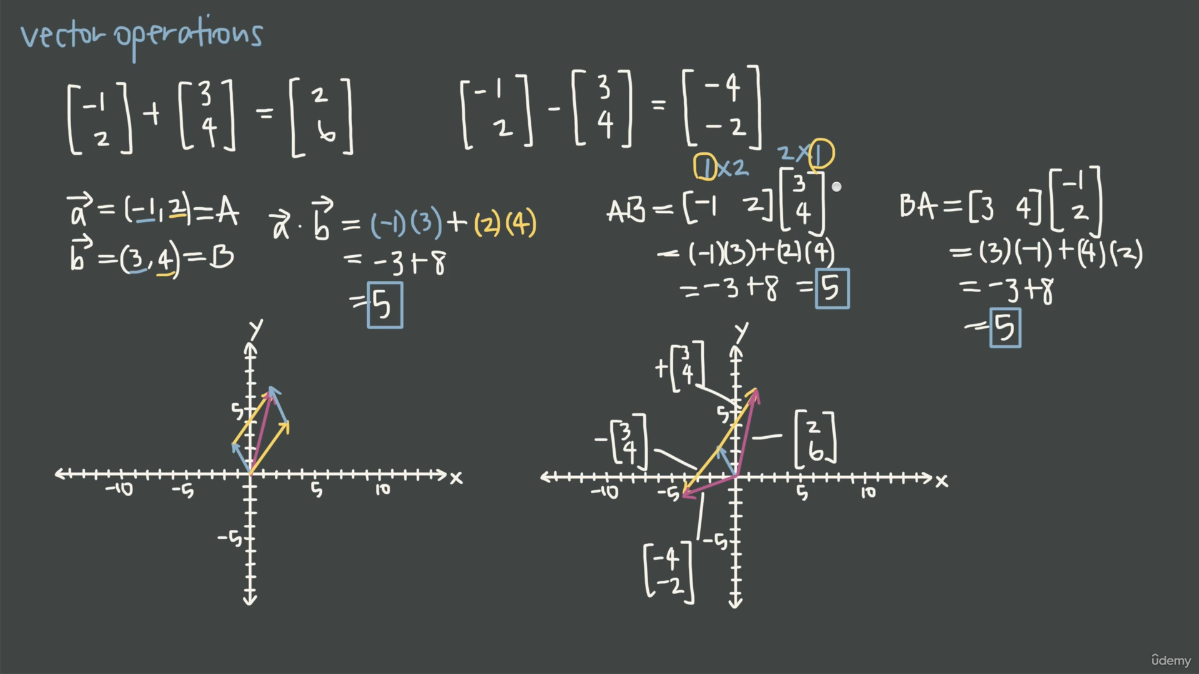

Slide 4
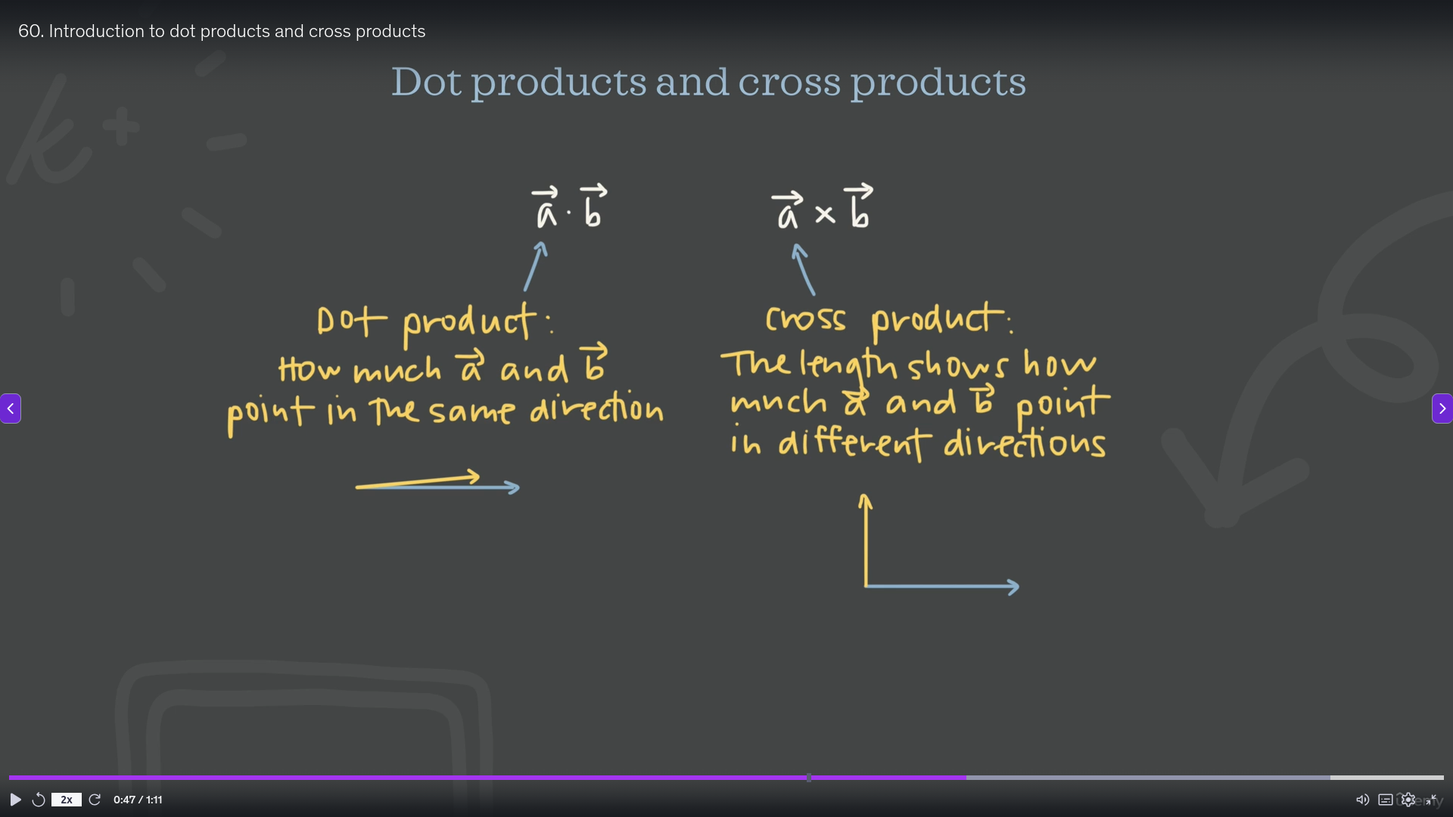

Slide 5
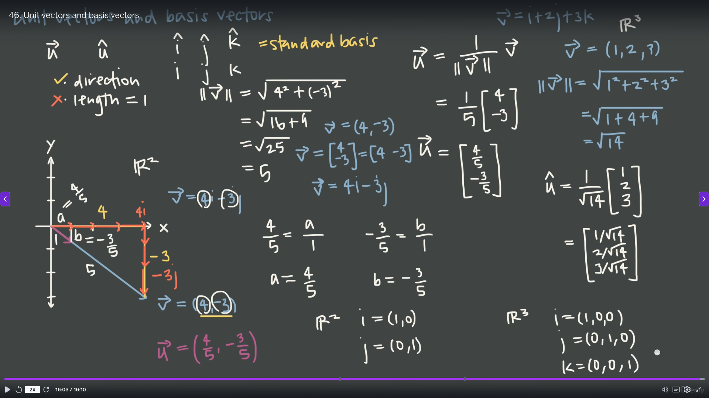

Slide 6
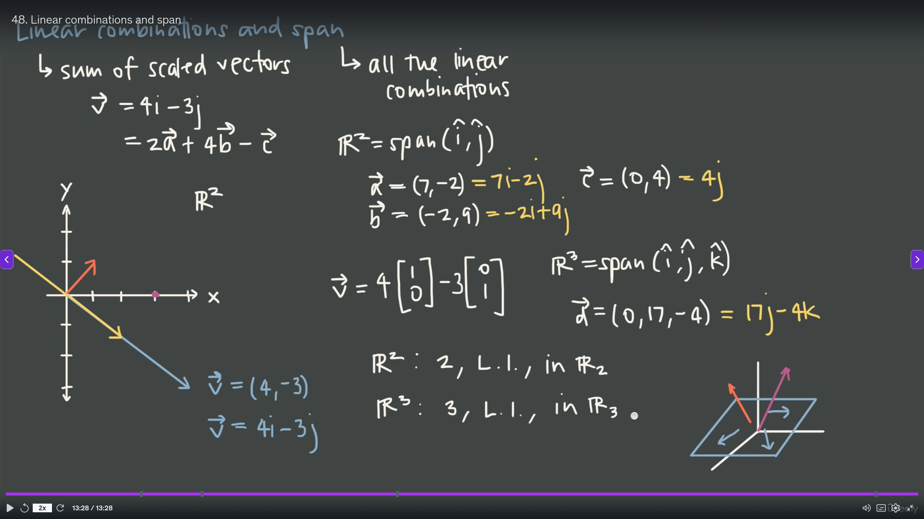

Slide 7
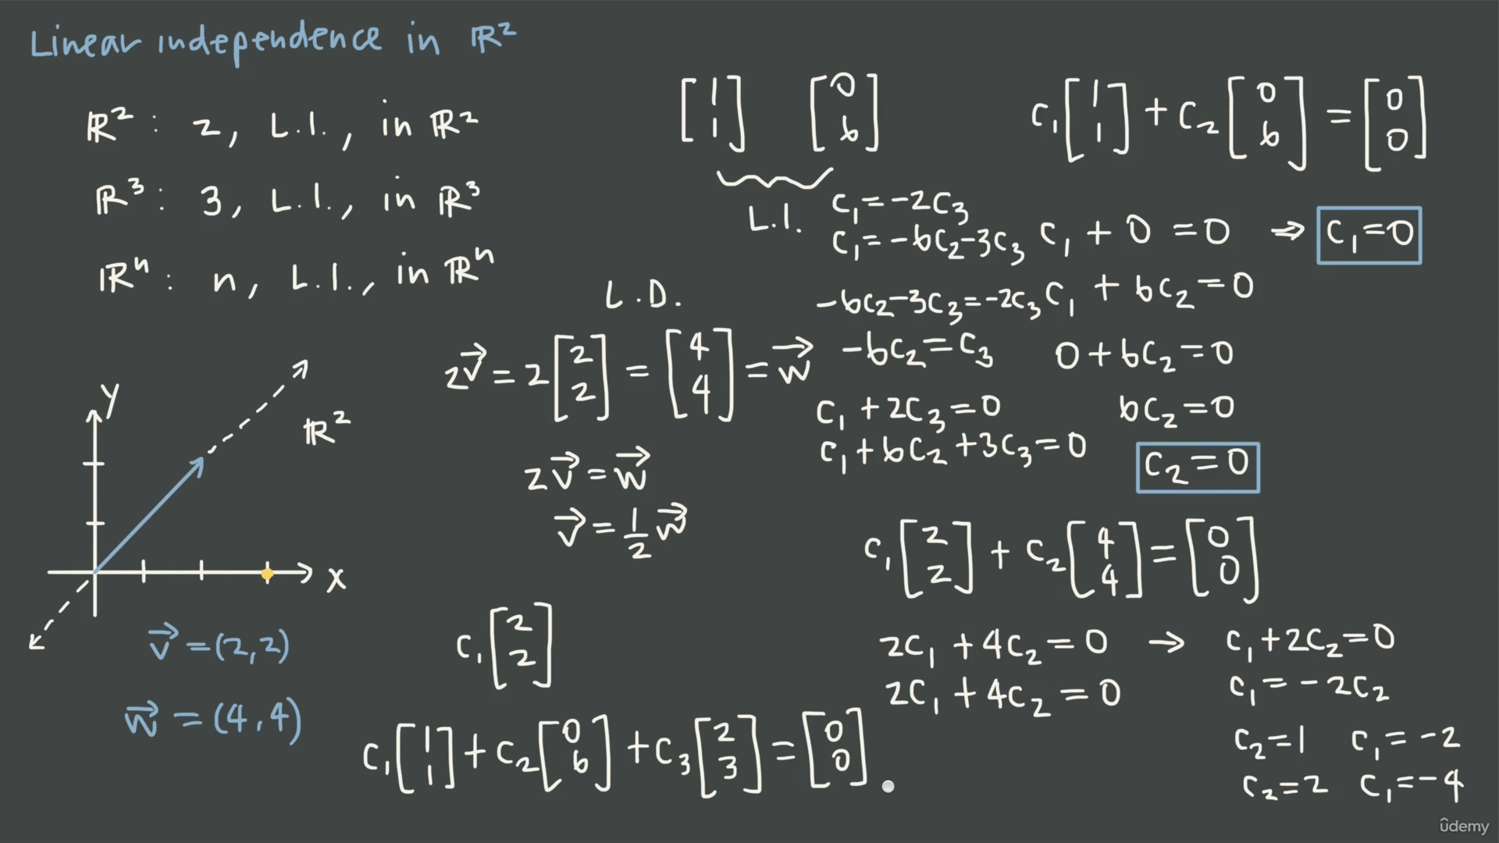

Slide 8
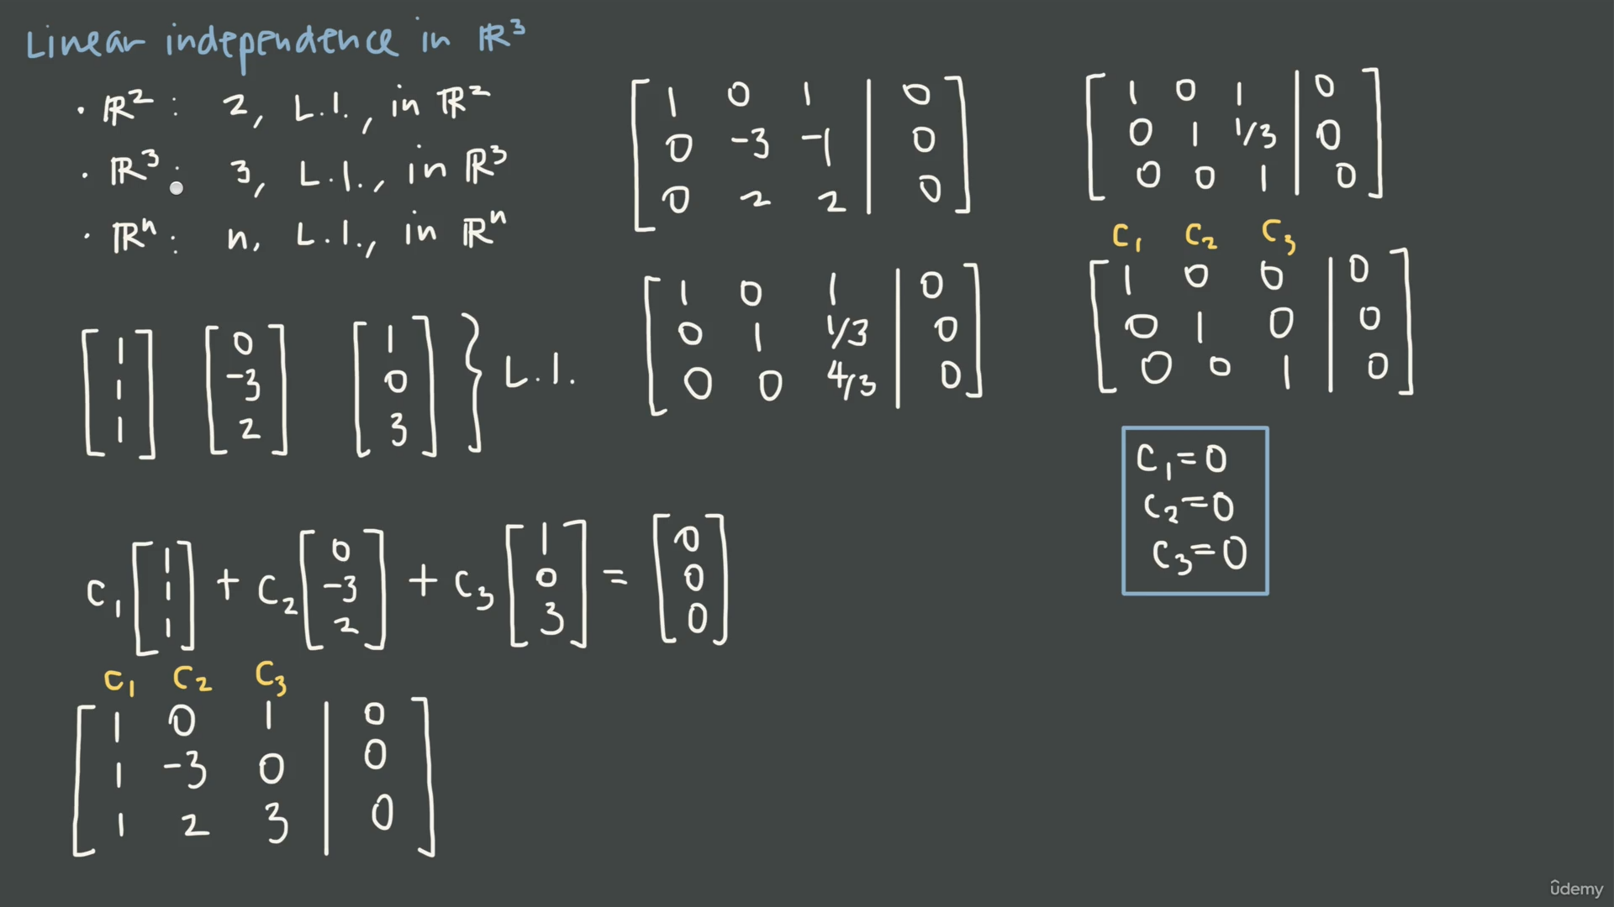

Slide 9
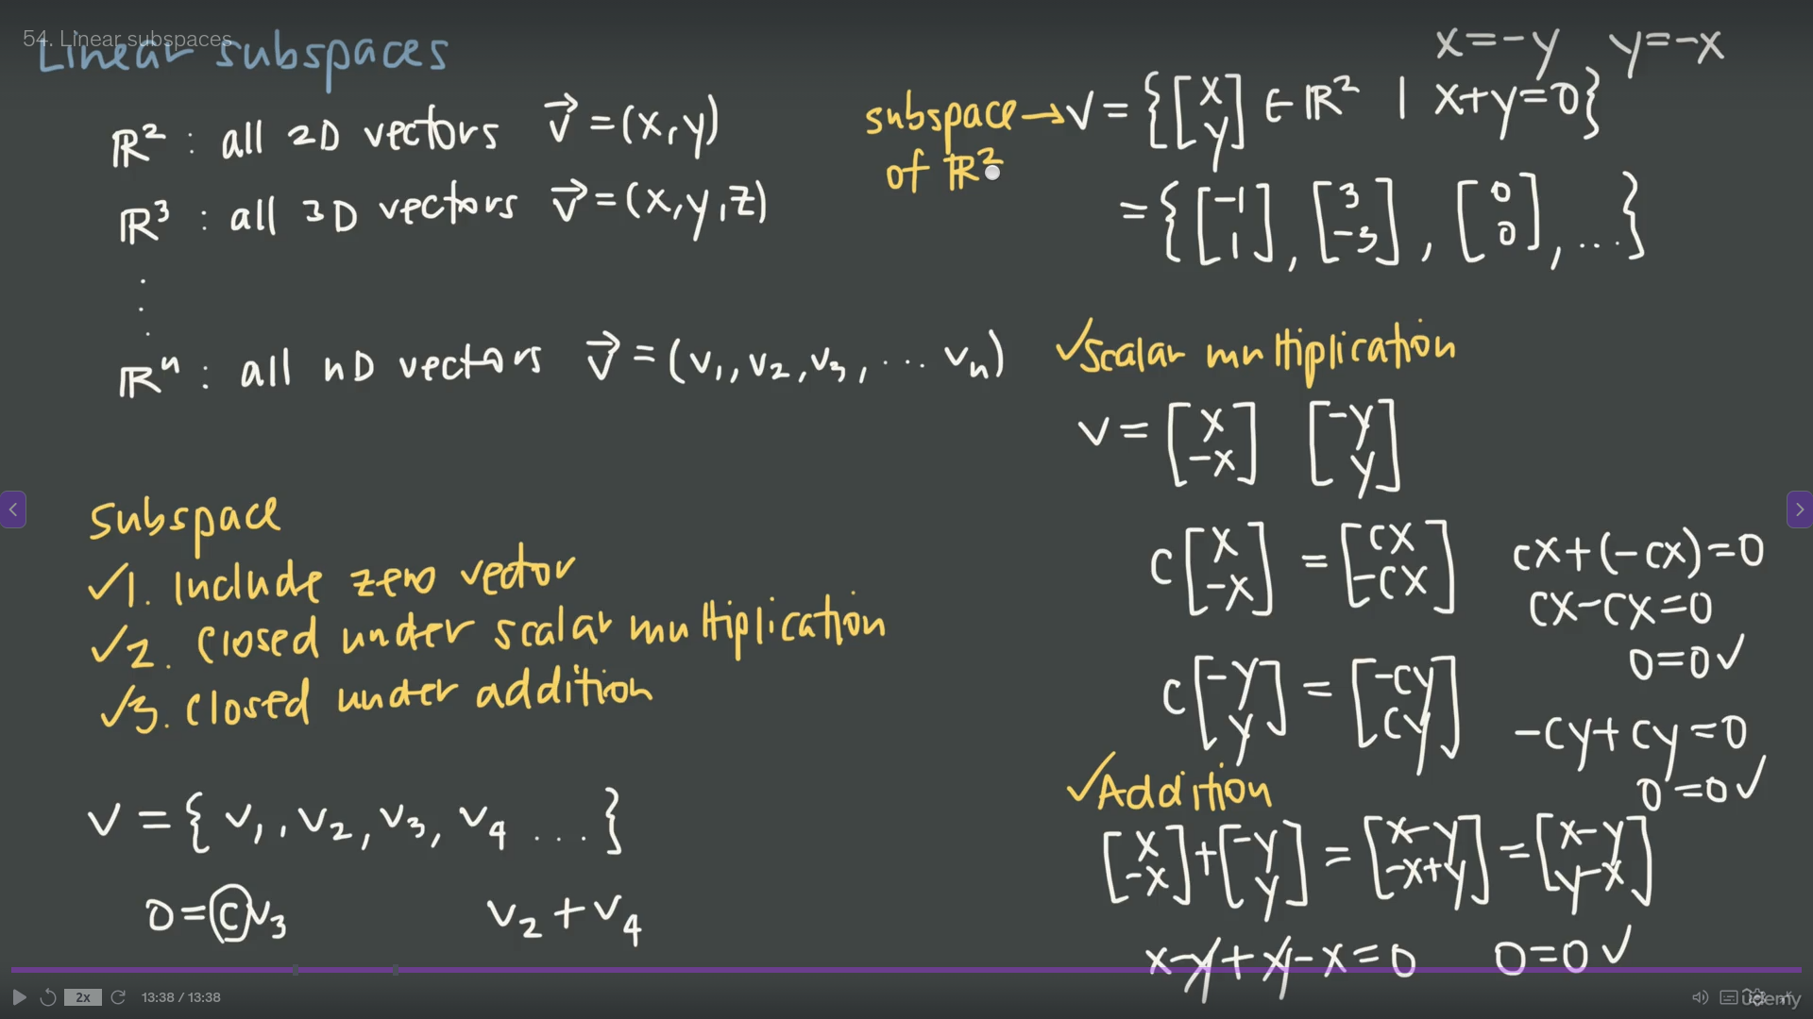

Slide 10
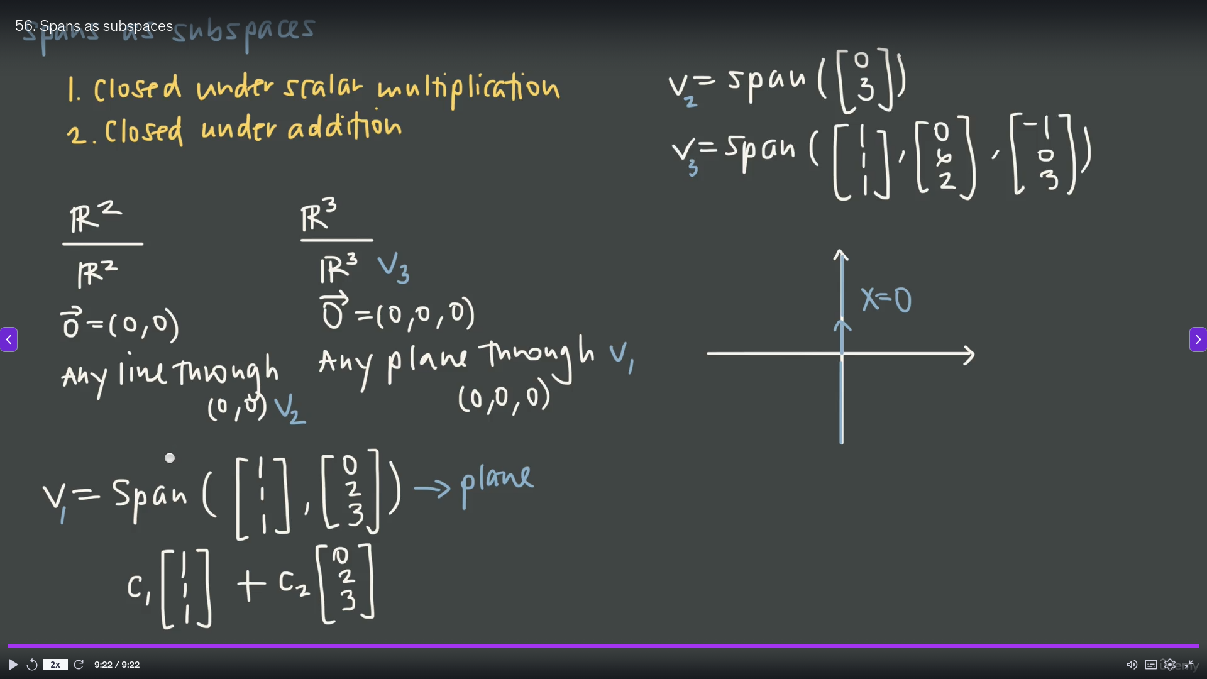

Slide 11
