Slide 1
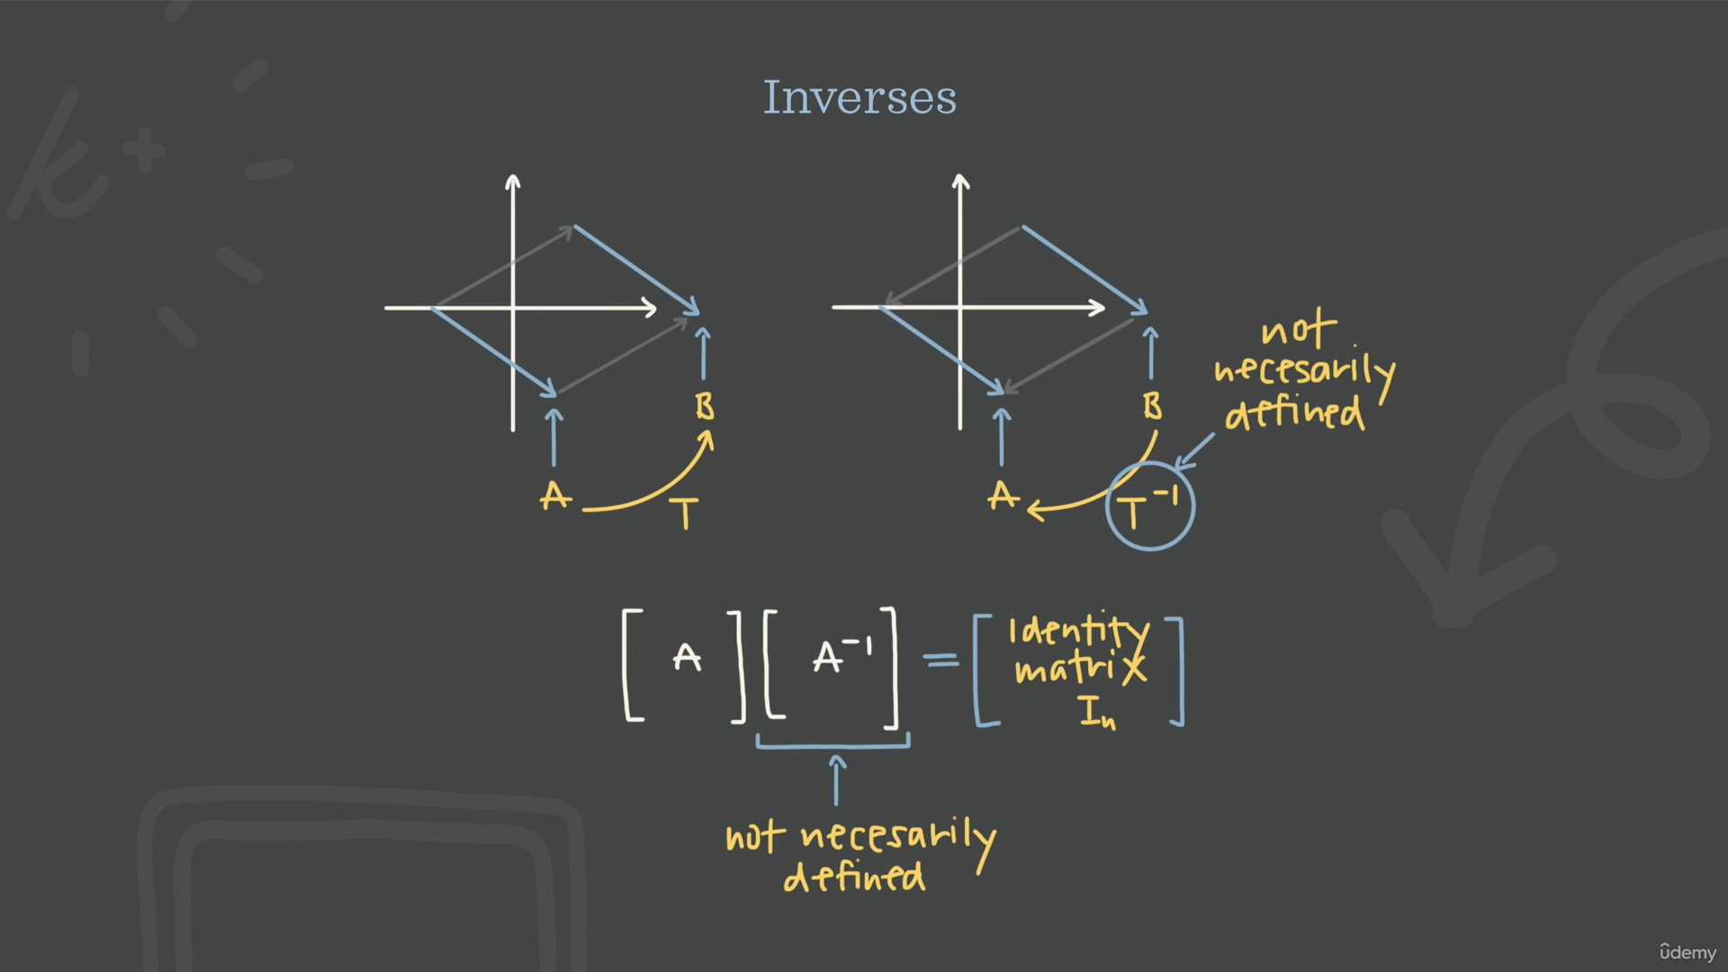

Slide 2
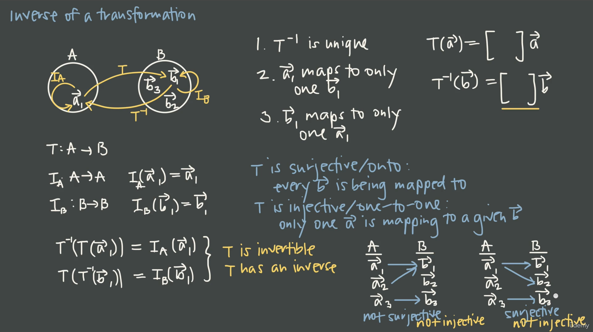

Slide 3
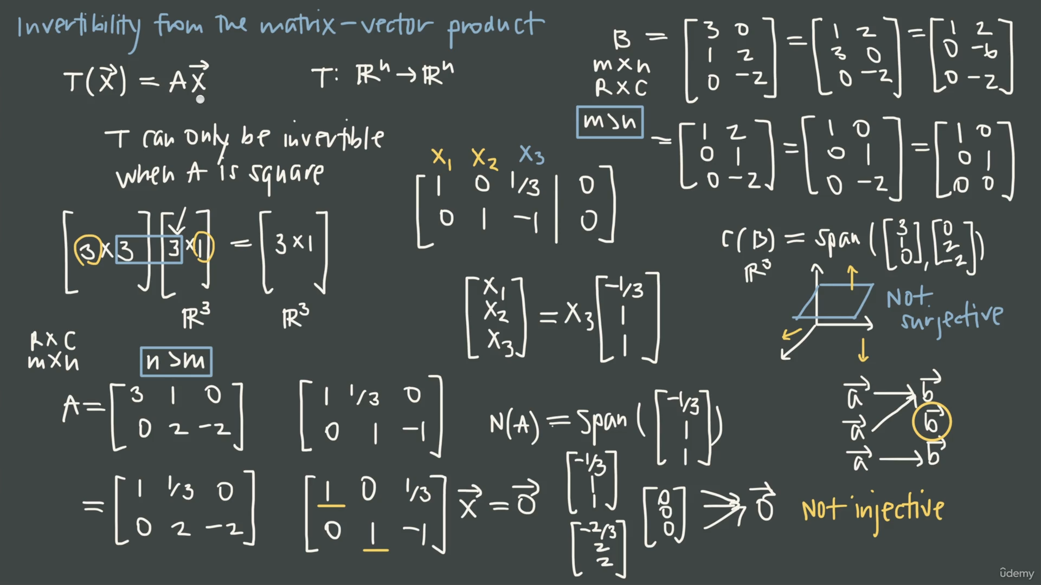

Slide 4
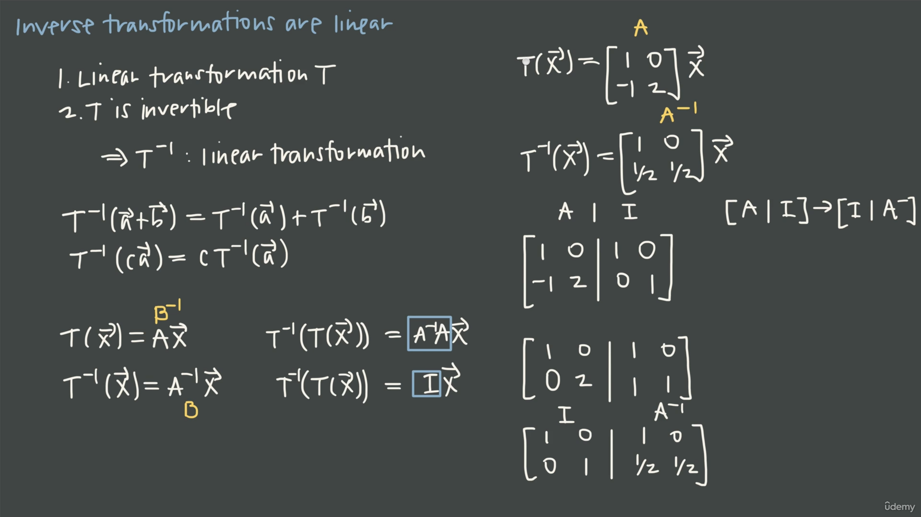

Slide 5
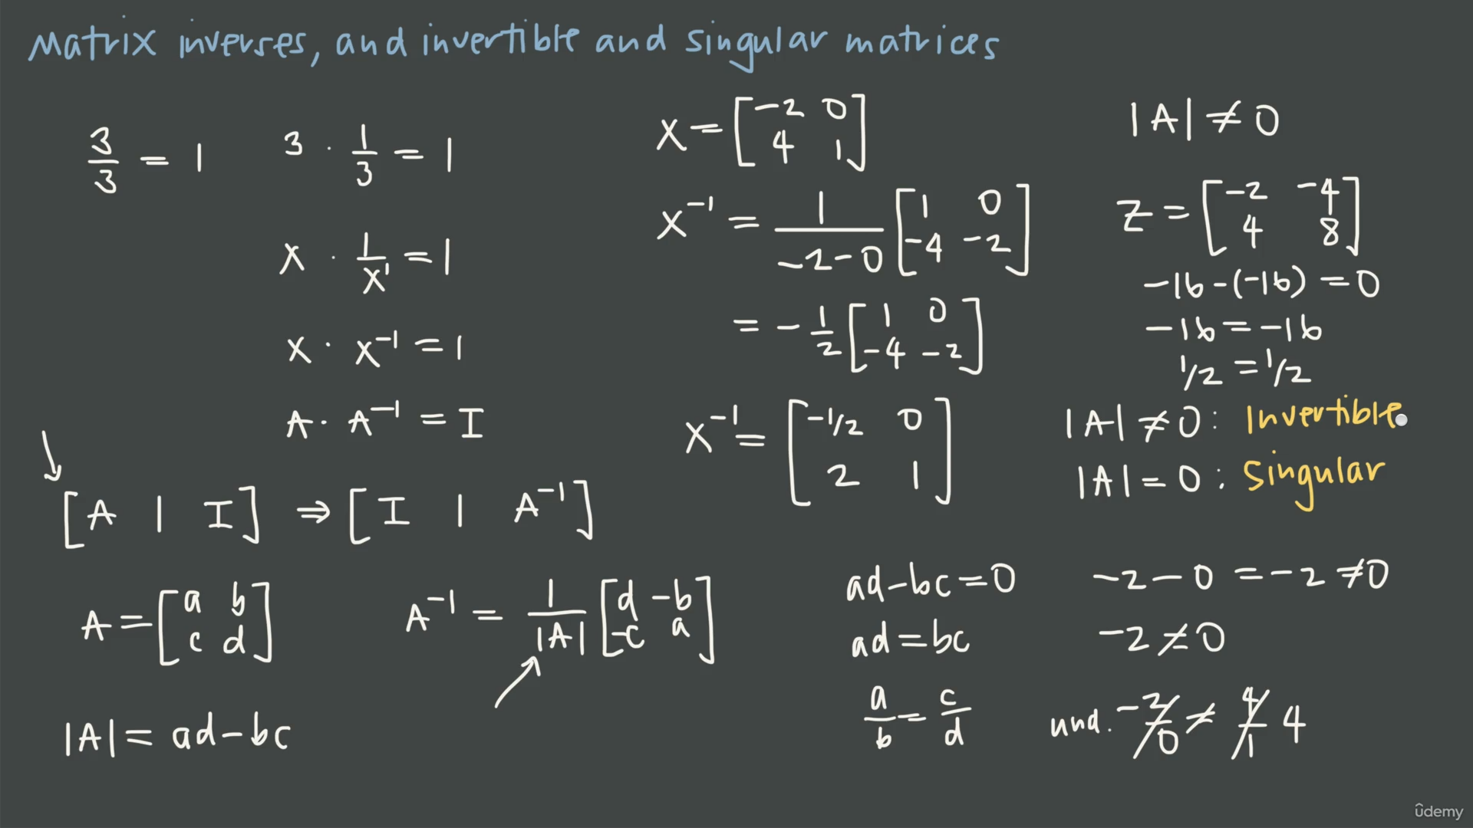

Slide 6
The "Division by Zero" Analog: In basic arithmetic, every number has a reciprocal (e.g., 5 becomes 1/5) except for zero.
A singular matrix is the matrix equivalent of the number zero.
It is "singular" because it represents a point where the standard rules of matrix algebra (like finding an inverse) break down.

Slide 7
