Slide 1
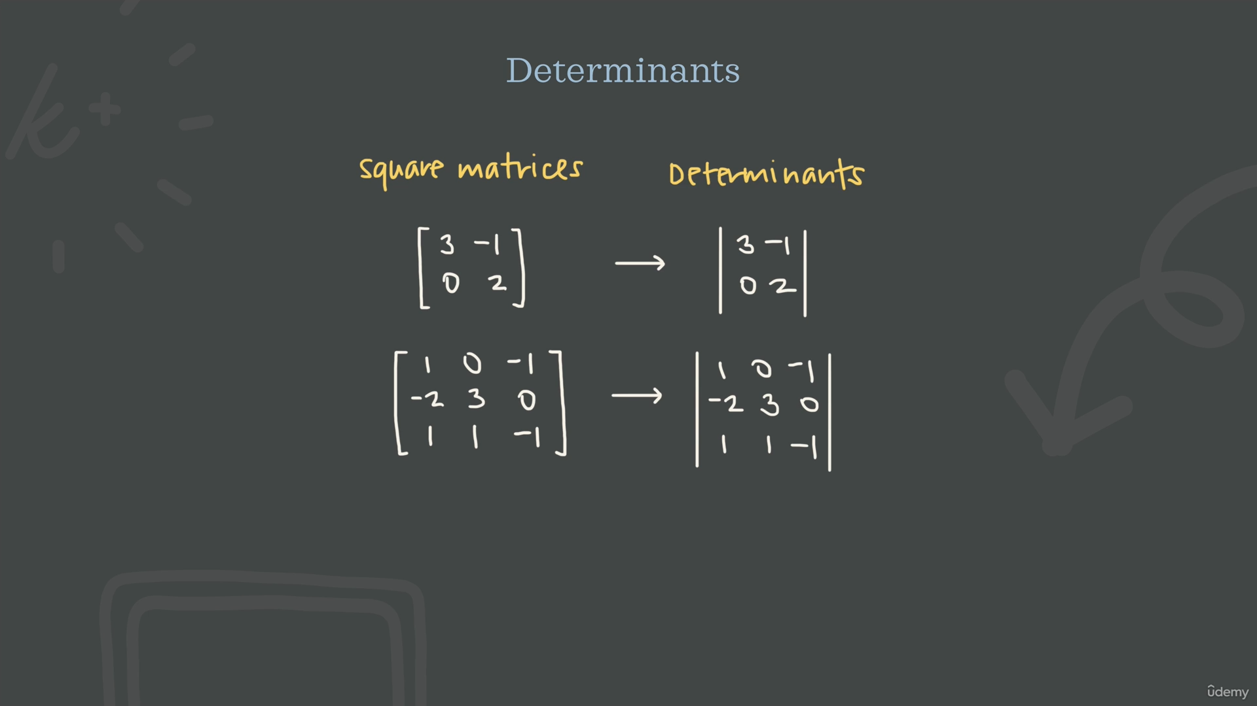

Slide 2
1. The Geometry of 2D Space
Imagine a unit square on a grid (a 1×1 square). When you apply a matrix transformation to that square, it usually turns into a tilted parallelogram.
The Determinant Value: The area of that new parallelogram is the determinant.
Example: If your determinant is 3, the transformation has tripled the area of any shape in that space. If it’s 0.5, everything has been squished to half its original size.
2. What about 3D and beyond?
In three dimensions, the logic stays the same, but the "size" changes:
Instead of area, the determinant represents the change in volume of a parallelepiped (a 3D slanted box).
In n dimensions, it represents the change in hyper-volume.
3. The "Sign" of the Determinant
Sometimes you'll get a negative determinant (e.g., −2). Since you can't have "negative area," what does that mean?
Orientation Flip: A negative determinant means the transformation flipped space over.
Think of it like looking at a piece of paper in a mirror. In 2D, if the order of your axes (the x and y vectors) switches from counter-clockwise to clockwise, the determinant becomes negative.

Slide 3
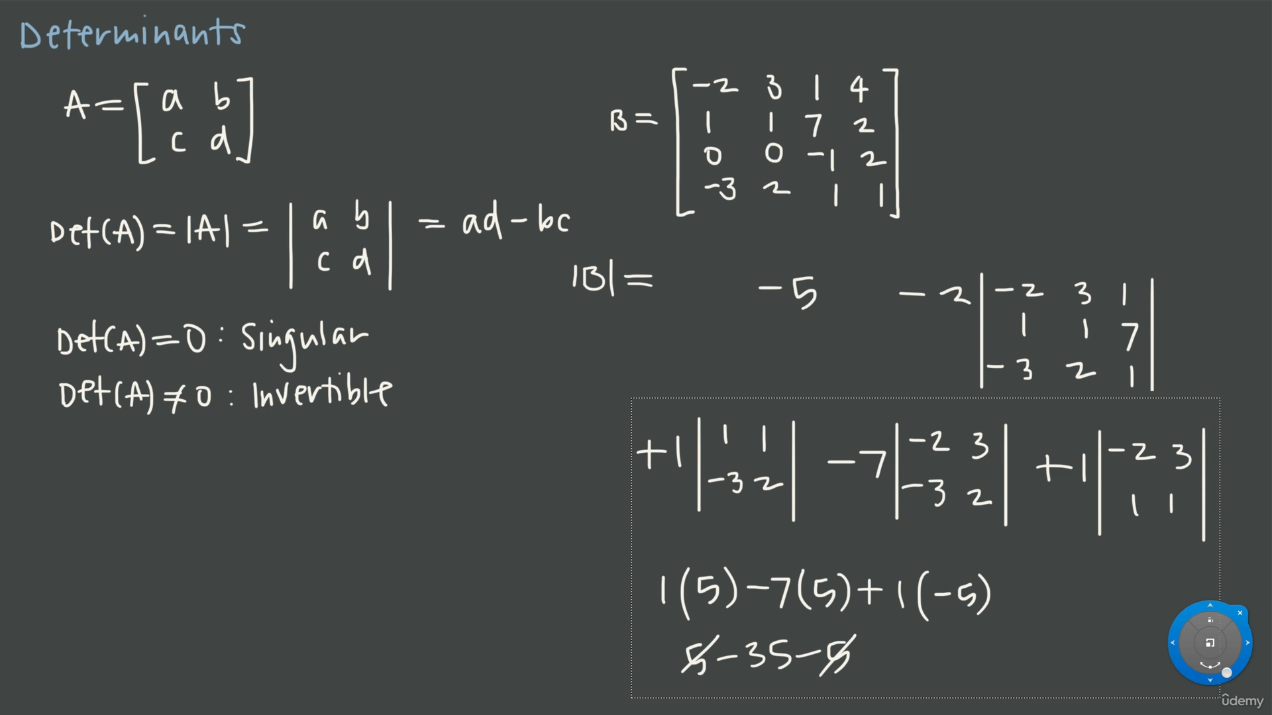

Slide 4
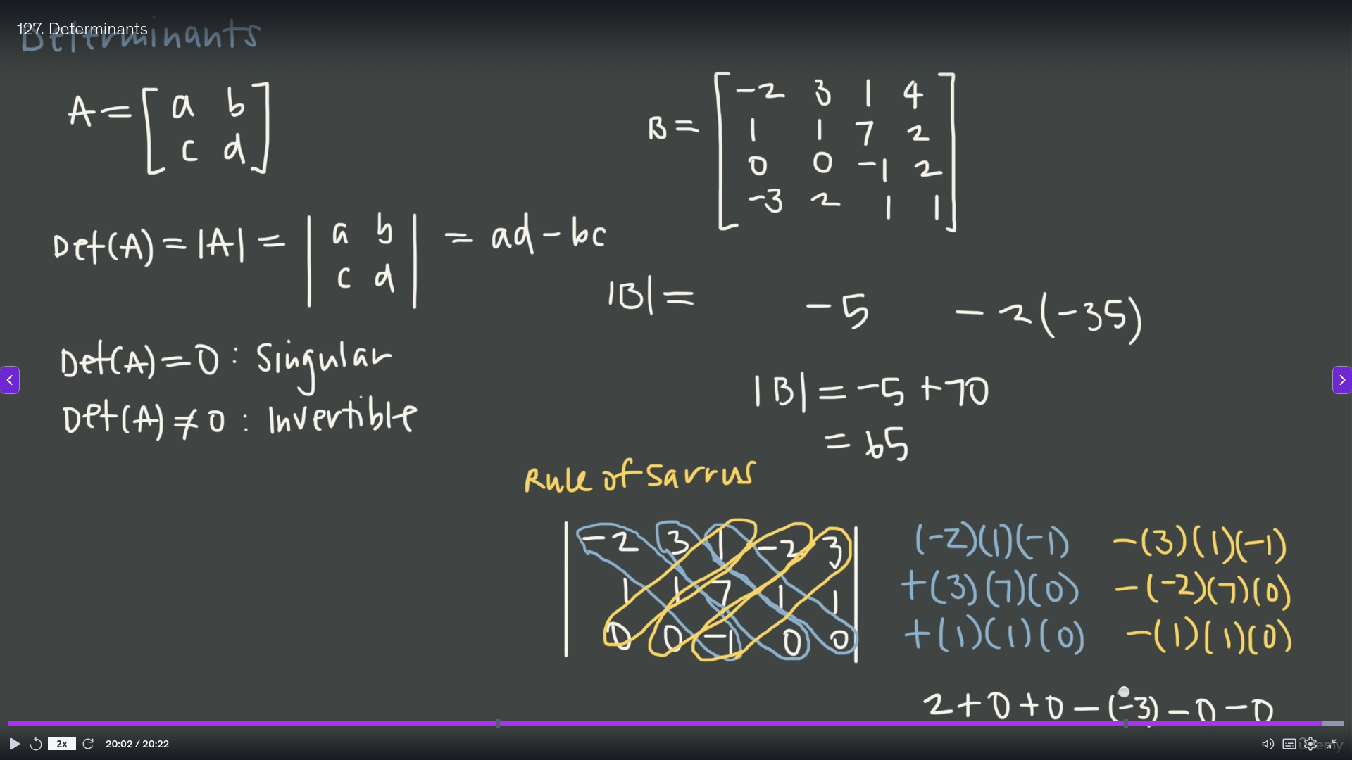

Slide 5
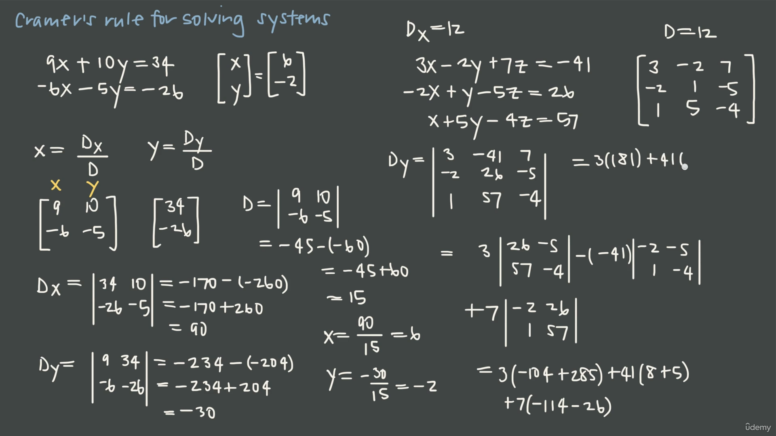

Slide 6
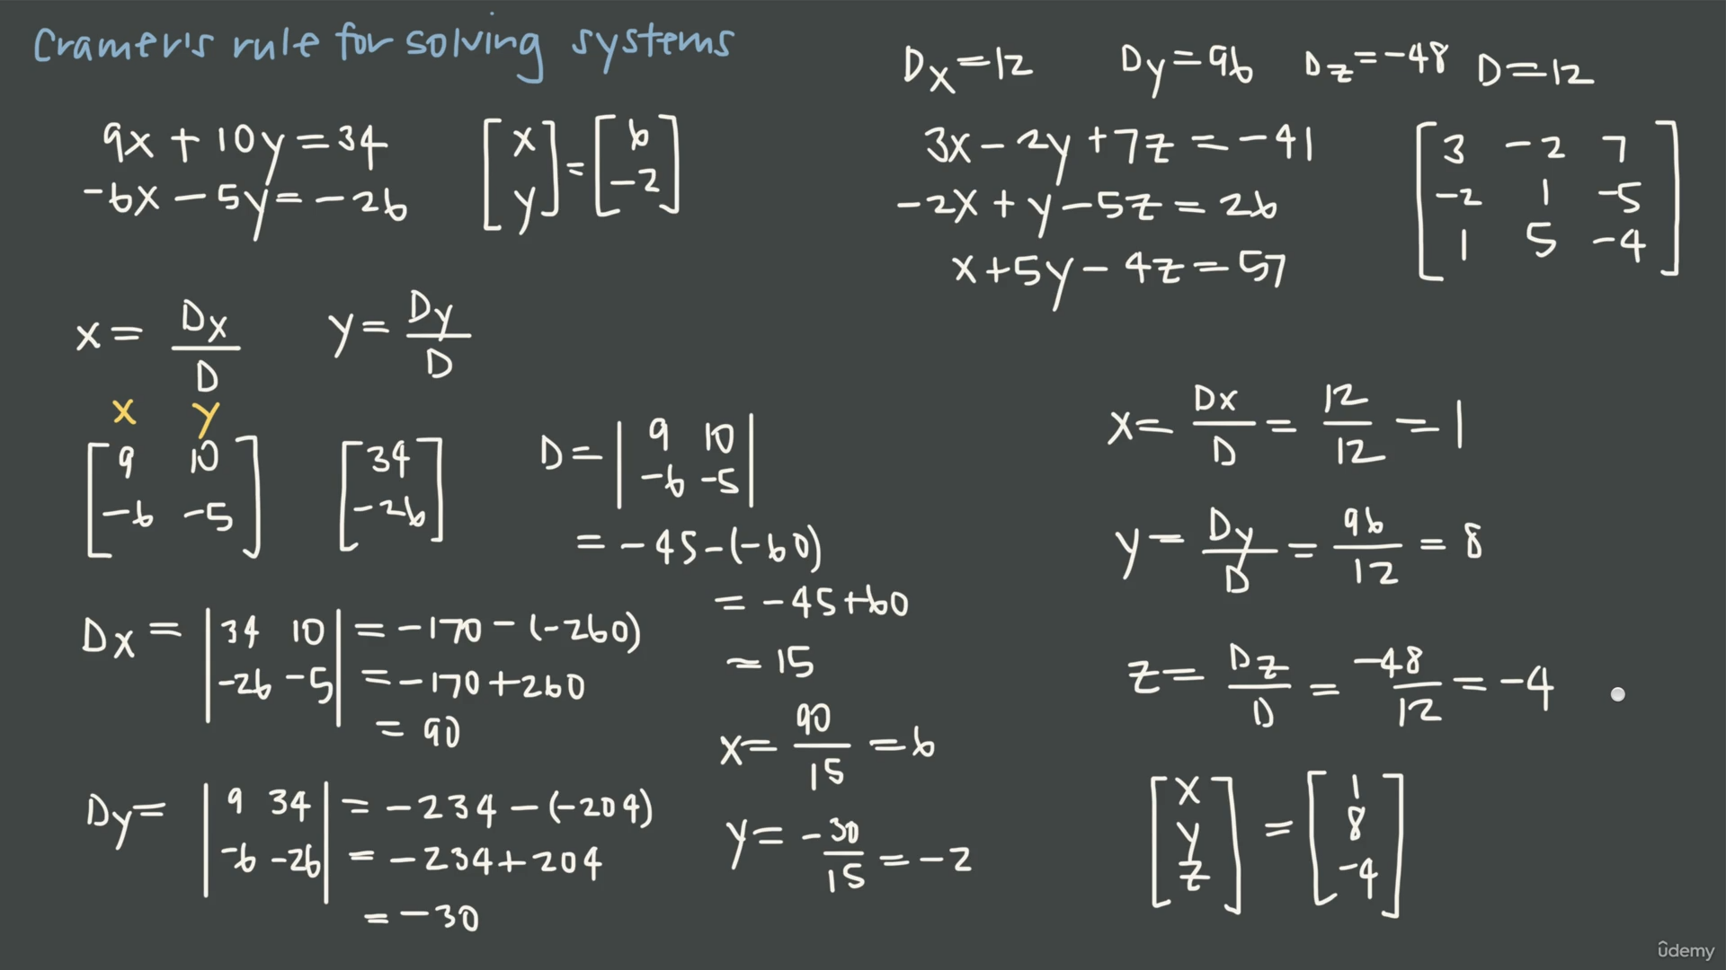

Slide 7
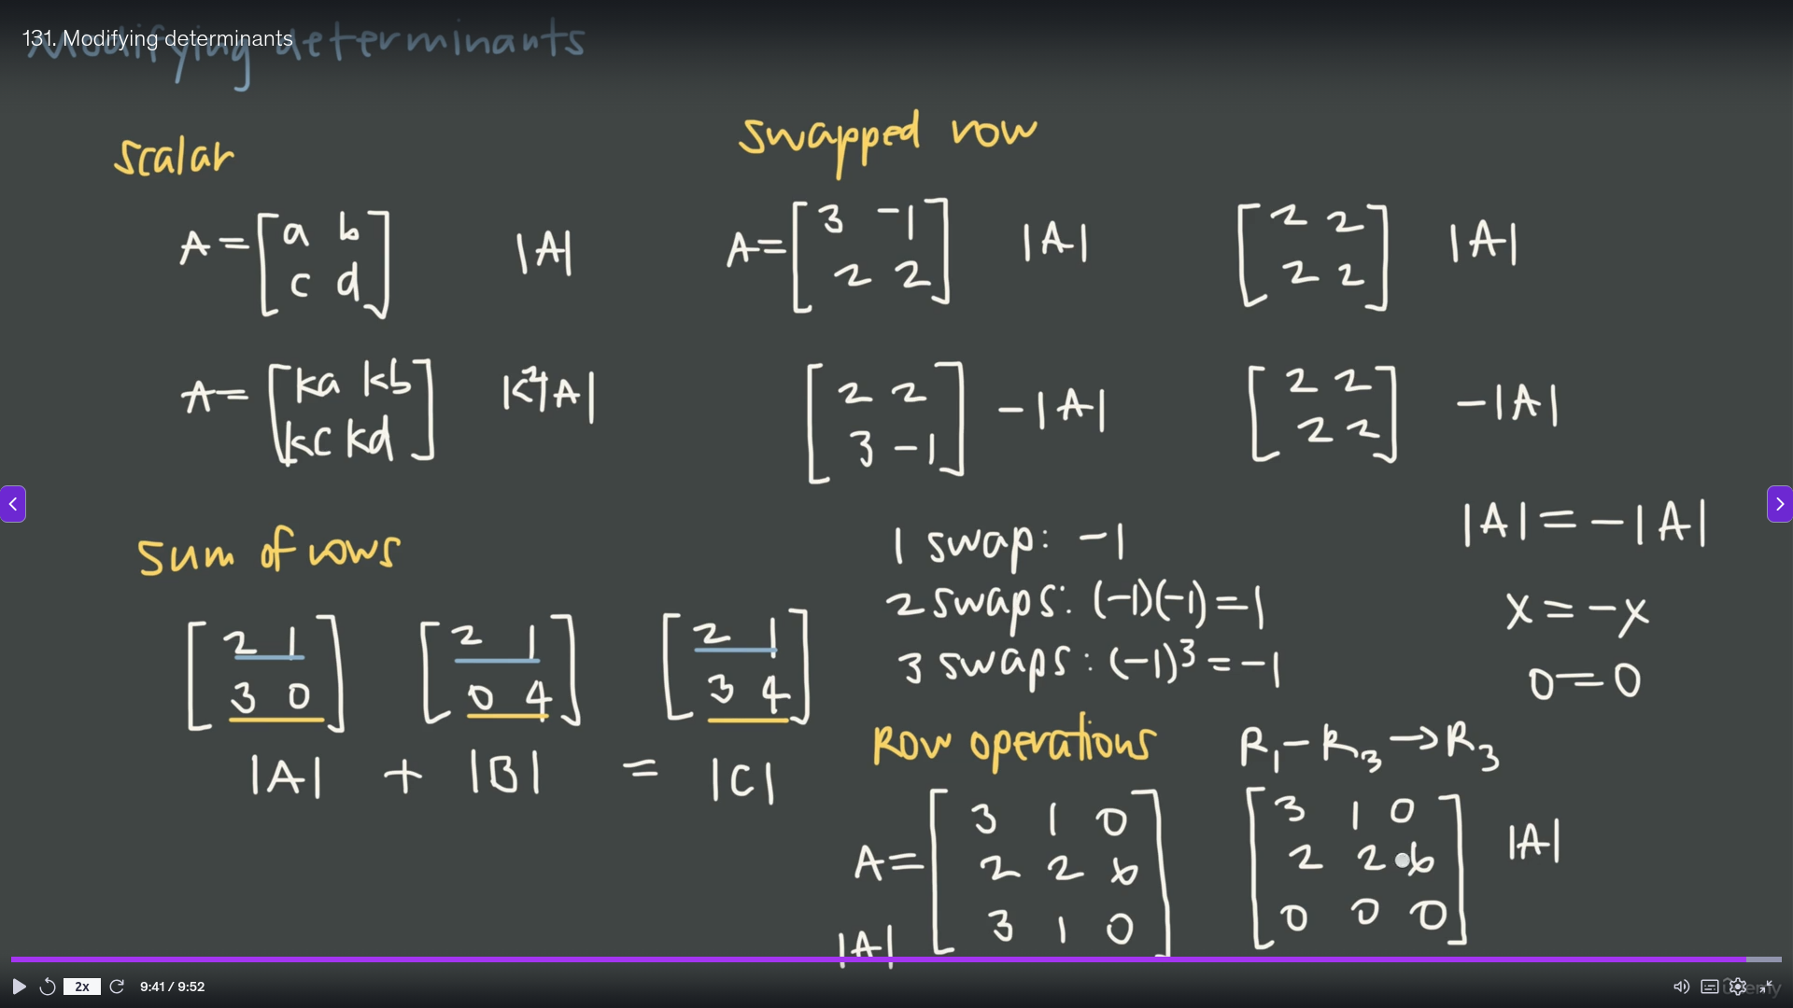

Slide 8
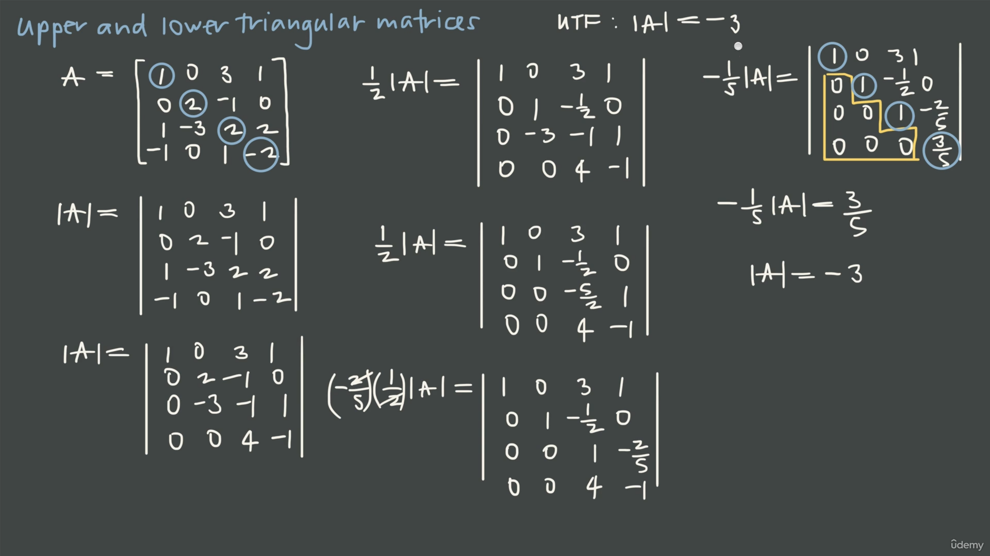

Slide 9
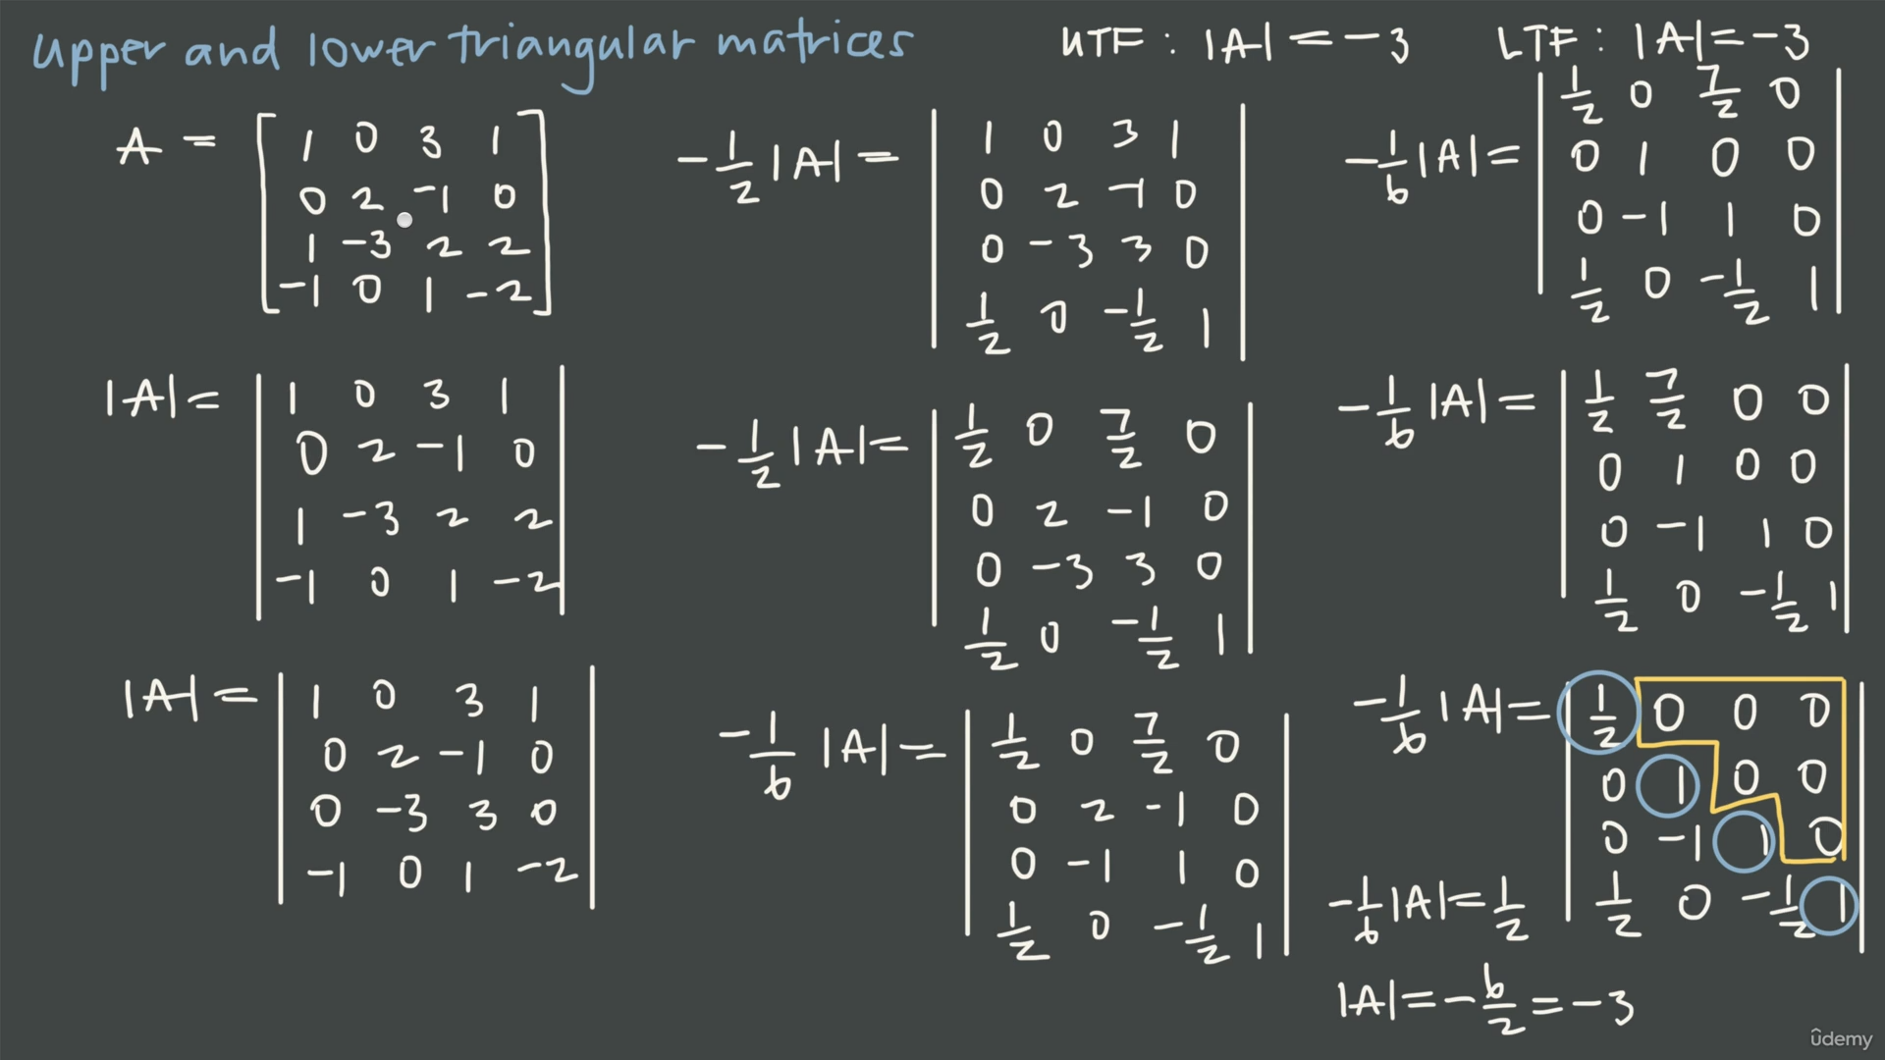

Slide 10
