Slide 1
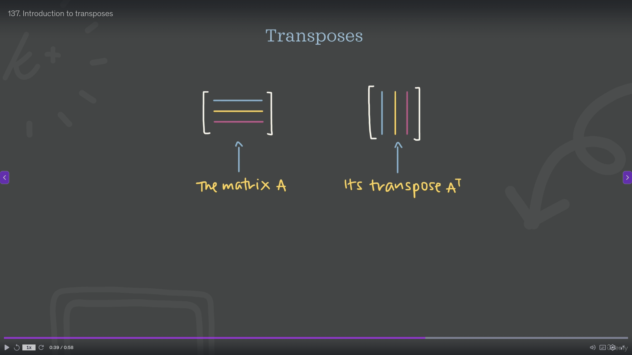

Slide 2
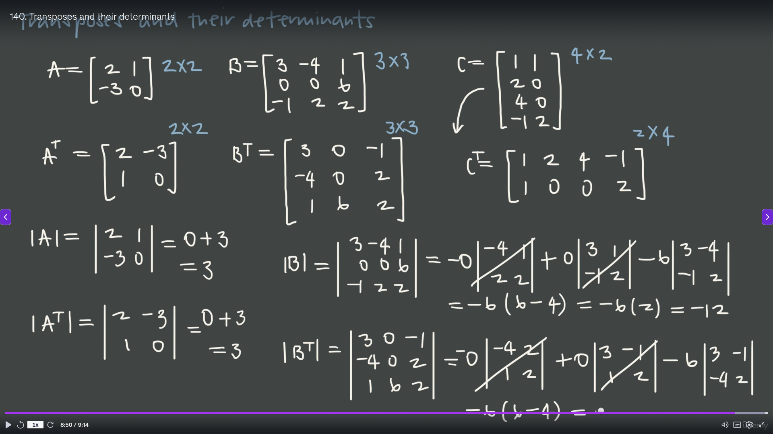

Slide 3
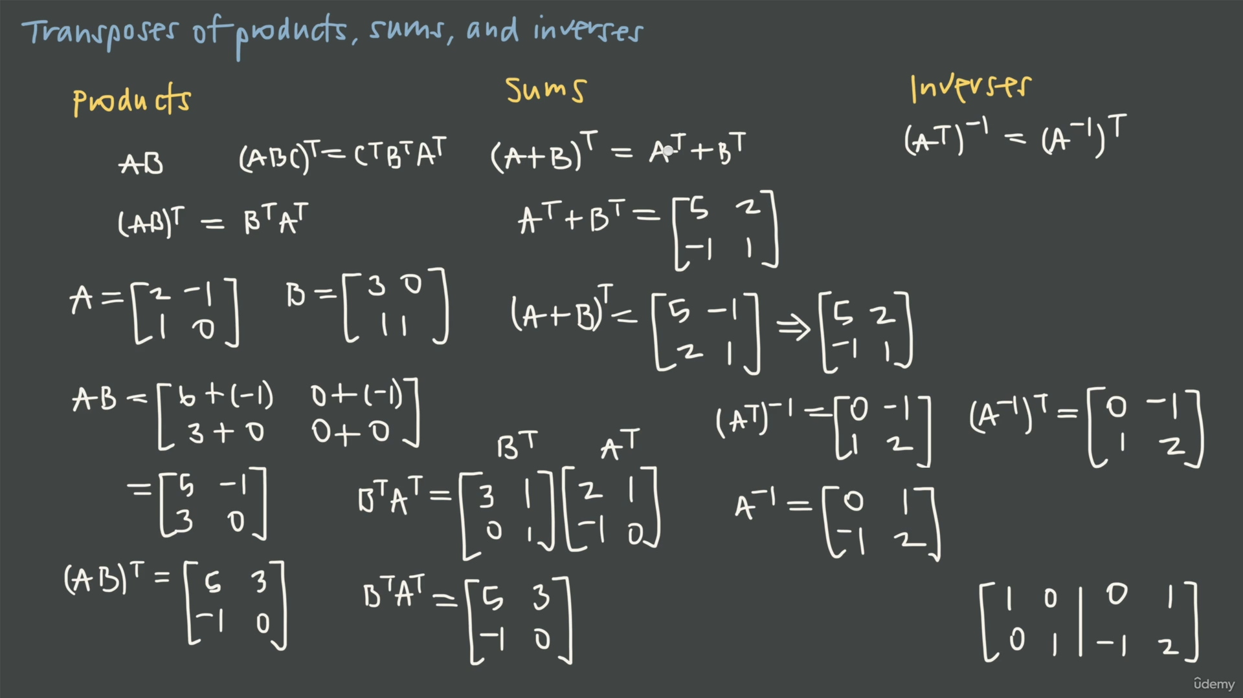

Slide 4
Transpose and Inverse Properties
A . A⁻¹ = A⁻¹ . A = I
(A⁻¹)⁻¹ = A
(A^{T})^{T} = A
(A^{T})⁻¹ = (A⁻¹)^{T}
(AB)^{T} = B^{T} . A^{T}
(A+B)^{T} = A^{T} + B^{T}
(AB)⁻¹ = B⁻¹ . A⁻¹
(k.A)⁻¹ = 1/k . A⁻¹
(k.A)^{T} = k . A^{T}
det(A^{T}) = det(A)
det(A⁻¹) = 1/det(A)
det(A.B)=det(A).det(B)

Slide 5
Tensors (Multilinear Map)
1
3
1 2 3
4 5 6
7 8 9
3x3 matrix
Represented as 2D array data structure.
Vectors = 1st order Tensor (1D arrays)
Matrices = 2nd order Tensor (2D arrays)
3rd order Tensor , is a stack of matrices ( 3D arrays )
Tensor may have n order.
1 2
3 4
1 2
3 4
1 2
3 4
1 2
3 4
2 x 2 x 3 Tensor (I ,j, k indices)

Slide 6
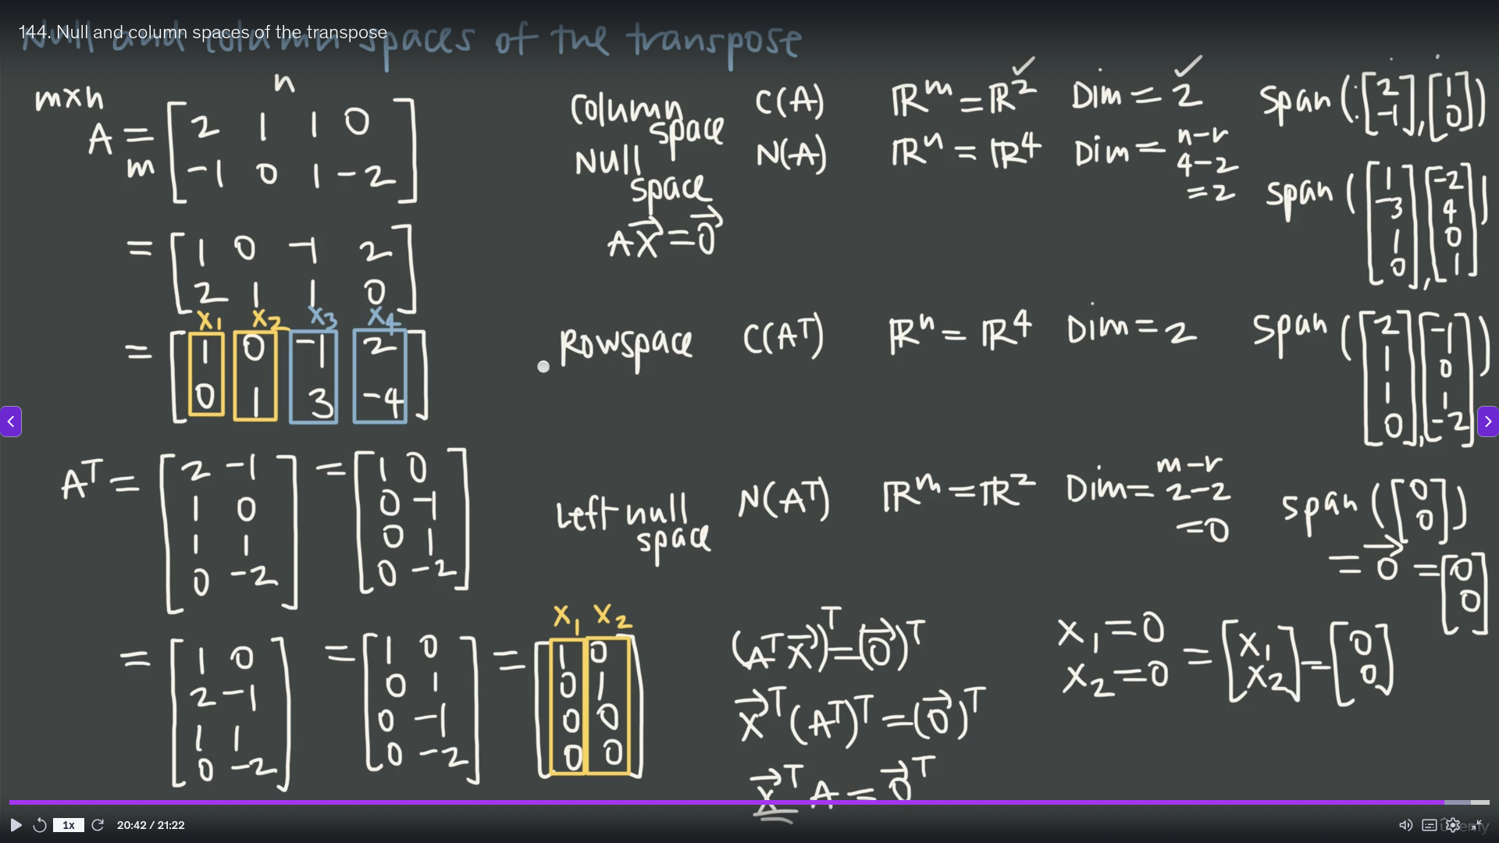

Slide 7
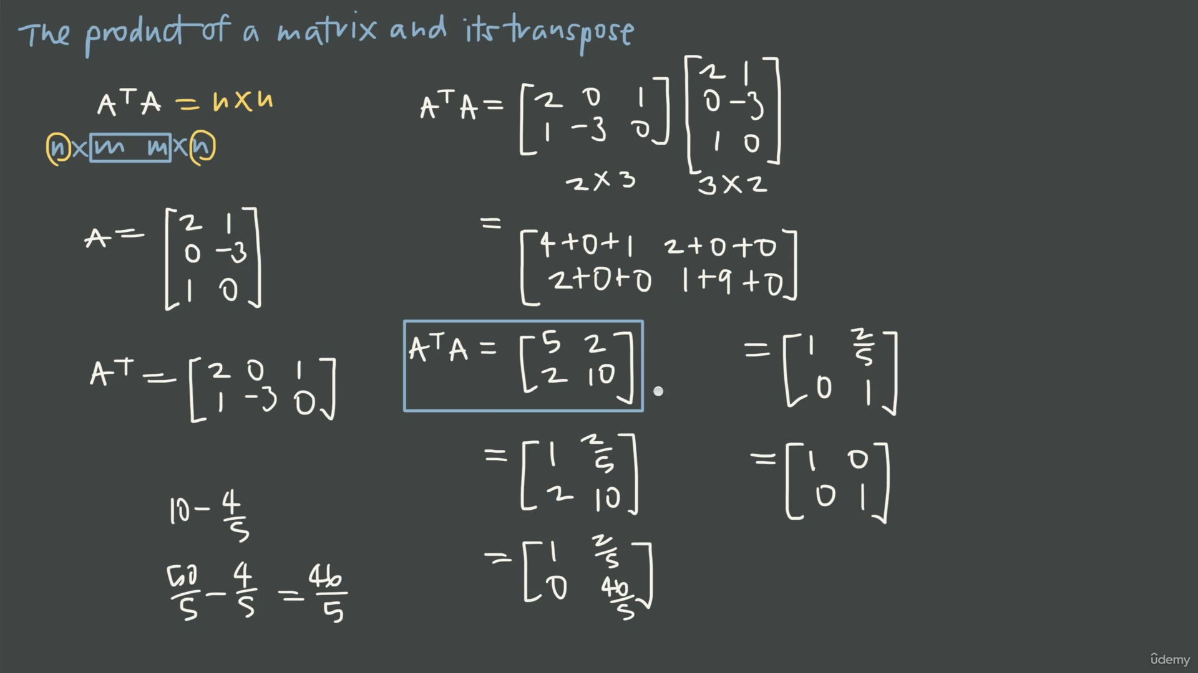

Slide 8
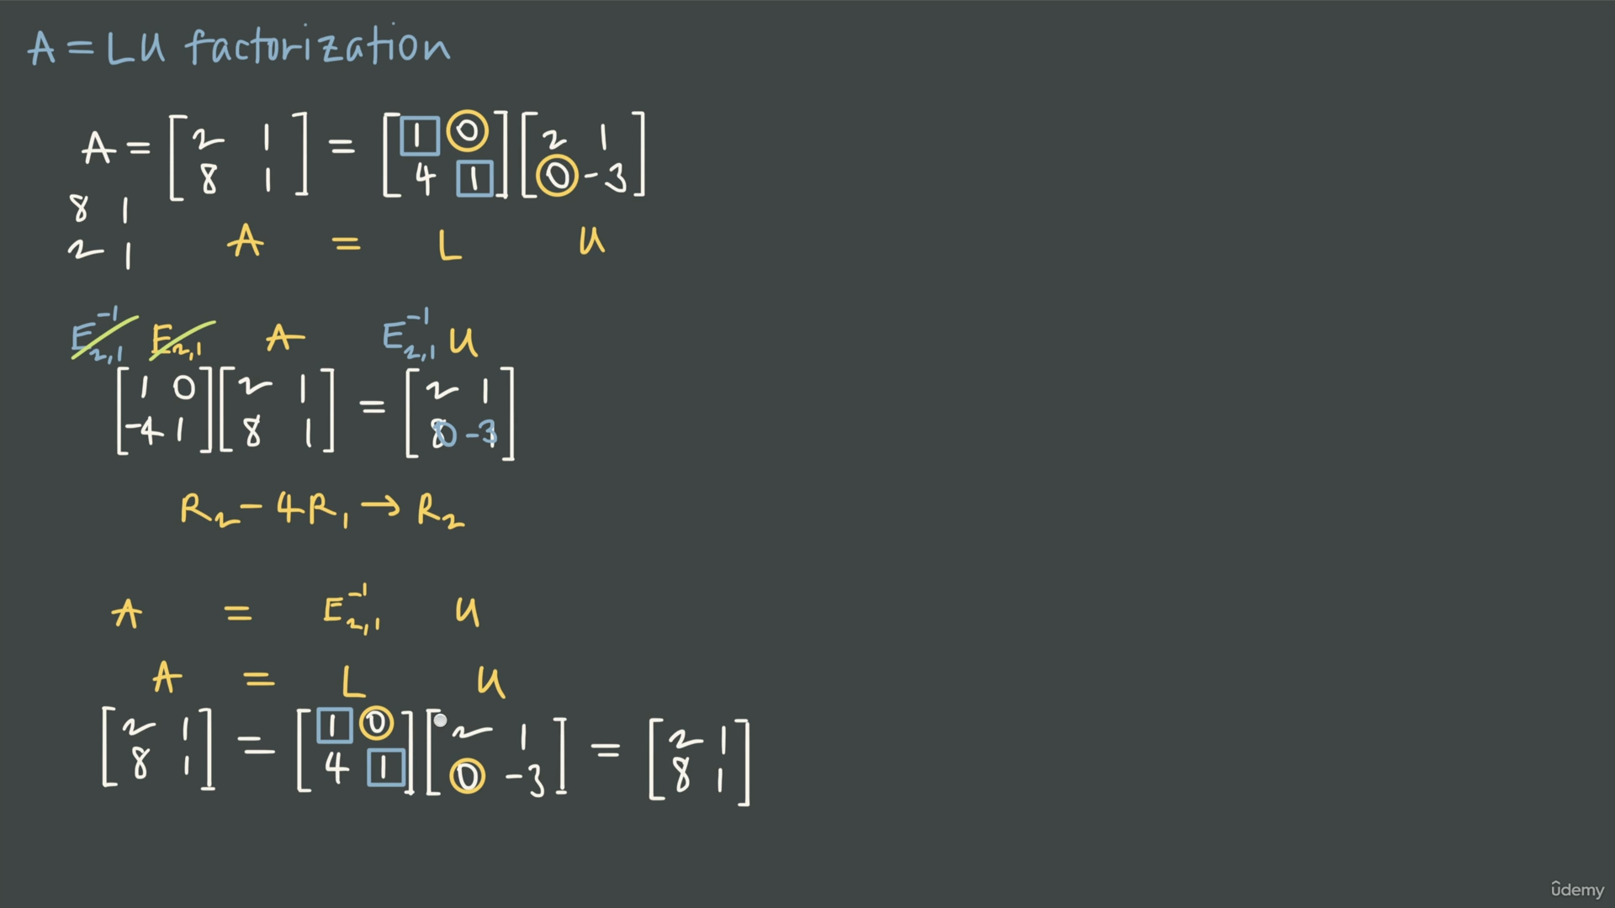

Slide 9
