Slide 1
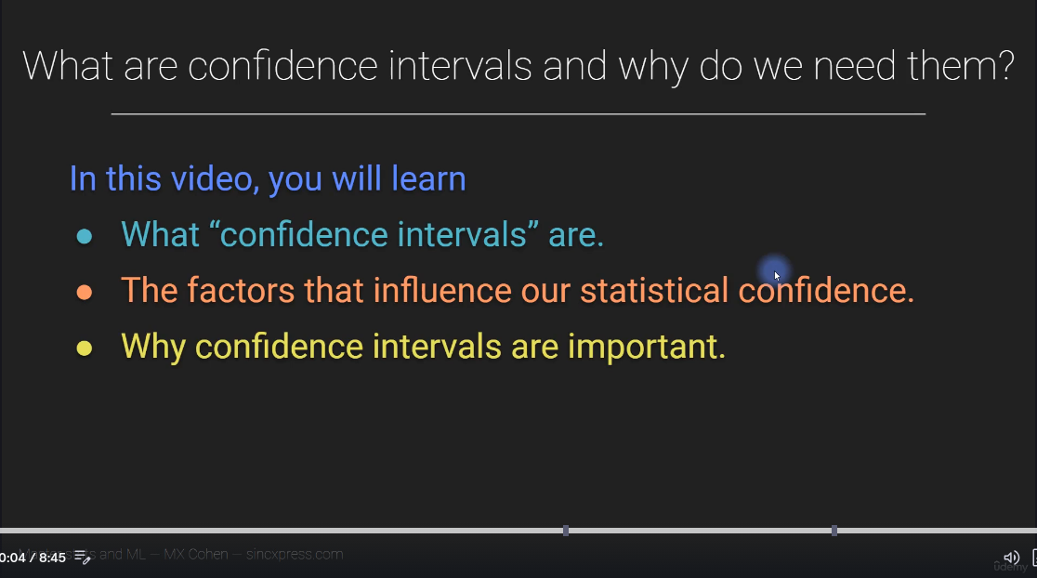

Slide 2
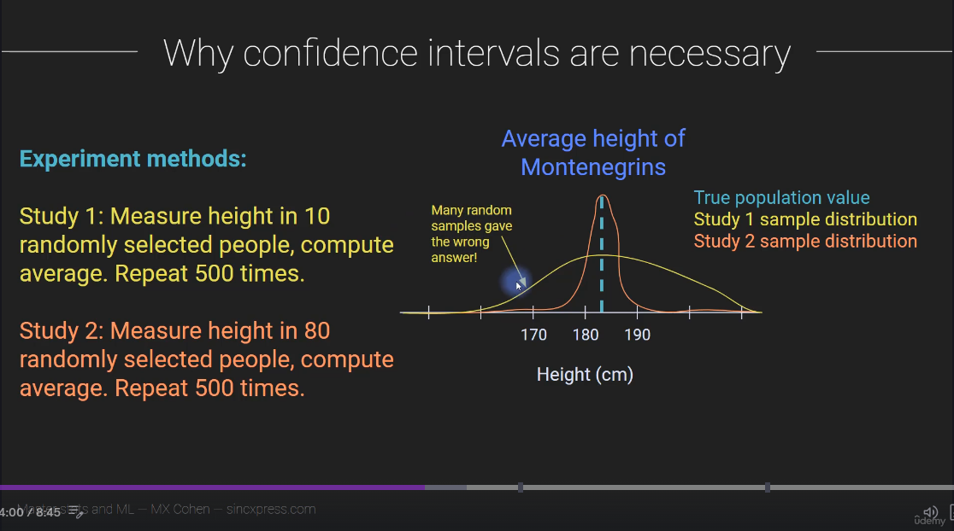

Slide 3
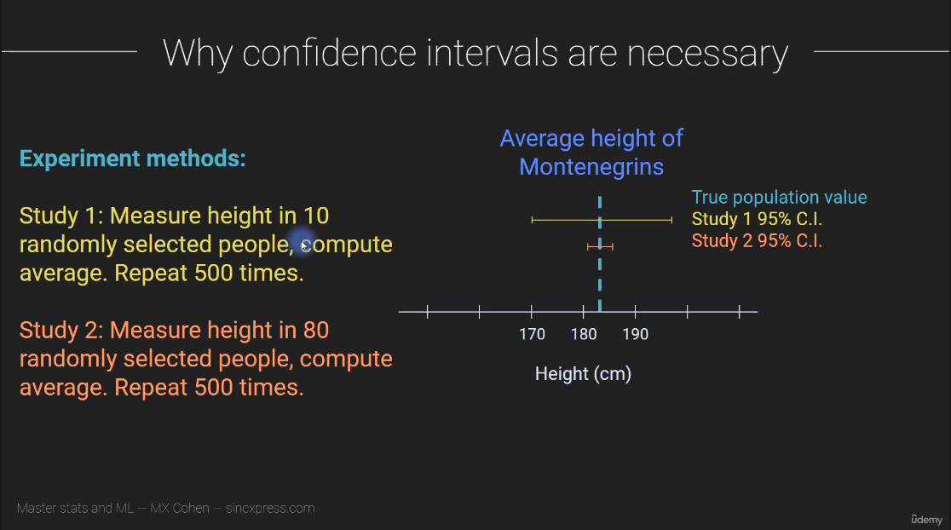

Slide 4
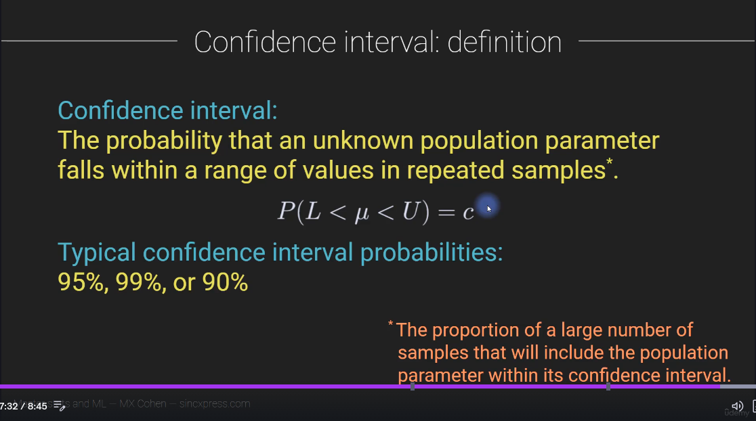

Slide 5
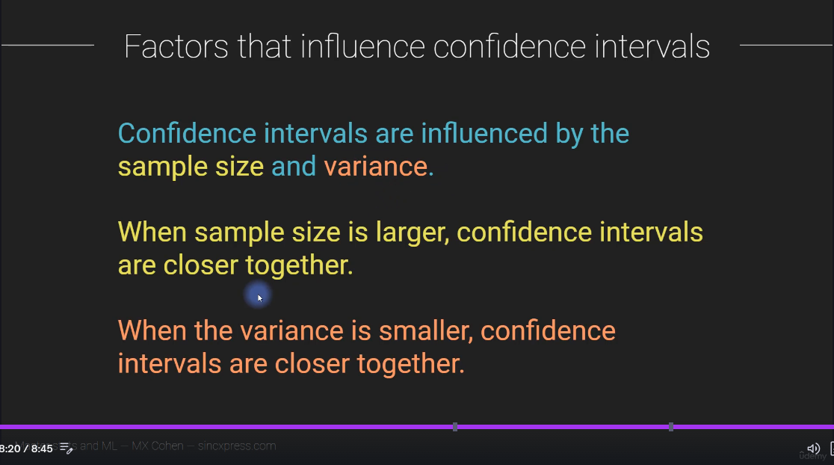

Slide 6
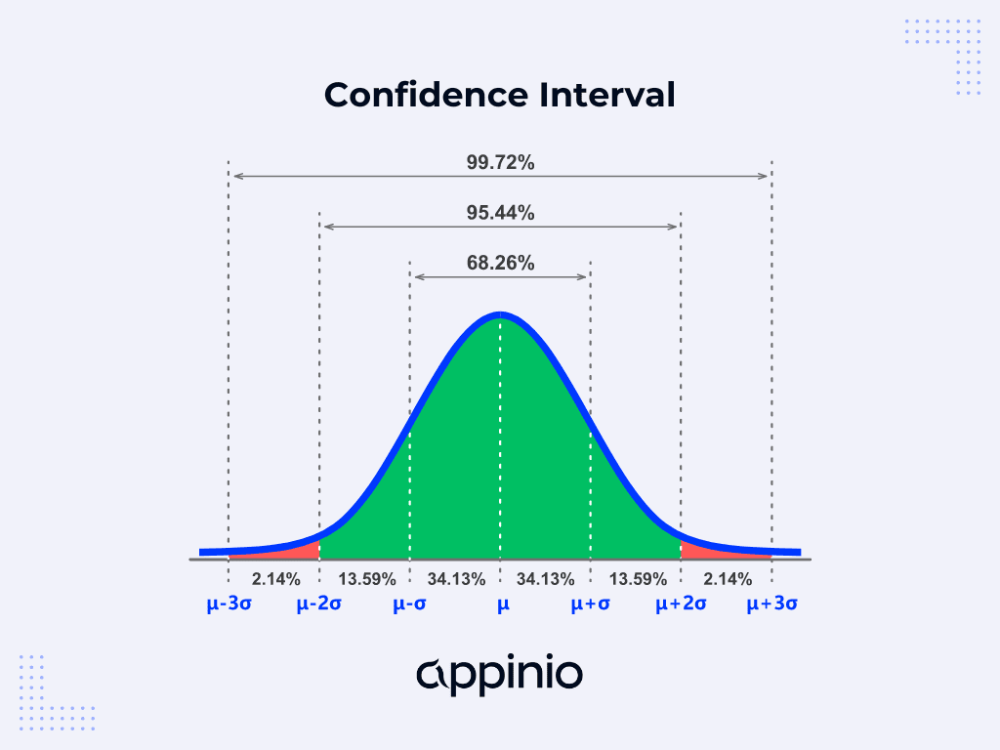

Slide 7
Importance of Confidence Interval in Statistical Analysis
Quantifying Uncertainty: Confidence intervals provide a measure of uncertainty around point estimates, allowing researchers to assess the reliability and precision of their findings. Confidence intervals help avoid overconfidence in statistical estimates by acknowledging and quantifying uncertainty.
Inference and Decision-making: Confidence intervals play a crucial role in statistical inference and decision-making. They enable researchers to make inferences about population parameters based on sample data, guiding decisions in research, business, healthcare, and policy-making.
Comparing Groups or Treatments: Confidence intervals facilitate comparisons between groups or treatments by providing a range of plausible values for population parameters. Whether comparing means, proportions, or other statistics, confidence intervals help assess the significance and magnitude of differences.
Sample Size Determination: Confidence intervals inform sample size determination for research studies. By specifying the desired level of precision and confidence, researchers can calculate the sample size needed to achieve their study objectives while minimizing costs and resources.

Slide 8
Communicating Results: Confidence intervals offer a concise way to communicate the precision and uncertainty of statistical estimates to stakeholders, including researchers, policymakers, and the general public. They provide a clear indication of the range within which the true population parameter is likely to fall.
Robustness to Assumptions: Unlike point estimates, which can be sensitive to outliers or violations of distributional assumptions, confidence intervals are more robust and provide a more comprehensive picture of the underlying uncertainty. They offer a flexible approach to statistical analysis, particularly in situations where parametric assumptions may not hold.
Quality Control and Process Improvement: In quality control and process improvement, confidence intervals are used to monitor and assess the performance of systems and processes. By tracking confidence intervals over time, organizations can identify trends, detect deviations from expected performance, and implement corrective actions as needed.
Scientific Reproducibility: Confidence intervals contribute to the transparency and reproducibility of scientific research by quantifying the uncertainty inherent in statistical estimates. Replication studies can use confidence intervals to assess the consistency and generalizability of findings across different samples or settings.
Decision-making under Uncertainty: In decision-making contexts, confidence intervals provide decision-makers with a framework for considering uncertainty and variability in their choices. Whether evaluating the effectiveness of interventions, assessing risks, or allocating resources, confidence intervals inform more informed and robust decisions.

Slide 9
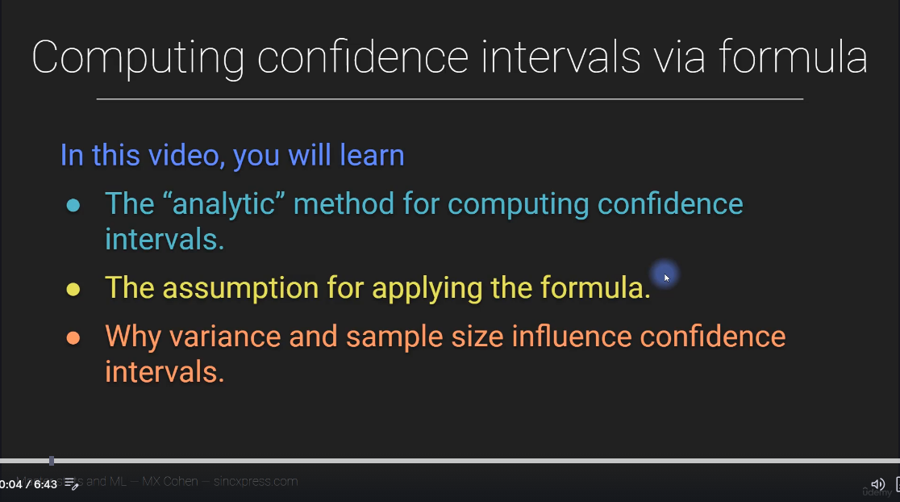

Slide 10
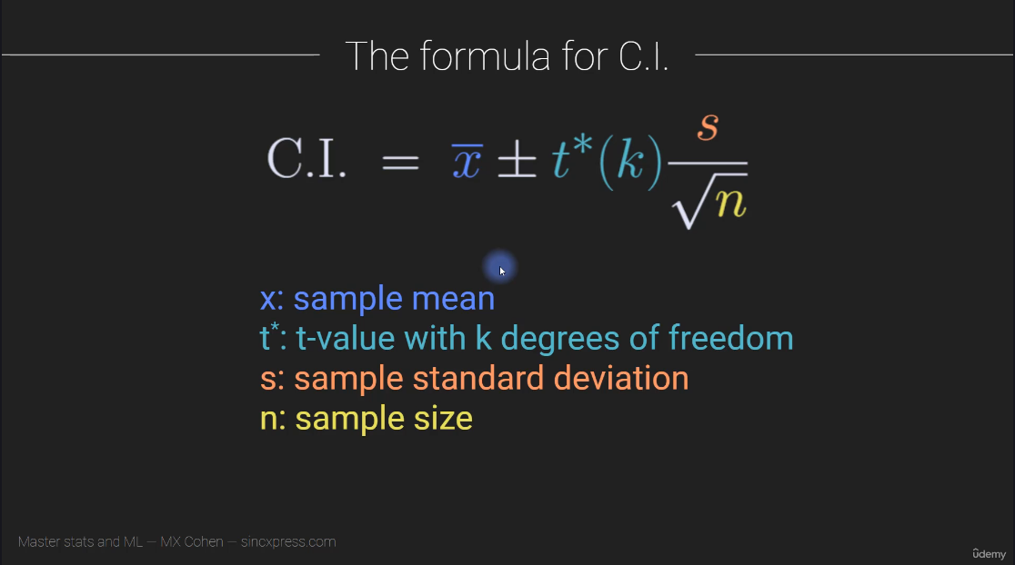

Slide 11
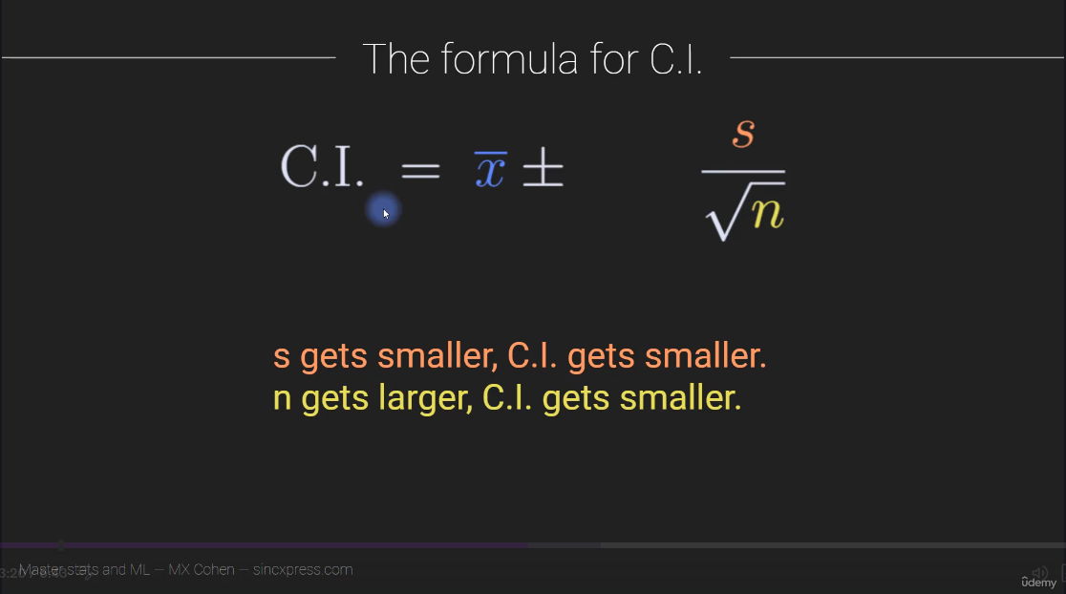

Slide 12
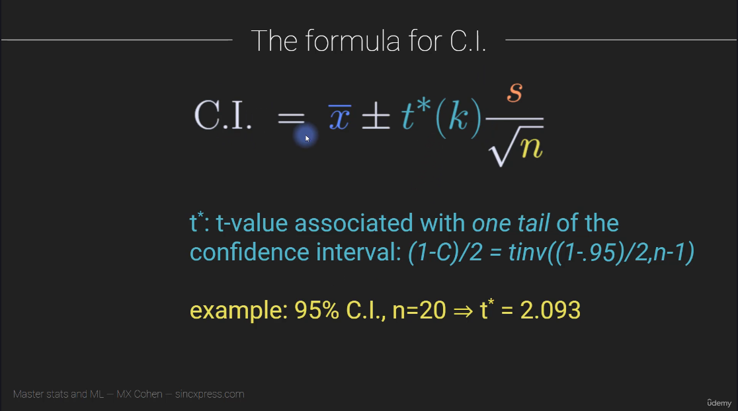

Slide 13
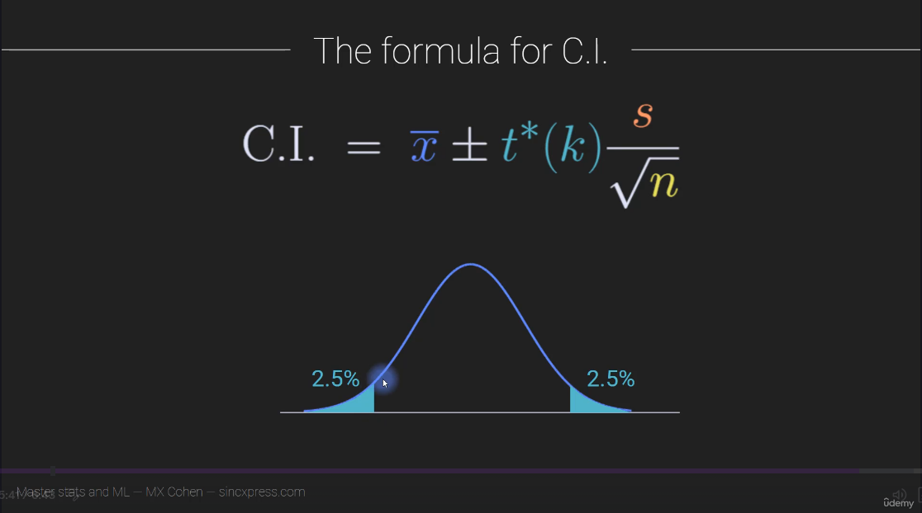

Slide 14
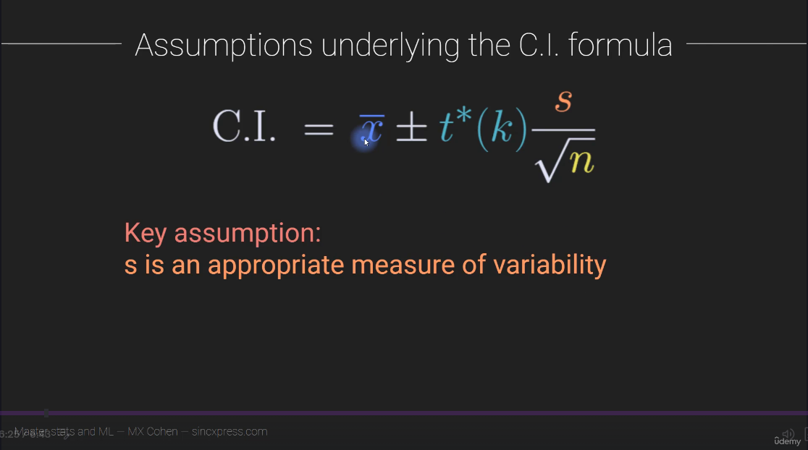

Slide 15
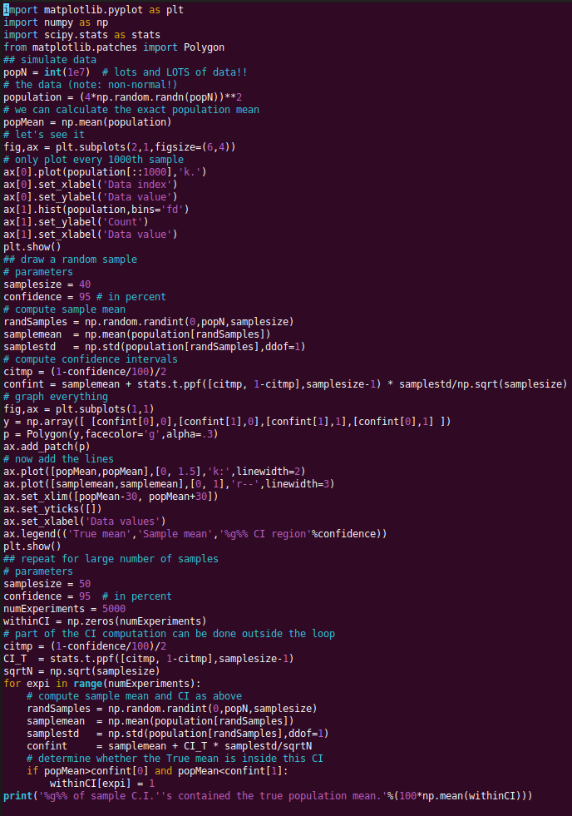
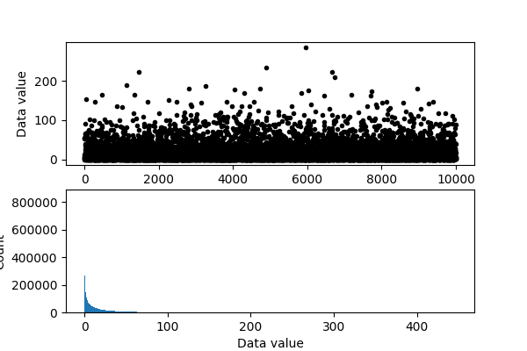
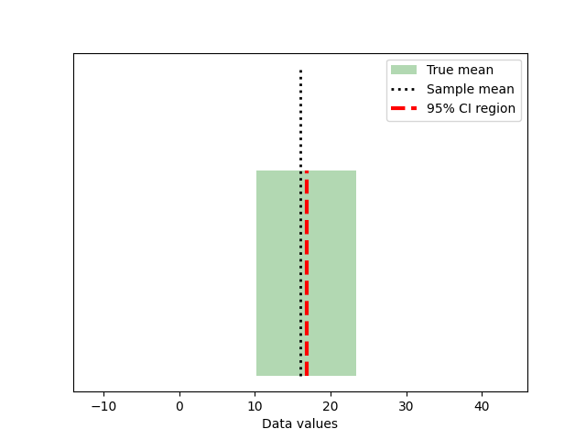

Slide 16
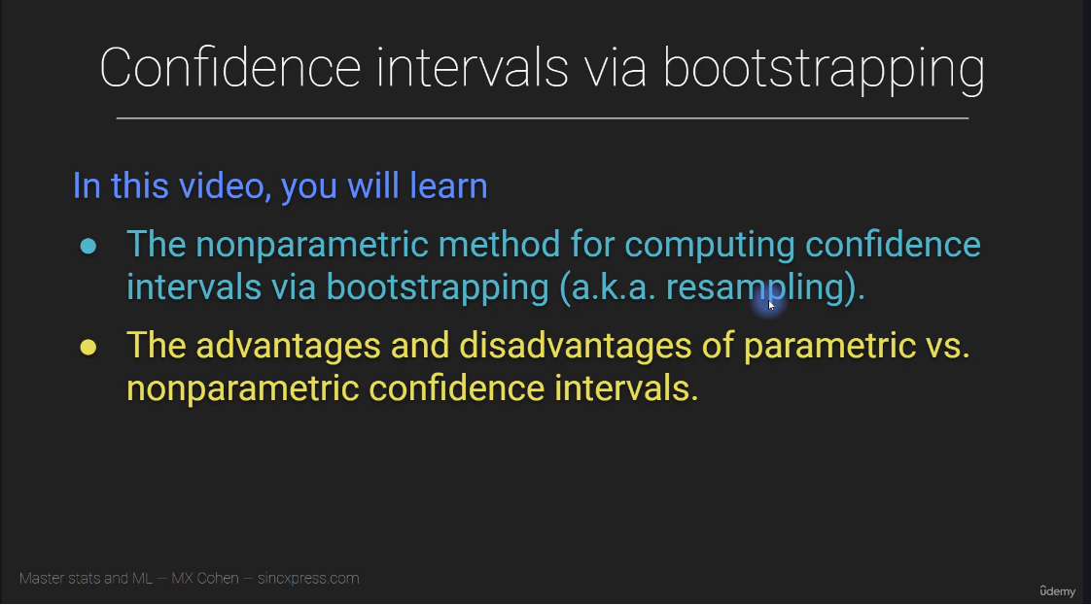

Slide 17
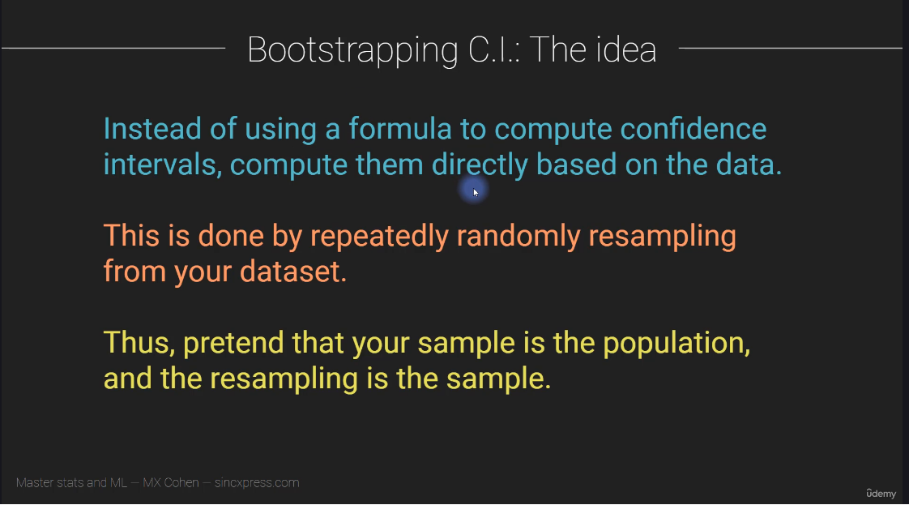

Slide 18
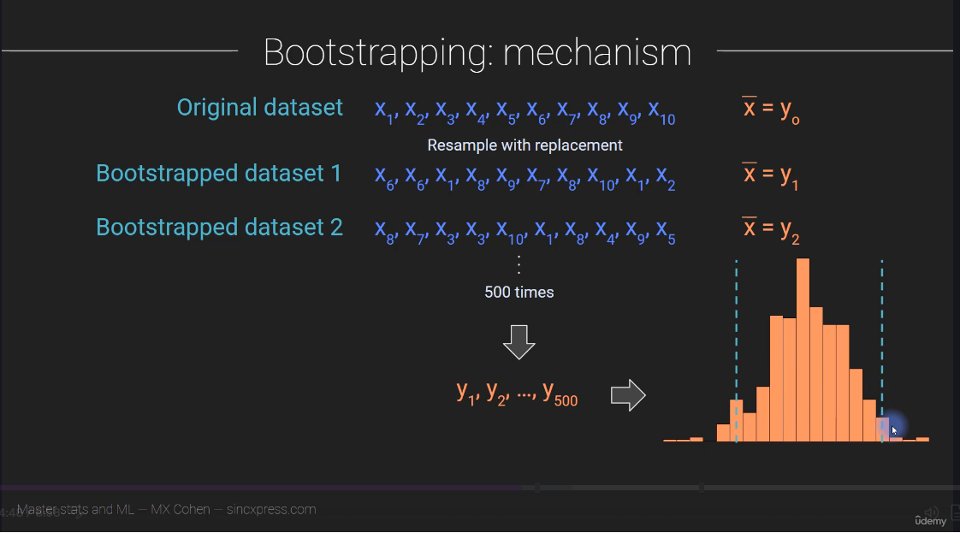

Slide 19
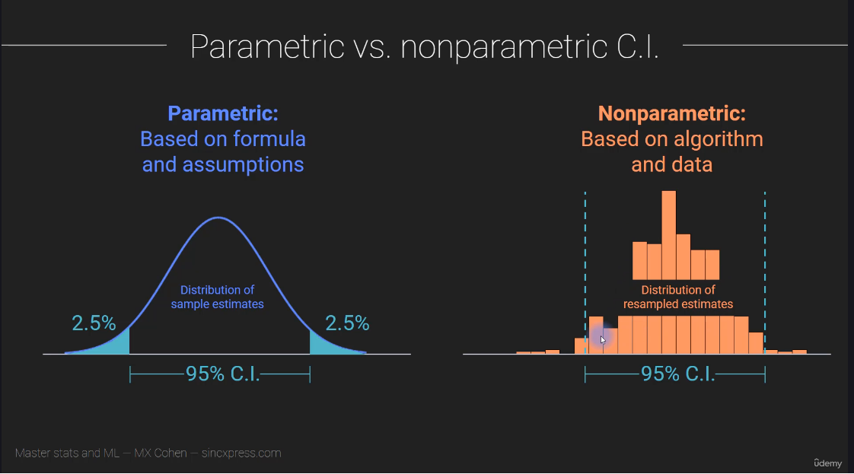

Slide 20
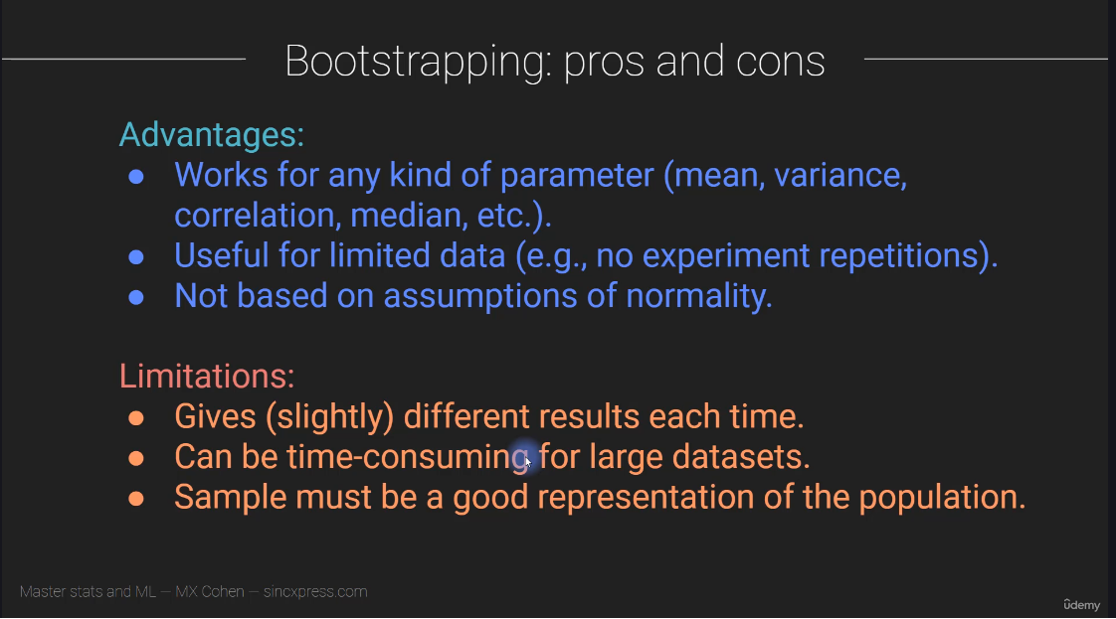

Slide 21


Slide 22
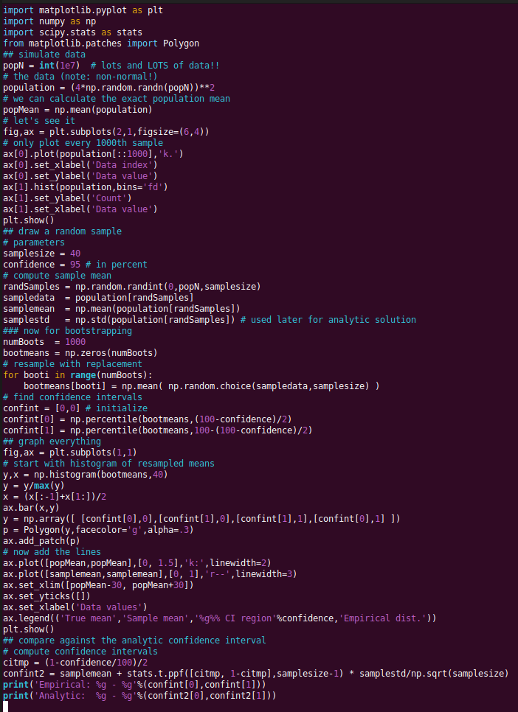
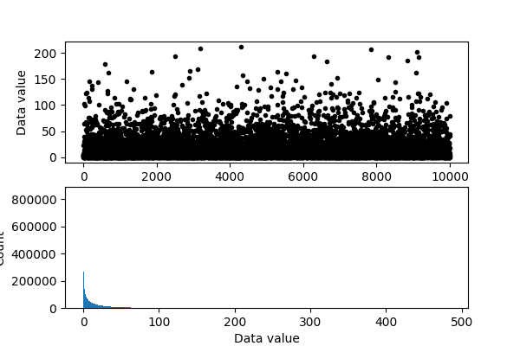
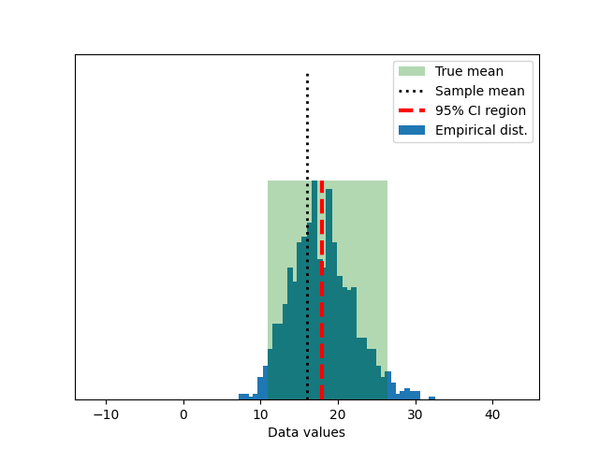


Slide 23
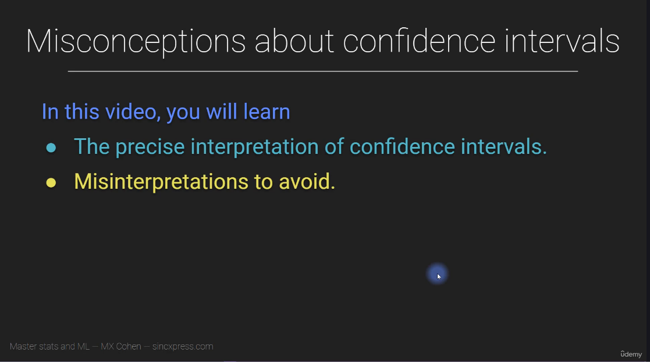

Slide 24
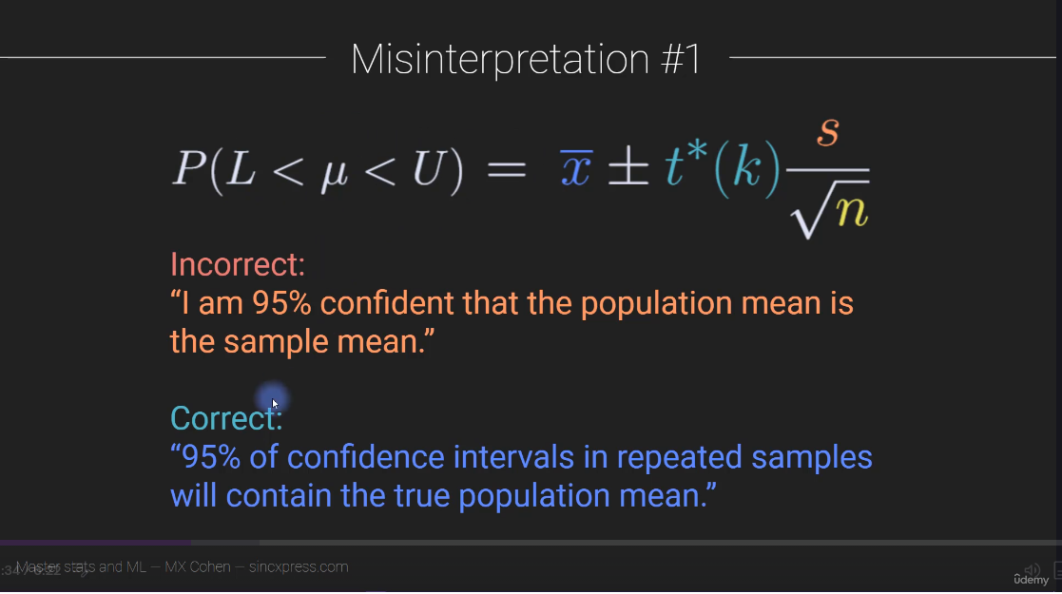

Slide 25
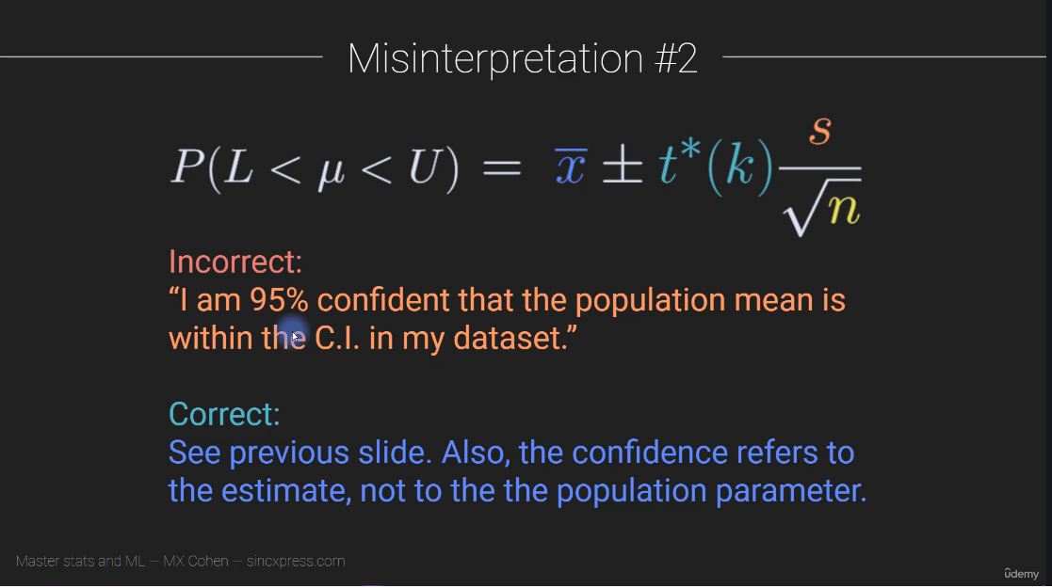

Slide 26
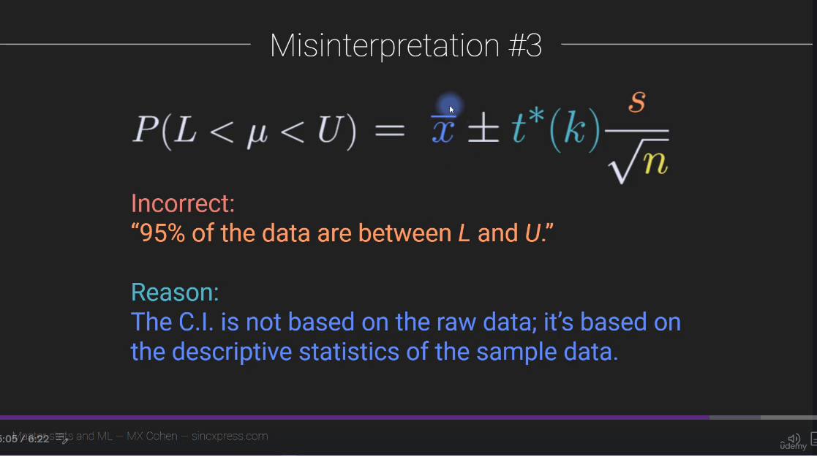

Slide 27
