Slide 1
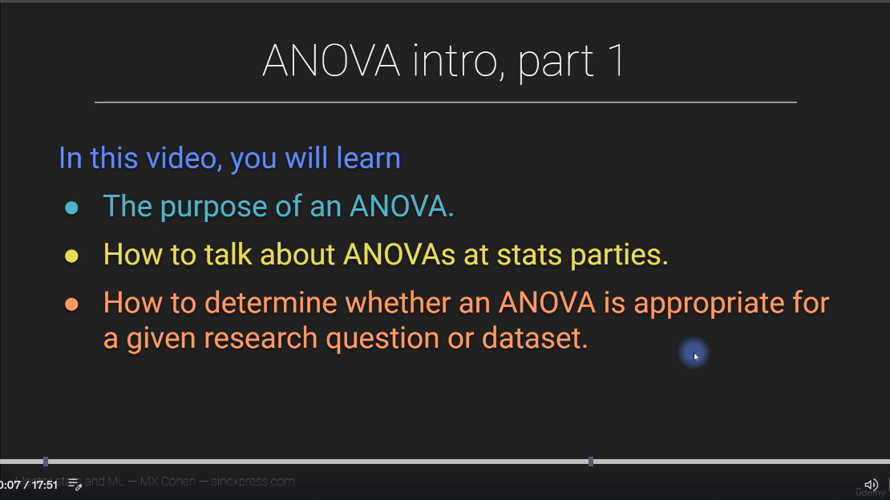

Slide 2
At its most basic level, variance analysis compares
"what happened"
against
"what was expected."
Expectations are usually set via a budget, a forecast, or past historical data.

Slide 3
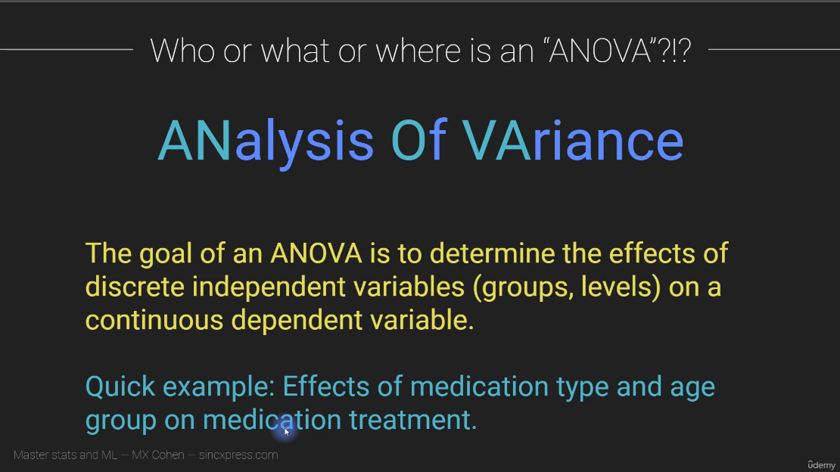

Slide 4
ANOVA is the quiet hero behind countless research studies and data-driven decisions. It is like a referee in a match impartial, logical, and precise. It tells us whether the differences we observe are real or simply products of chance.
Once you understand its core logic, ANOVA becomes more than just an equation. It becomes a mindset a way to think critically about variation, evidence, and truth in the noisy world of data.
It provides a disciplined way to separate signal from noise, truth from coincidence. Rather than trusting gut instinct, you get statistical evidence that supports your conclusions.

Slide 5
How ANOVA Works in Simple Terms
The logic behind ANOVA is beautifully simple once you look at it conceptually. It separates the total variation in your data into two parts:
1. Variation between groups — This measures how different the group means are from each other. If the treatments or conditions genuinely affect the outcome, this variation will be large.
2. Variation within groups — This measures how much individuals differ within the same group, which often happens due to natural randomness or measurement error.
If the between-group variation is much greater than the within-group variation, it signals that the groups are likely different in a meaningful way.
This relationship is summarized in a value called the F-statistic. The F-statistic is a ratio it compares the variability between groups to the variability within groups.
If the F-statistic is large, it suggests that at least one group mean is significantly different. If it is small, the differences you see are probably due to chance.

Slide 6
Interpreting ANOVA Results
When you perform an ANOVA test, you usually get three key numbers:
1. F-statistic — The main test statistic that tells you whether the differences between groups are meaningful.
2. p-value — This tells you how likely it is that the observed differences happened by chance.
3. Significance level (α) — A threshold, often 0.05, used to decide whether the p-value is small enough to call the result significant.
If the p-value is less than 0.05, you can conclude that at least one group mean is different. However, ANOVA does not tell you which specific groups differ only that there is a difference somewhere. To find out where, you use post-hoc tests, such as Tukey’s test, to pinpoint the exact differences.

Slide 7
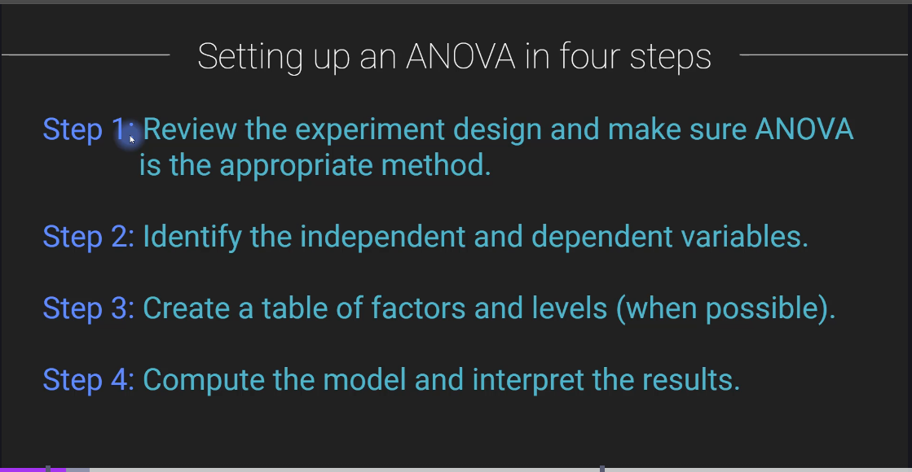

Slide 8
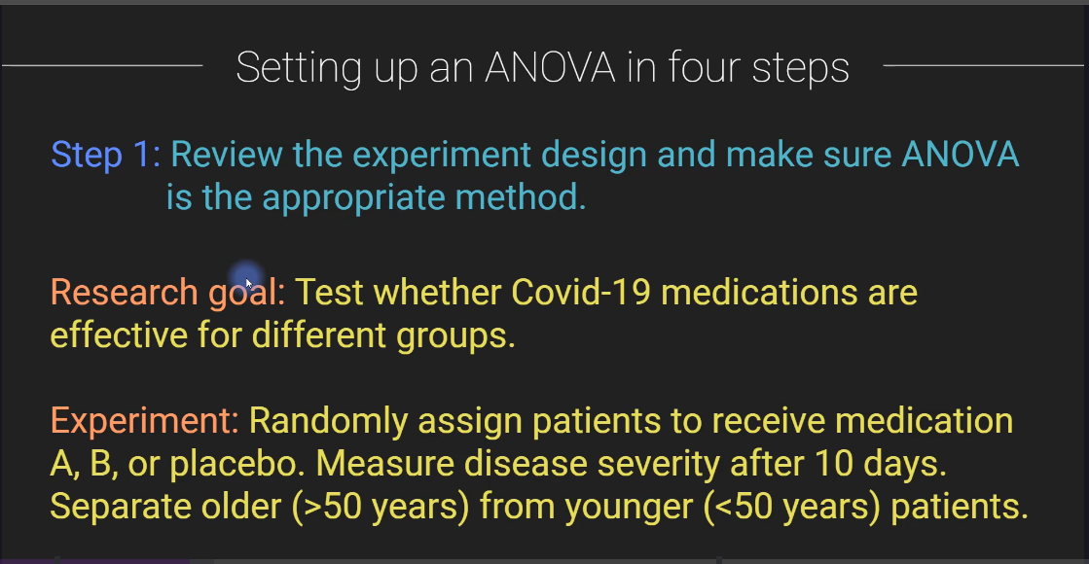

Slide 9
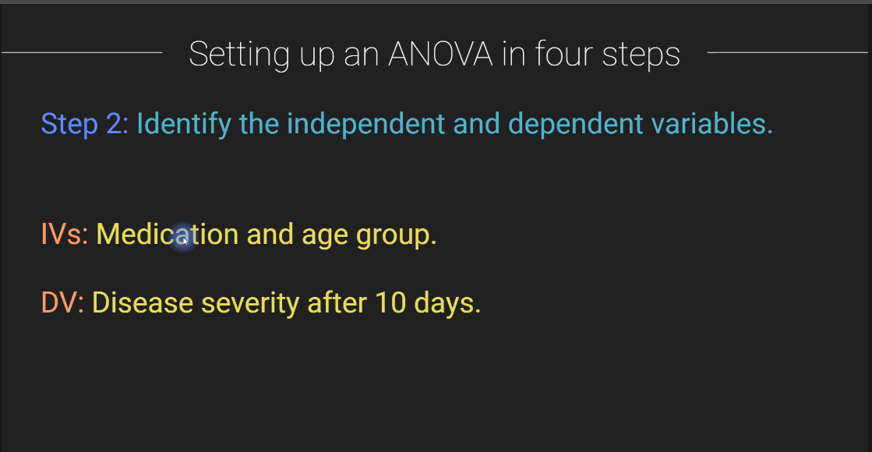

Slide 10
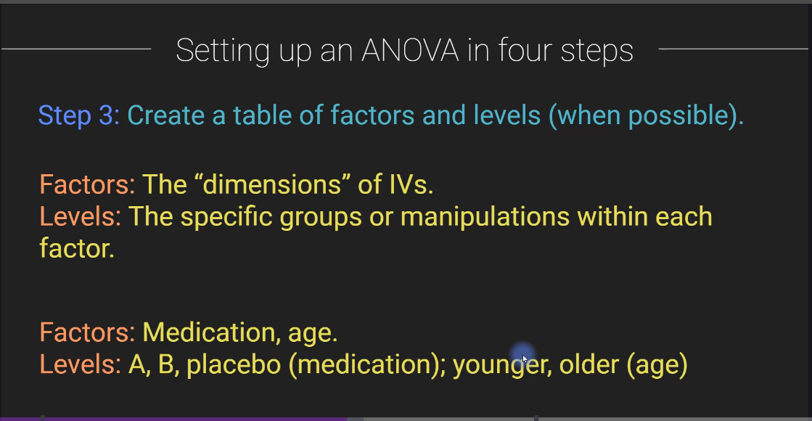

Slide 11
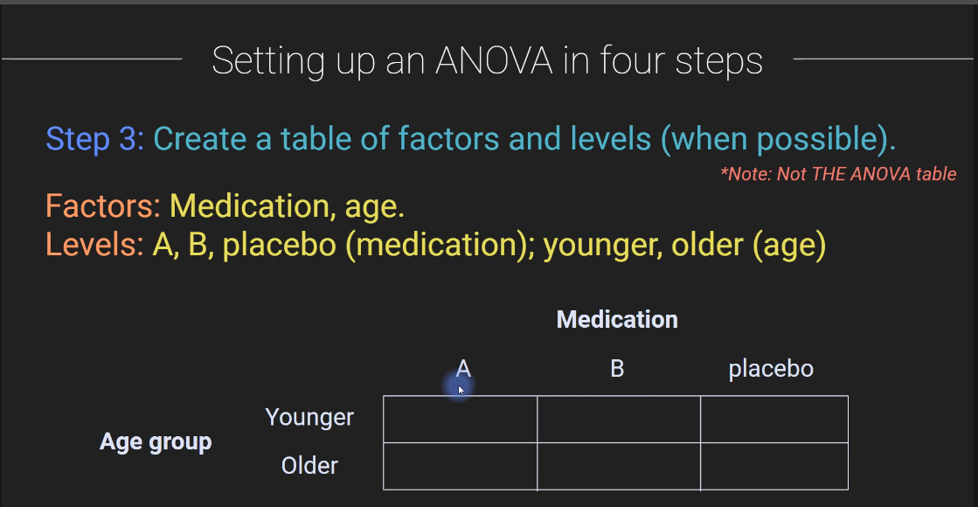

Slide 12
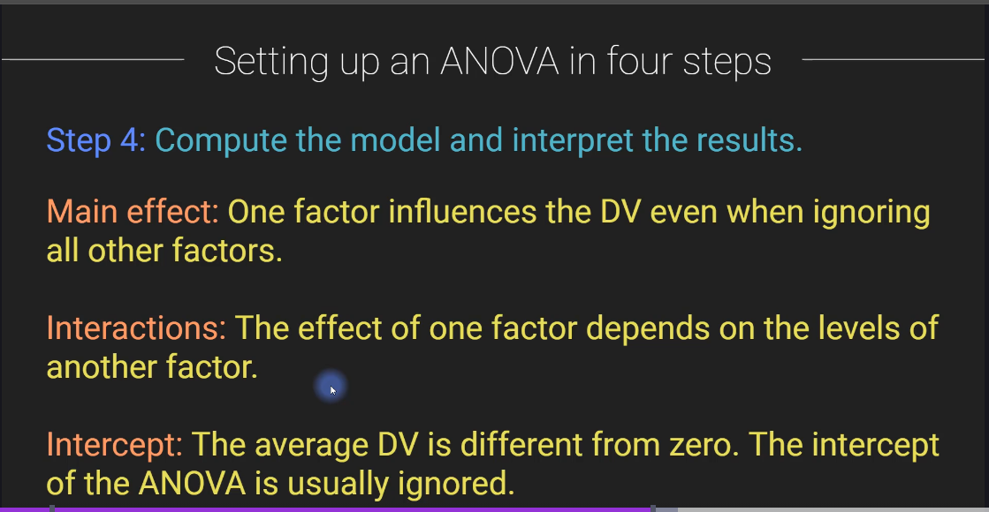

Slide 13
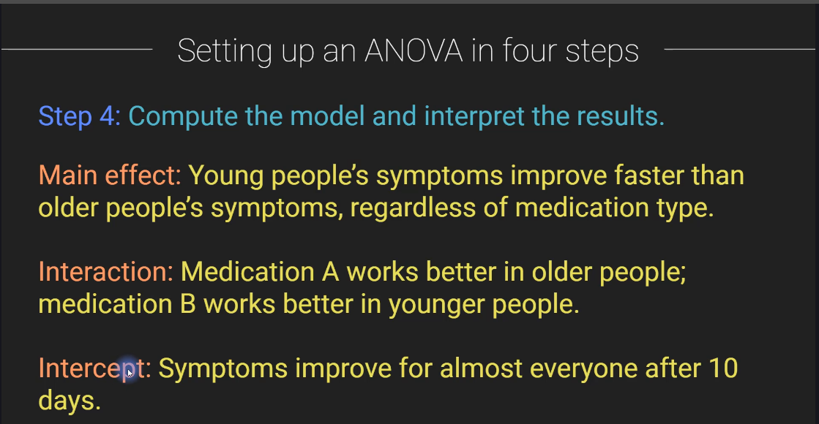

Slide 14
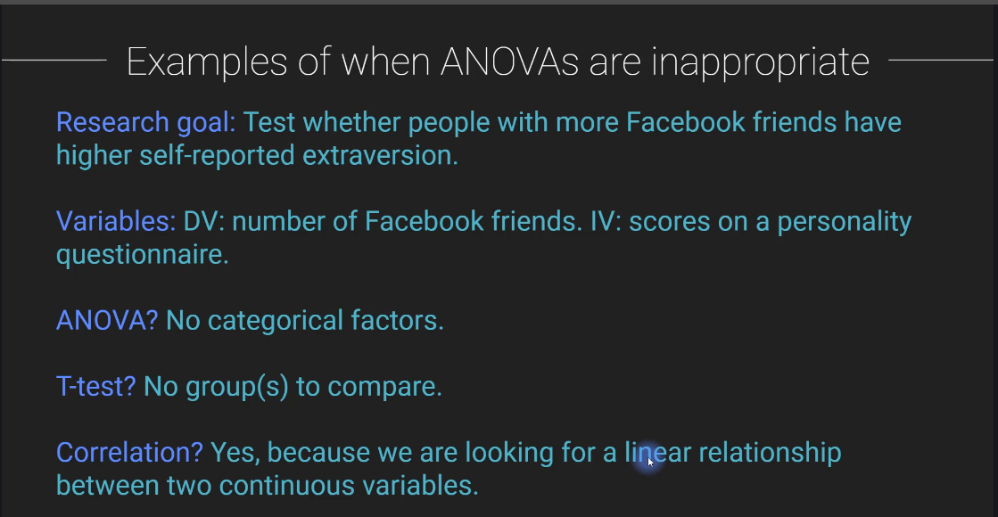

Slide 15
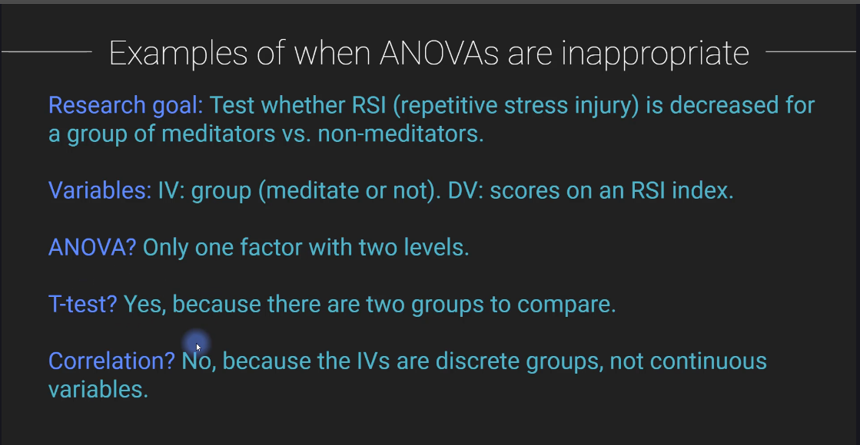

Slide 16
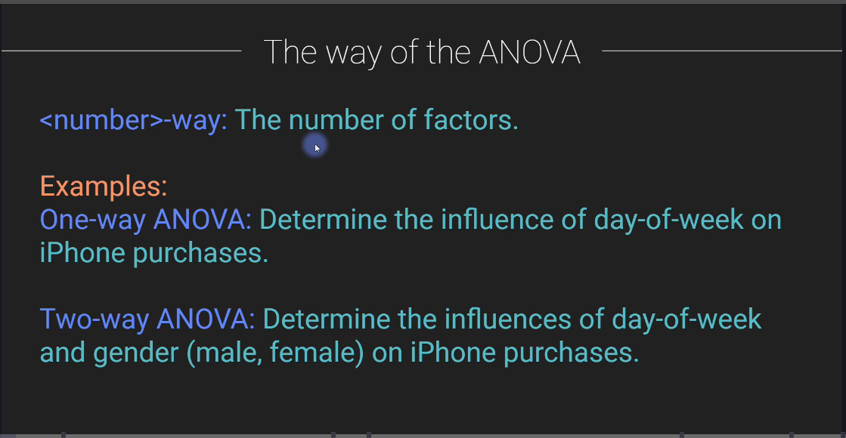

Slide 17
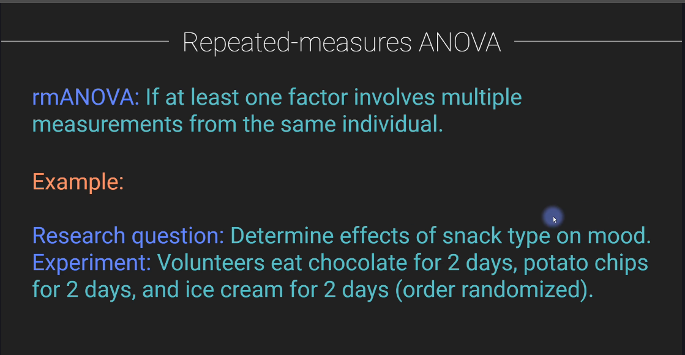

Slide 18
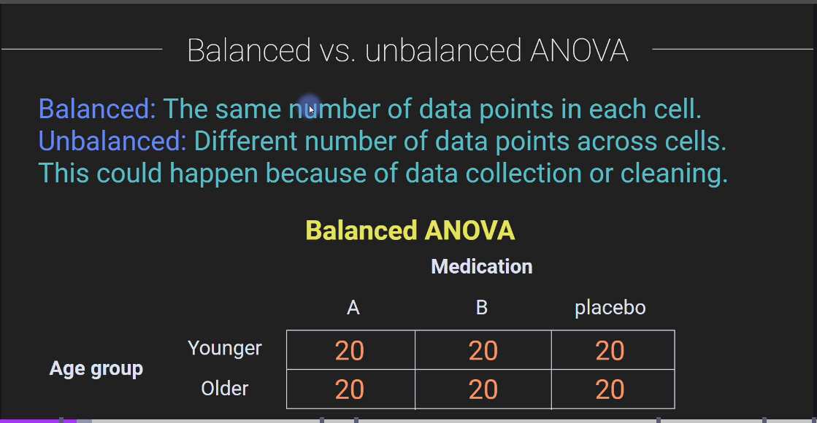

Slide 19
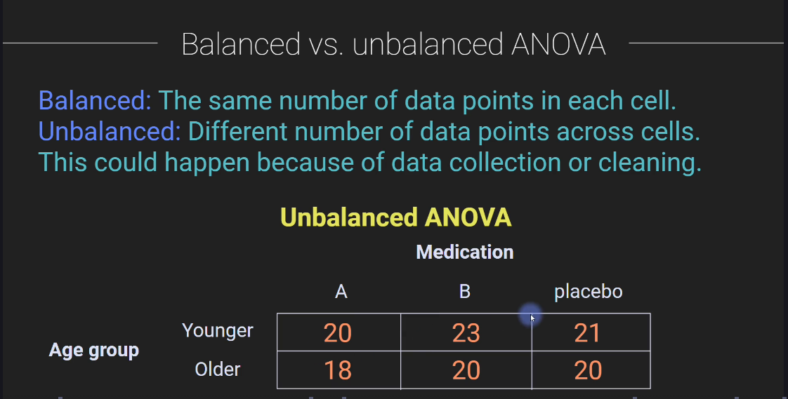

Slide 20
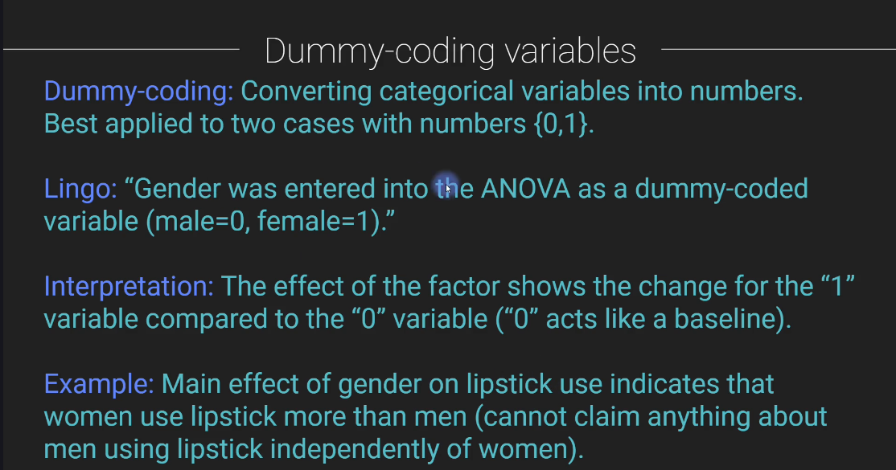

Slide 21
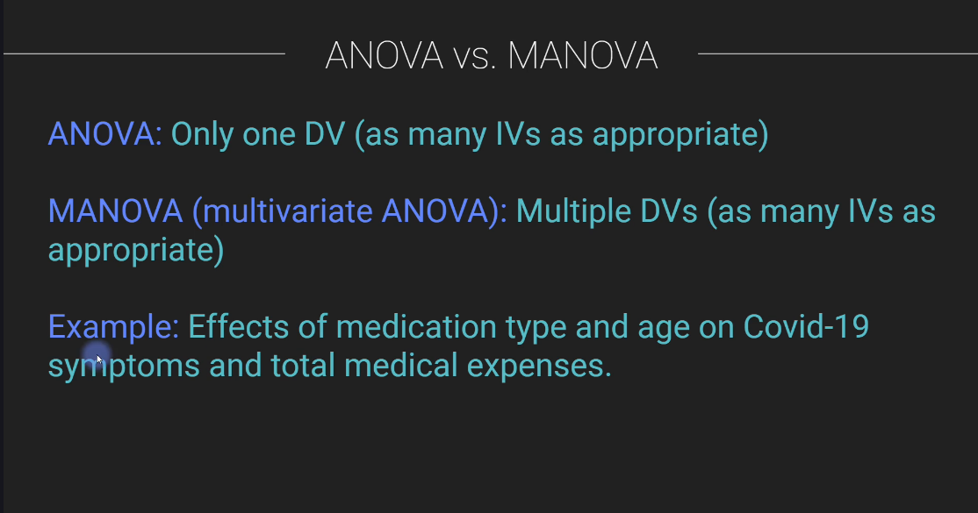

Slide 22
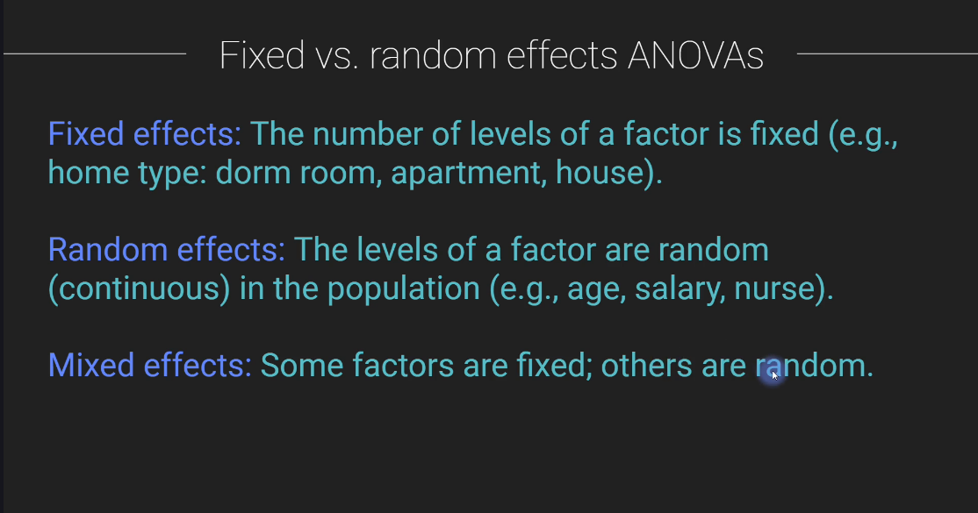

Slide 23
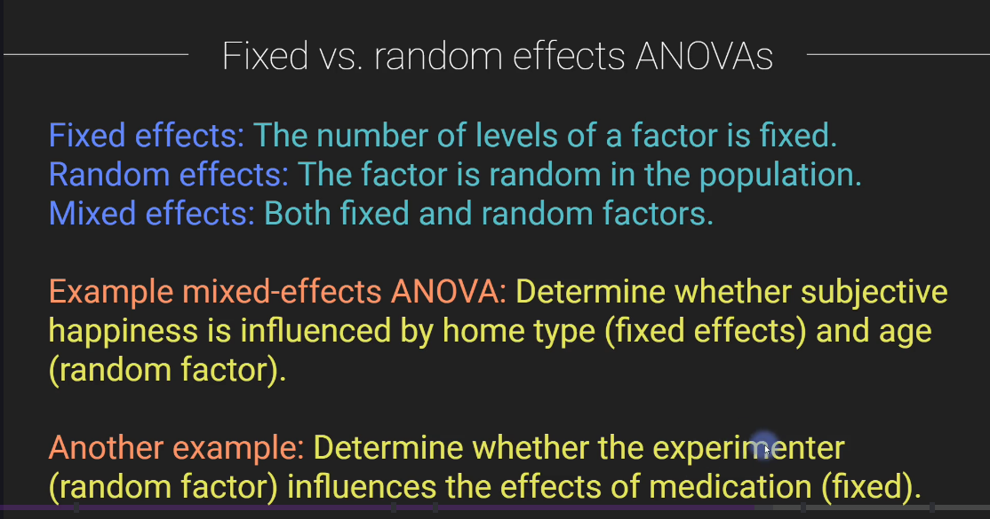

Slide 24
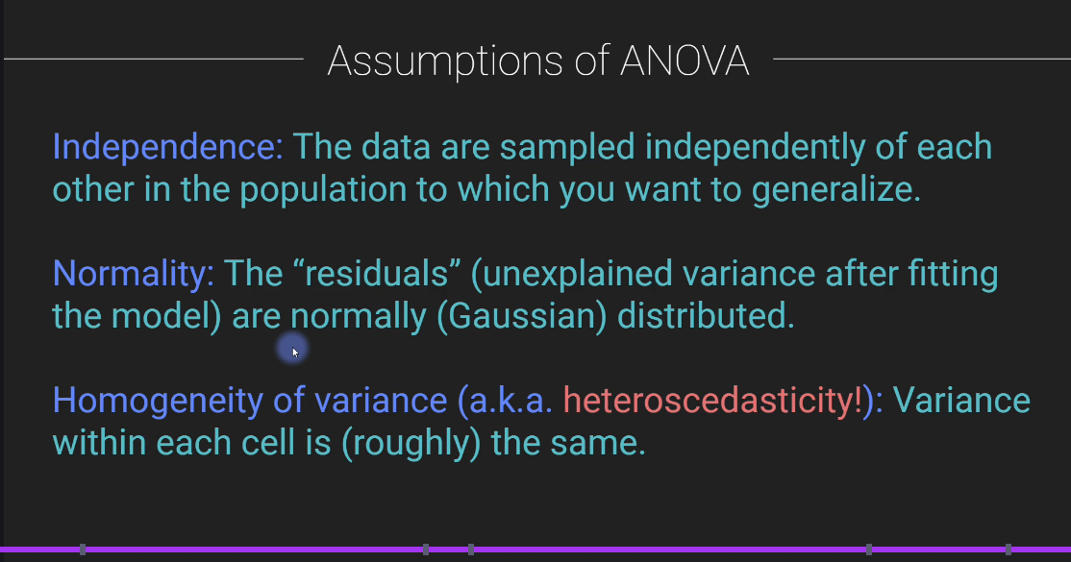

Slide 25
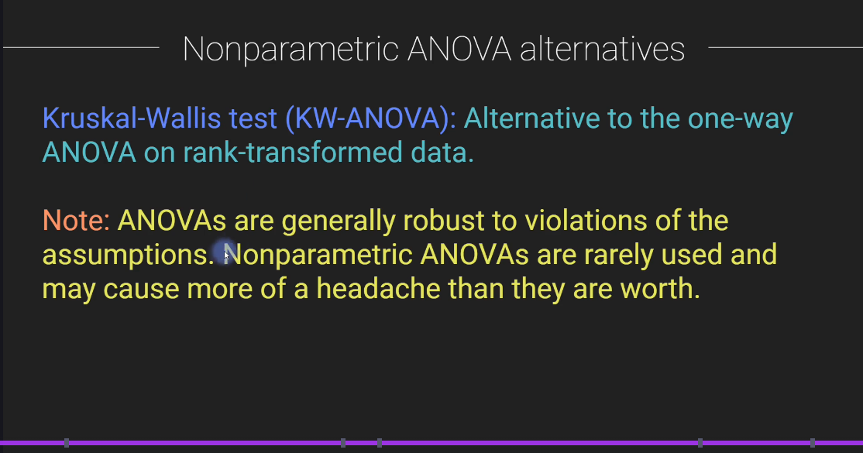

Slide 26
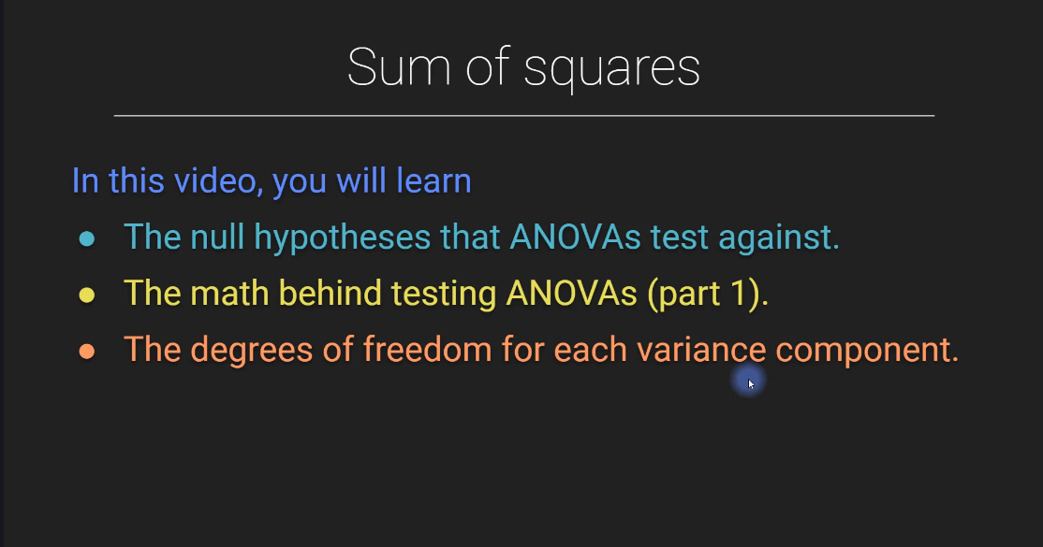

Slide 27
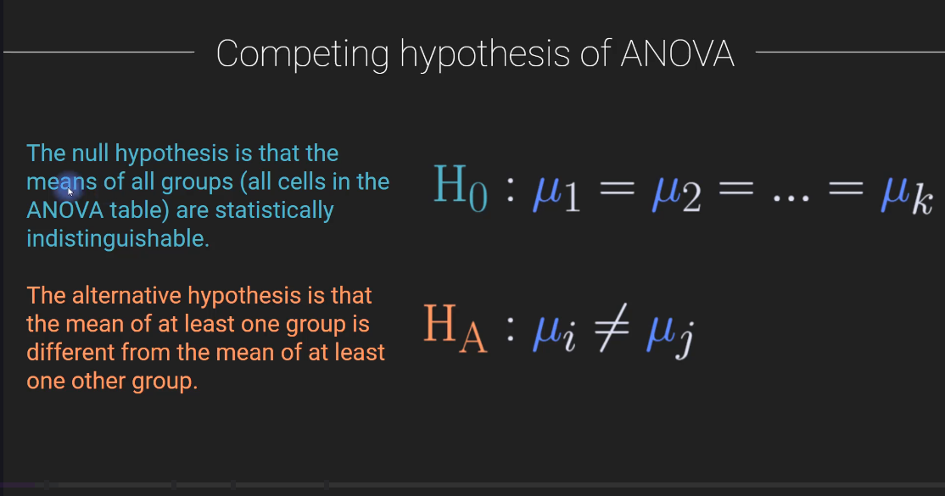

Slide 28
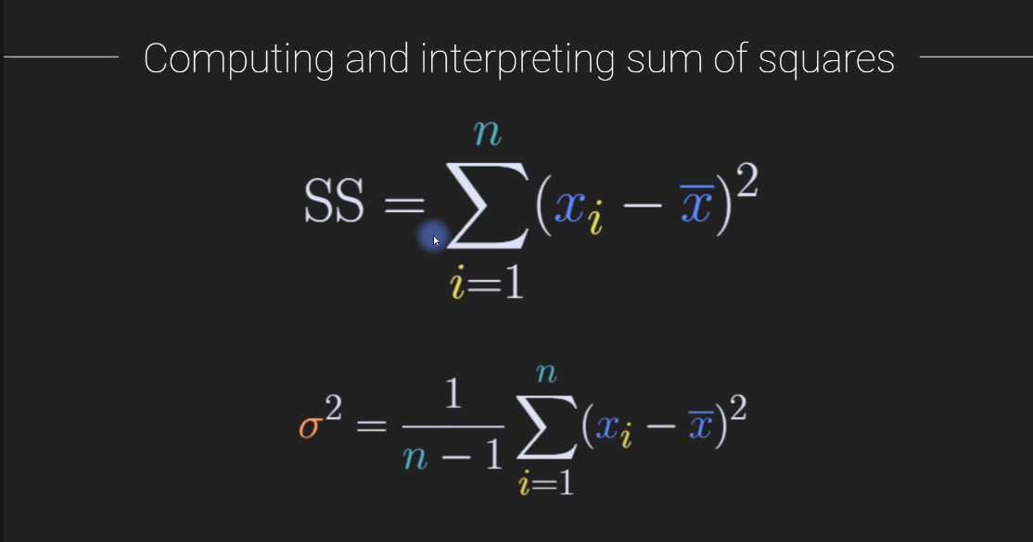

Slide 29
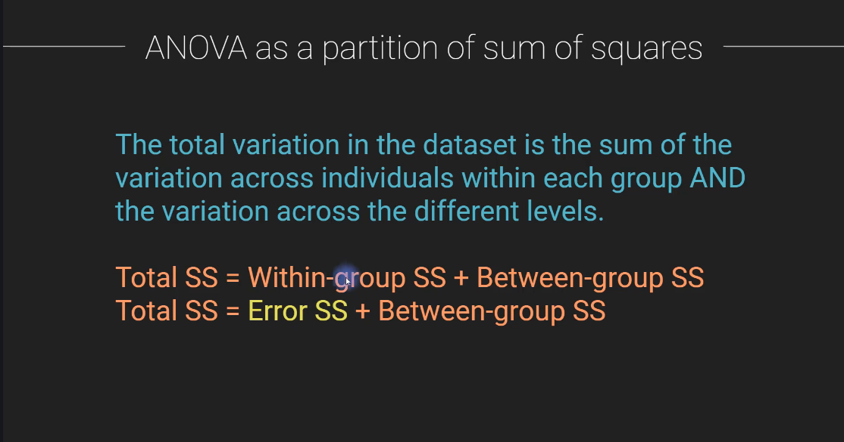

Slide 30
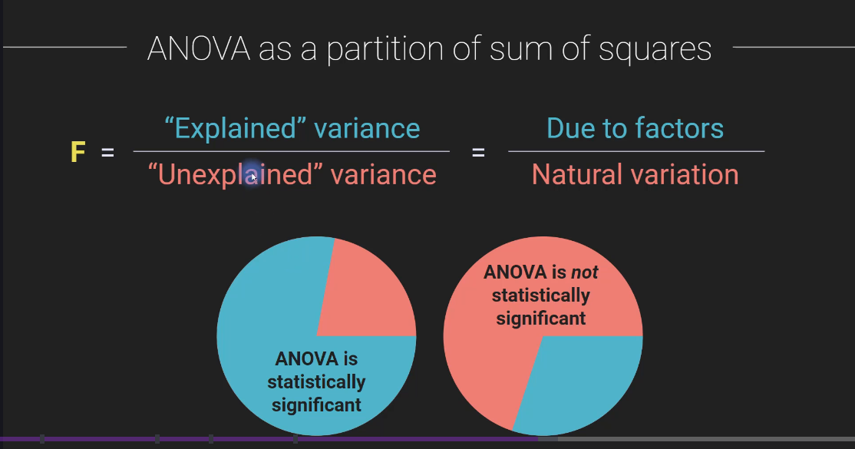

Slide 31
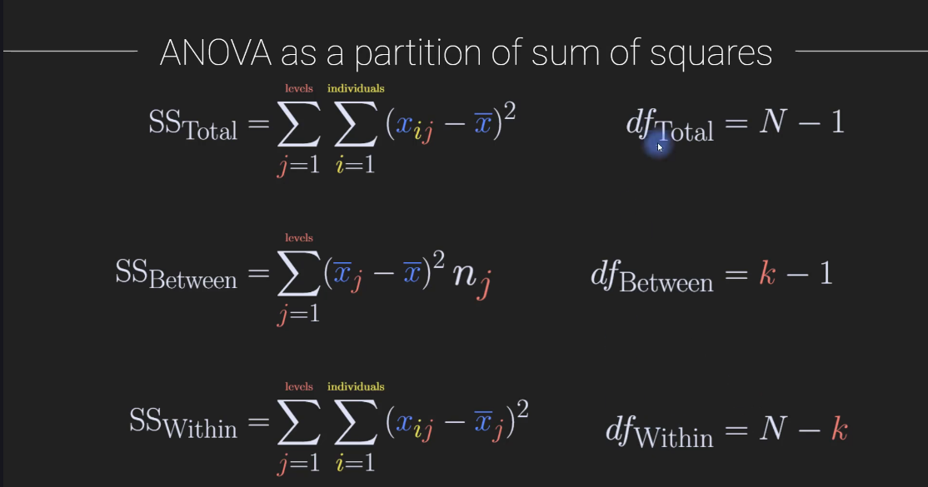

Slide 32
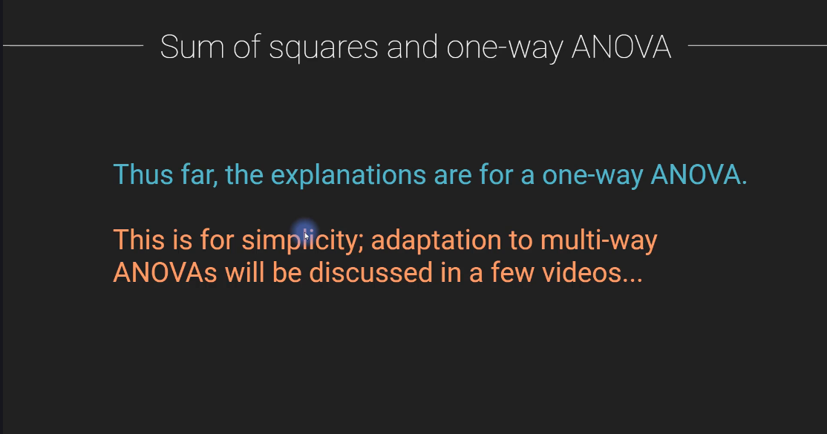

Slide 33
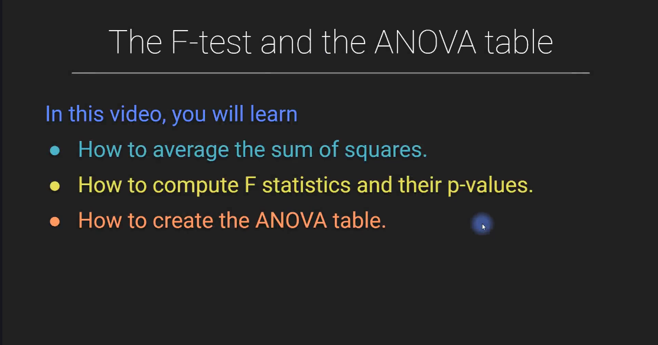

Slide 34
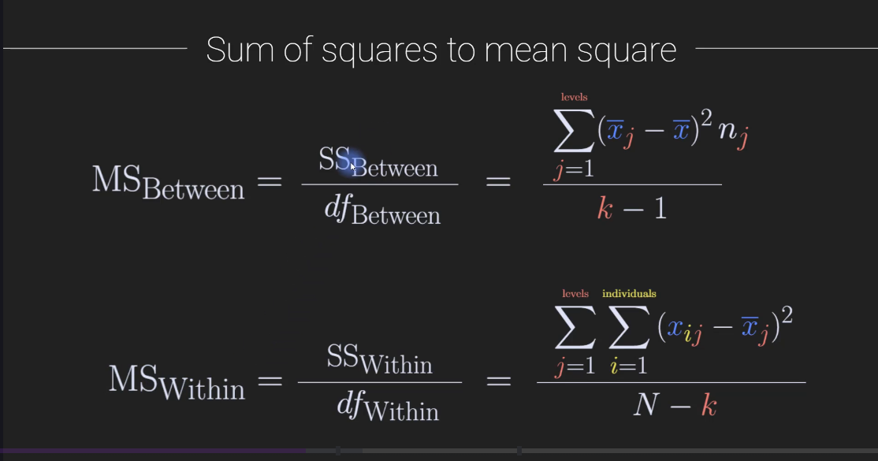

Slide 35
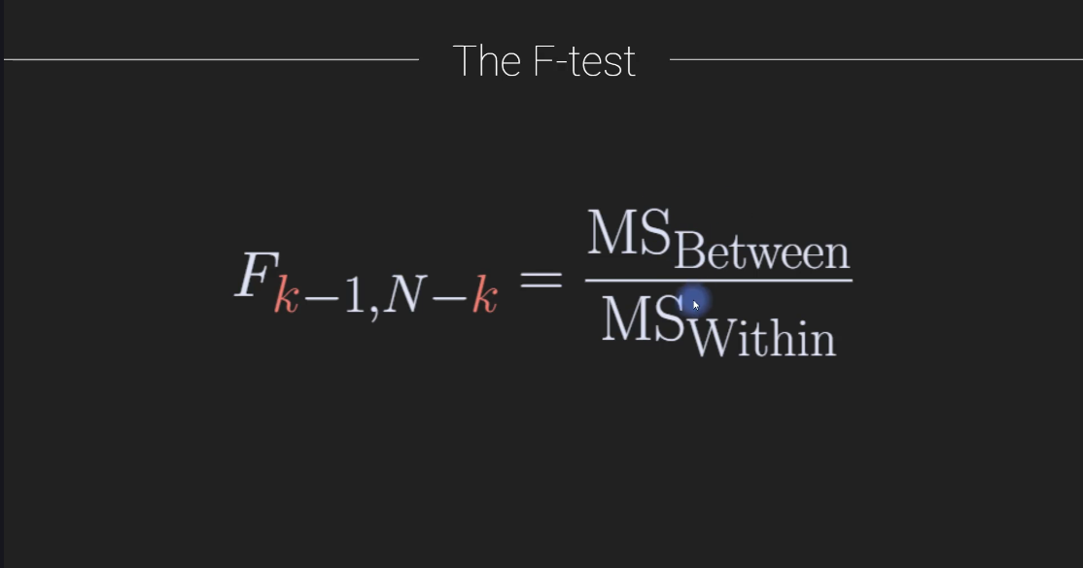

Slide 36
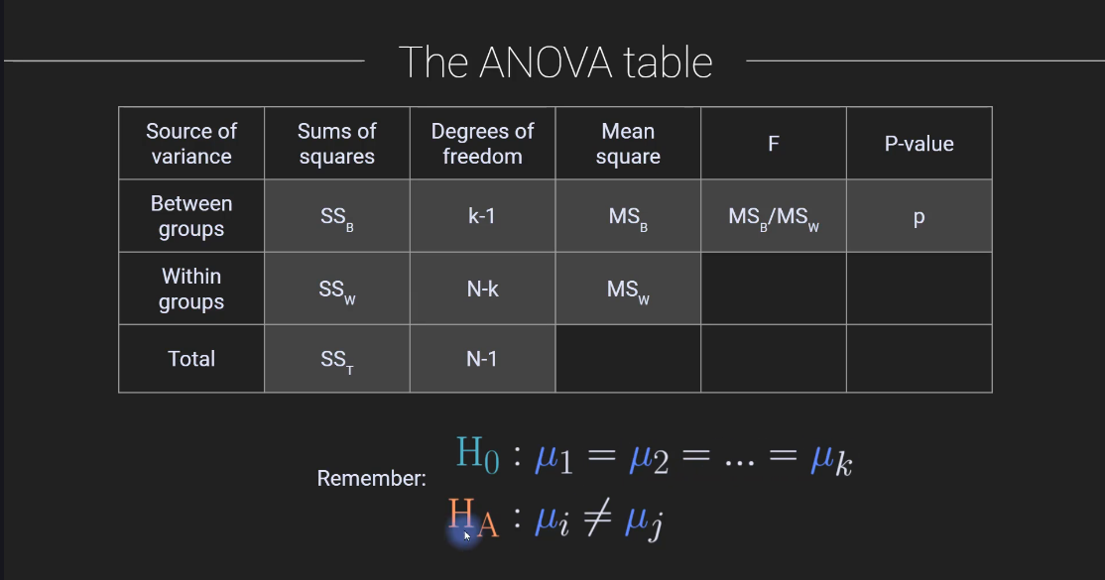

Slide 37
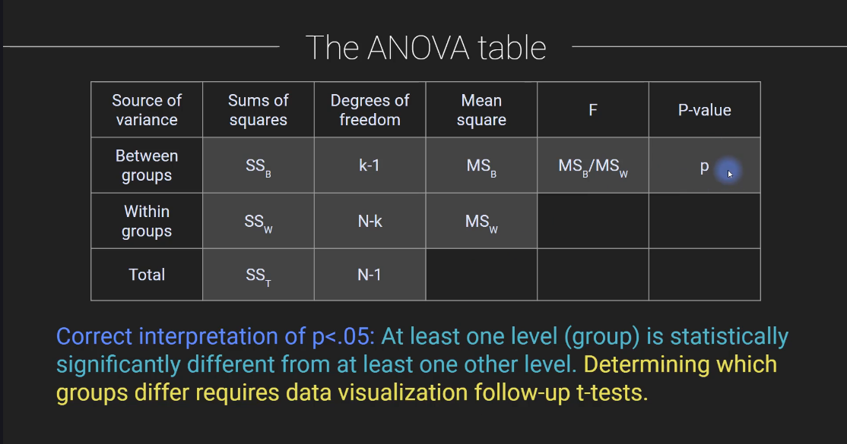

Slide 38
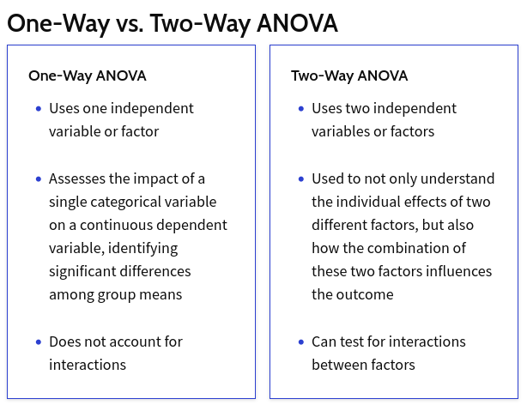

Slide 39
Cheat Sheet on Common Statistical Tests in Finance and Investing
Test | Purpose | When to Use | Applications in Finance/Investing
ANCOVA | Compares the arithmetical means of two or more groups while controlling for the effects of a continuous variable | • Normal distribution • Comparing multiple independent variables with a covariate | • Analyzing investment returns while controlling for market volatility • Evaluating the effectiveness of financial strategies while accounting for economic conditions
ANOVA | Compares the means of three or more groups | • Data is normally distributed | • Comparing financial performance across different sectors or investment strategies
Chi-Square Test | Tests for association between two categorical variables (can't be measured on a numerical scale) | • Data is categorical (e.g., investment choices, market segments) | • Analyzing customer demographics and portfolio allocations
Correlation | Measures the strength and direction of a linear relationship between two variables | • Data is continuous | • Assessing risk and return of assets, portfolio diversification

Slide 40
Cheat Sheet on Common Statistical Tests in Finance and Investing
Test | Purpose | When to Use | Applications in Finance/Investing
Durbin-Watson Test | Checks if errors in a prediction model are related over time | • Time series data | • Detecting serial correlation in stock prices, market trends
F-Test | Compares the variances of two or more groups | • Data is normally distributed | • Testing the equality of variances in stock returns and portfolio performance
Granger Causality Test | Tests for a causal relationship between two time series | • Time series data | • Determining if one economic indicator predicts another
Jarque-Bera Test | Tests for normality of data | • Continuous data | • Assessing if financial data follows a normal distribution

Slide 41
Cheat Sheet on Common Statistical Tests in Finance and Investing
Test | Purpose | When to Use | Applications in Finance/Investing
Mann-Whitney U Test | Compares medians of two independent samples | • Data is not normally distributed | • Comparing the financial performance of two groups with non-normal distributions
MANOVA | Compares means of two or more groups on multiple dependent variables simultaneously | • Data is normally distributed • Analyzing multiple related outcome variables | • Assessing the impact of different investment portfolios on multiple financial metrics • Evaluating the overall financial health of companies based on various performance indicators
One-Sample T-Test | Compares a sample mean to a known population mean | • Data is normally distributed, or the sample size is large | • Comparing actual versus expected returns
Paired T-Test | Compares means of two related samples (e.g., before and after measurements) | • Data is normally distributed, or the sample size is large | • Evaluating if a financial change has been effective

Slide 42
Cheat Sheet on Common Statistical Tests in Finance and Investing
Test | Purpose | When to Use | Applications in Finance/Investing
Regression | Predicts the value of one variable based on the value of another variable | • Data is continuous | • Modeling stock prices • Predicting future returns
Sign Test | Tests for differences in medians between two related samples | • Data is not normally distributed | • Non-parametric alternative to the paired t-test in financial studies
T-Test | Compares the means of two groups | • Data is normally distributed, or the sample size is large | • Comparing the performance of two investment strategies
Wilcoxon Rank-Sum Test | Compares the medians of two independent samples | • Data is not normally distributed | • Non-parametric alternative to the independent t-test in finance
Z-Test | Compares a sample mean to a known population mean | • Data is normally distributed, and the population standard deviation is known | • Testing hypotheses about market averages

Slide 43
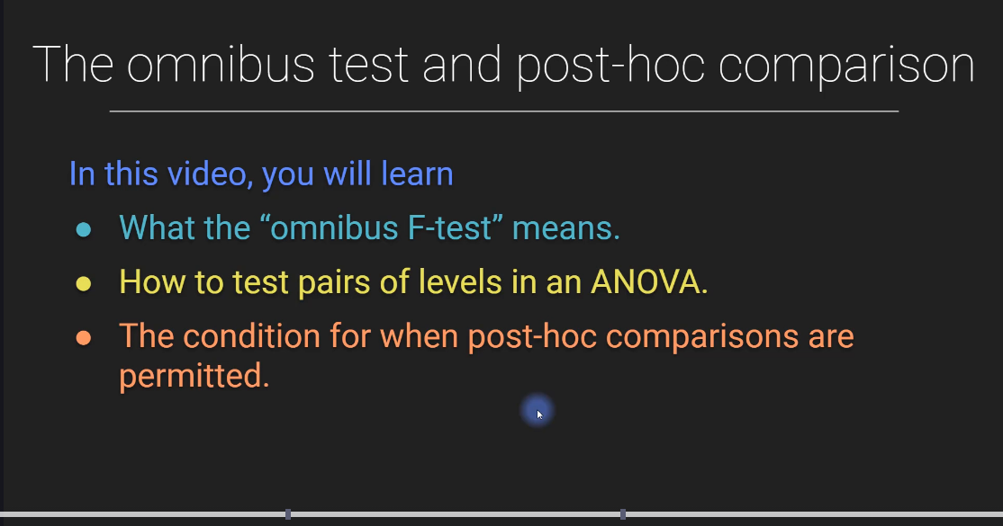

Slide 44
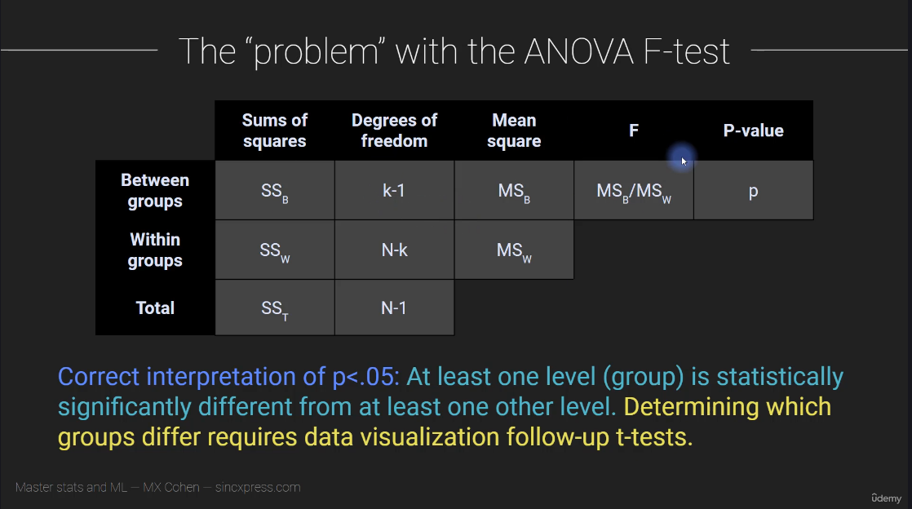

Slide 45
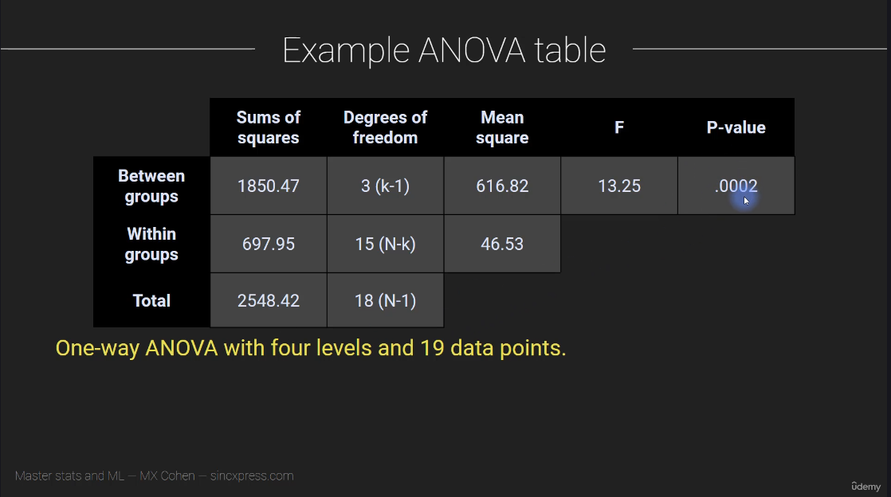

Slide 46
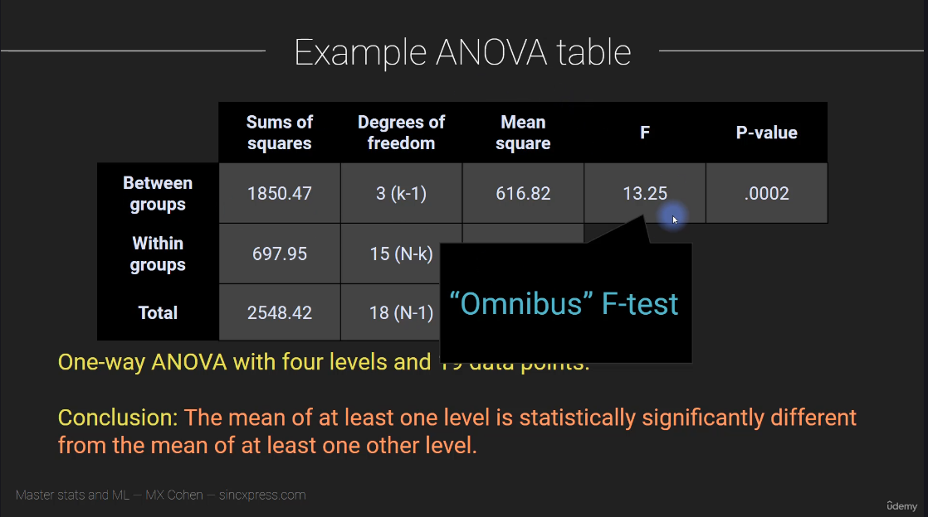

Slide 47
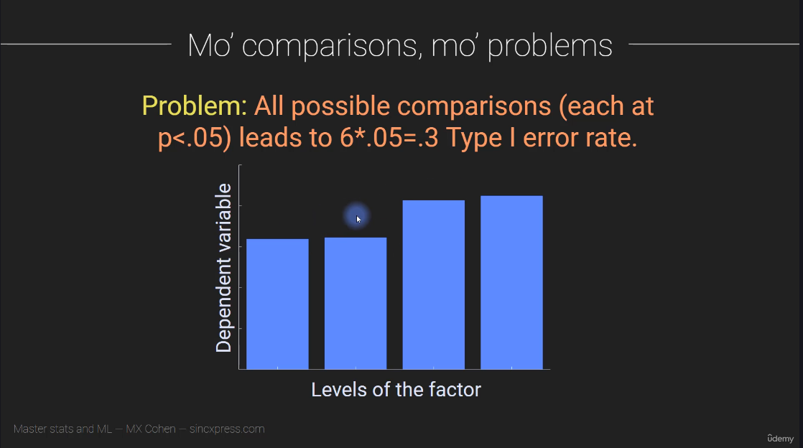

Slide 48
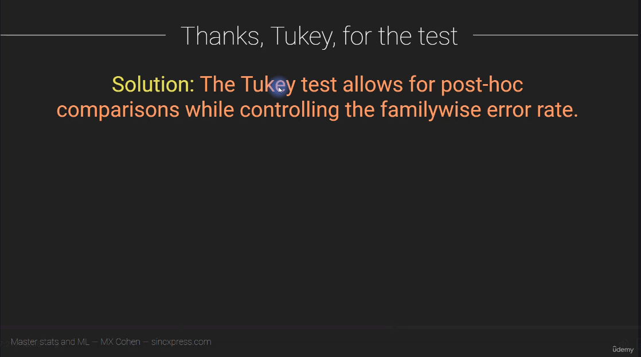

Slide 49
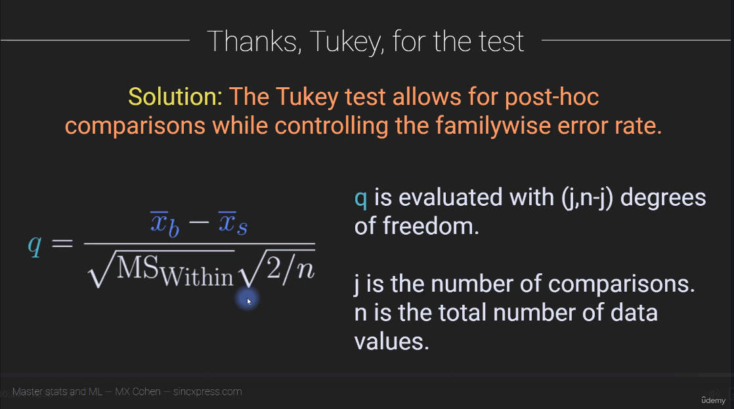

Slide 50
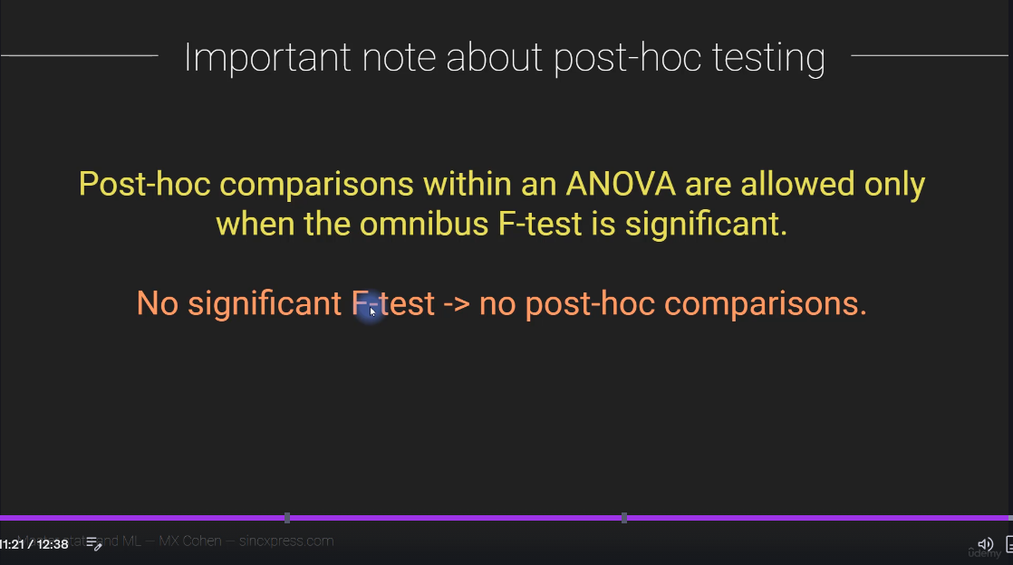

Slide 51
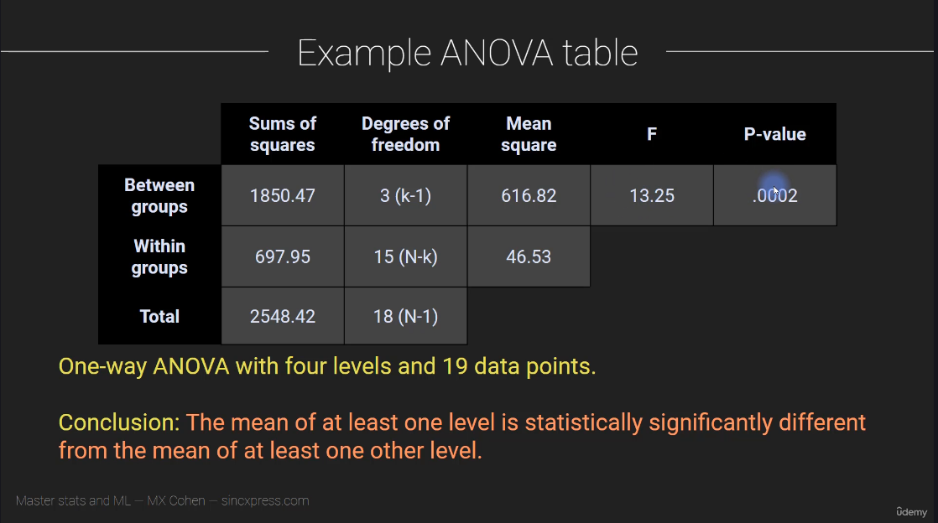

Slide 52
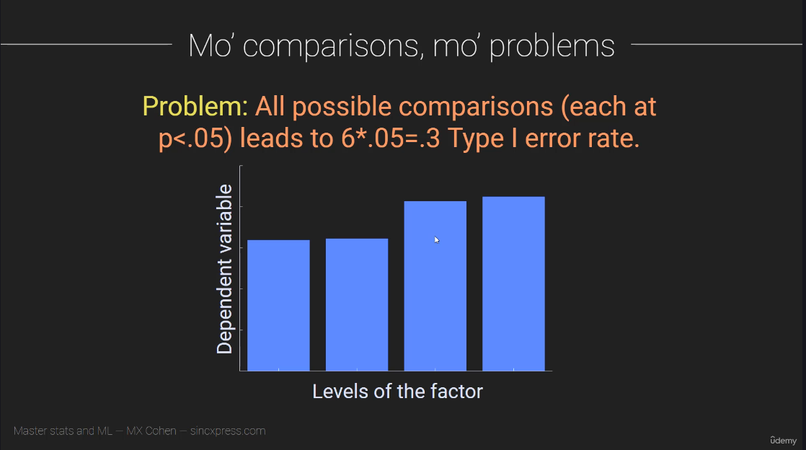

Slide 53
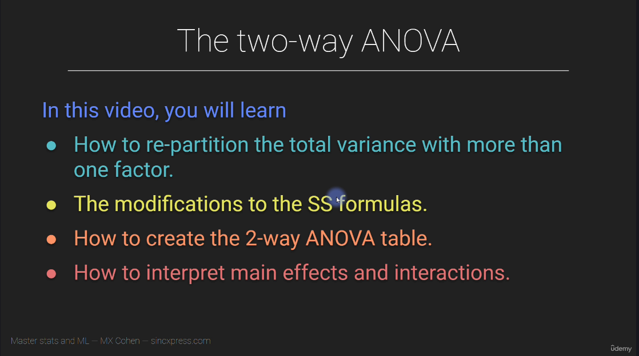

Slide 54
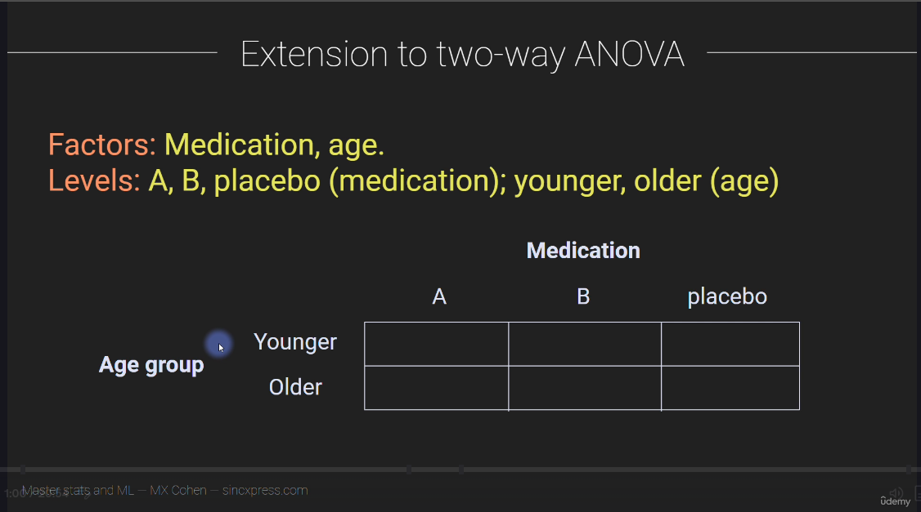

Slide 55
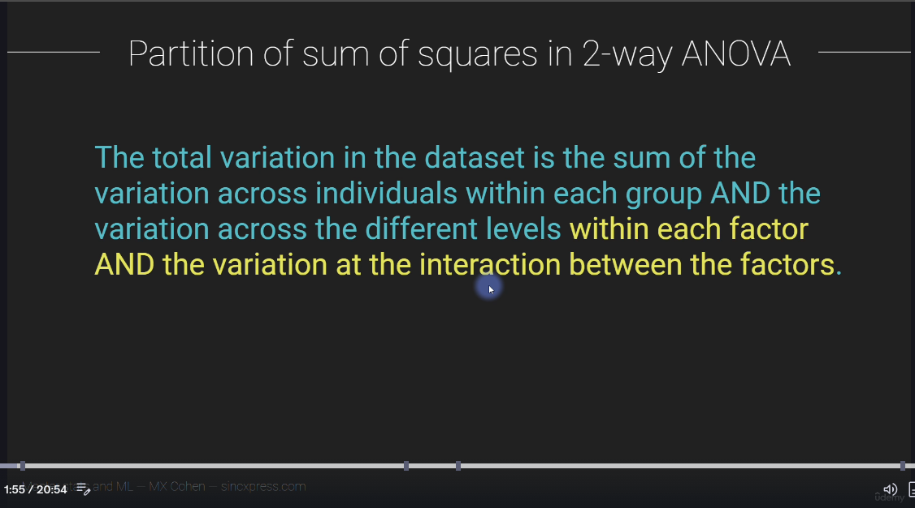

Slide 56
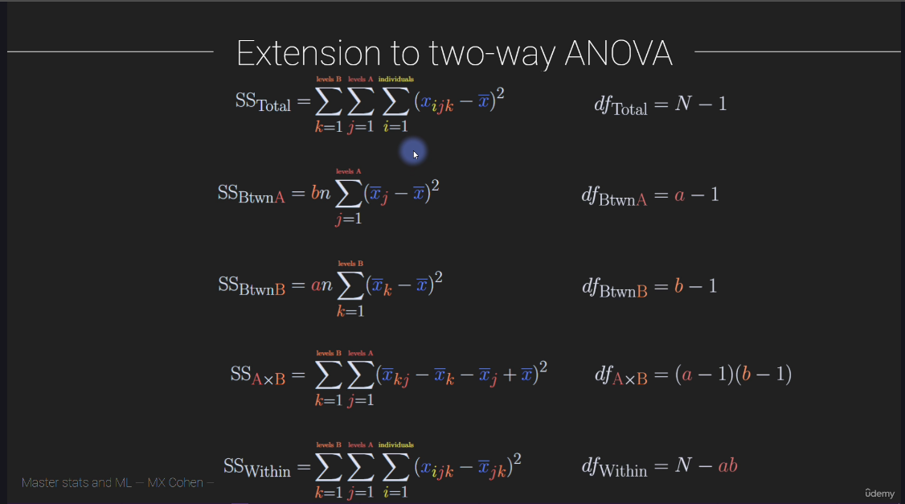

Slide 57
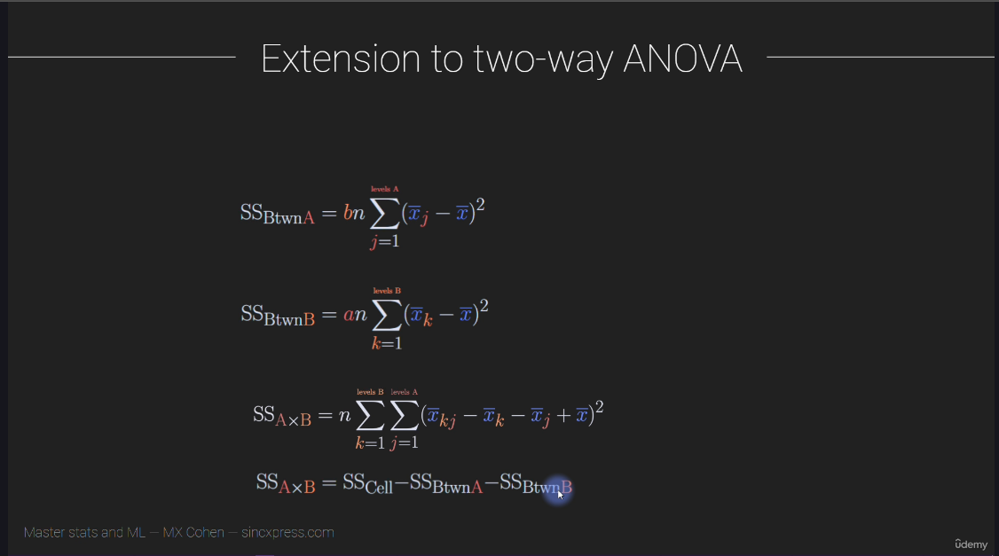

Slide 58
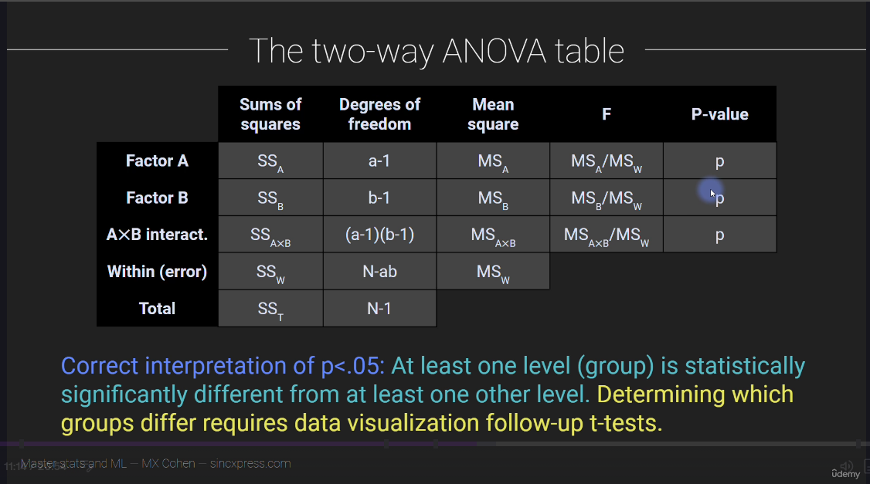

Slide 59


Slide 60


Slide 61


Slide 62


Slide 63


Slide 64


Slide 65


Slide 66


Slide 67


Slide 68


Slide 69

SLAYT : 44

Slide 70


Slide 71


Slide 72




Slide 73
Hipotez Testlerinde Pingouin Kullanımı: Veri Analizi ve Python
Emrecan Ulu – Medium. (PDF olarak github’a konulmuştur.)

Slide 74




Slide 75


Slide 76


Slide 77


Slide 78


Slide 79


Slide 80


Slide 81


Slide 82




