Slide 1
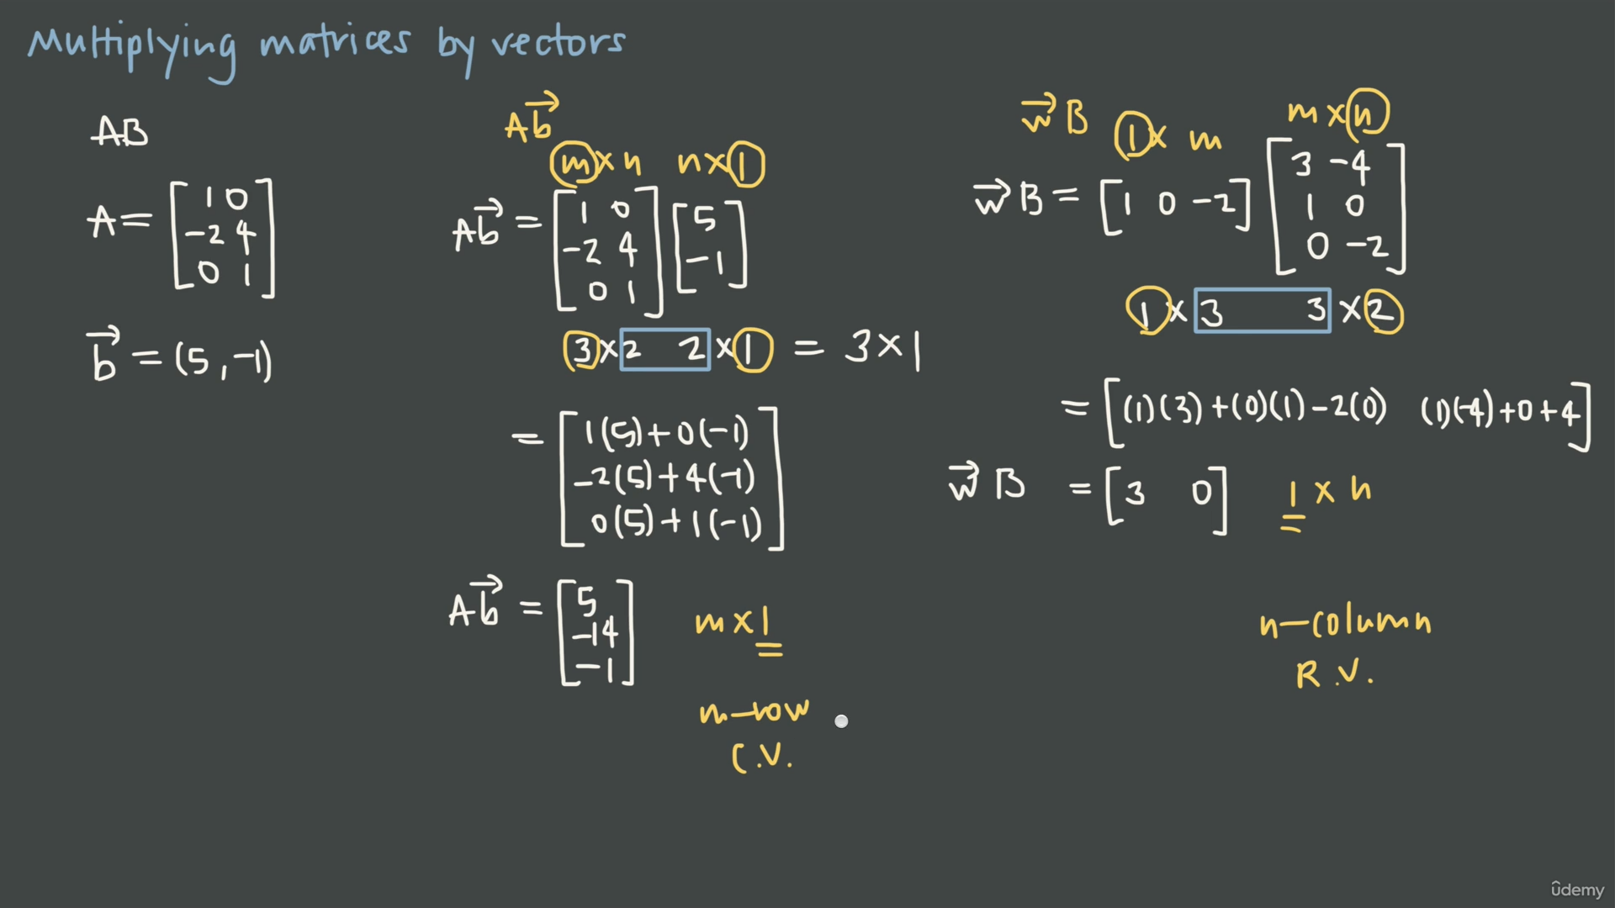

Slide 2
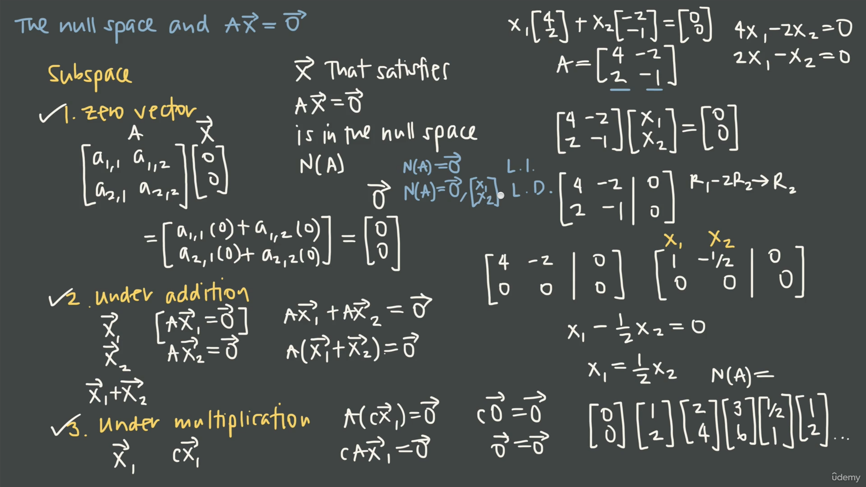

Slide 3
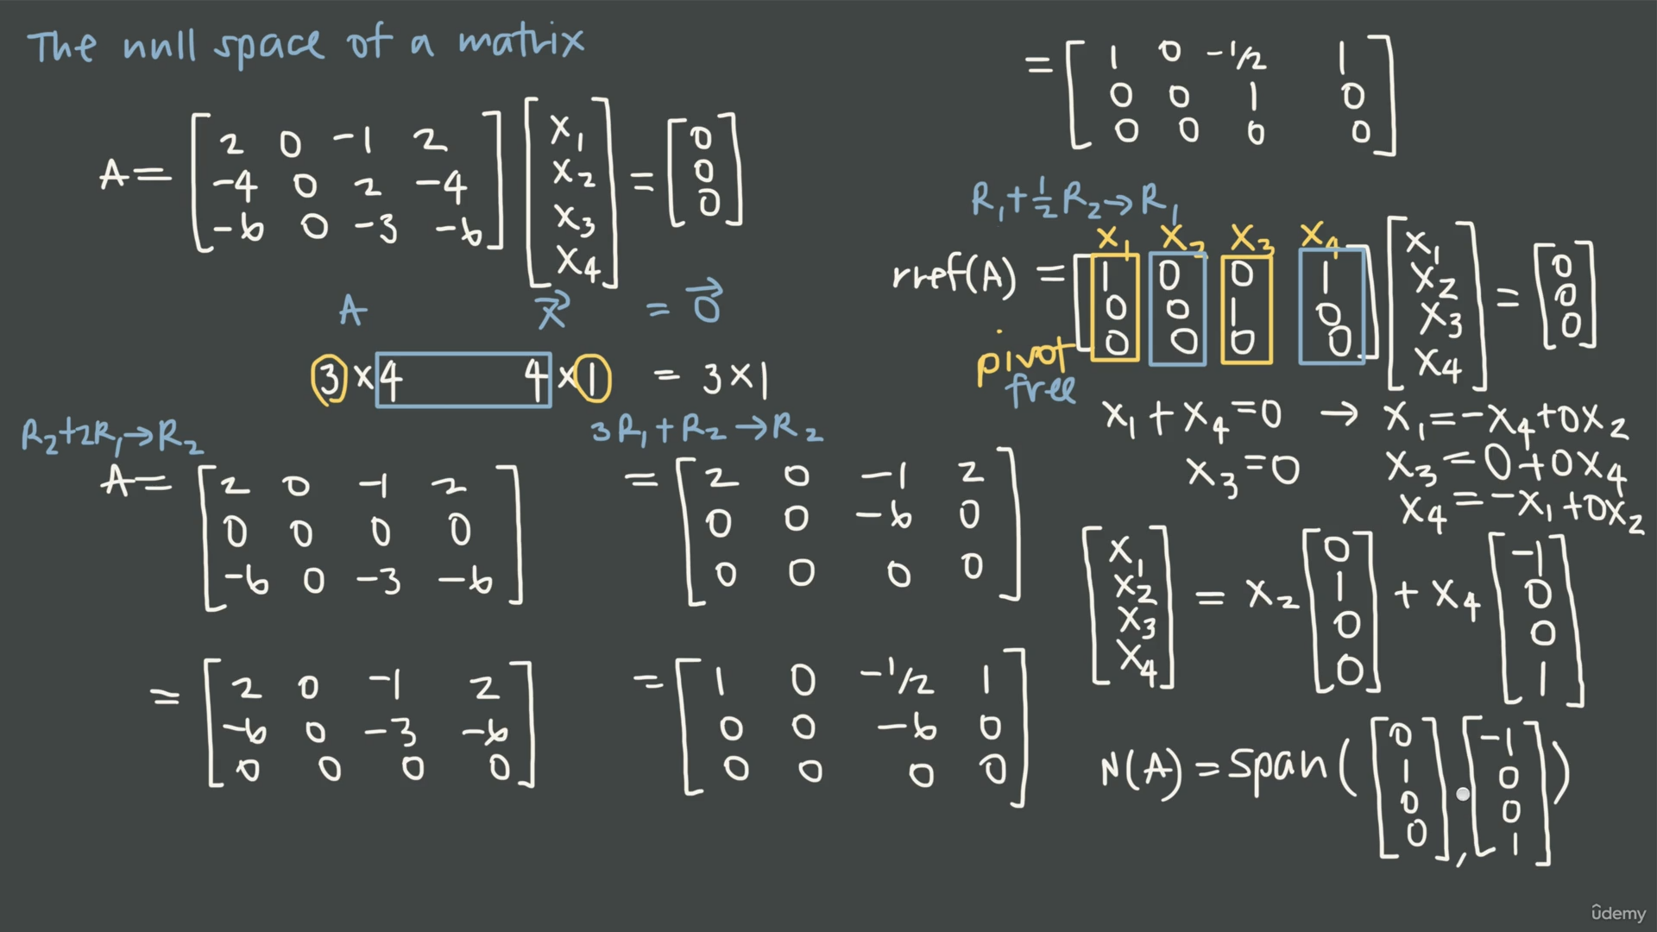

Slide 4
Example: Robotics and Degrees of Freedom
Imagine a robotic arm with 7 joints trying to reach a point in 3D space. Because it has more joints than needed, there is a null space in its movement matrix.
This allows the robot to "wiggle" its elbow or adjust its posture (to avoid an obstacle) while keeping its hand perfectly still at the target coordinates.
Would you like to see the mathematical steps for finding the null space of a simple 2D mass-spring system?

Slide 5
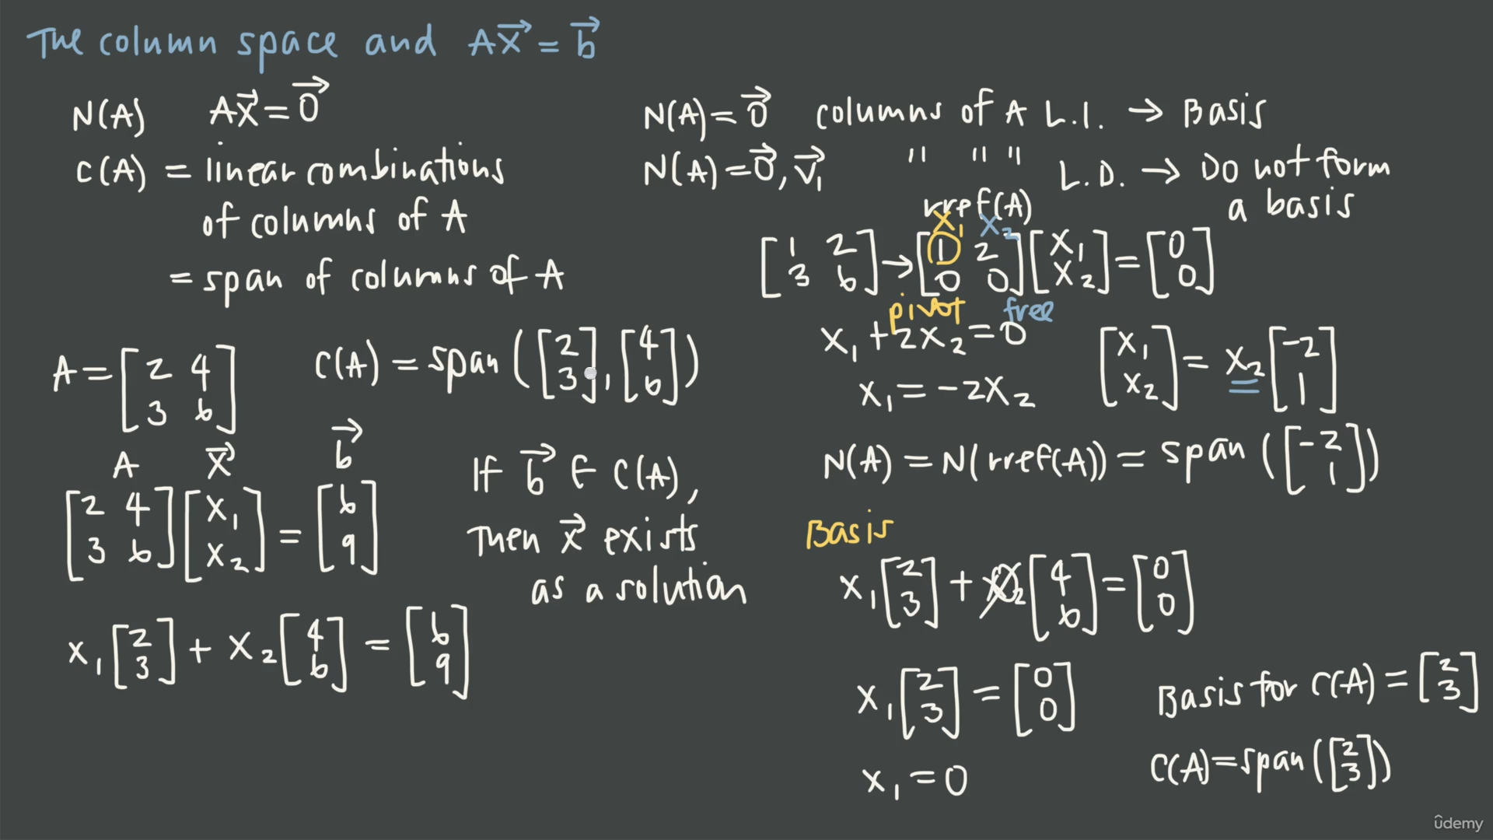

Slide 6
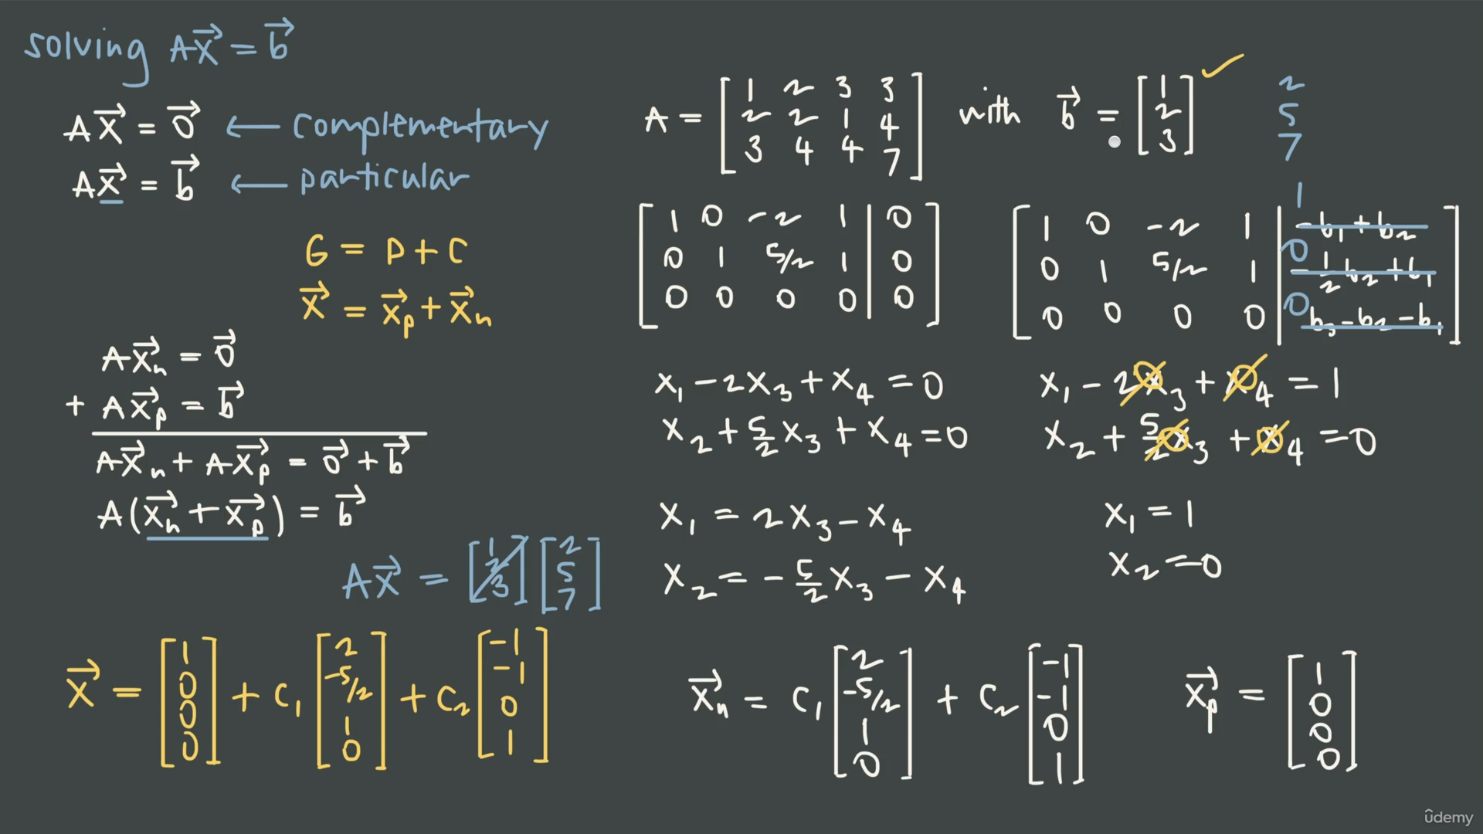

Slide 7
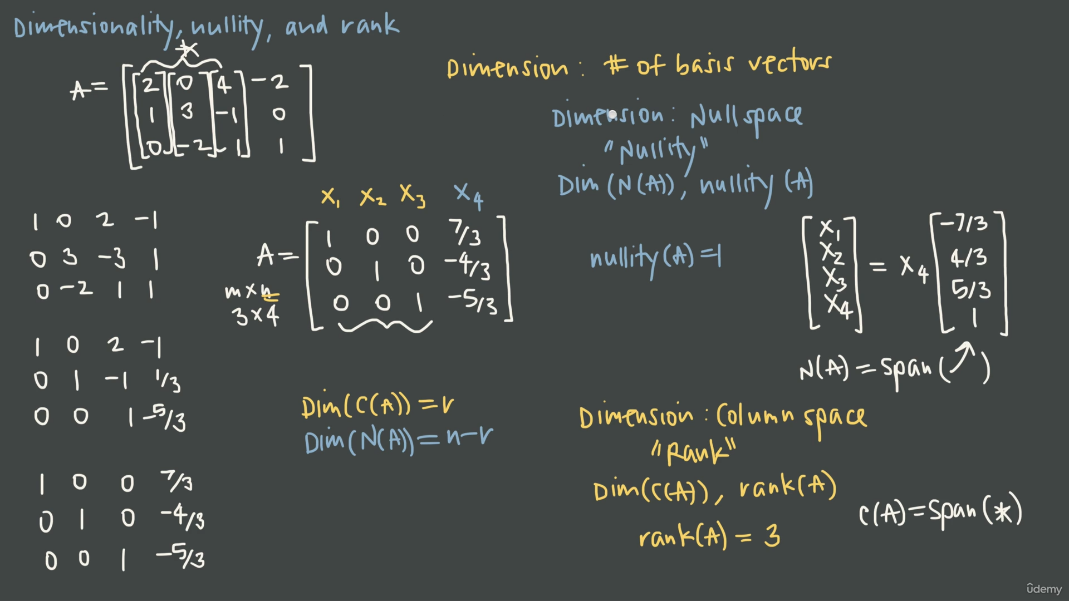

Slide 8
