Slide 1
AI for Software Engineers Course
Building AI Systems + Production + Real Use Cases
https://github.com/havelsan/YZ_EGITIM
Mehmet PEKMEZCİ
versiyon 3.2

Slide 2
Breakthrough
ReAct: Synergizing Reasoning and Acting in Language Models - 2022
Google : Shunyu Yao et al.
Reasoning + Acting
LLM agent loop (think-act-observe) Parallelism

Slide 3
Building AI Systems + Production + Real Use Cases
AI in real software architecture
LLM application patterns
AI agents (modern topic)
MLOps & LLMOps (important for engineers)
Example code generator environment
Cost, latency, and scaling
Security and risks (engineering angle)
Homeworks (2)

Slide 4
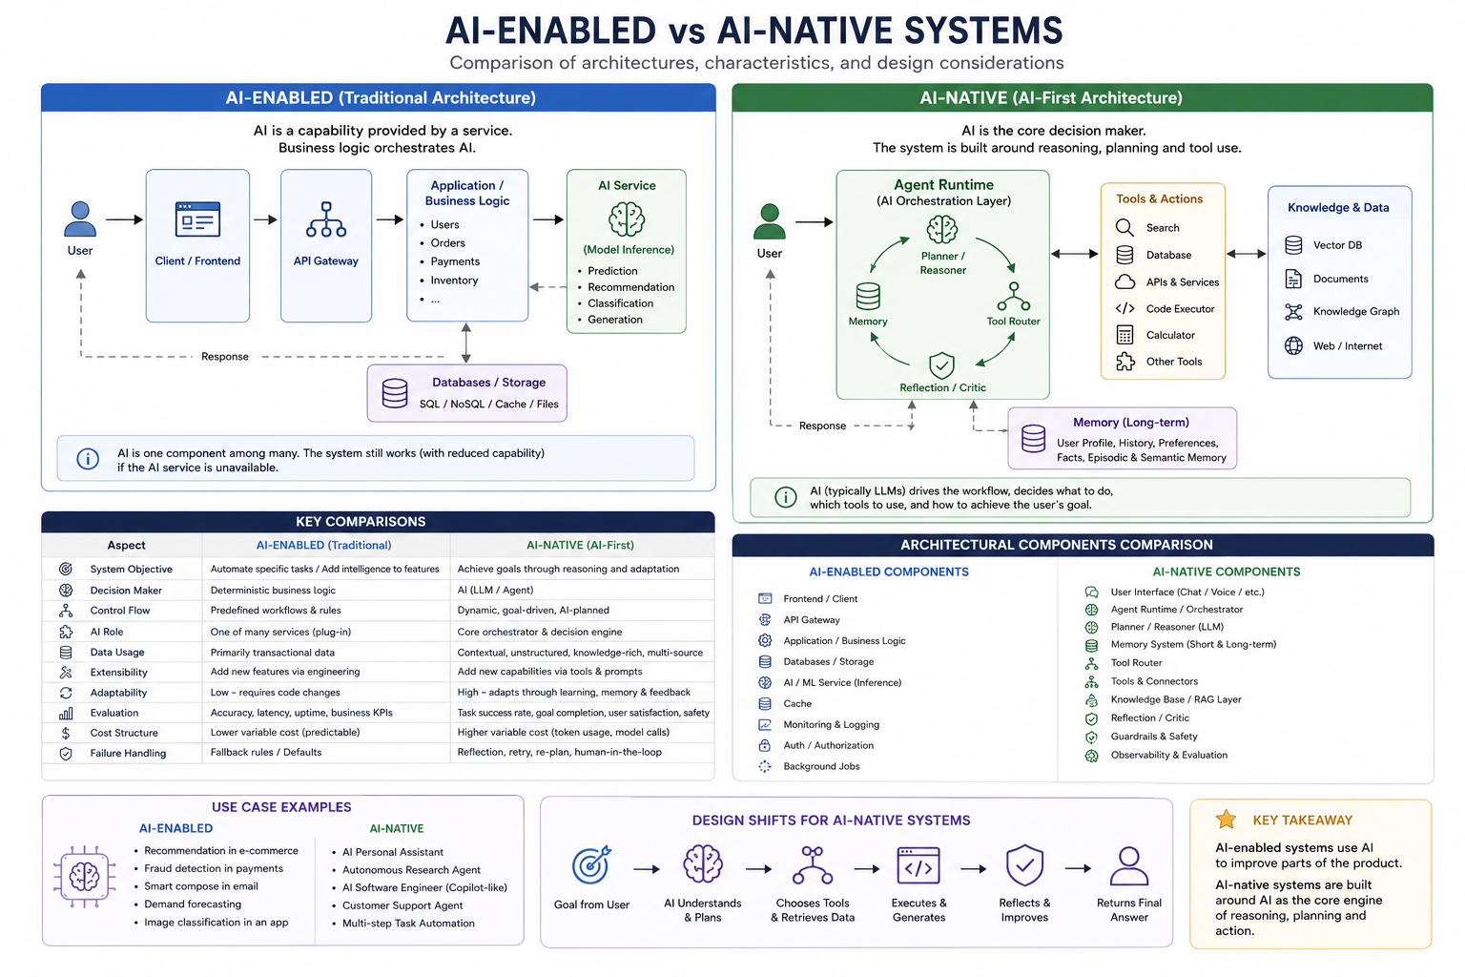

Slide 5
1. AI in real software architecture
Technology Stack
Where AI sits in system design
API-based AI integration
Microservices with LLMs

Slide 6
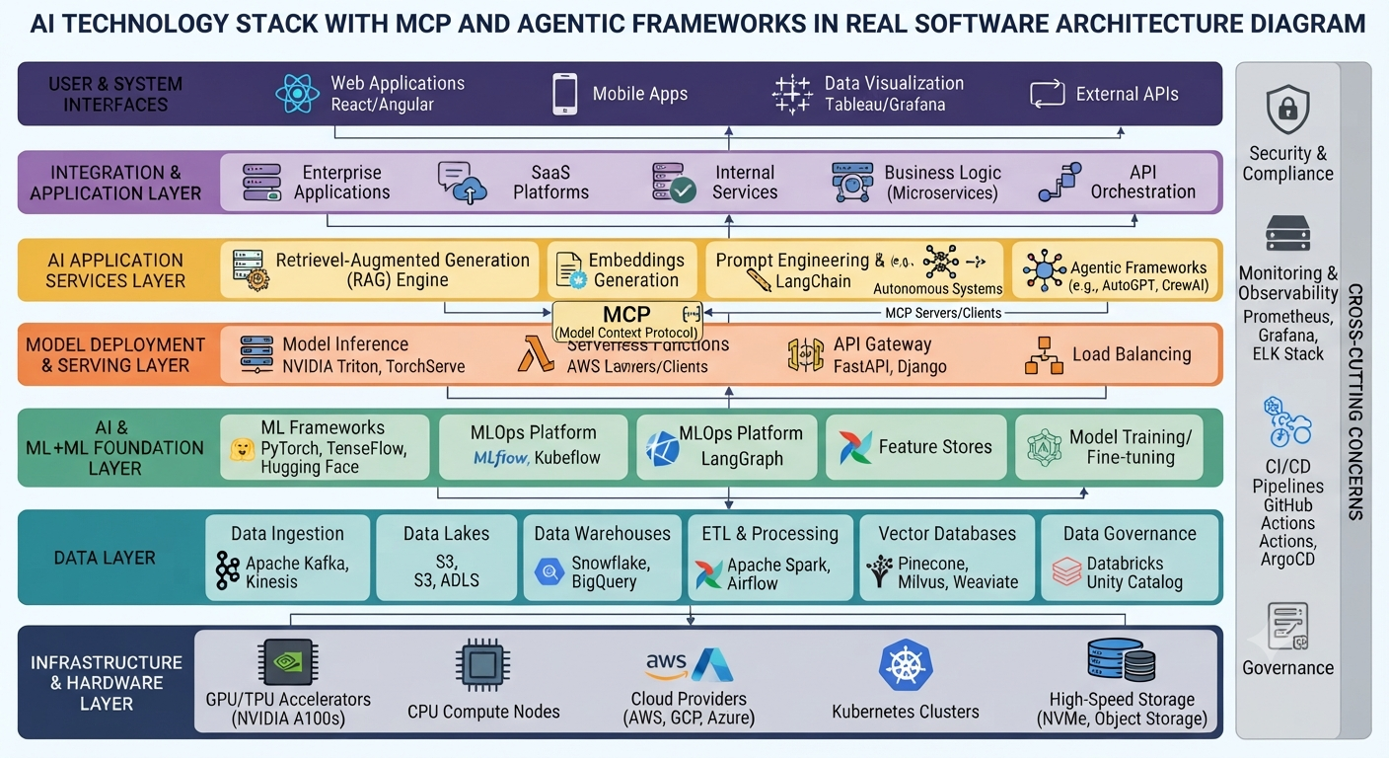
1. 1. Technology Stack

Slide 7
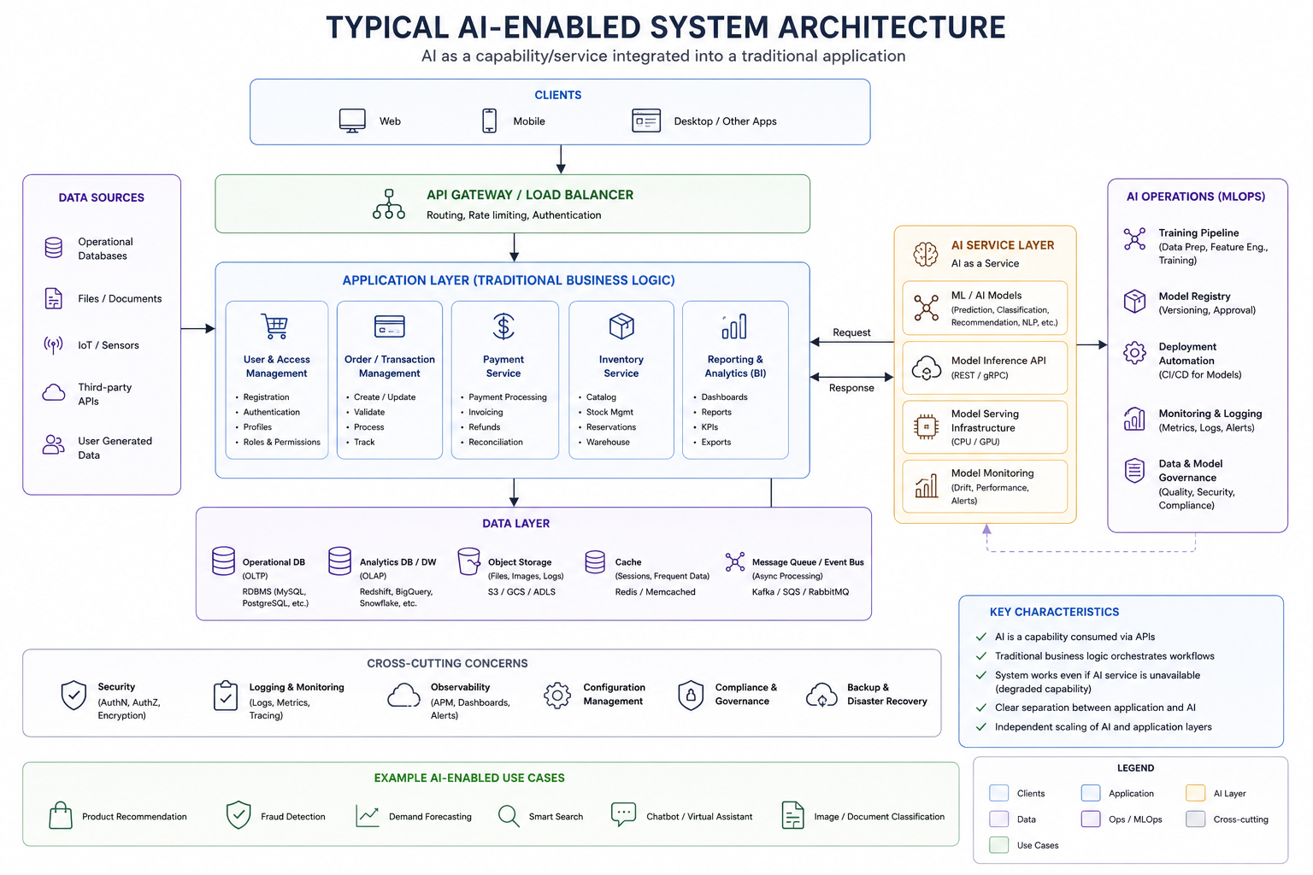
1.2. Where AI Sits In System Design : AI -Enabled

Slide 8
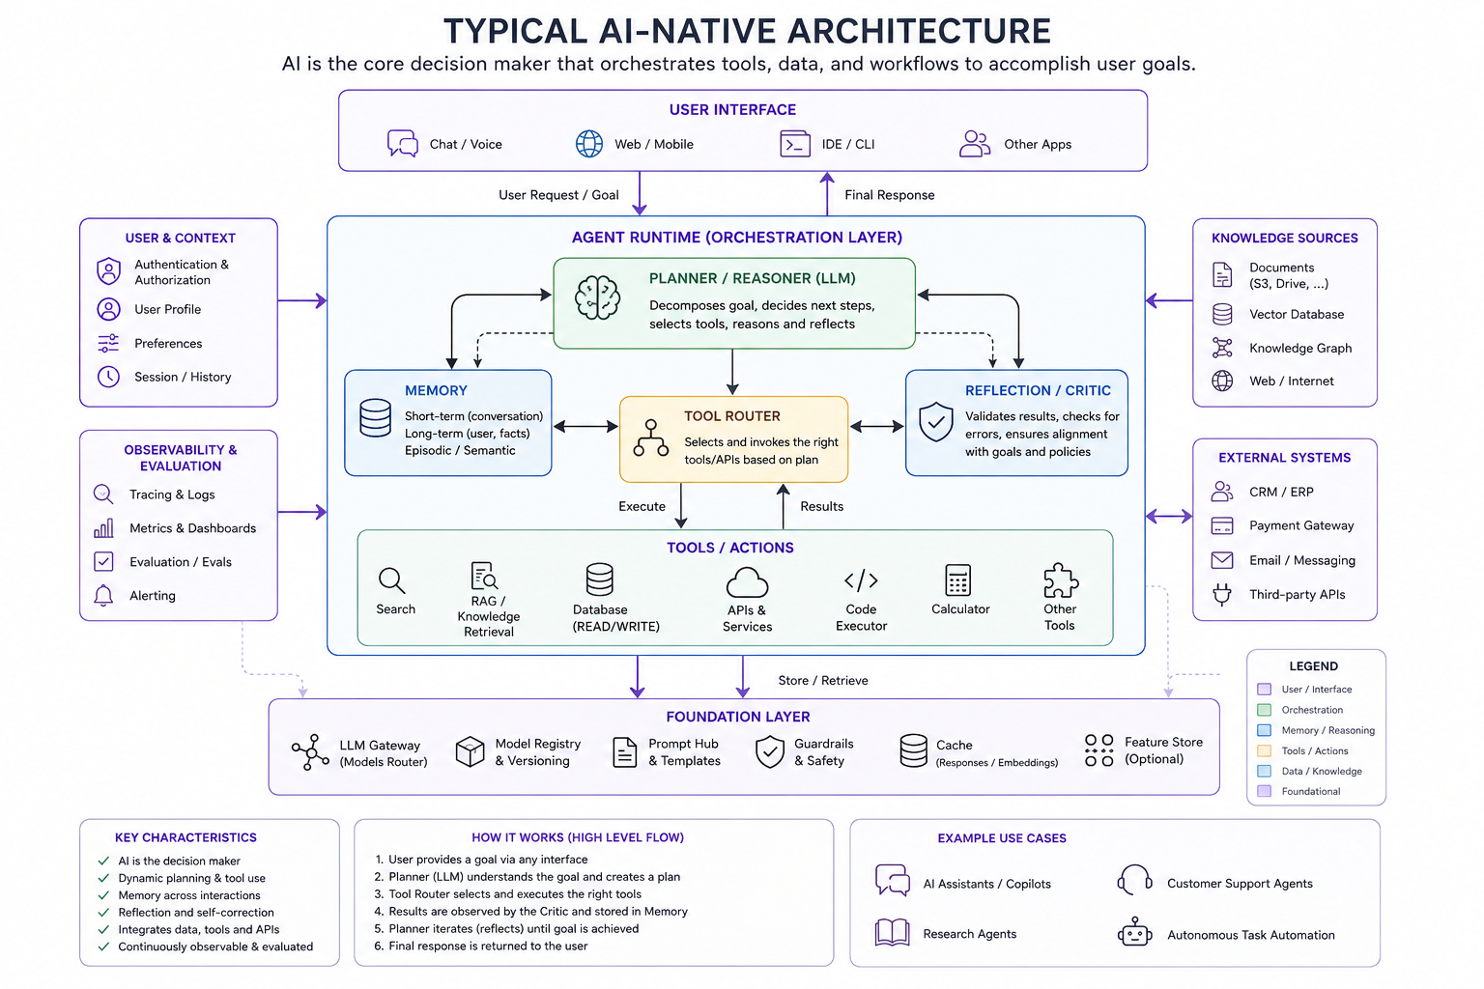
1.2. Where AI Sits In System Design : AI -Native

Slide 9
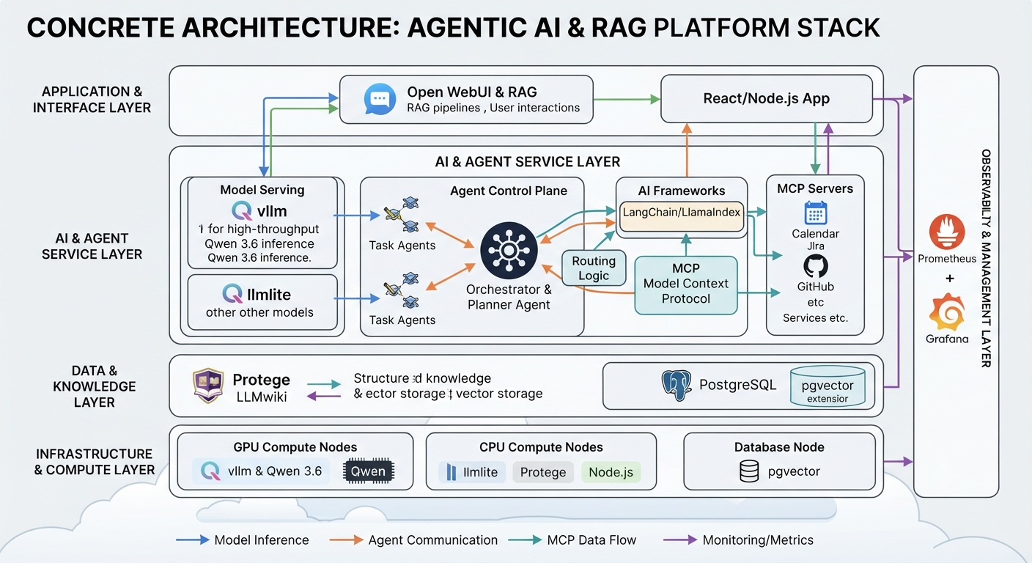
1.2. Where AI Sits In System Design : Example

Slide 10
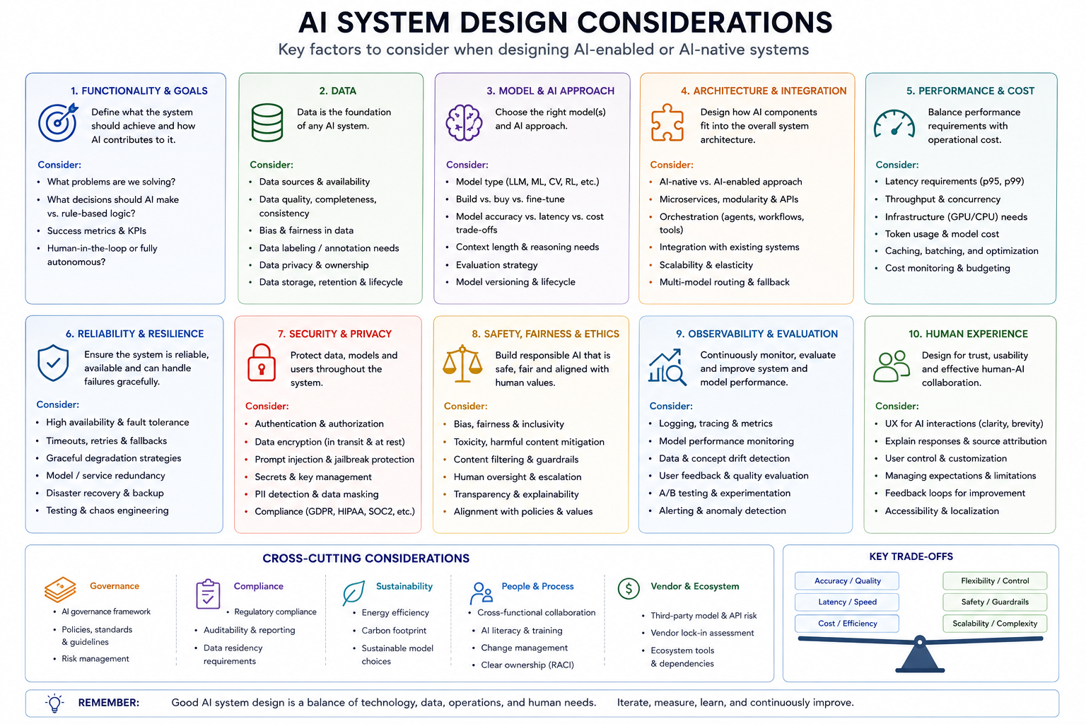
1.2. Where AI Sits In System Design : Design Considerations

Slide 11
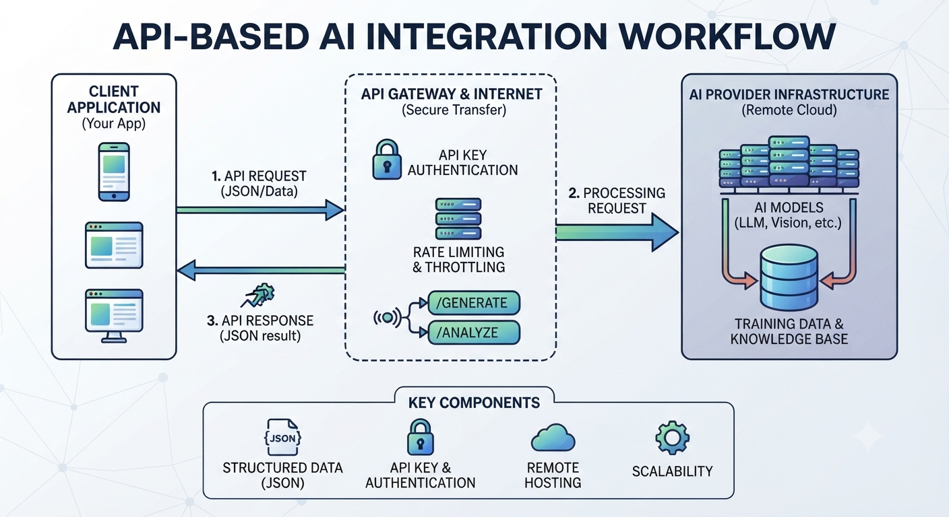
1.3. API Based AI Integration

Slide 12
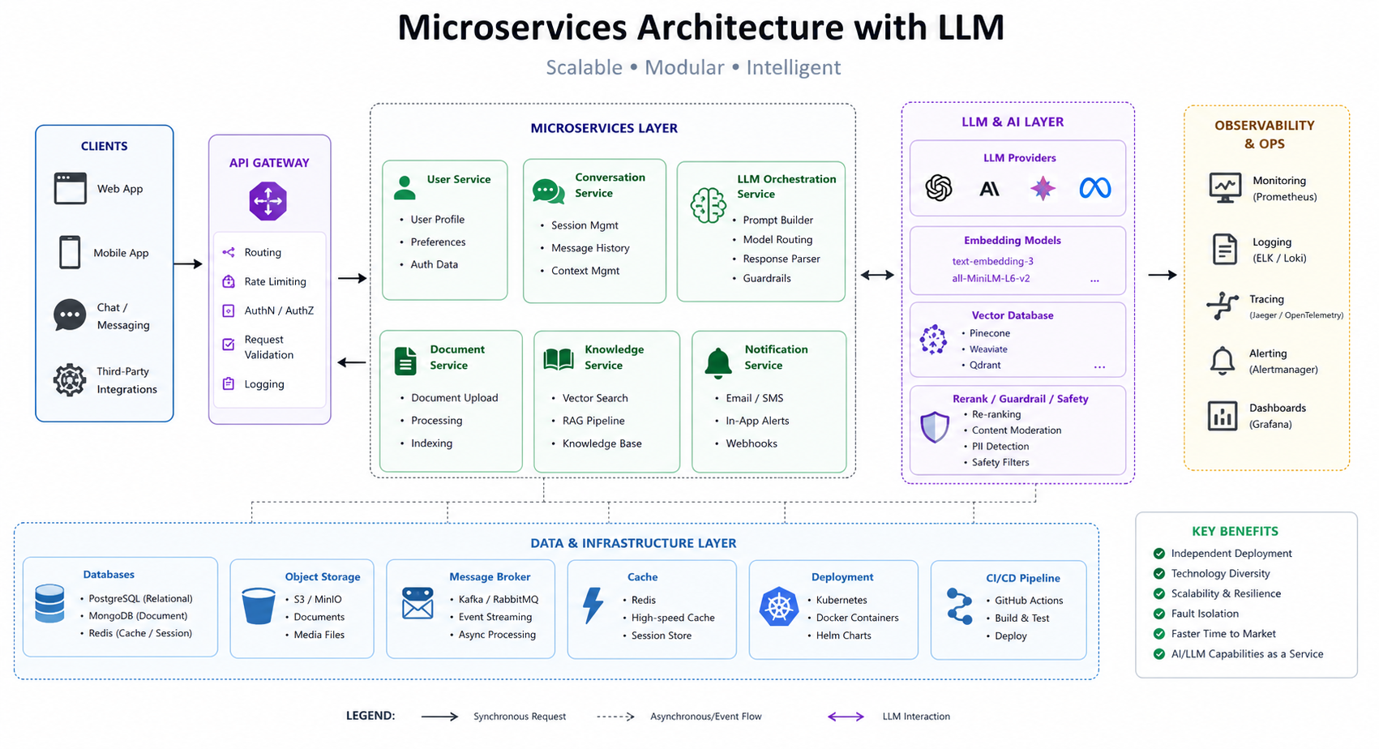
1.4. Microservices with LLMs

Slide 13
2. LLM application patterns
Chatbots
Copilots
Agents (basic intro) (Langgraph)
Function calling / tool use ( API / MCP )

Slide 14
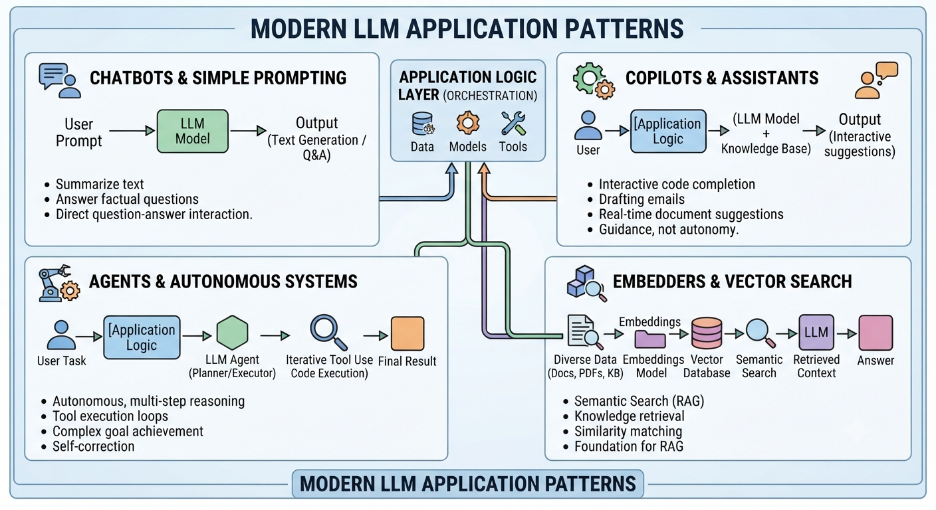
2. LLM application patterns

Slide 15
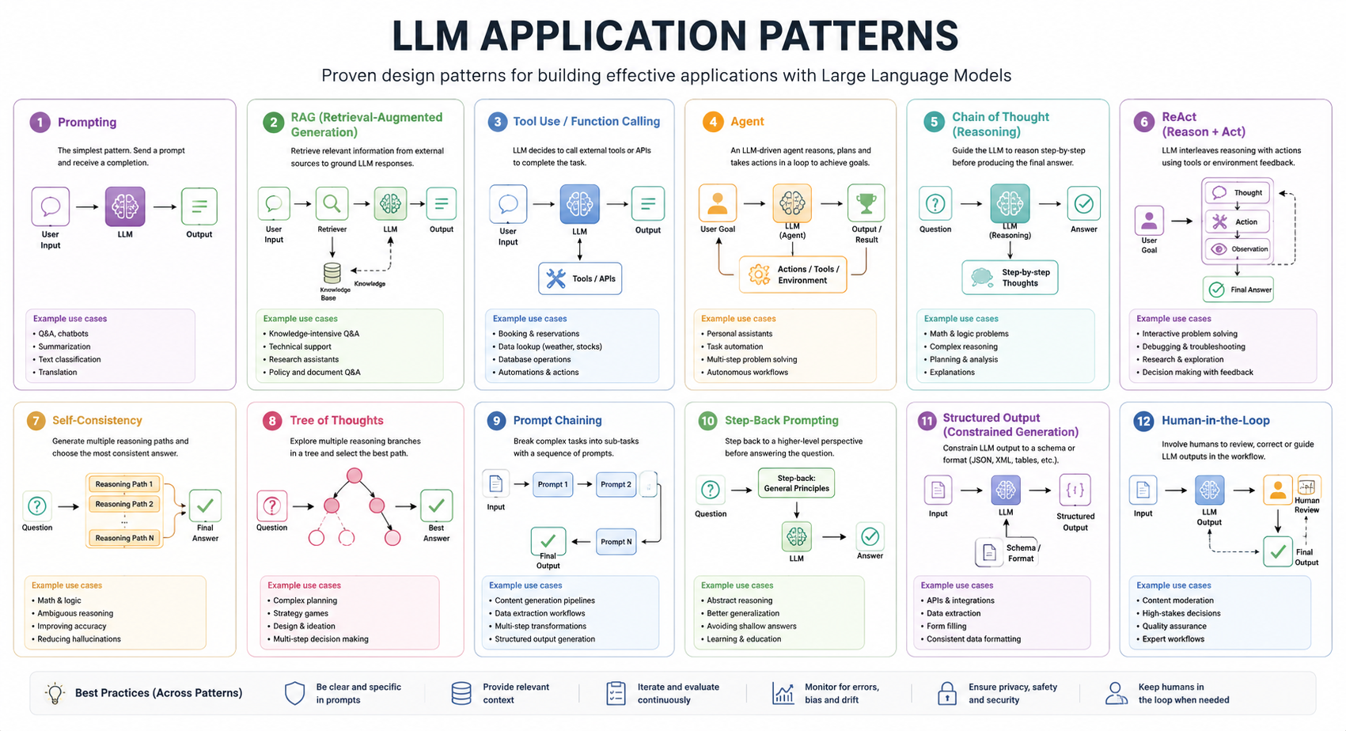
2. LLM application patterns

Slide 16
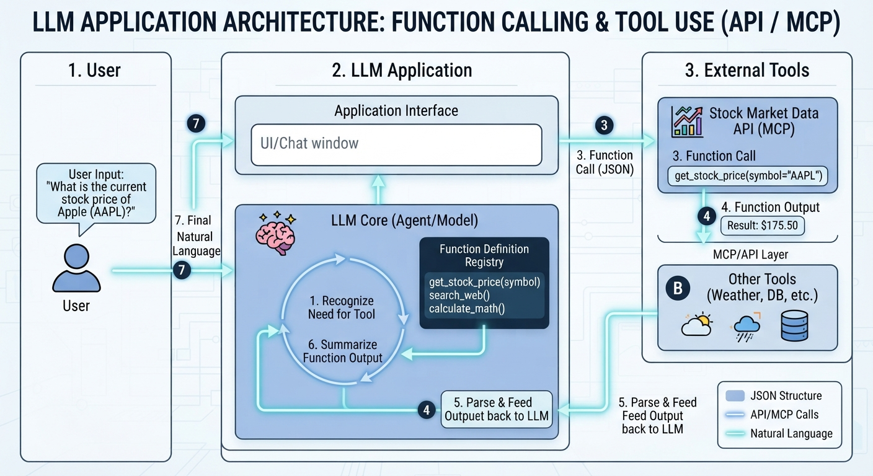
2. LLM application patterns

Slide 17
3. AI agents (modern topic)
What is an agent loop: plan → act → observe → repeat
When agents work / fail
Agentic RAG
Agent frameworks (LangCahin/Graph, LlamaIndex)
Multi Agent Systems

Slide 18
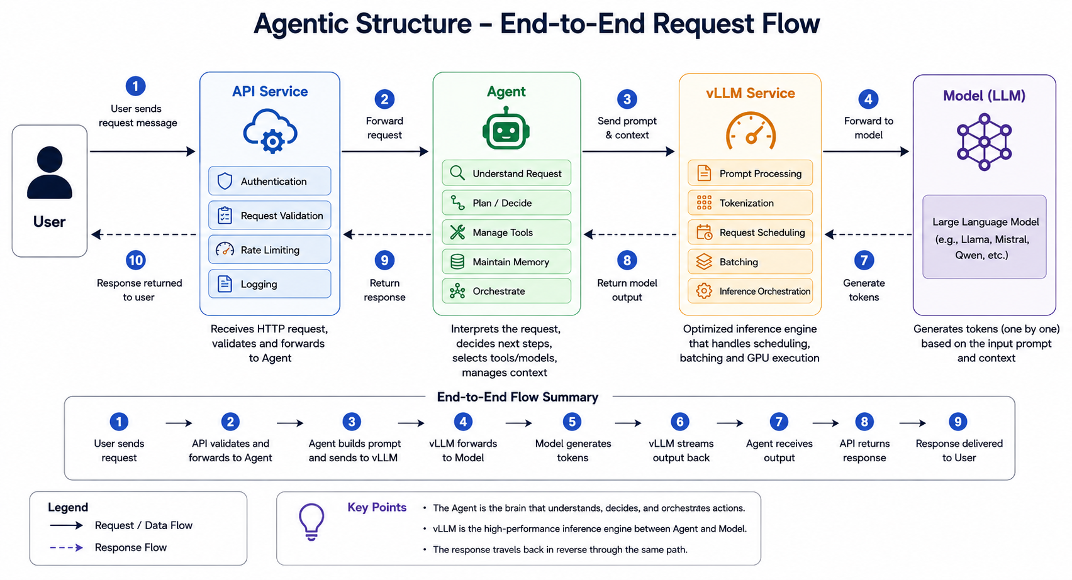
3. AI agents (modern topic)

Slide 19
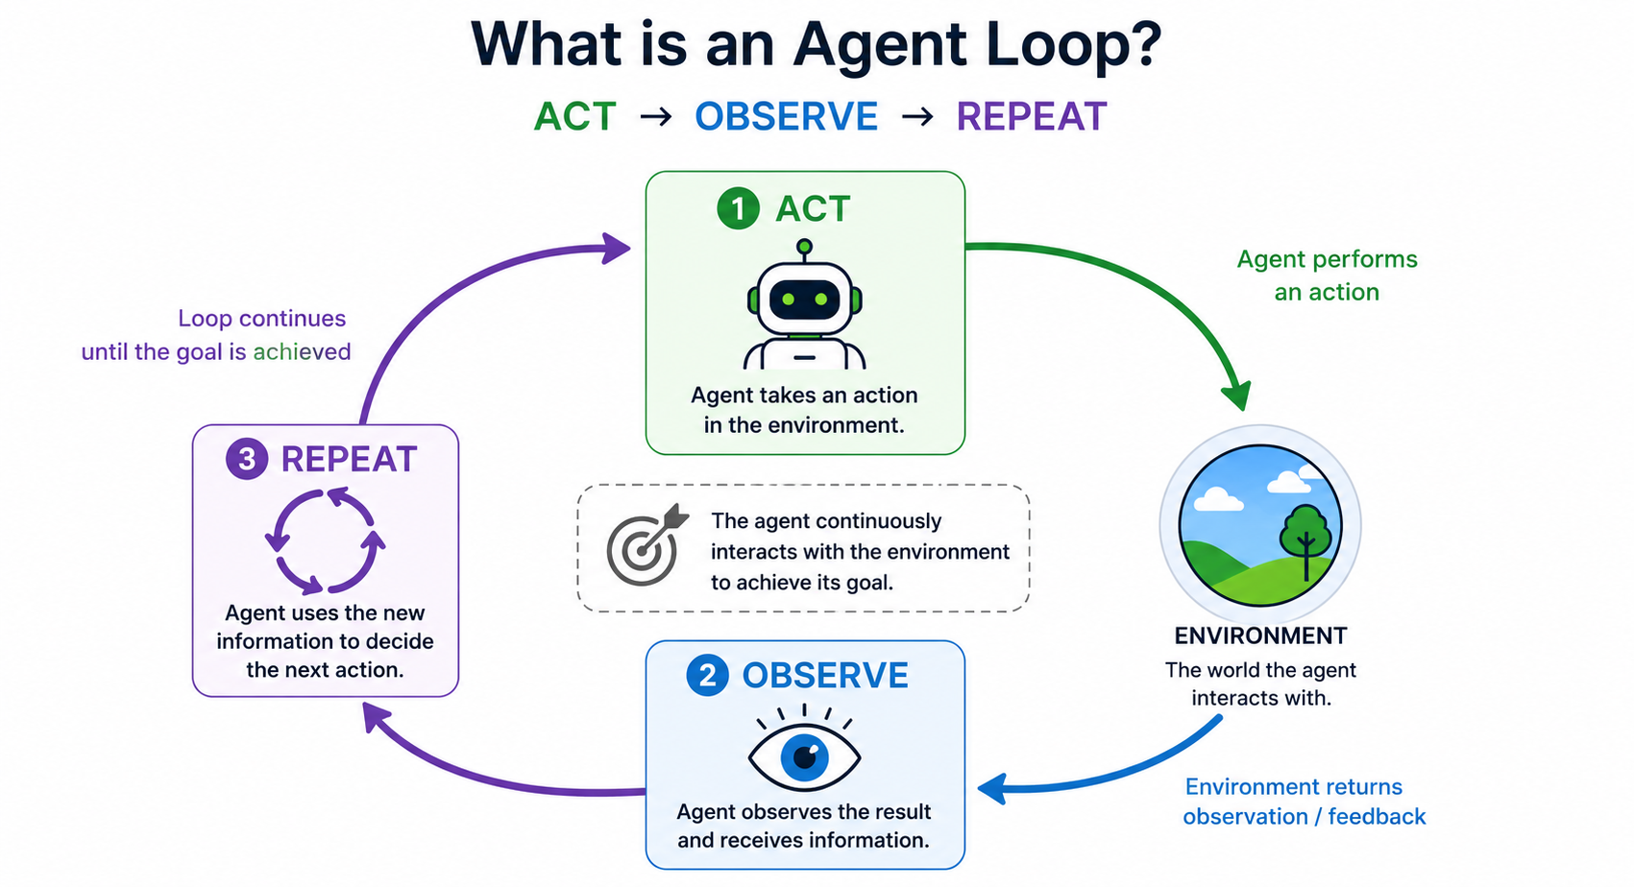
3.1. What is an Agent Loop : ACT -> OBSERVER -> REPEAT

Slide 20
3.1. What is an Agent Loop : ACT -> OBSERVER -> REPEAT
curl -X POST "http://localhost:5000/summarize" \ -H "Content-Type: application/json" \ -d '{ "text": "AI tools are completely flawless and have zero percent operational errors across all businesses. However, AI is totally unreliable, constantly fails, and causes companies to go bankrupt immediately. Remote work multiplies employee productivity by 200% and creates unmatched team synergy and bonding. Conversely, working from home breeds ultimate laziness and destroys communication, ruining all company operations. " }'
from fastapi import FastAPI
from pydantic import BaseModel
from langchain_openai import ChatOpenAI
from langchain_core.messages import HumanMessage
from langgraph.graph import StateGraph, START, END
from typing_extensions import TypedDict
app = FastAPI()
llm = ChatOpenAI(base_url="http://localhost:8000/v1", api_key="k", model="mistralai/Mistral-7B-Instruct-v0.3", temperature=0.1)
class AgentState(TypedDict):
text: str
lines: int
loops: int
class TextRequest(BaseModel):
text: str

Slide 21
3.1. What is an Agent Loop : ACT -> OBSERVER -> REPEAT
def summarize_node(state: AgentState) -> dict:
prompt = f"Summarize the following text to make it shorter. Completely remove and clean up any contradictory, inconsistent, or illogical expressions within the text:\n\n{state['text']}"
res = llm.invoke([HumanMessage(content=prompt)]).content.strip()
line_list = [l for l in res.splitlines() if l.strip()]
return {"text": "\n".join(line_list), "lines": len(line_list), "loops": state["loops"] + 1}
def route_condition(state: AgentState) -> str:
return END if state["lines"] < 50 or state["loops"] >= 5 else "summarize"
workflow = StateGraph(AgentState)
workflow.add_node("summarize", summarize_node)
workflow.add_edge(START, "summarize")
workflow.add_conditional_edges("summarize", route_condition)
agent_graph = workflow.compile()
@app.post("/summarize")
async def run_summarizer(req: TextRequest):
init_lines = len([l for l in req.text.splitlines() if l.strip()])
final = await agent_graph.ainvoke({"text": req.text, "lines": init_lines, "loops": 0})
return {"lines": final["lines"], "loops": final["loops"], "result": final["text"]}
if __name__ == "__main__":
import uvicorn
uvicorn.run(app, host="0.0.0.0", port=5000)

Slide 22
3.2. When Agents Work/Fail
Feature | Where Agents Work Well | Where Agents Tend to Fail
Task Complexity | Open-ended, multi-step tasks requiring reasoning and adaptation [1.2.1, 1.2.2]. | Highly repetitive, deterministic tasks where speed and 100% accuracy are required [1.2.2].
Environment | Dynamic/changing environments where fixed rules cannot cover every scenario [1.2.1, 1.2.2]. | Static systems where high-precision, hard-coded API integrations are safer [1.2.2, 1.3.3].
Logic & Reasoning | Handling exceptions or tasks that require "common sense" judgment [1.2.1, 1.3.2]. | Scenarios requiring strict, long-term adherence to ambiguous or complex instructions [1.4.2, 1.4.3].
Workflow | Orchestrating sub-tasks, searching for data, and synthesizing information [1.2.1, 1.2.2]. | Long, multi-hop chains where context "rot" or errors compound at each step [1.1.2, 1.4.1].
Failure Mode | Self-correction in non-critical, exploratory, or low-risk environments [1.2.2]. | High-stakes decision-making (e.g., financial/legal) where "silent failures" are unacceptable [1.3.2, 1.4.1].

Slide 23
3.2. When Agents Work/Fail
Situation | Agents Work Well | Why They Succeed | When They Fail | Why They Fail
Multi-step workflows | Breaking a complex task into smaller subtasks | Planning and memory reduce cognitive load | Very long workflows | Error accumulation across many steps
Information gathering | Searching multiple sources | Parallel retrieval and synthesis | Poor or missing sources | Garbage in, garbage out
Repetitive office tasks | Scheduling, email drafting, reporting | Rule-based automation | Ambiguous business rules | Incorrect assumptions
Software engineering | Writing boilerplate, debugging common issues | Large programming knowledge | Large unfamiliar codebases | Context window limitations
Customer support | FAQ answering | Consistent responses | Novel or emotional situations | Hallucinations or poor empathy
Data analysis | Cleaning data, summaries, SQL generation | Pattern recognition | Statistical inference requiring rigor | Incorrect calculations or assumptions
Scientific research | Literature review, hypothesis generation | Fast synthesis | Original discoveries | Cannot replace experimentation

Slide 24
3.2. When Agents Work/Fail
Situation | Agents Work Well | Why They Succeed | When They Fail | Why They Fail
Creative writing | Brainstorming, drafting | Strong language generation | Maintaining long-term consistency | Character or plot drift
Robotics | High-level planning | Flexible decision making | Precise low-level control | Latency and uncertainty
Decision support | Comparing alternatives | Can evaluate many factors | High-stakes autonomous decisions | Reliability and accountability concerns
Monitoring systems | Detecting anomalies from logs | Continuous observation | Rare edge cases | False positives/negatives
Human collaboration | Acting as an assistant | Interactive clarification | Fully replacing humans | Judgment and responsibility remain human

Slide 25
3.2. When Agents Work/Fail
Agents excel at :
Repetitive automation
Multi-step workflows
Tool orchestration
Large-scale information processing
Parallel task execution
Planning with feedback
Human assistance
Pattern recognition
Software automation
Agents struggle with :
Ambiguous objectives
Long chains of reasoning
Missing or incorrect information
Novel situations
Dynamic environments
High-stakes autonomous decisions
Replacing human judgment
Common-sense reasoning beyond available context
Accountability and ethical decisions

Slide 26
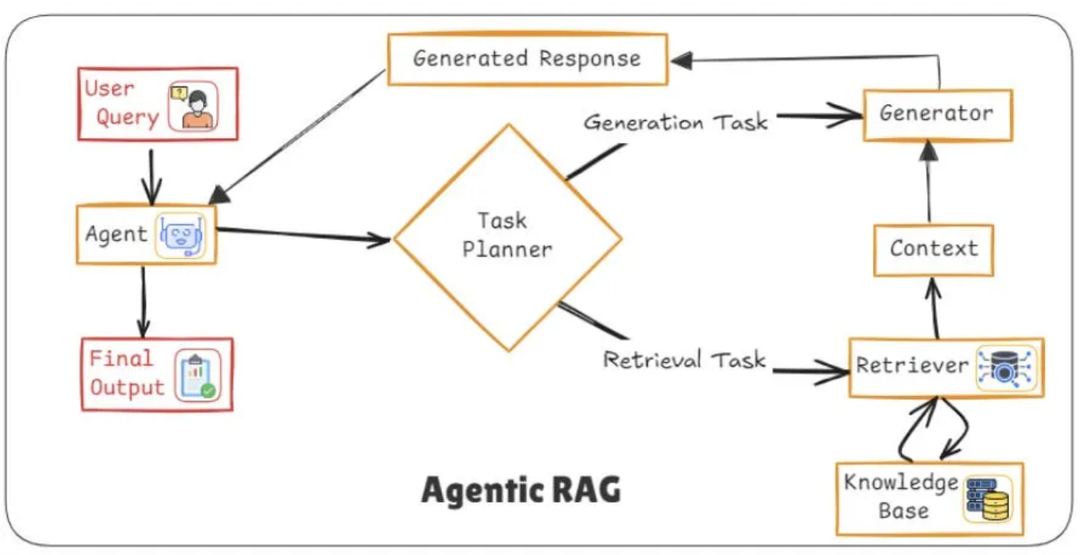
3.3. Agentic RAG

Slide 27
3.3. Agentic RAG
Realistic Example:
A user asks: “Is it safe for a fintech app to use LLMs for loan approvals under Indian regulations?”
Agentic RAG might:
1. Detect this is a regulatory + policy + risk question
2. Search RBI guidelines via web tools
3. Retrieve internal compliance documents
4. Cross-check recent regulatory updates
5. Synthesize a structured answer with citations and caveats
A traditional RAG would likely just retrieve semantically similar documents and
answer once.

Slide 28
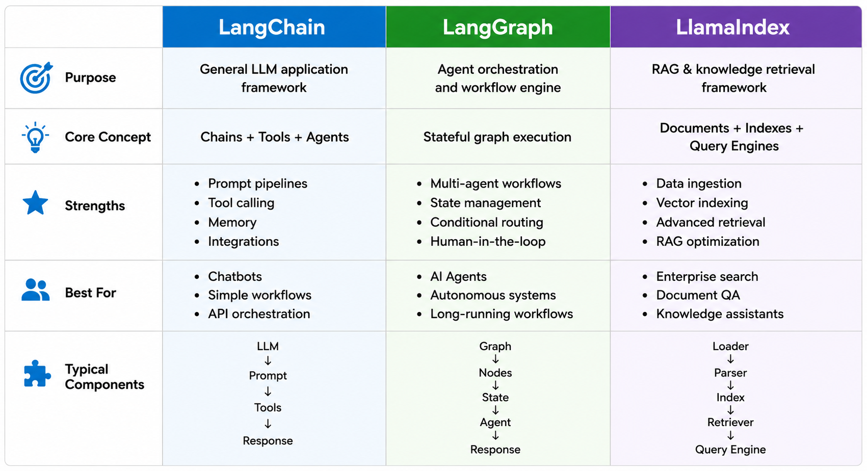
3.4. Agent Frameworks ( Langchain / Langgraph / LlamaIndex )

Slide 29
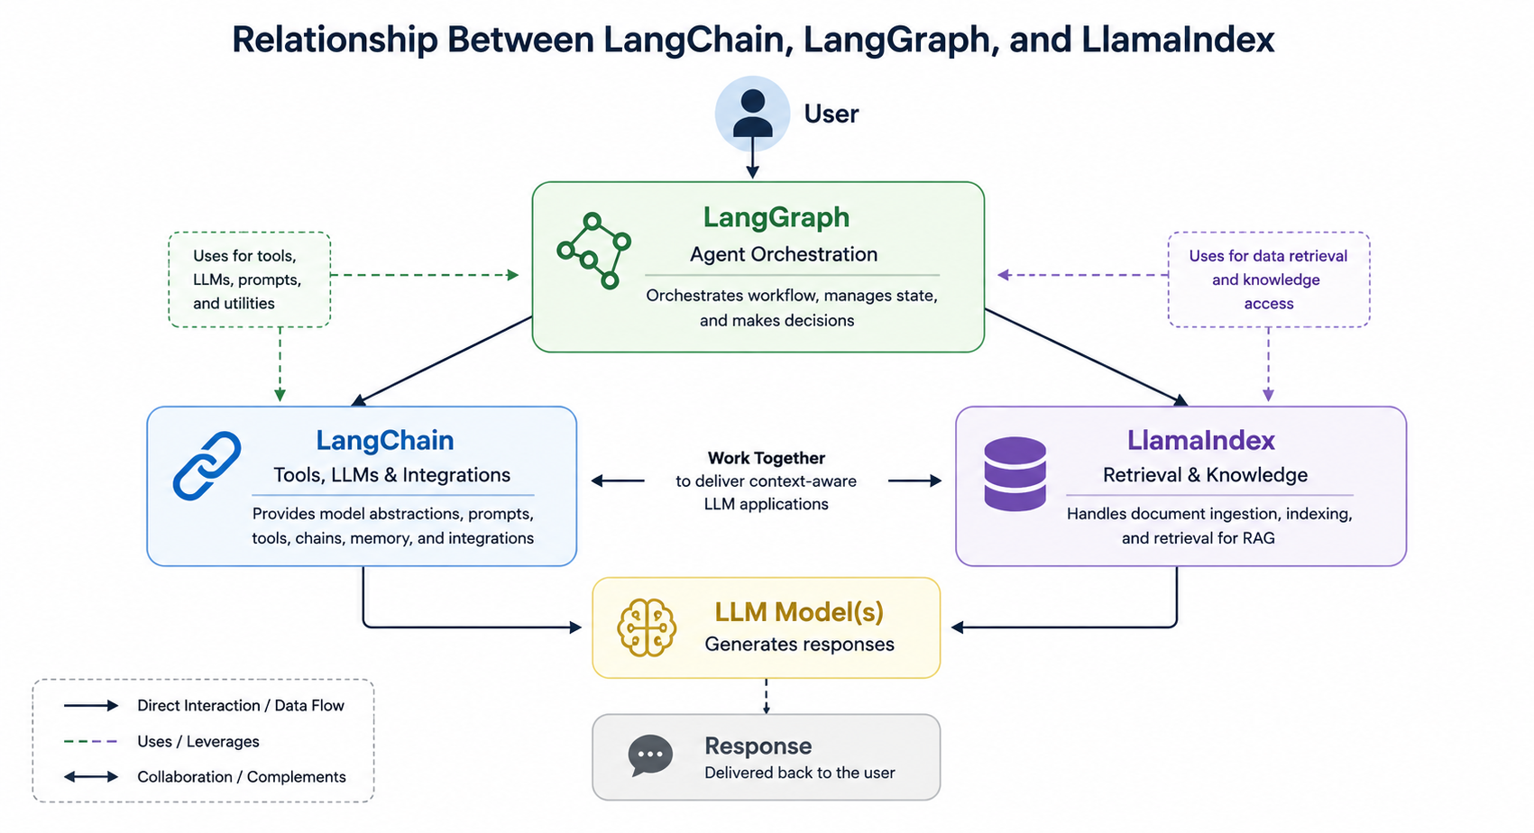
3.4. Agent Frameworks ( Langchain / Langgraph / LlamaIndex )

Slide 30
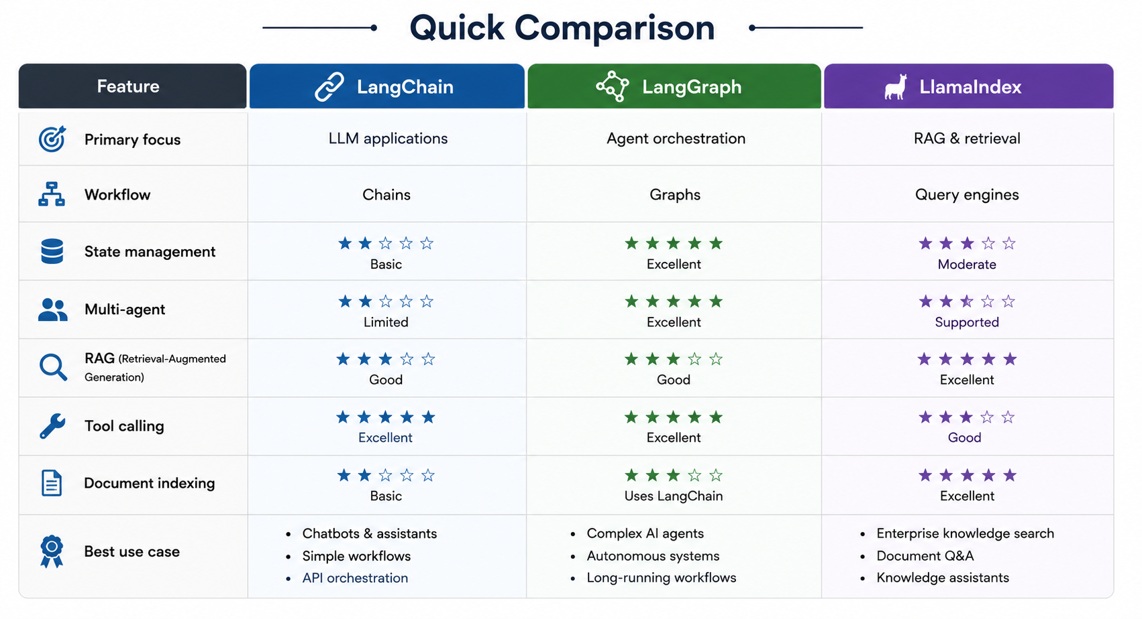
3.4. Agent Frameworks ( Langchain / Langgraph / LlamaIndex )

Slide 31
3.5. Multi Agent Systems
TRACK MANAGEMENT AGENT
TRACK MANAGEMENT TOOLS
TRACK MANAGEMENT MCP CLIENT
TRACK MANAGEMENT MCP SERVER
TRACK MANAGEMENT ADAPTERS
TRACK MANAGEMENT DEV. TEAM
RESPONSIBILITY
Agents for each CSCI (~180)
PLANNER
AGENT
(AGENTIC WORKFLOW)
RADAR SMARTS AGENT
RADAR SMARTS TOOLS
RADAR SMARTS MCP CLIENT
RADAR SMARTS MCP SERVER
RADAR SMARTS ADAPTERS
RADAR SMARTS DEV. TEAM
RESPONSIBILITY
OTHER AI SYSTEMS (BLUEVISION) AGENTS
OTHER AI SYSTEMS (BLUEVISION) TOOLS
OTHER AI SYSTEMS (BLUEVISION) MCP CLIENT
OTHER AI SYSTEMS (BLUEVISION) MCP SERVER
OTHER AI SYSTEMS (BLUEVISION) ADAPTERS
BLUEVISION DEV. TEAM
RESPONSIBILITY
GENERATIVE WORLD (VECTOR DB and MODELS)

Slide 32
4. MLOps & LLMOps (important for engineers)
Versioning models
Monitoring drift
Prompt versioning
Evaluation metrics (quality, latency, cost)

Slide 33
5. Cost, latency, and scaling
Token cost thinking
Caching strategies
Batch vs real-time inference

Slide 34
6. Security and risks (engineering angle)
Prompt injection
Data leakage
Model hallucination handling
Guardrails

Slide 35
7. Final hands-on project (choose one)
AI code assistant clone
PDF Q&A system (RAG)
Support chatbot for a product
Log analyzer using LLM

Slide 36
Building AI Systems + Production + Real Use Cases
Outcome: They can design and prototype real AI-powered systems.
Optional Advanced Topics (if time allows or for Q&A)
Open-source models (Llama, Mistral)
Multimodal models (text + image)
Teaching Strategy Tip (important)
Since your audience is experienced engineers:
Avoid long lectures > 20–25 min
Use “architecture-first explanation”
Always show:
diagram → API flow → code snippet → real use case
Emphasize:
“How would you build this in production?”

