Slide 1
AI for Software Engineers Course
LLMs , Generative AI and Modern AI Stack
https://github.com/havelsan/YZ_EGITIM
Mehmet PEKMEZCİ
versiyon 3.2

Slide 2
Breakthrough
Attention is All You Need - 2017
Google : Ashish Vaswani, Noam Shazeer, Niki Parmar, Jakob Uszkoreit, Llion Jones, Aidan N. Gomez, Lukasz Kaiser, Illia Polosukhin
Multi-Head
Self-Attention
Parallelism

Slide 3
LLMs, Generative AI, and Modern AI Stack
What Changed ML to LLMs
Transformers
How LLMs work in production
Embeddings
Prompting
RAG
Hands-on Labs

Slide 4
1 – What changed ML to LLMs
1. Rule Based → ML → Deep Learning → Transformers → LLMs
2. Why Transformers Replaced Older NLP

Slide 5
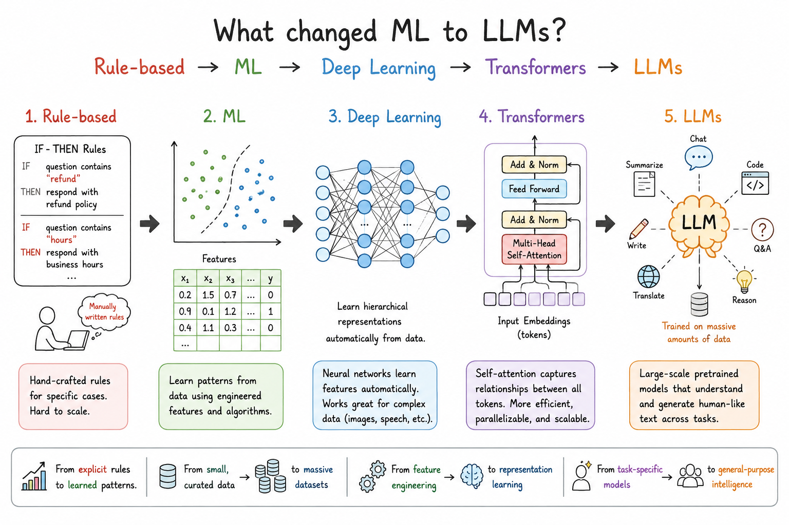
1.1 – Rule Based → ML → Deep Learning → Transformers → LLMs

Slide 6
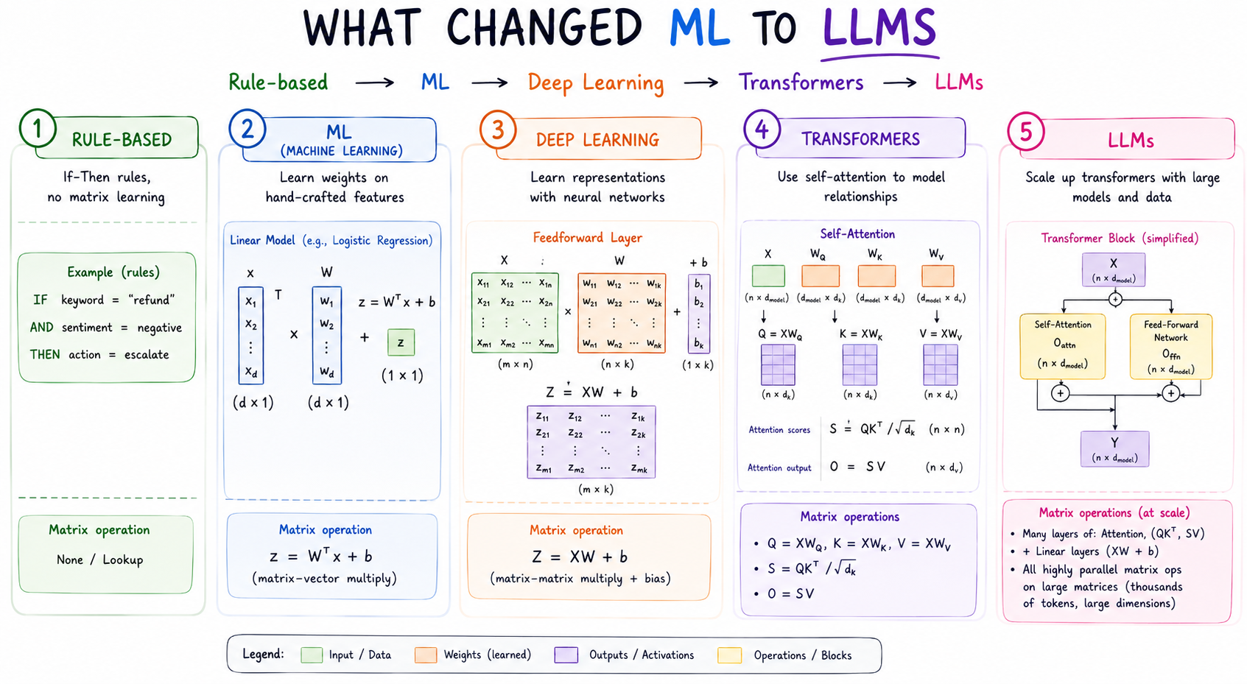
1.1 – Rule Based → ML → Deep Learning → Transformers → LLMs

Slide 7
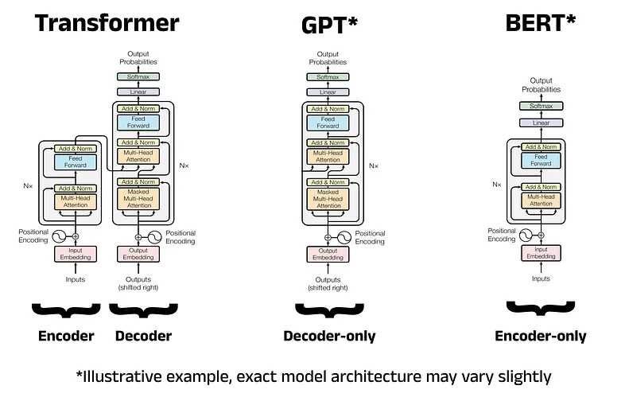
1.1 – Rule Based → ML → Deep Learning → Transformers → LLMs
Several massive everyday services use BERT to power their underlying search, recommendation, and text classification systems.
GPT : Gemini, ChatGPT
Billions of
parameters
BERT: Google Search, Amazon Search. Max 350 million parameters.

Slide 8
1.2 – Why Transformer replaced older NLP
Older models tried to carry information forward step by step ( RNNs, very slow).
Self-attention removed that limitation.
RNNs : Try to learn sequence one by one. (max 1GB model)
Transformers : Learn sequences in parallel, every word attends to every other word in the sentence/context simultaneously. ( consumes RAM, max 1TB model)
Google-Titans (2025) : Mixture of Transformers and RNNs, Can process 2 million context size.

Slide 9
2 – Transformers
Tokenization, Word Embeddings and Positional Embeddings
Self-Attention Mechanism
Context Window
Why LLMs Scale Well

Slide 10

2 – Transformers
A GPT with 7 billion parameters has roughly:
32 layers
hidden size ≈ 4096
attention heads ≈ 32

Slide 11
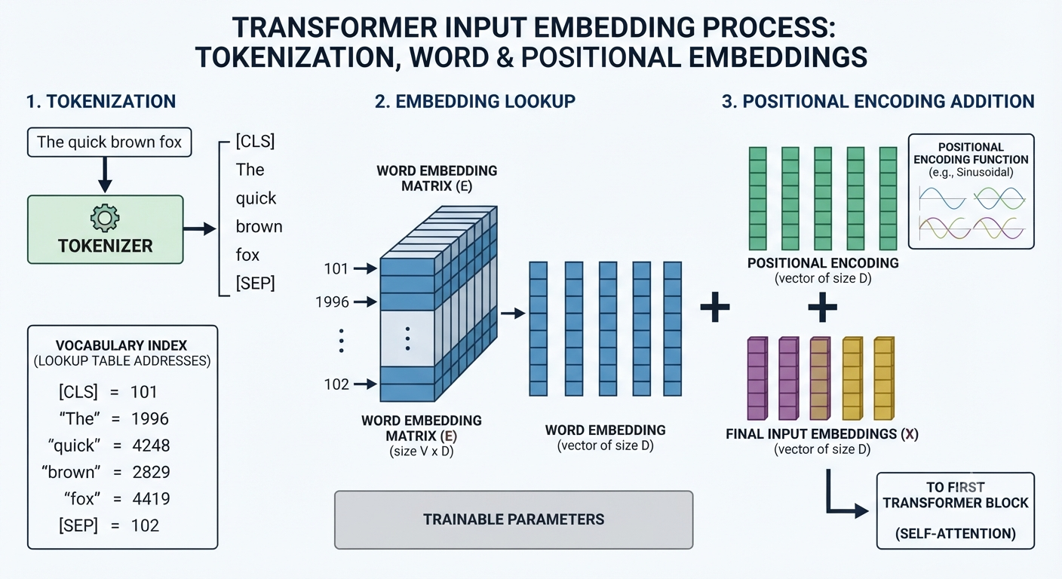
2.1 – Tokenization , Word Embeddings and Positional Embeddings

Slide 12
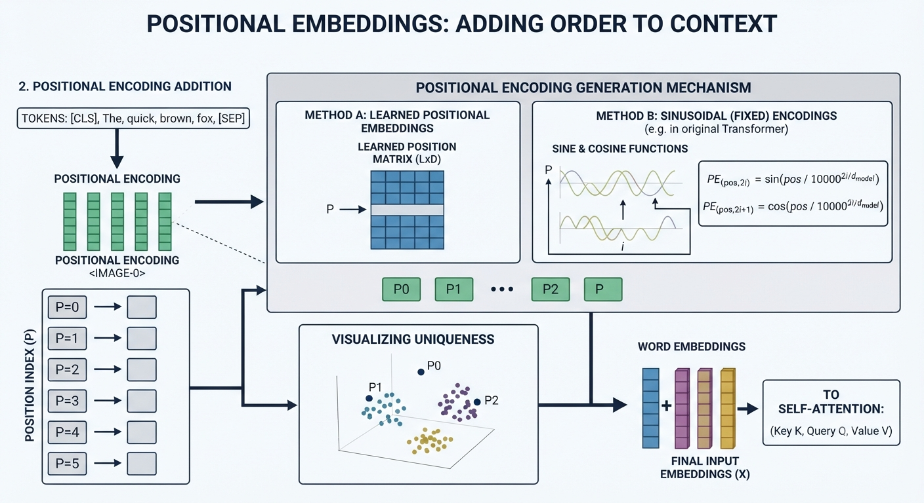
2.1 – Tokenization , Word Embeddings and Positional Embeddings

Slide 13
2.2 – Self-Attention Mechanism
“The dog that chased the cat was fast.” , we can figure out “fast” refers to “dog”. That is exactly what the attention mechanism does for machines — it decides which words to focus on when interpreting meaning and understanding the concepts in large sentences.
In the sentence “I went to Paris last summer, and it was amazing”, the word “it” gets high attention weight linked to “Paris”, not “summer”.

Slide 14
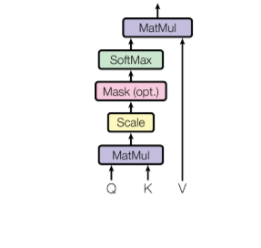
2.2 – Self-Attention Mechanism
Q = X . W^{Q}
K = X . W^{K}
V = X . W^{V}
Query (Q) Vector: Represents the current word’s perspective — what it wants to focus on in the sentence.
Key (K) Vector: Represents how relevant each word is when compared to a query. It is used to compute similarity scores.
Value (V) Vector: Contains the actual word representation, which is weighted based on attention scores to create the final contextualized word representation.
Q
K
V

Slide 15
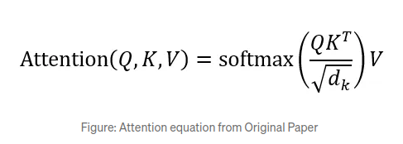
2.2 – Self-Attention Mechanism
Q (Query) = vector that represents what this word is asking
K (Key) = vector representing what each word offers
V (Value) = vector of actual word information
softmax = function that turns scores into probabilities
d= dimension of key and query vector
Q
K
V

Slide 16
2.2 – Self-Attention Mechanism

Slide 17
2.2 – Self-Attention Mechanism

Slide 18
3 – How LLMs Work In Production
1. Pre-training vs Fine Tuning (Supervised Fine Tuning, SFT)
2. Inference vs Training Cost
3. Context Window
4. APIs vs Self-Hosting

Slide 19
4 – Embeddings
1. What are Embeddings?
2. Similarity Search ( Cosine Similarity Concept)
3. Use Cases :
3.1. Semantic Search
3.2. Recommendation System
4. RAG System

Slide 20
5 – Prompting
Prompt Structure :
Role
Context
Constraints
Output Format
Prompt Anti-Patterns

Slide 21
6 – RAG
Why LLMs are not enough
Architecture : Documents → Embeddings → Vector DB → LLM
Tools : FAISS / Pinecone / Weaviate conceptually

Slide 22
Homework-2.1
Problem : Build a Simple Document Q&A System With RAG
Tasks :
Install Ubuntu
Install vLLM
Install a vector DB
Install OpenWebUI
Install opendataloader to import documents to RAG system.
Write a python program that searches user input within the documents and gives the document references along with the results.
Deliver :
1. Installation steps commands
2. Python files

