Slide 1
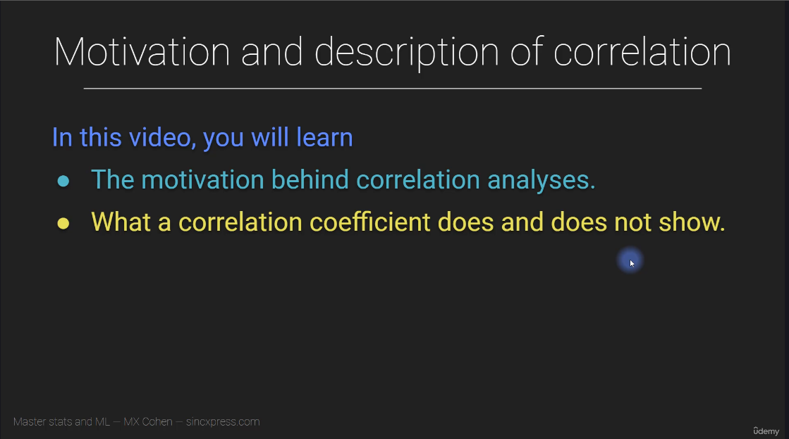

Slide 2
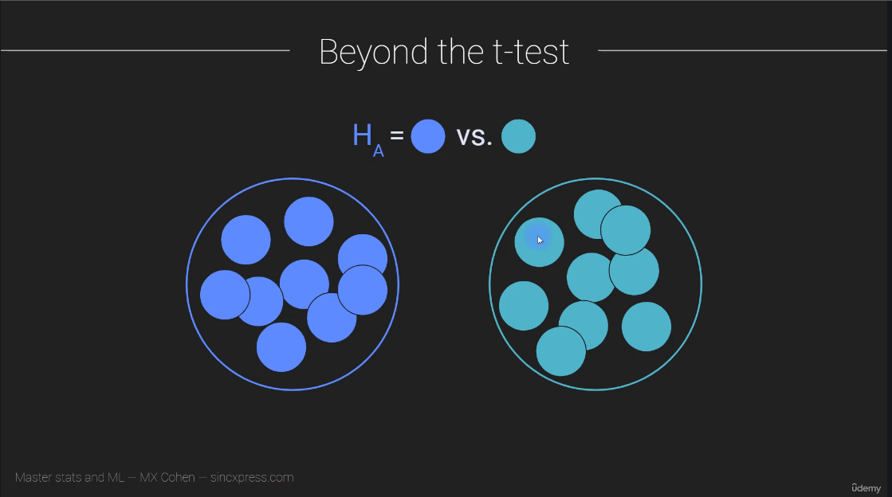

Slide 3
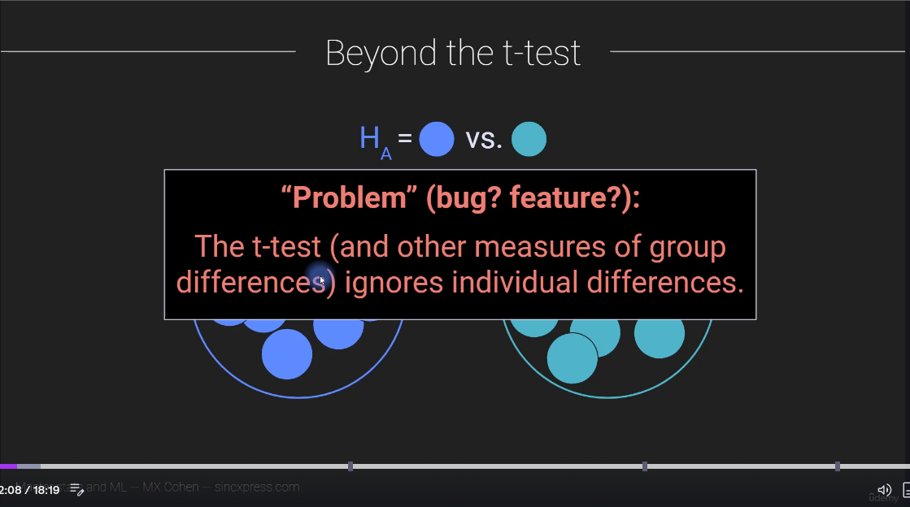

Slide 4
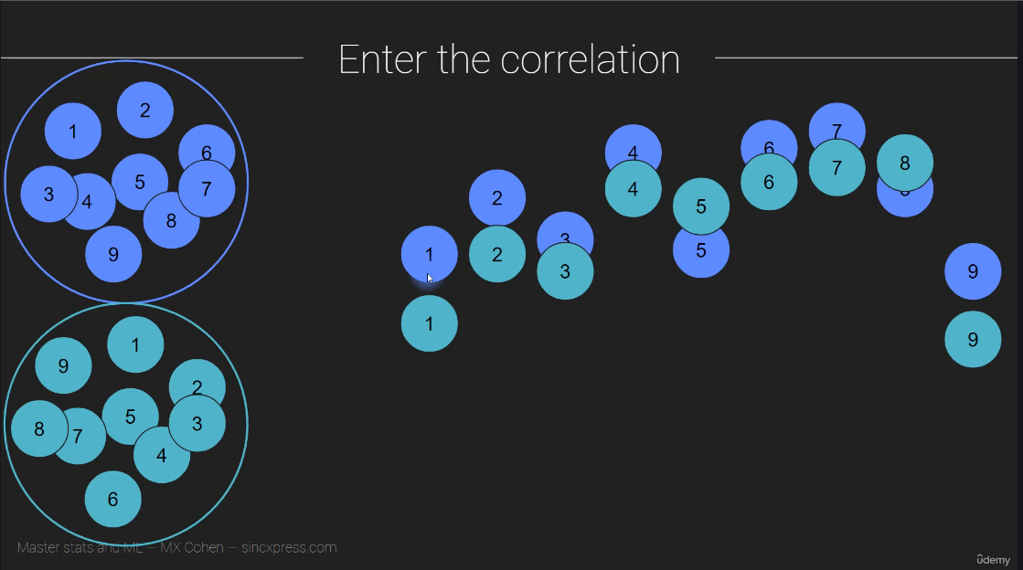

Slide 5
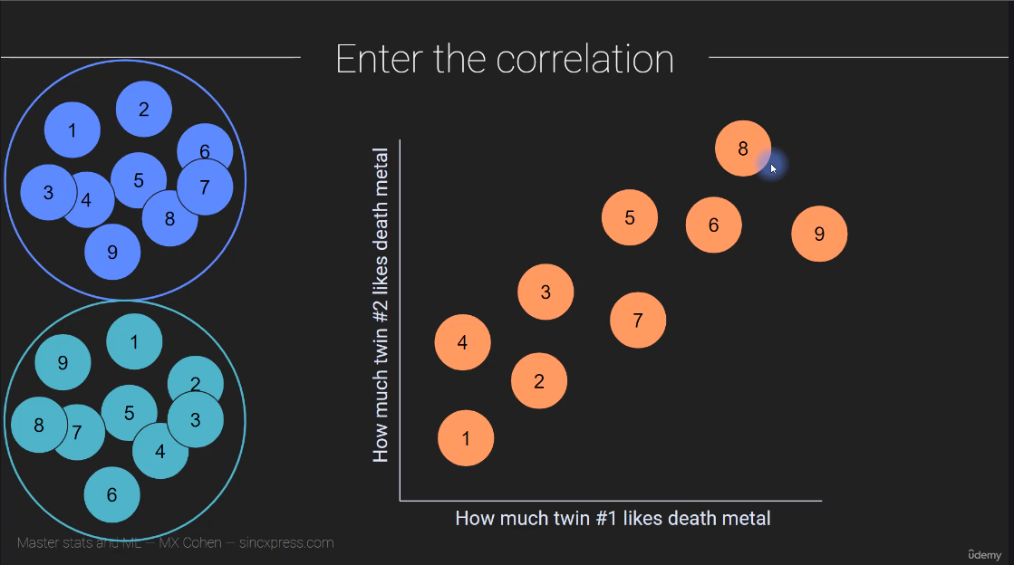

Slide 6
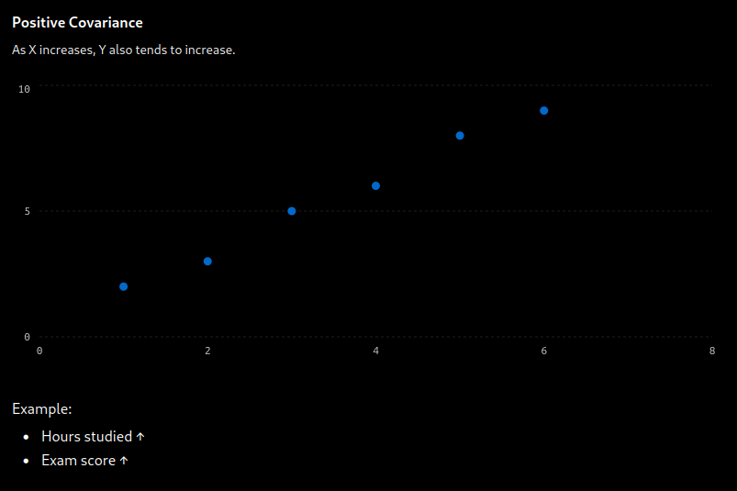

Slide 7
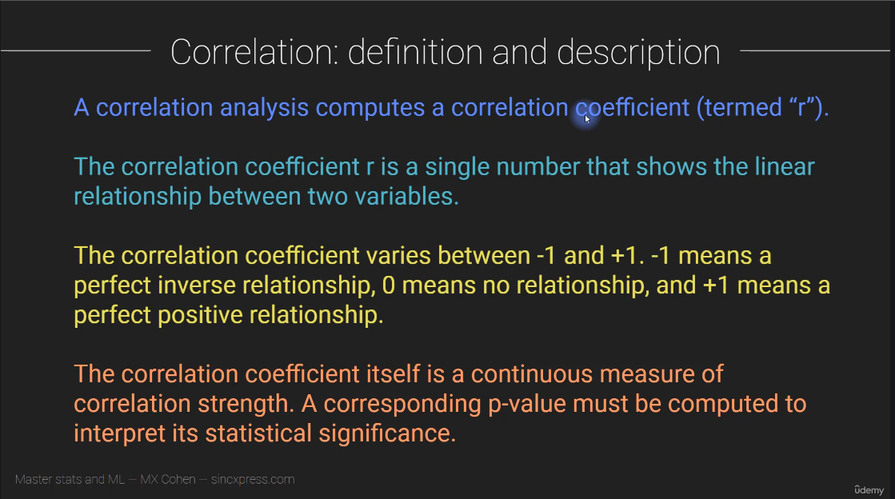

Slide 8
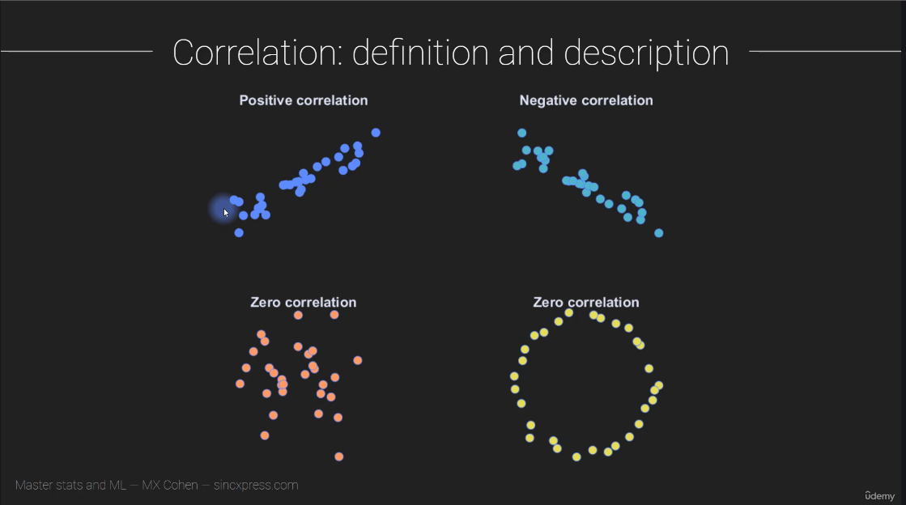

Slide 9
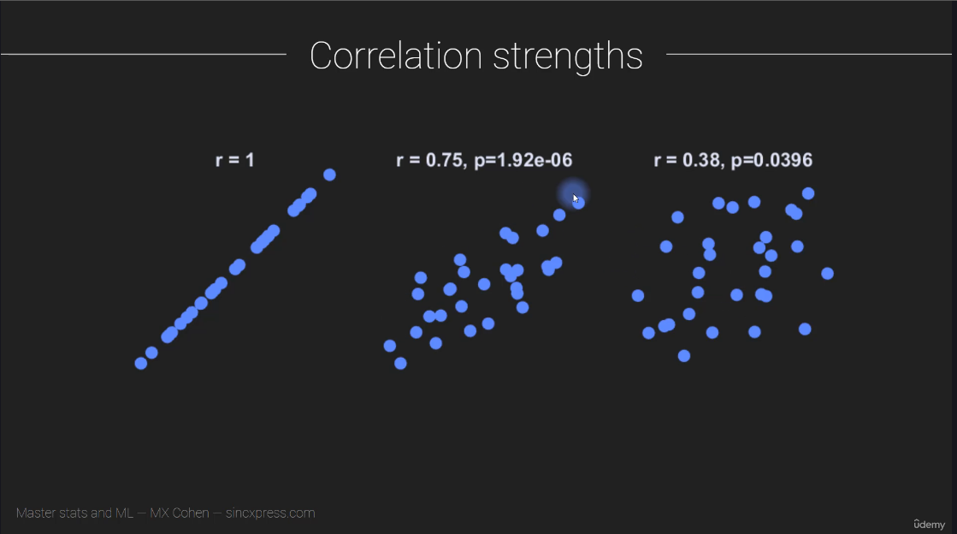

Slide 10
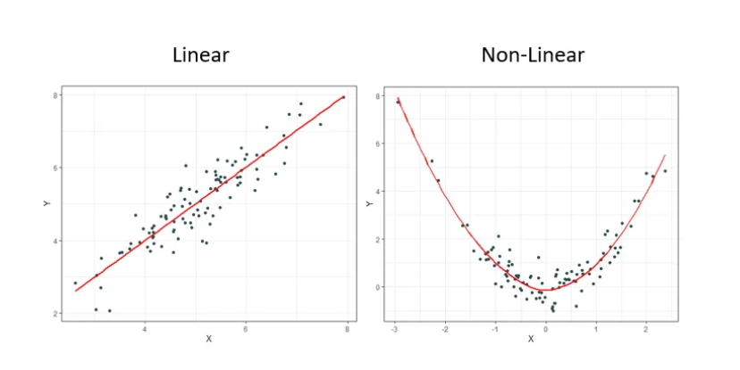
A New Coefficient of Correlation : Tim Sumner (Medium)

Slide 11
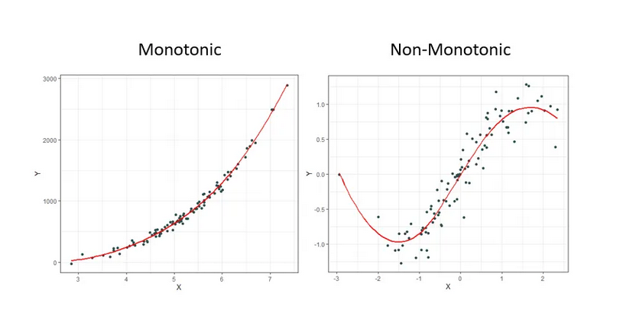
It should come as no surprise to most that it is rare to observe linear relationships in the real world. This is why other measures have been created over the decades such as Spearman’s ρ (rho) and Kendall’s τ (tau) to name a few. These newer measures are much better at identifying monotonic relationships and not just linear ones which makes them more robust since linear relationships are a specific type of monotonic relationship.

Slide 12
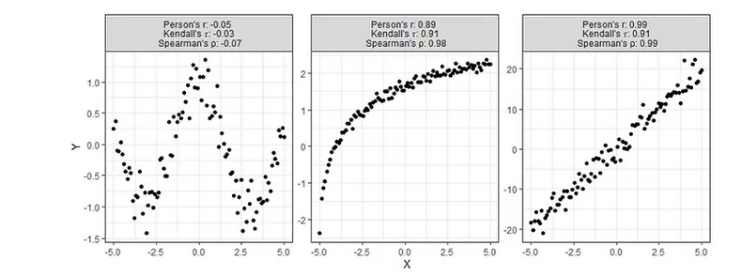
Despite having obvious shortcomings, these correlations are still being used to make many conclusions about all sorts of data. Is there any hope for identifying relationships that are even more complex than the ones shown above? Enter, the new coefficient ξ (pronounced “ksaai”). One last note before moving on, a paper was published in 2022 titled Myths About Linear and Monotonic Associations[2] related to the issue of stating which popular measure of correlation is preferred for which type of data.
[1] S. Chatterjee, A New Coefficient of Correlation (2020), Journal of the American Statistical Association.
[2] E. Heuvel and Z. Zhan, Myths About Linear and Monotonic Associations (2022), The American Statistician.

Slide 13
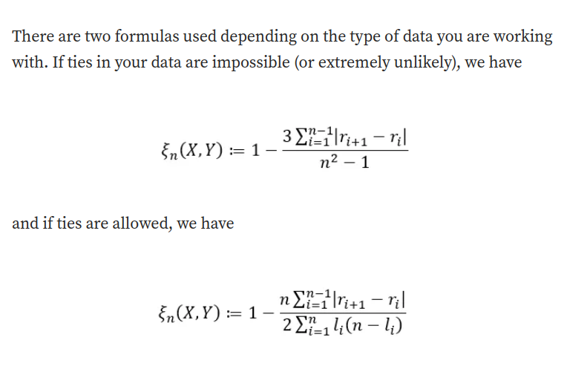

Slide 14
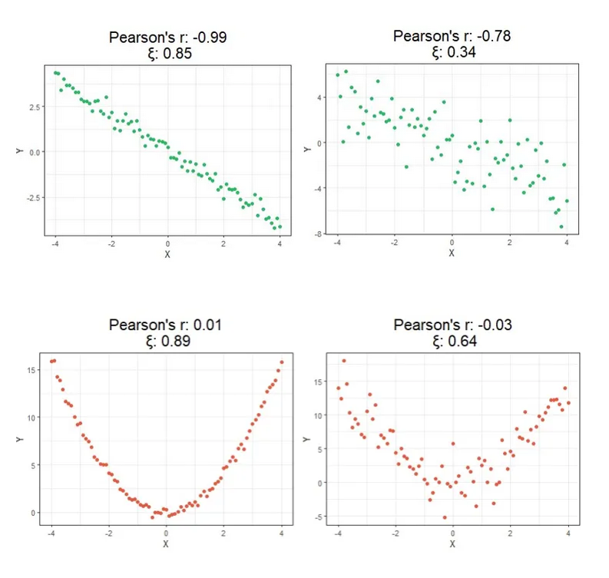

Slide 15
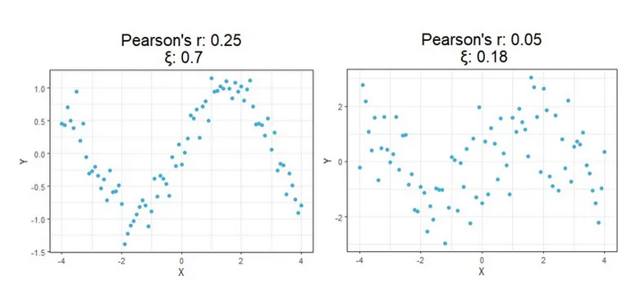

Slide 16
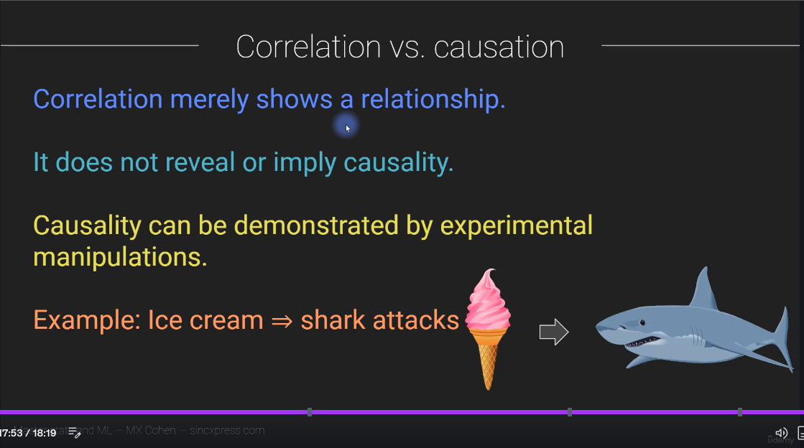

Slide 17
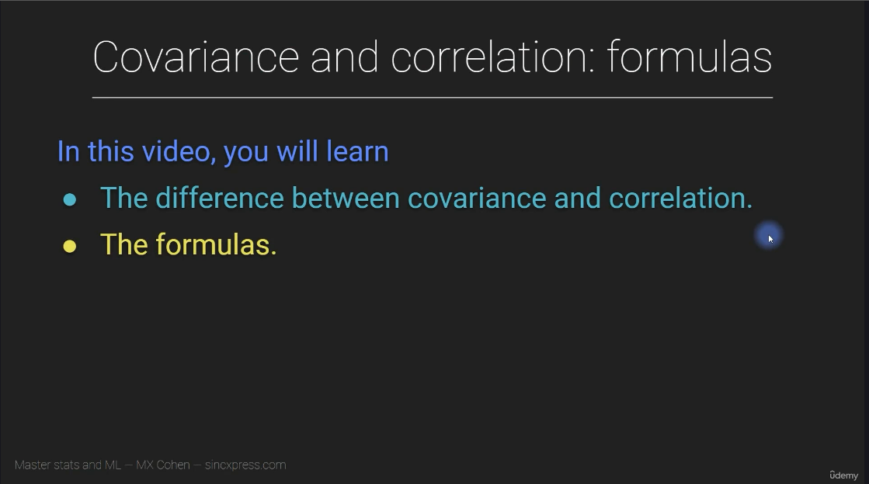

Slide 18
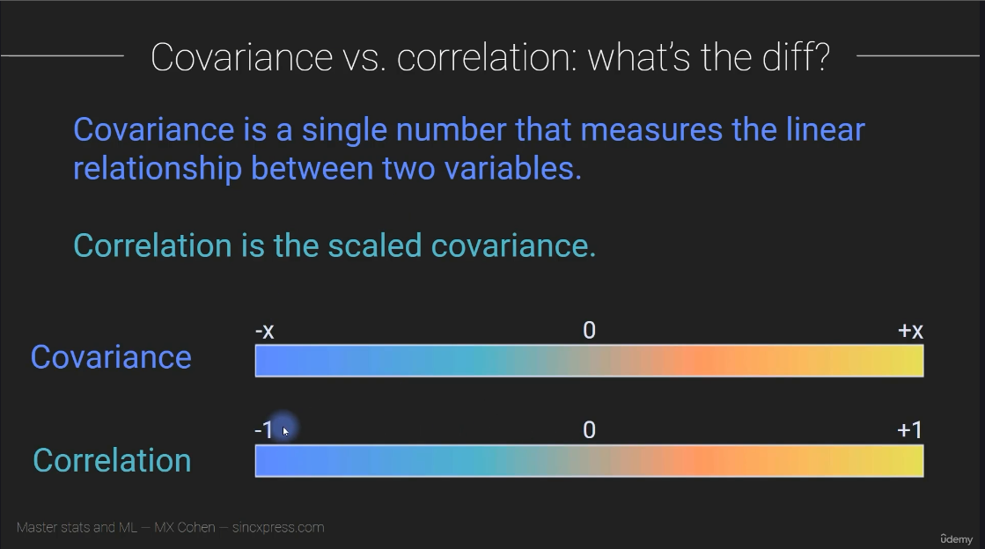

Slide 19
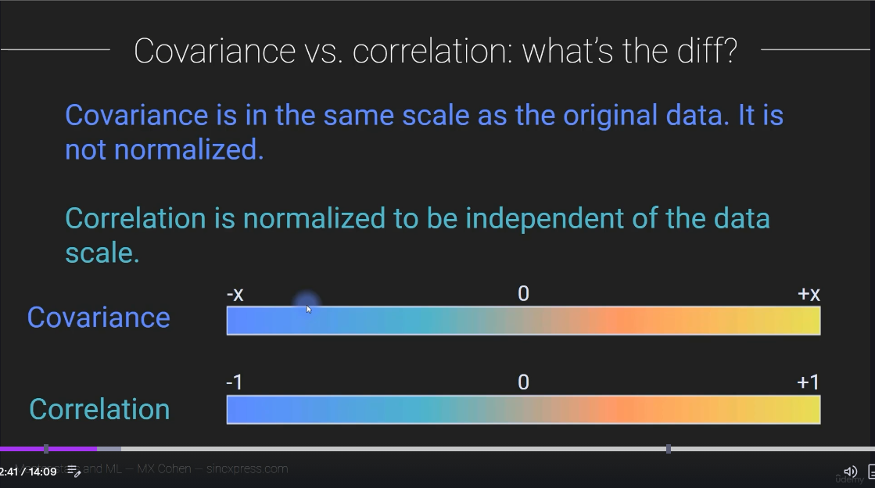

Slide 20
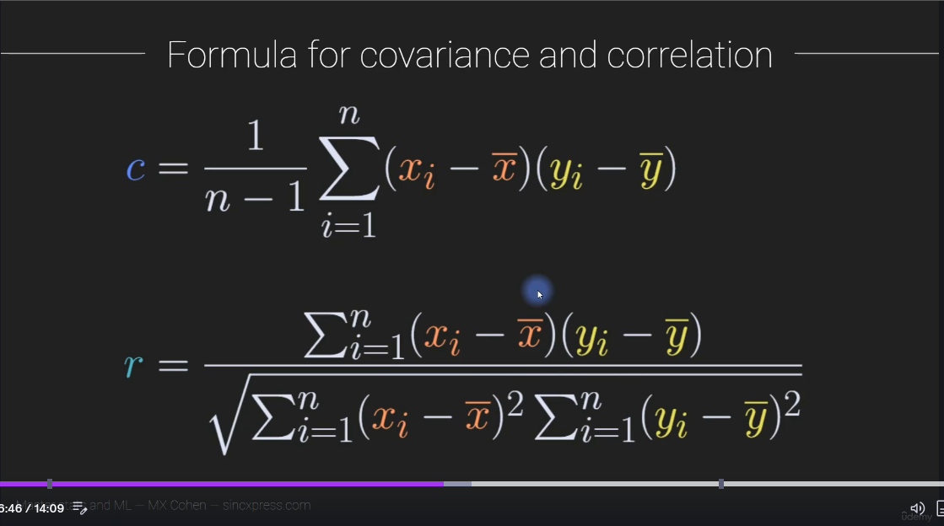
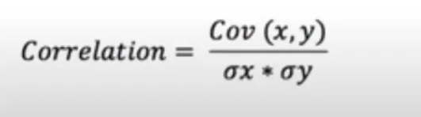

Slide 21
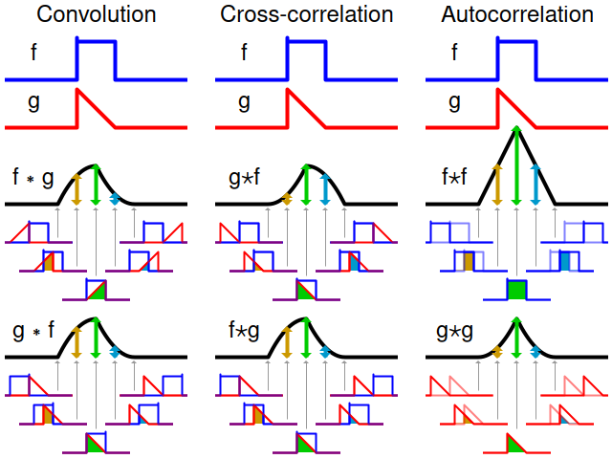

Slide 22
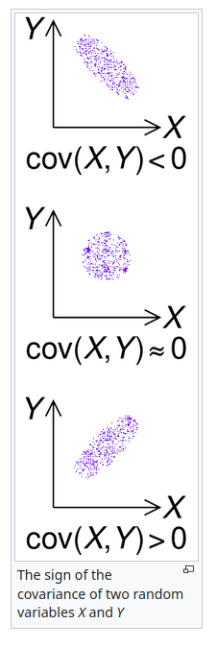
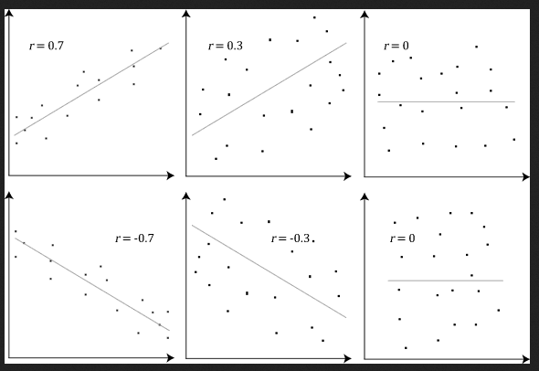

Slide 23
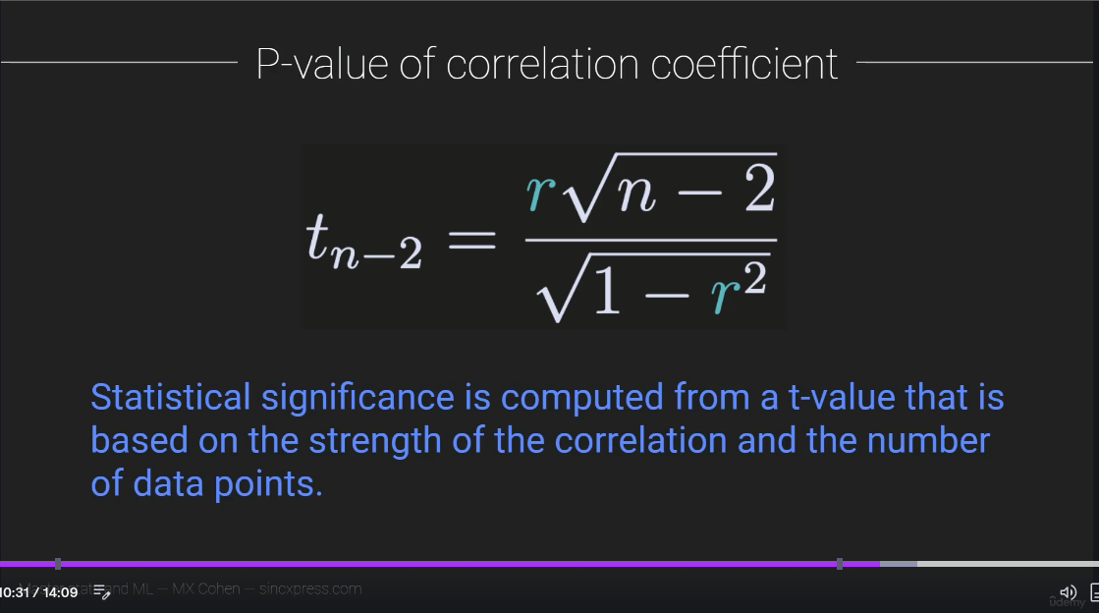

Slide 24
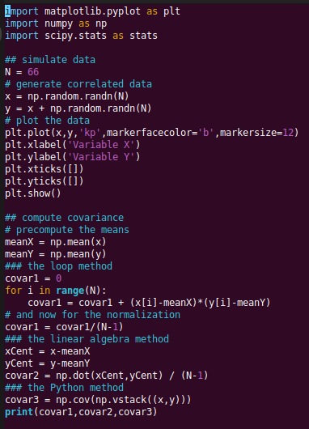
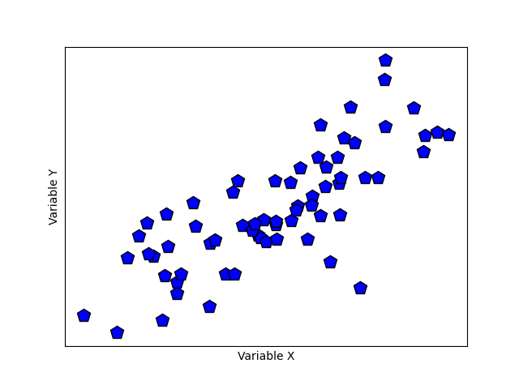
covar1
covar2
covar3

Slide 25
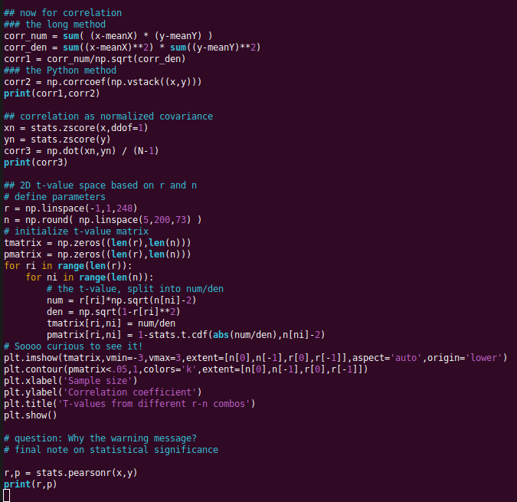

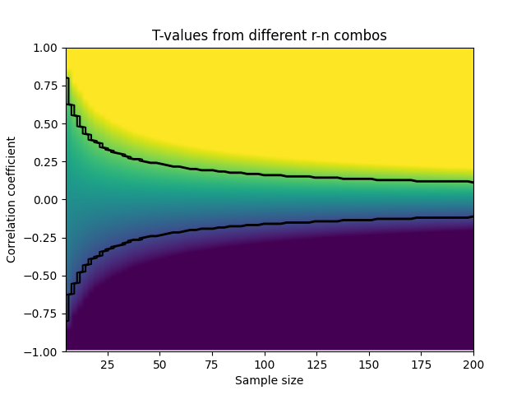


Slide 26
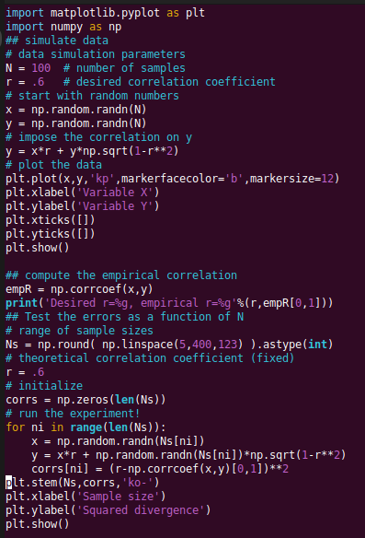
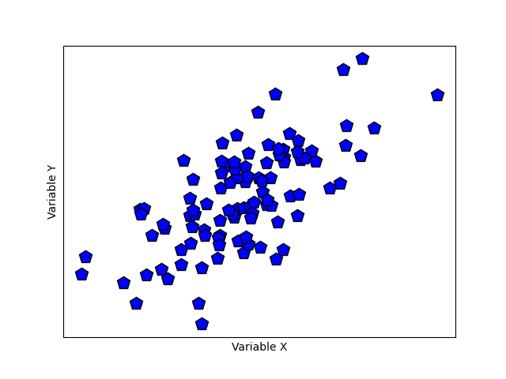
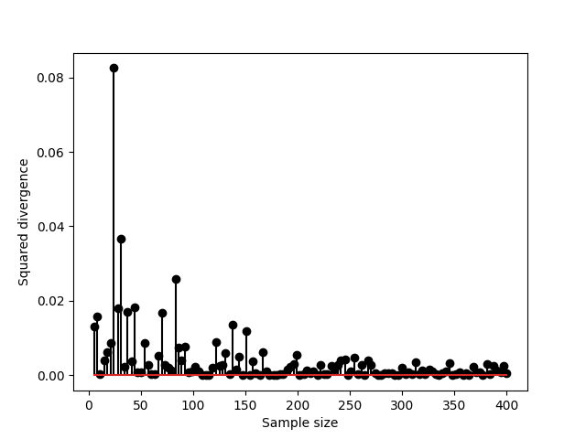
SIMULATE DATA WITH SPECIFIED CORRELATION

Slide 27
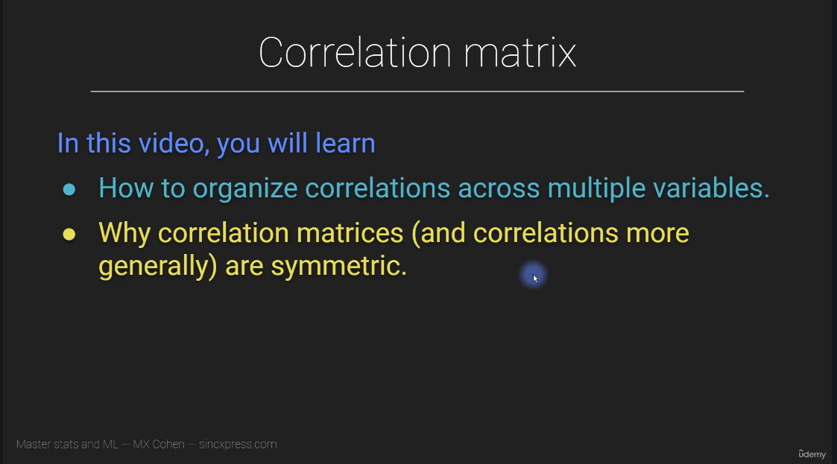

Slide 28
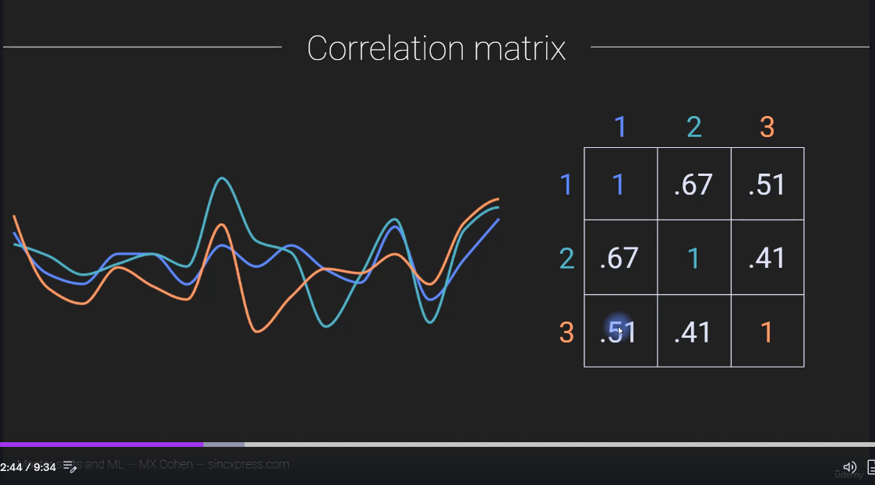

Slide 29
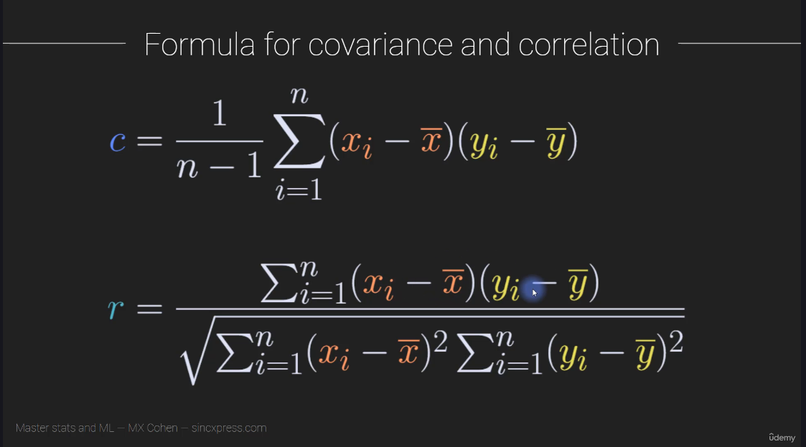

Slide 30
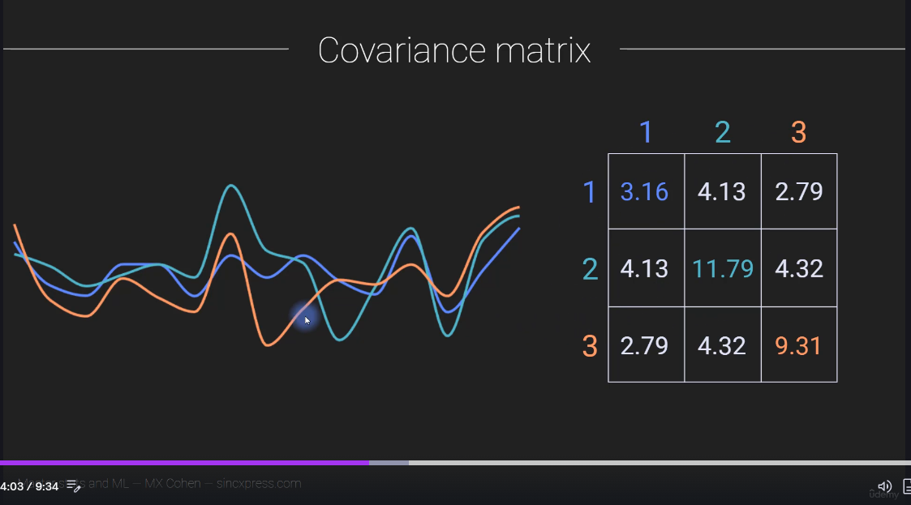

Slide 31
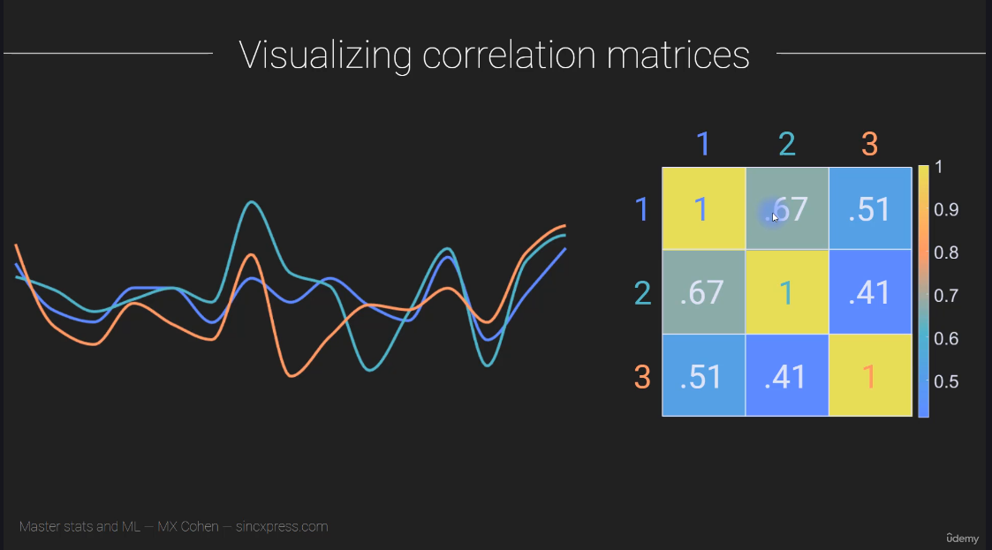

Slide 32
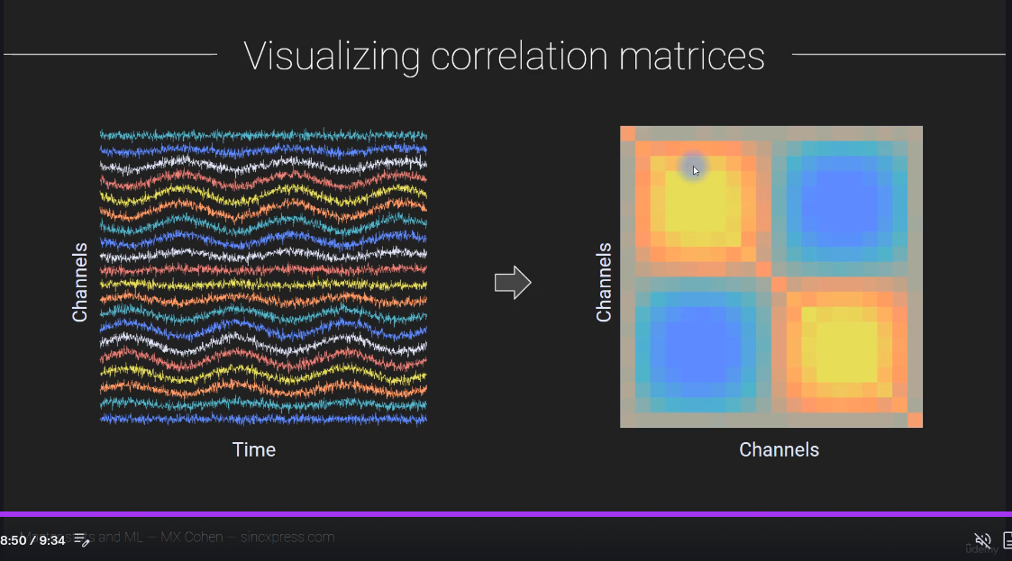

Slide 33
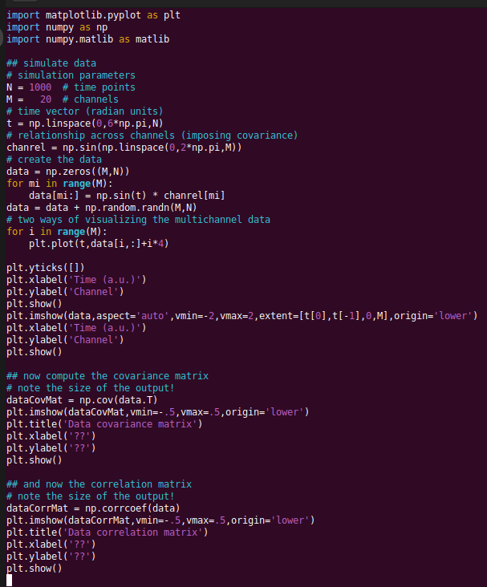
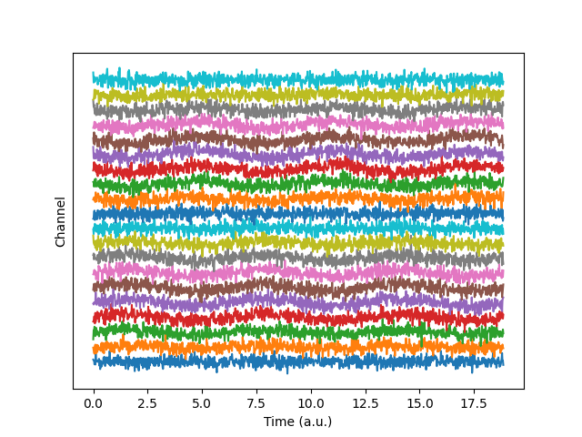
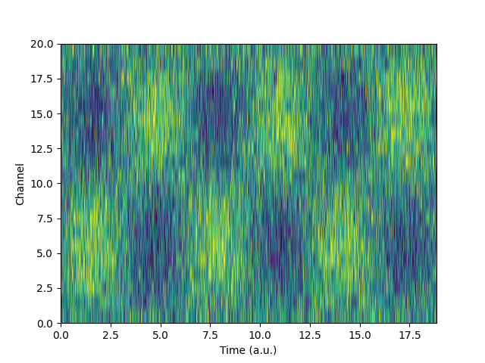
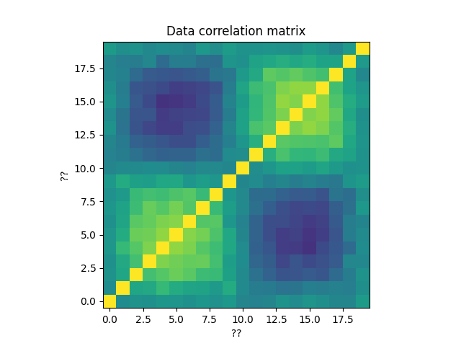
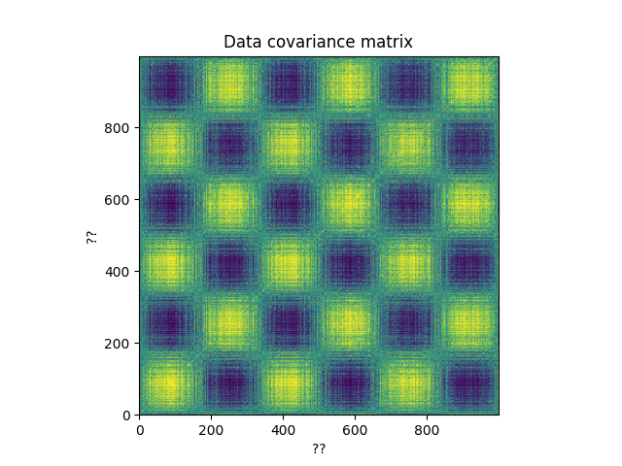

Slide 34
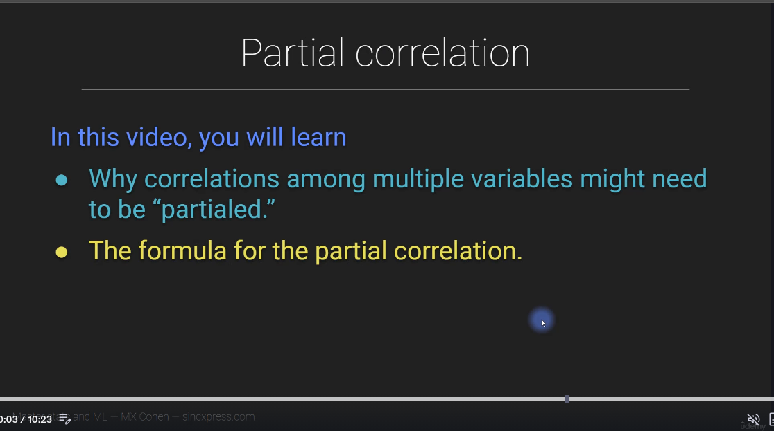

Slide 35
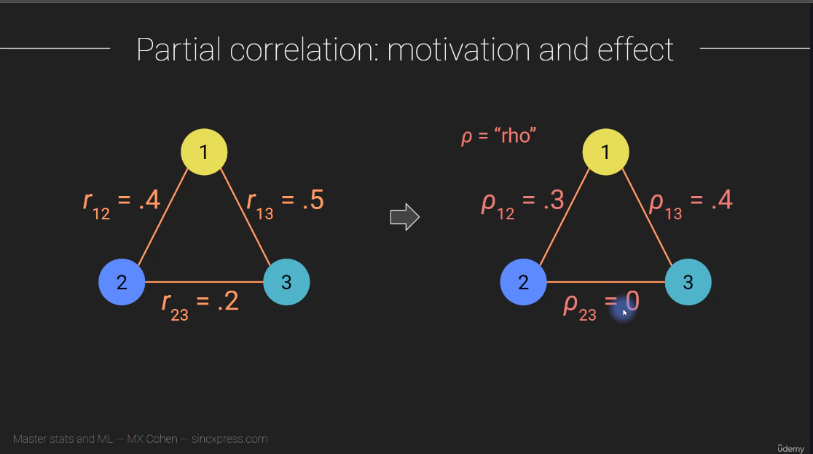
Good weather
Ice cream consumption
Shark attacks

Slide 36
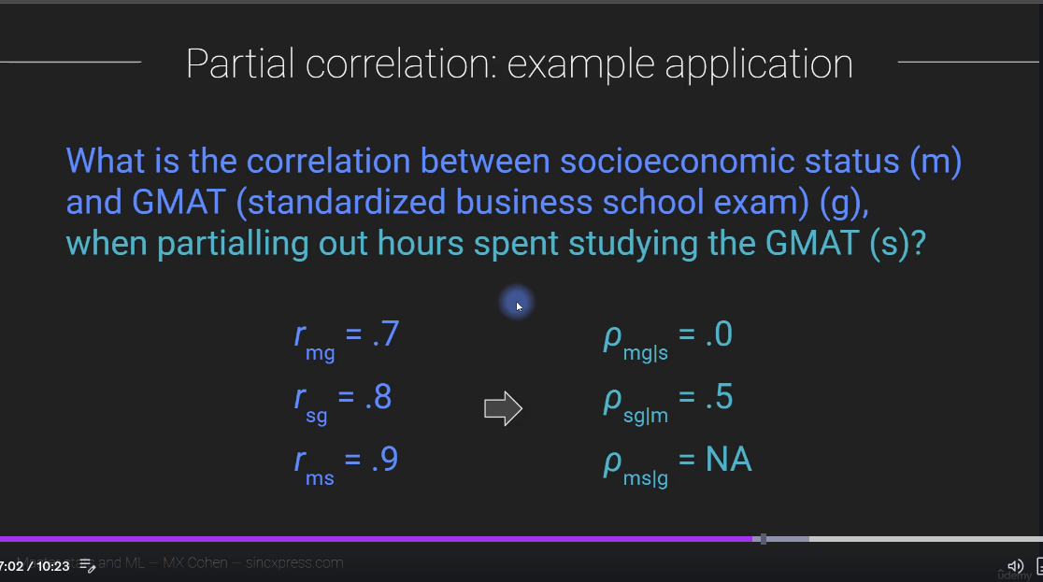

Slide 37
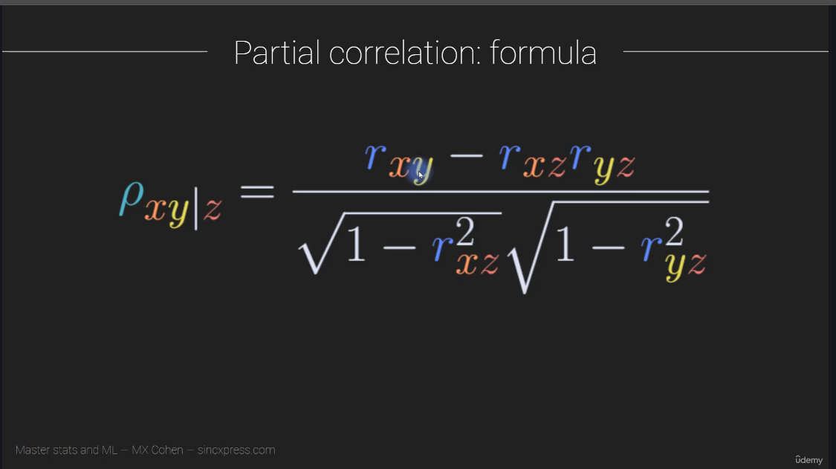

Slide 38
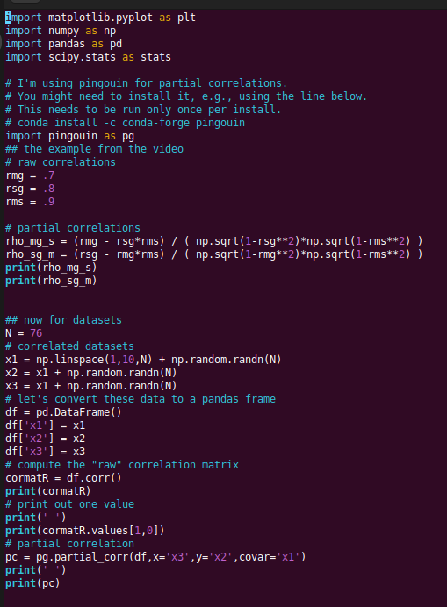
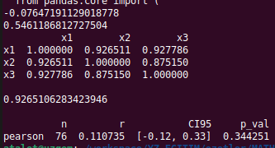

Slide 39
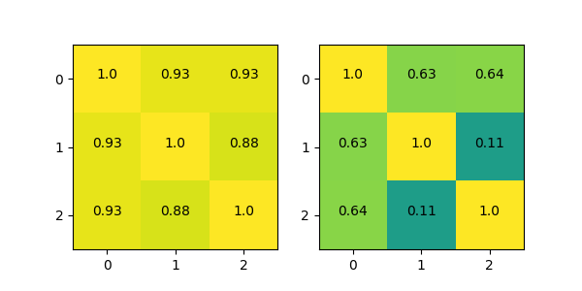


Slide 40


Slide 41


Slide 42


Slide 43


Slide 44


Slide 45


Slide 46


Slide 47


Slide 48


Slide 49





Slide 50


Slide 51


Slide 52


Slide 53


Slide 54





Slide 55



Slide 56


Slide 57


Slide 58




