Slide 1
RUST
INTRODUCTION
Komuta Kontrol ve Savunma Teknolojileri GMY
Deniz Savaş Sistemleri Direktörlüğü
Sistem Yönetimi ve Altyapı Yazılımları Grup Liderliği
HAVELSAN ÖZEL
Notes:
HAVELSAN ÖZEL
HAVELSAN ÖZEL

Slide 2
WHAT IS RUST
RUSTC (compiles to LLVM)
By default generates statically linked binaries
Libraries (CRATES) are generally source code, but may also be *.dlib/*.so
CARGO is the GRADLE of the rust.
BORROWING/LIFETIMES

Slide 3
RUST PROPERTIES
Open Source
No VM (JAVA has VM)
No GC (JAVA and GO has GC)
Compiled (binary)
No manual malloc/free (memory management)
Memory safe, data race free, No seg faults
A compiler that blocks lots of runtime errors
Interface with C/C++ (Can use C libraries within unsafe block (*.so),FFI)
Generics, Polymorphism, Strong and Static Typed
By Mozilla and an Active community
More than 200.000 crates (packages) (https://crates.io), Last year it was 100.000
Rust slows dev-team velocity by 50% (time-to-market) .

Slide 4
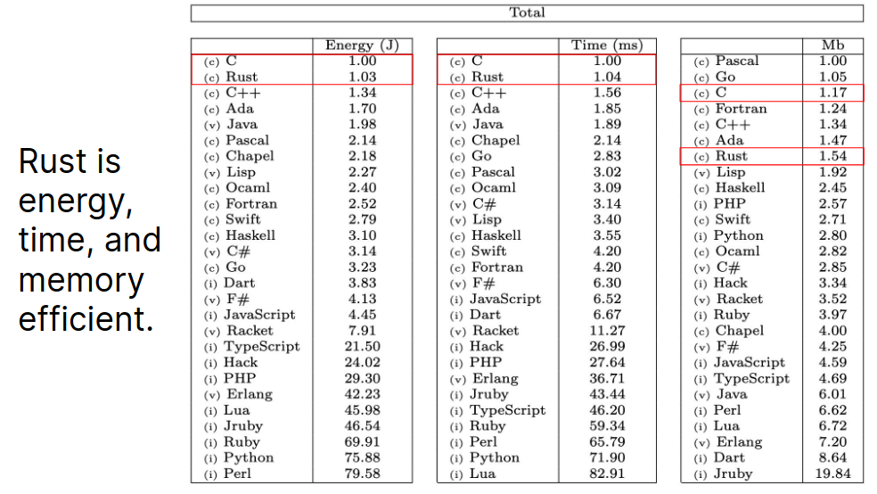
EFFICIENCY (2022 results, Java25 released in 2025)

Slide 5
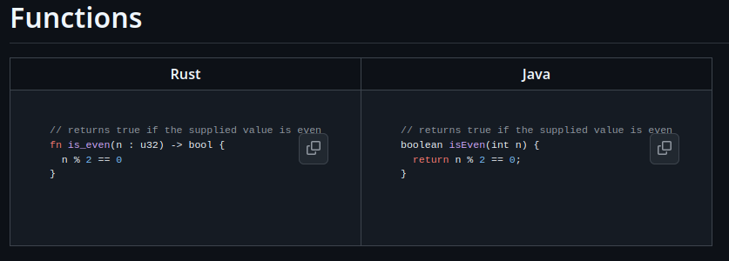
FUNCTIONS

Slide 6
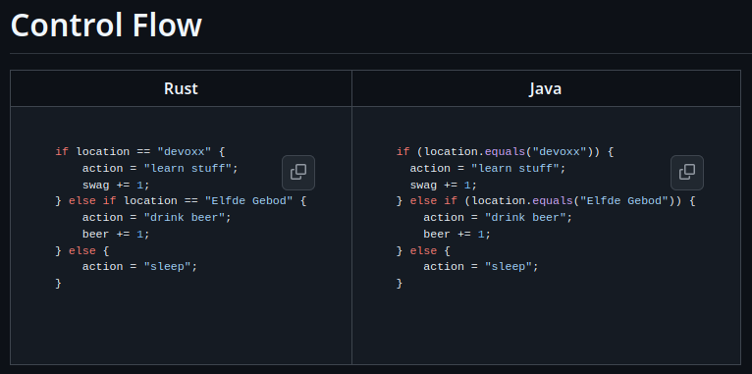
CONTROL FLOW

Slide 7
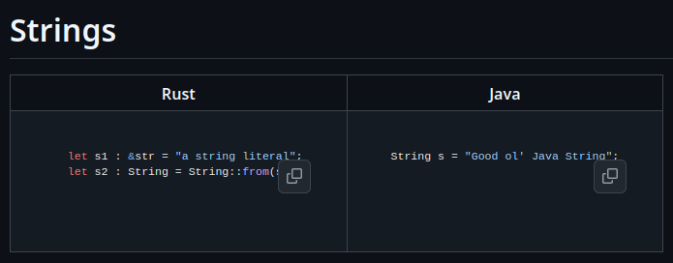
STRINGS

Slide 8
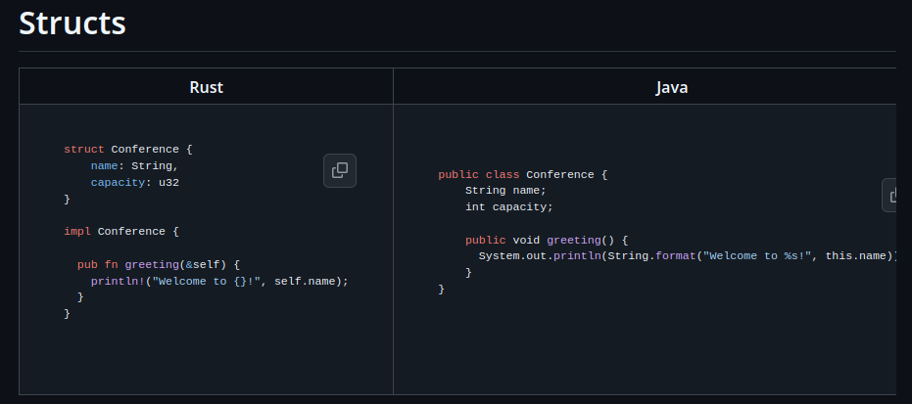
STRUCTS

Slide 9
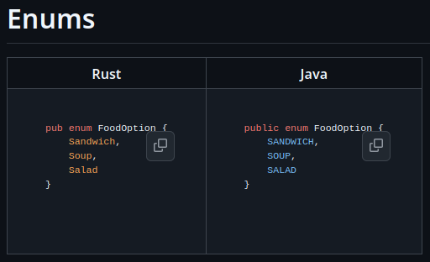
ENUMS

Slide 10
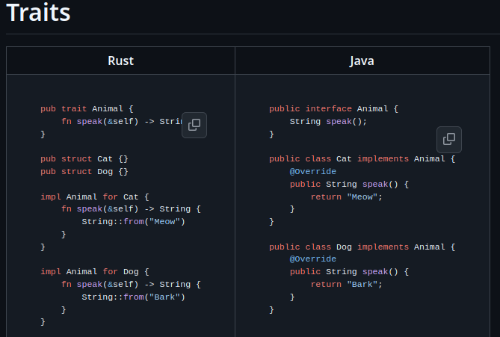
TRAITS / INTERFACES

Slide 11
GENERICS
// Define a function `printer` that takes a generic type `T` which
// must implement trait `Display`.
fn printer<T: Display>(t: T) {
println!("{}", t);
}

Slide 12
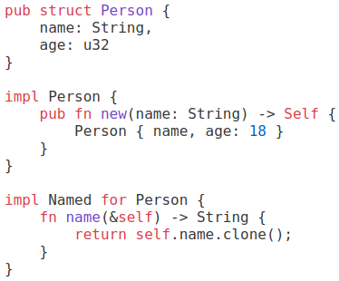
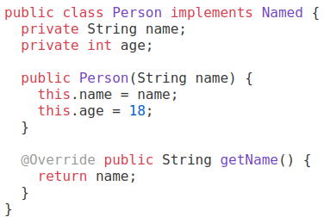
TRAITS / INTERFACES

Slide 13
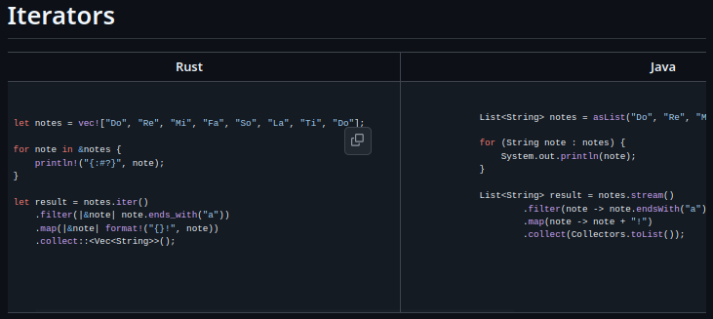
ITERATORS

Slide 14
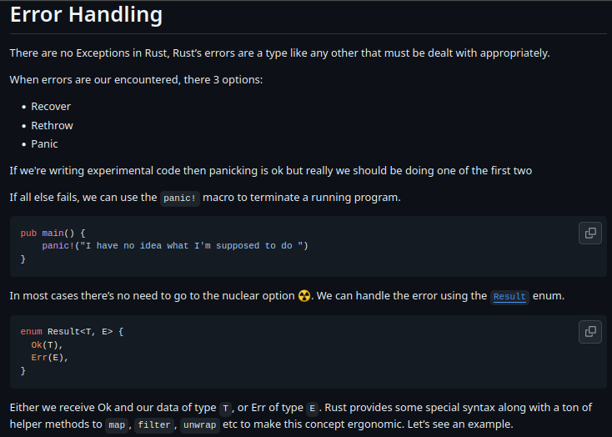
ERROR HANDLING

Slide 15
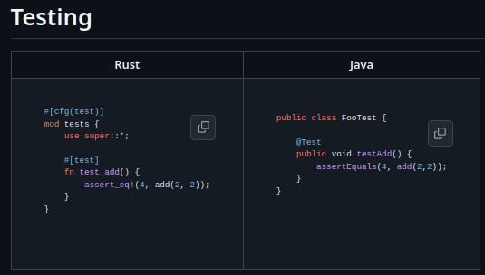
TEST

Slide 16
CARGO
#cargo new project-01-lib --lib
cargo new project-01
ls project-01/*/*
Cargo.toml
src/main.rs
cd project-01
cargo build ## --release
cargo run
cargo test
cargo bench
cargo clippy
cargo package
cargo publish ### publishes to a crate registry
cargo deb
cargo rpm

Slide 17
CARGO.toml
[profile.release]
opt-level = 'z' # Optimize for size.
lto = true # Enable Link Time Optimization
codegen-units = 1 # Reduce number of codegen units to increase optimizations.
panic = 'abort' # Abort on panic
[package]
name = "project-01"
version = "0.1.0"
edition = "2024"
authors = ["mehmetpekmezci <mpekmezci@havelsan.com.tr>"]
description=" Example Project"
categories = ["my-category-01", "segment-01::csci-01::csc-01"]
#build = "custom_build_name.rs"
exclude = ["/ci", "images/", ".*"]
include = ["/src", "COPYRIGHT", "/examples", "!/examples/big_example"]
#publish = ["some-registry-name"]

Slide 18
CARGO.toml
## used while compiling with "cargo build" , "cargo build --release"
[dependencies]
time = "0.1.12"
regex = "1.8.*"
#regex="1.11.*"
log="0.4.*"
## used while compiling with "cargo build --tests", "cargo build --benches", "cargo build --examples"
[dev-dependencies]
serde = "0.9"

Slide 19
https://github.com/havelsan/rust-dev-env
“devops” directory contains sctipts and docs to configure gitea crate/rpm/deb repository,
“books” directory contains pdf versions of
  cheats.rs,
  comprehensive_rust,
  rust_api_guidelines,
  rust_by_example,
  rust_cookbook,
  rust_design_patterns
“cargo_home” directory contains local crates, like downloaded maven repo.
“ide” directory contains scripts and docs to configure vscode with rust plugins
“reference-projects” contains example projects.
“rust” directory contains scripts to configure rust compiler and tool chain.
  Rust directory contains also default rust docs in (https://doc.rust-lang.org/) share/doc/rust/html/index.html

Slide 20
https://github.com/havelsan/rust-dev-env
“reference-projects”
  01.base-code_quality
  01.base-debug
  01.base-logging
  01.base-minimum_sized_executable
  01.base-packaging
  01.base-rust_lib (grpc lib example)
  01.base-rust_project_configurations
  01.base-test : test (unit and integration) example
  01.base-validation (validation framework example)
  01.base-versioning_and_dependency_management (dependencies/dev-dependencies)
  COMMON_MISTAKES.md
  PRINCIPLES.md

Slide 21
C++/RUST/ADA COMPARISON
Case | C++ | MISRA C++ | RUST | RUST + Clippy | Ada/SPARK
Array Out-of-Bounds | ❌ UB (garbage/crash) | ⚠️ Must manually check, enforced by rules & tools | ⚠️ Compiles, runtime panic on invalid index | ⚠️ Warns: “indexing may panic”; still runtime panic if unchecked | ✅ Range checks always; compile-time error if static; SPARK can prove absence
Null Pointer Dereference | ❌ UB | ⚠️ Must check manually | ✅ No null in safe Rust; must use Option | ✅ Warns on suspicious .unwrap() use | ✅ not null access forbids null at compile time; runtime Constraint_Error if violated
Integer Overflow | ❌ UB (signed); silent wrap (unsigned) | ⚠️ Must enforce manually, tools required | ⚠️ Debug = panic, Release = wraps silently | ⚠️ Warns “possible overflow”; still runtime panic/wrap depending on build | ✅ Raises Constraint_Error; in SPARK, provably absent at compile time
Use-after-Free (dangling pointer) | ❌ UB | ⚠️ Discouraged, but still possible | ✅ Prevented by ownership & borrow checker | ✅ Same — Clippy doesn’t allow bypass in safe Rust | ❌ Possible in unsafe Ada (manual Free misuse), but SPARK forbids

Slide 22
C++/RUST/ADA COMPARISON
Case | C++ | MISRA C++ | RUST | RUST + Clippy | Ada/SPARK
Data Race | ❌ UB (nondeterministic) | ⚠️ Must use mutex (rules enforce it) | ✅ Compiler enforces safe sharing (Arc<Mutex>) | ✅ Same; Clippy warns about risky sync patterns | ✅ Protected objects prevent races; SPARK can prove
Concurrency Abstraction | ❌ Raw threads, manual sync | ⚠️ Must wrap in mutex by rules | ✅ Safe concurrency primitives (Arc, Mutex, RwLock) | ✅ Same, plus warnings | ✅ Built-in tasks & protected objects, formally analyzable
Formal Verification | ❌ None | ⚠️ Possible with external analyzers (Polyspace, Astrée) | ⚠️ Limited (some model checking, not core goal) | ⚠️ Linting only, no proofs | ✅ SPARK: full formal verification (no runtime checks needed)

Slide 23
C++/RUST/ADA COMPARISON
SAFETY PYRAMID :
C++ : Maximum Freedom, Maximum Danger
MISRA C++ : Freedom, but heavily restricted by coding rules
Rust: Compiler is your safety net – memory & concurrency safe by design
Ada/SPARK : Safety-first language, provable correctness for critical systems.
Where Ada fails but Rust doesn’t:
Dangling pointers / use-after-free
Data races from shared globals
Unsafe pointer arithmetic
In other words:
Ada: Logical safety + runtime checks + formal proof, but weaker memory safety.
Rust: Memory safety + data race prevention guaranteed at compile time, but leaves logical correctness (like divide by zero, overflow) to runtime panics.

Slide 24
C++/RUST/ADA COMPARISON
C++: trusts the programmer. Compiles code with race conditions → possible silent corruption.
Rust: enforces safe concurrency at compile time. You can’t even compile racy code.
Ada: enforces safe concurrency at runtime and optionally at compile time (SPARK).
Rust: memory safety + thread safety, but still runtime panics in logical edge cases.
Ada: memory safety + thread safety + strong correctness guarantees. Many errors Rust allows until runtime are ruled out earlier in Ada.
SPARK Ada goes further: it can formally prove that division by zero, overflow, or race conditions can never occur at all.

Slide 25
REFERENCES
https://www.codecentric.de/en/knowledge-hub/blog/rust-for-java-developers
https://www.jfokus.se/jfokus17/preso/Introducing-Rust.pdf
https://www.cs.cmu.edu/~aldrich/courses/17-363-fa22/slides/19-rust.pdf
https://google.github.io/comprehensive-rust/
https://doc.rust-lang.org/
https://cheats.rs/
https://rust-lang-nursery.github.io/rust-cookbook/
https://rust-unofficial.github.io/patterns/
https://doc.rust-lang.org/rust-by-example/
https://docs.rs/
https://doc.rust-lang.org/book/
https://doc.rust-lang.org/cargo/
https://rust-unofficial.github.io/patterns/
https://github.com/mre/idiomatic-rust
https://www.mayhem.security/blog/best-practices-for-secure-programming-in-rust

Slide 26
REFERENCES
https://cratecode.com/info/rust-traits-best-practices
https://web.mit.edu/rust-lang_v1.25/arch/amd64_ubuntu1404/share/doc/rust/html/book/first-edition/testing.html
https://zerotomastery.io/blog/complete-guide-to-testing-code-in-rust/
https://doc.rust-lang.org/book/ch11-01-writing-tests.html
https://github.com/mozilla/rust-code-analysis
https://github.com/vaaaaanquish/Awesome-Rust-MachineLearning
https://github.com/Rust-GPU/Rust-CUDA
https://github.com/jprochazk/garde

Slide 27
Soru ve Cevaplar
Teşekkürler
www.havelsan.com.tr
© 2020 HAVELSAN All rights reserved.
Komuta Kontrol ve Savunma Teknolojileri GMY
Deniz Savaş Sistemleri Direktörlüğü
Sistem Yönetimi ve Altyapı Yazılımları Grup Liderliği
HAVELSAN ÖZEL
Notes:
HAVELSAN ÖZEL
HAVELSAN ÖZEL

