Slide 1
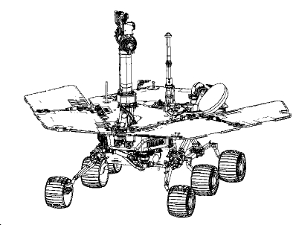


anytime
DC
RCAT property
RC
GC
S0
S1
S2
true
S3
S3
Buchi automaton
DC
S0
RC
S1
GC
S2
S0
S1
S2
true
!GC && !DC
RMOR
RC
RR
GR
DC
Execution trace
S2
Feed back

