Slide 1
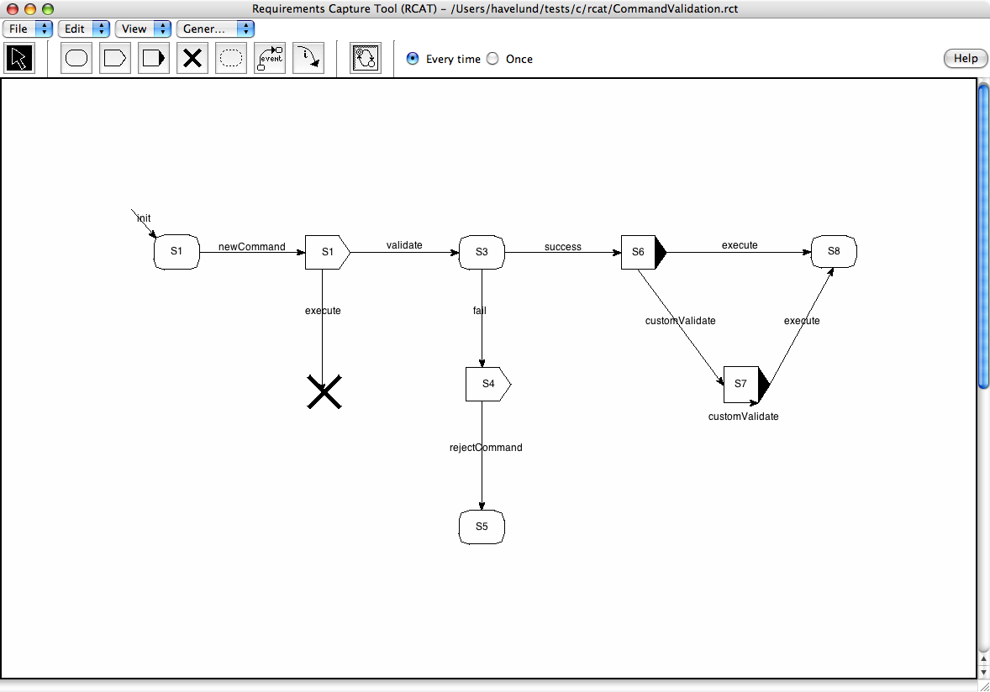
R
S
M
specification
monitor
void submit(int e){
switch state of{
S3:
if(e == fail){
state = S4;
}
…
}
}
state S3{
when fail -> s4;
…
}
fail = call(F29)
RCAT
connection
RMOR
C^{new}
instrumented
C program
void F29(int m){
…
}
C program
void F29(int m){
…
}
…
submit(fail);
F29(2);
…
…
F29(2);
…
C
C^{ins}

