Slide 1
Over paid and under delivered: do nfl quarterbacks put money where their mouth’s at?
Brought to you by kayla rivera, hazel vergaralope, brian Atchley, and Andrew kim
Notes:
Other title ideas: NFL QB ROI, putting money where their mouth is ;

Slide 2
What is qbr
ESPN's Total Quarterback Rating is a proprietary statistic that was introduced in 2011 and is designed to measure the total effectiveness and performance of a quarterback.
The metric takes into account all of a quarterback's contribution to a game, including passing, rushing, sacks, penalties, touchdowns, and turnovers.
Moreover, each play is weighted based on its "difficulty", the context of the game, and the strength of the opposing defense.
This means that statistics in garbage time of a blowout game hold less merit than statistics in a close game.
Also, a quarterback who throws for four touchdowns and 300 yards against a strong defense will have a higher QBR than a quarterback who has the same stat line against the worst defense in the NFL.
Notes:
"ESPN Introduces The Total Quarterback Rating". ESPN Press Room U.S. August 2, 2011. Retrieved November 12, 2020.

Slide 3
passer rating (aka passing efficiency in college football)
A measure of the performance of passers, primarily quarterbacks, in gridiron football.¹
Calculated using a player's passing attempts, completions, yards, touchdowns, and interceptions.
Passer rating in the NFL is on a scale from 0 to 158.3.
Passing efficiency in college football is on a scale from −731.6 to 1261.6.
Since 1973, passer rating has been the official formula used by the NFL to determine its passing leader.²
Passer rating is sometimes colloquially referred to as “quarterback rating” or “QB rating”, however the statistic applies only to passing (not to other contributions by a quarterback) and applies to any player at any position who throws a forward pass, not just to quarterbacks.
Notes:
"NFL.com – NFL Quarterback Rating Formula". NFL.com. Archived from the original on August 14, 2011. Retrieved August 6, 2011.
"NFL's Passer Rating". Pro Football Hall of Fame Official Site. NFL. January 1, 2005. Archived from the original on October 3, 2015. Retrieved December 27, 2016.

Slide 4
limitations
Intangible assets
Leadership
more?
Effect of experience
Injuries
Indirect added value
Stadium attendance
Jersey sales

Slide 5
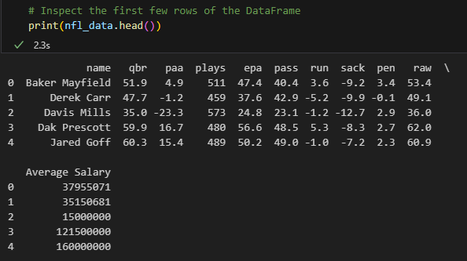
nfl_data.head()

Slide 6
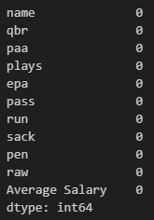
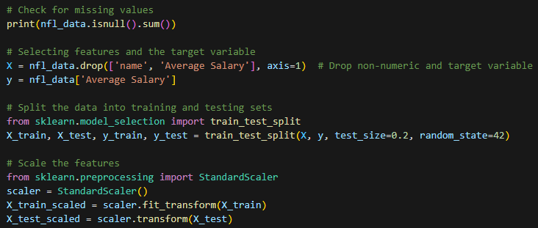
Standard Scaler

Slide 7
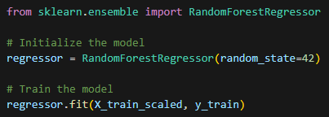
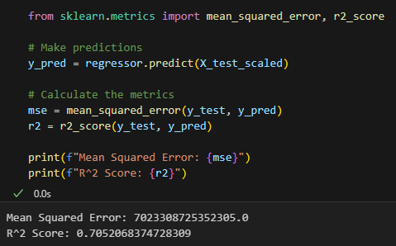
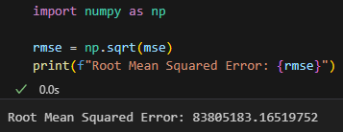
Random forest regressor

Slide 8
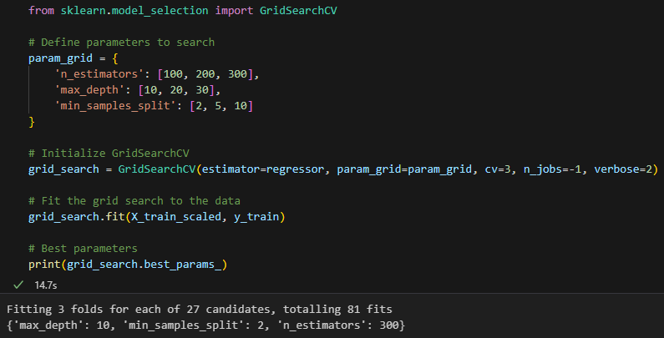
Random forest regressor (cont., hyperparameter tuning)

Slide 9
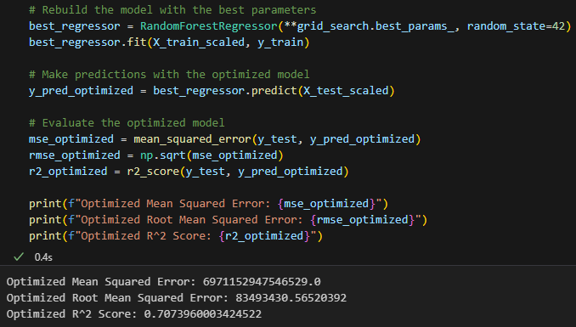
Random forest regressor (cont., hyperparameter tuning)

Slide 10
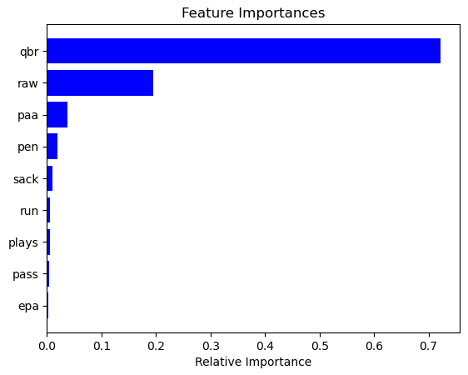
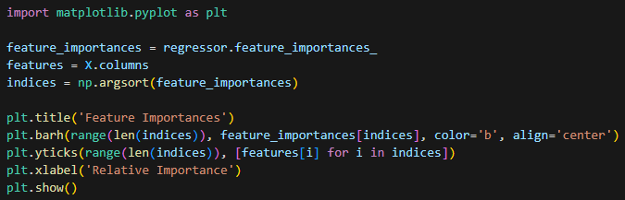
Feature imporantances

Slide 11
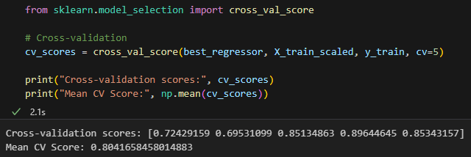
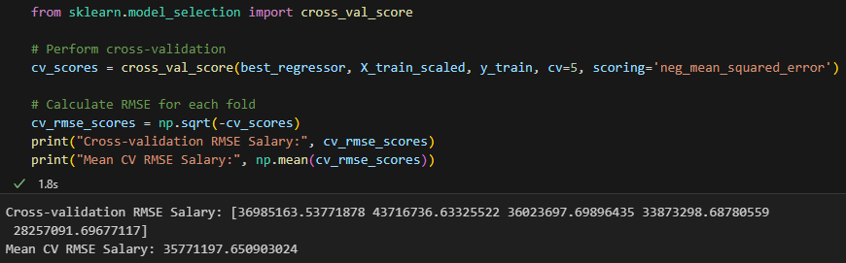
Cross validation

Slide 12
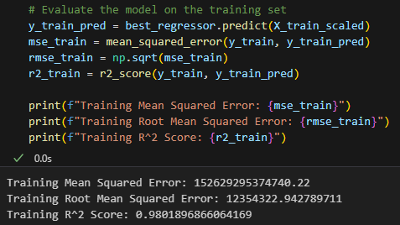
Evaluating the model using trained data

Slide 13
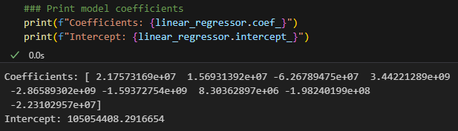
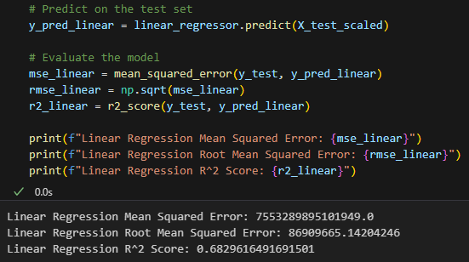
Linear regression

Slide 14
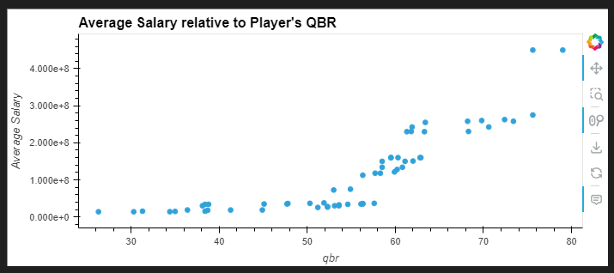
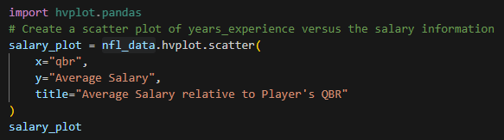
Linear regression charts

Slide 15
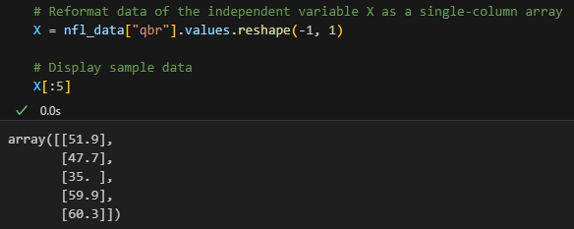




Actual analysis part 1

Slide 16
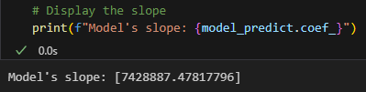
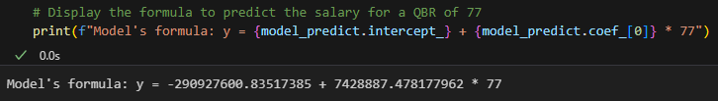



Actual analysis part 2

Slide 17

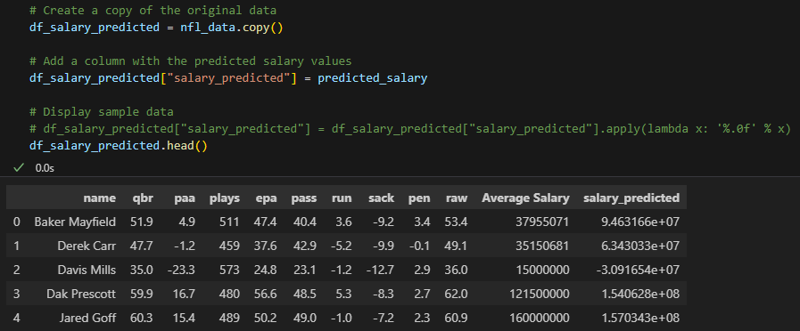
Overlaying the two graphs part 1

Slide 18
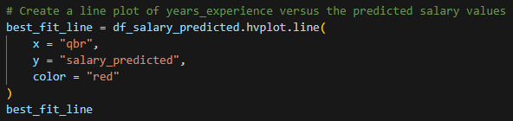
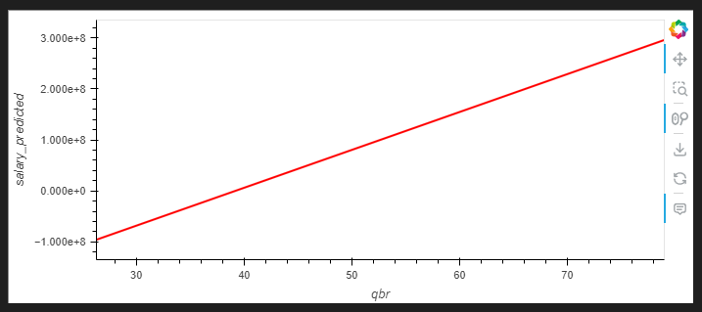
Overlaying the two graphs part 2

Slide 19
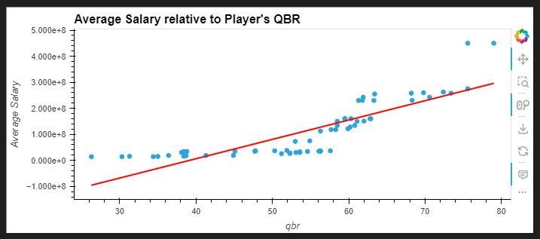

Overlaying the two graphs part 3

Slide 20
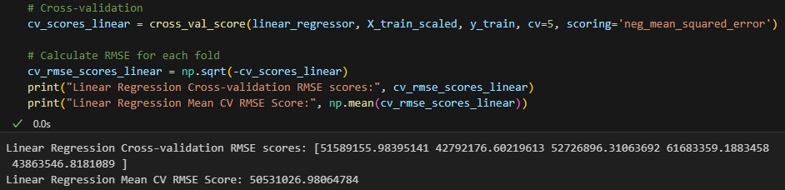
Cross validation and rmse, relocate?

Slide 23
End of slide, add more below!!

Slide 24
The end
Questions??

Slide 25


Slide 26


Slide 27


Slide 28


