Slide 1
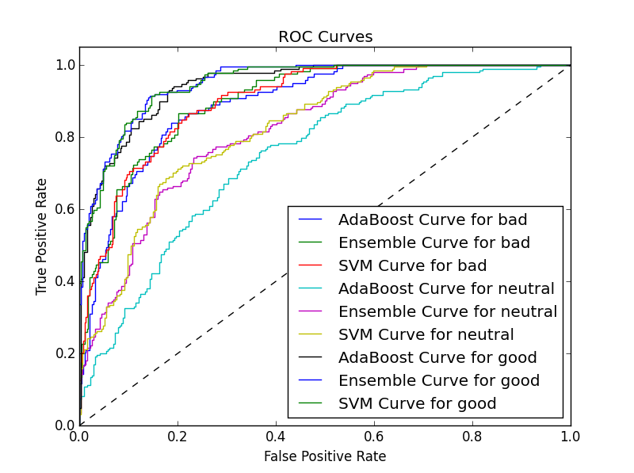
Multi-Class Movie Review Analysis
Movie Reviews taken from the 3-class Scale Rating Cornell Movie Dataset
Reviews shuffled before train-test split to make the learning author independent
Features Vectors derived from Positive/Negative Words taking into Account their POS tags derive using Stanford POS tagger
Trained and performance measured on Logistic Regression, Linear Regression, Naïve Bayes, AdaBoost, SVM, Ensemble
ROC Curve comparing Ensemble, AdaBoost and SVM

Slide 2
End to End Design of the System
Final System consists of Ensemble of SVM, SoftMax and Naïve Bayes
Soft-Voting performed to predict the final labels
Gains a cross-validated accuracy of 0.7031 on train set, beating SVM standing second at 0.6942

