Slide 1

Murder Analysis in India

Slide 2
Breakdown
Counts Data
Motives
Socio-economic factors

Slide 3
Counts Data Analysis (2015-2021)

Slide 4
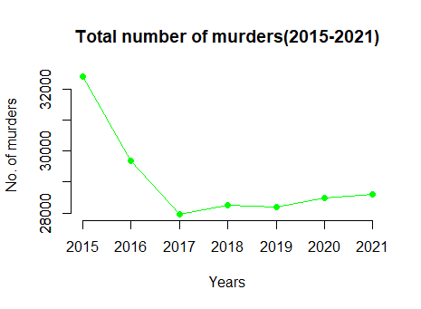
Key observations: 1. Comes down from a high point 2. Reaches minimum at 2017 3. Then starts to gradually increase.
Murder counts (2015-2021)

Slide 5
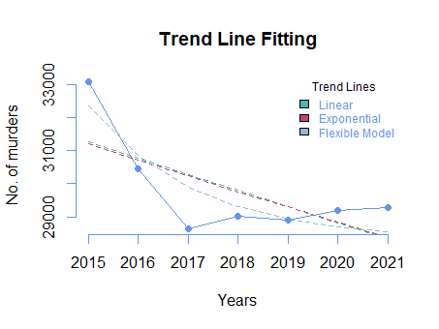
1. Linear Trend : Shows a decreasing trend over time 2. Exponential : Shows a decreasing trend as well 3. Flexible Model : Shows decreasing trend as well
Fitting Trend line

Slide 6
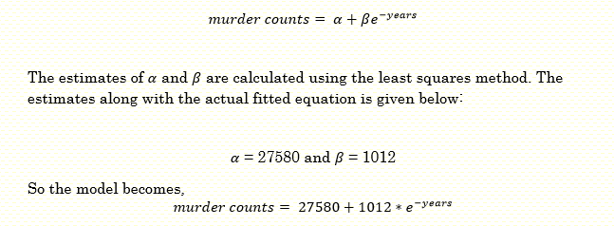
The Flexible Model
* here the year variable is standardised

Slide 7
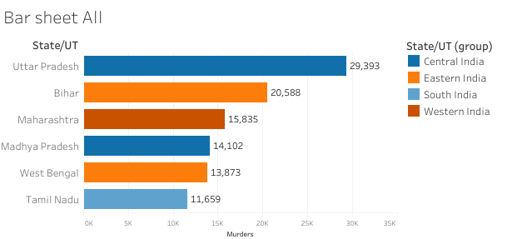
Spatial Analysis
Top 6 states in terms of total murders (2015-2021)

Slide 8
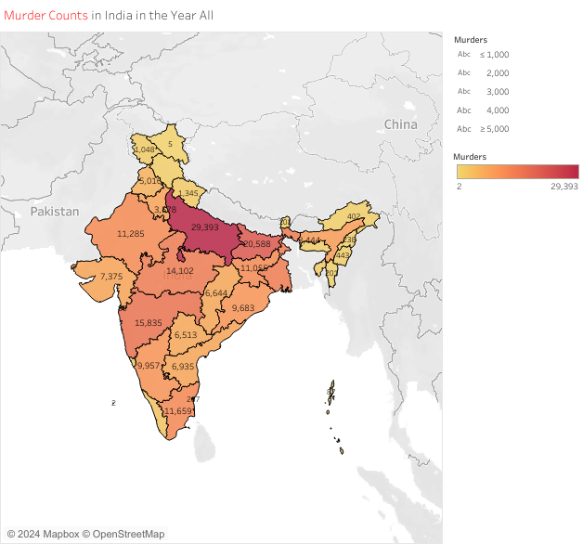
View of total murders in India
Uttar Pradesh has the highest number of murder cases.
Central zones of India have considerable amount of murders,

Slide 9
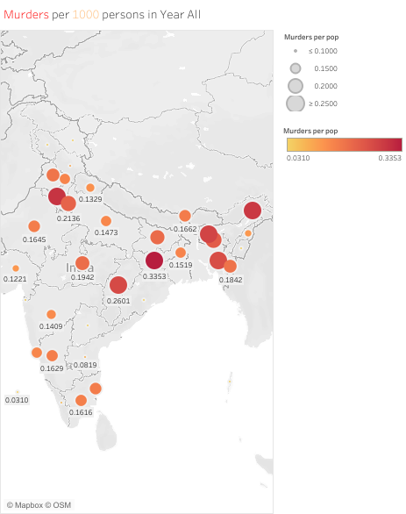

Murder rates across India
North East side has much more murder rate than the rest of India atleast through visual analysis

Slide 10
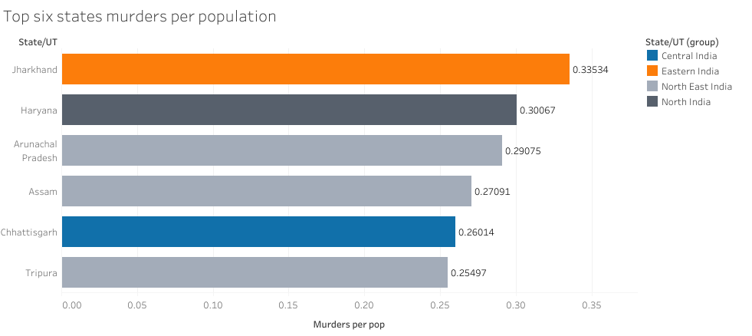
Murder rates ranking
Top 6 states in terms of murder rates (2015-2021)

Slide 11
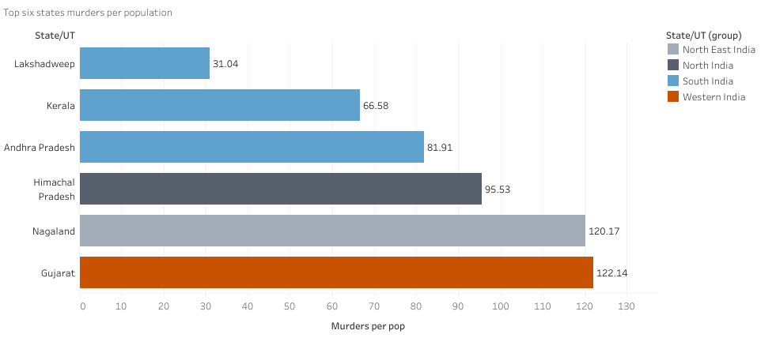
Murder rates ranking Reverse
Bottom 6 states in terms of murder rates (2015-2021)

Slide 12
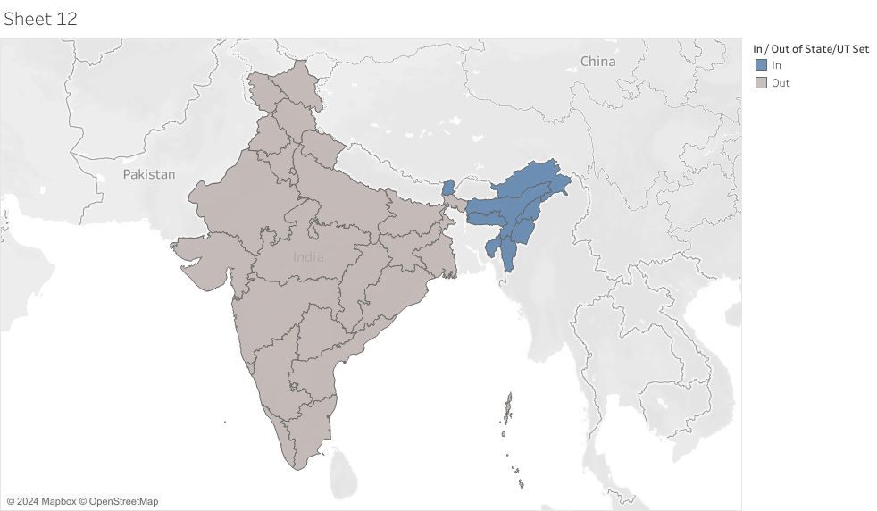
Defining the area Is murder per population is higher in North East India than in the rest of India?
* defining the region with blue

Slide 13
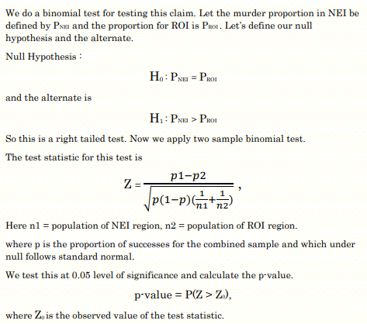
Formulating the test
The p-value being very close to 0 for this test.
So we conclude that based on the data we have the murder proportion in the NEI region is greater than that of ROI region at 2.5% level of significance

Slide 14
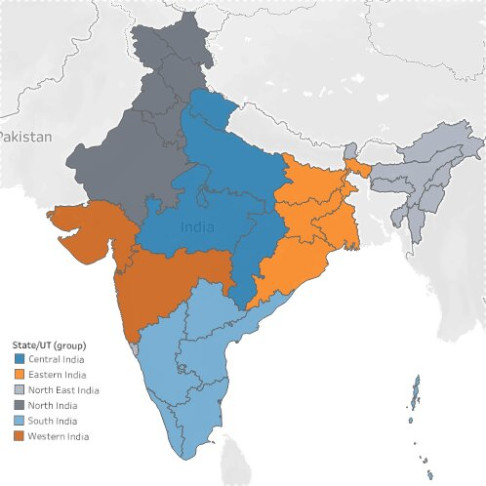
Breaking into administrative blocks
Central: Chhattisgarh, Madhya Pradesh, Uttarakhand, Uttar Pradesh.
Eastern: West Bengal, Jharkhand, Odisha, and Bihar.
North Eastern: Assam, Arunachal Pradesh, Manipur, Meghalaya, Mizoram, Nagaland, Tripura, Sikkim
North: Jammu & Kashmir, Ladakh, Chandigarh, Delhi, Haryana, Punjab, Rajasthan, Himachal Pradesh.
South : Puducherry, Andhra Pradesh, Karnataka, Kerala, Tamil Nadu, Telangana.
Western : Maharashtra, Dadra and Nagar Haveli and Daman and Diu, Goa, Gujarat.

Slide 15
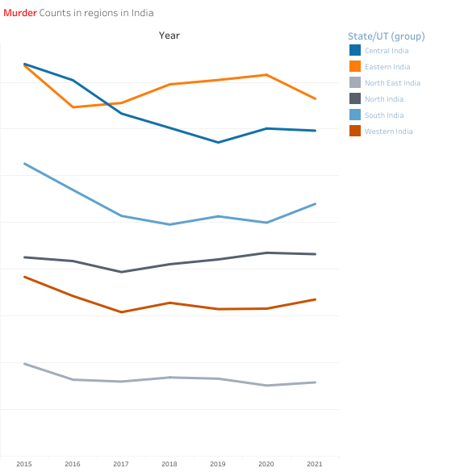
Murder Counts in different blocks over time
Central and East has the highest counts.
Followed by South India, North India and West India.
North East has the lowest count of all.

Slide 16
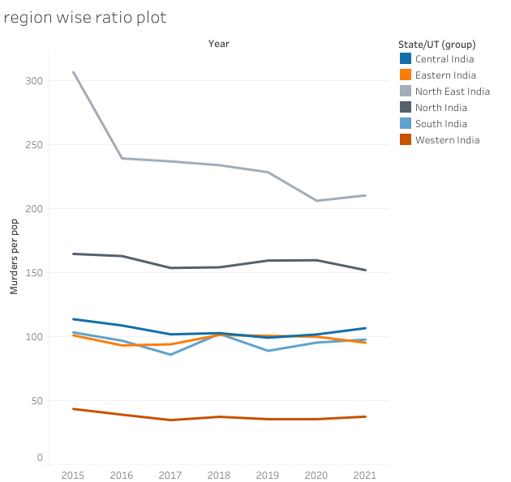
Rates in different blocks over time
North East India is above all the rest and by some margin
Followed by North India, East South and Central has almost similar rates.
Western India has the lowest

Slide 17
Questions from the plots
1. Are the murder counts in Central and Southern India correlated?
2. Is the increase of murder counts significant for Northern India?

Slide 18
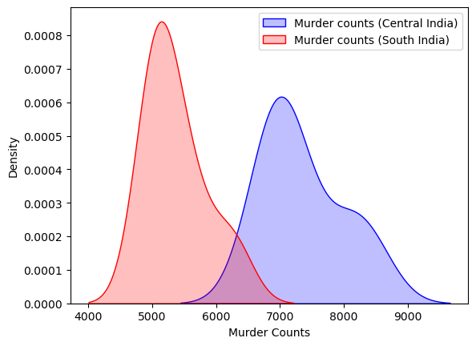
Distribution of murder counts in Central and South India
Both distribution are very close to normal.
We can apply the Pearson correlation test for testing the correlation between Central and South India.

Slide 19
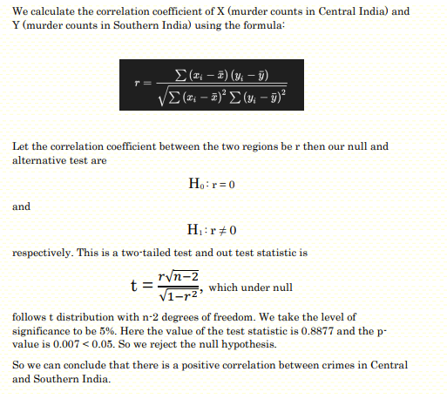
Formulating the test
1. The p-value is 0.007.
2. So we can conclude that there is a significant positive correlation between crimes in Central and Southern India

Slide 20
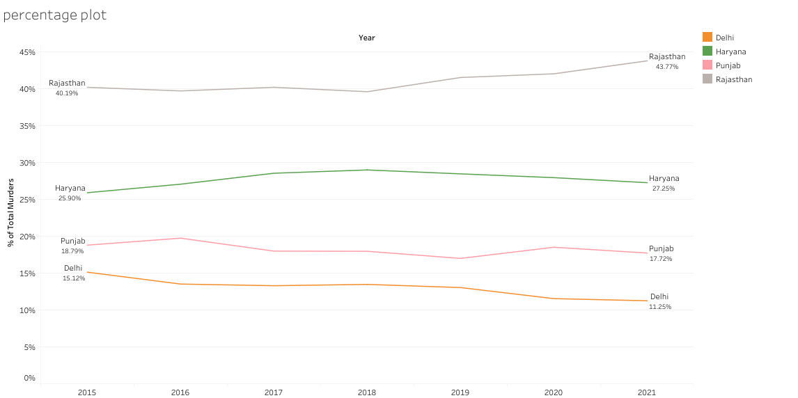
Deeper into North India
Rajasthan is by far the highest contributor of murders in North India and the contribution has increased by 3.5% over the time period.

Slide 21
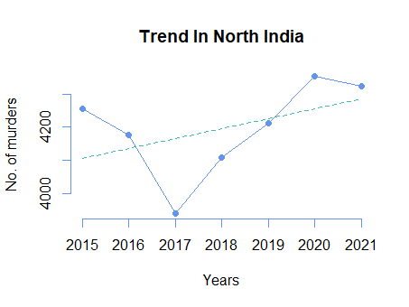
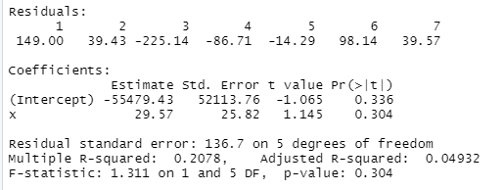
Trend in North India
We fit a linear trend model on the North India murder counts. The p-value for the coefficient is 0.3, that means we cannot conclude that there is significant increase in murder counts in Northern India

Slide 22
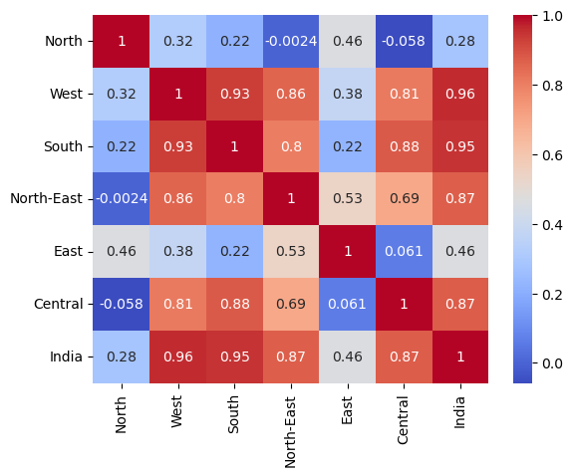
Correlation between blocks
North has low correlations with all the blocks.
East has moderate correlations with all blocks.
The rest have high correlations with each other.

Slide 23
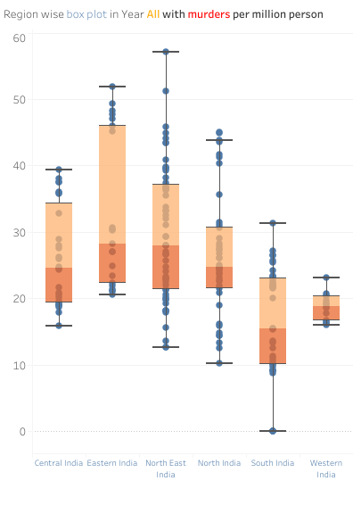
Idea of Variance
Variances are different for each block.
Eastern and North East India show significant disparities within these regions.
Western India has the lowest and most consistent murder count

Slide 24
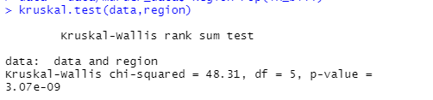
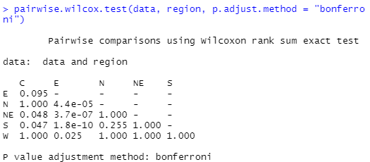
Kruskal Wallis Test
The p-value for Kruskal Wallis Test is very close to 0. There is effect of blocks in the median murder rates.
The 1’s in the pairwise are due to tied values.
As we see here NE is different from C, E. N is different from E and S is different from C. W is different from E

Slide 25
Critic
Modifiable areal unit problem (MAUP) : A plane may be divided into 50, 500, or other number of polygons, with spatial autocorrelation results differing fundamentally depending on the n that is chosen.
The aggregation problem refers to the dependence of spatial autocorrelation findings on the way that the spatial plane is divided into a particular set number of polygons.
Here we have taken administrative blocks divided in terms of cultural homogeneity and administrative benefits. This line of grouping might not be very effective in finding correlation between spatial units.
2. Boundary value problem

Slide 26
Motive Analysis (2016-2021)

Slide 27
Grouping motives into three major types
Greed | Loath | Love/Lust
Political Causes | Disputes | Illicit Relationship
Gain | Honour Killing | Love Affairs
Robbery and Dacoity | Extremism | Rape
Sale of body parts | Casteism
Dowry | Class Conflicts
Property Dispute | Religious
 | Gang Rivalry
 | Communalism

Slide 28
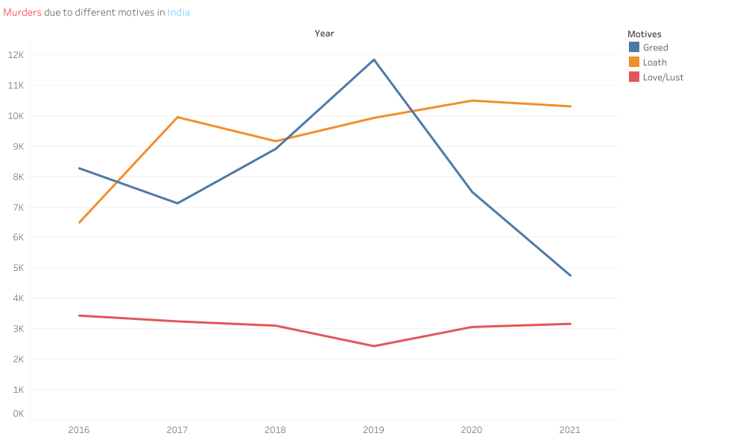
Count in each group over time
Loath has seen a gradual increase while Greed has seen a downward slide after 2019.

Slide 29
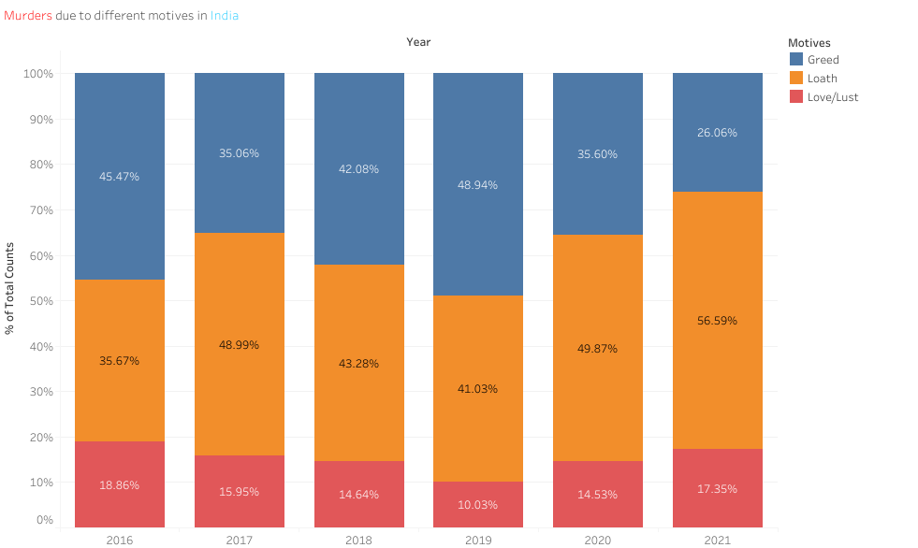
Contribution for each motive
Murders due to loath has seen a surge of 21% over the time period.

Slide 30
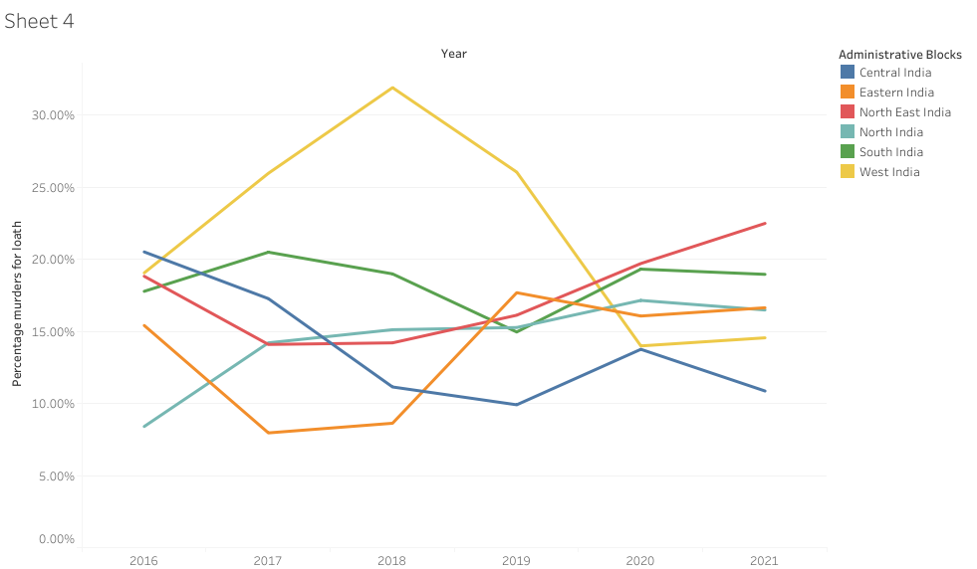
Percentage murders to loath in the blocks
West contributes the most and seen a decline and North East has seen some uprise.

Slide 31
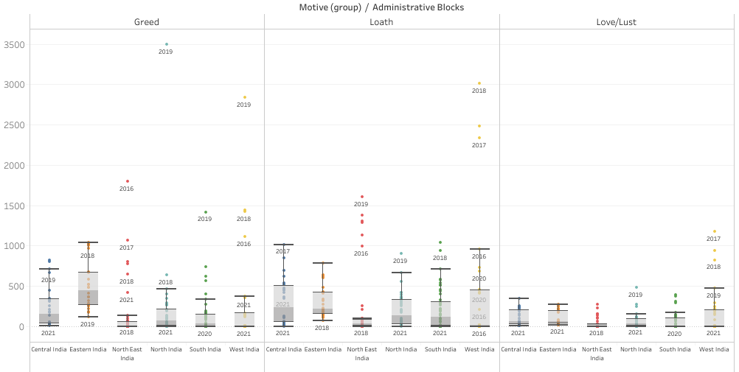
Box plots of murder ratios for blocks in different motives
Existence of outliers in West, South, North East and North India.

Slide 32
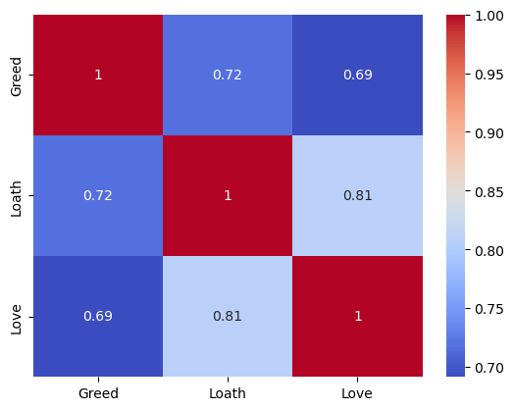
Correlation between motives
High correlations overall
Shared Underlying Causes : Economic Factors and Social Instability.
Highest correlation for Loath and Love

Slide 33
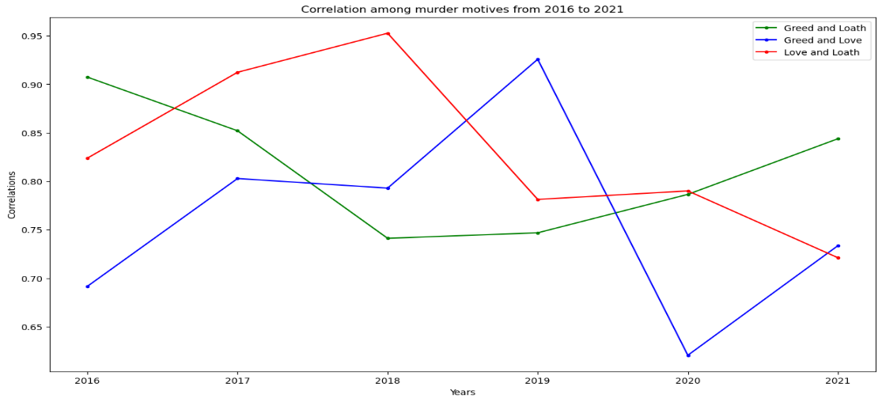
Correlation between motives (year-wise)
The correlation between love and loath has decreased from 2018. Dip after 2019 in correlation between greed and love. Slight increase for greed and loath.

Slide 34
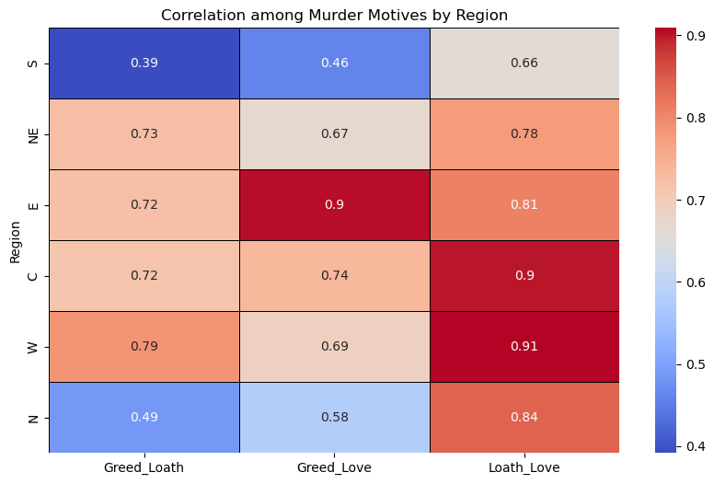
Correlation between motives (blockwise)
Loath and Love correlations are consistently high across all regions, indicating a strong connection between these motives
Greed and Loath show moderate correlations, suggesting some common underlying factors but also distinct differences.
Different regions show varying degrees of correlation among motives, reflecting unique socio-economic and cultural factors influencing crime.
Also we observe that South India has the least correlations among all the murder motives.

Slide 35
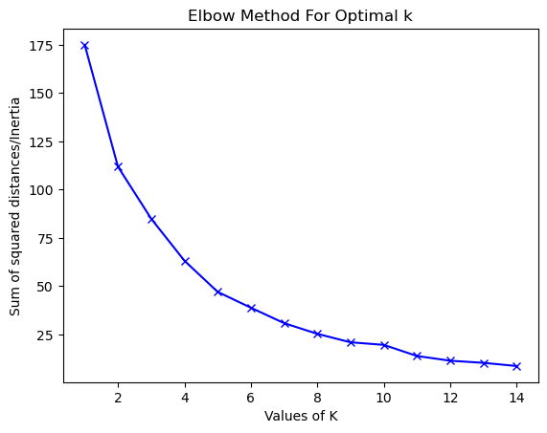
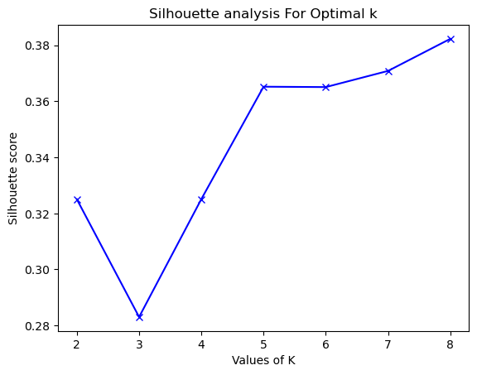
Cluster Analysis – K-Means Clustering
Selecting the K (number of neighbours) for K-Means Clustering.

Slide 36
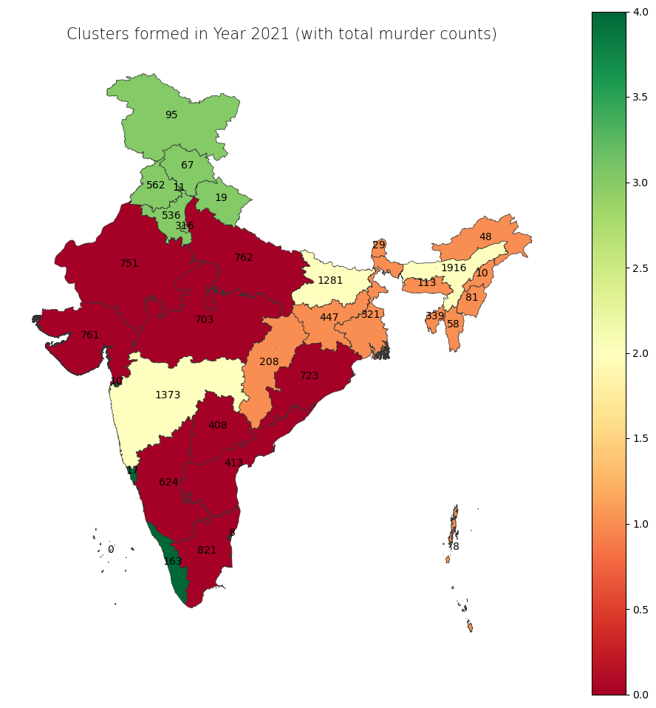
The Clusters
Green & Orange Clusters (Low Proportion Cluster): States like Kerala and some Northeastern states show low proportions in all three motives. This could imply effective law enforcement or unique socio-cultural factors.
Red & Yellow Clusters (High Proportion Cluster): Central and Northern states with high total counts show a high proportion of murders across motives. This could suggest a broader issue with violence or less effective crime prevention strategies.

Slide 37
Socio-Economic Factors (2016-2021)

Slide 38
Identifying the factors
Income Levels
Unemployment Rate
Poverty Rate
Population Density
Age Distribution
Urbanization
Literacy Rates
Education Attainments
Migration Patterns
Mental Health Problems
Rates Of Alcohol And Drug Use
Judicial Efficiency
Religious Composition
Governance Quality
* red means unable to collect sufficient data

Slide 39
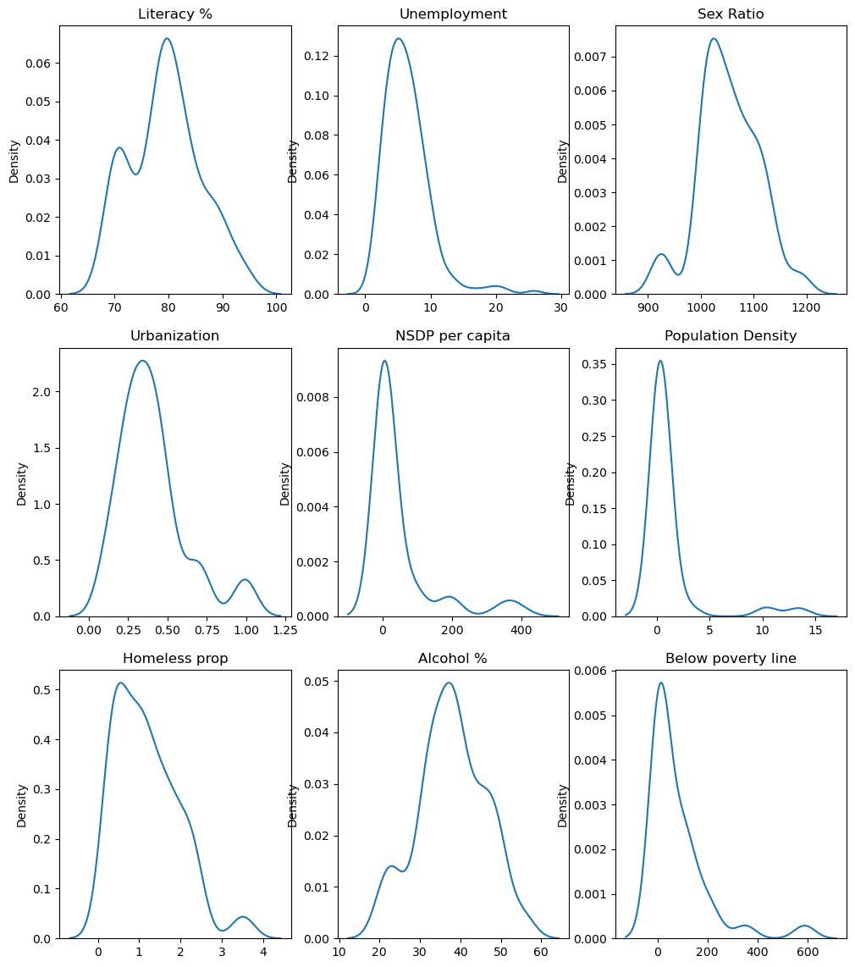
Distribution of each factor

Slide 40
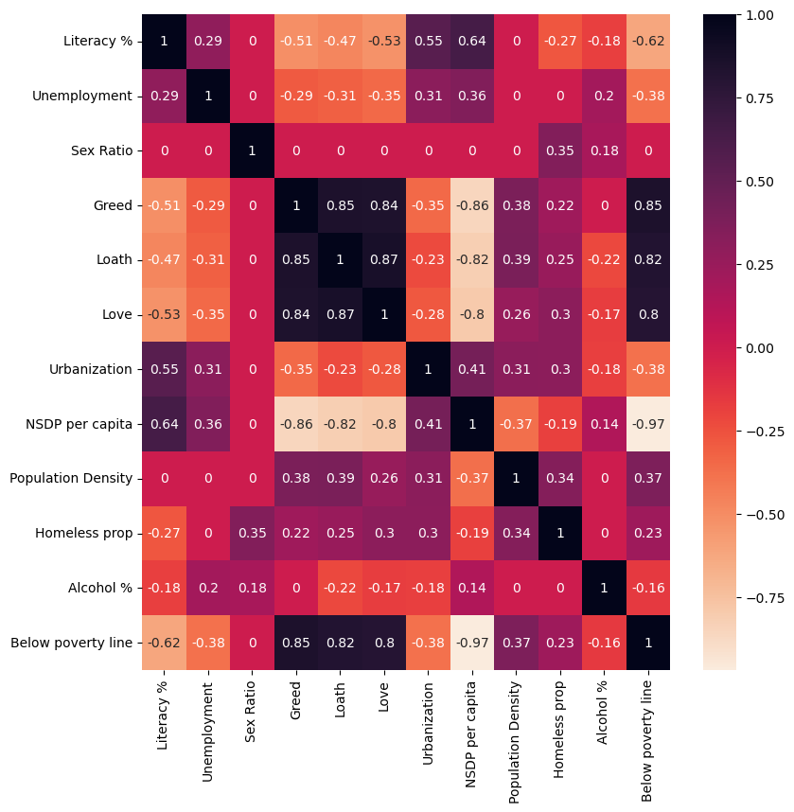
Correlation Matrix - Heatmap
Here we see that barring sex ratio every other socio-economic factor has a significant correlation with murder counts of different motives
Now we see that there is significant correlation among the various factors as well so this also pushes the concern for multicollinearity

Slide 41
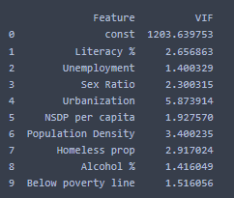
Multicollinearity test
VIF = 1 No correlation between the predictor and other predictors.
1 < VIF< 5 Moderate correlation, generally acceptable.
VIF > 5 High correlation, potential multicollinearity issue.
VIF > 10 Very high correlation, serious multicollinearity issue.
We see that Urbanization has a VIF of 5.87 i.e. close to 6 so we need to investigate the dependence of the variable with the other variables

Slide 42
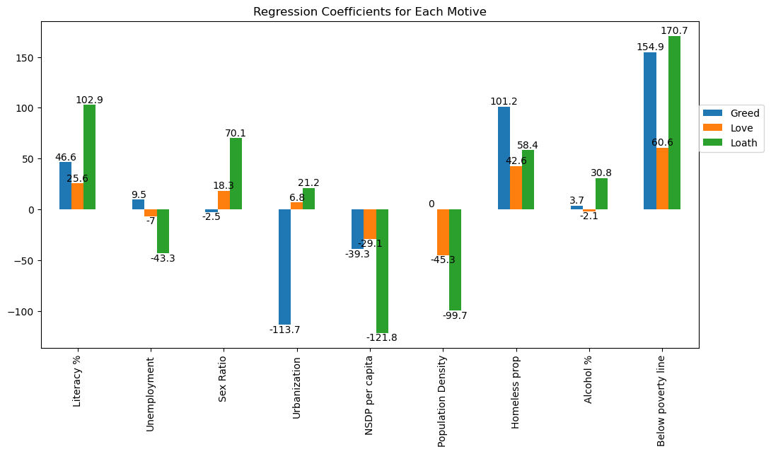
Variable Selection + Interpretation
Poverty (Below poverty line) is a strong predictor of murders across all motives, particularly for loath.
Urbanization shows a strong negative relationship with murders due to greed but a positive relationship with loath.
Homeless proportion and Literacy % are also significant predictors for murders due to all motives, with varying degrees of influence.
NSDP per capita and Population Density generally have a negative relationship with murders, particularly for greed and loath.
Unemployment, Sex Ratio, and Alcohol % show smaller and more varied impacts across different motives.

Slide 43
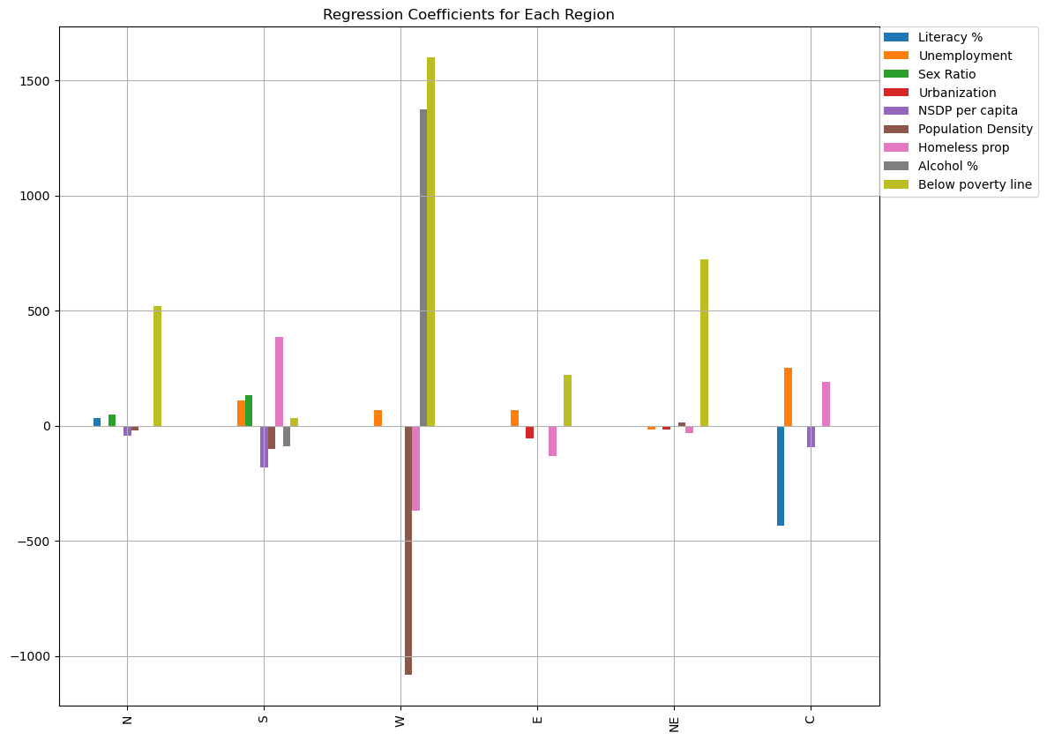
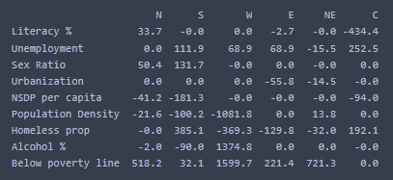
Variable Selection(Blocks)

Slide 44
1. Below Poverty Line: This variable shows strong positive coefficients across most regions, particularly in the West (1597.9), Central (721.3), and North (518.2), indicating that higher poverty levels are strongly associated with higher murder rates in these regions. 2. Unemployment: In the Central region, unemployment has a very high positive coefficient (252.5), suggesting a significant relationship with murder rates. The South also shows a notable positive relationship (111.9). 3.Population Density: This variable shows a strong negative coefficient in the West (-1081.8), indicating that higher population density is associated with lower murder rates in this region. 4.Homeless Proportion: In the South, the homeless proportion has a high positive coefficient (385.1), suggesting a significant relationship with murder rates. 5.Urbanization: Has a significant negative coefficient in the East (-55.8), suggesting higher urbanization is associated with lower murder rates in this region. 6. NSDP per Capita: Shows strong negative coefficients in the North (-41.2) and South (-181.3), suggesting higher economic development is associated with lower murder rates
Interpretation

Slide 45
Thank You

