Slide 1

Daudit
FYDP: Sam Haves, Arash Rai, Zain Zulfiqar, Vinit Shah

Slide 2


Recap
What we do => Data Auditing, Cleanliness, Hygiene
Who’s it for => Companies with large amounts of data
Currently data quality checking is done with brittle rules engines (don’t evolve with data) and noisy anomaly detection
Daudit aims solve these problems

Slide 3
Midterm Demo Recap
Single column null proportion error checking
Basic Slack functionality
Locally hosted
MySQL Integration

Slide 4
What’s New
More database integrations – PostgreSQL
More anomaly detection
Binary relationships
Additional Slack functionality
Cleaner notifications
Feedback buttons
Alert back-off to prevent noise

Slide 5
Database Integrations
Added integration for postgreSQL databases
Psycopg connector leveraged

Slide 6
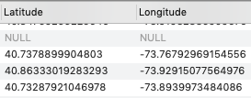

Anomaly Detection
Binary relations
Example NYC311 incident reports
Related fields
”Annoying neighbor from Manhattan”

Slide 7
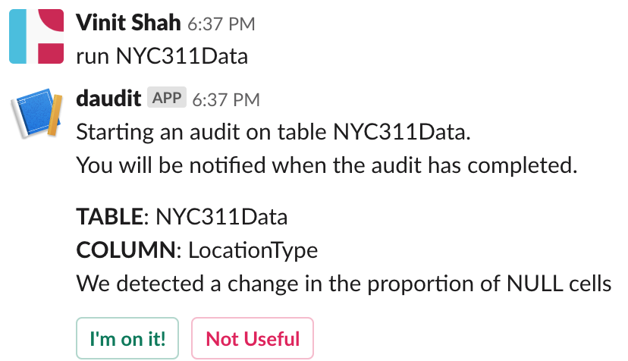
Slack Functionality

Slide 8
Alert Back-Off
Local MySQL database running along with Daudit to store alert data
Track usefulness of alerts via feedback buttons to update confidence intervals for monitored tables and columns
Tracking of alerts that are sent out
Track usefulness
Keep record of acknowledged alerts
Has it been acknowledged and who has it been acknowledged by?

Slide 9







Technologies
Technologies
Python
Flask
GitHub
MySQL
PostgreSQL
Slack API
AWS
Notes:
Arash -

Slide 10
Next Steps
Onboarding flow needs to be cleaned out
Get people actually using Daudit
Implement during co-op
Possible solutions include dockerizing Daudit, build scripts etc.
Improving anomaly detection reliability
Possible improvements
Better UX
Show accountability for anomalies
Show history of previous audits
Show health of data over a period of time

Slide 11
Demo

