Slide 1

Daudit
FYDP: Sam Haves, Arash Rai, Zain Zulfiqar, Vinit Shah

Slide 2


Recap
What we do => Data Auditing, Cleanliness, Hygiene
Who’s it for => Companies with large amounts of data
Currently data quality checking is done with brittle rules engines (don’t evolve with data) and noisy anomaly detection
Daudit aims solve these problems

Slide 3
Midterm Demo Recap
Single column null proportion error checking
Basic Slack functionality
Locally hosted
MySQL Integration

Slide 4
What’s New
More database integrations – PostgreSQL
More anomaly detection
Binary relationships
Additional Slack functionality
Cleaner notifications
Feedback buttons
Alert back-off to prevent noise

Slide 5
Database Integrations
Added integration for postgreSQL databases
Psycopg connector leveraged

Slide 6
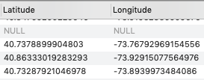

Anomaly Detection
Binary relations
Example NYC311 incident reports
Related fields
”Annoying neighbor from Manhattan”

Slide 7
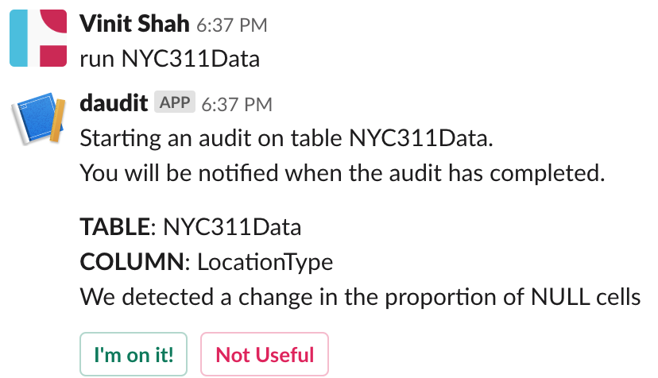
Slack Functionality

Slide 8
Alert Back-Off
Local MySQL database running along with Daudit to store alert data
Track

Slide 9




Current Technologies
Python
GitHub
MySQL
Slack API
Notes:
Arash -

Slide 10
How we do it – Database integration
Currently only support MySQL
No complicated queries, just getting full columns
Extension to other databases is not difficult
Assuming they have nicely defined APIs.

Slide 11
How we do it - Slack
Local slack app
Users add to internal Slack
Notifications and interactivity

