Slide 1


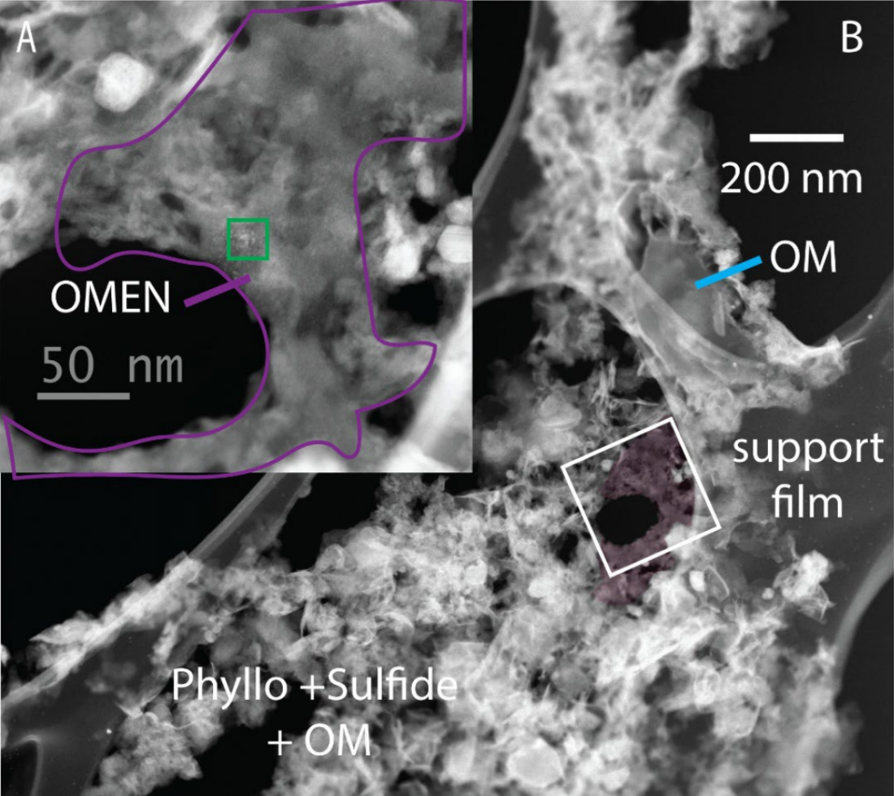
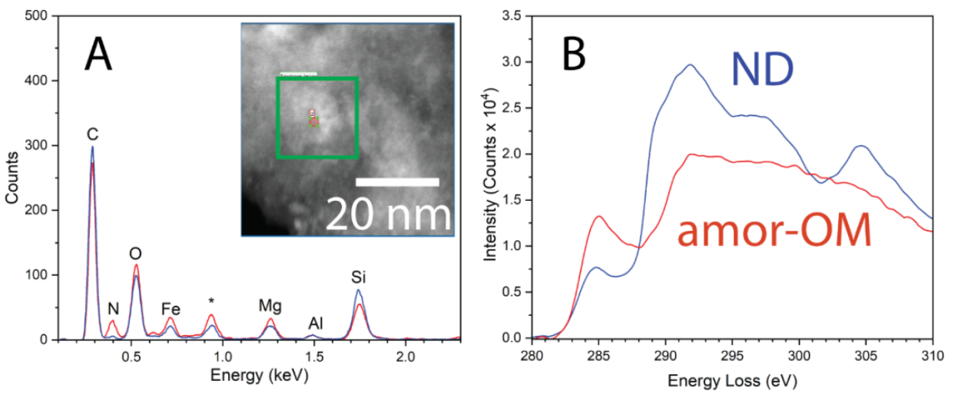

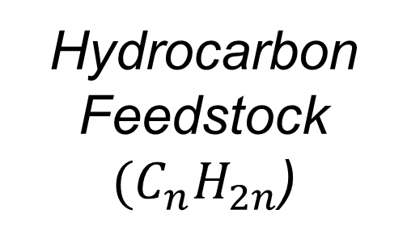
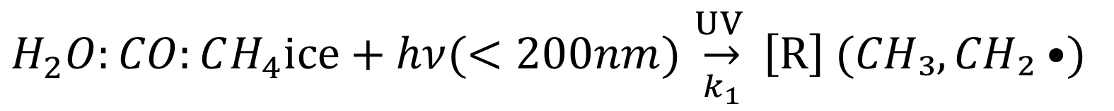
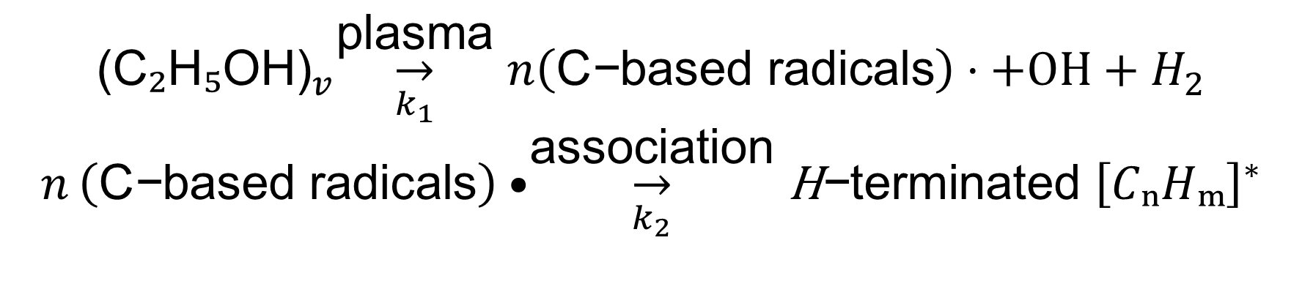
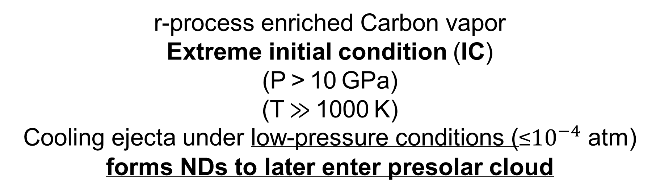
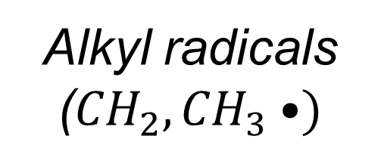
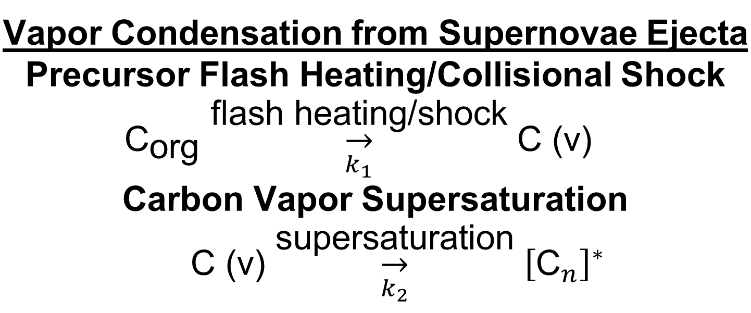

Coordinated In-Situ Analysis of Meteoritic Nanodiamonds
Mechanism | δ¹³C (‰) | δD (‰) | Key Anomalies | Viable Environment
Microplasma | -25 to -15 | +500 to +1000 | None | Presolar cloud
UV Photolysis | -35 to -15 | +100 to +1000 | None | Circumstellar
Supernova Condensation | Neutral | Low | Pt/Xe anomalies | SN ejecta only
Havishk Tripathi^{1,2} Rhonda Stroud^{1,2}, Larry Nittler¹
¹School of Earth and Space Exploration, ASU, Tempe, AZ
²Buseck Center for Meteorite Studies, ASU, Tempe, AZ
Introduction
Initial STEM-EDXS-EELS Results
Meteoritic nanodiamonds (NDs)
carbon nanograins (2–5 nm) trapped in carbonaceous meteorites thought to be presolar
carry stellar nucleosynthetic anomalies and encode processes predating the Solar System.
Challenge
Traditional bulk analyses mask ND subpopulation variation, preventing origin(s) identification. Objective
Differentiate presolar stardust vs. solar system ND formation in carbonaceous chondrites and returned asteroid samples
Figure 1 (left) STEM HAADF of microtomed Ryugu particle on lacey carbon grid.
(A) Organic matter (OM) with embedded nanodiamonds (OMEN) (magenta)
(B) Petrographic context OMEN in fine grained matrix (phyllosilicates/ sulfides/diamond-free OM). Elliptical void in OMEN suggests NDs form as an interstellar icy particle rind.
Figure 2
(A) Spectrum image ROI (inset) and
Extracted EDXS spectra from Amorphous C
is N-richer than ND (blue).
Cu peak = system artifact; Si/Al/Mg/Fe/O from heteroatoms in OM; residual from acid dissolution.
(B) Extracted
EELS C K-edge
From
ND (sp³)
amor-OM (sp²)
Methods
Sulfur -embed
Matrix, Microtome
Sample Prep
70-100 nm
thin section
In-situ aberration
corrected STEM/TEM
Imaging
EDXS (composition)
EELS (bonding)
Potential Formation Mechanisms & Distinct Isotopic Fingerprints
Isotopic Imaging
Cold Formation Mechanisms
Hot Formation Mechanisms
NanoSIMS
C,N Isotopes
Radical Mediated Nucleation
Circumstellar Outflow (CTTS at 1 AU)
HT/HP Processes
Microplasma Alcohol Vapor Dissociation
Early Solar System
active accretion
Lyα Dominated (88%)
Diffuse ISM & Cold Molecular Cloud
Vapor Condensation from Supernovae Ejecta Precursor Flash Heating/Collisional Shock $${\text{C}}_{\text{org}}\underset{k_{1}}{\overset{\text{flash} \text{heating}\text{/}\text{shock}}{→}}\text{C}\text{ (}\text{v}\text{)}$$ Carbon Vapor Supersaturation $\text{C}\text{ (}\text{v}\text{)}\underset{k_{2}}{\overset{\text{supersaturation}}{→}}{\left[{\text{C}}_{n}\right]}^{∗}$
Technical Approach
$${\text{(}\text{C}\text{₂}\text{H}\text{₅}\text{OH}\text{)}}_{v}\underset{k_{1}}{\overset{\text{plasma}}{→}}n\left(\text{C}\text{−}\text{based} \text{radicals}\right)⋅+OH+H_{2}$$
$$n \left(\text{C}\text{−}\text{based} \text{radicals}\right)•\underset{k_{2}}{\overset{\text{association}}{→}}\text{H}\text{−}\text{terminated} {\left[CₙHₘ\right]}^{∗}$$
Photon-processed ice grains
Locate ND clusters embedded in organic matter in carbonaceous chondrites and returned asteroid samples
Measure C and N isotopes of clusters to check for multiple formation histories
UV Flux
FUV Flux (erg cm⁻² s⁻¹) (912-1700Å) ~1.6 × 10⁴
G₀
FUV Flux (erg cm⁻² s⁻¹) (912-1700Å) 0.05-5
G₀
Ethanol C-C Bonds are ideal Atmospheric pressure microplasma T ≈ 100 °C Residence time ≈1 ms
~10⁷
UV Flux
~30-3000
sp² Hybridization
r-process enriched Carbon vapor
Extreme initial condition (IC)
(P > 10 GPa)
(T ≫ 1000 K)
Cooling ejecta under low-pressure conditions (≤${10}^{−4}$ atm) forms NDs to later enter presolar cloud
Outer Nebula
Hydrocarbon
Feedstock
$({C_{n}H}_{2n}$)
Alkyl radicals
(${CH}_{2},{CH}_{3}•)$
cluster-mediated
CO–H₂ ice reactions
Inner Nebula
References
FUV Flux (erg cm⁻² s⁻¹) (912-1700Å) 0.05-5
G₀
Hydrocarbon Catalysis
on Fe-Ni grains
under solar nebula conditions
S. J. Desch and N. Miret-Roig, "The Sun's birth environment: Context for meteoritics," Space Sci. Rev., vol. 220, no. 7, Art. no. 76, 2024.
G. R. Huss and R. J. Lewis, "Presolar diamond, SiC, and graphite in meteorites," Geochim. Cosmochim. Acta, vol. 60, pp. 331–346, 1996.
G. R. Huss, S. T. Husa, and S. A. Sandford, "UV processing of presolar organic ices," Astrophys. J., vol. 849, p. 75, 2017.
A. Kouchi et al., "Novel routes for diamond formation in interstellar ices and meteoritic parent bodies," Astrophys. J. Lett., vol. 626, L129, 2005.
A. Kumar et al., "Formation of nanodiamonds at near-ambient conditions via microplasma dissociation of ethanol vapour," Nat. Commun., vol. 4, Art. no. 2618, 2013.
J. Llorca and I. Casanova, "CO + H₂ reaction over Fe–Ni metal at low pressures: Implications for nebular diamond formation," Geochim. Cosmochim. Acta, vol. 64, no. 15, pp. 2673–2684, 2000.
L. R. Nittler and F. Ciesla, "Astrophysics with extraterrestrial materials," Annu. Rev. Astron. Astrophys., vol. 54, pp. 53–93, 2016.
G. Pareras et al., "Single-atom catalysis in space – II. Ketene–acetaldehyde–ethanol and methane synthesis via Fischer–Tropsch chain growth," Astron. Astrophys., vol. 687, p. A230, 2024.
R. M. Stroud et al., “Electron microscopy observations of the diversity of Ryugu organic matter and its relationship to minerals at the micro‐to nano‐scale,” Meteori. & Planeta. Sci. 59 (8), 2023-2043
Carbon Cluster Formation
Meteoritic Nanodiamond Formation
Diamond Nucleation
UV Flux
Fischer-Tropsch Fe-Ni Catalysis
~30-3000
UV Flux
FUV Flux (erg cm⁻² s⁻¹) (912-1700Å) ~1.6 × 10⁴
G₀
M = Fe-Ni catalytic site (metal grain surface)
Nebular conditions (~300-700K, 10⁻⁴ atm)
~10⁷
CO adsorption and activation
$$CO(g)+M \overset{k_{1}}{→} M​−​C + M​−​O$$
H₂ activation
$$H_{2}(ads)+2 M \overset{k_{H}}{→} 2 M​−​H$$
CH₂ initiation
$$M​−​C+2 M​−​H \overset{k_{α}}{→} M​−​CH_{2}+M$$
Carbene insertion
$$M​−​CH_{2}+CO(g)+M​−​H \overset{k_{ins}}{→} M​−​C_{2}H_{4}+M​−​O$$
Chain growth
$$\text{repeat} \text{CH}\text{₂ }\text{initiation}\text{ +} \text{Carbene} \text{insertion}$$
$\text{build} M​−​C_{n}H_{2n}$
UV/H-radical Exposure
Isotopic Signature ⇌ Origin
δ¹³C |  | δ¹⁵N |  | Viable Environment
> Solar | ~ Solar | > Solar | ~ Solar
✓ |  |  | ✓ | C star outflow
 | ✓ | ✓ |  | Diffuse ISM Cold Molecular Cloud
 | ✓ | ✓ |  | Outer Nebula
 | ✓ |  | ✓ | Inner Nebula
UV Photolysis of Organic-Rich Ices
G₀ > 30
$$H_{2}O:CO:CH_{4}ice+hν(<200nm)\underset{k_{1}}{\overset{UV }{→}}{\left[R\right]}^{ }(CH₃,CH₂•)$$
Organic ice mantles absorb FUV photons (λ < 200 nm)
H₂O-rich ice + minor CH₄, CH₃OH, CO, NH₃
(1-5%)
Notes:
Found as trace components of primitive carbonaceous chondrites
Presolar cloud fluxes (G₀ = 30–3000) initiated chemical precursors.
- Peak CTTS fluxes (G₀ ~10⁷) optimized diamond nucleation.
FUV Range: 912–1700 Å
(far-UV photochemical region)
moderate flux + Ambient UV from nearby massive stars.
- Flux decline post-accretion/cluster dispersal halted production

Slide 2
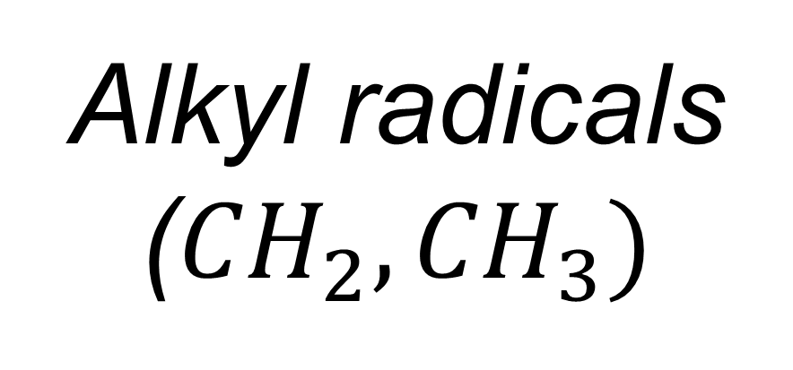
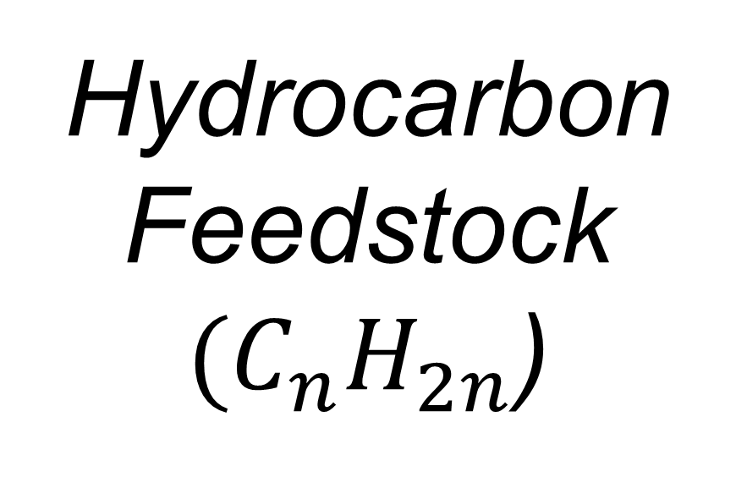
v
sp² Hybridization
Hydrocarbon
Feedstock
$({C_{n}H}_{2n}$)
Alkyl radicals
(${CH}_{2},{CH}_{3})$
Carbon Cluster Formation
Meteoritic Nanodiamond Formation
Diamond Nucleation
UV/H-radical Exposure

