Slide 1
Data Structures and Algorithms (ESO207)
Lecture 12:
Queue : a new data Structure :
Finding shortest route in a grid in presence of obstacles

Slide 2
Queue: a new data structure
Data Structure Queue:
Mathematical Modeling of Queue
Implementation of Queue using arrays

Slide 3



Stack
A special kind of list where all operations (insertion, deletion, query)
take place at one end only, called the top.
Behavior of Stack:
Last in
top
$$a_{n}$$
$$a_{n−1}$$
$$a_{1}$$
(LIFO)
First out

Slide 4



Queue: a new data structure
A special kind of list based on
First in
(FIFO)
First Out
$$a_{1}$$
$$a_{2}$$
$$a_{n}$$
front
rear

Slide 5

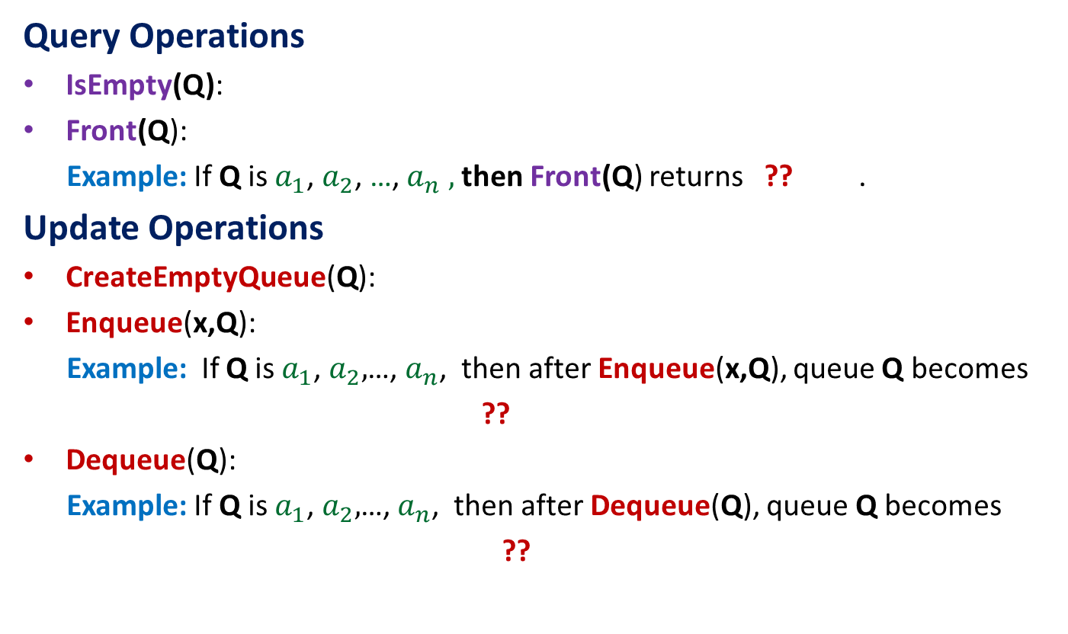
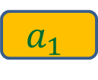

Operations on a Queue
Query Operations
IsEmpty(Q):
Front(Q):
Example: If Q is $a_{1}$, $a_{2}$, …,${ a}_{n} ,$ then Front(Q) returns ?? .
Update Operations
CreateEmptyQueue(Q):
Enqueue(x,Q):
Example: If Q is $a_{1}$, $a_{2},$…, $a_{n}$, then after Enqueue(x,Q), queue Q becomes
??
Dequeue(Q):
Example: If Q is $a_{1}$, $a_{2},$…, $a_{n}$, then after Dequeue(Q), queue Q becomes
??
determine if Q is an empty queue.
returns the element at the front position of the queue.
$$a_{1}$$
Create an empty queue
insert x at the end of the queue Q
$a_{1}$, $a_{2}$ ,…, $a_{n}$, $x$
return element from the front of the queue Q and delete it
$a_{2}$ ,…, $a_{n}$

Slide 6






How to access $i$th element from the front ?
To access $i$th element, we must perform
dequeue (hence delete) the first $i−1$ elements from the queue.
$$a_{1}$$
$$a_{i−1}$$
$$a_{i}$$
$$a_{n}$$
An Important point you must remember for every data structure You can define any new operation only in terms of the primitive operations of the data structures defined during its modeling.

Slide 7
Implementation of Queue using array
Assumption: At any moment of time, the number of elements in queue is n.
Keep an array of Q size n, and two variables front and rear.
front: the position of the first element of the queue in the array.
rear: the position of the last element of the queue in the array.
Enqueue(x,Q)
{ rear ← rear+1;
Q[rear]←x
}
Dequeue(Q)
{ x← Q[front];
front← front+1;
return x;}
There is a serious problem !
b
d
x
y
u
front
front
rear
rear

Slide 8
Implementation of Queue using array
t
x
u
h
k
v
front
rear
How to perform Enqueue(t,Q) ?
How to perform Enqueue(x,Q) ?

Slide 9
Implementation of Queue using array
Enqueue(x,Q)
{ rear ← rear+1;
Q[rear]←x
}
Dequeue(Q)
{ x← Q[front];
front← front+1;
return x;
}
IsEmpty(Q)
{ ?? }
(rear+1) mod n ;
(front+1) mod n ;
Do it as an exercise

Slide 10
Exercise Questions
Can you implement a stack using a single queue (you need to define the pop and push operations using enqueue and dequeue)? What about the converse?
Can you implement a queue using a) a single stack b) two stacks c) single stack and recursion?

Slide 11
Shortest route in a grid with obstacles

Slide 12

Shortest route in a grid
From a cell in the grid, we can move to any of its neighboring cell in one step.
Problem: From top left corner, find shortest route to each cell avoiding obstacles.
Input : a Boolean matrix $G$ representing the grid such that
$G[i,j]$ = 0 if ($i,j$) is an obstacle, and 1 otherwise.
obstacles

Slide 13
Step 1:
Realizing
the nontriviality of the problem

Slide 14
Shortest route in a grid nontriviality of the problem
Definition: Distance of a cell c from another cell c’
is the length (number of steps) of the shortest route between c and c’.
We shall design algorithm for computing distance of each cell from the start-cell.
As an exercise, you should extend it to a data structure for retrieving shortest route.

Slide 16

Get inspiration from nature
The ripples travels along the shortest route ?

Slide 17
Shortest route in a grid nontriviality of the problem
How to find the shortest route to in the grid ?
Create a ripple at the start cell and trace the path it takes to

Slide 18
propagation of a ripple from the start cell

Slide 19
ripple reaches cells at distance 1 in step 1

Slide 20
ripple reaches cells at distance 2 in step 2

Slide 21
ripple reaches cells at distance 3 in step 3

Slide 22
ripple reaches cells at distance 8 in step 8

Slide 23
ripple reaches cells at distance 9 in step 9

Slide 24
ripple reaches cells at distance 10 in step 10

Slide 25
ripple reaches cells at distance 11 in step 11

Slide 26
ripple reaches cells at distance 12 in step 12

Slide 27
ripple reaches cells at distance 13 in step 13

Slide 28
ripple reaches cells at distance 14 in step 14

Slide 29
ripple reaches cells at distance 15 in step 15
Think for a few more minutes with a free mind ☺.
Did you get some insight into the problem from the animation ?
The route taken by ripple is indeed the shortest.

Slide 30
Step 2: Designing algorithm for distances in grid
(using an insight into propagation of ripple)

Slide 31

A snapshot of ripple after $i$ steps

Slide 32



A snapshot of ripple after $i$ steps
$L_{i}$
$L_{i}$ : the cells of the grid at distance $i$from the starting cell.

Slide 33


A snapshot of the ripple after $i+1$ steps
The purpose of the animation was just to make you realize this important Observation. If you have got it, feel free to erase the animation from your mind ☺.
$L_{i}$
$L_{i+1}$
Observation: Each cell of $L_{i+1}$ is a neighbor of a cell in $L_{i}$.

Slide 34
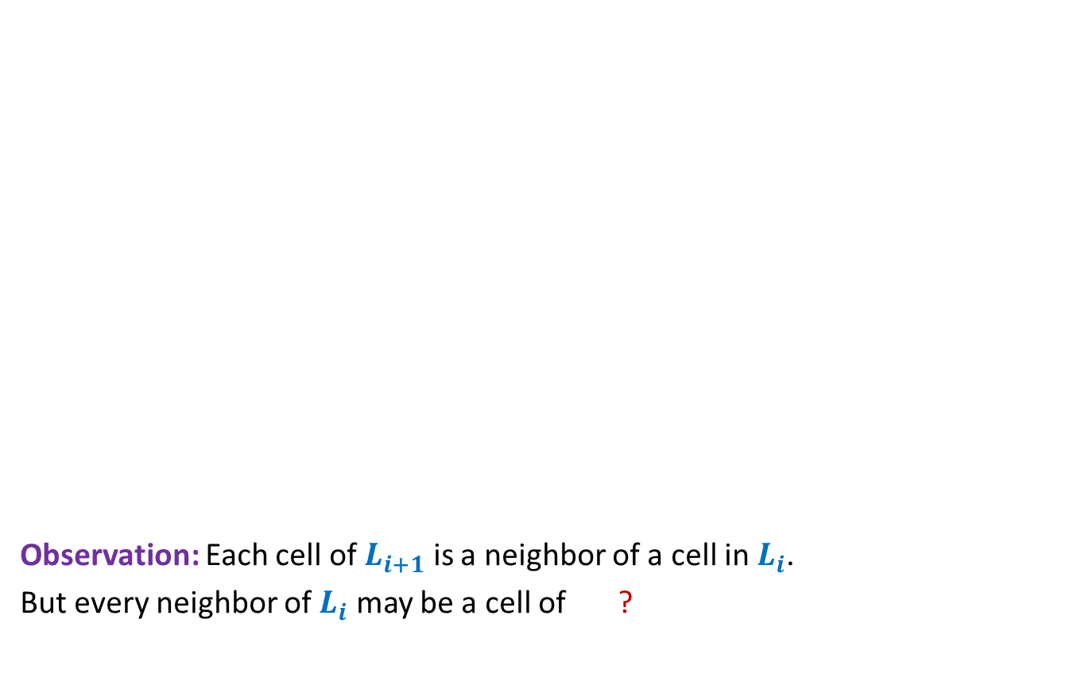

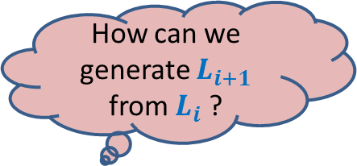
Distance from the start cell
It is worth spending some time on this matrix.
Does the matrix give some idea to answer the question ?
Observation: Each cell of $L_{i+1}$ is a neighbor of a cell in $L_{i}$.
But every neighbor of $L_{i}$ may be a cell of ?
$0$ 1 2 3 4 5 6 7 8 9 10 11 12 13 27 28 29 30
$1$ 2 3 4 5 7 8 9 10 11 12 13 14 26 27 28 29
2 3 4 5 15 10 11 12 25 26 27 28
3 4 5 6 14 13 12 11 12 13 24 25 26 27
4 5 6 13 14 23 24 25 26
5 6 7 14 15 22 23 24 25
6 7 8 15 16 17 18 19 20 21 22 23 24
7 8 9 16 17 18 20 21 22 23 24 25
8 9 10 17 18 26
How can we generate $L_{i+1}$ from $L_{i}$ ?
9 10 11 18 19 27
10 11 12 13 14 15 16 17 18 19 20 35 36 28
17 18 19 20 21 34 35 29
24 23 22 21 20 19 18 19 20 21 22 30 31 32 33 34 30
25 23 22 21 20 19 20 21 22 23 29 34 35 31
26 24 21 22 23 24 28 33 34 32
27 25 22 23 24 25 26 27 32 33 33
28 27 26 27 26 25 24 23 24 25 26 27 28 29 30 31 32 33 34
$L_{i−1}$ or $L_{i+1}$.

Slide 35
How can we generate $L_{i+1}$ from $L_{i}$ ?

Slide 36



How can we generate $L_{i+1}$ from $L_{i}$ ?
$$L_{i−1}$$
$$L_{i}$$
$$L_{i+1}$$

Slide 37

How can we generate $L_{i+1}$ from $L_{i}$ ?
Suppose all cells of $L_{i−1}$ get visited first.
$$L_{i−1}$$
$$L_{i}$$
$$L_{i+1}$$

Slide 38

How can we generate $L_{i+1}$ from $L_{i}$ ?
Suppose all cells of $L_{i−1}$ get visited first.
Then all cells of $L_{i}$ are visited, and
$$L_{i−1}$$
$$L_{i}$$
$$L_{i+1}$$

Slide 39


How can we generate $L_{i+1}$ from $L_{i}$ ?
Suppose all cells of $L_{i−1}$ get visited first.
Then all cells of $L_{i}$ are visited, and
then all cells of $L_{i+1}$ are visited.
So by the time all cells of $L_{i}$ are visited, if a cell neighboring to a cell of $L_{i}$ is unvisited, it must be a cell of $L_{i+1}$.
☺
$$L_{i−1}$$
$$L_{i}$$
$$L_{i+1}$$

Slide 40

How can we generate $L_{i+1}$ from $L_{i}$ ?
So the algorithm should be:
Initialize the distance of all cells except start cell as $∞$
First compute $L_{1}$.
Then using $L_{1}$ compute $L_{2}$
Then using $L_{2}$ compute $L_{3}$
…
$$L_{i−1}$$
$$L_{i}$$
$$L_{i+1}$$

Slide 41
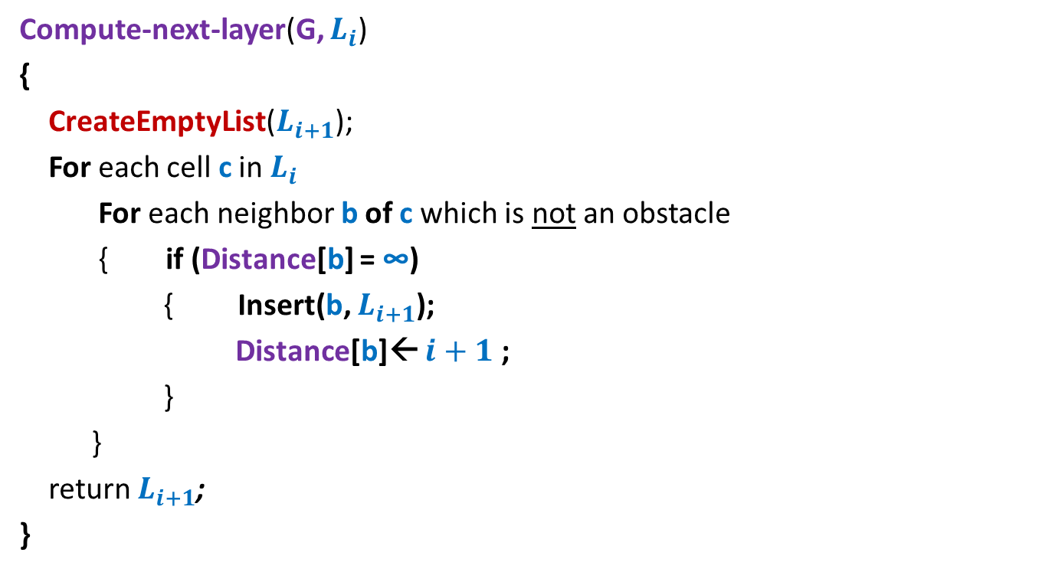

Algorithm to compute $L_{i+1}$ if we know $L_{i}$
Compute-next-layer(G, $L_{i}$)
{
CreateEmptyList($L_{i+1}$);
For each cell c in $L_{i}$
For each neighbor b of c which is not an obstacle
{ if (Distance[b] = ∞)
{ Insert(b, $L_{i+1}$);
Distance[b]← $i+1$ ;
}
}
return $L_{i+1}$;
}

Slide 42
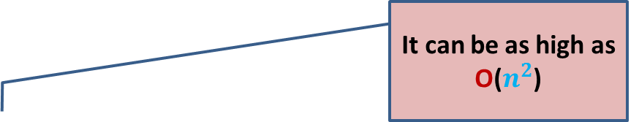

The first (not so elegant) algorithm (to compute distance to all cells in the grid)
Distance-to-all-cells(G, $c_{0}$)
{ $L_{0}$ ← {$c_{0}$};
For($i$= 0 to ?? )
$L_{i+1}$ ← Compute-next-layer(G, $L_{i}$);
}
The algorithm is not elegant because of
So many temporary lists that get created.
It can be as high as O($n^{2}$)

Slide 43


Towards an elegant algorithm …
Key points we observed:
We can compute cells at distance $i+1$ if …
Therefore, we need a mechanism
to enumerate the cells in
we know all cells up to distance $i$.
non-decreasing order of distances from the start cell.
How to design such a mechanism ?

Slide 44

Keep a queue Q
Spend some time to see how seamlessly the queue ensured
the requirement of visiting cells of the grid in non-decreasing order of distance.
$$L_{i}$$
Q
$$L_{i+1}$$

Slide 45
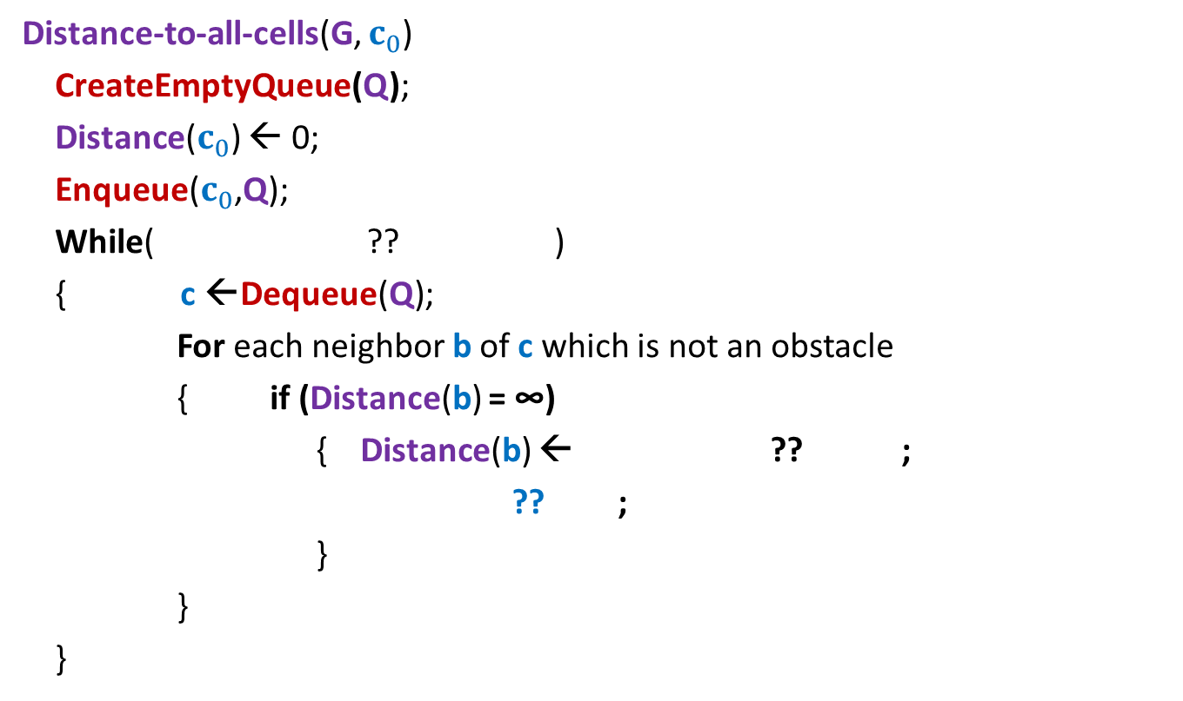
An elegant algorithm (to compute distance to all cells in the grid)
Distance-to-all-cells(G, $c_{0}$)
CreateEmptyQueue(Q);
Distance($c_{0}$) ← 0;
Enqueue($c_{0}$,Q);
While( ?? )
{ c ←Dequeue(Q);
For each neighbor b of c which is not an obstacle
{ if (Distance(b) = ∞)
{ Distance(b) ← ?? ;
?? ;
}
}
}
Not IsEmptyQueue(Q)
Distance(c) +1
Enqueue(b, Q);

Slide 46
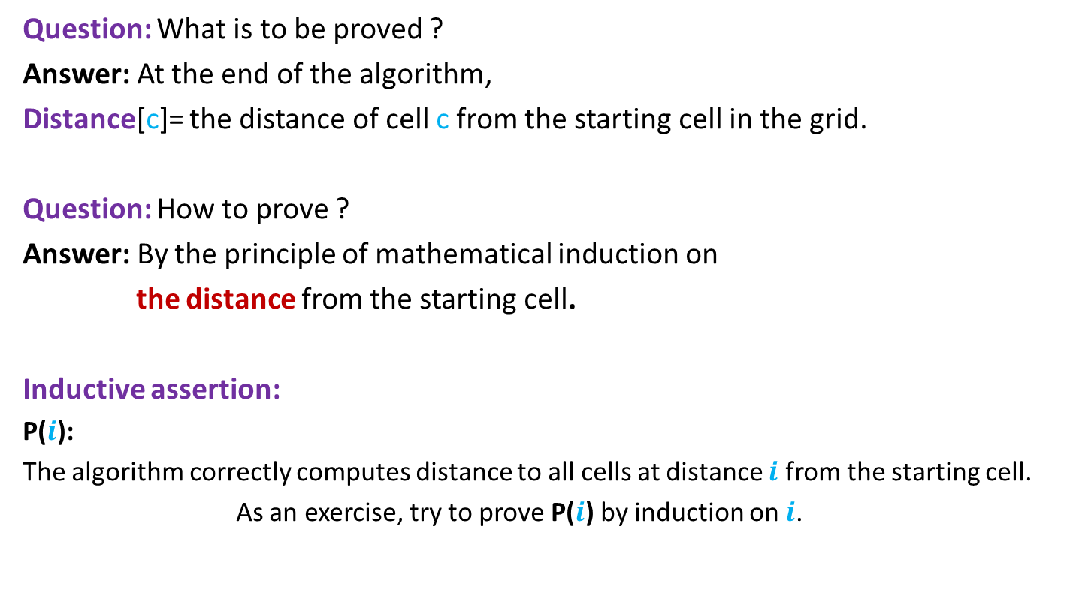
Proof of correctness of algorithm
Question: What is to be proved ?
Answer: At the end of the algorithm,
Distance[c]= the distance of cell c from the starting cell in the grid.
Question: How to prove ?
Answer: By the principle of mathematical induction on
the distance from the starting cell.
Inductive assertion:
P($i$):
The algorithm correctly computes distance to all cells at distance $i$ from the starting cell.
As an exercise, try to prove P($i$) by induction on $i$.

