Slide 1
Technical Arts (TA 101AA)
Engineering Graphics
Prof. Nachiketa Tiwari
Department of Design

Slide 2
Orientation of Lines
Parallel Lines
Perpendicular Lines
Shortest Distance

Slide 3
Normal & Point Views of a Line
Projected from the Top/Horizontal View
b_{H}
H
A1
b_{A2}, a_{A2}
d
a_{H}
Line of Sight
b_{A1}
A2
N
A1
H
F
d
a_{A1}
a_{F}
b_{F}
Note the direction of projectors.
Note how distances are measured along projectors.

Slide 4
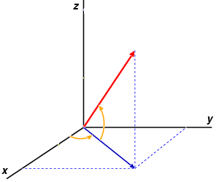
Orientation of a Line in 3-D Space
To define the direction of a line in 3-D space
  Project the line onto a plane.
  Measure the angle between the line and its projection (ᴪ).
  Measure the angle between the projected line and an appropriate reference line in the 2D plane (θ)
  ᴪ, θ together define the direction in 3-D space.
Which plane to project?
  A Principal orthographic plane!
  Horizontal (H) plane locally parallel to Earth’s surface and N-S direction as the reference line.
  Maps used for navigation are in horizontal view
Slope or grade: Angle from H plane to line (ᴪ)
Bearing/azimuth: Angle between projected line and the reference line in H plane

Slide 5
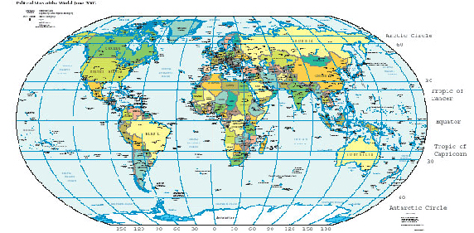
How do pilots of aircraft, and captains of ships define the direction of a line?
Geographical maps are on the horizontal plane (surface of the earth).

Slide 6
Azimuth and Bearing
Grade and Slope

Slide 7
Bearing of a Line
N
Bearing: Specified in the horizontal view
  Maps: Always in Horizontal Views
Value of angle: Always < 90ᵒ
Format: X-Number-Y
  X: North or South
  Y: East or West
  Number: 0ᵒ to 90ᵒ
N 30⁰ E
N 60⁰ W
B
D
W
E
A
C
S 45⁰ W
S
Bearing is the deviation from North or South point of a compass

Slide 8
Azimuth of a Line
N
Azimuth: Always read clockwise from the North.
Format: N-Number
Other name: Whole Circle Bearing
N 30⁰
B
D
W
E
A
N 300⁰
C
N 225⁰
S
Azimuth of a line is an alternative way to express Bearing.

Slide 9
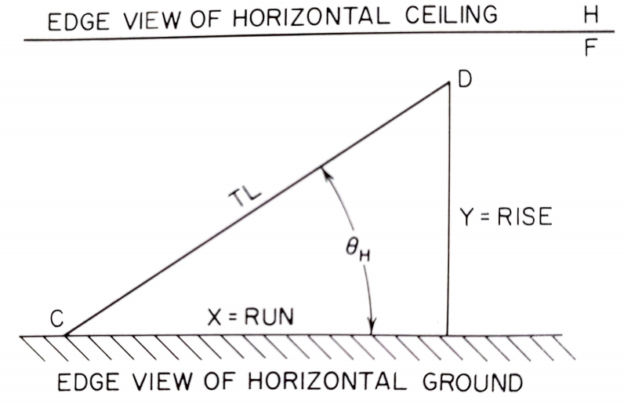
Slope of a Line
Slope relates the actual line to its projection on the horizontal plane
Always use TL and Normal View
Slope =
Θ: Slope angle of a line.

Slide 10
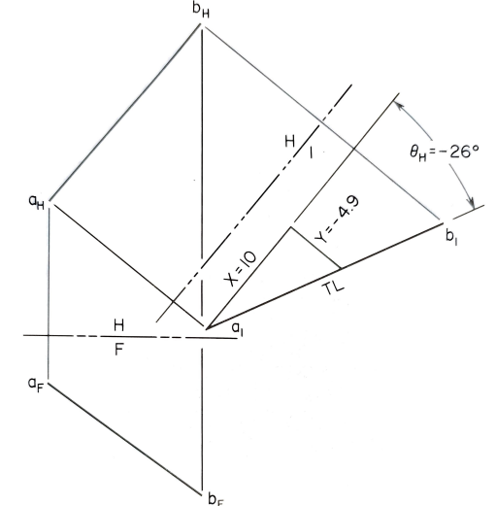
Grade of a Line
Grade of a line (in percent) = (tan (θ)) X 100.
Slope, Slope angle and grade: Positive if the line travels upwards, i.e., towards the hinge line.
Or else it is negative.

Slide 11
Important Points
Slope, slope angle and grade can be defined only when line is seen in its Normal View. in a view showing height .
The calculation of slope is easy if denominator is in multiple of 10.

Slide 12
Slope of an Oblique Line
B_{H}
H
1
θ_{H} = -26⁰
A_{H}
Rise (Y) = -5
Run (X) = 10
B_{A}
TL
H
F
A_{A}
Slope of Line
= Rise/Run
= Y/X
= - 0.5
A_{F}
B_{F}

Slide 13
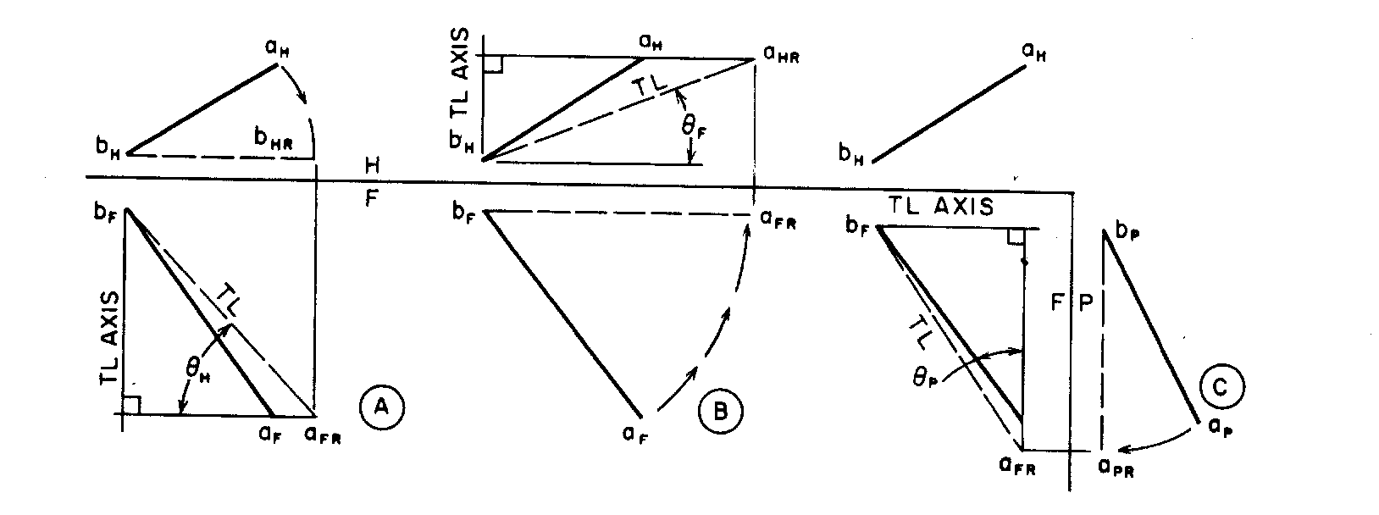
Angle Between a Line & a Principal Plane.

Slide 14
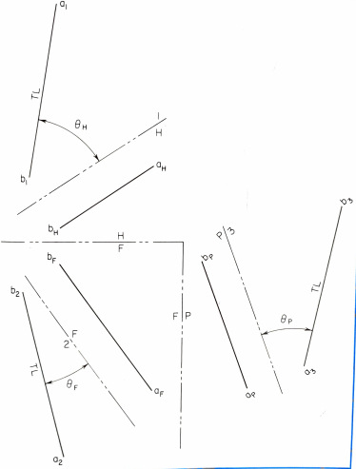

Angle Between Lines & Principal Planes Using the Auxiliary Plane Method

Slide 15
Parallel Lines

Slide 16
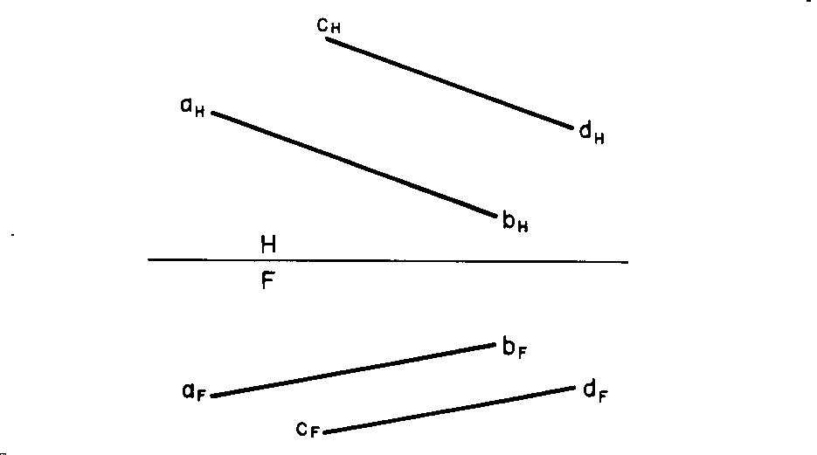
Parallel Lines
Two lines are parallel if they lie on the same plane and do not intersect or touch.
Parallel lines appear parallel in all views.
CASE 1

Slide 17
Parallel Lines
Question
If the lines appear parallel in two adjacent views, will they be necessarily parallel?
In this figure, consider Lines AB and CD.
C_{H}
A_{H}
D_{H}
B_{H}
H
F
B_{F}
A_{F}
D_{F}
C_{F}
Are lines AB and CD parallel?

Slide 18
Lines that Appear Parallel in Two Views Need Not Be Parallel
A_{H}
Some lines may appear parallel in two views but may not really be parallel.
Always check the third view.
C_{H}
B_{H}
D_{H}
H
F
C_{P}
P
B_{F}
C_{F}
B_{P}
D_{F}
D_{P}
A_{F}
A_{P}
Are lines AB and CD parallel?
Draw profile view.

Slide 19
Perpendicular Lines

Slide 20
Test for Perpendicularity
If projections of two lines meet perpendicularly, but none of the projections is of True Length, then the lines need not be perpendicular.
However, the lines are perpendicular if in an auxiliary view showing TL for at-least one line, the projections meet at 90º angle.
J_{H}
I_{H}
L_{H}
K_{H}
H
F
K_{F}
I_{F}
L_{F}
J_{F}
J_{F}
Are the lines JI and KL perpendicular?
No line in True Length

Slide 21
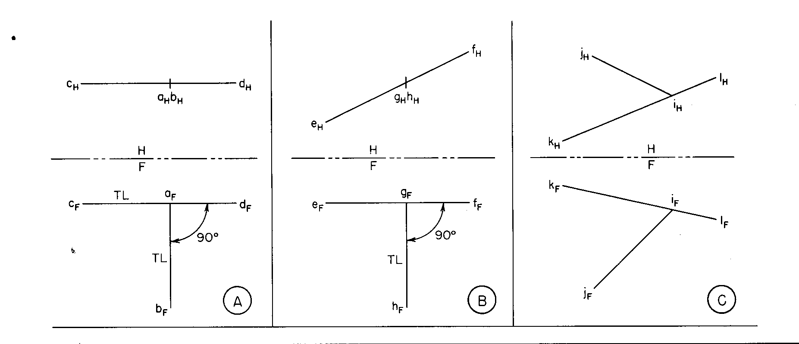
Perpendicular lines
Two lines are perpendicular if there is a 90º angle
between them and if in that view at least one line is in its TL.
Perpendicular (both lines in TL)
Perpendicular (only one line in TL)
Not perpendicular

Slide 22
Perpendicular Lines
Given: AB in H and F views; BC only in F view. Complete line BC in H view such that AB and BC are perpendicular to each other
A1
b_{H}
c_{H}
d
c_{A1}
a_{H}
b_{A1}
TL
H
a_{A1}
F
a_{F}
c_{F}
b_{F}
  If the lines are at 90º angle in an auxiliary view where one of the lines is of TL, then the lines are mutually perpendicular.

Slide 23
Shortest Distance: Point to a Line.
Practical Requirements
Connect pipe / wire from a given point to the main pipe line/ electric supply lines.
Shortest distance saves material.

Slide 24
Thank You

