Slide 1
Technical Arts (TA 101AA)
Engineering Graphics
Prof. Nachiketa Tiwari
Department of Design

Slide 2
Lines in 3D Space

Slide 3
The Problem
H
A_{H}
B_{H}
A
A_{F}
F
B_{F}

Slide 4
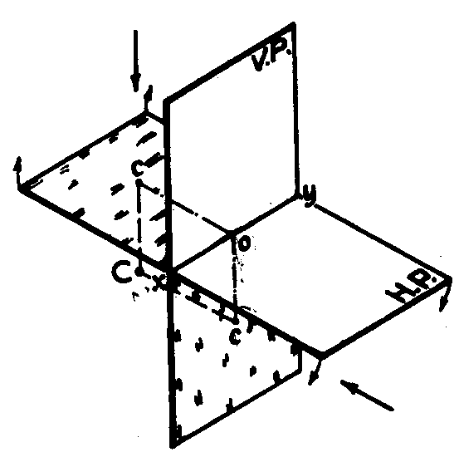
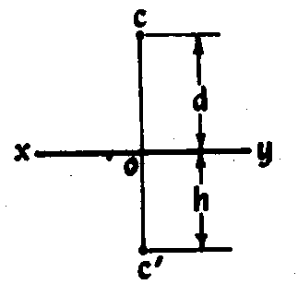
Projection of a Point
A point has only position, no orientation in space.
A point is behind the frontal plane by d units and below the horizontal plane by h units.
HORIZONTAL
PLANE
FRONTAL
PLANE

Slide 5
Important Terms
Normal means perpendicular to a plane or a line.
Normal Line (N): Line in a particular view which shows the True Length of the line.
  Direction of sight is perpendicular to the line.
  The plane of projection is parallel to the line.
Point view of a line : The direction of viewing is parallel to the line itself.
  The plane of projection is perpendicular to line.

Slide 6
Projection of Lines
A line is considered to be of infinite length.
  The portion between any two points on is a segment.
A straight line segment is the shortest distance between its end points.
Direction of line in space is known if we have two of its orthographic views.
We can also locate a line if we know its direction in space (bearing/azimuth and slope), and at least one point on it.

Slide 7
Classification of Lines
Based on the number of principal planes on which the line appears “Normal”.
  In each such plane, you get the “True Length View” of the line.
A line which is parallel to two principal planes of projection, will appear “normal” in two views.
  It is named using these two views. There are three such possibilities.
A line which is parallel to one principal plane will appear normal in only one view.
  The line is named after that view. There are three such possibilities.
A line which is inclined to all three principle planes is termed “Oblique”.
  Its True Length is not visible on any of the three principal projection planes.

Slide 8
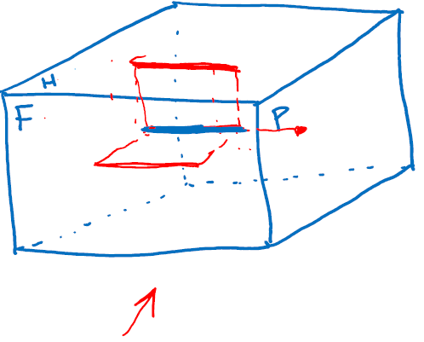
Illustration
A_{H}
N
B_{H}
H
F
P
N
B_{P ,} A_{P}
A_{F}
B_{F}
HORIZONTAL-FRONTAL LINE
Having normal view in H and F planes.
N stands for Normal View of Line

Slide 9
Illustration
A_{H}
N
B_{H}
H
F
P
B_{F}
N
, A_{F}
B_{P}
A_{P}
HORIZONTAL –PROFILE LINE

Slide 10
Illustration
A_{H}
, B_{H}
H
F
P
A_{F}
A_{P}
N
N
B_{F}
B_{P}
FRONTAL -PROFILE

Slide 11
Illustration
A_{H}
N
B_{H}
H
F
P
A_{F}
B_{F}
B_{P}
A_{P}
HORIZONTAL
Inclined to Frontal and Profile

Slide 12
Illustration
A_{H}
B_{H}
H
F
P
N
B_{P}
B_{F}
A_{F}
A_{P}
FRONTAL
Inclined to Horizontal and Profile

Slide 13
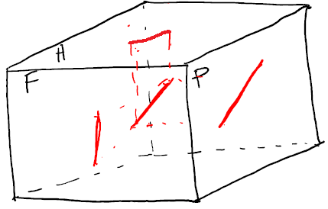
Illustration
A_{H}
B_{H}
H
F
P
A_{F}
A_{P}
B_{F}
B_{P}
PROFILE
Inclined to Horizontal and Frontal

Slide 14
Illustration
A_{H}
B_{H}
Questions
What is such a line’s True Length?
What is its true direction in space?
How do we get its Normal View?
H
F
P
A_{F}
A_{P}
B_{F}
B_{P}
Oblique
Inclined to all Planes

Slide 15
Auxiliary View of an Oblique Line
H
H or A2
A_{H}
B_{H}
A
A_{F}
Where is the Point View of line?
F or A1
B
F
A_{A}
True Length/Normal View)
B_{F}
P
A
B_{A}
A3
LINE OF SIGHT
How do we determine Auxiliary Plane A3?

Slide 16
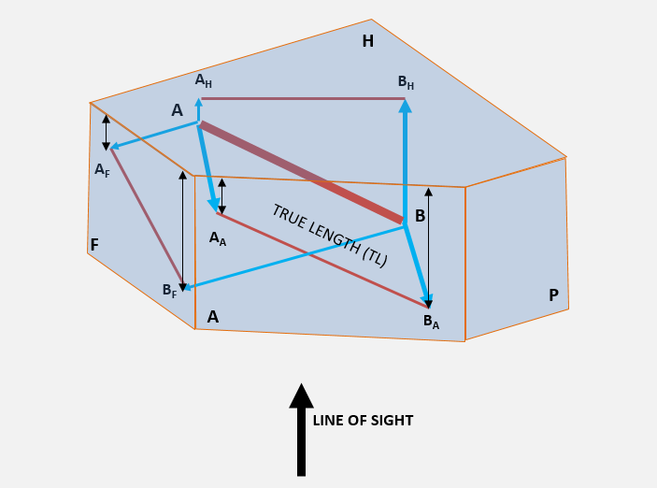
The Three Adjacent Planes
Plane on which Auxiliary View is projected (A3).
Plane from which projectors are drawn (A2).
Plane from which measurements are taken (A1).
A2
A1
A3

Slide 17
Auxiliary View of an Oblique Line
Define the Auxiliary Plane
  Note: A_{H}-B_{H} on A2 is parallel to edge-view of A3. Thus, projection of A-B on A3 will be a Normal View.
  Thus, if a view of a line on a plane is parallel to an edge-view of another plane, then the view of that line will be Normal View on that plane (A3)
Determine the end-points on A3.
  Distance of points A_{A} and B_{A} on auxiliary plane A3 from the hinge line will be same as those between the A1-A2 hinge line and points A_{F} and B_{F}, respectively.
A2
A1
A3

Slide 18
Normal View of Oblique Lines
Suppose you know projections of line in planes A1 and A2.
Can you then draw the Normal and Point Views of line AB?
a_{A3}
N
a_{A2}
Line of Sight
A3
b_{A3}
A4
Line of Sight
A2
A1
b_{A4} , a_{A4}
b_{A2}
A3
A2
d
Point View
a_{A1}
d
b_{A1}

Slide 19
Normal View of Oblique Lines
Projected from the Top/Horizontal View
b_{H}
H
A1
b_{A2}, a_{A2}
d
a_{H}
Line of Sight
b_{A1}
A2
N
A1
H
F
d
a_{A1}
a_{F}
b_{F}
Note the direction of projectors.
Note the distances along projectors.

Slide 20
Normal View of Oblique Lines
Projected from the Front View
B_{H}
Instead of taking distances from Horizontal view to the ends of the line along projectors the same can be also taken from profile view.
A_{H}
H
P
F
B_{P}
B_{F}
F
A1
A_{P}
A_{F}
B_{A1}
TL
A_{A1}
A1
A_{A2} ,B_{A2}
A2

Slide 21
Normal View of an Oblique Line
By Rotation in a View
Hold one end of line and rotate the other end in the horizontal direction
This will rotate the projected view on H plane but there will be no rotation in vertical direction
On Front view the rotation will reflect as movement of one end of line along horizontal line

Slide 22
True Length of a Line
By rotation towards the Frontal Plane,
i.e., make parallel to the Frontal Plane.
B_{H}
A_{H}
B/_{H}
H
P
F
B_{F}
B/_{F}
B_{P}
TL
A_{P}
A_{F}

Slide 23
True Length of a Line
By rotation towards Horizontal Plane,
i.e., make parallel to Horizontal Plane.
B_{H}
B/_{H}
TL
A_{H}
H
P
F
B_{P}
B_{F}
Can we also rotate towards Profile plane?
A_{P}
A_{F}
B/_{F}

Slide 24
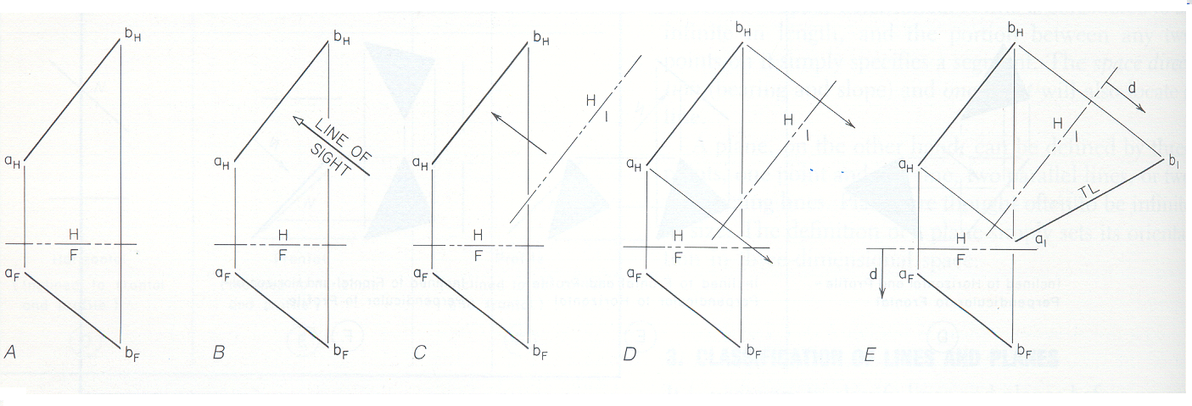
Finding Normal View: Summary
Method 1: Use of auxiliary plane.

Slide 25
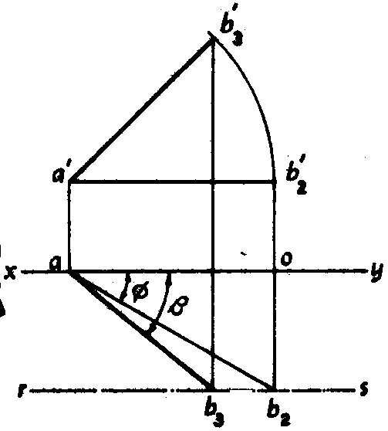
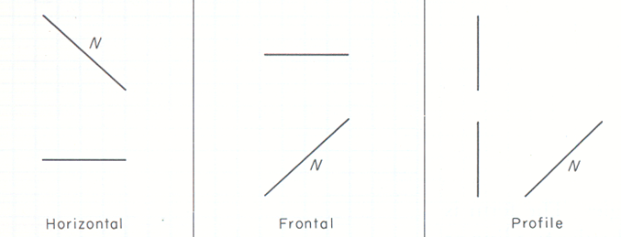
Finding Normal View: Summary
Method 2: Rotation in one plane, & modifying the projection in other plane.
Why does it work?

Slide 26
Thank You

