Slide 1
Technical Arts (TA 101AA)
Engineering Graphics
Prof. Nachiketa Tiwari
Department of Design

Slide 2
Perpendicular Lines

Slide 3
Test for Perpendicularity
If projections of two lines meet perpendicularly, but none of the projections is of True Length, then the lines need not be perpendicular.
However, the lines are perpendicular if in an auxiliary view showing TL for at-least one line, the projections meet at 90º angle.
J_{H}
I_{H}
L_{H}
K_{H}
H
F
K_{F}
I_{F}
L_{F}
J_{F}
J_{F}
Are the lines JI and KL perpendicular?
No line in True Length

Slide 4
Shortest Distance

Slide 5
Shortest Distance (SD): Point to a Line
The concept of perpendicular lines can be used to determine shortest distance from a point to a line.
Problem Definition: A line AB in a plane showing its True Length, and the projection of Point O in the same plane, what is the shortest distance between O and AB?
H
F
Will it be OP, such that OP is normal to AB?
O
A
TL
P
B

Slide 6
Shortest Distance (SD): Point to a Line
Given: AB in TL and projection of O is in the vertical plane in which AB is contained, we wish to know whether OP is the actual shortest distance between O and AB.
Is OP perpendicular to AB?
Yes!
H
F
Is the TL of OP seen in F view as depicted here?
Not necessarily. The TL of OP needs to be found out thru an auxiliary view.
O
A
TL
P
B
OP will indeed be the shortest distance when line AB is depicted in its Point View.

Slide 7
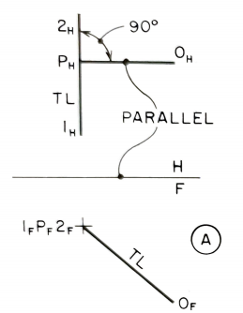

SD: Point to a Line (given in TL & PV)
Construction
Draw a line O-P perpendicular to line 1-2 at ‘P’.
Similarly in F view, Join point ‘O’ and point view of line.
Point view of line 1-2 is given in F view. Hence OP is in TL in the F view.
Line OP is parallel to H plane.

Slide 8
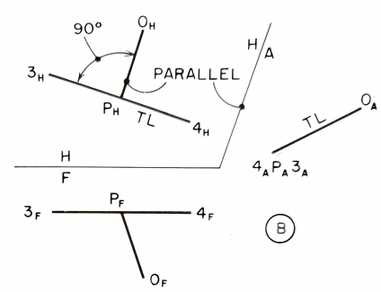
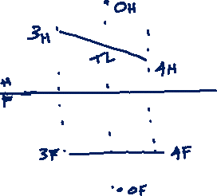
SD: Line in TL but Its PV Not Provided
Point View is required for line 3-4.
Construct auxiliary view H/A to get Point View of line 3-4
Point P must lie along a line from ‘O’ parallel to H/A folding line.
Hence OP is in TL in view A.

Slide 9
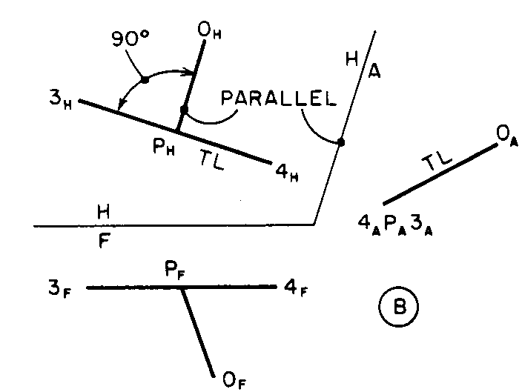
Once point P is found in H view, drop it to the F view on line 3-4.

Slide 10
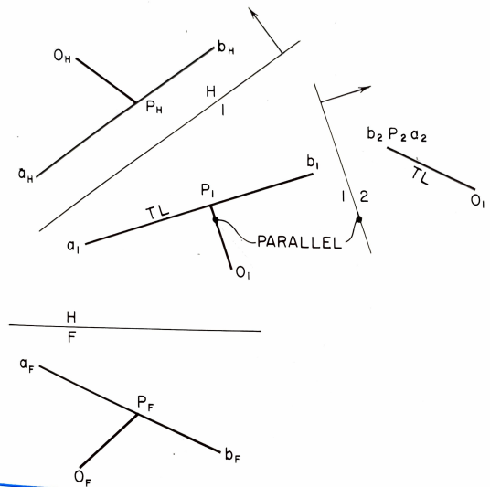
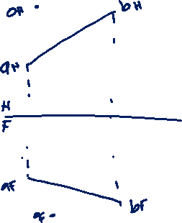
Given Line Not of TL
The shortest distance is seen as TL when line is made a point view.
In view 1 line AB is made TL. O located using distance from F view.
In view 2 AB is made point view. Distances from view H are transferred into view 2.

Slide 11
















Draw Perpendicular from a Point (A) to a Line (CD) Which is not in its TL
$$A_{H}$$
$$D_{H}$$
H
$$B_{H}$$
1
$$C_{H}$$
H
F
1
2
$$C_{V}$$
$$C_{1}$$
$$B_{1}$$
$$TL$$
$$PV (CD)$$
$$D_{1}$$
$$TL$$
$$A_{1}$$
$$A_{2}$$
$$B_{V}$$
$$A_{V}$$
$$D_{V}$$

Slide 12
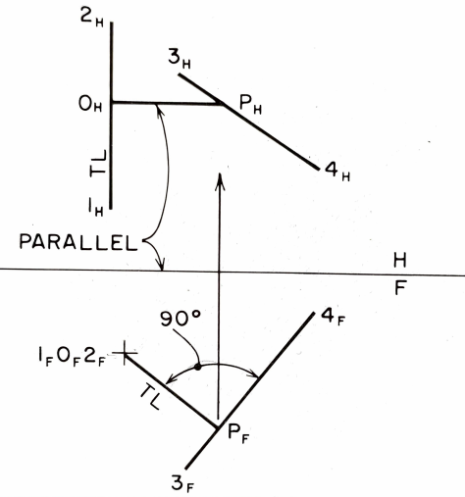

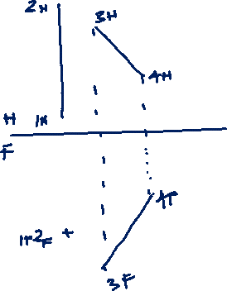
SD Between Two Lines, With One Line in PV
Two lines that are not parallel and do not intersect (skew lines).
The shortest connector between two skew lines is the connector perpendicular to each line.

Slide 13
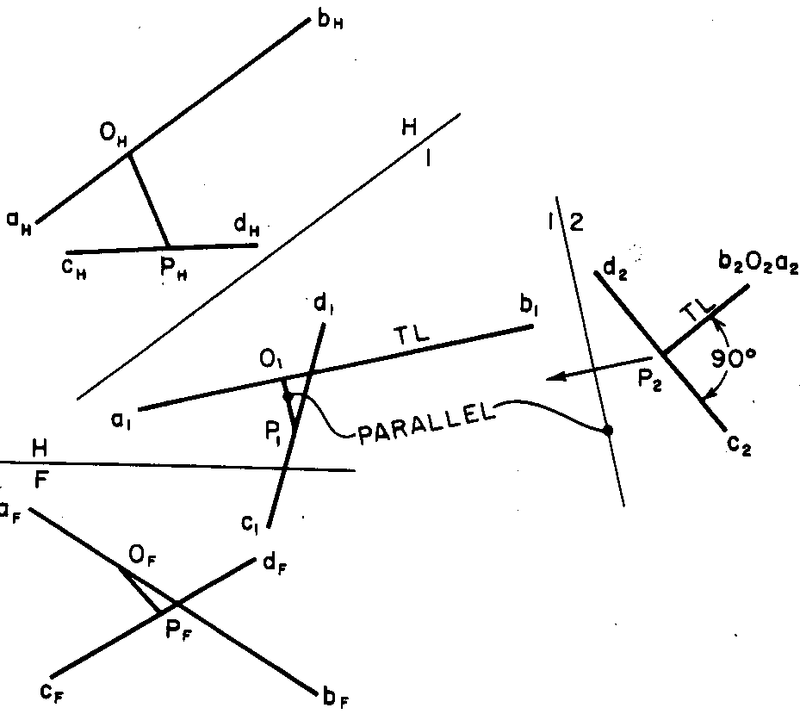
Distance between Skew Lines When Neither are in PV
A line AB is made in point view. (TL then point view) In view 2 the shortest distance OP is added as a TL connector.
Connector makes 90⁰ angle to line CD.

Slide 14
Shortest Distance Between Two Skew Lines
3. Drop perpendicular from PV of AB to CD in A2
1. Get TL of AB and project CD in A1
2. Get PV of AB and project CD in A2
4. In A2, which line is in TL? CD or OP?
5. Obviously, CD is not in TL in A2. OP is the required TL of the shortest distance between AB and CD (in A2)
B_{H}
H
A1
O_{H}
A1
A2
In TL
A_{H}
6. O is not fixed in space, somewhere in line AB
C_{H}
D_{H}
B_{A2},O_{A2},A_{A2}
D_{A2}
P_{H}
D_{A1}
7. Project OP back in A1, H, and F views (from A2)
O_{A1}
B_{A1}
90⁰
TL
P_{A2}
8. Notice that P is in CD and O is in AB
A_{A1}
P_{A1}
C_{A2}
HP
FP
A_{F}
9. How do you locate point O in A1?
O_{F}
D_{F}
C_{A1}
10. Use another basic concept, OP will be parallel to hinge-line A1-A2, why?
P_{F}
C_{F}
B_{F}

Slide 15
Thank You

