Slide 1
Technical Arts (TA 101AA) Engineering Graphics
Prof. Nachiketa Tiwari
Department of Design

Slide 2
Solid-Solid Interactions

Slide 3
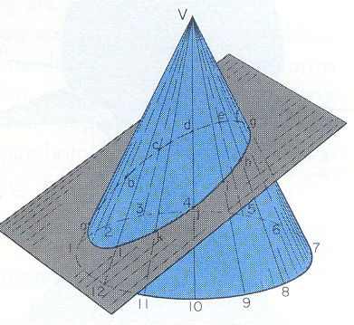
Intersection of a Plane & a Cone
Method 1: Selected Line Method - When an edge view (EV) of the plane is available!
In FP, the cone is seen as a triangle and the plane as Edge View.
Draw lines V-1, V-2 , etc. called ‘elements’ or ‘generators’ in top and front views.
The points of intersection of ‘generators’ and EV give the ‘line of intersection’ of plane and cone in FP.
Locate the points of intersection (e and i) in the HP.
Similarly, locate all other points of intersection in top view and draw the ‘curve of intersection.’
What will be the shape of the ‘curve of intersection’ in top view?
4
3
5
c
d
2
b
e
6
f
a
v
g
7
1
h
l
i
8
12
k
j
11
10
9
HP
v
FP
g
f
Plane in EV
e
h
d
i
c
j
a
b
k
l
4
5
2
3
6
7
12
11
10
9
8
1

Slide 4
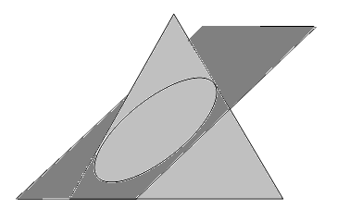
Intersection of a Plane & a Cone
Method 2: Cutting Plane Method -When an oblique plane cuts the cone
Draw generators in both top and front views.
Pass a ‘vertical cutting plane’ through generators
V-2 and V-8, it will be in EV in top view.
The ‘cutting plane’ cuts the cone in two halves; and cuts the oblique plane at points X and Z.
Transfer the points X-Z in the VP.
Points of intersection of line X-Z with generators
(V-2 and V-8) in VP yield desired ‘points of intersection of cone and the oblique plane’.
Transfer these ‘points of intersection’ (b and h) from VP to HP.
Similarly, get all other points of intersection.
4
3
5
2
X_{H}
c
6
b
d
e
a
v
f
1
g
7
l
h
Z_{H}
12
i
8
k
Cutting plane
11
j
9
10
HP
v
VP
c
d
e
f
g
Z_{F}
X_{F}
i
h
b
j
a
l
k
1
2
3
4
5
6
7
12
11
10
9
8

Slide 5
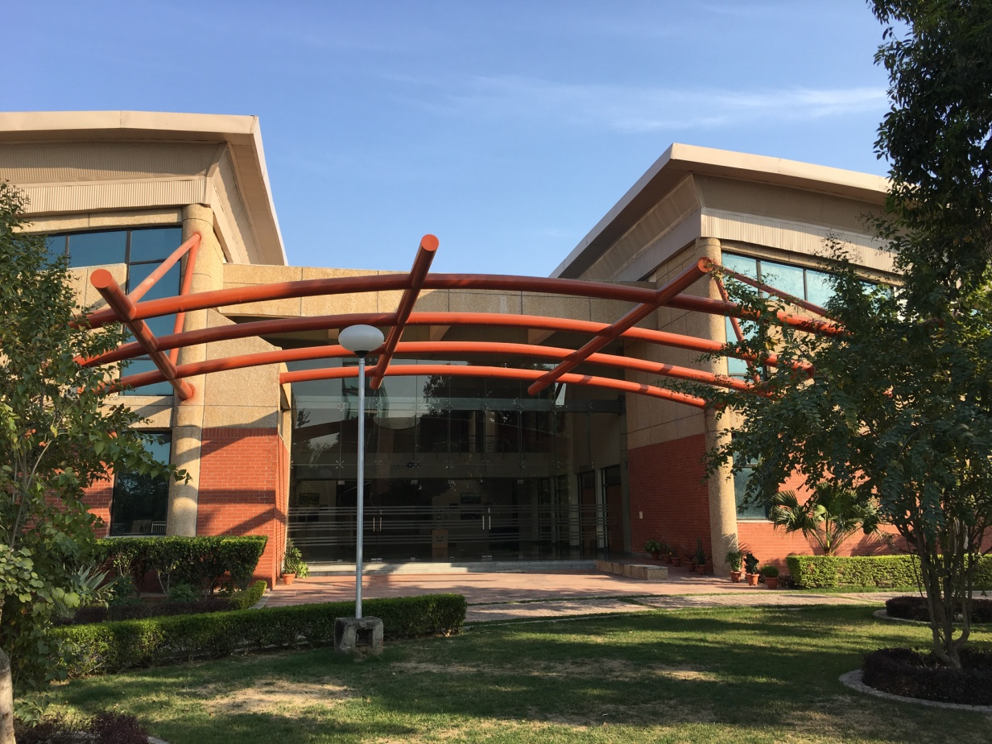
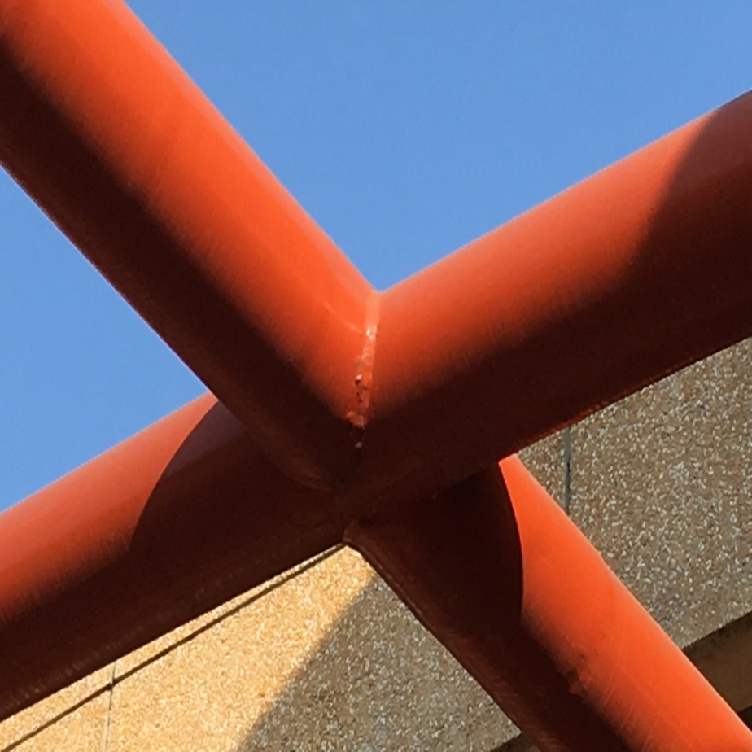
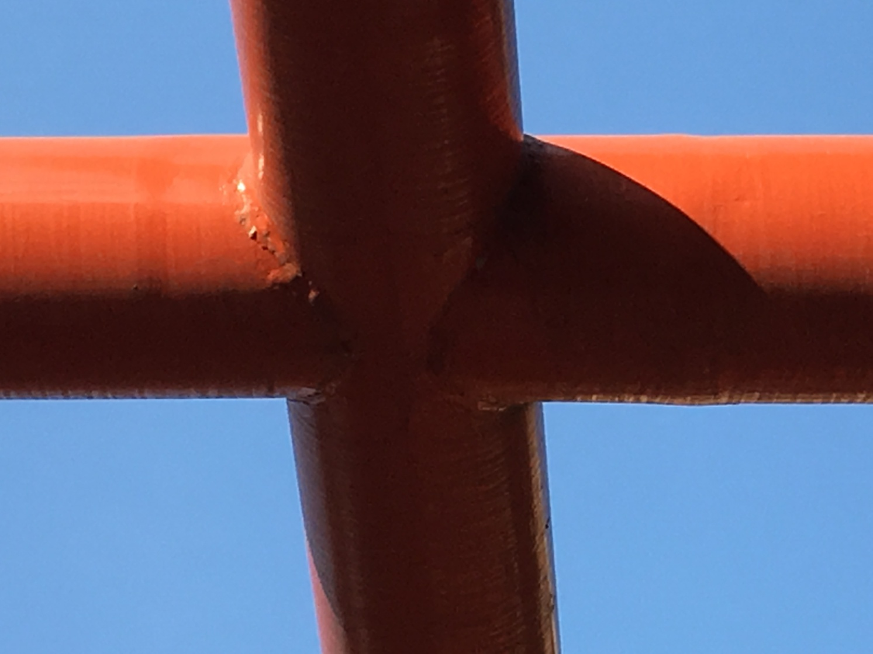
Importance of Solid-Solid Intersections?

Slide 6
Intersection of Two Solids
Two Methods:
Selected line method
Select sufficient number of lines on a surface.
Find the points where each of these lines pierces the other surface.
A line joining these piercing points would give the curve of intersection between the two surfaces.

Slide 7
Intersection of Two Solids
Two Methods:
Cutting plane method
Pass a number of cutting planes through each of the given surfaces simultaneously.
Each plane will cut a line (straight or curved) from each given surface.
These lines will intersect in a point (or points) common to both surfaces.
A curve connecting those points will give the curve of intersection between the two surfaces.

Slide 8
Two Prisms: Selected Line Method
c_{H}, (c’ _{H})
c
4
8
b
p_{H}
p’_{H}
s’
d
a
5
d_{H}, (d’_{H})
b_{H}, (b’_{H})
(q’_{H}), s’_{H}
s
1
r’
(q_{H}), s_{H}
1_{H},(3_{H})
5_{H}, (7_{H})
p
r
6
q’
2
7
r_{H}
r’_{H}
b’
2_{H}
6_{H}
q
3
a_{H}, (a’_{H})
d’
HP
a’
Project 4-2 and 8-6 from HP and find the intersection with p-p’ in VP
Join the intersection lines 1-2, 3-2, 5-6 and 7-6
VP
d_{V}
a_{V},(c_{V})
b_{V}
s_{V}
1_{V}
5_{V}
s’_{V}
(p_{V}), r_{V}
2_{V}
6_{V}
(p’_{V}), r’_{V}
(4_{V})
(8_{V})
q_{V}
q’_{V}
3_{V}
7_{V}
d’_{V}
a’_{V},(c’_{V})
b’_{V}

Slide 9
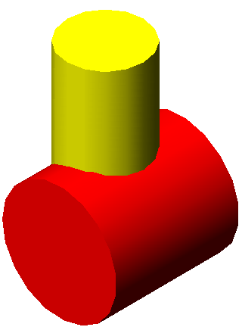
Two Cylinders: Selected Line Method
3_{H}
4_{H}
5_{H}
2_{H}
6_{H}
1_{H}
7_{H}
12_{H}
8_{H}
11_{H}
10_{H}
9_{H}
HP
VP
P
12_{F}
11_{F}
10_{F}
9_{F}
8_{F}
9_{P},11_{P}
7_{P,}1_{P}
1_{F}
7_{F}
8_{P,}12_{P}
6_{P,}2_{P}
2_{F}
6_{F}
10_{P}
5_{P,}3_{P}
3_{F}
5_{F}
4_{P}
4_{F}

Slide 10
Intersection of Two Cylinders
3_{H}
4_{H}
2_{H}
5_{H}
6_{H}
1_{H}
7_{H}
12_{H}
8_{H}
11_{H}
10_{H}
9_{H}
7
8
1
9
12
11
10
H
F
P
12_{F}
11_{F}
9_{F}
7_{F}
8_{P,}12_{P}
7_{P,}1_{P}
1_{F}
2_{F}
10_{F}
6_{F}
10_{P}
6_{P,}2_{P}
3_{F}
5_{F}
5_{P,}3_{P}
4_{F}

Slide 11
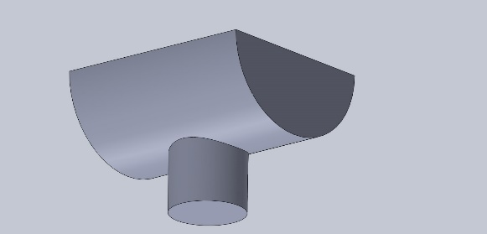
Two Cylinders: Cutting Plane Method
D
4’
4
C
3’
3
B
2’
2
HP
A
1’
Draw the principal views.
Take a ‘vertical cutting
plane’ cutting one
of the cylinders (vertical one)
in front view.
Draw the ‘cutting plane’ in profile view and get its intersection with the other (horizontal) cylinder.
The points of intersection of two cylinders are located in front view through projectors from top and profile views.
Repeat this process by taking more ‘cutting planes’ and get the corresponding ‘points of intersections’ in VP.
Join the points 4’-3’-2’-1-2-3-4 to get the ‘curve of intersection’.
VP
1
1
2
3’
2’
2
3
4
4’
3
4
A
B
C
D

Slide 12
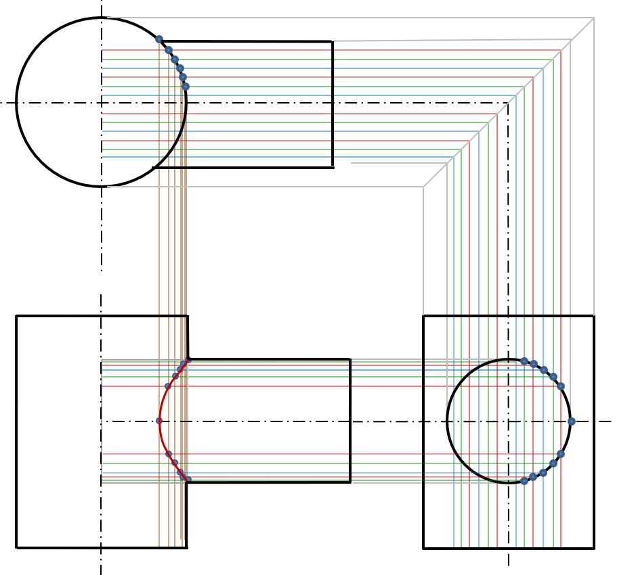
Two Cylinders

Slide 14
Cylinder & Prism: Selected Line Method
Note that the backside of the intersection overlaps with the front side.

Slide 15
Cylinder & Prism: Selected Line Method
Note that the backside of the intersection overlaps with the front side.

Slide 16



Cylinder & Cone: Selected Line Method

Slide 17
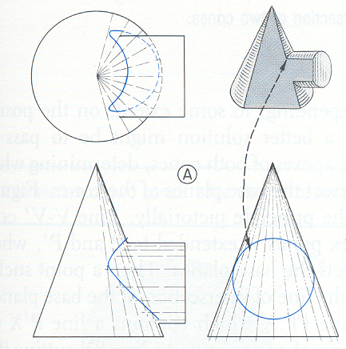
Intersection of Cone and Cylinder

Slide 18
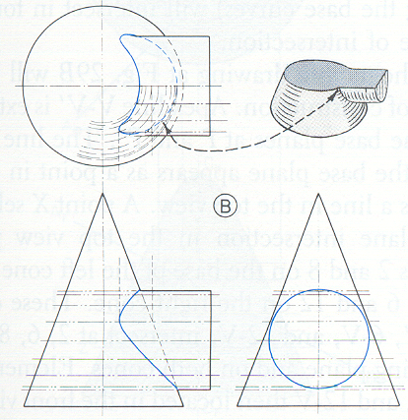
Intersection of Cone and Cylinder

Slide 19
Cone-Cylinder: Selected Line Method
2
1
12
3
j
j
11
i
k
k
i
l
l
4
a
a
10
g
O
g
b
b
5
e
c
c
e
9
d
d
6
8
7
HP
VP
O
O
b, l
a
a
c, k
c
b
l
k
d, j
d
j
e, i
e
i
g
g
4
10
7
1
3, 5
2, 6
1, 7
8, 12
9, 11
6, 8
5, 9
4, 10
3, 11
2, 12

Slide 20
Thank You

