Slide 1
IMDB MOVIE ANALYSIS
Done by B.Havilah

Slide 2
CONTENTS OF THIS TEMPLATE
PROJECT DESCRIPTION | A brief overview of the project topic: its objectives
APPROACH | Project Execution:Tools and Techniques Employed
TECH-STACK USED | Specifying the software used and mentioning it’s purpose
INSIGHTS | Summary of the Insights and Knowledge I gained during this project
RESULTS | Project Accomplishments: Enhancing the understandings of IMDB analysis
CONCLUSION and LINKS | Concluding my project work and attached the links of drive,excel and my video.

Slide 3
TABLE OF CONTENTS
01
02
03
04
05
06
PROJECT DESCRIPTION
APPROACH
TECH-STACK USED
INSIGHTS
RESULTS
CONCLUSION

Slide 4
01
PROJECT DESCRIPTION

Slide 5

WHAT IS IMDB ANALYSIS?
IMDb analysis refers to the examination and evaluation of data and trends related to the Internet Movie Database (IMDb), a popular online database that provides information about films, television series, and video games. The analysis may involve:
studying user ratings, reviews,
cast and crew details,
box office performance
and other relevant data.
This analysis may involve to gain insights into the popularity, reception, and overall impact of movies and TV shows

Slide 6
INTRODUCTION
OBJECTIVE
MY WORK
Researchers, industry professionals, and enthusiasts often conduct IMDb analysis to understand audience preferences, track the success of media projects, and make informed decisions in the entertainment industry.
Here, in this project I have did IMDB analysis of the given dataset and gained insights and created a report like a story telling : Five Why Approach and analysed the impacts of various aspects on imdb scores by visualizing and extra.

Slide 7
02
APPROACH

Slide 8
MOVIE GENRE ANALYSIS
I began by carefully examining the provided dataset, which contained information about various movies, including their genres and IMDB scores.
I did data cleaning : removing null values and duplicate values of the given dataset.
I manipulated the genres column of the dataset , I separated each genre and sorted them
Using =UNIQUE(B2:I3757) where B to I is the data range of genres after separating them, I got 8 genres.
I utilized Excel's COUNTIF function, allowing me to count the occurrences of each genre in the dataset.
Therefore, it gives the number of movies associated with that genre.
Having identified the most common genres, I proceeded to conduct a comprehensive analysis of the impact of these genres on IMDB scores.
To achieve this, I employed Excel functions such as AVERAGE, MEDIAN, MODE, MAX, MIN, VAR, and STDEV of imdb ratings with formulas as :
=IFERROR(AVERAGEIF($C$2:$I$3757,"Biography",$B$2:$B$3757),"")

Slide 9
MOVIE DURATION ANALYSIS
In tackling the second task regarding Movie Duration Analysis, I commenced the analysis by examining the distribution of movie durations within the provided dataset, which included information about movies and their corresponding IMDB scores.
To gain a comprehensive understanding of the impact of movie durations on IMDB scores, I employed various statistical measures.
Firstly, I utilized Excel's AVERAGE, MEDIAN, and STDEV functions to calculate key descriptive statistics, such as the mean, median, and standard deviation of movie durations.
The formulas I used are : =AVERAGE(B2:B3757), =MEDIAN(B2:B3757), =STDEV(B2:B3757)
To visualize the relationship between movie duration and IMDB score, I further implemented Excel's capabilities by creating a scatter plot.
Additionally, I incorporated a trendline onto the scatter plot, enabling a quantitative assessment of the direction and strength of the relationship between movie duration and IMDB score.

Slide 10
LANGUAGE ANALYSIS
In approaching the task of Language Analysis for the IMDB Movie dataset, I started by examining the distribution of movies based on their language.
This involved leveraging Excel's functionalities to derive meaningful insights into the prevalence of different languages in the dataset and their potential impact on IMDB score.
To determine the most common languages used in movies, I employed Excel's COUNTIF function. This allowed me to efficiently count the occurrences of each language in the dataset, providing a clear picture of language distribution.
This gives the no.of movies associated with each language
I calculated descriptive statistics, including the mean, median, and standard deviation of the IMDB scores for each language.
To determine the relationship between imbd and for each specific language, ( case for English) I used formulas :
=AVERAGEIF($B$2:$B$3757, "English", $C$2:$C$3757)
=MEDIAN(IF($B$2:$B$3757="English", $C$2:$C$3757))
=STDEV.P(IF($B$2:$B$3757="English", $C$2:$C$3757))
Where B column has languages and C column has respective imdb scores.

Slide 11
DIRECTOR ANALYSIS
In addressing the task of Director Analysis for the IMDB Movie dataset, my approach involved identifying the influence of directors on movie ratings through a systematic analysis.
First I identified all the unique directors from the director column by using the formula =UNIQUE(A2:A3757) where A is the column with all the director names.
Next,I calculated the average imbd score for each director by matching with unique director column with the formula:
=IFERROR(AVERAGEIFS($B$2:$B$3757, $A$2:$A$3757, C3:C3757), "")
Where B is the column with imdb scores and c is the column of unique director names.
Later I calculated the percentile
Next,I found out the highest Avg Imdb score and also the director associated with it.

Slide 12
BUDGET ANALYSIS
In addressing the task of Budget Analysis for the IMDB Movie dataset, my approach involved exploring the relationship between movie budgets and their financial success.
To understand the correlation between movie budgets and gross earnings, I utilized Excel's CORREL function.
This statistical measure allowed me to calculate the correlation coefficient, providing insights into the degree and direction of the relationship between the two variables.
A positive correlation would suggest that higher budgets are associated with higher gross earnings.
I calculated the profit of each movie by using the formula =(C2:C3757-B2:3757),where C column with movie gross and B is column of movie budget.
Later I calculated the profit margin and also found the highest profit margin using =MAX() function.
I also used the =MAX() function to identify the movie with highest gross.

Slide 13
03
TECH-STACK USED

Slide 14
MS EXCEL 2022
Excel's built-in functions are powerful tools for calculating descriptive statistics
Excel allows for the creation of various charts and visualizations, helping to present findings in a more digestible and accessible manner

Slide 15
04
INSIGHTS

Slide 16
GENRE ANALYSIS
Adventure movies generally have a moderate average rating with a relatively narrow range of scores.
Action movies have a slightly lower average rating compared to Adventure, with a moderate level of variability.
Biography movies tend to have a slightly lower average rating and a moderate level of variability.
Comedy movies have a moderate average rating with a relatively narrow range of scores.
Crime movies have a moderate average rating with a moderate level of variability.
Drama and Western movies have a moderate to high average rating with a relatively narrow range of scores.
Horror movies have a moderate to high average rating with a moderate level of variability.
Fantasy and Romance movies have a moderate average rating with a lower level of variability.
Thriller movies have a higher average rating with a moderate level of variability.
Musical movies have a relatively high median score, suggesting consistent positive reception, and a lower level of variability.
Mystery movies have a moderate average rating with a moderate level of variability.
Sci-Fi movies have a lower average rating with a higher level of variability.
Family movies have a significantly higher average rating compared to other genres, with a relatively narrow range of scores.
Documentary movies have a higher level of variability in IMDb scores.
Genres like "Family" and "Adventure" tend to have higher average IMDb scores compared to others.
"Documentary" and "Sci-Fi" genres have a wider range of IMDb scores, indicating greater variability in audience preferences.
"Animation" and "Musical" genres have relatively high median scores, suggesting consistent positive reception.
These insights can guide decisions regarding genre selection and highlight potential audience preferences within specific genres.

Slide 17
MOVIE DURATION ANALYSIS
The provided statistics give insights into the distribution of movie durations and their impact on IMDb scores:
Average Duration:
The average duration of movies is approximately 110.26 minutes.
Median Duration:
The median duration, which represents the middle value in the dataset, is 106 minutes.
Standard Deviation of Duration:
The standard deviation of movie durations is approximately 22.65 minutes.
Interpretation:
The average duration provides a central tendency measure, indicating the typical length of movies in the dataset.
The median duration being lower than the average suggests that there might be some longer movies pulling the average higher.
The standard deviation reflects the variability or spread in movie durations. A higher standard deviation indicates a wider range of durations, suggesting diversity in the dataset.
Impact on IMDb Score: While the statistics provide insights into movie durations, the impact on IMDb scores is not directly addressed in the provided information. To explore this relationship further, you might consider creating a scatter plot or regression analysis to examine how movie duration correlates with IMDb scores. This additional analysis could reveal patterns or trends in how movie length influences audience ratings.

Slide 18
LANGUAGE ANALYSIS
English-language movies dominate the dataset with 3598 movies.
Languages like Mandarin, Japanese, and Hindi exhibit strong average IMDb scores.
Small sample sizes in some languages may affect the reliability of the statistics.
Portuguese-language movies have a high average IMDb score of 7.76, and the median is 8, indicating positive audience reception.
Japanese-language movies show a positive trend with an average IMDb score of 7.66 and a median of 8, indicating generally favorable ratings.
Other languages like Zulu ,Dari, Romanian etc. have only one movie entry but most of them have the average rating around 7.5
Positive trends in average and median scores suggest generally well-received movies in various languages.
Consideration of language diversity is essential for catering to a broader audience and potentially improving ratings.
These insights can guide decisions related to language preferences and potential target audiences for future movie productions.

Slide 19
DIRECTOR ANALYSIS
Directors like James Cameron, Christopher Nolan, and Andrew Stanton fall into the high percentile, suggesting consistently high IMDb scores.
These are the directors who have 100 percentile : Akira Kurosaw, Kevin Jordan, Jafar Panahi ,Shane Curruth and Majid Majidi.
The comparison to the highest percentile directors, such as Akira Kurosawa and Majid Majidi, provides a benchmark for excellence in movie ratings.
Akira Kurosawa is also the director with the highest average IMDB score.
Some directors classified as "Low" percentile still have competitive average IMDb scores, showcasing variations in audience reception.
Understanding directors' impact on ratings can be valuable for decision-making in the film industry.
These insights can guide studios and filmmakers in selecting directors and understanding their potential influence on the success of a movie based on historical IMDb scores

Slide 20
BUDGET ANALYSIS
Correlation:
Correlation coefficient: 0.0995
Indicates a weak positive correlation between movie budgets and gross earnings.
Profit Analysis:
Highest Profit Margin (HPM): 99.99%
Movie with HPM: "Paranormal Activity"
Highest Profit: $523,505,847
Movie with Highest Profit: "Avatar"
Individual Movies:
"Paranormal Activity" achieved the highest profit margin, indicating exceptional financial success.
"The Dark Knight Rises" had a profit of $198,130,642, contributing positively to overall financial success.
"John Carter" experienced a significant loss of $190,641,321, impacting profitability negatively.
"The Lone Ranger" had a substantial loss of $125,710,090, contributing to a low profit margin.
Key Points:
The correlation analysis suggests a weak positive relationship between movie budgets and gross earnings. However, other factors likely contribute to a movie's financial success.
"Avatar" stands out with the highest profit and a substantial profit margin, showcasing both critical and financial success.
Movies like "Paranormal Activity" demonstrate that even with lower budgets, they can achieve exceptional profit margins.
Some movies, like "John Carter" and "The Lone Ranger," faced significant losses, highlighting the financial risks associated with high-budget productions.
These insights can guide filmmakers and studios in understanding the financial dynamics of the film industry, helping them make informed decisions regarding budget allocations and profitability expectations.

Slide 21
05
RESULTS

Slide 22
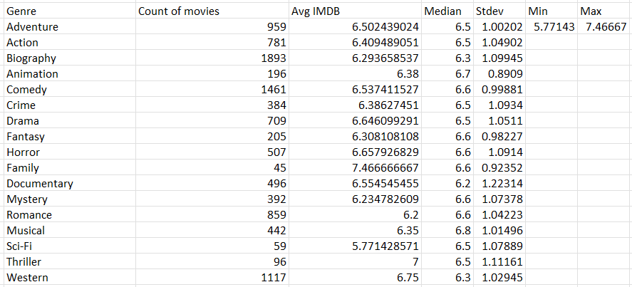
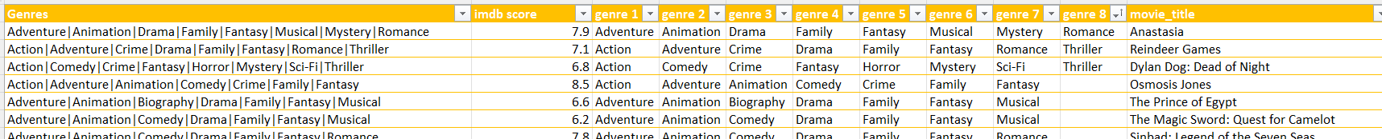
A.GENRE ANALYSIS

Slide 23
B.MOVIE DURATION ANALYSIS

Slide 24
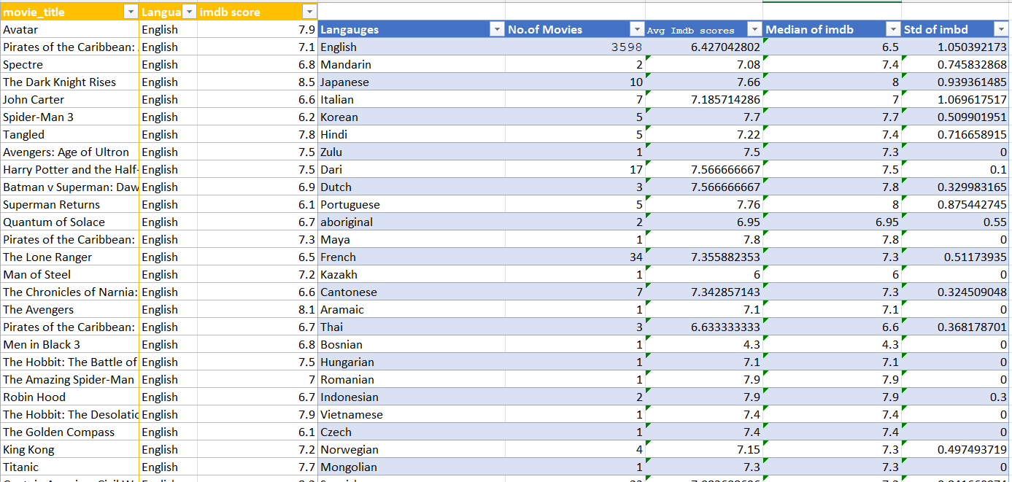
C.LANGUAGE ANALYSIS

Slide 25
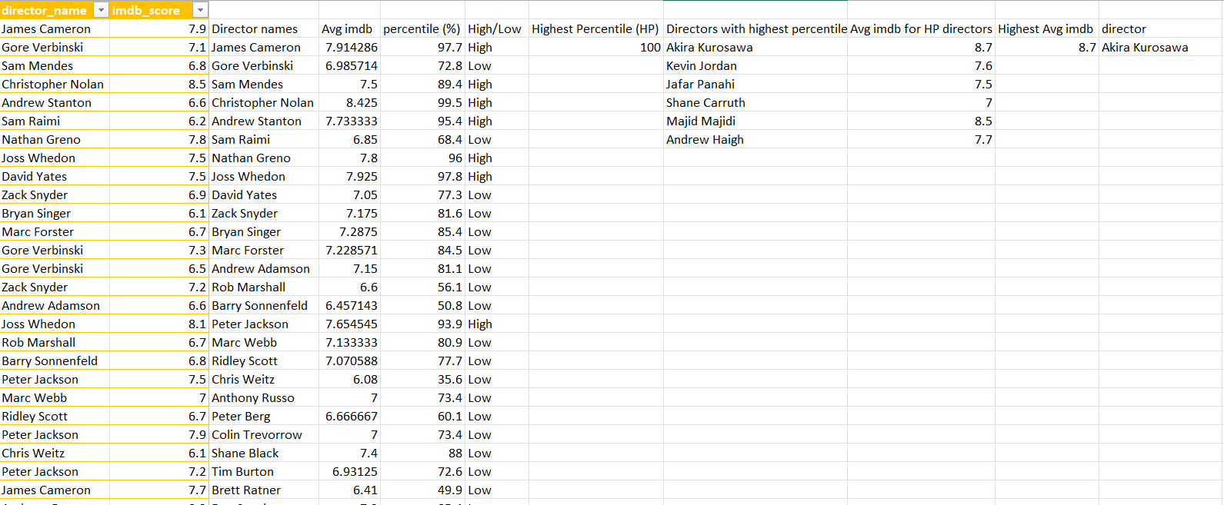
D.DIRECTOR ANALYSIS

Slide 26
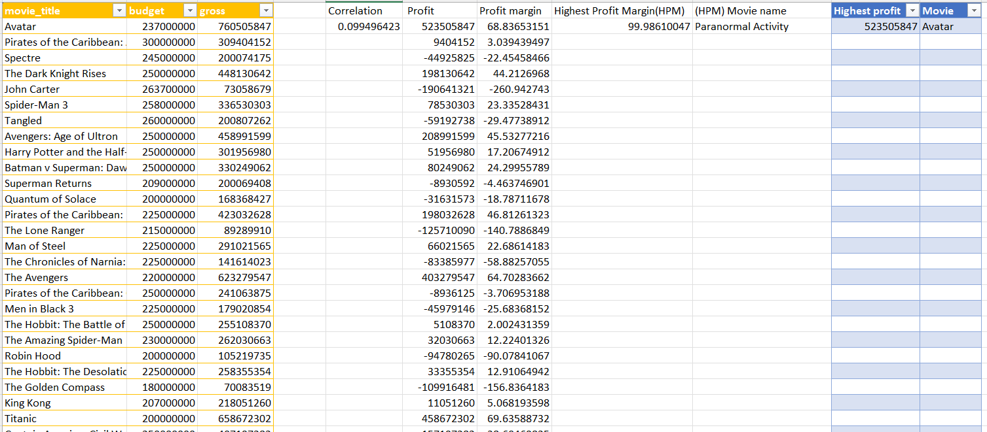
E.BUDGET ANALYSIS

Slide 27
$523,505,847
99.986%
$760,505,847
Highest profit for AVATAR MOVIE
Highest gross for AVATAR MOVIE
Highest profit margin for Paranormal Activity movie

Slide 28
DATA STORY -1
Based on “Genres”, using 5 why approach method
1.Q: “Why do certain movie genres dominate the industry?”
A: Certain genres have universal appeal and resonate with diverse audiences.
2.Q: “Why do these genres have universal appeal?”
A: They often tap into fundamental human emotions and experiences.
3.Q: “Why do emotional and relatable experiences attract more viewers?”
A: Viewers seek connections and emotional engagement, making these genres popular.
4.Q: “Why do emotionally engaging movies often receive higher IMDb scores?”
A: Positive emotional experiences contribute to positive reviews and higher ratings.
5.Q: “Why do positive reviews impact a movie's success?”
A: Positive reviews influence other viewers, contributing to increased popularity.

Slide 29
DATA STORY - 2
Based on “Languages”, using 5 why approach method
1.Q: "Why do certain languages dominate the film industry globally?"
A: Certain languages have a broader international audience and market reach.
2.Q: "Why do these languages have a broader international audience?“
A: They are commonly spoken or widely understood across various regions.
3.Q: "Why does wide language understanding contribute to higher IMDb scores?“
A: A broader audience increases the likelihood of positive reviews and higher ratings.
4.Q: "Why do positive reviews play a crucial role in a movie's global success?“
A: Positive reviews create a positive perception, driving international viewership.
5.Q: "Why does international viewership contribute to a movie's overall success?“
A: A diverse audience increases the movie's global impact and commercial success.

Slide 30
DATA STORY - 3
1.Q: "Why do certain directors consistently produce high-rated movies?"
A: Renowned directors bring a unique vision and storytelling expertise to their projects.
2.Q: "Why does a unique vision and storytelling expertise lead to higher IMDb scores?“
A: Directors with a strong vision often create memorable and impactful films.
3.Q: "Why do memorable and impactful films receive positive reviews and high ratings?“
A: Viewers appreciate and celebrate movies that leave a lasting impression.
4.Q: "Why does leaving a lasting impression contribute to a director's continued success?“
A: Positive reception builds a director's reputation, attracting more opportunities.
5.Q: "Why does a director's reputation influence a movie's success beyond IMDb ratings?“
A: A director's reputation affects audience expectations and can drive box office success.
Based on “Directors”, using 5 why approach method

Slide 31
DATA STORY - 4
Based on “Durations”, using 5 why approach method
1.Q: "Why do movies with longer durations sometimes receive higher IMDb scores?"
A: Longer durations allow for more in-depth storytelling and character development.
2.Q: "Why does in-depth storytelling and character development contribute to higher IMDb scores?“
A: Viewers appreciate movies that offer a rich and immersive narrative experience.
3.Q: "Why does a rich and immersive narrative experience lead to positive reviews and higher ratings?“
A: Positive viewer experiences result in favorable reviews and elevated ratings.
4.Q: "Why do elevated ratings for movies with longer durations impact audience perceptions?“
A: Positive ratings shape audience perceptions, influencing their viewing choices.
5.Q: "Why does audience influence contribute to the overall success of movies with longer durations?“
A: Positive audience influence enhances the long-term success and cultural impact of the movie.

Slide 32
CONCLUSION
As we conclude our cinematic journey through data, we recognize that the world of movies is multifaceted and ever-evolving. IMDb scores, a reflection of audience sentiments, serve as a compass for filmmakers navigating the intricacies of storytelling and production. Armed with these insights, the film industry can continue to captivate global audiences, leaving an indelible mark on the tapestry of cinematic excellence.

Slide 33
LINKS
GOOGLE DRIVE LINK
imdb folder link
EXCEL WORK BOOK LINK
my_excel_book
PRESENTATION VIDEO LINK
Loom_link

