Slide 1
Impact of Car features on price & profitability
Done by : B.Havilah

Slide 2
Contents of this Presentation
Project Description | Over view of the project
Approach | An assortment of graphic resources that are suitable for use in this presentation
Tech-Stack used | Specifying the software I used along with its purpose.
Insights | Insights derived for the given project dataset.
Results | Screenshots of the results which I have obtained in this work.
Conclusion and links | Conclusion and links of the ppt,video and my work.

Slide 3
01
Project Description

Slide 4
About the project
IMPACT OF CAR FEATURES
ON PRICE & PROFITABILITY
This project aims to investigate how various car features influence both the price and profitability of vehicles. By analyzing a dataset containing information on car specifications, pricing, and sales figures, the project seeks to uncover insights that can inform decision-making processes within the automotive industry
Key analysis include :Market Category and Popularity Analysis, Engine Power and Price Relationship, Key Feature Identification, Manufacturer Price Variation, Fuel Efficiency and Engine Cylinders Relationship.Through these analyses, the project aims to provide actionable insights for overall profitability in the automotive market.

Slide 5
02
Approach & Insights

Slide 6

Analysis
Task 1A:
First I have gathered all unique car models in one column of EXCEL by using applying the formula to original car models column A = UNIQUE(A2:A11200).
Next , I matched the respective popularity and Market Category for each unique car model.
Insight : The Average Popularity is 1406.729
I also created pivot table which shows the market category and sum of popularity correspondingly.
Task 1B:
I created a bar graph in Power BI with market category by sum of popularity.
Insight: 1902985 is the highest sum of popularity for the market category: flex fuel.
I used Power BI for this specific visualization.

Slide 7

Task 2 :To represent the relationship between engine power and MSRP( price) , I created:
Scatter plot and added trend line to the chart.
Insight: As the Engine Horse power increases, MSRP also increases.
At Engine Horse power 1001 we obtain 3 average MSRPs ,among them 2065902 is the highest average MSRP.
Task 3 :
I have done regression analysis for Engine HP and Popularity with MSRP.
Used Power Bi function to visualize the regression analysis. Applied filters.
Insight: MSRP depends strongly on various variable like Vehicle size, MPG,HP
Also used HP and MPG variables in Excel , which gives HP is more strongly related to MSRP.

Slide 8


Task 4A: I Created a pivot table that shows the average price of cars for each manufacturer .
Task 4B: I Created a bar chart or a horizontal stacked bar chart that visualizes the relationship between manufacturer and average price.
Insight: Bugatti has the Highest Average of MSRP : 1757223.67
Task 5A:
Created a scatter plot with the number of cylinders on the x-axis and highway MPG on the y-axis.
Insight : The highway MPG doesn’t really depend on no.of cylinders .
Highest highway MPG is recorded as 354 with 4 cylinders.
Task 5B:
Calculated the correlation coefficient between the number of cylinders and highway MPG to quantify the strength and direction of the relationship.
Insight: The correlation coefficient is -0.61

Slide 9



Building Interactive Dashboard
For this section, I used Power BI for the visuals and MS Excel for the pivot tables.
Task 1:
Created Stacked column chart to show the distribution of car prices by brand and body style.
I Calculated the total MSRP for each brand and body style using Pivot Tables.
Insight: Sedan vehicle style has the highest number of Make (2843) and it has also has the highest MSRP
Task 2:
I used Clustered column chart to compare the average MSRPs across different car brands and body styles.
I Calculated the average MSRP for each brand and body style using Pivot Tables.
Insight :Maybach has the highest Average MSRP in total 1808289.29 combined with Convertible and Sedan vehicle styles.

Slide 10


Task 3:
Implemented Scatter plot chart to visualize the relationship between MSRP and transmission type varying with body style in power BI.
Calculated the average MSRP for each combination of transmission type and body style using Pivot Tables in Excel.
Insight: Automated Manual transmission type has the highest average of MSRP with 108718.99
Task 4:
Created Line chart to show the trend of fuel efficiency (MPG) over time for each body style.
Calculated the average MPG for each combination of body style and model year using Pivot Tables.
Insight: Sedan vehicle style has the highest MPG.

Slide 11
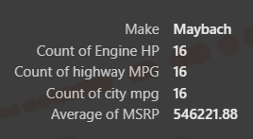
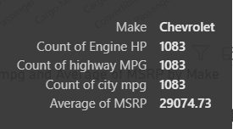
Task 5:
Created a scattered chart to visualize the relationship between horsepower, MPG, and price across different car brands.
Insight: The price doesn’t depend on no.of HP and MPG that one car brand have , as per the visuals Chevrolet has count of 1083 HP and MPG in total but has only 29074.73.
Maybach has only 16 MPG and HP but has average MSRP of 546221.88
Which means MSRP is not necessarily increase the average MSRP of the brand.
The chart just represents the increase in count of HP and MPG linearly.
Calculated the average horsepower, MPG, and MSRP for each car brand using Pivot Tables

Slide 12
03
TECH-STACK USED

Slide 13


MS-EXCEL and POWER BI DESKTOP
Why I have choosen these softwares:
Used Excel mainly for pivot tables and easy calculations.
Used Power BI for interactive dashboard and mainly for smooth visuals.

Slide 14
04
RESULTS

Slide 15
Excel visuals

Slide 17
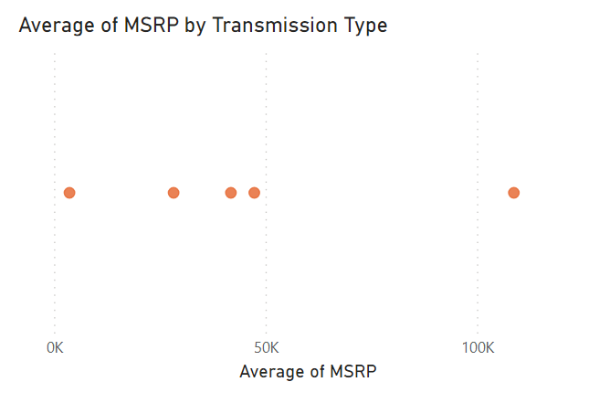
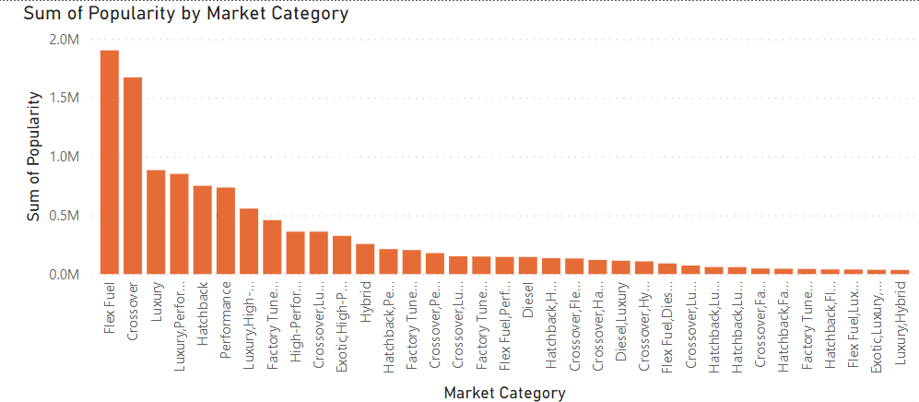
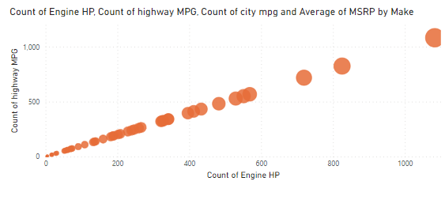
Power BI visuals

Slide 18
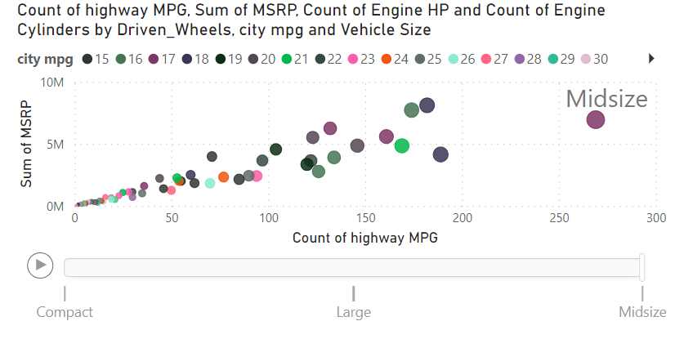
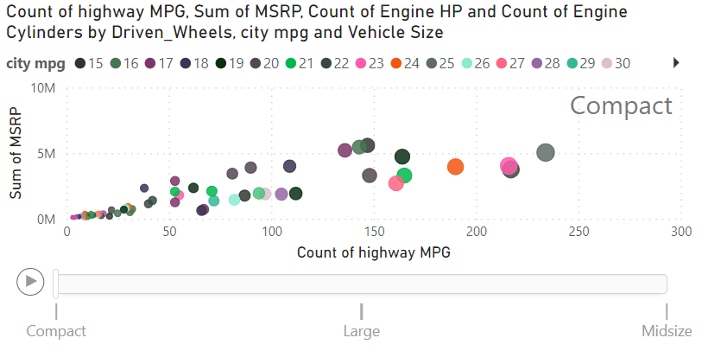
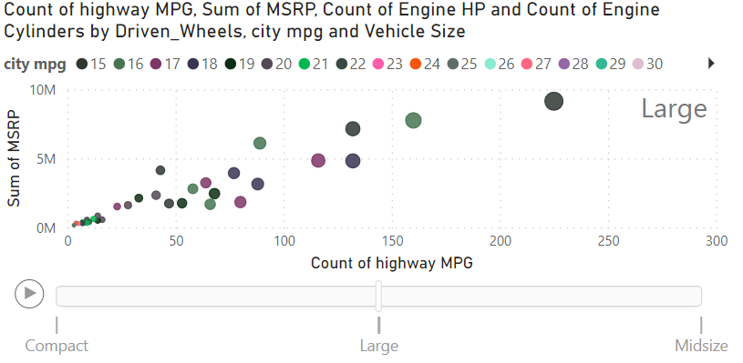
For task 3 in analysis section – regression analysis

Slide 19
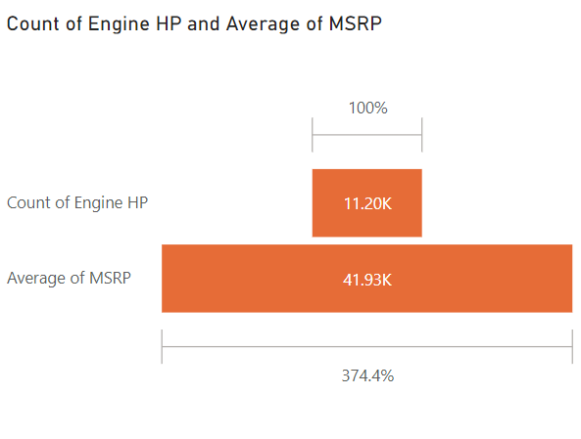
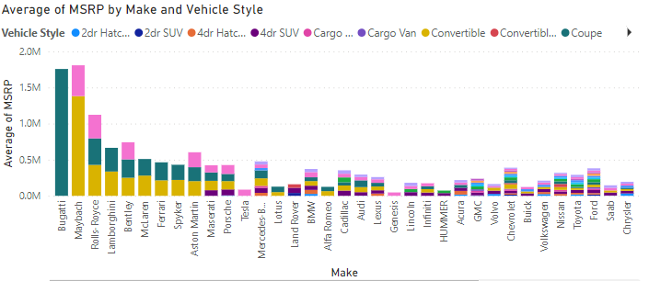
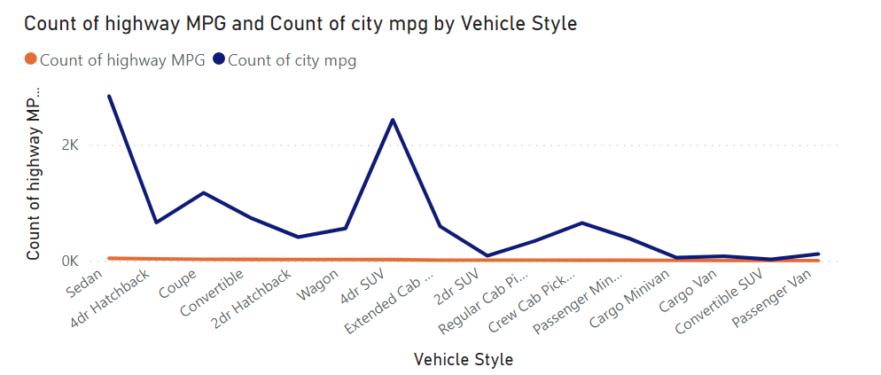

Slide 20
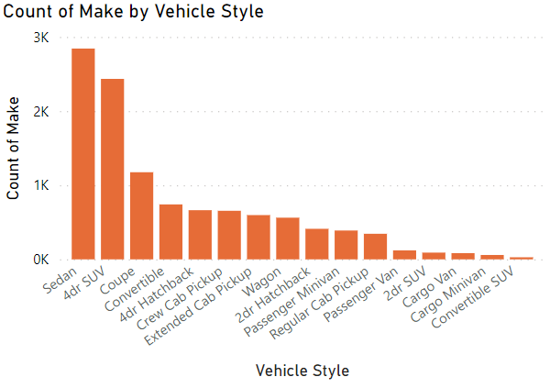
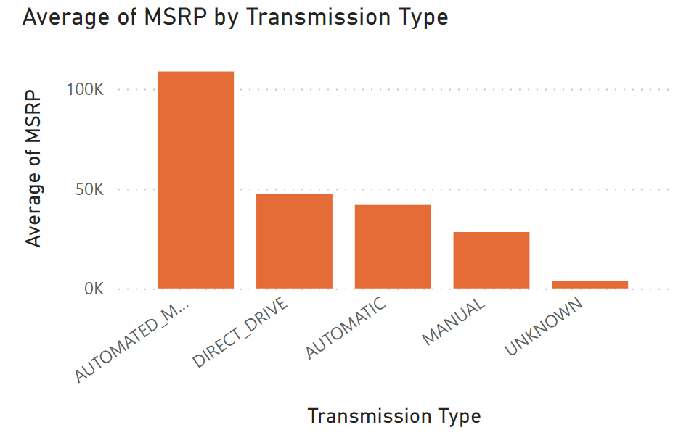
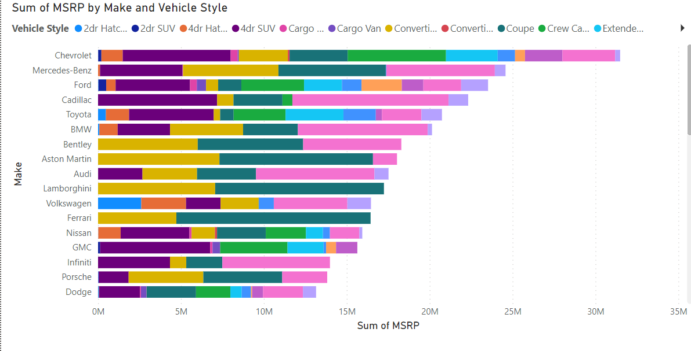

Slide 21
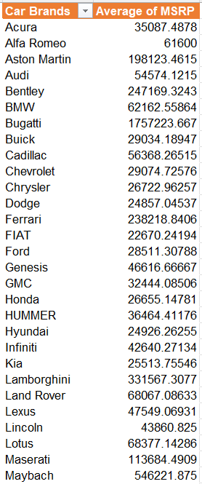
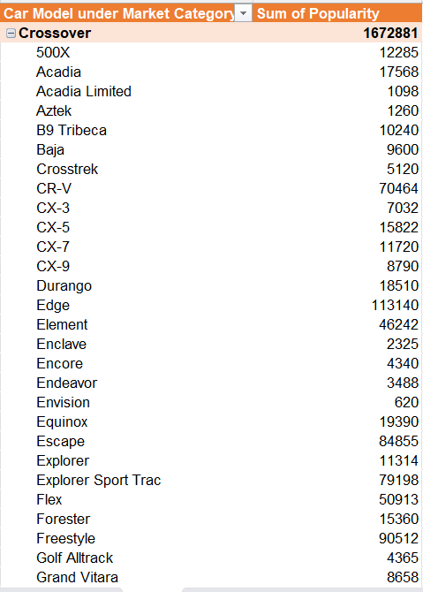
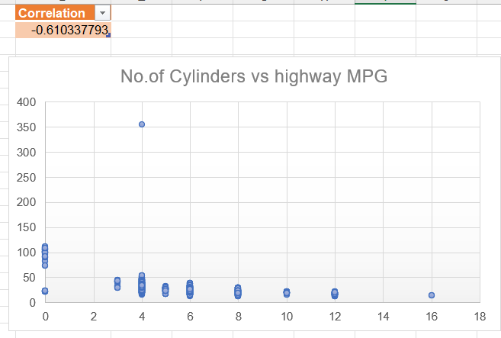
PIVOT TABLES – SECTION 1

Slide 22
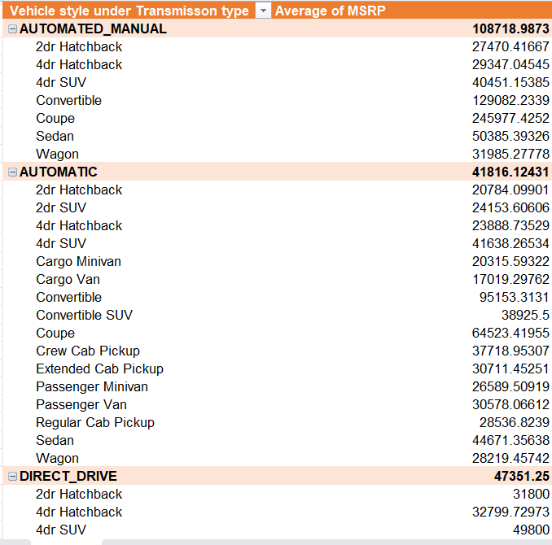
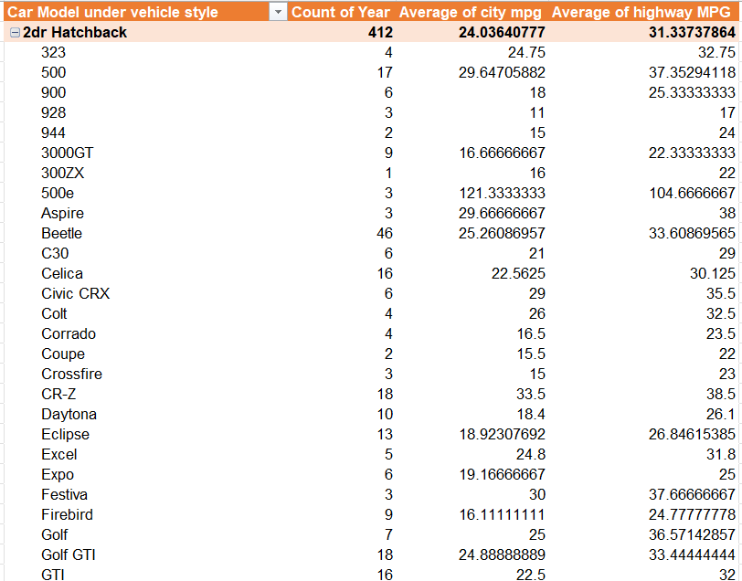
PIVOT TABLES – SECTION 2

Slide 23
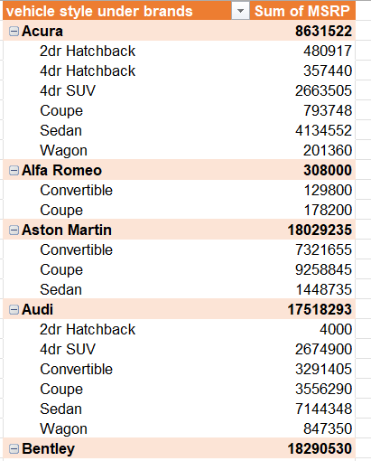
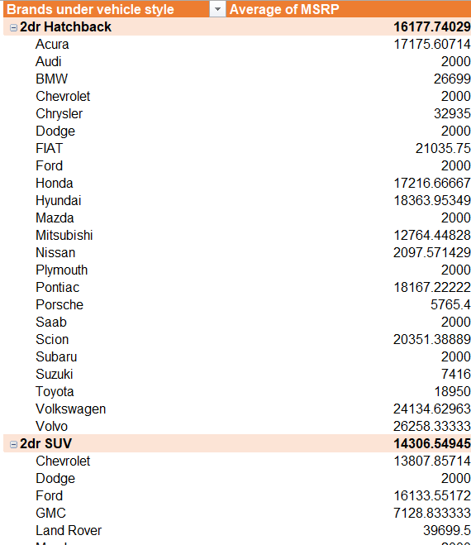

Slide 24
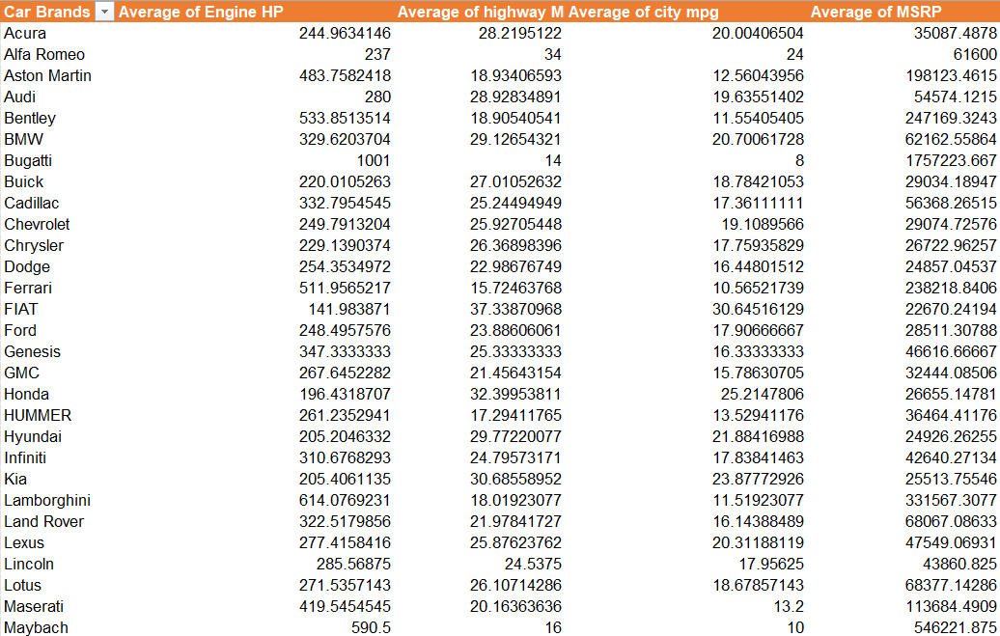

Slide 25
05
CONCLUSION

Slide 26
Overall, the project involved comprehensive data analysis and visualization techniques using both Excel and Power BI. Insights were drawn regarding various relationships between car attributes such as horsepower, MPG, manufacturer, and MSRP. These insights can be valuable for understanding market trends and making informed decisions in the automotive industry.
Google drive link: Impact_car_features
Excel workbook: my_excel_book
Power BI file: power_bi_file
Power BI visuals pdf: power_bi_pdf
Video presentation link: my_loom_video

