Slide 1
Entry for Magnum Opus
MyShelf
An Online Book Manager
A Scheduler and a library Management System
Team Members –
Joney Singhal (ABV-IIITM Gwalior)
Rajesh Kumar (ABV-IIITM Gwalior)

Slide 2
Brief Introduction
MyShelf is an online book manager where you can keep all the details of your favorite readable like books, magazines etc. You can keep track of what others read and also maintain your own online BookShelf. Other Features -
Store E-books of your favorite books.
You can add Schedule, when to read your books.
As per Schedule you will be notified via mails and sms’s.
You can Categorize the books.
You can search all the books available on the hub.
Rate the Books stored in other’s Bookshelf.
Admin can control all the shelf and maintain creditability of the content.
You can review the books .
Socialize by commenting and sending messages to others.

Slide 3
Utility
Need for Digitalization leads to the online book management system.
Right thing at the right time via proper schedulers and notifier.
Social networking and the sharing of data.
Ebook Readers and multi format supports.
More you explore, more you get inspired. Shelve into others bookshelves and know what they read.

Slide 4
Process Flow Details(Simplest Working)
MyShelf
Enjoy the features
Logout
If Not Registered
Register
If Registered
Login
Add Books
Add Schedule
Rate Books
Power Search
Socialize

Slide 5
Project Implementation
Technology Used –
HTML, CSS, JQuery and JavaScript (Client Side)
PHP, MySQL (Server Side)
Python (Link Extractor)
Tools Used –
Dreamweaver
Notepad++
WAMP
Agents like Web Browser

Slide 6
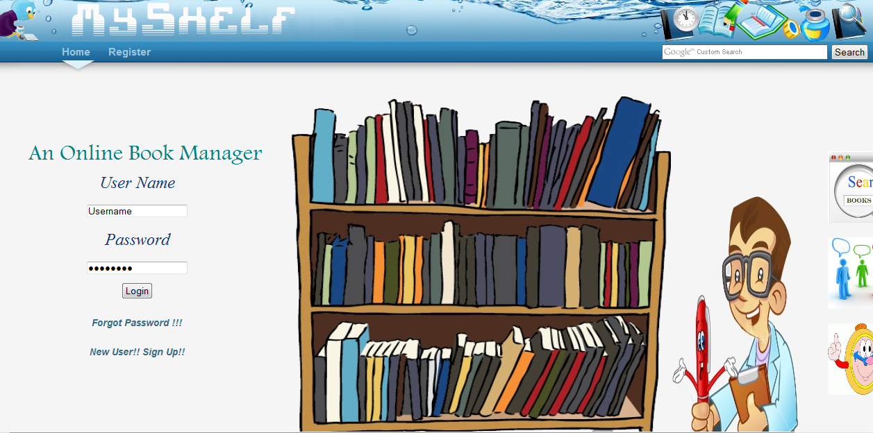
Snapshots

Slide 7
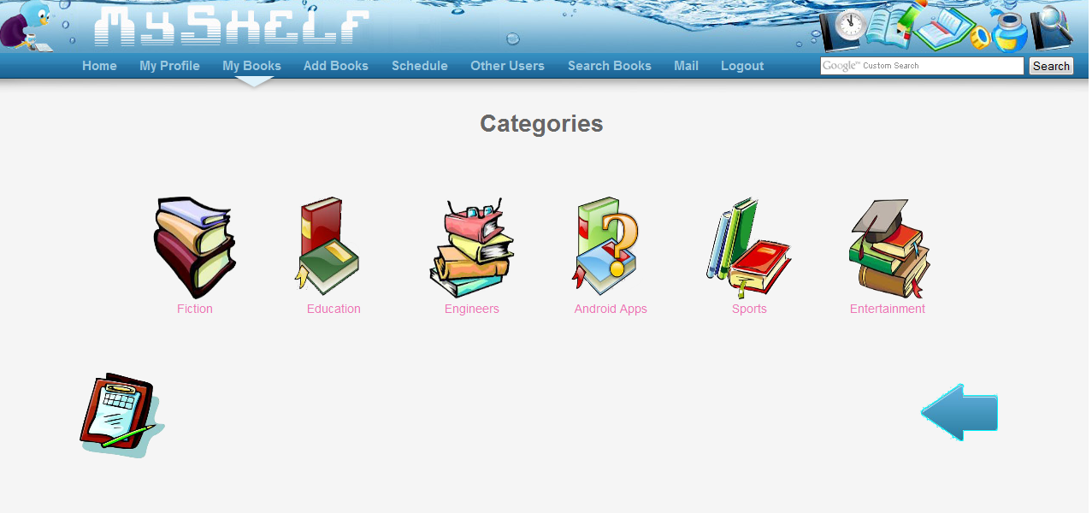

Slide 8
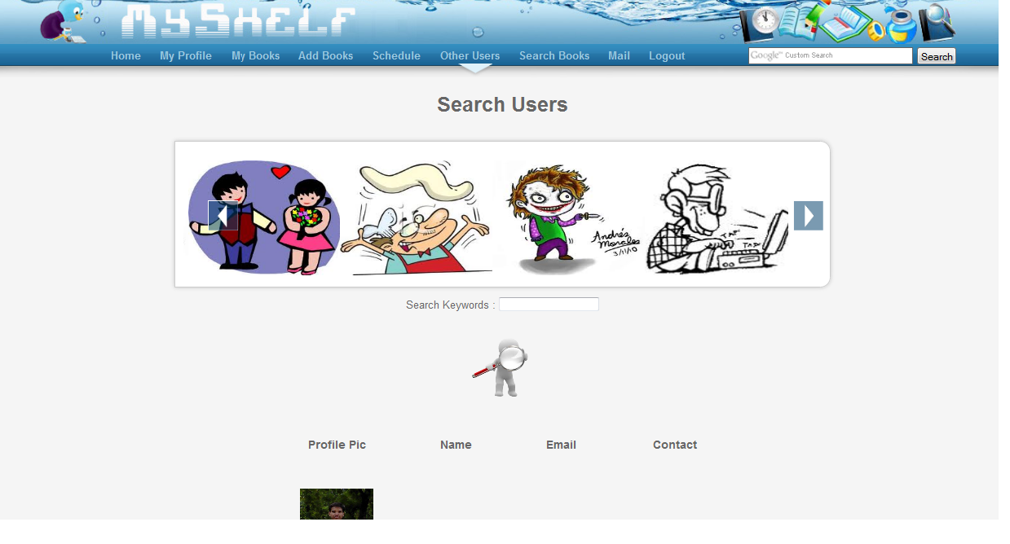

Slide 9
Role of Each Member
Joney Singhal (ABV-IIITM Gwalior)–
Designing of the Web-Application using HTML,CSS, JQuery and JavaScript.
Rajesh Kumar (ABV-IIITM Gwalior)
Development of the modules by using PHP and AJAX.

