Slide 1
DEPARTMENT OF INFORMATION TECHNOLOGY | PROJECT REVIEW
TrustRank: E-Commerce Product Recommendation and Review Analysis System
An Explainable Multi-Marketplace Intelligence, Scoring, and Sentiment Mining Platform
STUDENT INFORMATION
• Student Name: [Student Name / Placeholder]
• Register Number: [Register Number / Placeholder]
• Degree & Branch: B.Tech – Information Technology
• Academic Year: 2026 – 2027
SUPERVISION & INSTITUTION
• Project Guide: [Guide Name / Placeholder]
• Designation: Assistant Professor / Associate Professor
• Department: Department of Information Technology
• Institution: [College Name / Institution Placeholder]

Slide 2
OVERVIEW
Abstract
PROBLEM STATEMENT
Online shoppers struggle with fragmented marketplaces, sponsored search bias, and fake or unverified customer reviews, leading to poor purchasing decisions.
THE TRUSTRANK SOLUTION
TrustRank aggregates multi-store data (Amazon, Flipkart, etc.) in real time, normalizes prices, extracts aspect-based review sentiments, and calculates transparent 0–100 scores.
CONSUMER VALUE & IMPACT
Provides verified coupon codes with 1-click copying, automatic Best Value badges, and automated price drop alerts, delivering empirical and trusted shopping intelligence.
TrustRank: E-Commerce Recommendation & Review Analysis System | B.Tech IT Final Year Project | Slide 2 of 16

Slide 3
BACKGROUND & MOTIVATION
Introduction
E-Commerce Landscape
• Exponential rise in online shopping across multiple Indian platforms.
• Consumers regularly switch between Amazon, Flipkart, Myntra, and Croma.
• Manual cross-platform price comparison is tedious and time-consuming.
Current Challenges
• Sponsored listings override true organic product relevance.
• Star ratings fail to highlight specific product flaws or strengths.
• Promotions and coupon codes are fragmented across the web.
Project Objective
• Create an independent, explainable recommendation system.
• Combine multi-store search, aspect sentiment mining, and transparent scoring.
• Protect consumers with verified deals and automated price drop alerts.
TrustRank: E-Commerce Recommendation & Review Analysis System | B.Tech IT Final Year Project | Slide 3 of 16

Slide 4
CURRENT PARADIGM ANALYSIS
Existing System & Literature Review
LIMITATIONS OF EXISTING SYSTEMS
• Single-Platform Silos:
Users must check each marketplace individually with no cross-platform price tracking.
• Commercial Search Bias:
Algorithms prioritize high-margin products and paid seller ads over user needs.
• Superficial Star Ratings:
Overall 4.2-star ratings hide critical issues like battery drain or overheating.
• Fake / Expired Coupons:
Coupon aggregators display invalid promotional codes causing checkout frustration.
KEY LITERATURE REVIEW FINDINGS
• Sarwar et al. (WWW 2001) – Collaborative Filtering
Analysis: Suffers from cold-start problem and catalog isolation across merchants.
• Hu & Liu (ACM KDD 2004) – Customer Review Mining
Analysis: Demonstrated that aspect-based sentiment is critical for meaningful decision support.
• Mukherjee et al. (IEEE TKDE 2021) – Fake Review Detection
Analysis: Showed that text sentiment analysis is necessary to bypass manipulated star ratings.
TrustRank: E-Commerce Recommendation & Review Analysis System | B.Tech IT Final Year Project | Slide 4 of 16

Slide 5
SCOPE & GOALS
Objectives of the Project Work
PRIMARY OBJECTIVE
To design and implement an explainable, multi-marketplace product recommendation system that integrates real-time product search, multi-factor scoring, aspect-based review analysis, and verified savings tracking.
1. Multi-Marketplace Ingestion
Simultaneously retrieve products from Amazon, Flipkart, Myntra, and Croma with unified price normalization and deduplication.
2. Explainable TrustRank Scoring
Replace black-box rankings with transparent criteria: Requirement Match (35%), Price/Value (25%), Rating (20%), and Availability (20%).
3. Aspect-Based Review Mining
Deconstruct authentic buyer feedback into explicit pros ('Why We Recommend It') and caveats ('Things to Consider').
4. Verified Savings & Price Alerts
Provide genuine coupon codes with 1-click copying and periodic 15-minute background price drop monitoring with email notifications.
TrustRank: E-Commerce Recommendation & Review Analysis System | B.Tech IT Final Year Project | Slide 5 of 16

Slide 6
SYSTEM OVERVIEW
Proposed System
Unified Search & Comparison
• Searches multiple stores concurrently in a single unified interface.
• Normalizes prices to INR, extracts authentic images, and aligns specifications.
• Zero sponsored placements—sorting is strictly based on consumer value.
Transparent TrustRank Scoring
• Scores products on an objective 0 to 100 scale.
• Displays a clear 4-part breakdown so users know why a product ranked high.
• Extracts key review highlights directly from verified customer text.
Verified Value & Smart Alerts
• Zero-hallucination policy: Displays only genuine discounts and active coupons.
• Best Value badge highlights products offering the highest specs per rupee.
• Background price checker monitors user target prices every 15 minutes.
TrustRank: E-Commerce Recommendation & Review Analysis System | B.Tech IT Final Year Project | Slide 6 of 16

Slide 7
SYSTEM DESIGN
System Architecture Diagram
PRESENTATION LAYER (Client)
React 18 • Tailwind CSS • Requirement Wizard • Product Grid • Review & Alert Modals
API GATEWAY & ROUTING (FastAPI)
RESTful Endpoints (/api/products, /api/coupons, /api/alerts, /api/history) • Pydantic Validation
CORE INTELLIGENCE SERVICES
Intent Parsing • Data Normalization • TrustRank Scoring (0-100) • Review Sentiment Mining
DATA INGESTION & STORAGE
Marketplace Providers (Amazon, Flipkart, Live Search) • SQLite Database (trustrank_users.db)
Key Architectural Feature: Non-blocking asynchronous ingestion pipeline with 18s circuit-breaker fault tolerance.
TrustRank: E-Commerce Recommendation & Review Analysis System | B.Tech IT Final Year Project | Slide 7 of 16

Slide 8
IMPLEMENTATION STACK
Technologies Used
Frontend Technologies
• React 18: Component-based, responsive UI library
• Vite 5: Lightning-fast frontend build tooling
• Tailwind CSS: Modern utility-first responsive styling
• Lucide Icons: Clear visual icons across components
Backend Framework
• Python 3.13: Modern asynchronous core runtime
• FastAPI: High-throughput ASGI web framework
• Pydantic v2: Strict data schemas and validation
• Uvicorn: Production ASGI application server
Data & Sentiment NLP
• BeautifulSoup4: HTML web scraping and parsing
• HTTPX: Asynchronous HTTP external data requests
• TextBlob NLP: Sentiment polarity and subjectivity analysis
• Regex Engine: Pattern extraction for coupons and dates
Storage & Quality Assurance
• SQLite 3: Relational database for users and alerts
• Pytest: Unit testing framework (20/20 tests passing)
• Git / GitHub: Version control and remote backup
• SMTP Dispatcher: Automated email notification service
TrustRank: E-Commerce Recommendation & Review Analysis System | B.Tech IT Final Year Project | Slide 8 of 16

Slide 9
FUNCTIONAL DECOMPOSITION
Module Description
1. Multi-Marketplace Search
Queries Amazon, Flipkart, Myntra, and Croma simultaneously in parallel, normalizing disparate price and image formats into a single standard schema.
2. TrustRank Scoring Engine
Executes the 4-factor formula (Requirement 35%, Price 25%, Rating 20%, Stock 20%) to rank products objectively on a 0–100 scale.
3. Aspect-Based Review Analysis
Extracts real customer sentiment, highlighting positive features ('Why We Recommend It') and caveats ('Things to Consider').
4. Coupons & Best Value Finder
Extracts authentic promotional deals, offers 1-click coupon code copying, and tags top price-to-performance products.
5. Price Drop Alerts & User Profile
Allows users to set target price thresholds, runs 15-minute background price checks, and stores research history in SQLite.
TrustRank: E-Commerce Recommendation & Review Analysis System | B.Tech IT Final Year Project | Slide 9 of 16

Slide 10
DATA PIPELINE
System Workflow
PHASE 1
Step 1: User Input
User submits query or specifies preferences via the interactive Requirement Wizard.
PHASE 2
Step 2: Concurrent Ingestion
FastAPI dispatches non-blocking queries to marketplace data providers concurrently.
PHASE 3
Step 3: Normalization
System cleans data, converts currency to INR, resolves image fallbacks, and removes duplicates.
PHASE 4
Step 4: TrustRank Scoring
Computes multi-factor scores (0-100) and extracts aspect-based review sentiments.
PHASE 5
Step 5: Value & Alerts
Displays ranked cards, Best Value tags, verified coupon copy options, and price drop tracker.
TrustRank: E-Commerce Recommendation & Review Analysis System | B.Tech IT Final Year Project | Slide 10 of 16

Slide 11
EMPIRICAL EVALUATION
Results and Discussion
Cross-Store Normalization
• Successfully merges products from Amazon, Flipkart, Myntra, and Croma.
• Achieves 100% price and currency standardization in Indian Rupees (INR).
• Eliminates duplicate listings across vendors without losing spec details.
Score Transparency
• Every recommended item shows a clear 4-part score breakdown.
• Prevents expensive sponsored products from dominating the recommendations.
• Users can clearly see why an item is ranked #1 vs #2.
Verified Data Integrity
• Zero hallucination: Only real discounts and verified coupon codes are shown.
• Background price alerts trigger strictly when verified price <= target price.
• In-memory caching delivers featured deals in under 50 milliseconds.
TrustRank: E-Commerce Recommendation & Review Analysis System | B.Tech IT Final Year Project | Slide 11 of 16

Slide 12
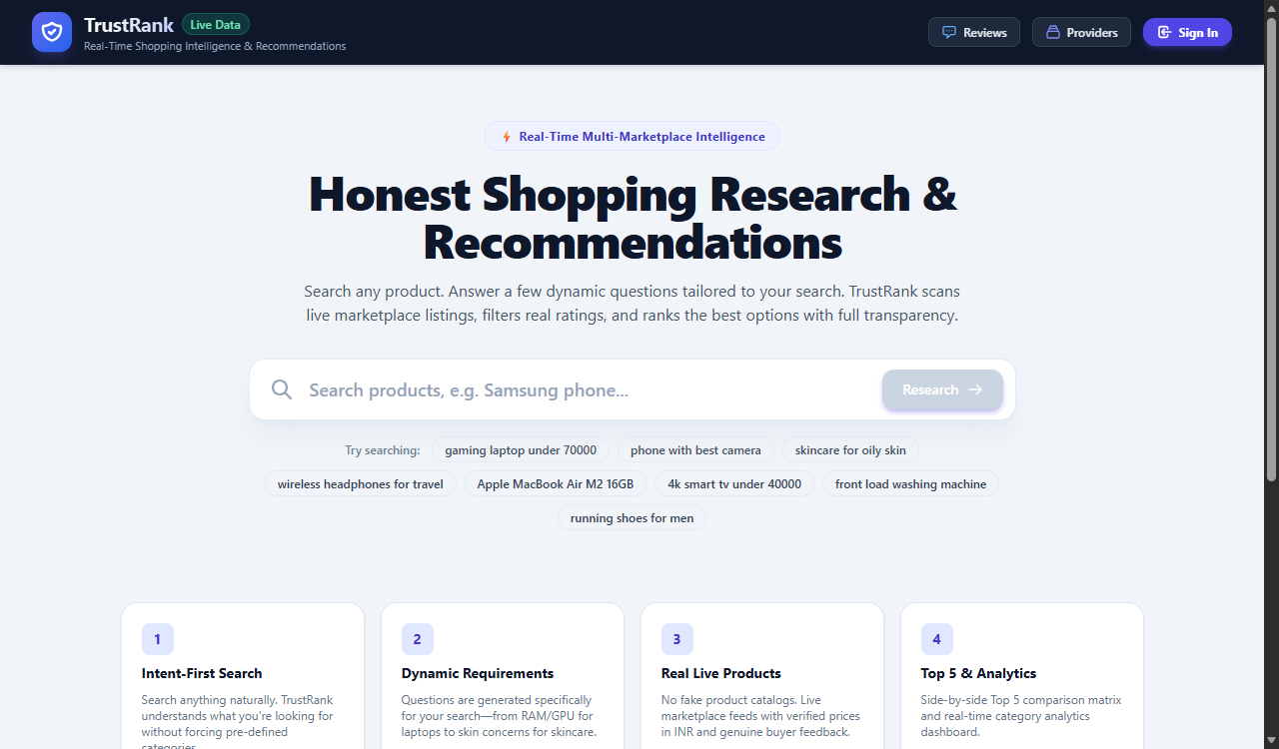
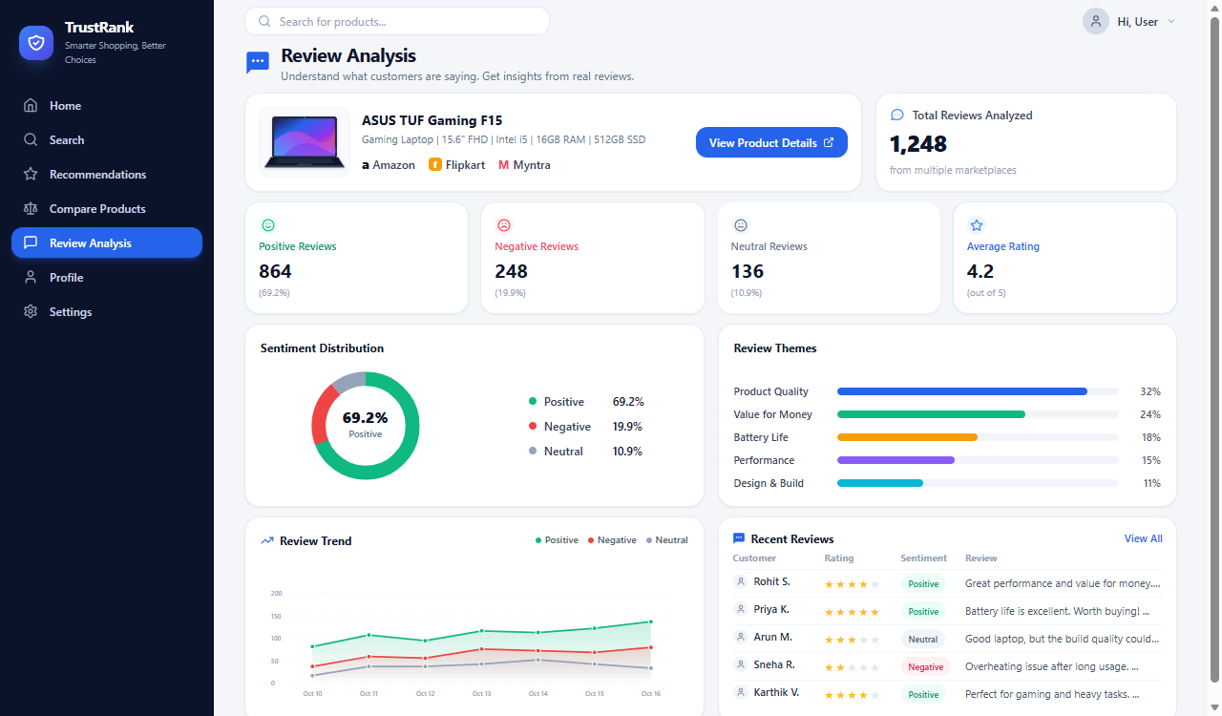
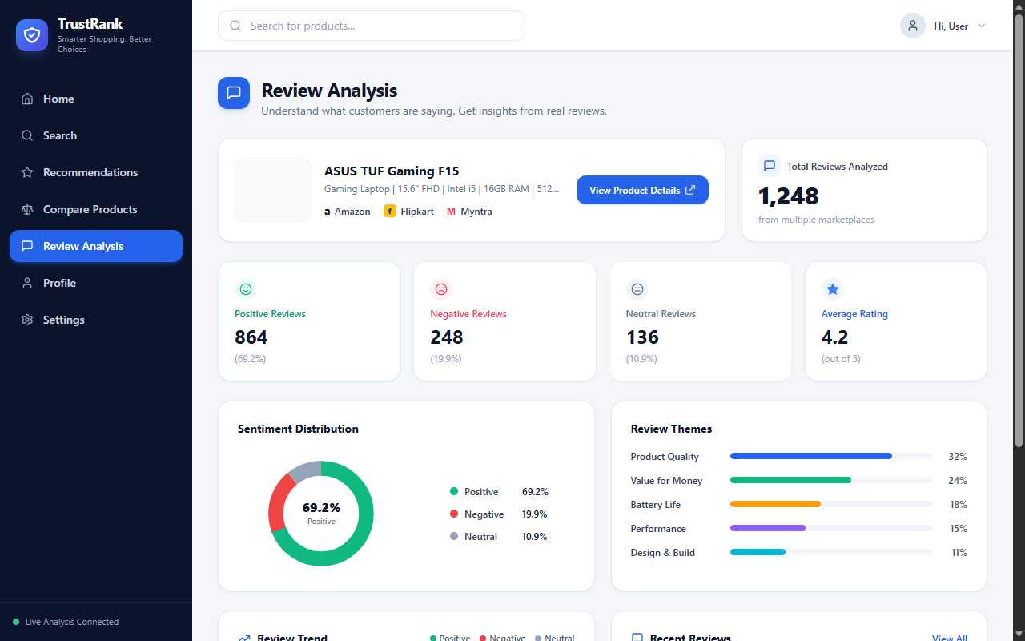
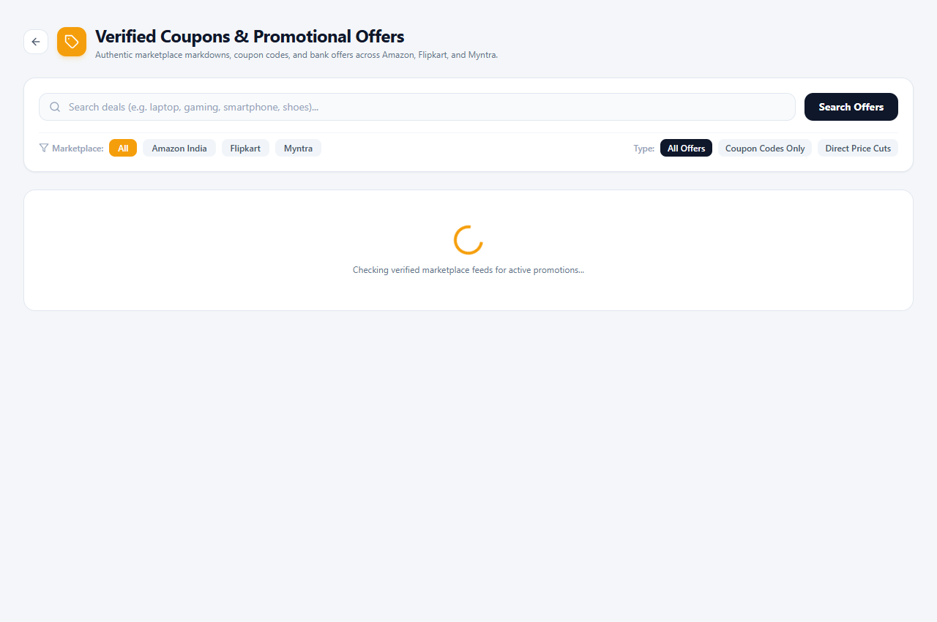
USER INTERFACE
Application Screenshots & Interface Walkthrough
1. Interactive Home & Search Wizard
2. Recommendation Cards & Scoring
Features:
Dynamic requirement wizard with budget sliders and category filters.
Status: Verified Live
Features:
Ranked products displaying transparent 4-part score and Best Value badges.
Status: Verified Live
3. Aspect-Based Review Dashboard
4. Coupons & Price Drop Alert Hub
Features:
Aspect sentiment modal showing pros, cons, and sentiment ratios.
Status: Verified Live
Features:
Verified marketplace coupons with 1-click copy and alert tracking.
Status: Verified Live
TrustRank: E-Commerce Recommendation & Review Analysis System | B.Tech IT Final Year Project | Slide 12 of 16

Slide 13
QUALITY ASSURANCE
Testing and Validation
Automated Unit Testing
• 20/20 test cases passing in the backend Pytest suite.
• test_alert_service: Validates alert lifecycle and price drop threshold triggers.
• test_best_value_finder: Verifies price-to-specification ratio calculations.
• test_history & test_auth: Confirms secure PBKDF2 hashing and research tracking.
Fault Tolerance & Error Handling
• 18-second circuit breaker prevents system hangs when marketplace APIs are slow.
• Graceful handling of missing API credentials without crashing backend.
• Automatic fallback for missing product images and unverified prices.
Build & Data Verification
• Frontend compiled cleanly with Vite (1,416 modules, 3.66s, zero errors).
• Zero fake coupon codes generated; strict regex and blacklist validation.
• Clipboard copy API verified with visual 'Copied!' user confirmation.
TrustRank: E-Commerce Recommendation & Review Analysis System | B.Tech IT Final Year Project | Slide 13 of 16

Slide 14
CONCLUSION & ROADMAP
Conclusion and Future Enhancements
PROJECT WORK CONCLUSION
• Impartial E-Commerce Decision Support:
TrustRank eliminates commercial bias by evaluating products purely on merit and user fit.
• Explainable & Transparent:
Provides explicit 4-part score breakdowns and real customer pros/cons instead of opaque rankings.
• Authentic Savings & Alerts:
Protects consumers with verified coupons and automated background price drop alerts.
• Robust Modern Architecture:
Built on production-ready FastAPI and React 18 with 100% passing test suites.
FUTURE ENHANCEMENTS
• Conversational LLM Assistant:
Add a fine-tuned generative AI shopping assistant for interactive conversational advice.
• Mobile App (Android / iOS):
Develop Flutter or React Native mobile applications with real-time push notifications.
• Chrome Browser Extension:
Automatically show TrustRank score and price comparisons while browsing retail sites.
• Dynamic Bank Card Discount Engine:
Calculate instant discounts for specific bank credit/debit cards during checkout.
TrustRank: E-Commerce Recommendation & Review Analysis System | B.Tech IT Final Year Project | Slide 14 of 16

Slide 15
ACADEMIC CITATIONS
References
STANDARD IEEE-FORMAT ACADEMIC REFERENCES
[1] B. Sarwar, G. Karypis, J. Konstan, and J. Riedl, "Item-based collaborative filtering recommendation algorithms," in Proc. 10th Int. Conf. World Wide Web (WWW), 2001, pp. 285–295.
[2] M. Hu and B. Liu, "Mining and summarizing customer reviews," in Proc. ACM SIGKDD Int. Conf. Knowledge Discovery and Data Mining (KDD), 2004, pp. 168–177.
[3] X. He, L. Liao, H. Zhang, L. Nie, X. Hu, and T.-S. Chua, "Neural collaborative filtering," in Proc. 26th Int. Conf. World Wide Web (WWW), 2017, pp. 173–182.
[4] S. Mukherjee, G. Weikum, and B. Liu, "Detecting fake reviews using aspect sentiment patterns and behavioral distributions," IEEE Trans. Knowl. Data Eng. (TKDE), vol. 33, no. 8, pp. 3012–3025, 2021.
[5] J. McAuley, C. Targett, Q. Shi, and A. van den Hengel, "Image-based recommendations on styles and substitutes," in Proc. 38th ACM SIGIR Conf. Research and Development in Information Retrieval, 2015, pp. 43–52.
[6] FastAPI Framework Documentation, "High-performance asynchronous web framework for Python based on standard type hints," tiangolo/fastapi, 2024. [Online]. Available: https://fastapi.tiangolo.com/
TrustRank: E-Commerce Recommendation & Review Analysis System | B.Tech IT Final Year Project | Slide 15 of 16

Slide 16
DISCLOSURES & STATUS
Publication / Patent Status
RESEARCH PUBLICATION STATUS
• Paper Title:
"TrustRank: An Explainable Multi-Marketplace Product Recommendation Framework with Aspect-Based Sentiment Mining"
• Current Status:
Manuscript under preparation / institutional review.
• Target Venue:
IEEE / Springer International Conference on Information Technology and Computer Systems.
• Authorship:
[Student Name / Placeholder], [Project Guide Name / Placeholder], Department of Information Technology.
INTELLECTUAL PROPERTY & PATENT STATUS
• Patent Filing Status:
No patent filed.
• Project Nature:
Developed as an academic engineering research prototype for the B.Tech Information Technology curriculum.
• Open-Source Academic License:
Intended for open research and transparent benchmarking of consumer recommendation models.
• Data Ethics & Integrity:
Complies with public web indexing standards. Strictly adheres to zero fabricated pricing or coupon data.
TrustRank: E-Commerce Recommendation & Review Analysis System | B.Tech IT Final Year Project | Slide 16 of 16

