Slide 1
Azure AI Services
Ondřej Václavek
Software architect, HAVIT, s.r.o. vaclavek@havit.cz

Slide 2
Azure AI Services
Azure OpenAI Service
Azure AI Vision
Azure AI Model Catalog
Azure AI Speech
Azure AI Language
Azure AI Translator
Azure AI Foundry
Azure AI Search
Azure AI Content Safety
Azure Machine Learning
Azure AI Document Intelligence
Azure AI Video Indexer
Microsoft Copilot in Azure
Microsoft AI Skills Fest 8.4.2025 – 28.5.2025 (link)

Slide 3
Azure OpenAI Service
Conversational AI
Content Creation
GTP-4
DALL-E
OpenAI studio
Question / answer API
Context can be added
Assistence can be added ie:
You are an assistant designed to extract entities from text. Users will paste in a string of text and you will respond with entities you've extracted from the text as a JSON object. Here's an example of your output format:
{
"name": "",
"company": "",
"phone_number": ""
}
Samples: https://github.com/Azure/openai-samples

Slide 4
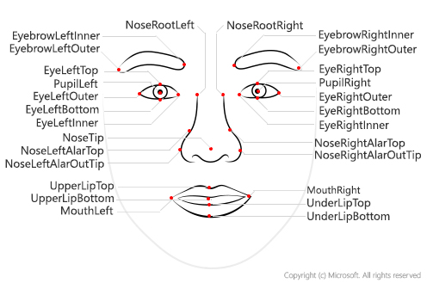
Azure AI Vision
Computer vision X Custom vision
Image Analysis
Spatial Analysis
Search content of photos
OCR
Add captions
Remove backgrounds
Video Indexer
Objects tagging
Smart crop
Facial Recognition
Vision studio

Slide 5
Azure AI Speech
Speech to text
Text to speech
Speech translation
Speaker verification and recognition
Captioning
Post call transcription and analysis
Live speech avatar
Custom voice / personal voice
Speech studio

Slide 6
Azure AI Language
Text classification
Analyze sentiment
Detect language
Custom text classification
Structural information extraction
Text summarization
Understand conversations
Question answering
Conversation understanding
Language studio
AI Foundry / Language

Slide 7
Azure AI Content Safety
Detect and filter violence, hate, sexual and self-harm content
Monitor text, images, and multimodal content
Analyze human and AI-generated content
Content safety studio

Slide 8
Azure AI Document Intelligence
Document Analysis and extraction
OCR
Layout detection
Extraction with custom / prebuilt model
Document Intelligence Studio

Slide 9
DEMO

